Slide 1
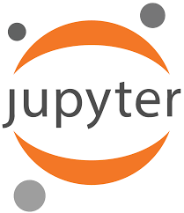
Jupyter Notebook

Slide 2
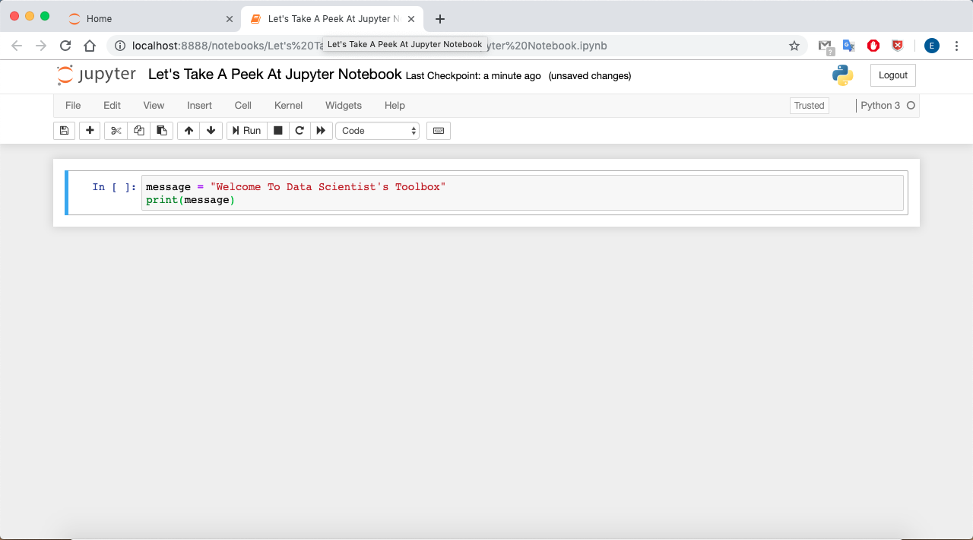

Slide 3
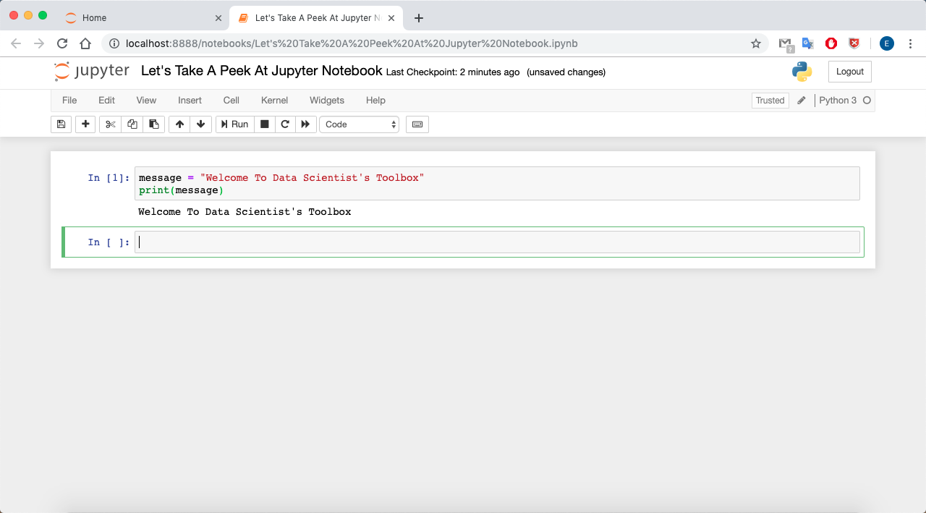

Slide 4
Advantages of Using Jupyter Notebook
Support many languages such as R, Python, Scala
Free and open source
Rerun small code snippets
Easy to investigate data
Interactive output
Big Data Integration i.e. Apache Spark

Slide 6
What can you do in Jupyter Notebook?

Slide 10
Did you know?
That Python and Jupyter is used to capture Black Hole picture
Jupyter
Numpy
Scipy
Astropy
Pandas
Matplotlib

Slide 11
Installation

