Slide 1
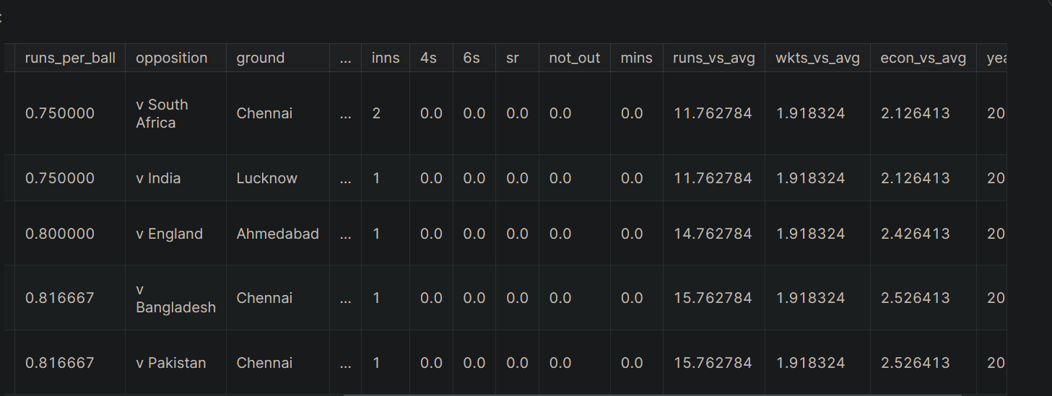

Slide 2
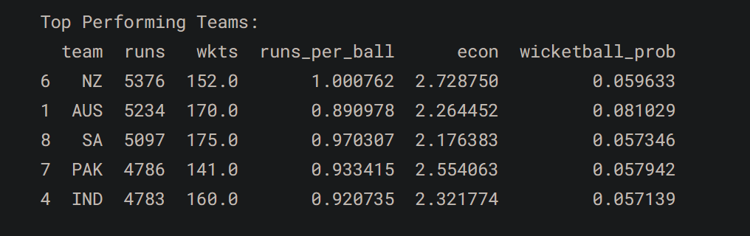
1. Team Performance Analysis:
Explore team-wise performance metrics.
Analyze runs scored, wickets taken, and batting/bowling styles.
Identify top-performing teams and their strengths.

Slide 3
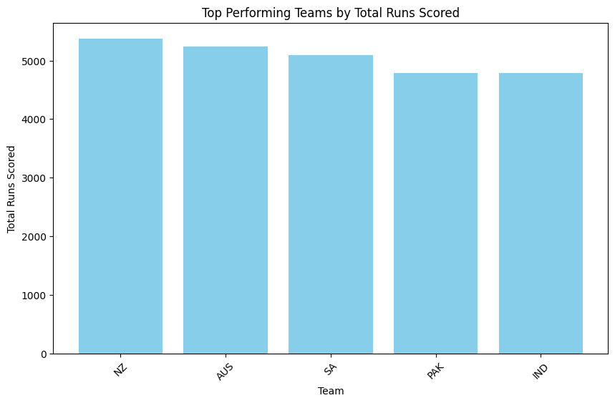

Slide 4
2. Player Performance Analysis:¶
Evaluate individual player statistics for both batting and bowling.
Identify leading run-scorers and wicket-takers.
Assess the impact of players on their team's performance.

Slide 5
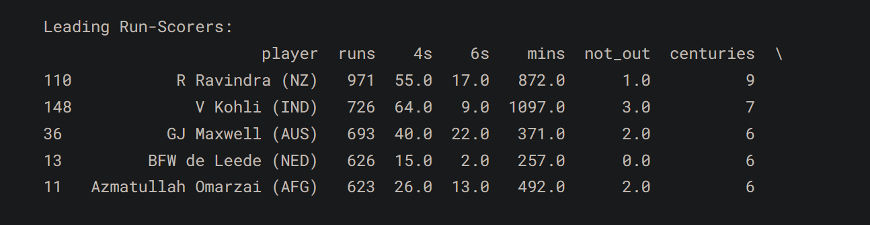

Slide 6
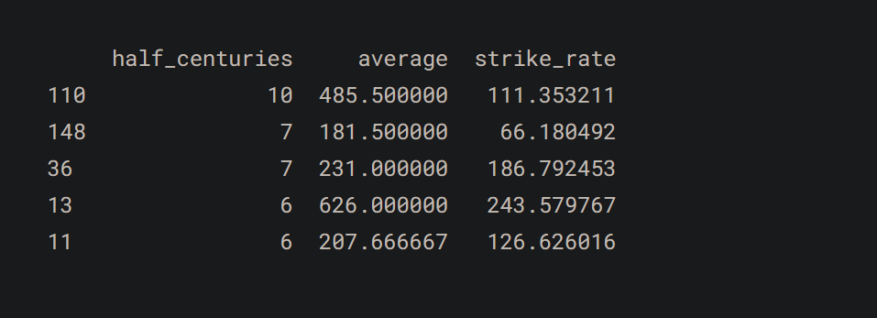

Slide 7
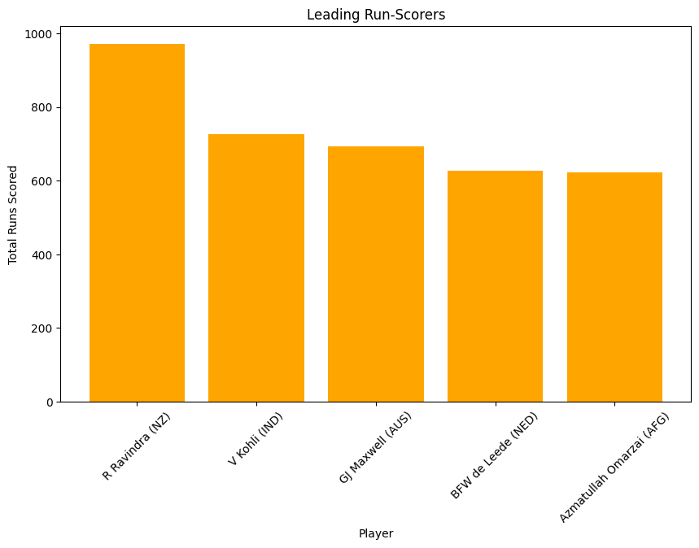

Slide 8
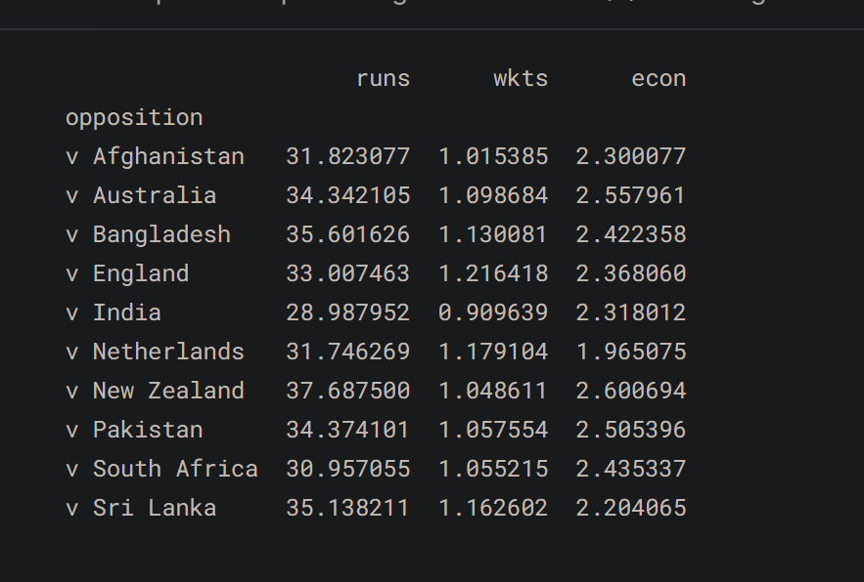
Performance against Different Oppositions:

Slide 9
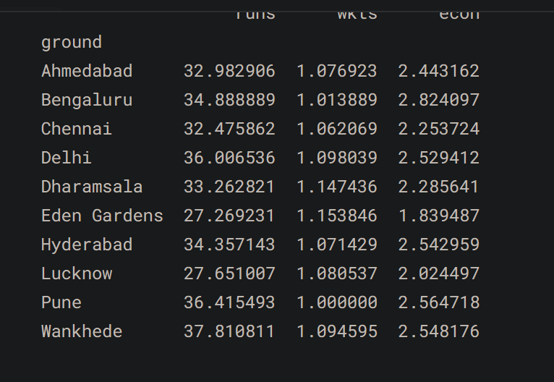
2. Performance Variations Across Different Playing Grounds:

Slide 10
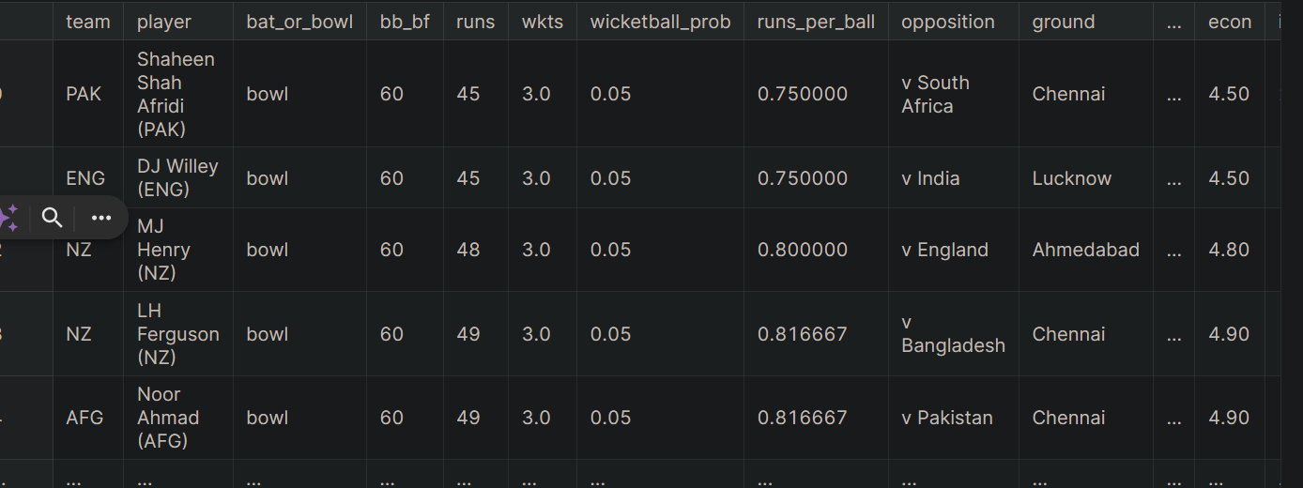
3. Identify Specific Teams or Players Excelling in Certain Conditions:

Slide 11
4. Temporal Analysis:
Study performance trends over time, considering start dates and overs played.
Identify any temporal patterns or changes in team and player performance.

Slide 12
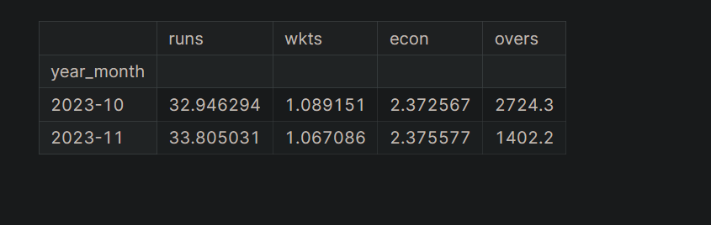

Slide 13
