Slide 1
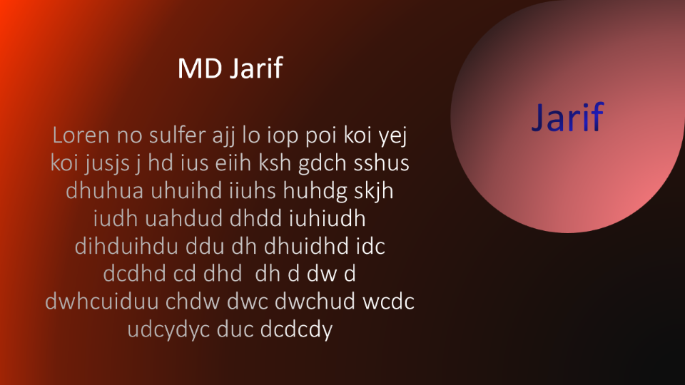
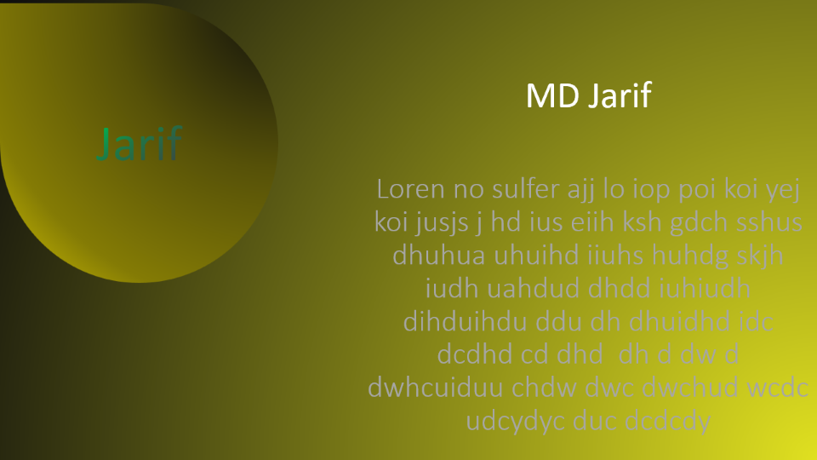
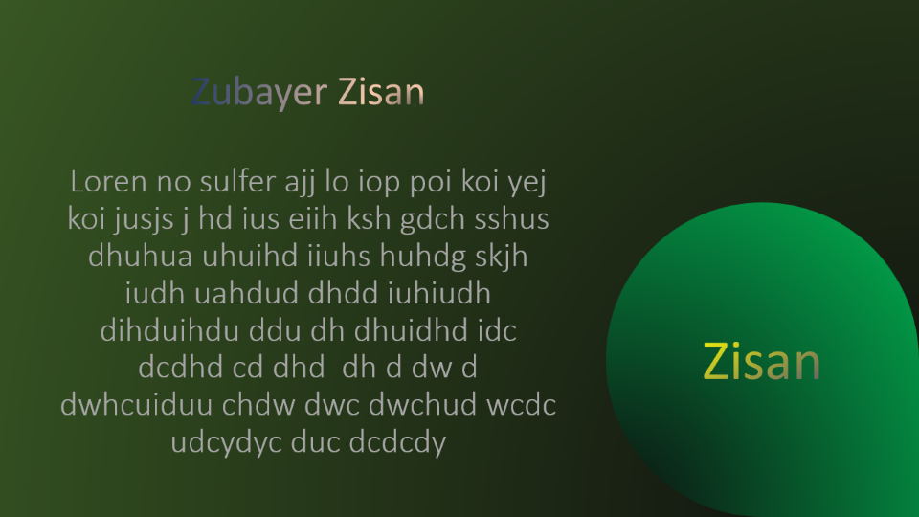
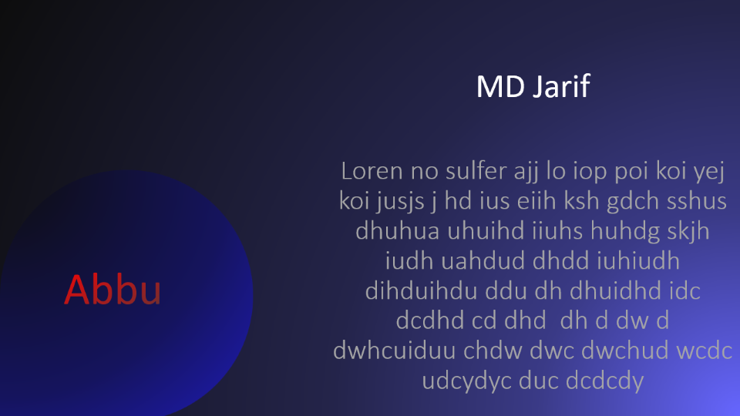

Slide 2
Loren no sulfer ajj lo iop poi koi yej koi jusjs j hd ius eiih ksh gdch sshus dhuhua uhuihd iiuhs huhdg skjh iudh uahdud dhdd iuhiudh dihduihdu ddu dh dhuidhd idc dcdhd cd dhd dh d dw d dwhcuiduu chdw dwc dwchud wcdc udcydyc duc dcdcdy
Zubayer Zisan
Zisan

Slide 3
Loren no sulfer ajj lo iop poi koi yej koi jusjs j hd ius eiih ksh gdch sshus dhuhua uhuihd iiuhs huhdg skjh iudh uahdud dhdd iuhiudh dihduihdu ddu dh dhuidhd idc dcdhd cd dhd dh d dw d dwhcuiduu chdw dwc dwchud wcdc udcydyc duc dcdcdy
MD Jarif
Abbu

Slide 4
Loren no sulfer ajj lo iop poi koi yej koi jusjs j hd ius eiih ksh gdch sshus dhuhua uhuihd iiuhs huhdg skjh iudh uahdud dhdd iuhiudh dihduihdu ddu dh dhuidhd idc dcdhd cd dhd dh d dw d dwhcuiduu chdw dwc dwchud wcdc udcydyc duc dcdcdy
Jarif
MD Jarif

Slide 5
Loren no sulfer ajj lo iop poi koi yej koi jusjs j hd ius eiih ksh gdch sshus dhuhua uhuihd iiuhs huhdg skjh iudh uahdud dhdd iuhiudh dihduihdu ddu dh dhuidhd idc dcdhd cd dhd dh d dw d dwhcuiduu chdw dwc dwchud wcdc udcydyc duc dcdcdy
Jarif
MD Jarif

