Slide 1
QA Cinema Project
Tashfeen Arshad
Syed Zaidi
Damian Poclitar
Jariful Hoque
Kya Edmeade
Notes:
Tash

Slide 2
Objective
• What was the brief?
To create a full-stack web application for a client.
Our client is a well-known cinema chain, QA Cinemas
Our team has been tasked with building a new website for them, which should present information about movies, listings, upcoming releases etc.
There are various features which the client has requested, some are essential while others are desirable.
There is time for two 5-day Sprints before the site goes live.
Notes:
Tash

Slide 3
Scope
The minimum requirements for this project are as follows:
Full commitment to an Agile Approach, including daily stand-up meetings and utilisation of sprints, user stories and other sprint artifacts.
A fully expanded Kanban board with user stories, tasks needed to complete the project.
A fully fleshed out Risk Assessment with matrix, showing the risks and issues of the project.
Code fully integrated into a central repository using a Version Control System. This repo should incorporate pull and merge requests, repo ownership, Feature Branch Model and any other aspects you deem appropriate.
Fully designed back-end using Node and API development tool using Express.
Fully designed front-end using React that is responsive and reactive.
Database management system using MySQL or MongoDB deployed locally or using a cloud provider
Fleshed out Test Suite covering unit and integration testing for the backend, as well as automation and user acceptance tests for the front end. Industry standard of 80% should be strived for.
Notes:
Tash

Slide 4
Planning: How Did we approach the specification
The role of scrum master was assigned to Kya, who took daily notes and briefed the instructor on our day to day own goings and made the jira board
Tash was the product owner and he set up the GitHub repository.
In depth discussion talking about the MVP and breaking it down into manageable user stories
Negotiations around who would take each user story based on interest, confidence as well as vision and creativity.
This felt like the best way to get through the tasks efficiently and creating the best product we could make.
Then have daily scrum meetings in the morning to make sure that everyone was up to date.
Notes:
Kya

Slide 5
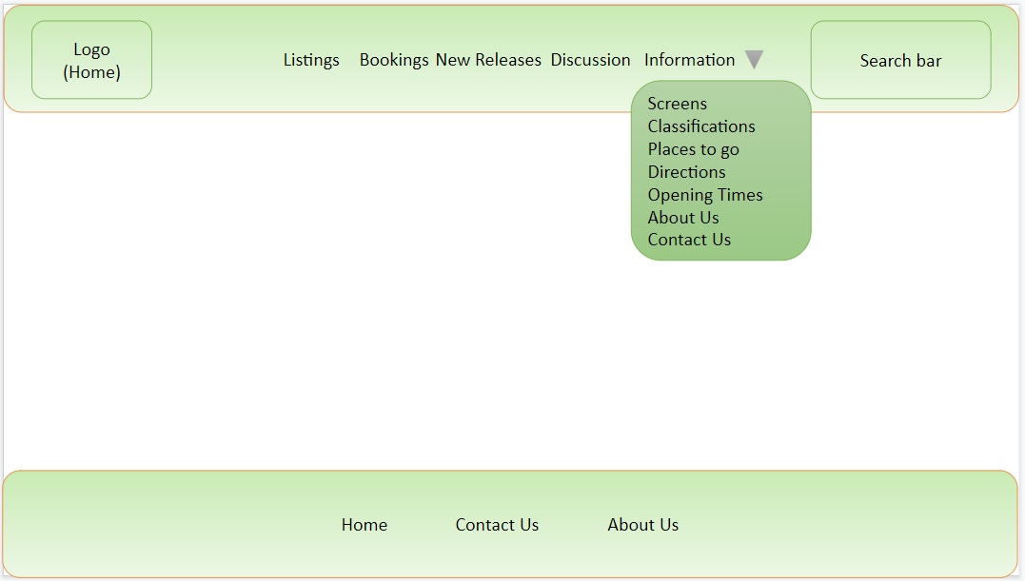
Notes:
Kya

Slide 6
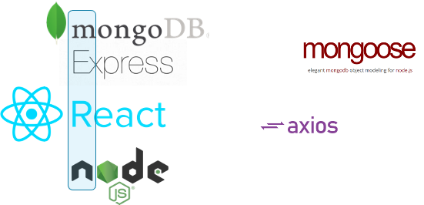




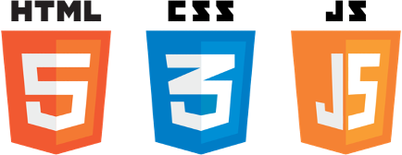

Tech Stack
Notes:
Kya

Slide 7
Sprint planning
Sprint planning was done at the start of each week
Planning involved filling the Jira Board with relevant Epics, User Stories, and Tasks- with priority for MVP and a few optional user stories which had a lower priority
Stories were assigned point estimates based on difficulty and members of the team were assigned stories
Daily Standup meetings were held to measure progress and reassign tasks if necessary
Daily Standup meetings also allowed for people to express concerns and other team members to help out where they were needed most
Integrated Jira and Github together allowing for the tracking of work completed in Jira through the use of smart commits

Slide 8
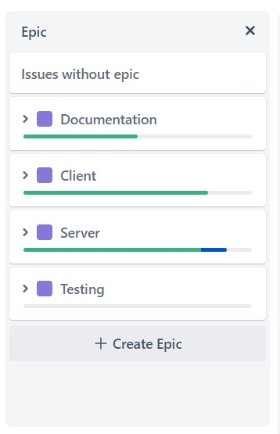
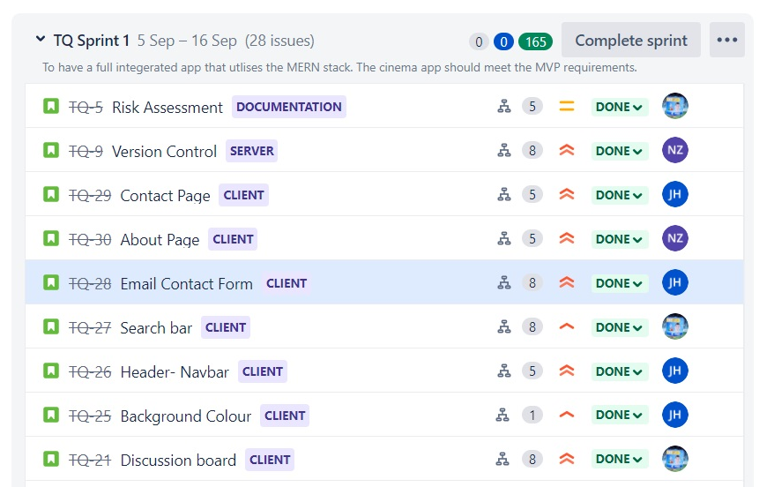
Epics and Product Backlog
Notes:
An Epic is a large, overarching piece of work that is made up of multiple user stories, which are then comprised of multiple Tasks
Issues are simply backlog items in agile development, initially for the product backlog, and later pulled into the sprint backlog

Slide 9
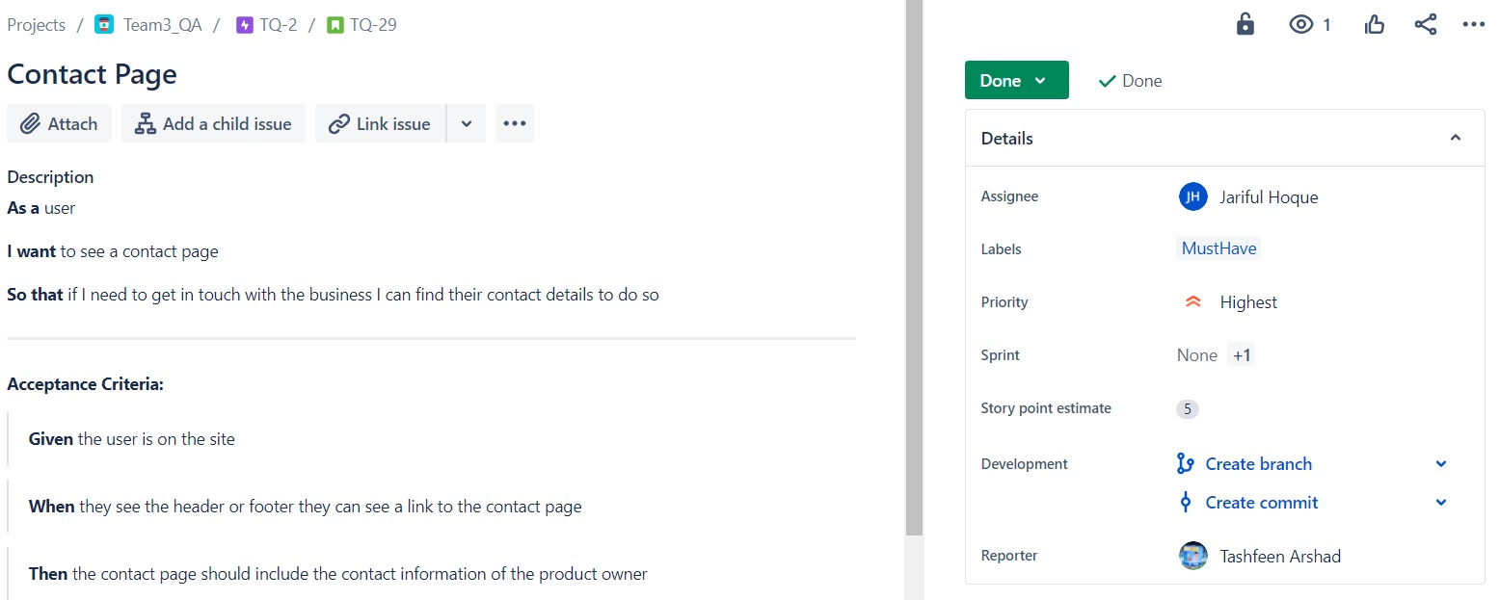
User Stories
Notes:
A User Story is an end goal expressed from a user’s perspective
Acceptance criteria is attached to our user stories to understand what a feature needs
The MoSCoW method is a popular prioritisation technique used for managing requirements
We use story points as to estimate the amount of work needed to complete a task

Slide 10
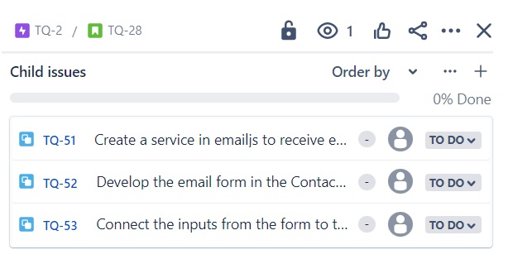
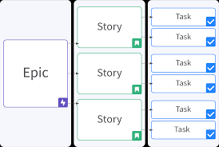
Tasks
User stories are broken down to smaller tasks created as child-issues

Slide 11
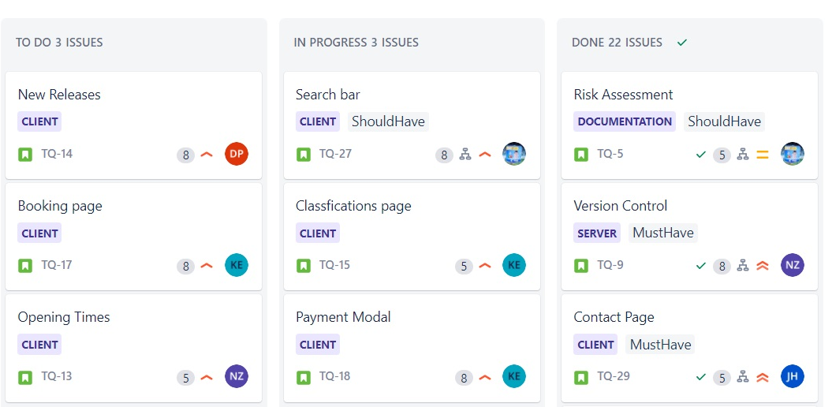
Kanban Board

Slide 12
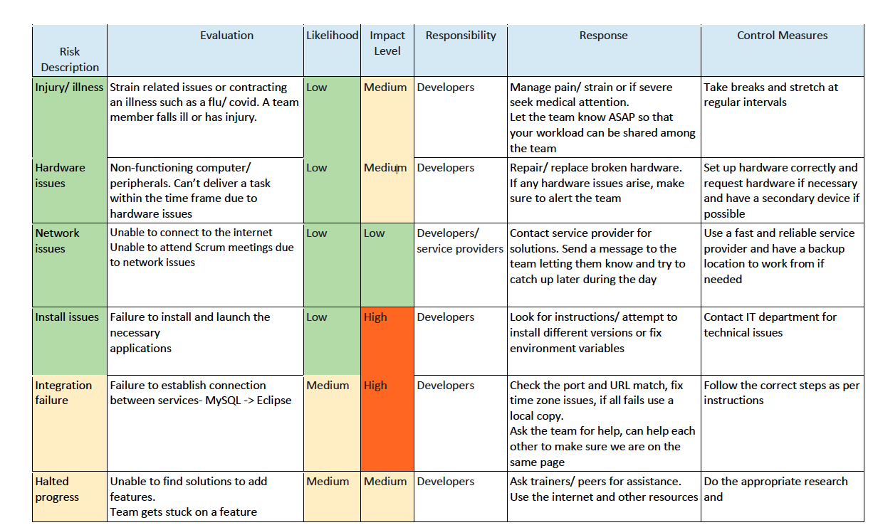
Risk Assessment

Slide 13


Version Control
Git was used as Version Control System (VCS)
Feature-Branch Model (FBM) was used to reduce merge conflicts
GitHub was used as online Repository Hosting Site
Jira was used to keep track of user stories

Slide 14

Server-MongoDB
Mongo was used to data storage. The project contains 3 schemas for data.
Movie
Title
Year
Rated
Runtime
Genre
Director
Actors
Plot
Poster
Showtime: [Days, Times]
Trailer
Discussion
Name
Comment
Movie
Rating
Booking
First Name
Last Name
Adult Tickets
Children Tickets
Concession
Price
Date
Movie Booking: [Movie, Day, Time]
Payment: [Card Num, Expiring, CVV]

Slide 15
Server Express
Express was used to create API endpoints for each schema in order for data to be retrieved by the front end.
Any errors that might occur return a 500 status with error message or if the result is empty it returns a 404.
Movie endpoint:
/getAll Returns all entries with 200 status
/getAllCurrent Returns all entries that have date value lower than current with 200 status
/getAllNew Returns all entries that have date value higher than current with 200 status
/get/:id Returns entry with the ID given with 200 status
Discussion endpoint:
/getAll Returns all entries with 200 status
/create Saves the given POST body in the database and then returns the entry with a 201 status
Booking endpoint:
/get/:id Returns entry with the ID given with 200 status
/create Saves the given POST body in the database and then returns the entry with 201 status

Slide 16

Client-React
React is a JavaScript library that we used in our web application. It is a tool used to build User Interfaces (UI). It was created by Facebook with the aim of simplifying the development of visual interfaces.
Throughout the web application we have used numerous react components. These components allowed us to organize information across our webpages.
Libraries such as React-bootstrap allowed us to incorporate the bootstrap toolkit in React to easily modify style sheet elements

Slide 17




Styling
Background: Gradient: #1f007f, #5821f0
Navbar, Footer and section backgrounds: #640049
Buttons and navbar letters: #a20049
Letters: #bdbdbd

Slide 18
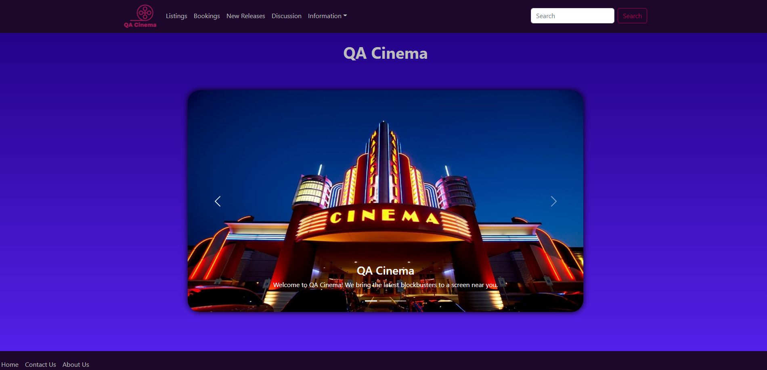
Final Design

Slide 19

Testing
Testing was performed on the express backend using mocha and chai
­
­Mocha is a JavaScript testing framework which allowed us to write tests for our backend
­
­Chai is an assertion library that allowed us to send HTTP requests to the backend and make assertions based on the response, this ensured express could effectively communicate with our MongoDB database
­
­Istanbul is a JavaScript coverage tool that showed the total code coverage of our tests, this meant we could be sure exactly how much of our code was being tested.

Slide 20
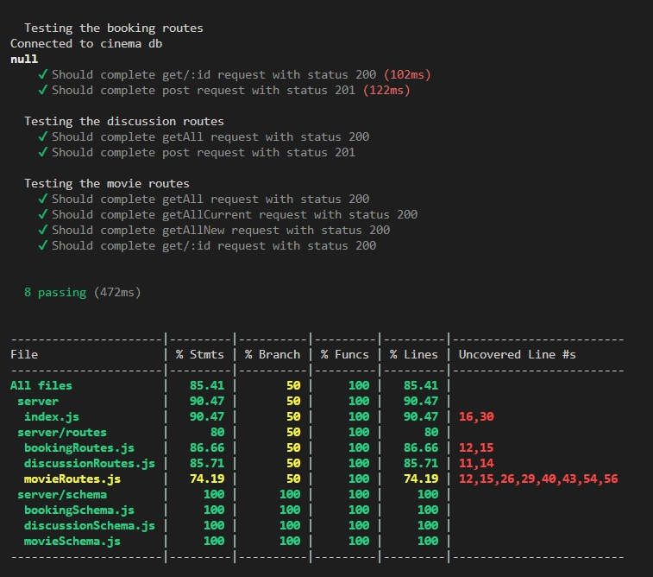
Coverage
Overall coverage of 80%
Testing 3 routes, involving 8 requests
This can be improved upon by testing cases for expected error statuses

Slide 21
Sprint Reviews
Sprint 1: We completed all our user stories on Jira for our epics which you can see on our Jira board. Along the way we added new user stories to our sprint where we thought the project could be improved and spiced up by adding extra features.
No user stories were left behind during sprint 1 and we accomplished all our targets for this specific sprint.
Sprint 2 : Likewise, all user stories were completed and extra features were added to our sprint where we thought our project could go that extra mile.
Again, no user stories were left behind but we did modify pages from our previous sprint to improve functionality. Throughout the project smart commits were made to keep our work was tracked
Notes:
Kya

Slide 22
Retrospective
•We completed the MVP and the Wish List and began implementing ideas and features that we believed would make the website not only more appealing, but intuitive to navigate making a seamless user experience.
•We had time to refine and continuously work on design to present the MVP and our skills to the best of our ability.
•We believe that a further step could be acceptance testing to see how easily users can interact with the website. And adding features to streamline ticket sales and increase traffic to the website.
Notes:
Kya

Slide 23
Things to add in the future
Things to add if more time:
• User account section - modify bookings, subscription accounts
• Cinema admin section (add movie, delete movie etc..)
• Discussion board from other sites e.g. Facebook, IMDB etc
• Search for anything within the site
• Email customer when successfully booked with seat numbers etc
•Age validation for movie bookings and discussion boards
Interactive seat selection
Cloud database
Email confirmation of bookings
Dedicated pages for each movies
Creating a separate database to test from

Slide 24
Demo

