Slide 1
23
Multithreading

Slide 2
The most general definition of beauty …Multeity in Unity.
  Samuel Taylor Coleridge
Do not block the way of inquiry.
  Charles Sanders Peirce
A person with one watch knows what time it is; a person with two watches is never sure.
  Proverb

Slide 3
Learn to labor and to wait.
  Henry Wadsworth Longfellow
The world is moving so fast these days that the man who says it can’t be done is generally interrupted by someone doing it.
  Elbert Hubbard

Slide 4
OBJECTIVES
In this chapter you will learn:
What threads are and why they are useful.
How threads enable you to manage concurrent activities.
The life cycle of a thread.
Thread priorities and scheduling.
To create and execute Runnables.
Thread synchronization.
What producer/consumer relationships are and how they are implemented with multithreading.
To enable multiple threads to update Swing GUI components in a thread-safe manner.
About interfaces Callable and Future, which you can use with threading to execute tasks that return results.

Slide 5
23.1 Introduction
23.2 Thread States: Life Cycle of a Thread
23.3 Thread Priorities and Thread Scheduling
23.4 Creating and Executing Threads
23.4.1 Runnables and the Thread Class
23.4.2 Thread Management with the Executor Framework
23.5 Thread Synchronization
23.6 Producer/Consumer Relationship without Synchronization
23.5.1 Unsynchronized Data Sharing
23.5.2 Synchronized Data Sharing—Making Operations Atomic

Slide 6
23.7 Producer/Consumer Relationship: ArrayBlockingQueue
23.8 Producer/Consumer Relationship with Synchronization
23.9 Producer/Consumer Relationship: Bounded Buffers
23.10 Producer/Consumer Relationship: The Lock and Condition Interfaces
23.11 Multithreading with GUI
23.12 Other Classes and Interfaces in java.util.concurrent
23.11.1 Performing Computations in a Worker Thread
23.11.2 Processing Intermediate Results wit SwingWorker
23.13 Wrap-Up

Slide 7
23.1 Introduction
The human body performs a great variety of operations in parallel—or concurrently
Computers, too, can perform operations concurrently
Only computers that have multiple processors can truly execute multiple instructions concurrently
Operating systems on single-processor computers create the illusion of concurrent execution by rapidly switching between activities, but on such computers only a single instruction can execute at once

Slide 8
23.1 Introduction
Most programming languages do not enable you to specify concurrent activities
Historically, concurrency has been implemented with operating system primitives available only to experienced systems programmers
Ada made concurrency primitives widely available to defense contractors building military command-and-control systems
  not widely used in academia and industry
Java makes concurrency available to you through the language and APIs

Slide 9
Performance Tip 23.1
A problem with single-threaded applications that can lead to poor responsiveness is that lengthy activities must complete before others can begin. In a multithreaded application, threads can be distributed across multiple processors (if available) so that multiple tasks execute concurrently and the application can operate more efficiently. Multithreading can also increase performance on single-processor systems that simulate concurrency—when one thread cannot proceed (because, for example, it is waiting for the result of an I/O operation), another can use the processor.

Slide 10
23.1 Introduction
An application of concurrent programming
  Start playback of an audio clip or a video clip while the clip downloads
  synchronize (coordinate the actions of) the threads so that the player thread doesn’t begin until there is a sufficient amount of the clip in memory to keep the player thread busy
The Java Virtual Machine (JVM) creates threads to run a program, the JVM also may create threads for performing housekeeping tasks such as garbage collection
Programming concurrent applications is difficult and error-prone
  Follow some simple guidelines
    Use existing classes from the Java API such as the ArrayBlockingQueue class that manage synchronization for you. The classes in the Java API are written by experts, have been fully tested and debugged, operate efficiently and help you avoid common traps and pitfalls.
    If you find that you need more custom functionality than that provided in the Java APIs, you should use the synchronized keyword and Object methods wait, notify and notifyAll
    If you need even more complex capabilities, then you should use the Lock and Condition interfaces

Slide 11
23.1 Introduction
The Lock and Condition interfaces should be used only by advanced programmers who are familiar with the common traps and pitfalls of concurrent programming

Slide 12
23.2 Thread States: Life Cycle of a Thread
A thread occupies one of several thread states (Fig. 23.1)
A new thread begins its life cycle in the new state.
When the program starts the thread it enters the runnable state.
  considered to be executing its task
Runnable thread transitions to the waiting state while it waits for another thread to perform a task
  transitions back to the runnable state only when another thread notifies the waiting thread to continue executing
A runnable thread can enter the timed waiting state for a specified interval of time
  transitions back to the runnable state when that time interval expires or when the event it is waiting for occurs.

Slide 13
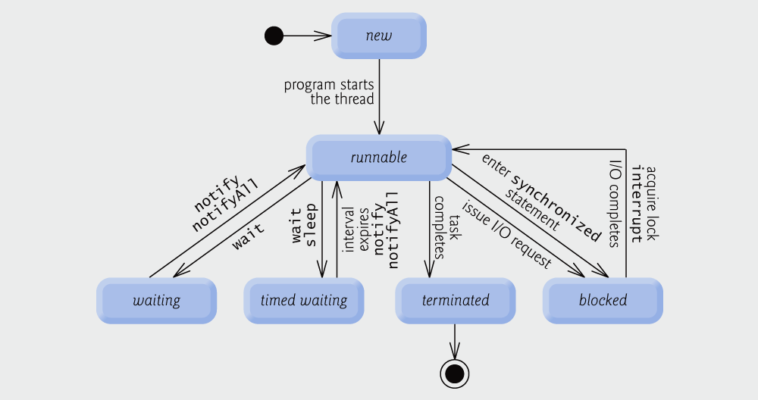
Fig. 23.1 | Thread life-cycle UML state diagram.

Slide 14
23.2 Thread States: Life Cycle of a Thread
Timed waiting and waiting threads cannot use a processor, even if one is available.
A runnable thread can transition to the timed waiting state if it provides an optional wait interval when it is waiting for another thread to perform a task.
  returns to the runnable state when
    it is notified by another thread, or
    the timed interval expires
A thread also enters the timed waiting state when put to sleep
  remains in the timed waiting state for a designated period of time then returns to the runnable state
A runnable thread transitions to the blocked state when it attempts to perform a task that cannot be completed immediately and it must temporarily wait until that task completes.
  A blocked thread cannot use a processor, even if one is available
A runnable thread enters the terminated state (sometimes called the dead state) when it successfully completes its task or otherwise terminates (perhaps due to an error).

Slide 15
23.2 Thread States: Life Cycle of a Thread
At the operating system level, Java’s runnable state typically encompasses two separate states (Fig. 23.2).
  Operating system hides these states from the JVM
  A runnable thread first enters the ready state
  When thread is dispatched by the OS it enters the running state
  When the thread’s quantum expires, the thread returns to the ready state and the operating system dispatches another thread
  Transitions between the ready and running states are handled solely by the operating system

Slide 16

Fig. 23.2 | Operating system’s internal view of Java’s runnable state.

Slide 17
23.3 Thread Priorities and Thread Scheduling
Every Java thread has a thread priority that helps the operating system determine the order in which threads are scheduled
Priorities range between MIN_PRIORITY (a constant of 1) and MAX_PRIORITY (a constant of 10)
By default, every thread is given priority NORM_PRIORITY (a constant of 5)
Each new thread inherits the priority of the thread that created it

Slide 18
23.3 Thread Priorities and Thread Scheduling
Informally, higher-priority threads are more important to a program and should be allocated processor time before lower-priority threads
  Does not guarantee the order in which threads execute
Timeslicing
  enables threads of equal priority to share a processor
  when thread’s quantum expires, processor is given to the next thread of equal priority, if one is available
Thread scheduler determines which thread runs next
Higher-priority threads generally preempt the currently running threads of lower priority
  known as preemptive scheduling
  Possible indefinite postponement (starvation)

Slide 19
Portability Tip 23.1
Thread scheduling is platform dependent—the behavior of a multithreaded program could vary across different Java implementations.

Slide 20
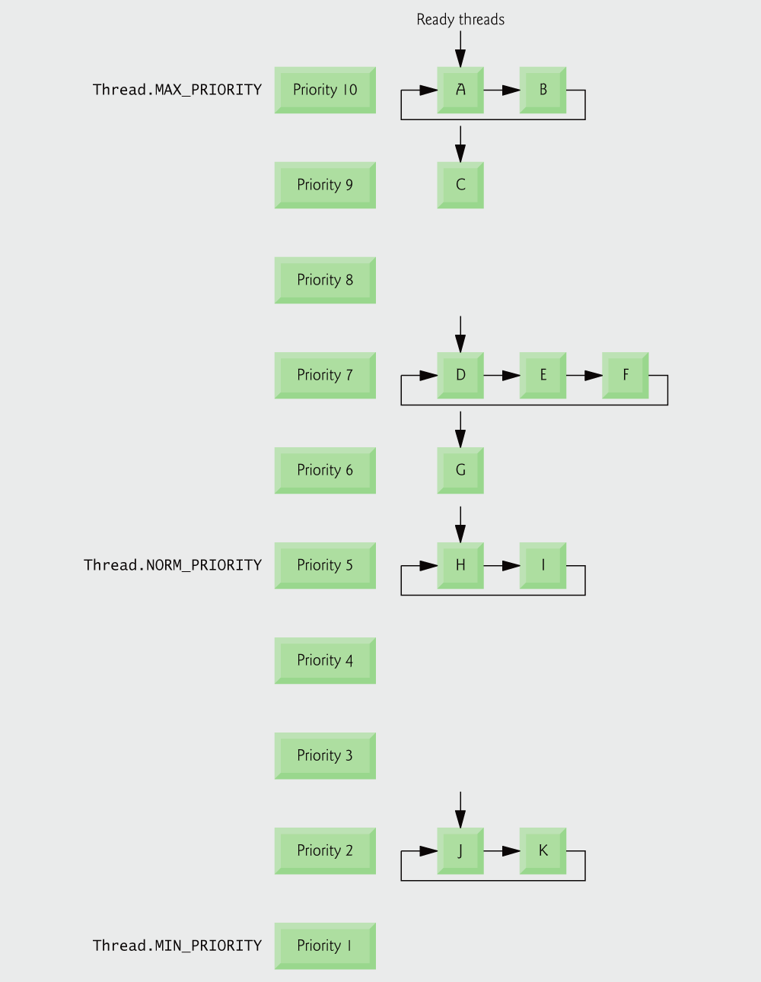
Fig. 23.3 | Thread-priority scheduling.

Slide 21
Portability Tip 23.2
When designing multithreaded programs consider the threading capabilities of all the platforms on which the programs will execute. Using priorities other than the default will make your programs’ behavior platform specific. If portability is your goal, don’t adjust thread priorities.

Slide 22
23.4 Creating and Executing Threads
Runnable interface (of package java.lang)
Runnable object represents a “task” that can execute concurrently with other tasks
Method run contains the code that defines the task that a Runnable object should perform

Slide 23
23.4.1 Runnables and the Thread Class
Method sleep throws a (checked) InterruptedException if the sleeping thread’s interrupt method is called
The code in method main executes in the main thread, a thread created by the JVM

Slide 24
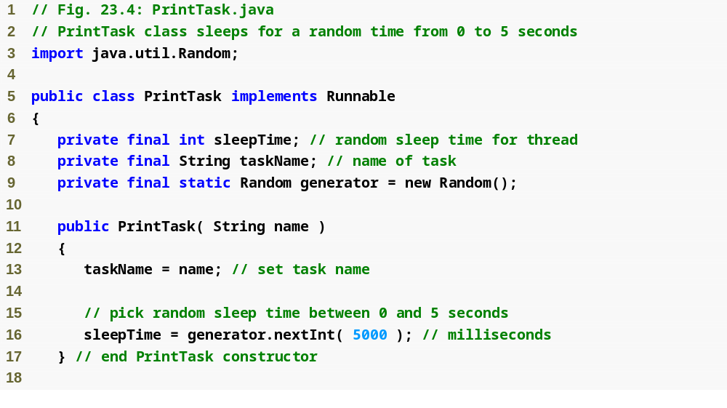
Outline
Implement Runnable to define a task that can execute concurrently
PrintTask.java
(1 of 2 )

Slide 25
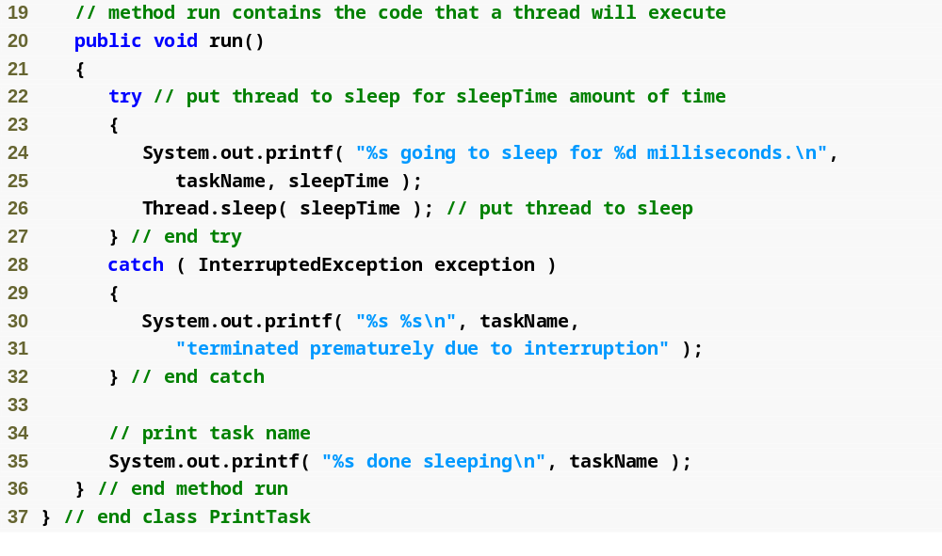
Define task in method run
Outline
PrintTask.java
(2 of 2 )

Slide 26
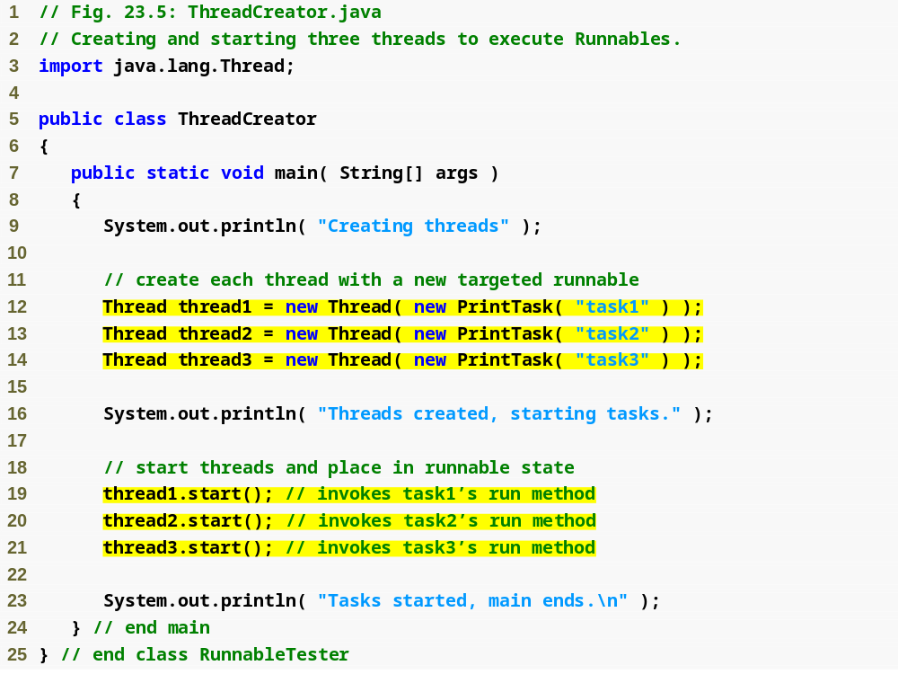
Outline
ThreadCreator .java
(1 of 2 )
Create Threads to execute each new Runnable object
Start the Threads to begin processing the concurrent tasks

Slide 27
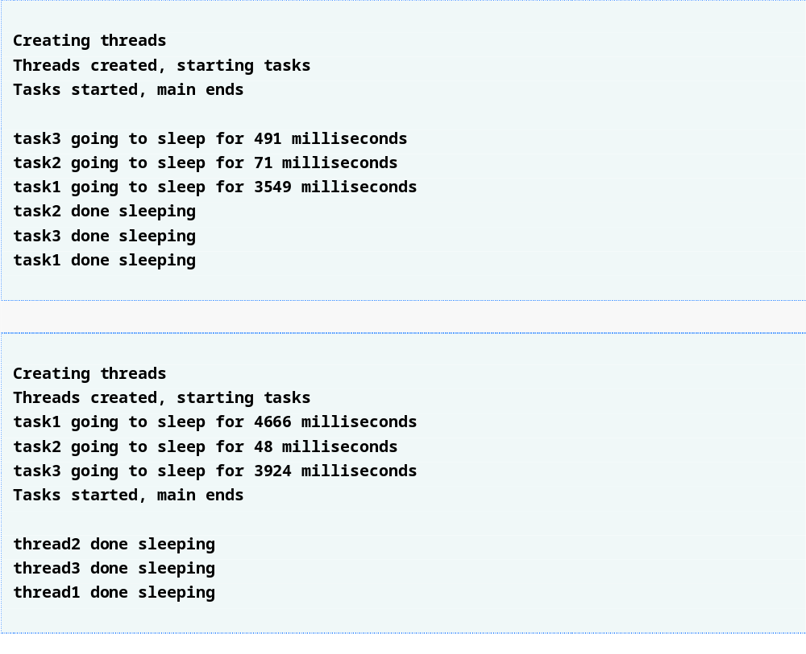
Outline
ThreadCreator .java
(2 of 2 )

Slide 28
23.4.2 Thread Management with the Executor Framework
Recommended that you use the Executor interface to manage the execution of Runnable objects
An Executor object creates and manages a thread pool to execute Runnables
Executor advantages over creating threads yourself
  Reuse existing threads to eliminate new thread overhead
  Improve performance by optimizing the number of threads to ensure that the processor stays busy
Executor method execute accepts a Runnable as an argument
  Assigns each Runnable it receives to one of the available threads in the thread pool
  If none available, creates a new thread or waits for a thread to become available

Slide 29
23.4.2 Thread Management with the Executor Framework
Interface ExecutorService
  package java.util.concurrent
  extends Executor
  declares methods for managing the life cycle of an Executor
  Objects of this type are created using static methods declared in class Executors (of package java.util.concurrent)
Executors method newCachedThreadPool obtains an ExecutorService that creates new threads as they are needed
ExecutorService method execute returns immediately from each invocation
ExecutorService method shutdown notifies the ExecutorService to stop accepting new tasks, but continues executing tasks that have already been submitted

Slide 30
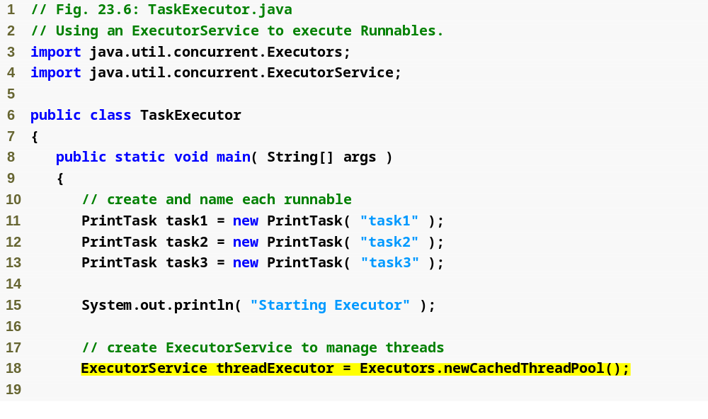
Outline
TaskExecutor .java
(1 of 2 )
Creates an ExecutorService that manages a cached thread pool

Slide 31
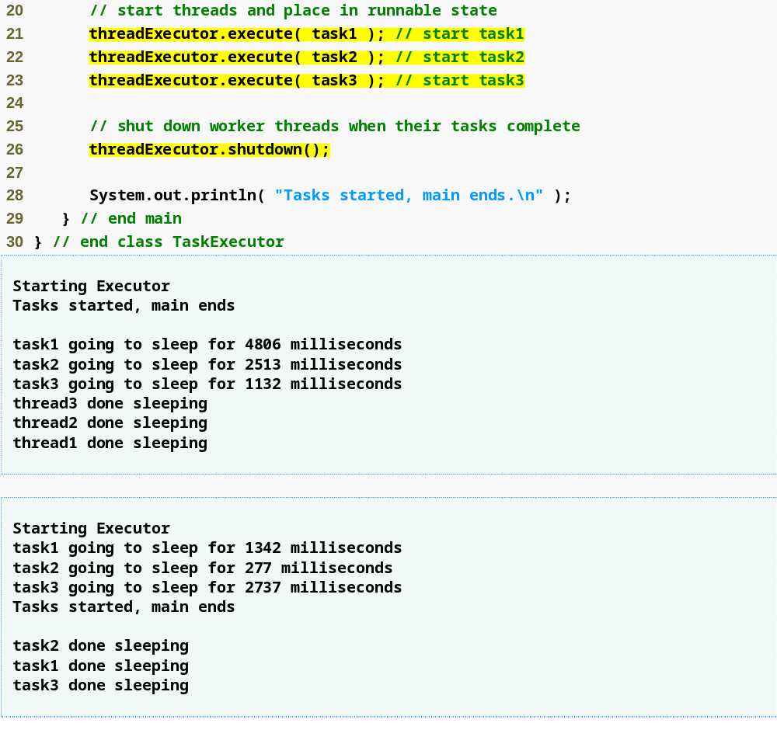
Outline
Use the ExecutorService’s execute method to assign each new Runnable object to a thread in the thread pool
Prevent the ExecutorService from accepting additional Runnable objects
TaskExecutor .java
(2 of 2 )

Slide 32
23.5 Thread Synchronization
Coordinates access to shared data by multiple concurrent threads
  Indeterminate results may occur unless access to a shared object is managed properly
  Give only one thread at a time exclusive access to code that manipulates a shared object
  Other threads wait
  When the thread with exclusive access to the object finishes manipulating the object, one of the threads that was waiting is allowed to proceed
Mutual exclusion

Slide 33
23.5 Thread Synchronization
Java provides built-in monitors to implement synchronization
Every object has a monitor and a monitor lock.
  Monitor ensures that its object’s monitor lock is held by a maximum of only one thread at any time
  Can be used to enforce mutual exclusion
To enforce mutual exclusion
  thread must acquire the lock before it can proceed with its operation
  other threads attempting to perform an operation that requires the same lock will be blocked until the first thread releases the lock

Slide 34
23.5 Thread Synchronization
synchronized statement
  Enforces mutual exclusion on a block of code
  synchronized ( object )
  {
  statements
  } // end synchronized statement
  where object is the object whose monitor lock will be acquired (normally this)
A synchronized method is equivalent to a synchronized statement that encloses the entire body of a method

Slide 35
23.5.1 Unsynchronized Data Sharing
ExecutorService method awaitTermination forces a program to wait for threads to complete execution
  returns control to its caller either when all tasks executing in the ExecutorService complete or when the specified timeout elapses
  If all tasks complete before awaitTermination times out, returns true; otherwise returns false

Slide 36
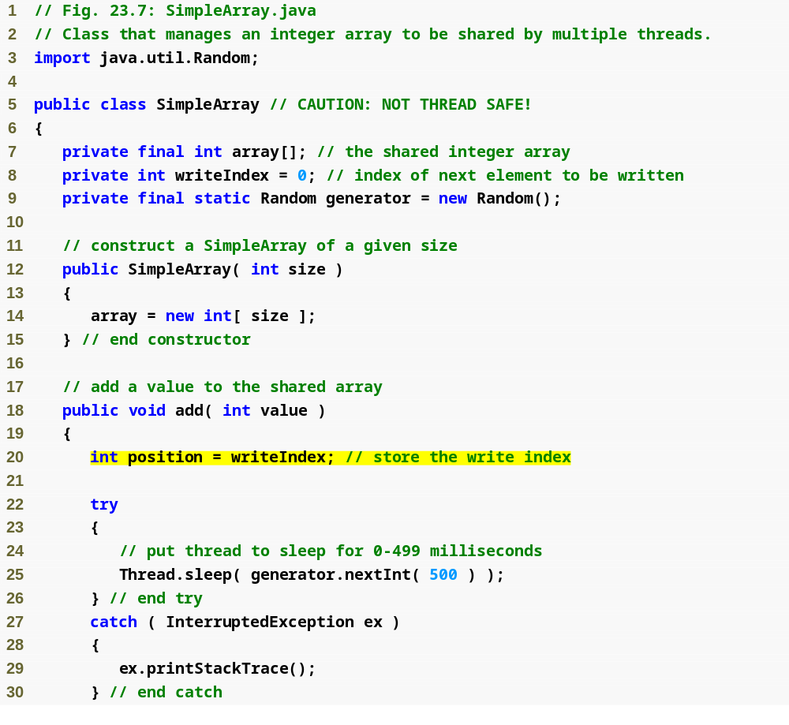
Outline
SimpleArray.java
(1 of 2 )
Track where next item will be placed

Slide 37
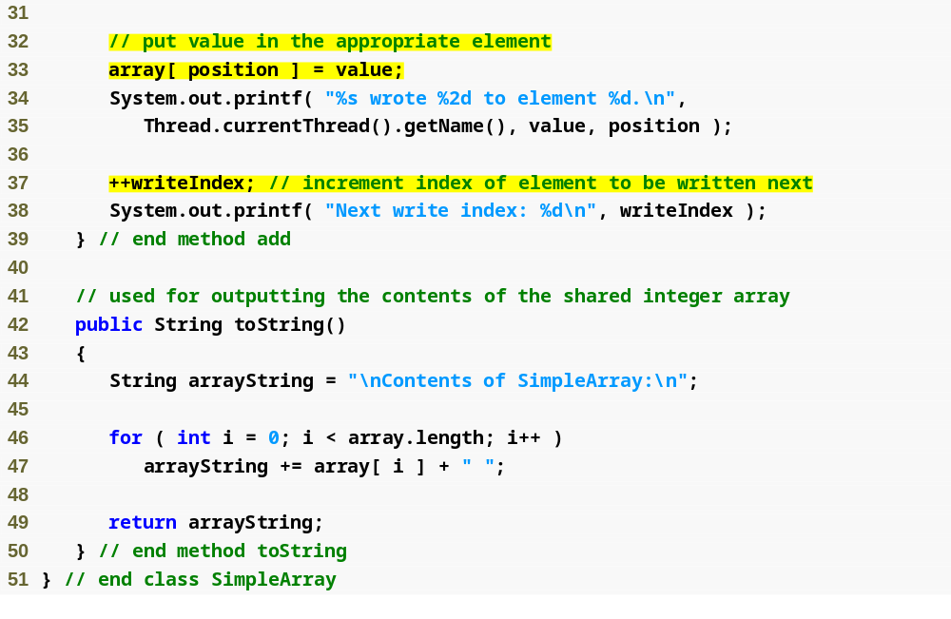
Place the item
Outline
Specify where next item will be placed
SimpleArray.java
(2 of 2 )

Slide 38
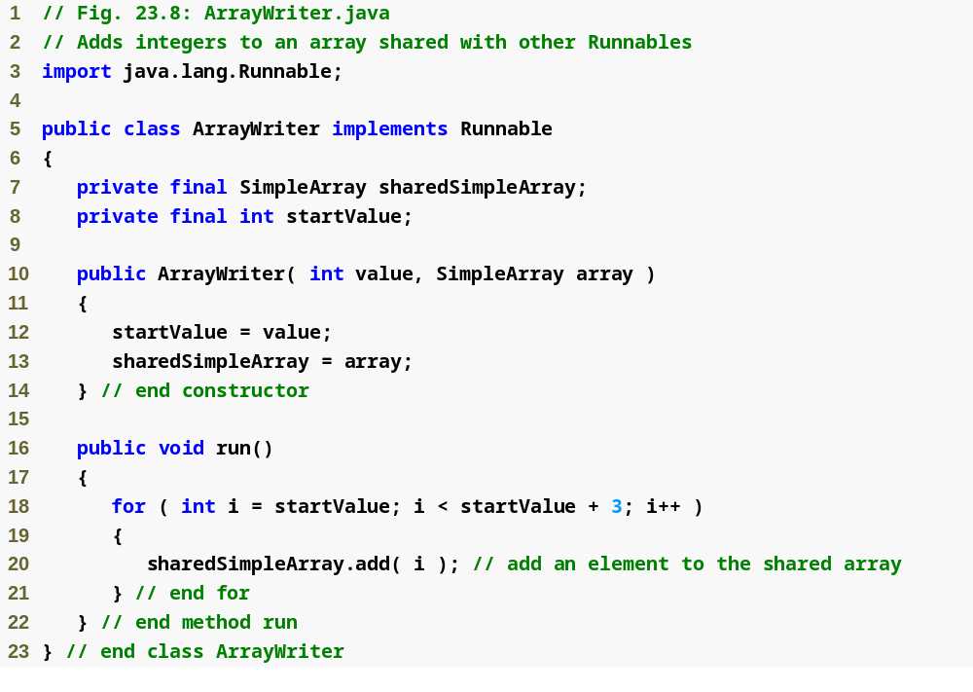
Outline
ArrayWriter.java

Slide 39
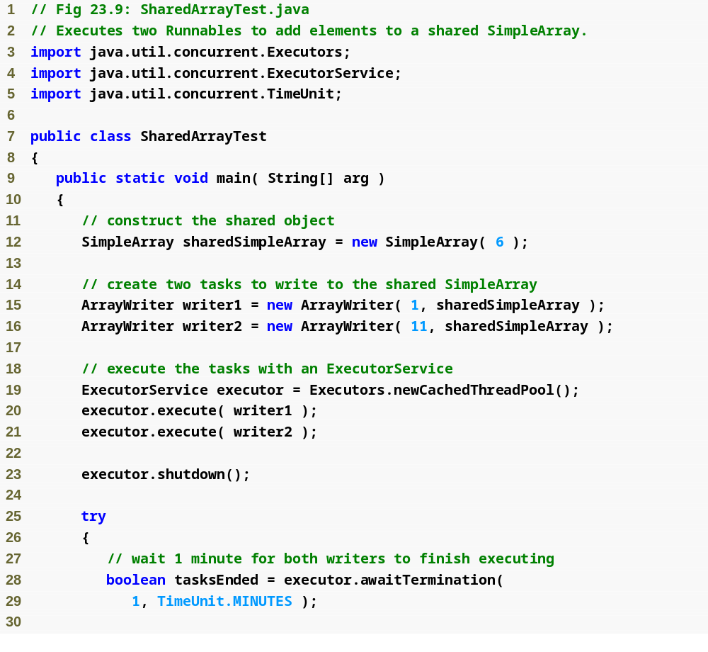
Outline
SharedArrayTest .java
(1 of 2 )
Both ArrayWriters share the same SimpleArray object

Slide 40
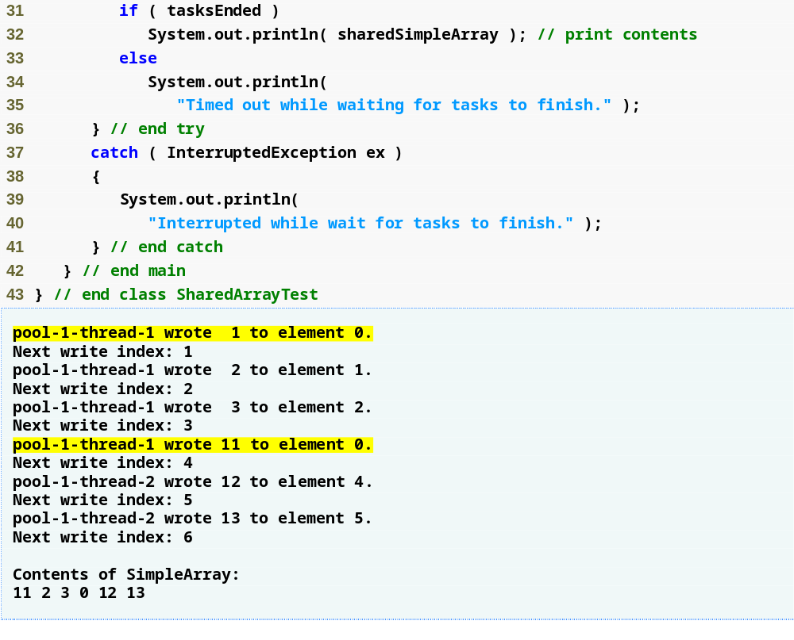
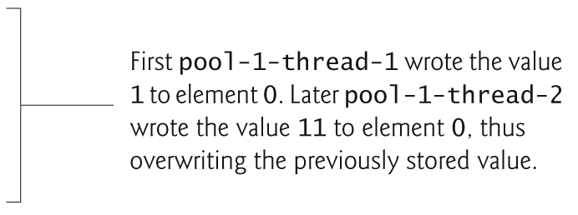
Outline
SharedArrayTest .java
(2 of 2 )

Slide 41
23.5.2 Synchronized Data Sharing—Making Operations Atomic
Simulate atomicity by ensuring that only one thread carries out a set of operations at a time
Immutable data shared across threads
  declare the corresponding data fields final to indicate that variables’ values will not change after they are initialized

Slide 42
Software Engineering Observation 23.1
Place all accesses to mutable data that may be shared by multiple threads inside synchronized statements or synchronized methods that synchronize on the same lock. When performing multiple operations on shared data, hold the lock for the entirety of the operation to ensure that the operation is effectively atomic.

Slide 43
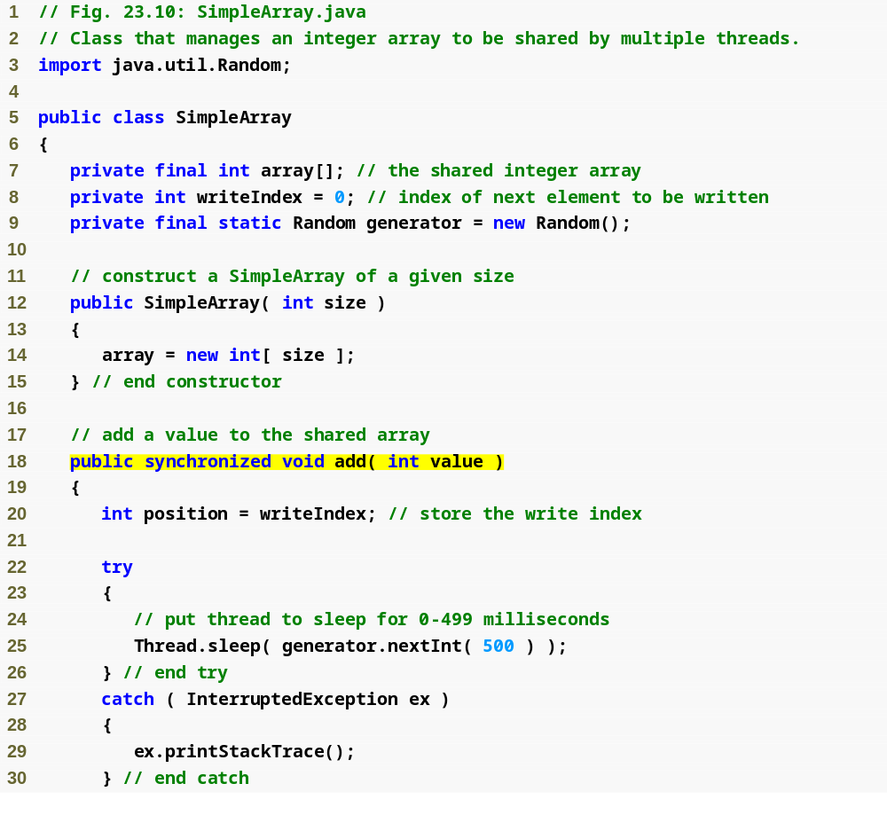
Outline
SimpleArray.java
(1 of 3 )
Using synchronized prevents more than one thread at a time from calling this method on a specific SimpleArray object

Slide 44
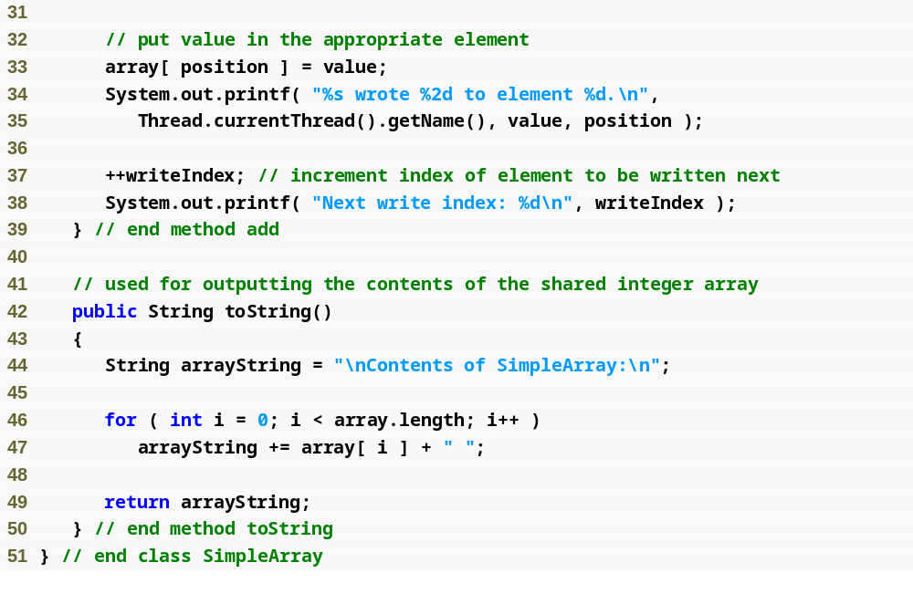
Outline
SimpleArray.java
(2 of 3 )

Slide 45
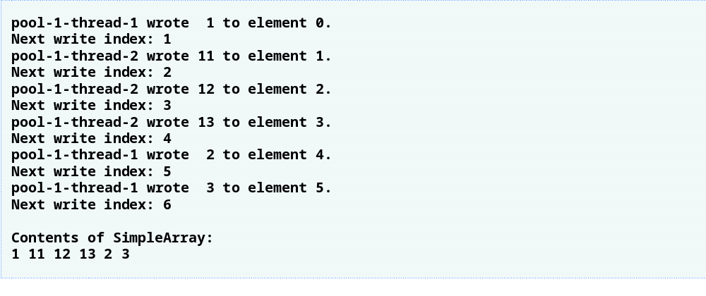
Outline
SimpleArray.java
(3 of 3 )

Slide 46
Performance Tip 23.2
Keep the duration of synchronized statements as short as possible while maintaining the needed synchronization. This minimizes the wait time for blocked threads. Avoid performing I/O, lengthy calculations and operations that do not require synchronization with a lock held.

Slide 47
Good Programming Practice 23.1
Always declare data fields that you do not expect to change as final. Primitive variables that are declared as final can safely be shared across threads. An object reference that is declared as final ensures that the object it refers to will be fully constructed and initialized before it is used by the program and prevents the reference from pointing to another object.

Slide 48
23.6 Producer/Consumer Relationship without Synchronization
Multithreaded producer/consumer relationship
  Producer thread generates data and places it in a shared object called a buffer
  Consumer thread reads data from the buffer
Operations on the buffer data shared by a producer and a consumer are state dependent
  Should proceed only if the buffer is in the correct state
  If in a not-full state, the producer may produce
  If in a not-empty state, the consumer may consume
Must synchronize access to ensure that data is written to the buffer or read from the buffer only if the buffer is in the proper state

Slide 49
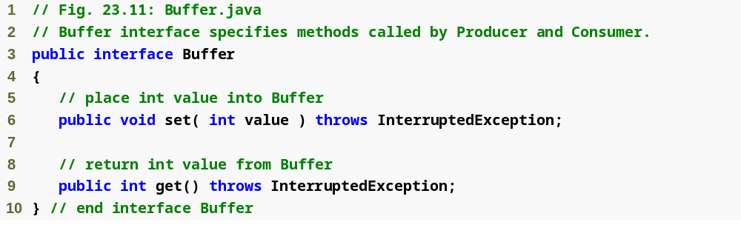
Interface Buffer that will be implemented in each of our Producer/Consumer examples
Outline
Buffer.java

Slide 50
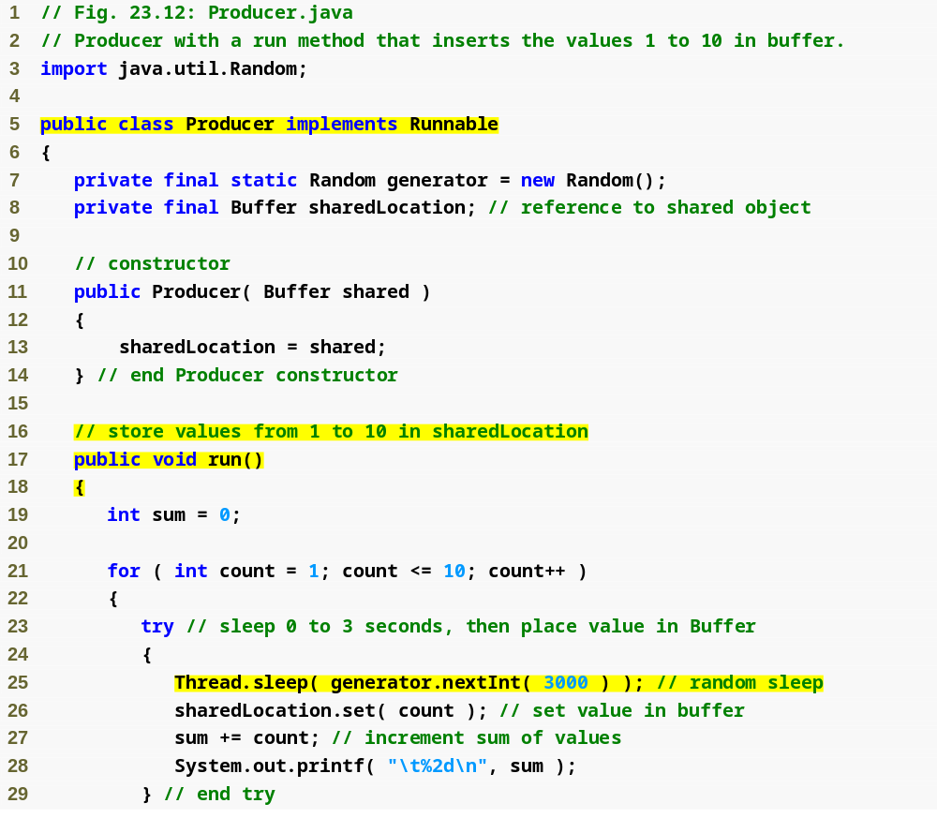
Outline
Class Producer represents a Runnable task that places values in a Buffer
Producer.java
(1 of 2 )
Defines the Producer’s task
Places a value in the Buffer

Slide 51
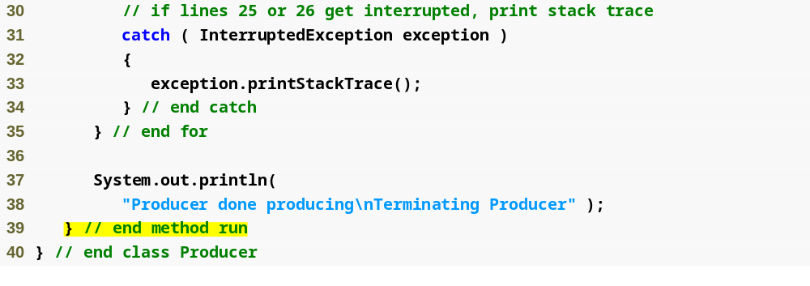
Outline
Producer.java
(2 of 2 )

Slide 52
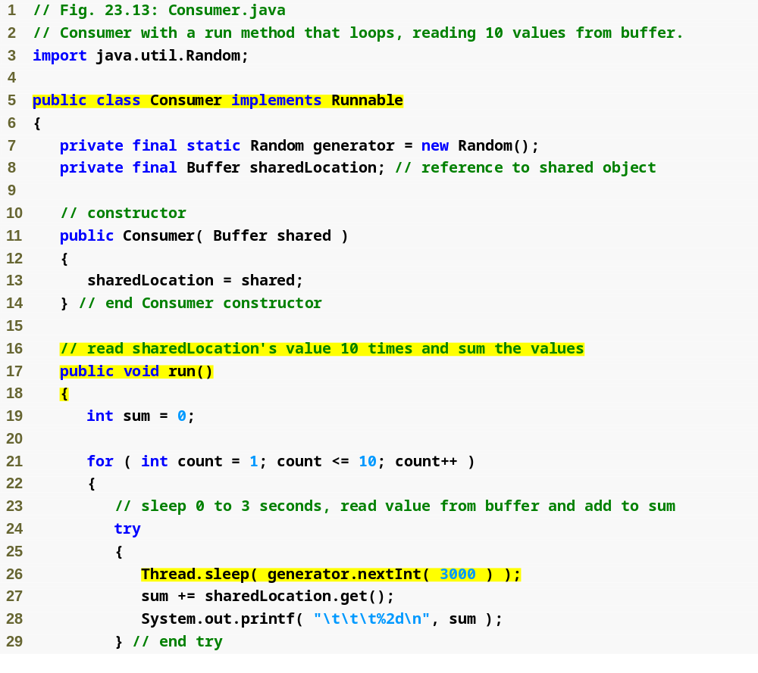
Outline
Class Consumer represents a Runnable task that reads values from a Buffer
Consumer.java
(1 of 2 )
Defines the Consumer’s task
Reads a value from the Buffer

Slide 53
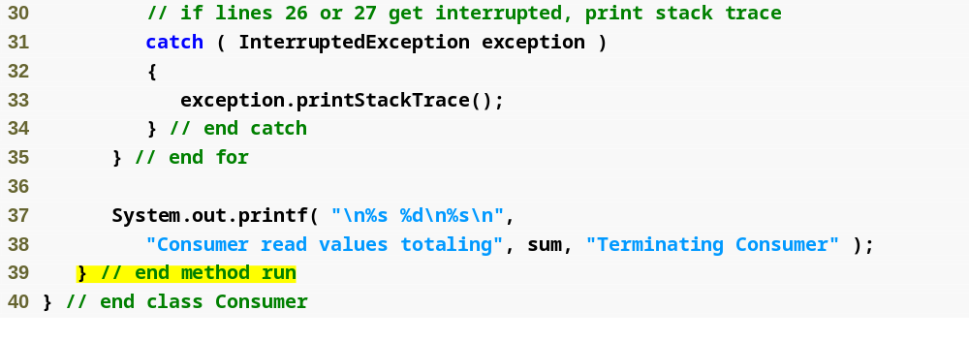
Outline
Consumer.java
(2 of 2 )

Slide 54
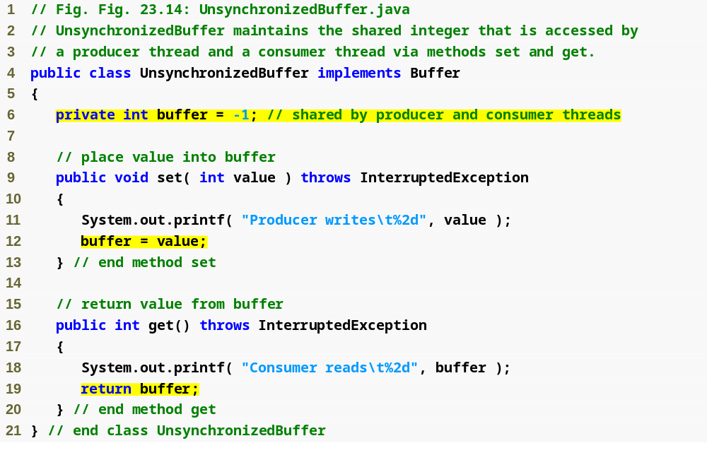
Outline
Unsynchronized implementation of interface Buffer
Unsynchronized Buffer.java

Slide 55
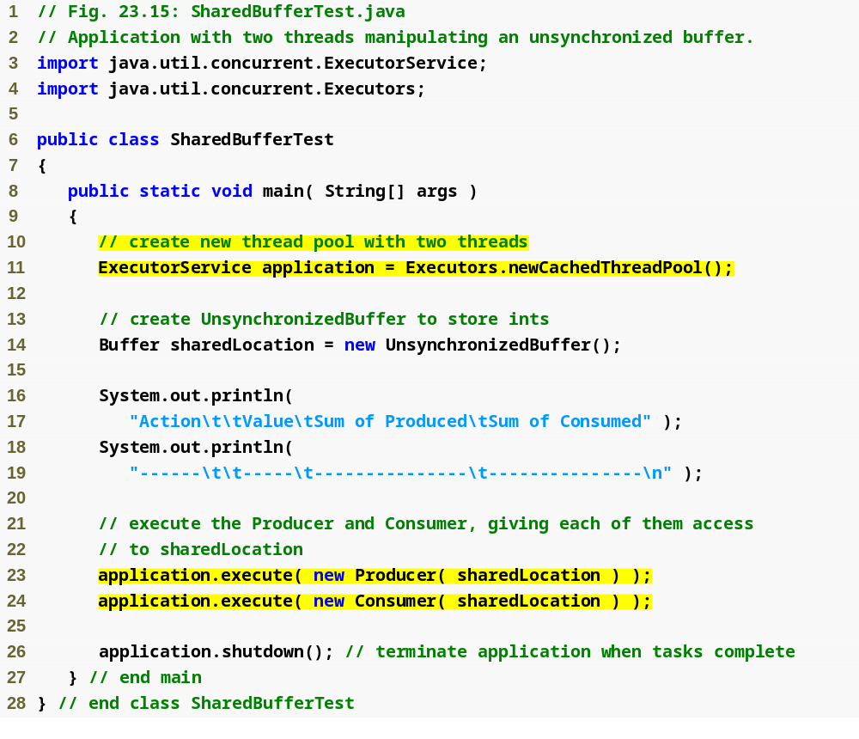
Outline
SharedBufferTest.java
(1 of 3 )
Producer and Consumer share the same unsynchronized Buffer

Slide 56
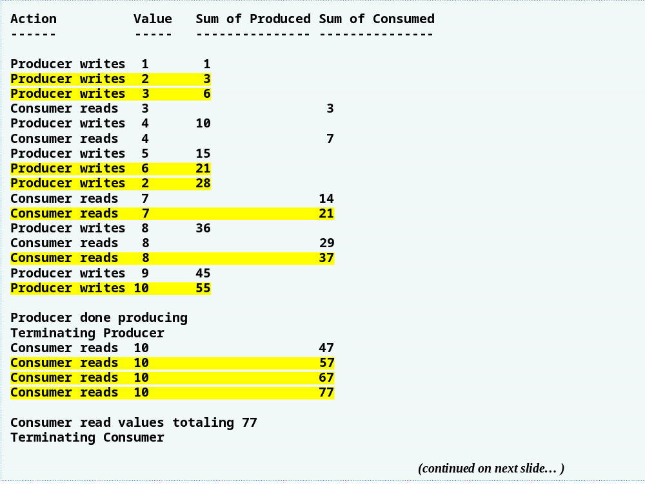
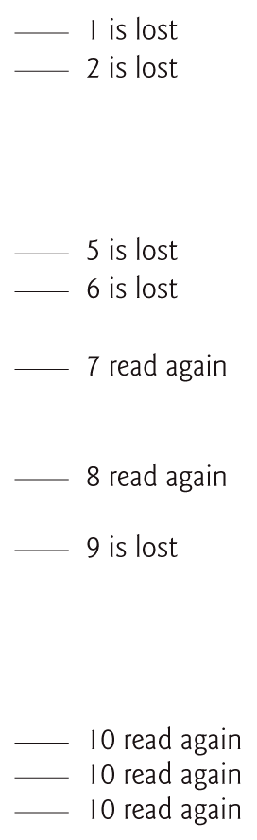
Outline
SharedBufferTest.java
(2 of 3 )

Slide 57
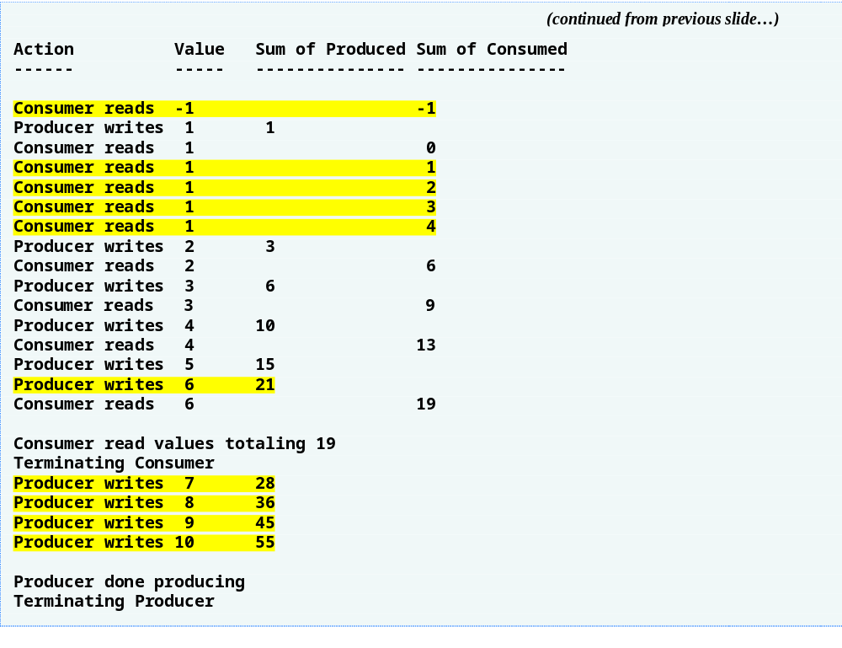
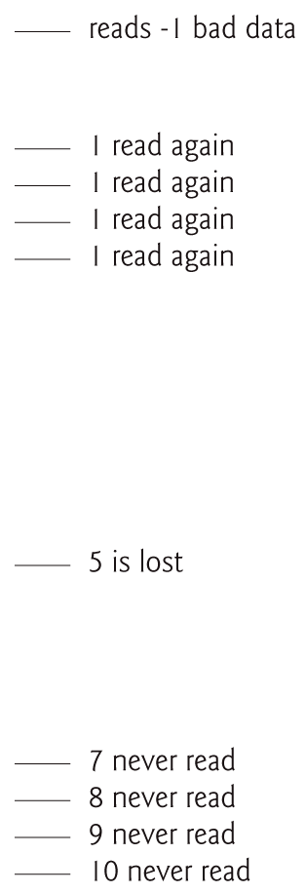
Outline
SharedBufferTest.java
(3 of 3 )

Slide 58
23.7 Producer/Consumer Relationship: ArrayBlockingQueue
ArrayBlockingQueue (package java.util.concurrent)
  Good choice for implementing a shared buffer
  Implements interface BlockingQueue, which extends interface Queue and declares methods put and take
  Method put places an element at the end of the BlockingQueue, waiting if the queue is full
  Method take removes an element from the head of the BlockingQueue, waiting if the queue is empty
  Stores shared data in an array
  Array size specified as a constructor argument
  Array is fixed in size

Slide 59
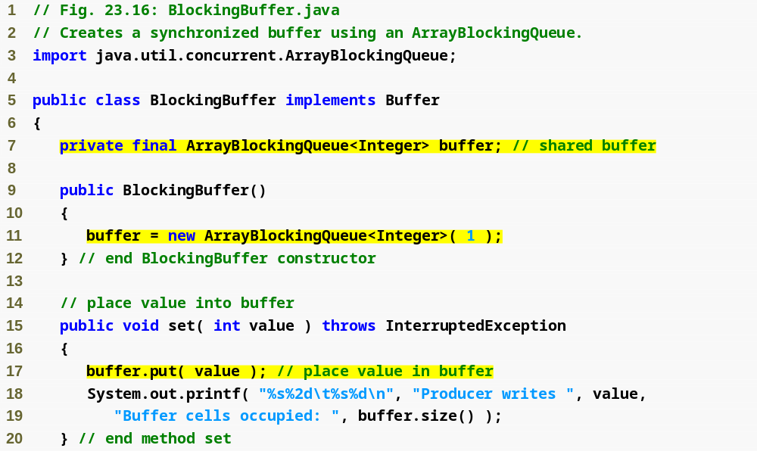
Outline
Synchronized implementation of interface Buffer that uses an ArrayBlockingQueue to implement the synchronization
BlockingBuffer .java
(1 of 2 )
Creates a single element buffer of type ArrayBlockingQueue

Slide 60
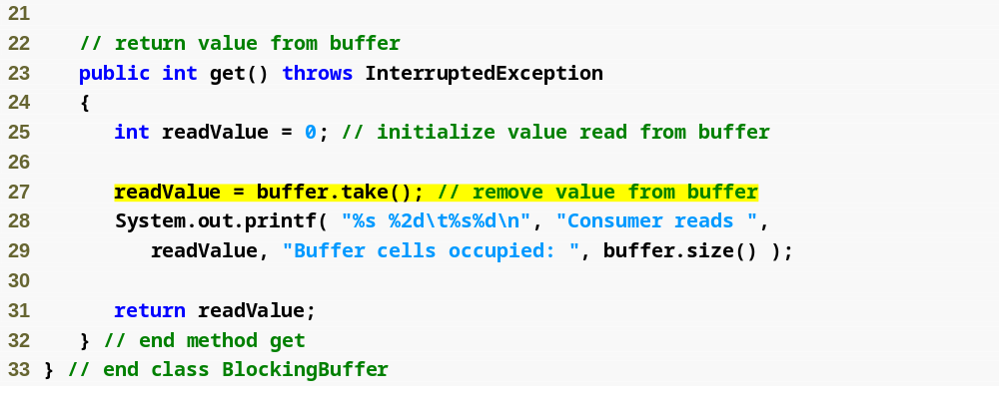
Outline
BlockingBuffer .java
(2 of 2 )

Slide 61
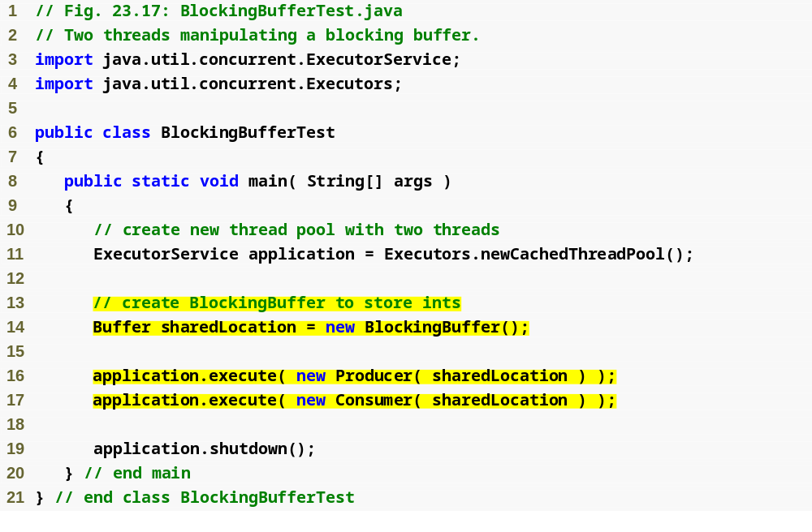
Outline
BlockingBuffer Test.java
(1 of 2 )
Producer and Consumer share the same synchronized Buffer

Slide 62
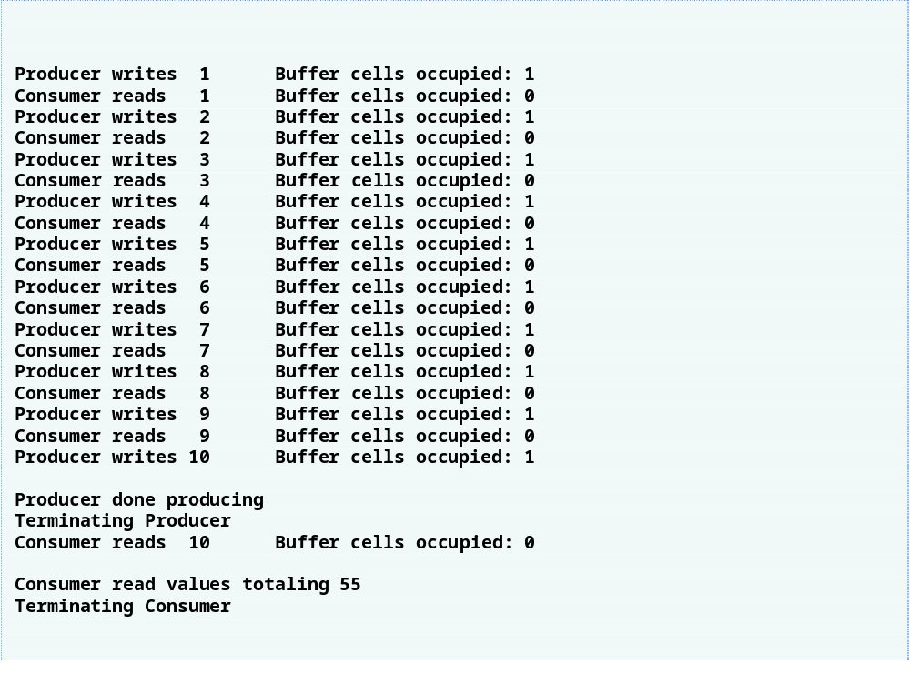
Outline
BlockingBuffer Test.java
(2 of 2 )

Slide 63
23.8 Producer/Consumer Relationship with Synchronization
Can implement a shared using the synchronized keyword and Object methods wait, notify and notifyAll
  can be used with conditions to make threads wait when they cannot perform their tasks
A thread that cannot continue with its task until some condition is satisfied can call Object method wait
  releases the monitor lock on the object
  thread waits in the waiting state while the other threads try to enter the object’s synchronized statement(s) or method(s)
A thread that completes or satisfies the condition on which another thread may be waiting can call Object method notify
  allows a waiting thread to transition to the runnable state
  the thread that was transitioned can attempt to reacquire the monitor lock
If a thread calls notifyAll, all the threads waiting for the monitor lock become eligible to reacquire the lock

Slide 64
Common Programming Error 23.1
It is an error if a thread issues a wait, a notify or a notifyAll on an object without having acquired a lock for it. This causes an IllegalMonitorStateException.

Slide 65
Error-Prevention Tip 23.1
It is a good practice to use notifyAll to notify waiting threads to become runnable. Doing so avoids the possibility that your program would forget about waiting threads, which would otherwise starve.

Slide 66
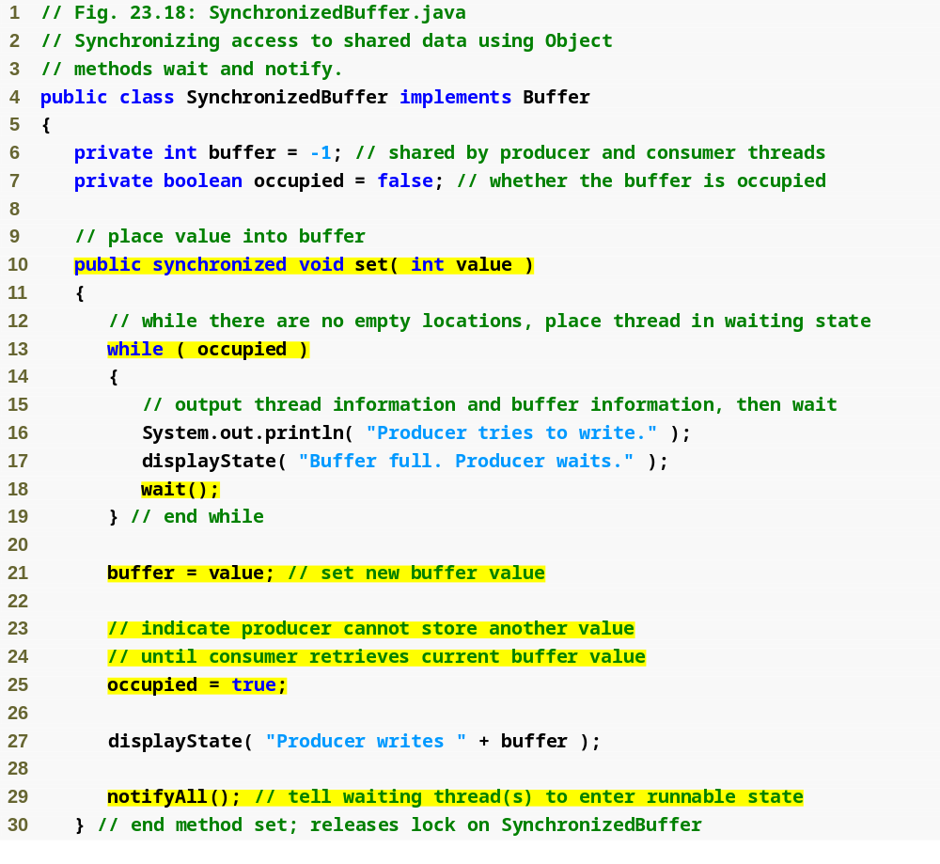
Outline
Synchronized implementation of interface Buffer that uses monitors and monitor locks
Synchronized Buffer.java
(1 of 3 )
Synchronized method that allows a Producer to write a new value only if the buffer is empty
Producer cannot write so it must wait
Notify waiting Consumer that a value is now available

Slide 67
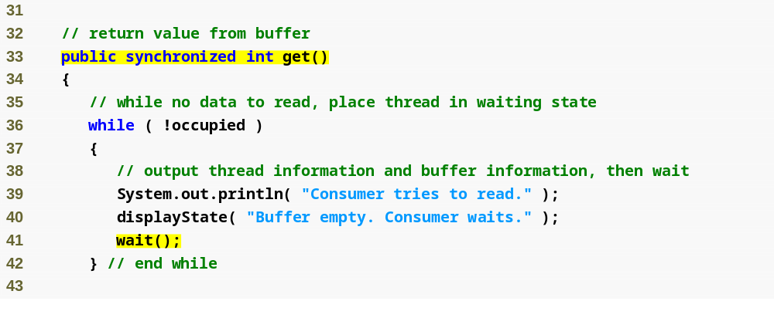
Synchronized method that allows a Consumer to read a value only if the buffer is full
Outline
Synchronized Buffer.java
(2 of 3 )
Consumer cannot read so it must wait

Slide 68
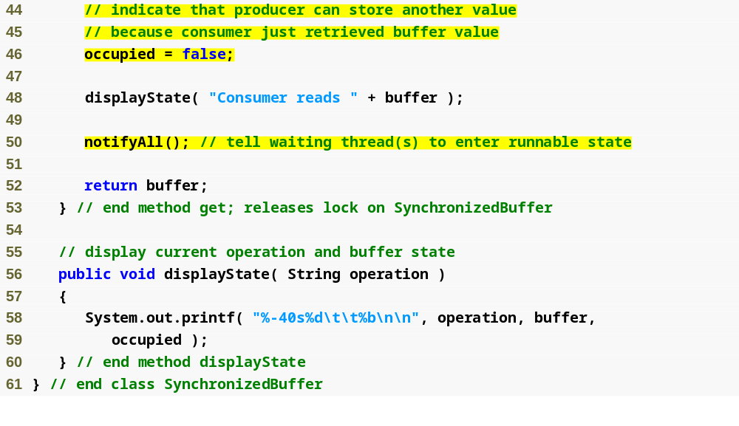
Outline
Notify waiting Producer that a value is now available
Synchronized Buffer.java
(3 of 3 )

Slide 69
Error-Prevention Tip 23.2
Always invoke method wait in a loop that tests the condition the task is waiting on. It is possible that a thread will reenter the runnable state (via a timed wait or another thread calling notify­All) before the condition is satisfied. Testing the condition again ensures that the thread will not erroneously execute if it was notified early.

Slide 70
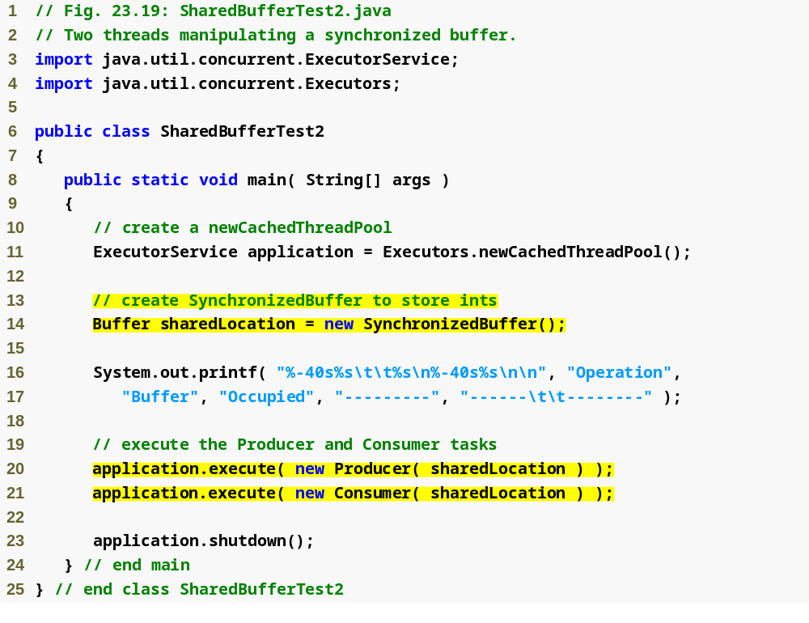
Outline
SharedBuffer Test2.java
(1 of 3 )
Producer and Consumer share the same synchronized Buffer

Slide 71
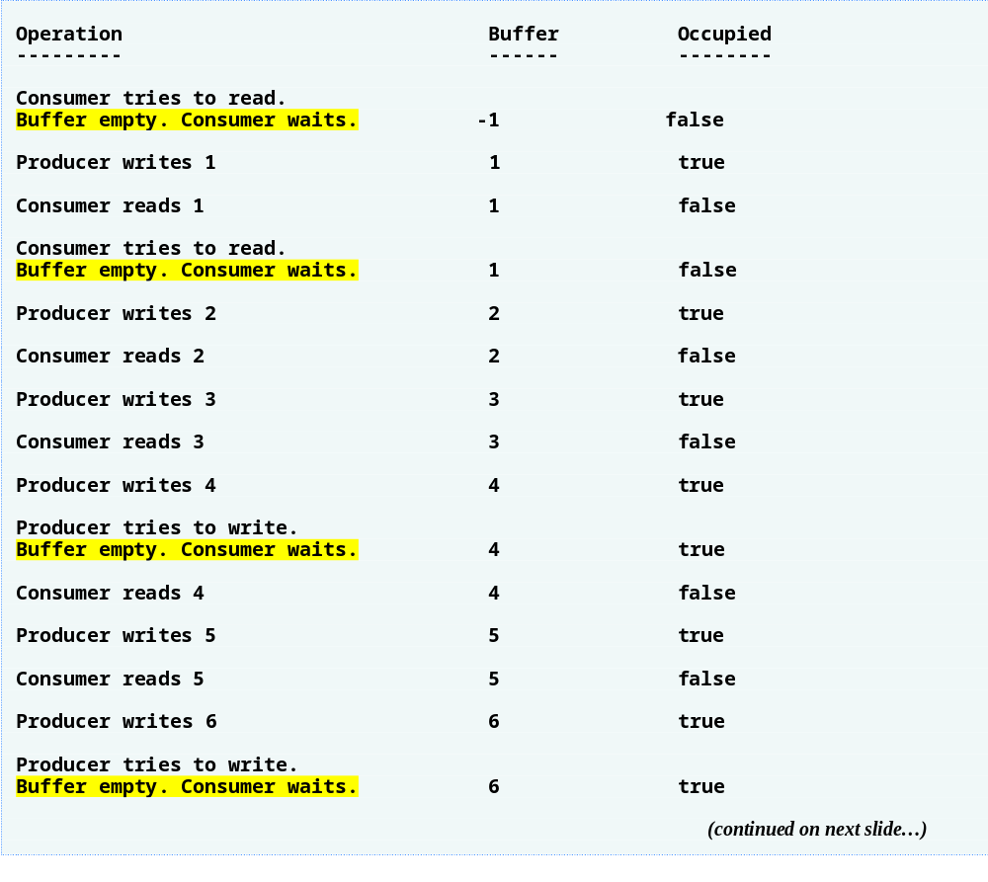
Outline
SharedBuffer Test2.java
(2 of 3 )

Slide 72
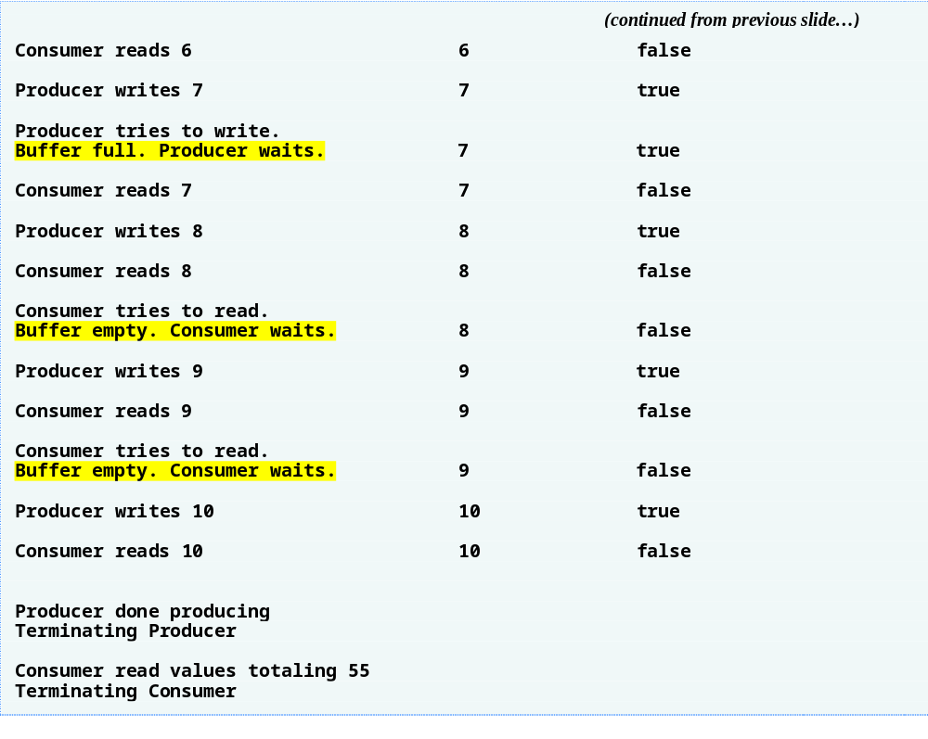
Outline
SharedBuffer Test2.java
(3 of 3 )

Slide 73
23.9 Producer/Consumer Relationship: Bounded Buffers
Cannot make assumptions about the relative speeds of concurrent
Bounded buffer
  Used to minimize the amount of waiting time for threads that share resources and operate at the same average speeds
  Key is to provide the buffer with enough locations to handle the anticipated “extra” production
  ArrayBlockingQueue is a bounded buffer that handles all of the synchronization details for you

Slide 74
Performance Tip 23.3
Even when using a bounded buffer, it is possible that a producer thread could fill the buffer, which would force the producer to wait until a consumer consumed a value to free an element in the buffer. Similarly, if the buffer is empty at any given time, a consumer thread must wait until the producer produces another value. The key to using a bounded buffer is to optimize the buffer size to minimize the amount of thread wait time, while not wasting space..

Slide 75
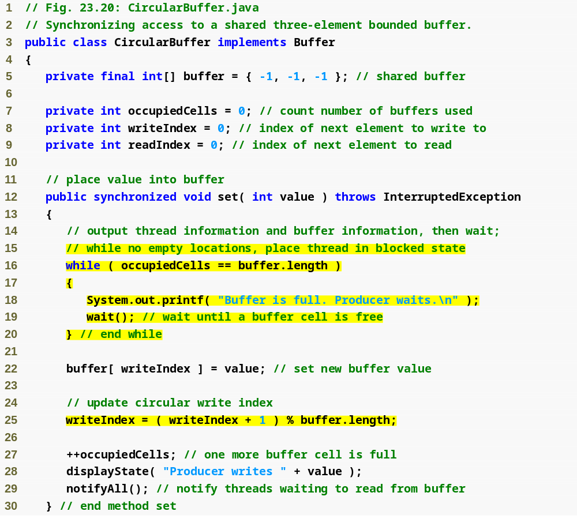
Outline
CircularBuffer .java
(1 of 3 )
Determine whether buffer is full
Specify next write position in buffer

Slide 76
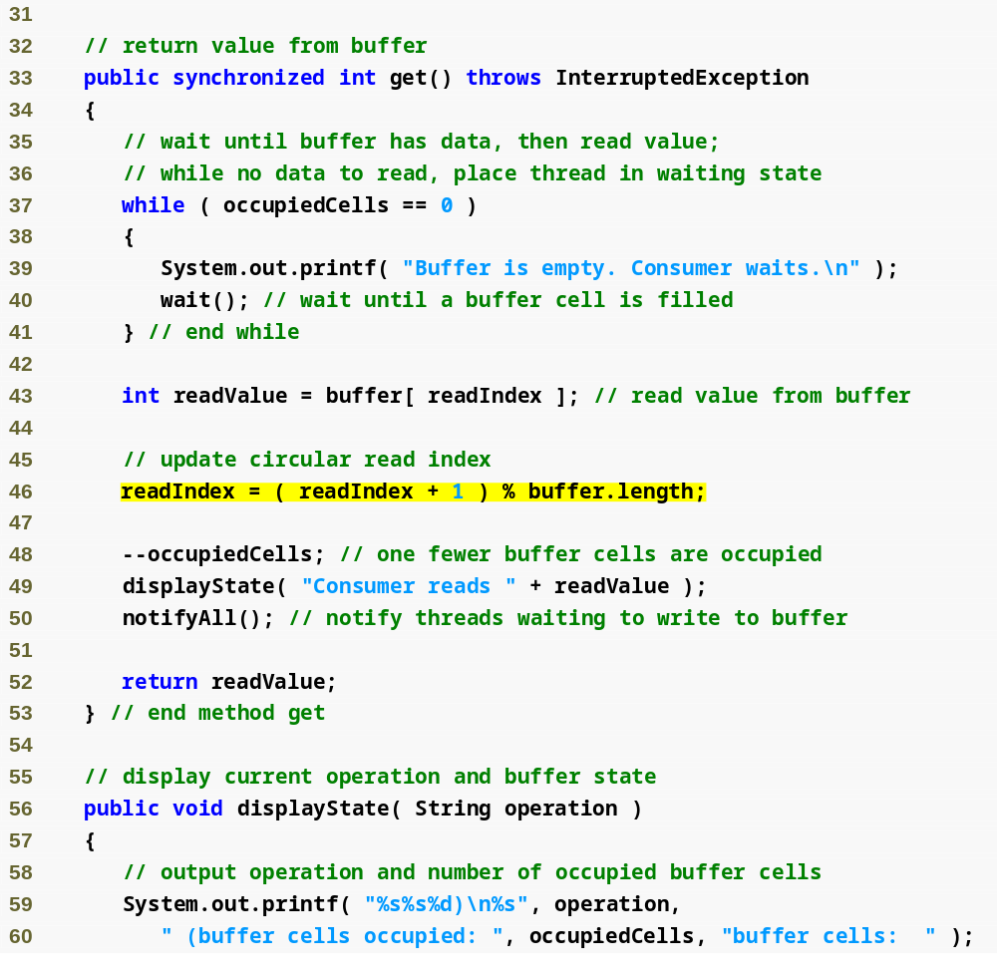
Outline
Determine whether buffer is empty
CircularBuffer .java
(2 of 3 )
Specify the next read location in the buffer

Slide 77
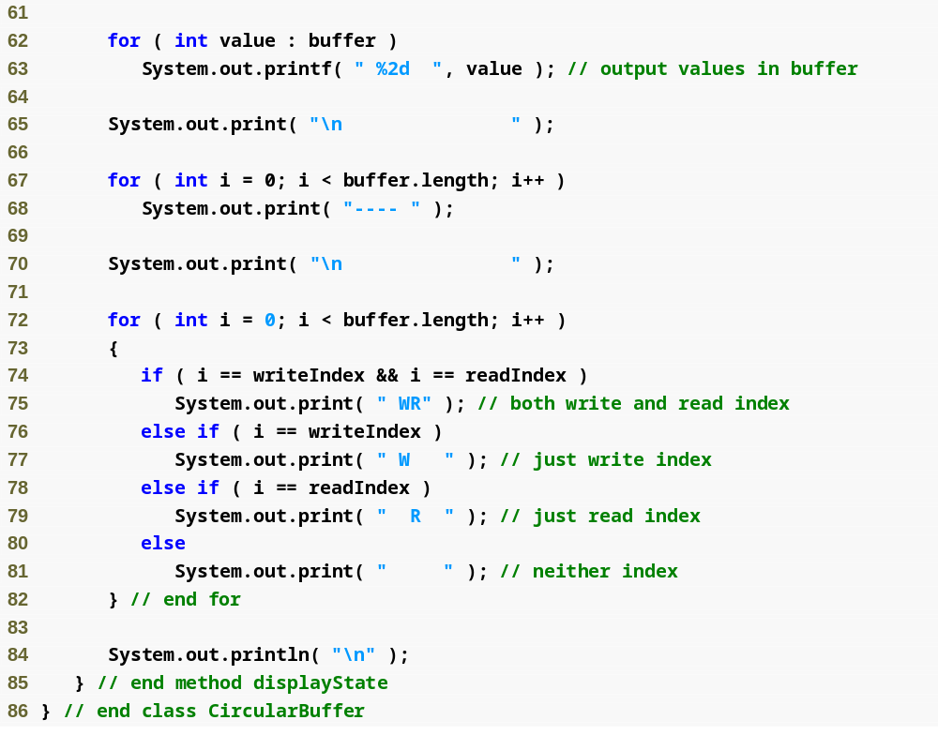
Outline
CircularBuffer .java
(3 of 3 )

Slide 78
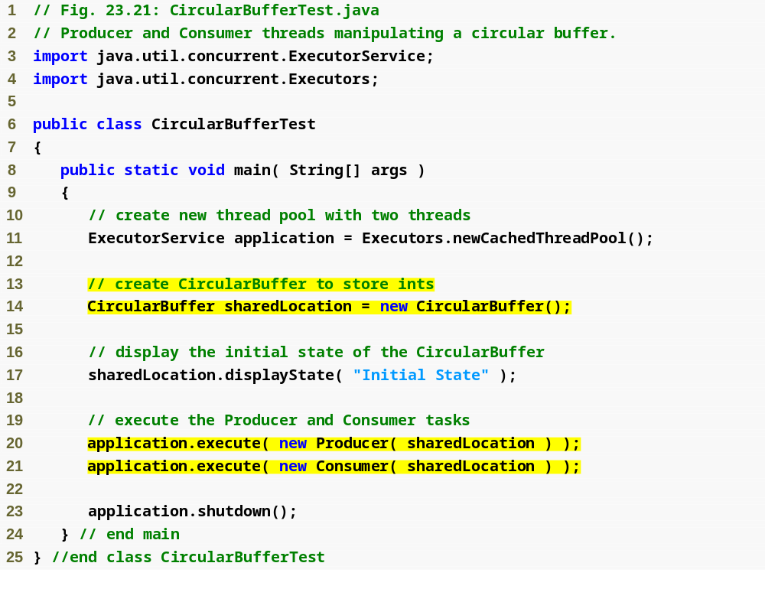
Outline
CircularBuffer Test.java
(1 of 5 )
Producer and Consumer share the same synchronized circular Buffer

Slide 79
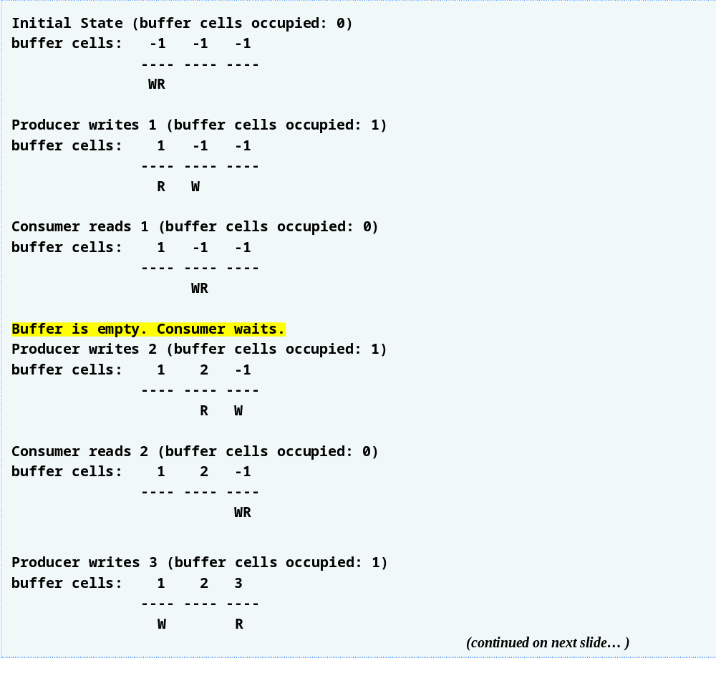
Outline
CircularBuffer Test.java
(2 of 5 )

Slide 80
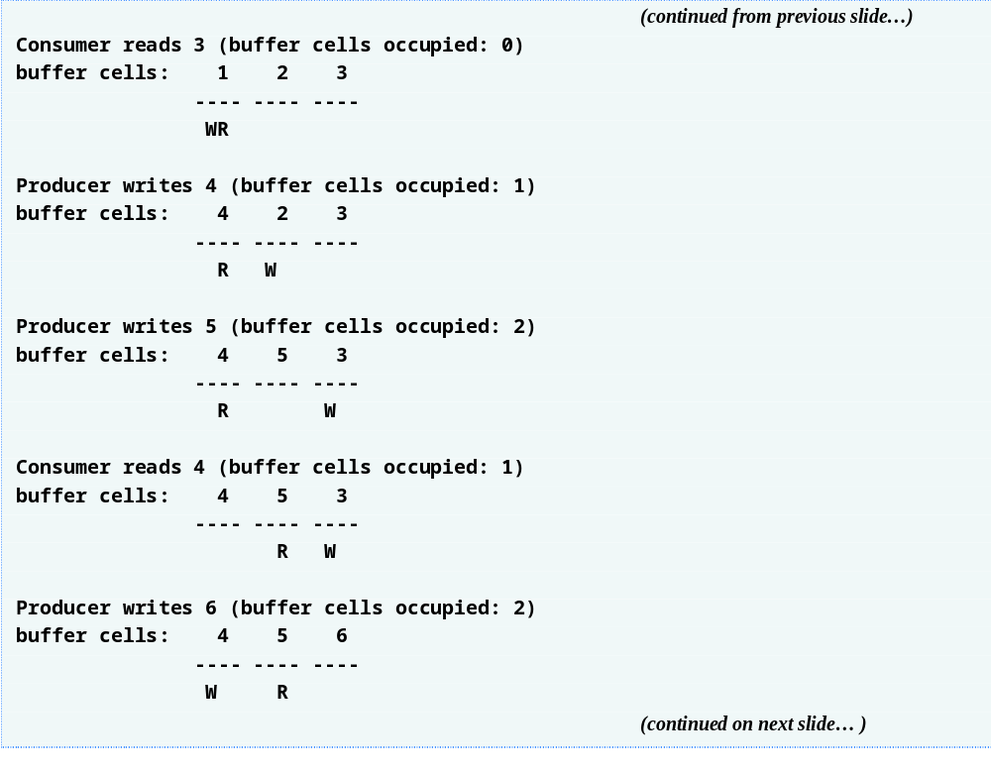
Outline
CircularBuffer Test.java
(3 of 5 )

Slide 81
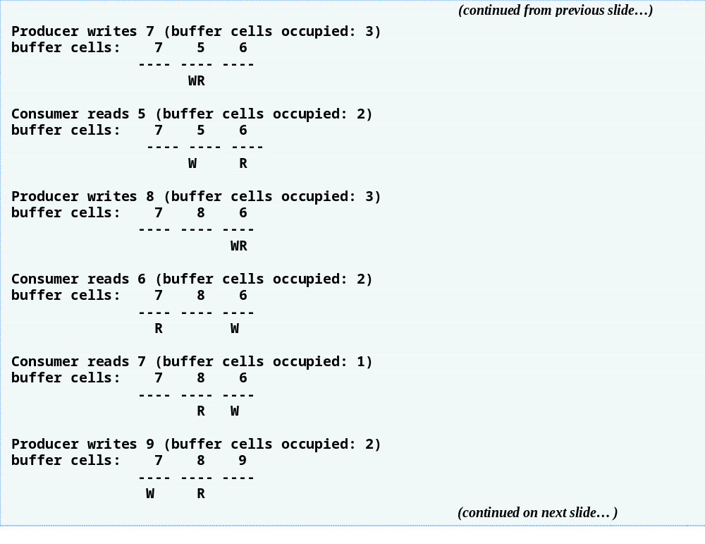
Outline
CircularBuffer Test.java
(4 of 5 )

Slide 82
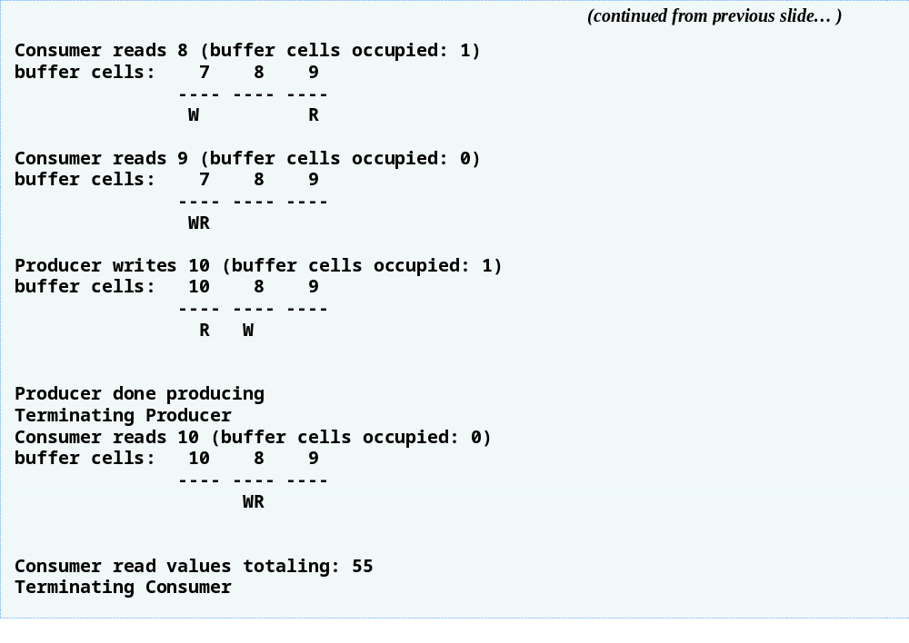
Outline
CircularBuffer Test.java
(5 of 5 )

Slide 83
23.10 Producer/Consumer Relationship: The Lock and Condition Interfaces
Introduced in Java SE 5
Give programmers more precise control over thread synchronization, but are more complicated to use
Any object can contain a reference to an object that implements the Lock interface (of package java.util.concurrent.locks)
Call Lock’s lock method to acquire the lock
  Once obtained by one thread, the Lock object will not allow another thread to obtain the Lock until the first thread releases the Lock
Call Lock’s unlock method to release the lock
All other threads attempting to obtain that Lock on a locked object are placed in the waiting state

Slide 84
23.10 Producer/Consumer Relationship: The Lock and Condition Interfaces
Class ReentrantLock (of package java.util.concurrent.locks) is a basic implementation of the Lock interface.
ReentrantLock constructor takes a boolean argument that specifies whether the lock has a fairness policy
  If true, the ReentrantLock’s fairness policy is “the longest-waiting thread will acquire the lock when it is available”—prevents starvation
  If false, there is no guarantee as to which waiting thread will acquire the lock when it is available
A thread that owns a Lock and determines that it cannot continue with its task until some condition is satisfied can wait on a condition object
Lock objects allow you to explicitly declare the condition objects on which a thread may need to wait

Slide 85
23.10 Producer/Consumer Relationship: The Lock and Condition Interfaces
Condition objects
  Associated with a specific Lock
  Created by calling a Lock’s newCondition method
To wait on a Condition object, call the Condition ’s await method
  immediately releases the associated Lock and places the thread in the waiting state for that Condition
Another thread can call Condition method signal to allow a thread in that Condition’s waiting state to return to the runnable state
  Default implementation of Condition signals the longest-waiting thread
Condition method signalAll transitions all the threads waiting for that condition to the runnable state
When finished with a shared object, thread must call unlock to release the Lock

Slide 86
23.10 Producer/Consumer Relationship: The Lock and Condition Interfaces
Lock and Condition may be preferable to using the synchronized keyword
  Lock objects allow you to interrupt waiting threads or to specify a timeout for waiting to acquire a lock
  Lock object is not constrained to be acquired and released in the same block of code
Condition objects can be used to specify multiple conditions on which threads may wait
  Possible to indicate to waiting threads that a specific condition object is now true

Slide 87
Software Engineering Observation 23.2
Using a ReentrantLock with a fairness policy avoids indefinite postponement.

Slide 88
Performance Tip 23.4
Using a ReentrantLock with a fairness policy can decrease program performance significantly.

Slide 89
Common Programming Error 23.2
Deadlock occurs when a waiting thread (let us call this thread1) cannot proceed because it is waiting (either directly or indirectly) for another thread (let us call this thread2) to proceed, while simultaneously thread2 cannot proceed because it is waiting (either directly or indirectly) for thread1 to proceed. The two threads are waiting for each other, so the actions that would enable each thread to continue execution can never occur.

Slide 90
Error-Prevention Tip 23.3
When multiple threads manipulate a shared object using locks, ensure that if one thread calls method await to enter the waiting state for a condition object, a separate thread eventually will call Condition method signal to transition the thread waiting on the condition object back to the runnable state. If multiple threads may be waiting on the condition object, a separate thread can call Condition method signalAll as a safeguard to ensure that all the waiting threads have another opportunity to perform their tasks. If this is not done, starvation might occur.

Slide 91
Common Programming Error 23.3
An IllegalMonitorStateException occurs if a thread issues an await, a signal, or a signalAll on a condition object without having acquired the lock for that condition object.

Slide 92
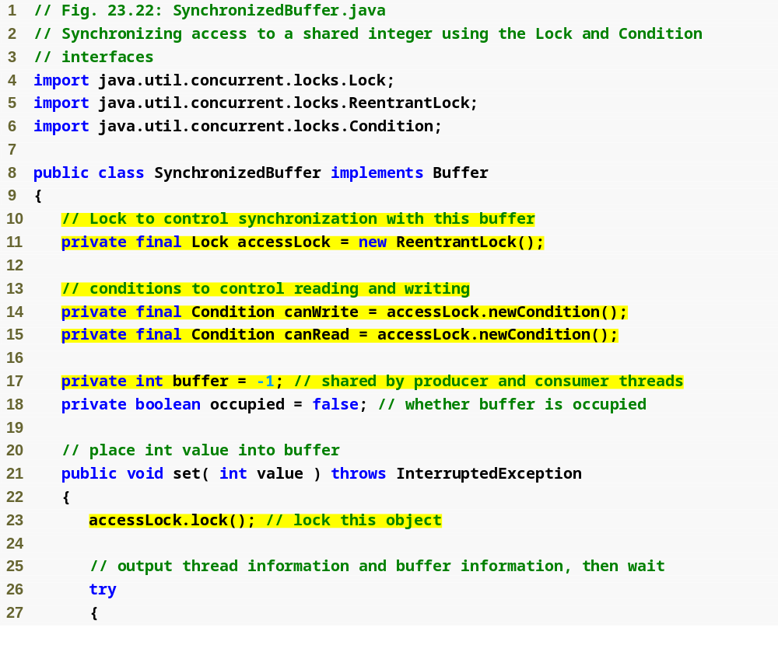
Outline
Synchronized Buffer.java
(1 of 4 )
Synchronized implementation of interface Buffer that uses Locks and Conditions
Condition indicating when a producer can write
Condition indicating when a consumer can read
Manually acquire the lock to implement mutual exclusion

Slide 93
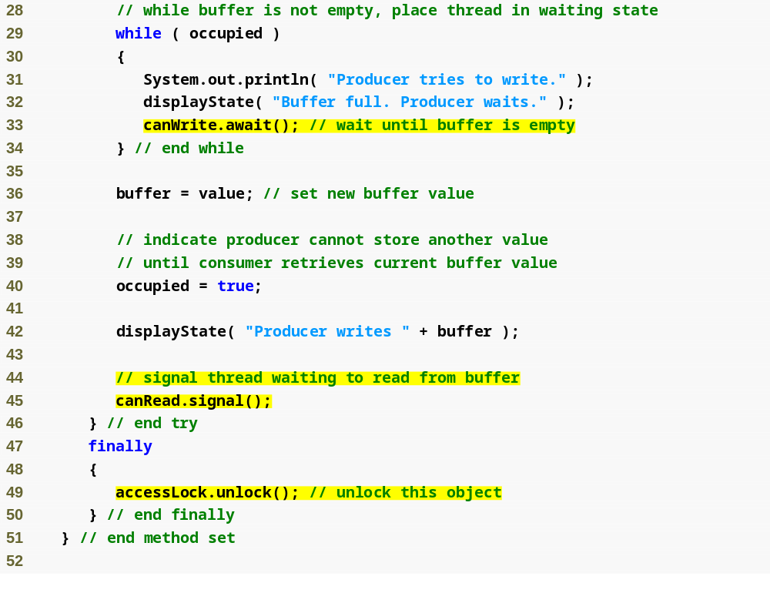
Outline
Producer must wait until buffer is empty and release the lock
Synchronized Buffer.java
(2 of 4 )
Producer signals the consumer that a value is available for reading
Release the lock so consumer can read

Slide 94
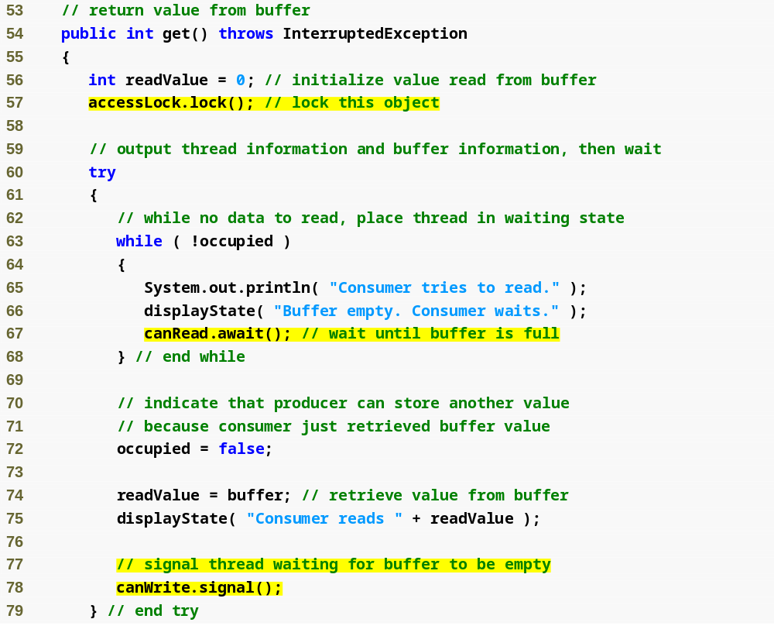
Outline
Manually acquire the lock to implement mutual exclusion
Synchronized Buffer.java
(3 of 4 )
Consumer must wait until buffer is full and release the lock
Consumer signals the producer that space is available for writing

Slide 95
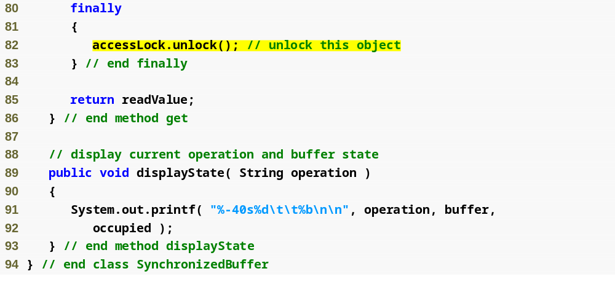
Release the lock so producer can write
Outline
Synchronized Buffer.java
(4 of 4 )

Slide 96
Error-Prevention Tip 23.4
Place calls to Lock method unlock in a finally block. If an exception is thrown, unlock must still be called or deadlock could occur.

Slide 97
Common Programming Error 23.4
Forgetting to signal a waiting thread is a logic error. The thread will remain in the waiting state, which will prevent the thread from proceeding. Such waiting can lead to indefinite postponement or deadlock.

Slide 98

Outline
SharedBuffer Test2.java
(1 of 3 )

Slide 99

Outline
SharedBuffer Test2.java
(2 of 3 )

Slide 100

Outline
SharedBuffer Test2.java
(3 of 3 )

Slide 101
23.11 Multithreading with GUI
Event dispatch thread handles interactions with the application’s GUI components
  All tasks that interact with an application’s GUI are placed in an event queue
  Executed sequentially by the event dispatch thread
Swing GUI components are not thread safe
  Thread safety achieved by ensuring that Swing components are accessed from only the event dispatch thread—known as thread confinement
Preferable to handle long-running computations in a separate thread, so the event dispatch thread can continue managing other GUI interactions
Class SwingWorker (in package javax.swing) implements interface Runnable
  Performs long-running computations in a worker thread
  Updates Swing components from the event dispatch thread based on the computations’ results

Slide 102

Fig. 23.24 | Commonly used SwingWorker methods.

Slide 103
23.11.1 Performing Computations in a Worker Thread
To use a SwingWorker
  Extend SwingWorker
  Overrides methods doInBackground and done
  doInBackground performs the computation and returns the result
  done displays the results in the GUI after doInBackground returns
SwingWorker is a generic class
  First type parameter indicates the type returned by doInBackground
  Second indicates the type passed between the publish and process methods to handle intermediate results
ExecutionException thrown if an exception occurs during the computation

Slide 104

Outline
Background Calculator.java
(1 of 2 )
Create a subclass of SwingWorker to
Possibly lengthy Fibonacci calculation to perform in the background

Slide 105

Outline
Display the calculation results when done
Background Calculator.java
(2 of 2 )

Slide 106
Software Engineering Observation 23.3
Any GUI components that will be manipulated by SwingWorker methods, such as components that will be updated from methods process or done, should be passed to the SwingWorker subclass’s constructor and stored in the subclass object. This gives these methods access to the GUI components they will manipulate.

Slide 107

Outline
FibonacciNumbers.java
(1 of 5 )

Slide 108

Outline
FibonacciNumbers.java
(2 of 5 )

Slide 109

Outline
FibonacciNumbers.java
(3 of 5 )

Slide 110

Outline
FibonacciNumbers.java
(4 of 5 )

Slide 111







Outline
FibonacciNumbers.java
(5 of 5 )

Slide 112
23.11.2 Processing Intermediate Results with SwingWorker
SwingWorker methods
  publish repeatedly sends intermediate results to method process
  process executes in the event dispatch thread and receives data from method publish then displays the data in a GUI component
  setProgress updates the progress property
Values are passed asynchronously between publish in the worker thread and process in the event dispatch thread
process is not necessarily invoked for every call to publish
PropertyChangeListener
  Interface from package java.beans
  Defines method propertyChange
  Each call to setProgress generates a PropertyChangeEvent to indicate that the progress property has changed

Slide 113

Outline
PrimeCalculator .java
(1 of 5 )

Slide 114

Outline
PrimeCalculator .java
(2 of 5 )
Specify progress status as a percentage of the number of primes we are calculating

Slide 115

Publish each prime as it is discovered
Outline
PrimeCalculator .java
(3 of 5 )
Process all the published prime values

Slide 116

Outline
PrimeCalculator .java
(4 of 5 )

Slide 117

Outline
PrimeCalculator .java
(5 of 5 )

Slide 118

Outline
FindPrimes.java
(1 of 6 )

Slide 119

Outline
FindPrimes.java
(2 of 6 )

Slide 120

Outline
FindPrimes.java
(3 of 6 )

Slide 121

Outline
FindPrimes.java
(4 of 6 )

Slide 122


Outline
FindPrimes.java
(5 of 6 )

Slide 123



Outline
FindPrimes.java
(6 of 6 )

Slide 124
23.12 Other Classes and Interfaces in java.util.concurrent
Callable interface
  package java.util.concurrent
  declares a single method named call
  similar to Runnable, but method call allows the thread to return a value or to throw a checked exception
ExecutorService method submit executes a Callable
  Returns an object of type Future (of package java.util.concurrent) that represents the executing Callable
  Future declares method get to return the result of the Callable and other methods to manage a Callable’s execution

