Slide 1
Exploring the Landscape of Online Coding Education in Africa: A Literature Review
Joreen Arigye
PhD candidate School of Engineering Education Purdue University 23rd-May-2024
Notes:
Thursday 5/23rd /2024
9:00 AM - 1:00 PM Congress hall, Grand hotel Adriatic, OpatijaOUT of 18 papers, I am number 11

Slide 2

Background
Technological advancements has led to the popularity of online learning
Accelerated by the global pandemic
Teaching programming can be challenging
Discrepancies in online programming education due to infrastructural and resource availability
https://www.cedefop.europa.eu/mt/news/coronavirus-boosts-interest-online-learning

Slide 3
Research Objective
To investigate the online teaching and learning landscape of
computer programming in Africa.

Slide 4
Methodology
(“online education” OR “e-learning” OR “MOOCs” OR “coding education” OR “self-paced learning” OR “programming” OR “digital skills” OR “technology education” OR “online learning platforms” OR “computer science education” OR “distance education” OR “educational technology”) AND (“Africa”)
Records identified on google scholar based on 1st search criteria
n = 1,820,000 articles
refined
(“online education” OR “e-learning” OR “MOOCs” OR “coding education” OR “programming” OR “digital skills” OR “computer science education”) AND (“Africa” OR “Sub-Saharan Africa”) AND (“self-paced learning” OR “online learning platforms”)
]]
Records based on 2nd refined search
n = 5570 articles
Identification
refined
(“coding education” OR “programming education” OR “computer science education”) AND (“Africa” OR “Sub-Saharan Africa”) AND (“online learning”)
Records based on 2nd refined search
n = 1730 articles

Slide 5
Methodology
n =1730 articles
Records identified after title, abstract and conclusion screening
n = 31 articles
Screening
Articles should be peer-reviewed.
Articles should be in English.
Articles should be freely accessible.
Articles should not be more than 20 years old.
Records identified after full text screening
n= 11 articles
Eligibility
Studies included in the literature review
n = 11 articles
Included

Slide 6
Results

Slide 7
Results

Slide 8
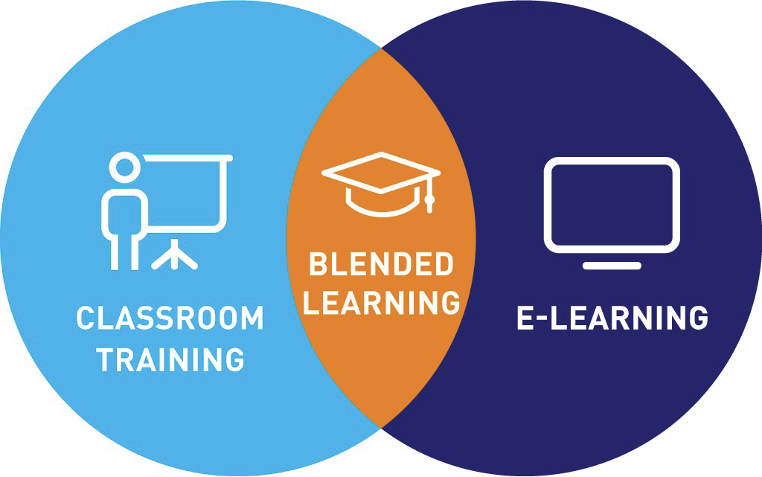








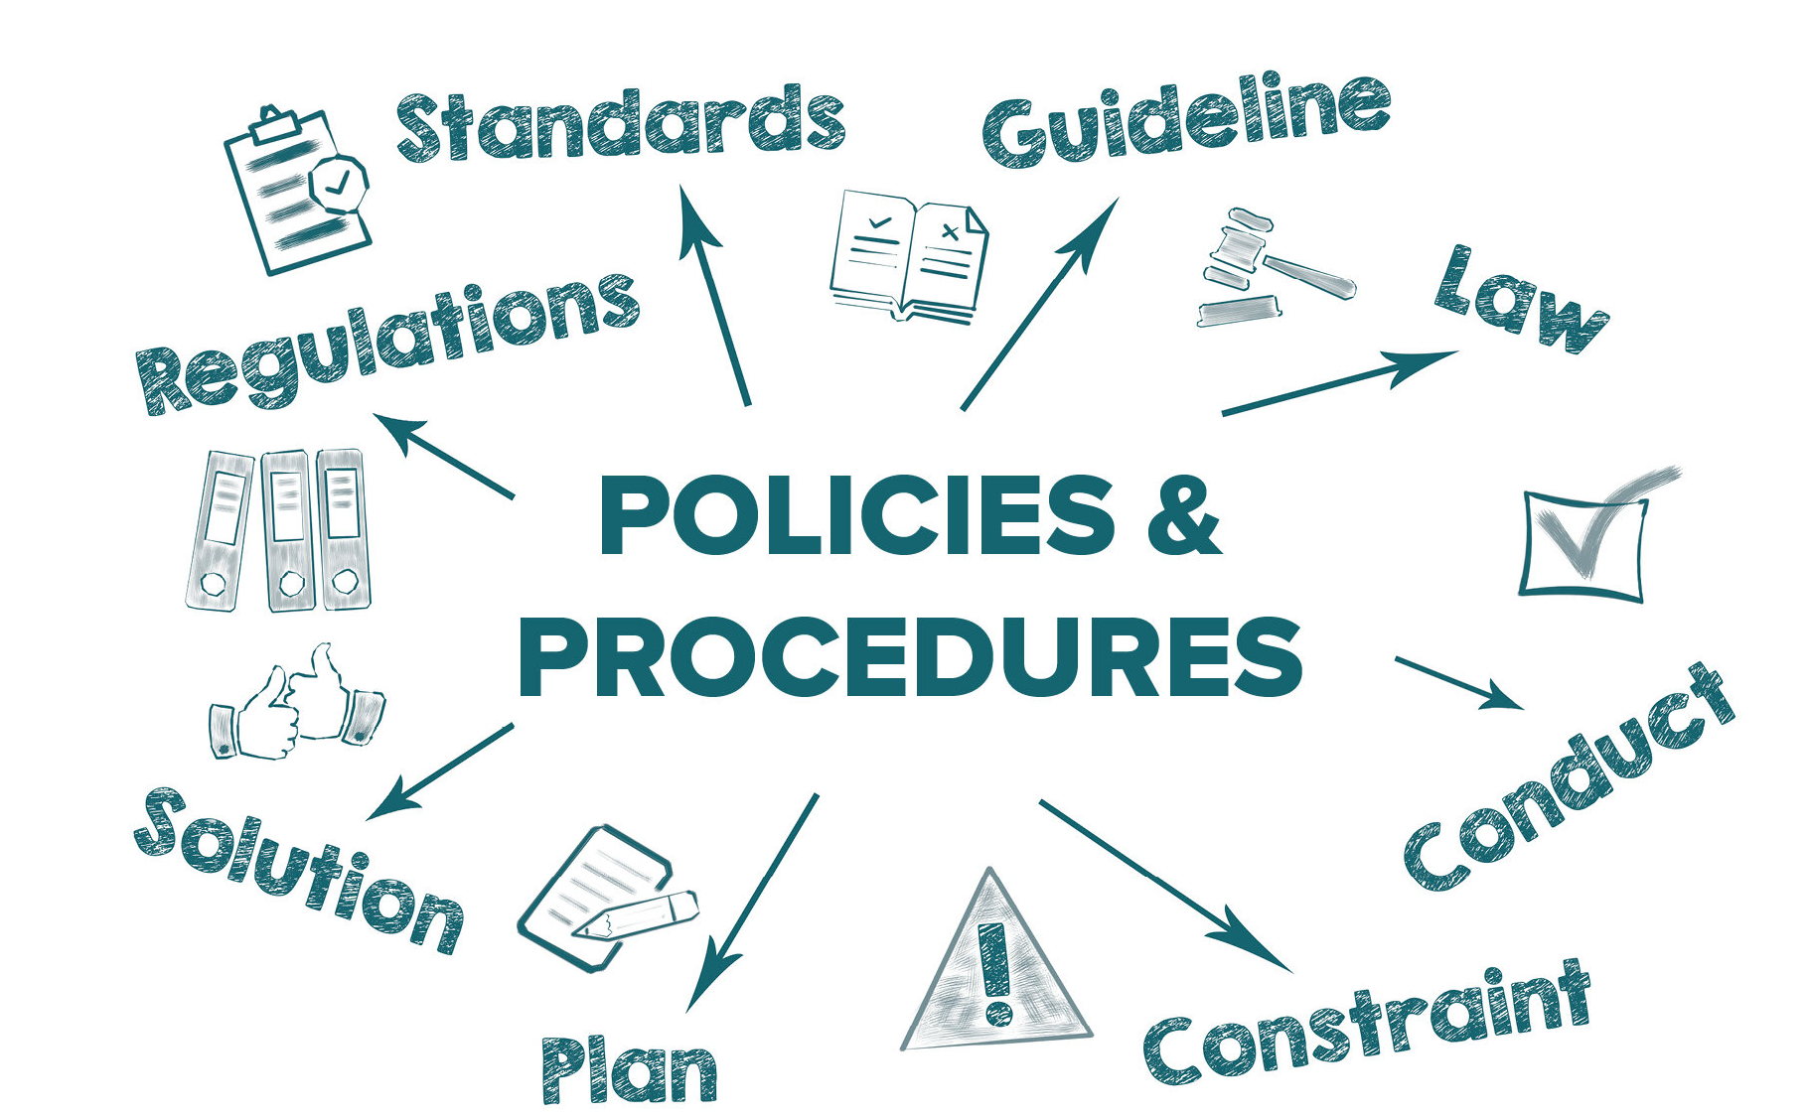
Results
1. Blended Learning
3. Non-formal Ways
[20] Namibia
[22] Sudan
[23] South Africa
[30] South Africa
[24] Nigeria, Africans living outside Africa, Ghana, Uganda, South Africa, Rwanda, Egypt, Malawi, Kenya, Cameroon, Ethiopia, Swaziland
2. Innovative Tools & Methods
3. Policy Development
[25] Nigeria
[27] Namibia
[28] Ghana
[29] South Africa
[21] Uganda
[26] Tanzania

Slide 9
Conclusion
Discussion:
Course Design
Promotes self-discipline and independence.
Enhances self-regulated learning and outcomes.
Facilitates online collaboration and teamwork
Culturally appropriate pedagogical supports and materials.
Limitations:
Small sample size (11 studies)
Limited to English publications
Reliance on google scholar
Future Work:
Informal out-of-school coding experiences.
Evaluation of locally developed, culturally relevant MOOCs.
Effectiveness of strategies for improving engagement and completion rates.
Research on qualifications and training of programming educators in Africa.

Slide 10

Thank you
Questions?
jarigye@purdue.edu
https://www.linkedin.com/in/joreen-arigye/

