Slide 1
MFCC Based Automatic Speaker Recognition System

Slide 2
Presented By:
Subarna Alam
ID:1606082
Jarin Tasnim
ID:1606090
Barproda Halder
ID:1606092
Md. Minhajul Awal
ID:1606093

Slide 3
OUTLINE
1.Introduction
2. Silence Reduction In Speech Signal
3.Feature Extraction Using MFCC
4.Feature Matching
Vector Quantization
LBG Algorithm
Euclidean Distance
5.Applications
6.Limitations

Slide 4
INTRODUCTION
Speaker Recognition is the process of automatically recognizing who is speaking on the basis of individual information included in speech waves.
Text Dependent Speaker Recognition
Text Independent Speaker Recognition

Slide 5
Silence Reduction

Slide 6
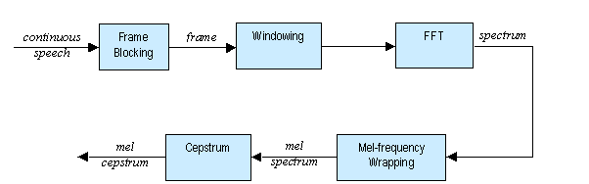
Feature Extraction
From: http://minhdo.ece.illinois.edu/teaching/speaker_recognition/speaker_recognition.html

Slide 7
Mel Frequency Cepstrum Coefficient Processor
Frame Blocking
Windowing
Fast Fourier Transform(FFT)
Mel Frequency Wrapping
Cepstrum

Slide 8
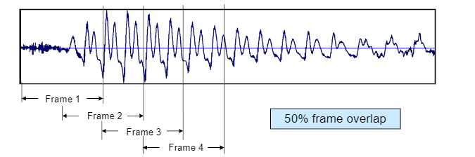
Frame Blocking and Windowing
From: https://docplayer.net/23002968-Digital-speech-processing-lectures-7-8-time-domain-methods-in-speech-processing.html

Slide 9
Mel Frequency Wrapping

Slide 10

Cepstrum Coefficient
A cepstrum is the result of taking the IFT of the logarithm of the estimated spectrum of the signal.

Slide 11
Feature Matching
Vector Quantization
VQ is a process of mapping vectors from a large vector space to a finite number of regions in that space.
Each region is called a cluster and can be represented by its center called a codeword.
The collection of all code-words is called a codebook.

Slide 12
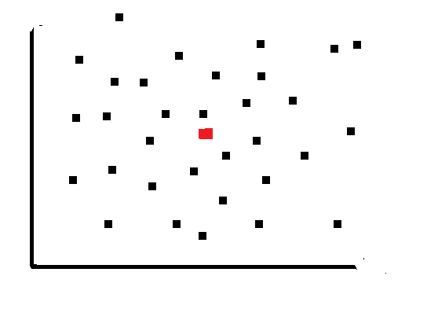
LBG Algorithm for Vector Quantization
1.Design a one vector codebook

Slide 13
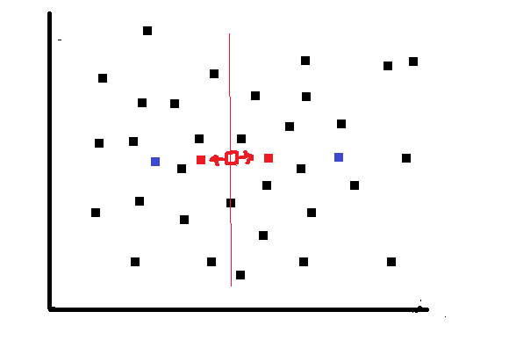
2. Double the size of the codebook by splitting each current codebook
3.Searching the nearest neighbor
4.Updating the centroid

Slide 14
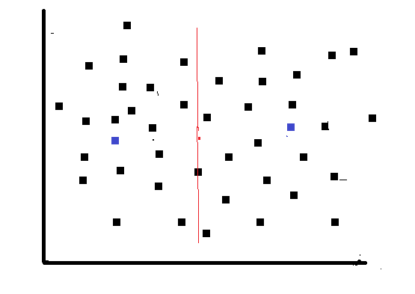
5.Repeating the previous steps until the average distance falls below a present threshold.

Slide 15
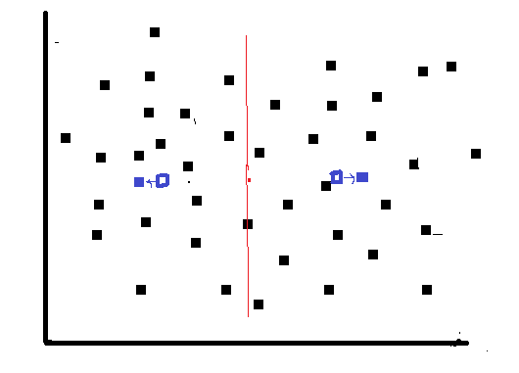
6. Repeating all the previous steps until a codebook of desired size is designed

Slide 16
Euclidean Distance
The Euclidean distance D between two vectors X and Y is:
D = sum((x-y).^2).^0.5

Slide 17
Result:
35 out of 37 test speakers were recognized successfully by the system
Accuracy=94%

Slide 18
Applications:
Security
Informational physical facility
Monitoring

Slide 19
THANK YOU

