Slide 1
TASK 02: INDIVIDUAL PAPER PRESENTATION
SUBMITTED BY
JARIN AKTER MOU
ID : 20301070
COURSE : CSE438 (APPLIED DATA SCIENCE )
TEAM 05
SESSION : FALL 23
COURSE INSTRUCTOR :
ANNAJIAT ALIM RASEL
STUDENT TUTOR
ØFARAH BINTA HAQUE
ØSANIA AZMEE BHUIYAN
RESEARCH ASSISTANT
ØMD.SABBIR HOSSAIN

Slide 2
PRESENTATION TITLE
Dual Incongruity Perceiving Network for Sarcasm Detection

Slide 3
AGENDA
• Introduction
• Contribution
• Dataset
• Methodology
• Results
• Future Scopes

Slide 4
INTRODUCTION
• Sarcasm, a form of verbal irony, conveys meanings opposite to the intended message.
01
• Detecting sarcasm, especially in multi-modal data, poses significant challenges.
02
• The Dual Incongruity Perceiving (DIP) network adeptly captures visual and textual cues, identifying incongruity.
03
• Integration of channel-wise reweighting and continuous contrastive learning enhances detection accuracy.
04

Slide 5
Contribution
• Introducing the DIP network: a novel, multi-modal approach to sarcasm detection.
• Leveraging dual perception and incongruity detection for improved accuracy.
• Utilizing channel-wise reweighting and continuous contrastive learning techniques.
• Demonstrating state-of-the-art performance on the SARC dataset.
• Applicability extends to social media analysis, sentiment analysis, and NLP.

Slide 6
DATASET
• Utilizing the SARC dataset comprising sarcastic and non-sarcastic Reddit comments.
• High inter-modal incongruity adds complexity to the sarcasm detection task.
• Segregated into training, validation, and test sets.
• Establishing a standardized benchmark for evaluating sarcasm detection models.
• Potential expansion to include images, videos, and audio for a comprehensive analysis.

Slide 7
Methodology
• DIP network architecture involves SID and MAE branches.
• SID incorporates channel-wise reweighting and gaussian distribution.
• MAE employs siamese layers and continuous contrastive learning.
• Fusion of embeddings addresses both factual and affective incongruity.
• Innovative methodology demonstrates significant improvements in detection accuracy.

Slide 8
Results
• DIP network surpasses state-of-the-art models, achieving an F1 score of 0.72.
• Effective implementation of channel-wise reweighting and continuous contrastive learning.
• Proficient in capturing both factual and affective incongruity in multi-modal data.
• Validation of DIP network's effectiveness with potential for further testing and refinement.

Slide 9
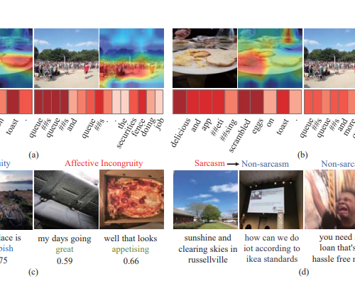
RESULT

Slide 10
Future Scopes
• Continual refinement of incongruity detection techniques for enhanced performance.
• Exploration of diverse multi-modal datasets for comprehensive insights.
• Application of DIP network in sentiment analysis and irony detection domains.
• Opportunities for interpretable models and cross-lingual sarcasm detection.
• Extension to include images and videos for broader applications.

Slide 11
REFERENCE
Wen, C., Jia, G., & Yang, J. (2023). DIP: Dual Incongruity Perceiving Network for Sarcasm Detection. In Proceedings of the IEEE/CVF Conference on Computer Vision and Pattern Recognition (pp. 2540-2550).

Slide 12


