Slide 1
TASK 01: INDIVIDUAL PAPER PRESENTATION
SUBMITTED BY :
JARIN AKTER MOU
ID : 20301070
COURSE : CSE438 (APPLIED DATA SCIENCE )
COURSE INSTRUCTOR :
ANNAJIAT ALIM RASEL
STUDENT TUTOR
FARAH BINTA HAQUE
SANIA AZMEE BHUIYAN
RESEARCH ASSISTANT
MD.SABBIR HOSSAIN

Slide 2
PRESENTATION TITLE
Pima Indians diabetes mellitus classification based on machine learning (ML) algorithms

Slide 3
CONTENT :
Introduction
Hypothesis
Dataset Processing
Methodology
Results
Discussion
Interpretation of Results
Conclusion
Future Work
Thank You

Slide 4

INTRODUCTION
In the era of technological advancements, integrating Machine Learning with healthcare systems becomes crucial. Today, we explore the prediction of diabetes using advanced algorithms within the Internet of Medical Things (IoMT) framework."

Slide 5
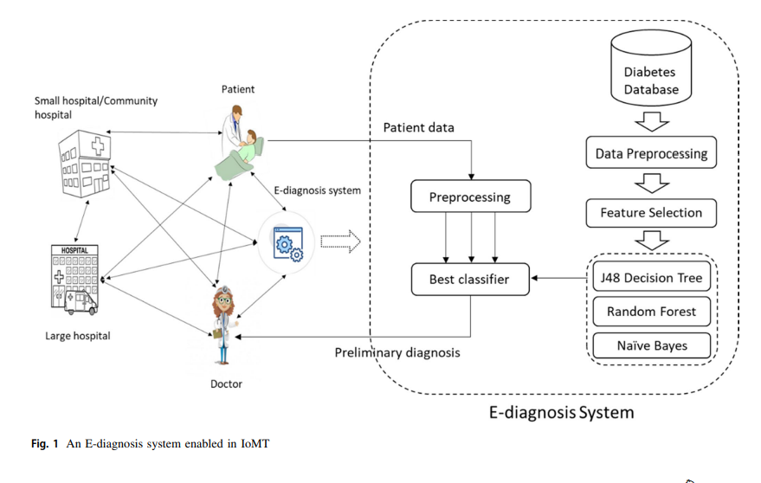
Hypothesis
Our research hypothesis is centered on harnessing the power of advanced machine learning algorithms to provide precise and reliable predictions of diabetes in patients. To achieve this, we employ these algorithms to analyze crucial features extracted from the Pima Indian Diabetes dataset, ultimately aiming to enhance the accuracy of diabetes diagnosis. In essence, we hypothesize that modern machine learning techniques can significantly contribute to the effectiveness of diabetes prediction and diagnosis in the context of healthcare.
Key Points:
Leveraging advanced machine learning algorithms.
Precise and reliable diabetes predictions as the primary objective.
Utilizing relevant features extracted from the Pima Indian Diabetes dataset.
Aims to improve the overall accuracy of diabetes diagnosis.
Significance of modern machine learning in healthcare.

Slide 6
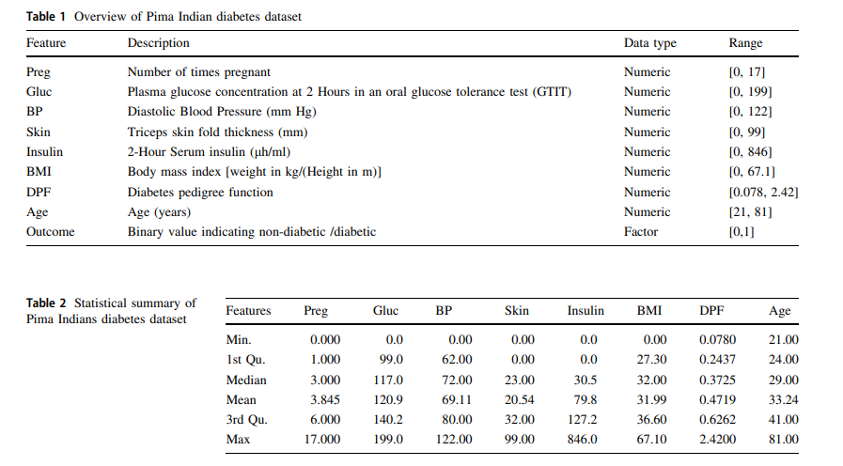
DATASET PROCESSING :
"In our research, we processed the Pima Indian Diabetes dataset, addressing inconsistencies and employing feature selection techniques such as PCA, k-means clustering, and importance ranking."
Key Steps:
Resolving inconsistencies in critical attributes.
Implementing feature selection techniques for data optimization.

Slide 7
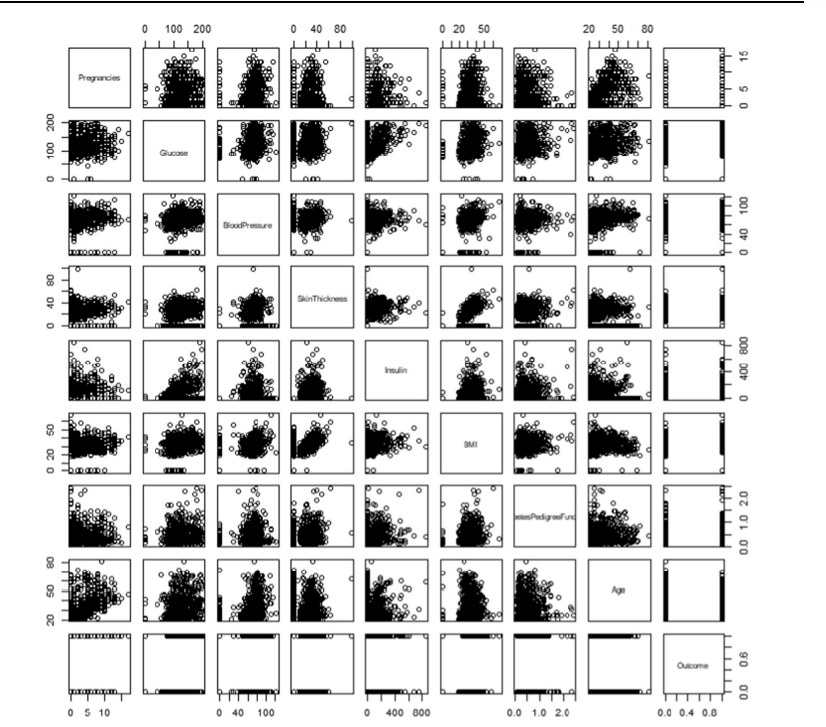
Methodology
In our study, we meticulously designed our methodology, leveraging a set of three prominent machine learning algorithms. These algorithms were thoughtfully selected based on their well-established effectiveness in the domain of diabetes prediction. Our chosen models include:
J48 Decision Tree: A decision tree algorithm derived from the ID3 model, developed by the WEKA team, which utilizes attributes for data partitioning to facilitate accurate classification.
Random Forest: A robust ensemble learning model that enhances predictive accuracy by creating multiple decision trees, resulting in improved overall performance and reliability.
Naïve Bayes: A simplistic yet powerful classification technique founded on the "naive" presumption of attribute independence, effectively employing Bayes probability theory to determine the likelihood of class outcomes.

Slide 8
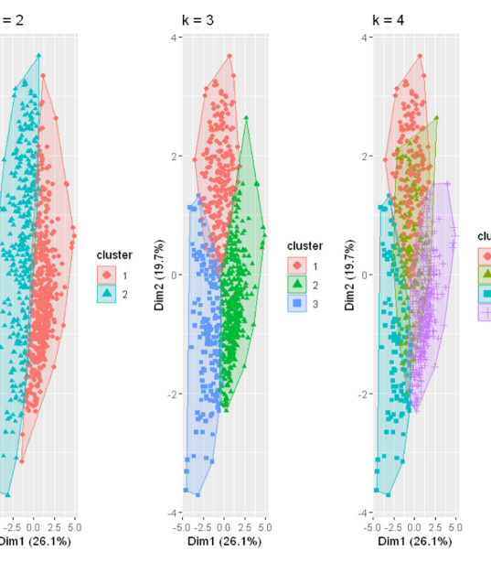
RESULTS
"Results indicate that Random Forest outperformed other models, achieving an accuracy of 79.57%. Additionally, Naïve Bayes demonstrated promising results, particularly with a fine-tuned feature selection approach."
Key Highlights:
Random Forest achieved the highest accuracy of 79.57%.
Naïve Bayes showed promise, especially with feature selection.
Our study provides insights into the performance of different machine learning models in diabetes prediction.

Slide 9
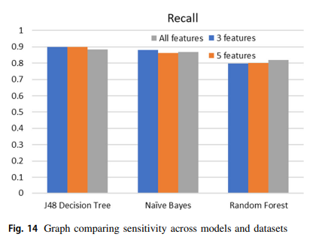
DISCUSSION
"In our discussion, we explore the implications of our findings, address challenges faced during the research, and analyze the alignment of our results with existing knowledge in diabetes prediction.

Slide 10
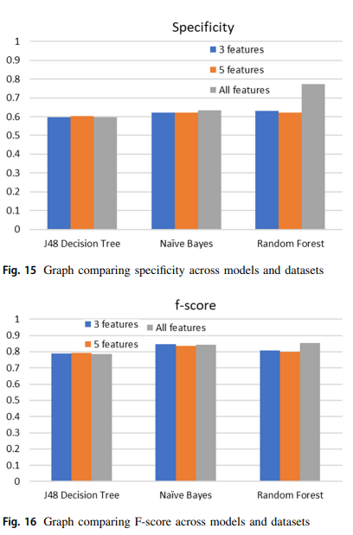
Interpretation of Results
"We identify Glucose, BMI, Age, Insulin, and Skin Thickness as critical features in diabetes prediction. Understanding the impact of these features enhances our comprehension of diabetes diagnosis."
Key Points:
Identification of critical features: Glucose, BMI, Age, Insulin, and Skin Thickness.
Understanding the impact of these features in diabetes prediction.
Utilization of interpretable models for detailed feature contributions.

Slide 11
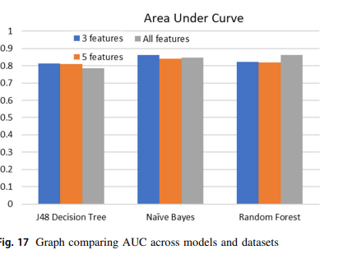
Conclusion
"In conclusion, our research underscores the potential of advanced machine learning algorithms in diabetes prediction within the IoMT framework. These findings pave the way for enhanced healthcare practices and the remote monitoring of chronic diseases."

Slide 12
FUTURE WORK
"Future work involves exploring more robust pre-processing techniques, addressing study limitations, and further refining machine learning models for even more accurate predictions in diabetes diagnosis."
Key Points:
Continuous improvement and innovation.
Robust pre-processing techniques.
Rigorous addressing of study limitations.
Ongoing model refinement.
Leveraging the potential of the IoMT.

Slide 13


