Slide 1

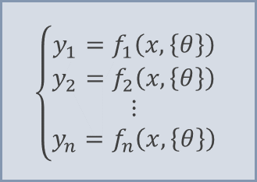

User-defined parameterized functions:
User-defined adjustable parameters:
$$\left\{\begin{aligned}y_{1}=f_{1}\left(x,\left\{θ\right\}\right) \\ y_{2}=f_{2}\left(x,\left\{θ\right\}\right) \\ ⋮ \\ y_{n}=f_{n}\left(x,\left\{θ\right\}\right)\end{aligned}\right.$$
$$\left\{θ\right\}=\left\{θ_{1},θ_{2},θ_{3},…,θ_{m}\right\}$$
pfparam.m
parfun.m
parfunset.m
Automatically evaluated parameterized functions upon parameter change
$$F\left(x,\left\{θ\right\}\right)=\left[f_{1}\left(x,\left\{θ\right\}\right),f_{2}\left(x,\left\{θ\right\}\right),…,f_{n}\left(x,\left\{θ\right\}\right)\right]$$

