Slide 1
polysurf – performance test
-a surface based on bilinear interpolation between 4 polylines implemented in MATLAB®
Date: 10/2016
Author: Jari Repo, University West, jari.repo@hv.se

Slide 2
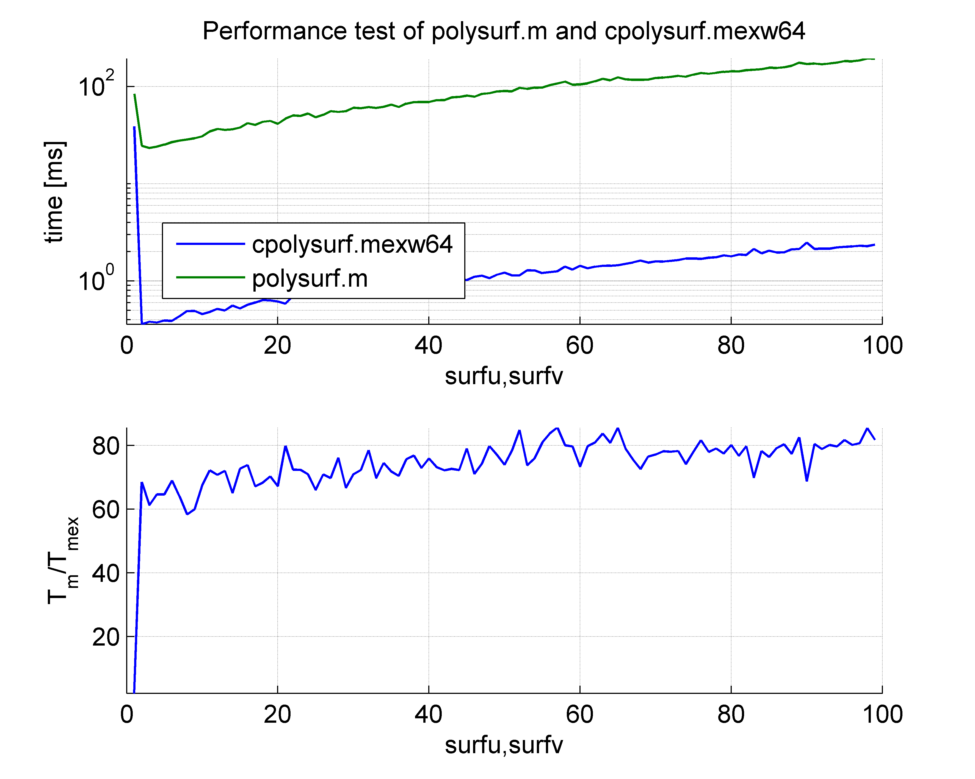
Computational time of cpolysurf.mexw64
The MEX-implementation of polysurf ”cpolysurf.mexw64” has considerable short execution times when compared with the m-file implementation in ”polysurf.m”. This becomes notable when increasing the number of surface segments.

Slide 3
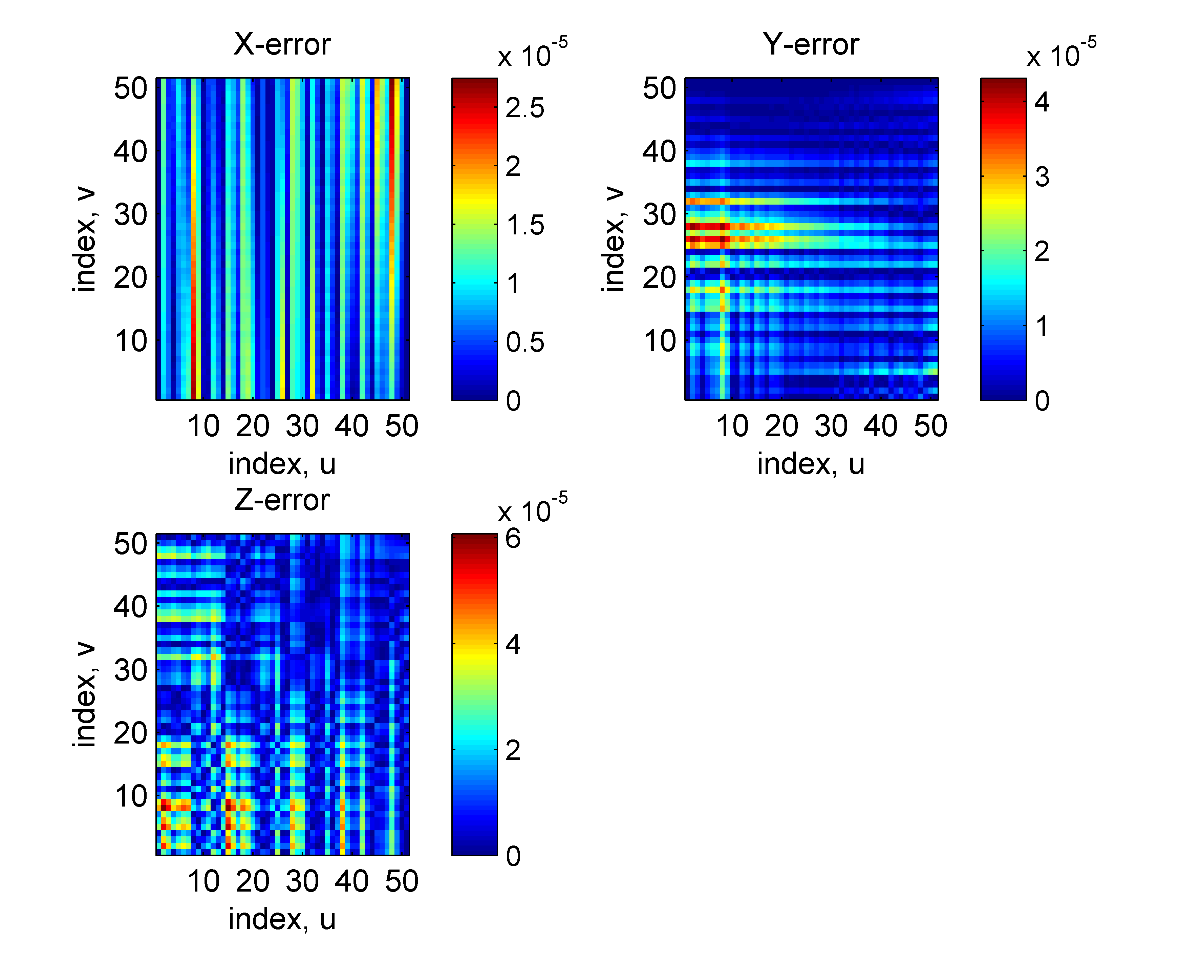
Numerical accuracy of cpolysurf.mexw64
The MEX-implementation of polysurf ”cpolysurf.mexw64” uses 16-bit fixed point values for the surface parameter values. The resulting error in the X-, Y- and Z-directions of the final surface is relatively small, in the order or 10^-5, when compared with the m-file implementation in ”polysurf.m” which is based on standard MATLAB® functions calls.

