Slide 1
polysurf
-a surface based on bilinear interpolation between 4 polylines implemented in MATLAB®
Date: 10/2016
Author: Jari Repo, University West, jari.repo@hv.se

Slide 2
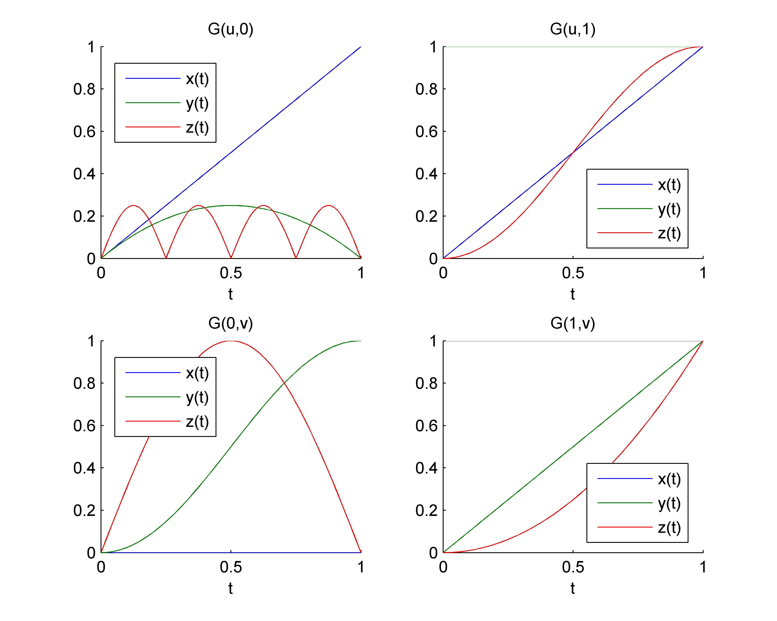
Step 1 – Define surface boundary functions
% G(u,0) -- parabolically twisted abs. sine
Gu0 = { @(t) t; ...
@(t) -4*.25*t.*(t-1); ...
@(t) abs(.25*sin(4*pi*t)) };
% G(u,1) -- squared quarter sine
Gu1 = { @(t) t; ...
@(t) ones(size(t)); ...
@(t) sin(pi/2*t).^2 };
% G(0,v) -- circular arc
G0v = { @(t) zeros(size(t)); ...
@(t) (1/2)*(1-cos(pi*t)); ...
@(t) sin(pi*t) };
% G(1,v) -- parabolic
G1v = { @(t) ones(size(t)); ...
@(t) t; ...
@(t) t.^2 };

Slide 3
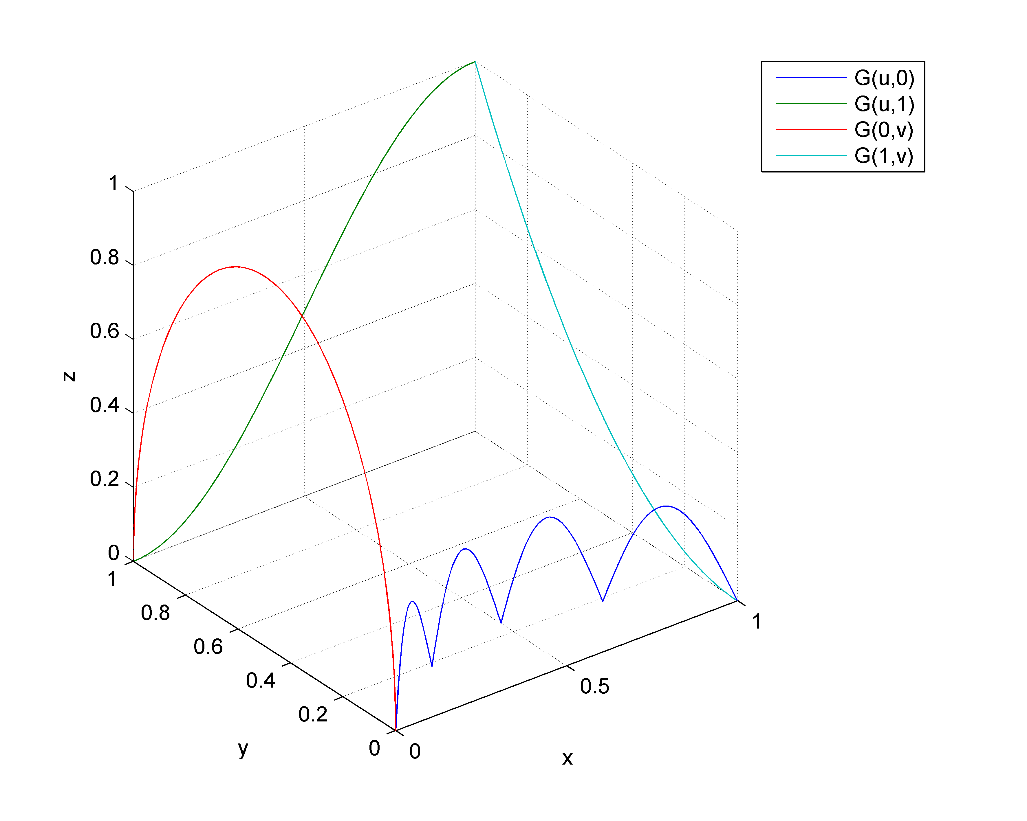
Step 1 – View surface boundary functions
fh3d = figure('name','3-d plot');
set(gcf,'renderer','opengl','doublebuffer','on')
set(gca,'fontsize',9)
cameratoolbar
X = [Gu0{1}(t); Gu1{1}(t); G0v{1}(t); G1v{1}(t)]';
Y = [Gu0{2}(t); Gu1{2}(t); G0v{2}(t); G1v{2}(t)]';
Z = [Gu0{3}(t); Gu1{3}(t); G0v{3}(t); G1v{3}(t)]';
ph = plot3(X,Y,Z);
view(3)
grid on
xlabel('x'),ylabel('y'),zlabel('z')
title('Surface boundary curves')
legend('G(u,0)','G(u,1)','G(0,v)','G(1,v)',...
'location','eastoutside')

Slide 4
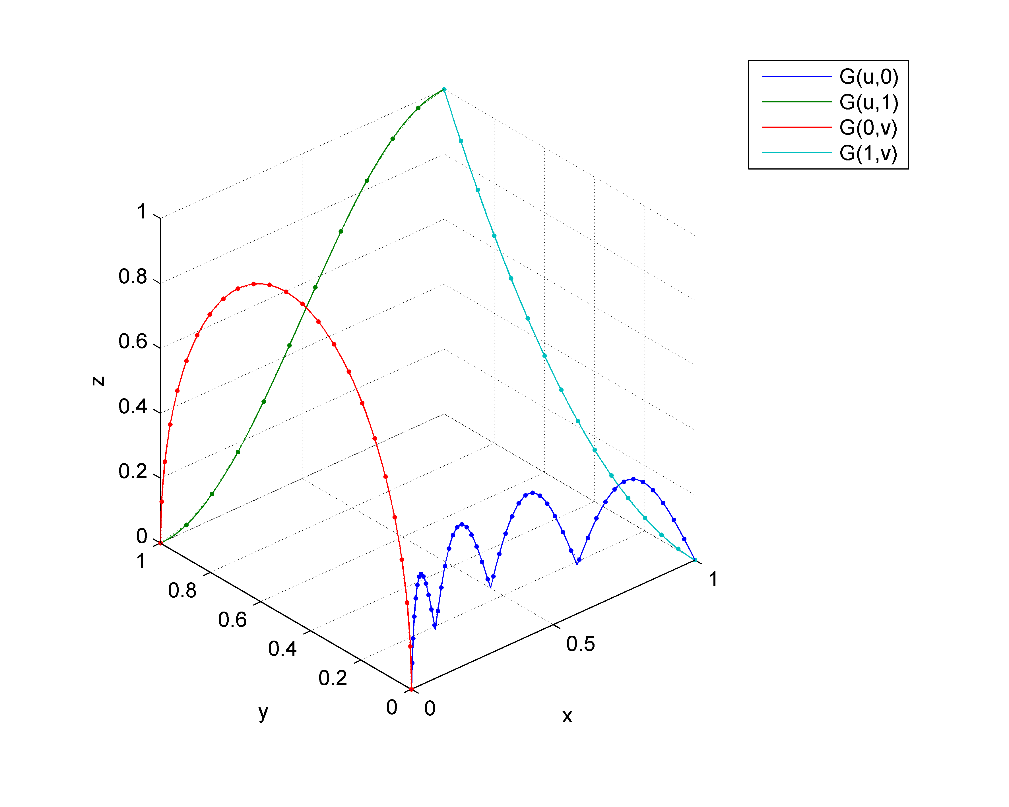
Step 2 – Generate polylines by sampling
t1 = linspace(0,1, 50);
t2 = linspace(0,1, 12);
t3 = linspace(0,1, 25);
t4 = linspace(0,1, 16);
% Store sampled boundary functions into a 4-cell array
P = cell(1,4);
P{1} = [Gu0{1}(t1); Gu0{2}(t1); Gu0{3}(t1)]; % G(u,0)
P{2} = [Gu1{1}(t2); Gu1{2}(t2); Gu1{3}(t2)]; % G(u,1)
P{3} = [G0v{1}(t3); G0v{2}(t3); G0v{3}(t3)]; % G(0,v)
P{4} = [G1v{1}(t4); G1v{2}(t4); G1v{3}(t4)]; % G(1,v)
% To view the content in P
% P{1},P{2},P{3},P{4}
% Output the individual polylines in the 3-d view
hold on
for k=1:4
plot3(P{k}(1,:),P{k}(2,:),P{k}(3,:),'.:',...
'Color',get(ph(k),'Color'))
end
hold off

Slide 5
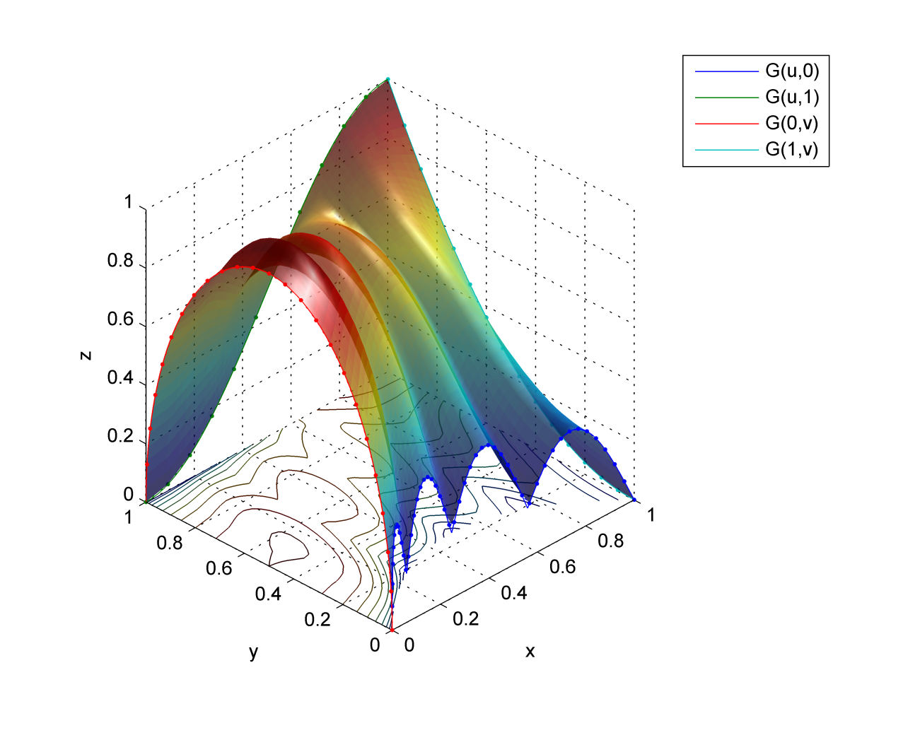
Step 3 – Generate bilinear surface
surfu = 50;
surfv = 50;
disp('Generating surface ...')
[Gx,Gy,Gz] = polysurf(P,surfu,surfv);
hold on
% plot3(Gx,Gy,Gz,'.')
sh = surf(Gx,Gy,Gz);
set(sh,'linestyle','none','facealpha',.75)
hold off
axis equal
% add some shading
lighting phong
light

Slide 6
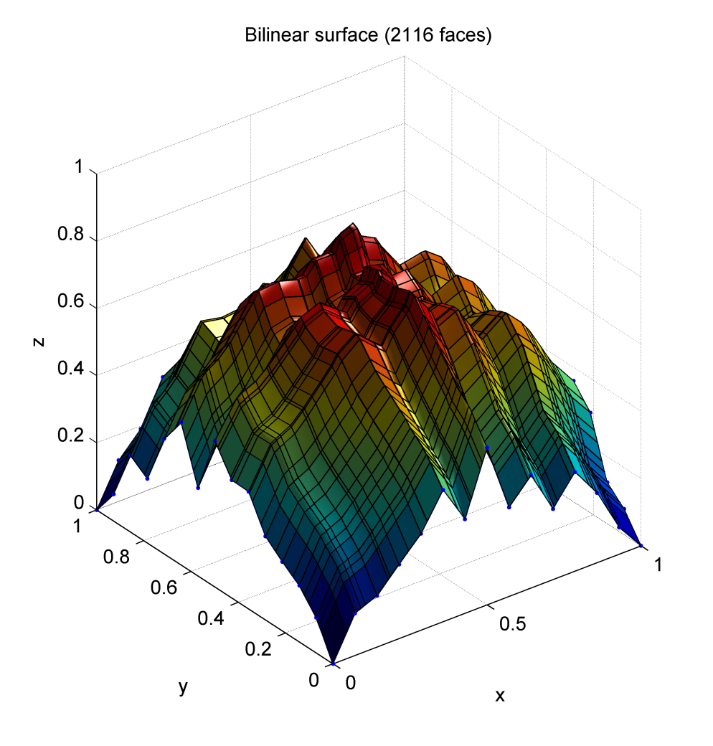
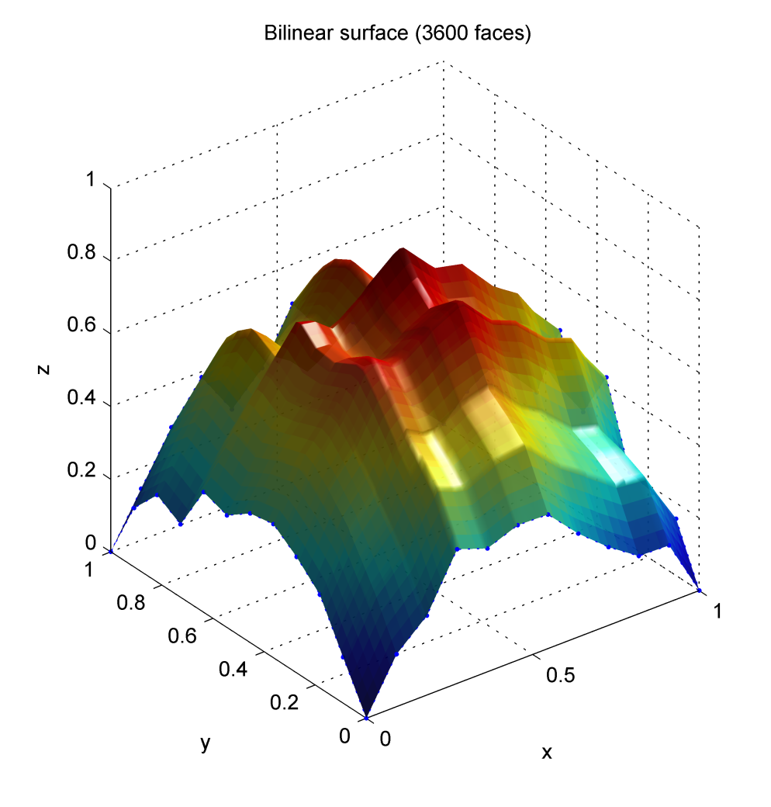
Step 3 – Bilinear surface (randomized edges)
see ”polysurfdemo_random.m”

