Slide 1
Production Line Simulation
-A JavaScript based simulation of a production line with multiple stations and buffers
Date: 2017-03-23
Author: Jari Repo, University West, jari.repo@hv.se

Slide 2
Example production line
Testline
S1
B2
S3
B1
S1
S2
B3
B4
S5
B5
S4
S: Station, B: Buffer (FIFO)

Slide 3
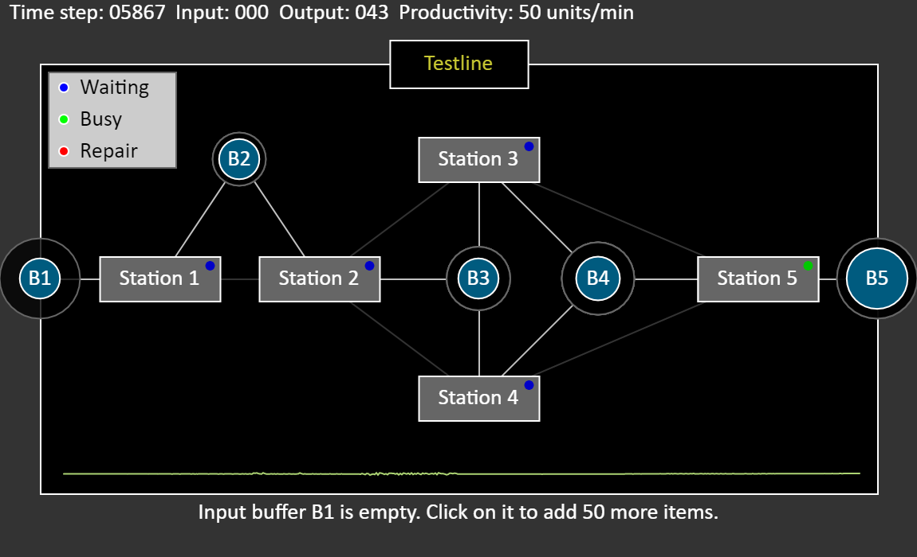
Implementation
Discrete-time simulation of a factory-like production line based on JavaScript. It supports multiple stations which can be linked serially, in parallel or in any combination thereof. In general terms this is an example of a multi-stage producer-consumer pattern which potentially could yield an unpredictable outcome. Other features:
The production line is implemented as a multi-level bi-directional linked list where each station is aware of the station that follows but also on the previous stations
The input to a station is drawn either directly from a previous station or from a FIFO-buffer
Configurable station throughput times and buffer sizes
Simulated station failures which affect the overall production rate
The visual output of the full production line is based on forward recursion
Time-based update of the production line based on a recursive backward propagation algorithm
Generates a realtime performance metric in terms of the overall production rate (number of produced items per time unit)

