Slide 1
Web APIS & Classification: Netflix/Disney Plus
Prepared by : Arti Jariwala
Date: 8th MARCH 2021
Date: 22ND MARCH 2021

Slide 2
Content Page
Problem Statement
The Process
Netflix Words
Disney Words
Common Words
Feature Importance
Conclusions & Recommendations

Slide 3
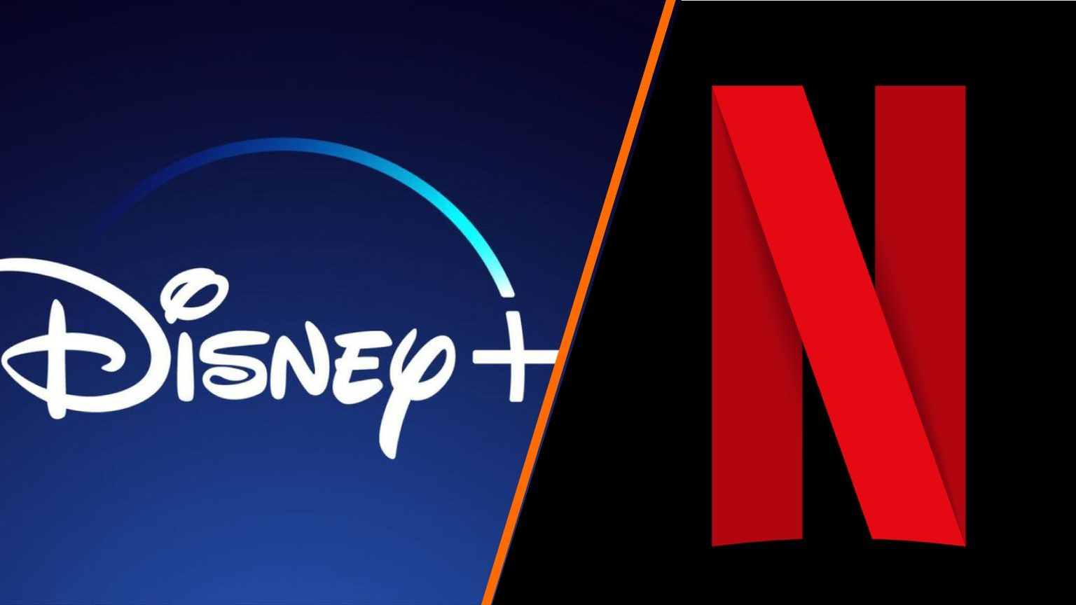
Problem Statement
As more people are shifting towards OTT platform, we would like to get more insights in the similarities and differences between two of the most competitive online streaming platforms: Netflix and Disney plus.
This analysis would help understand users which platform is more suitable for them and hence which one they would like to choose.

Slide 4
The Process
Web Scraping
Data Cleaning
Data Preprocessing
Conclusion & Recommendation
Data Modelling
Exploratory visualization

Slide 5
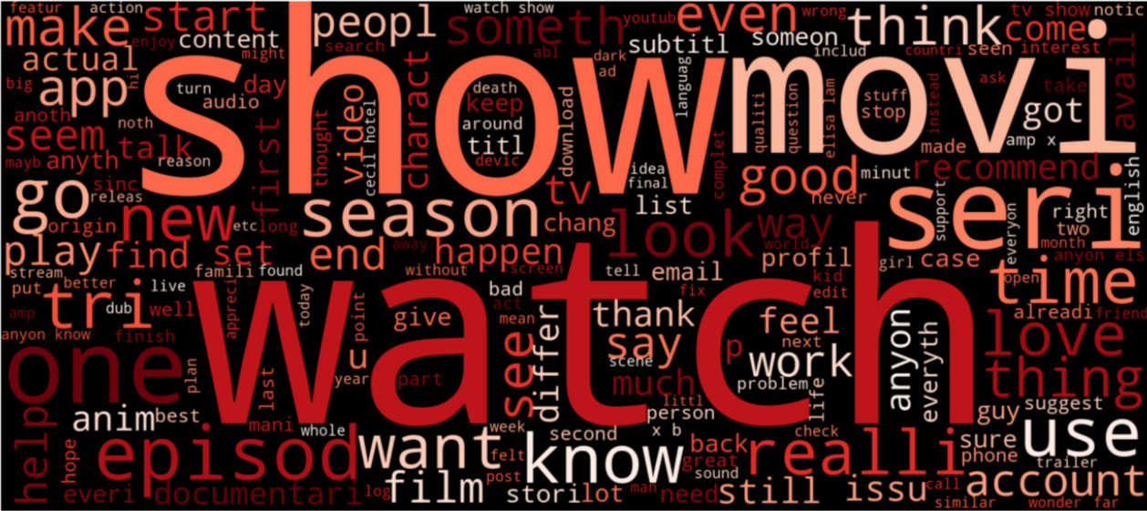
Netflix Word Cloud

Slide 6
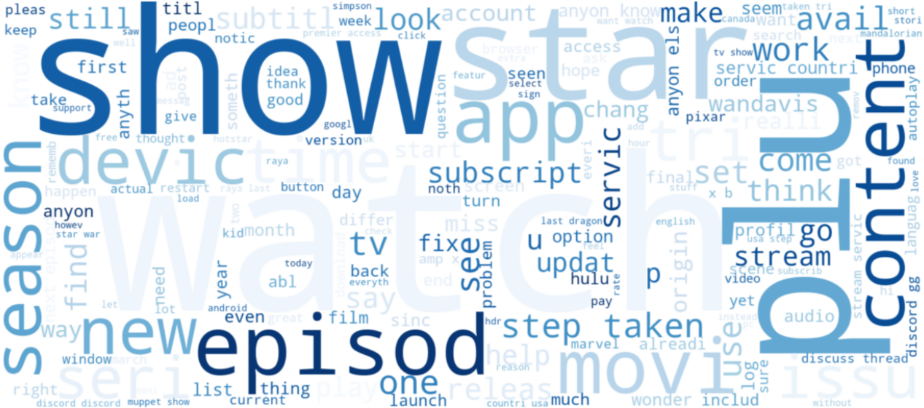
Disney Plus Word Cloud

Slide 7
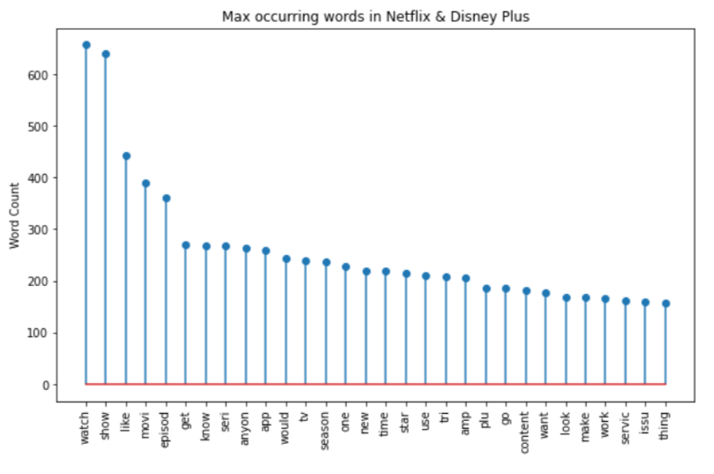
Common Words
Some general obvious words like watch, show, movie, episode, season, etc.
Not many unique words specific to any one platform came up.

Slide 8
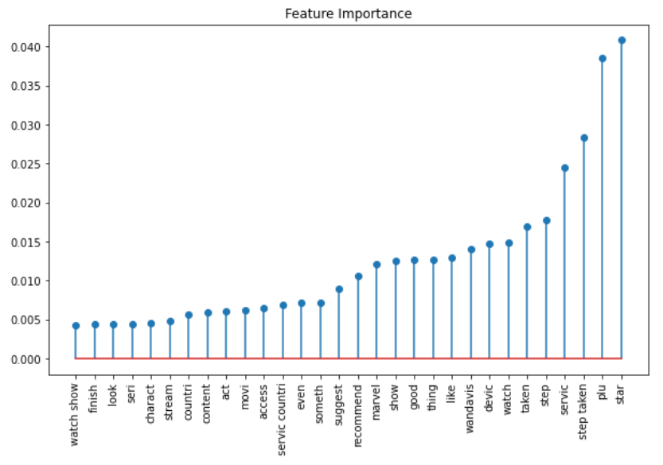
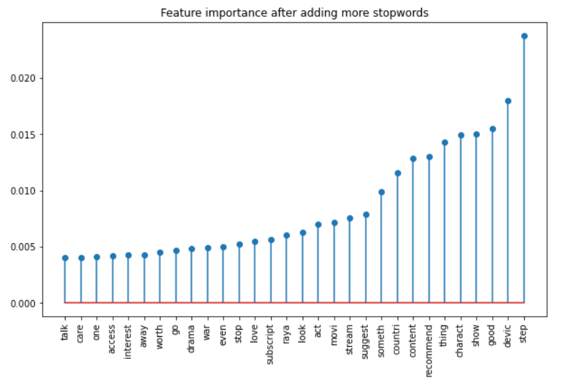
Feature Importance

Slide 9
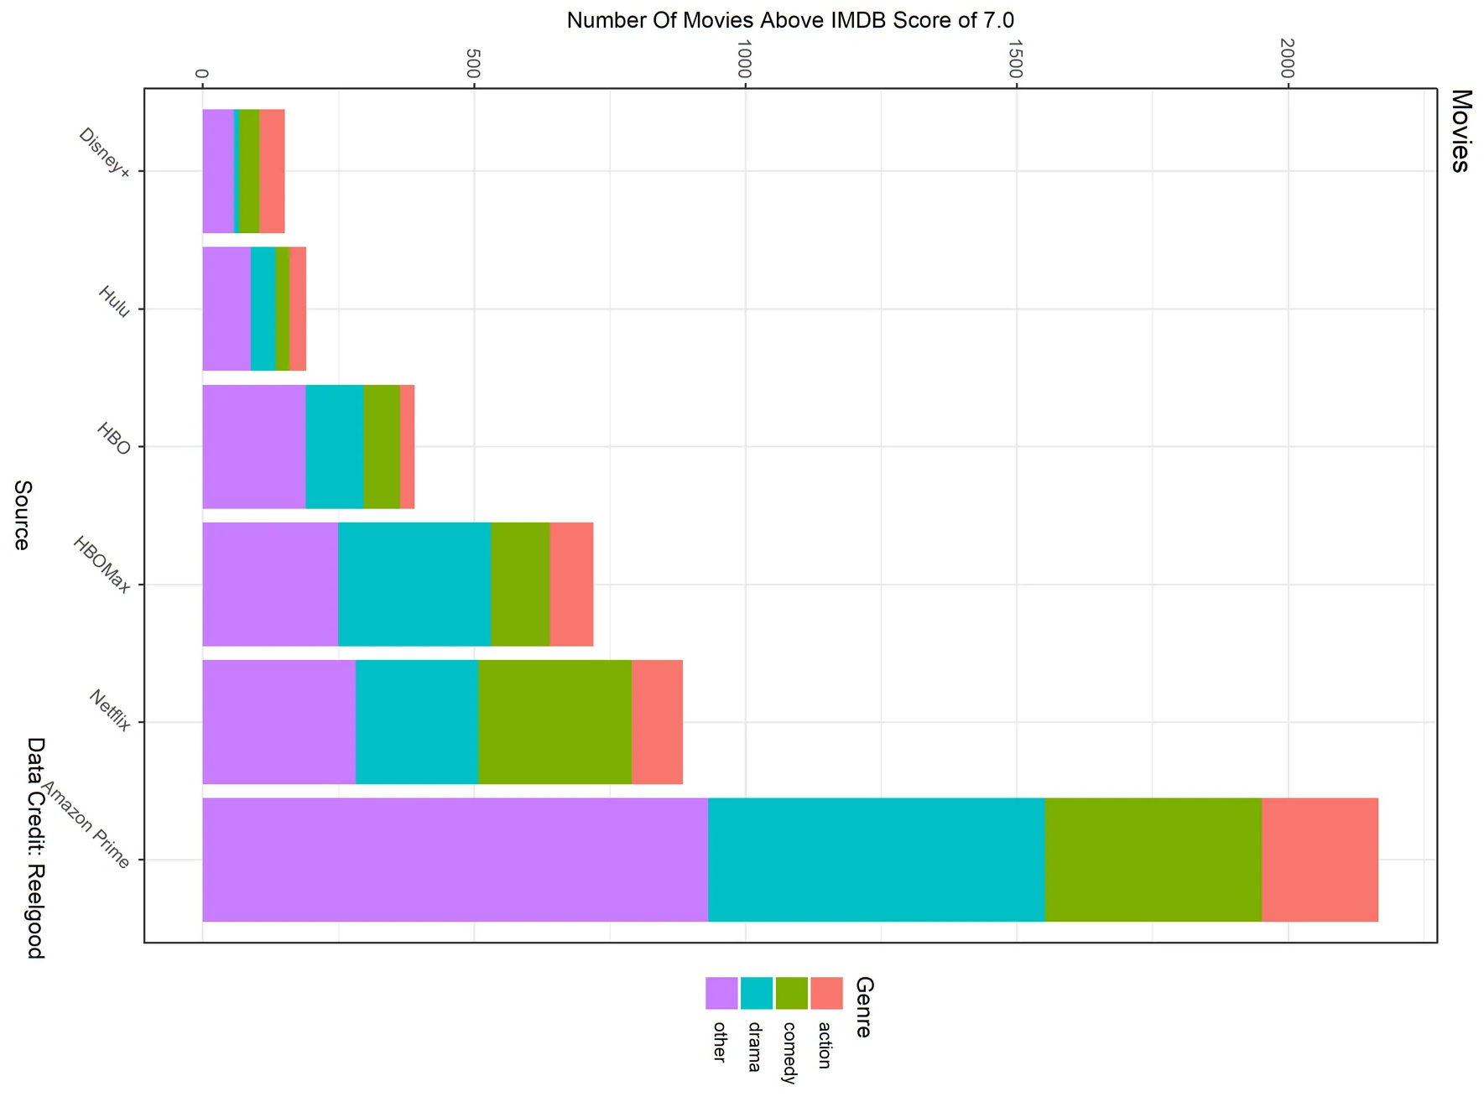
External Analysis
Source: https://www.theringer.com/tv/2020/6/8/21283950/streaming-service-comparison-hbo-max-netflix-disney

Slide 10
Conclusions
So the final model chosen was Naive Bayes with Count Vectorizer which returned an accuracy score of 77% for test data.
Common words : watch, series, tv, season, like, recommend, movie, stream, finish, access, subscript and so on. From these words we can interpret that people in general are talking about watching/recommending or have finish watching a series or a movie on a streaming platform. They are also talking or inquiring about the subscription or access policies in different countries.
Varied genres like crime, marvel, drama, war, love, documentary, anime.
Unique words like Wanda vision, stranger things, raya, drama, war, marvel, etc. Here we can get a clear understanding of which words belong to which platform.
Wandavision is the new series aired in January 2021 on disney plus.
Stranger things is the American series on Netflix since 2016.
Now if we consider drama and marvel features, we can clearly say that disney plus airs most of the marvel movies and netflix airs most of the drama movies/series.

Slide 11
Recommendations
Disney plus contains movies like Wanda vision which is a superhero fiction movie. It also contains few anime movies like Raya the last dragon, the Simpsons, etc. Hence based on the above and external analysis, on genres basis we can suggest users to go for Disney plus if they are more interested in marvel, animated movies or series.
Fewer named of movies and series came up in our analysis but features like drama, stranger things (series on Netflix), documentary, anime, etc. suggest that if users are more inclined towards these genres should go for Netflix.

Slide 12
Thank You!

