Slide 1
Web APIS & Classification: Netflix/Disney Plus
Prepared by : Arti Jariwala
Date: 8th MARCH 2021
Date: 22ND MARCH 2021

Slide 2
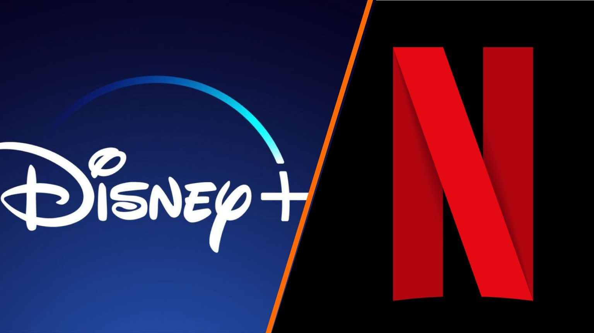
Problem Statement
As more people are shifting towards OTT platform, we would like to get more insights in the similarities and differences between two of the most competitive online streaming platforms: Netflix and Disney plus.
This analysis would help understand users which platform is more suitable for them and hence which one they would like to choose.

Slide 3
The Process
Web Scraping
Data Cleaning
Data Preprocessing
Conclusion & Recommendation
Data Modelling
Exploratory visualization

Slide 4
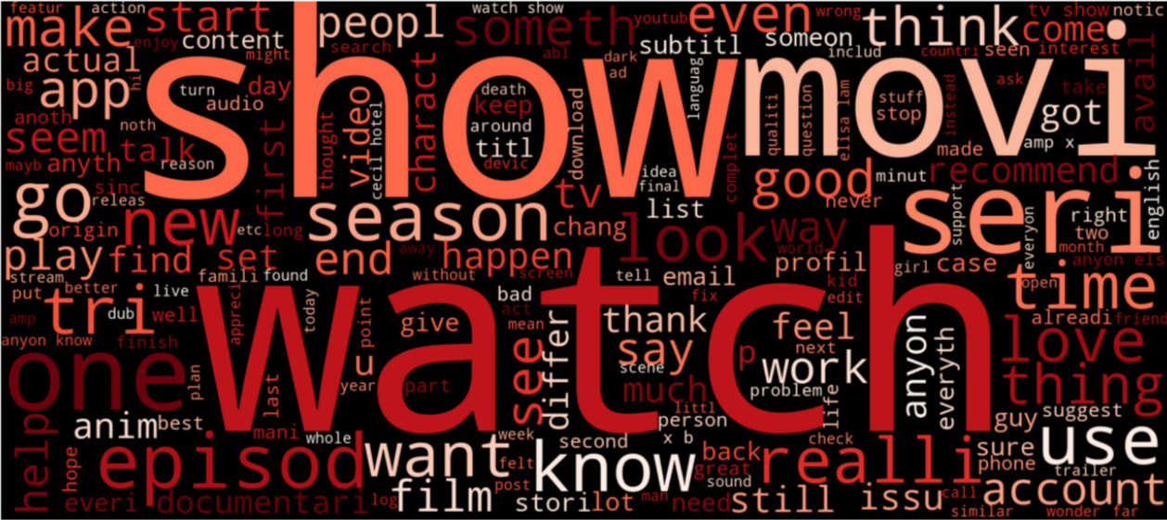
Netflix Word Cloud

Slide 5
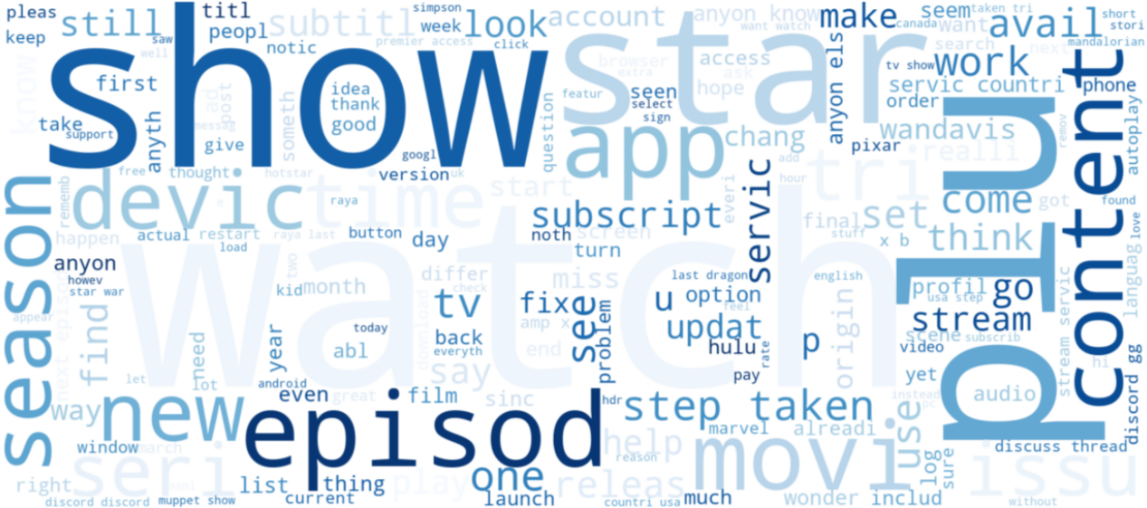
Disney Plus Word Cloud

Slide 6
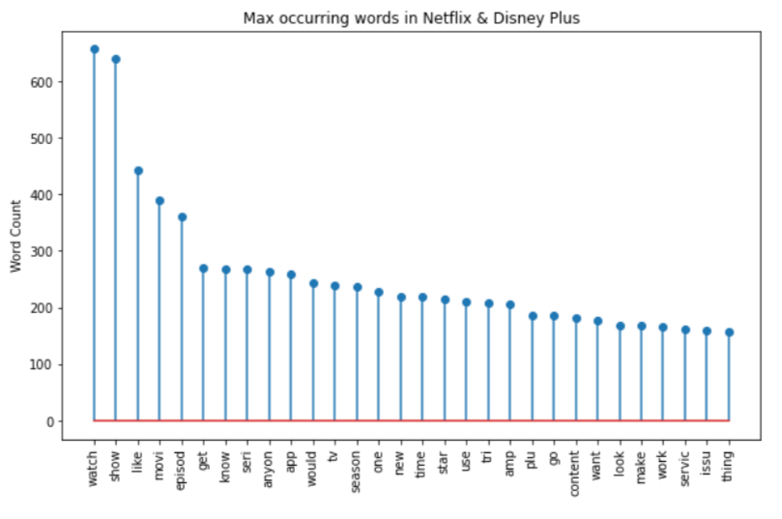
Common Words
Some general obvious words like watch, show, movie, episode, season, etc.
Not many unique words specific to any one platform came up.

Slide 7
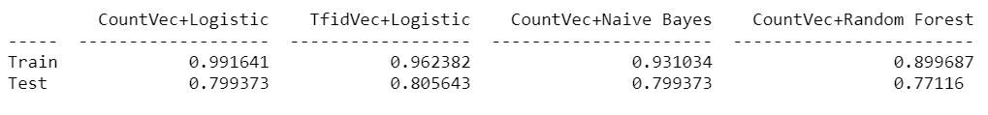
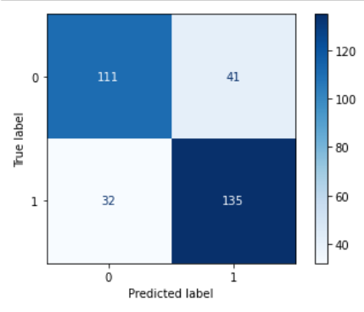
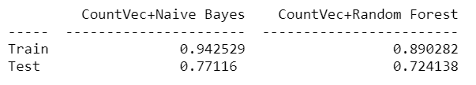
Model Comparison
Build and compared several models:
Logistic Regression
Naive Bayes
Random Forest Tree
Again build and compared Random Forest and Naive Bayes by adding additional stopwords.
Choose Naive Bayes as final model which gave 77% accuracy for predictions.

Slide 8
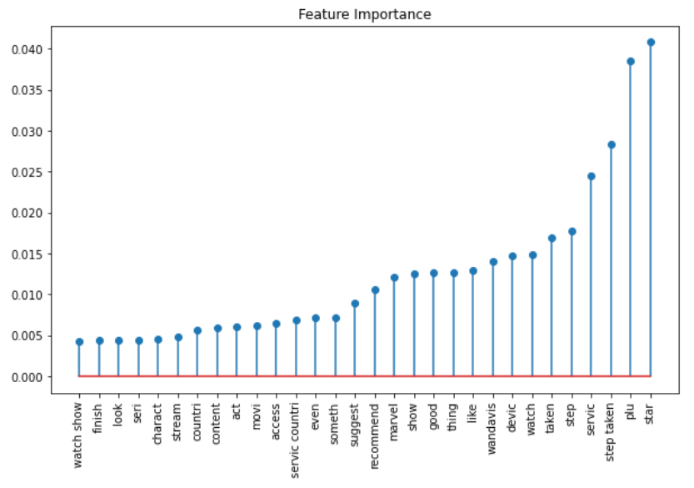
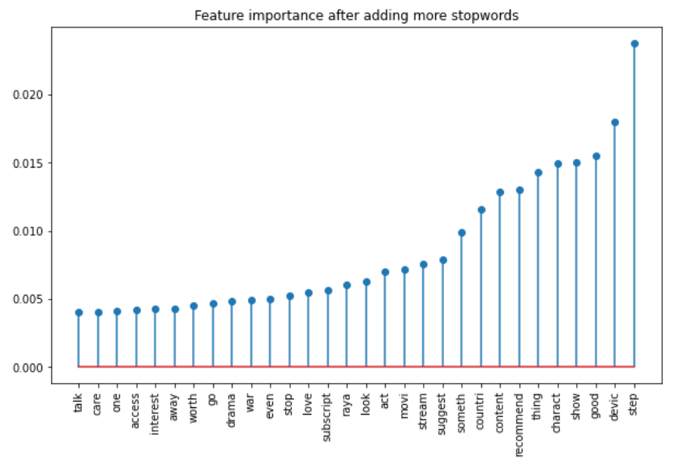
Important Features

Slide 9
Conclusions
Common words : watch, series, tv, season, like, recommend, movie, stream, finish, access, subscript.
Posts are about about watching/recommending or have finished watching a series or a movie on a streaming platform.
Inquiring about the subscription or access policies in different countries.
Varied genres like crime, marvel, drama, war, love, documentary, anime.
Unique words : Wanda vision, stranger things, raya, drama, war, marvel, etc.
Wandavision is the new series aired in January 2021 on disney plus.
Cecil hotel is the American series on Netflix since 2016.
Now if we consider drama and marvel features, we can clearly say that disney plus airs most of the marvel movies and netflix airs most of the drama movies/series.

Slide 10
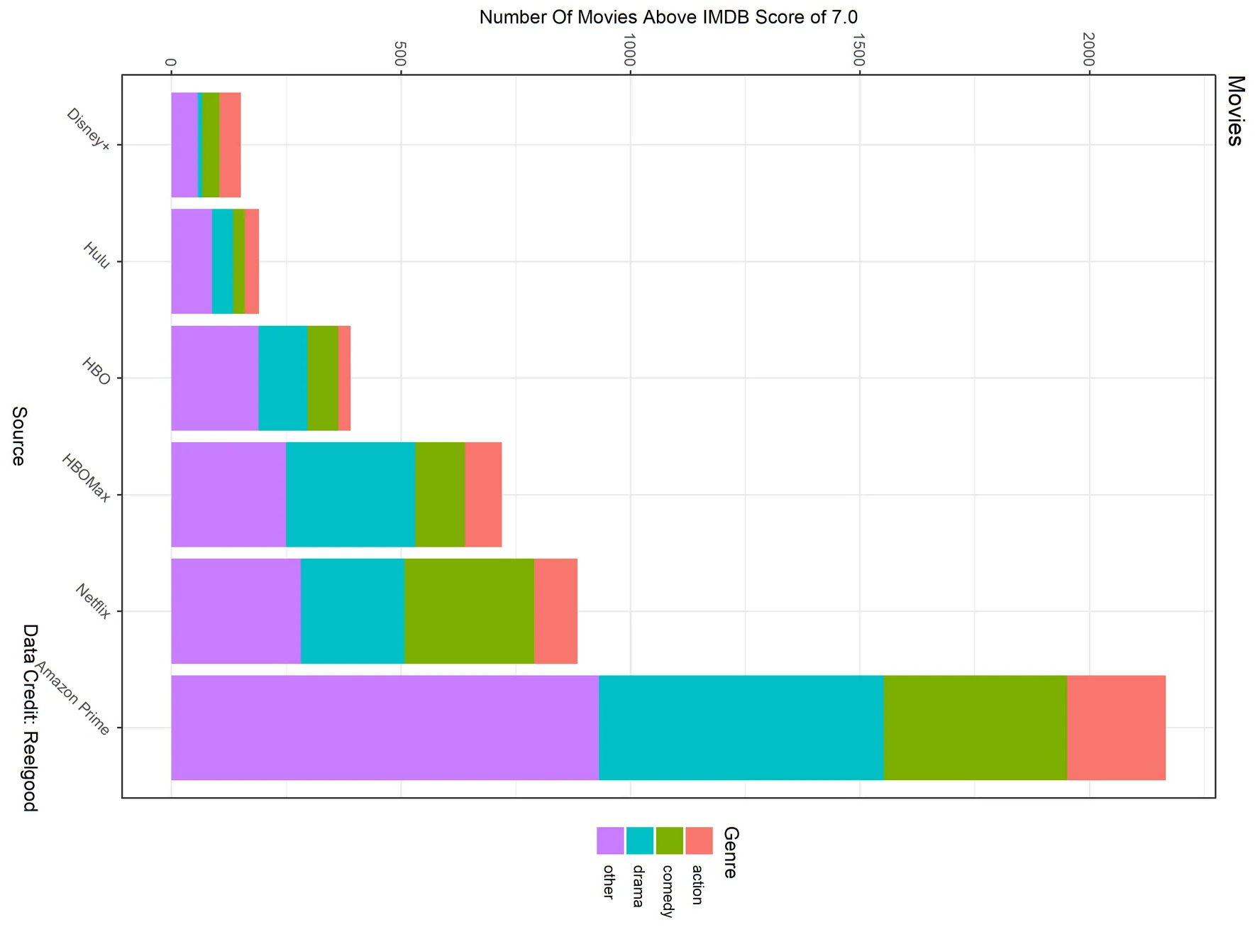
Recommendations
On genres basis we can suggest users to go for Disney plus if they are more interested in marvel, animated movies or series.
If users are more inclined towards drama, action, anime users should go for Netflix.

Slide 11
Thank You!

