Slide 1
Constellation Logger
Christian Jarjat

Slide 2
Goals
Able to search and filter Constellations based on Month and Latitude
Able to Create, Modify and view Logs of Constellations
Have multiple users that can only access their Logs

Slide 3
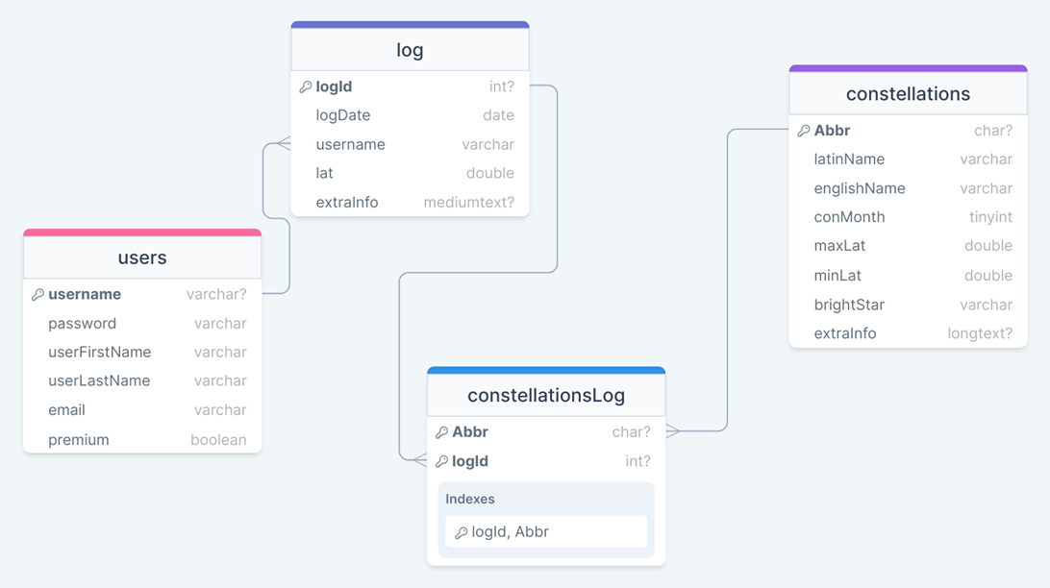
ERD

Slide 4
Uml Class Diagram

Slide 5
Technology stack

Slide 6
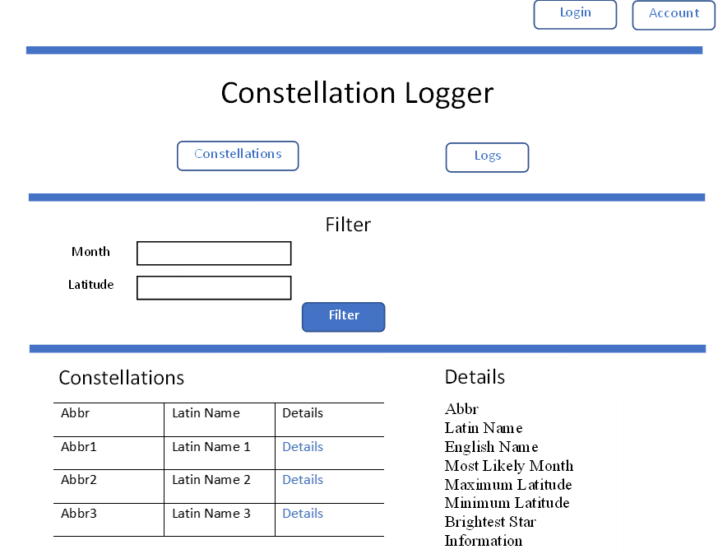
Notes:
Constellation Searcher
Free and can be assessed by people not logged in
Filter for month and latitude
Can have both or either on
A filter will wipe the previous filters
Each Constellation has a details link,
will display the details of the Constellation chosen
keeps the filtered list in place

Slide 7
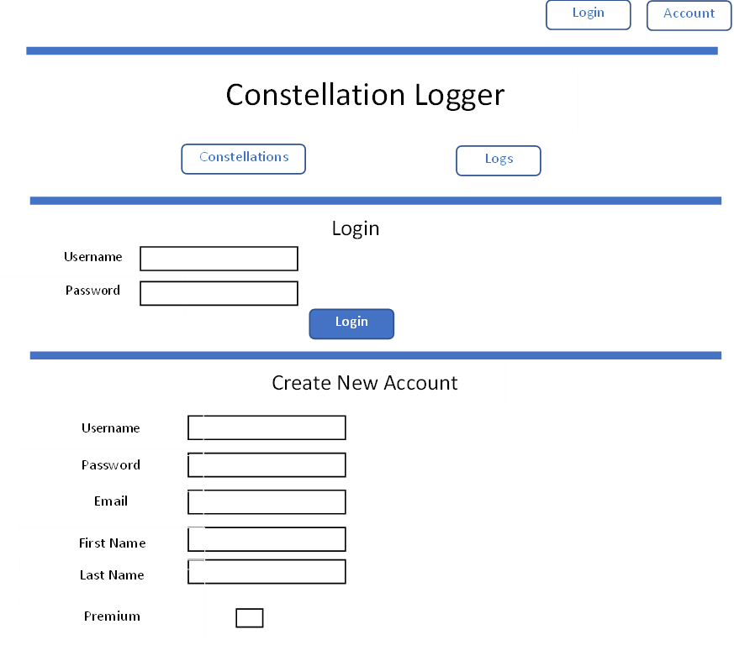

Notes:
Login area
Send here either by pressing login or logs while not being signed in
Login section
Both are case sensitive
while password hides the input
while log in if both username and password are correct
Create account
all have to be filled in
will check if the username has been taken though
once created, the new user will be automatically logged in in as well
Input Validation
correct username or password
all the fields filled when creating a new account
or the username has already been taken when creating a new account

Slide 8
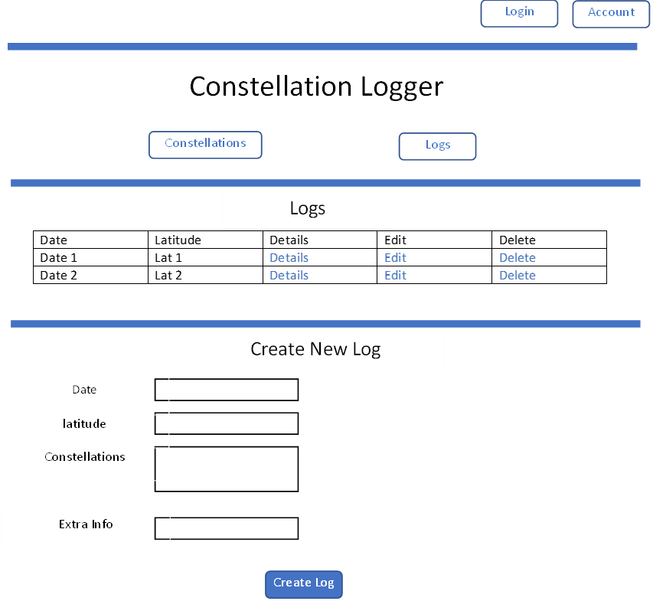
Notes:
Logger,
Only able to access if logged in
will send user to log in url if not logged in
Show the lift of logs for the current account
details and edit – merged
- go to the details url of the chosen log
delete will delete the chosen log and refresh page
Create log,
date and latitude have to be filled in
a list of the constellations can be picked from, allowing multiple choses

Slide 9
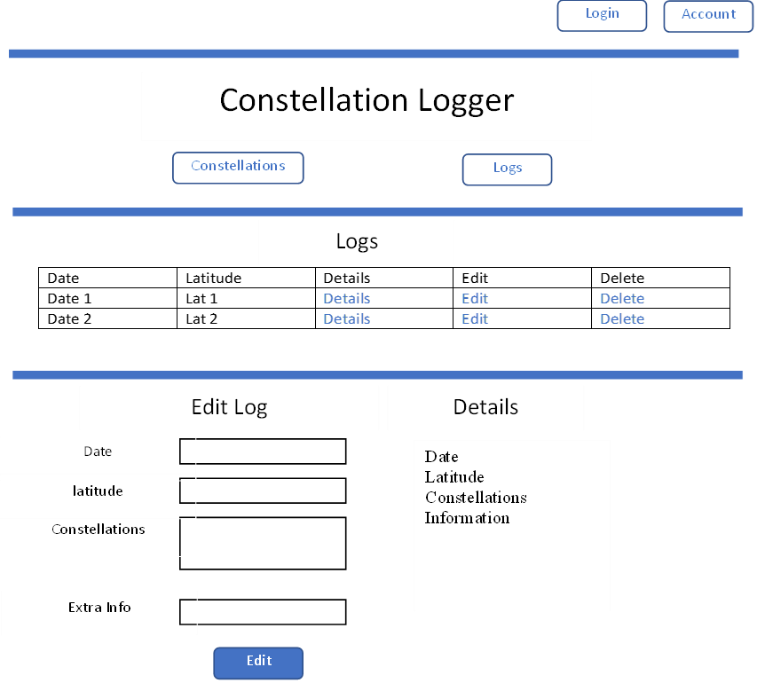
Notes:
For a given log
shows the details of the log
list of constellations has a details button next to each one,
will send to its details page
Edit
all forms need to be filled again including ones that don’t want to be changed

Slide 10
Problems Encountered
Keeping User logged in throughout website
Multiple filters Applied at once
Blank forms causing errors
Notes:
Keeping User logged in throughout website
Add a protected Static object for the logged in user,
change it every time someone logs in or out
Multiple filters Applied at once
If statements checking for null, and using the right SQL Statement based on it
Consterllation service
Blank forms causing errors
for latitude values for nullable values causing errors
data being placed into SQl
Go through with exception handling for each bit
addnew log in log service

Slide 11
Done Differently
Account Edit and Details
New Log Dropdowns changing based on the month/latitudes of Log
Create Separate Location Table In Database
More dynamic buttons based on the App’s current state
Add pictures / more information to Each Constellation
Notes:
Account Edit and Details
add an account edit/delete part on it own url
didn’t have enough time
New Log Dropdowns changing based on the month/latitudes of Log
when editing/adding logs
Only show the Constellations that apply to the logs date and latitude
Create Separate Location Table In Database
To allow more info on location of logs,
More dynamic buttons based on the App’s current state
Have one log in/Account button,
have it changed based on whether someone is logged in or not
Add pictures / more information to Each Constellation
for the details of each one
Filters have a Buffer Border
Show Constellations that are close to the filters separately from the main list
I month from the chosen month
10 degrees +/- from the latitude

