Slide 1

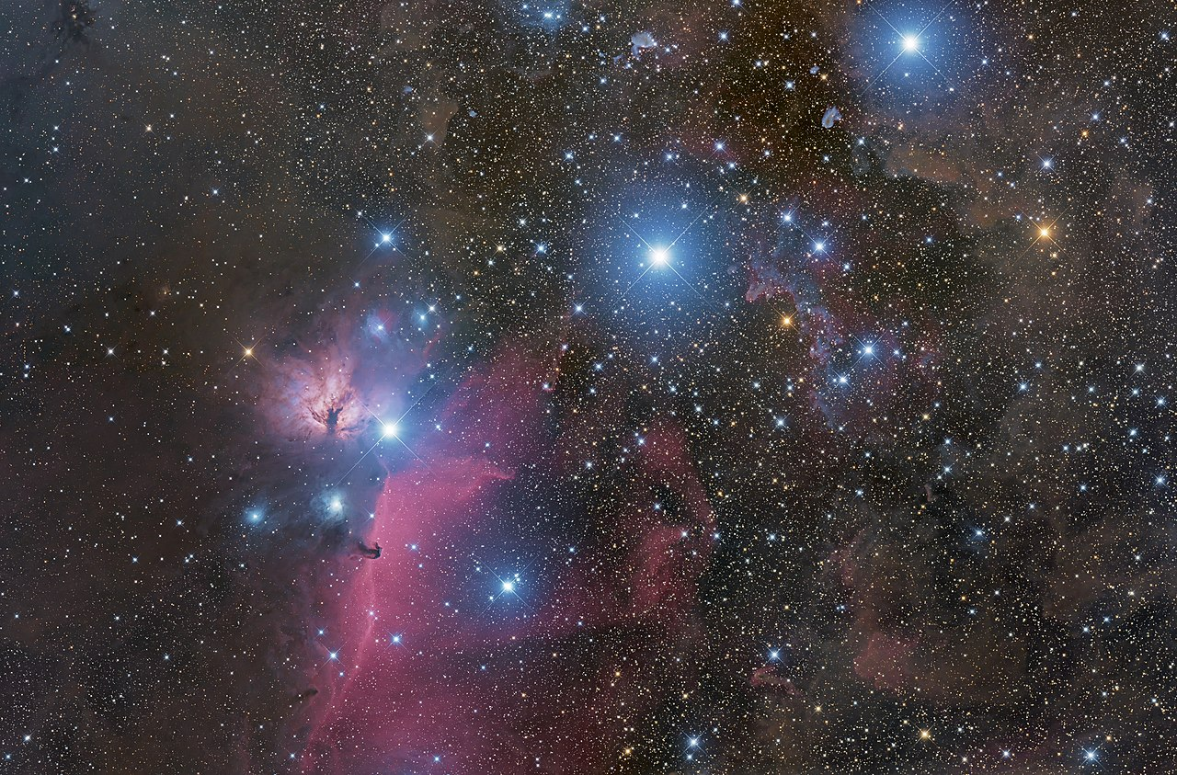
Constellation Logger
Christian Jarjat

Slide 2
Introduction to Project
Able to search and filter Constellations based on Month and Latitude
Able to Create, Modify and view Logs of Constellations
Have multiple users that can only access their Logs

Slide 3



Technology stack
Java 17
Spring Boot
Maven
mySQL
JDBC
Thymeleaf
Junit5
Notes:
Java 17
Spring Boot
Web
Maven
mySQL
JDBC
Thymeleaf

Slide 4
Flow Chart
Front End
User Input
Controller
Process Input
Service
Validate Input
DAO
Database
Query Database
DAO
Service
Controller
Front End
Map Query
Update App’s Current State
Process Output
Display Output

Slide 5
Data
Date Collected from sites
http://www.ianridpath.com/constellations1.html
http://www.constellationdirectory.org/index.html
https://www.constellation-guide.com/
Formatted into sql help of seprate java program

Slide 6
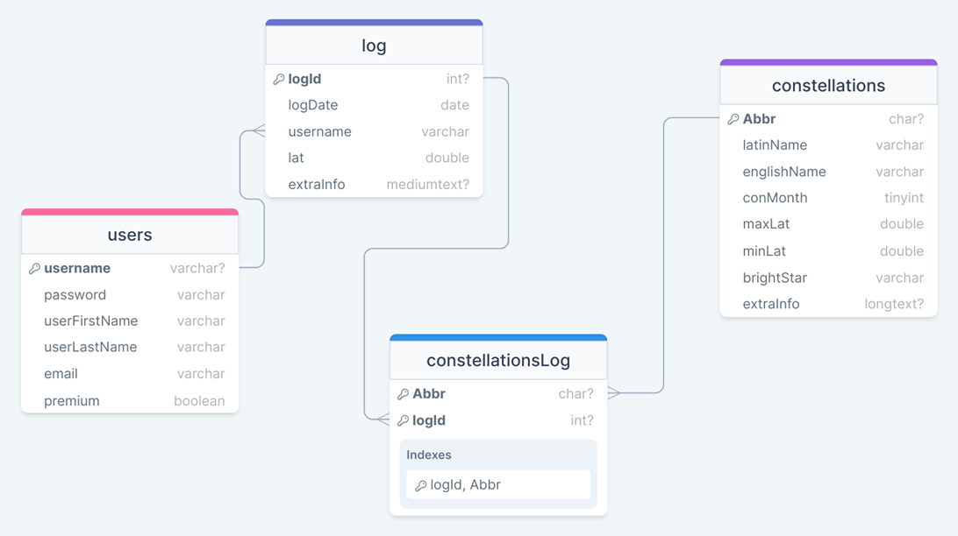
ERD

Slide 7
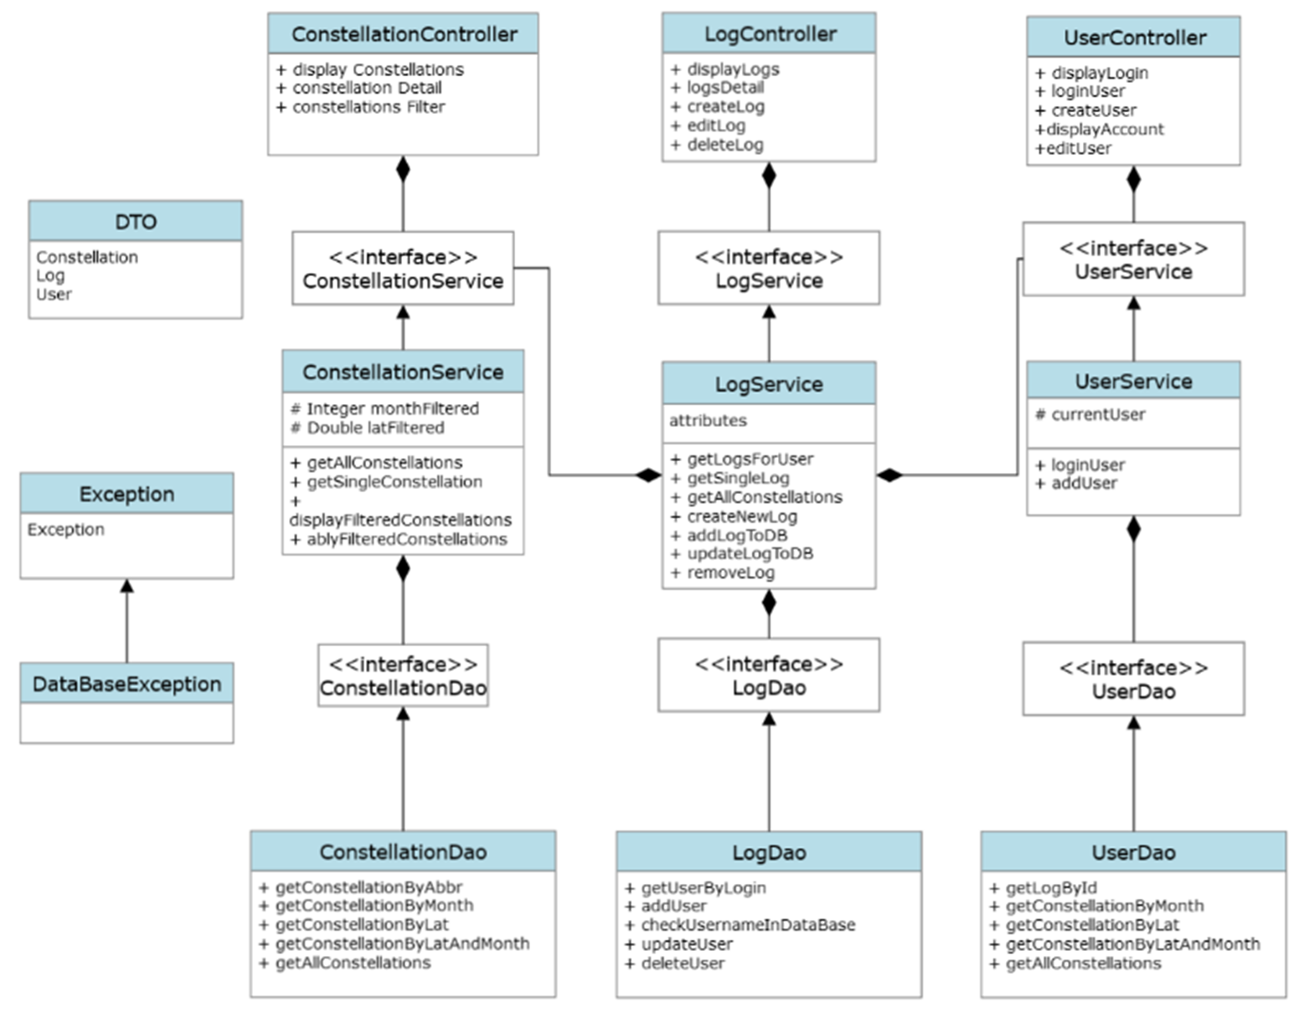
Uml Class Diagram

Slide 8
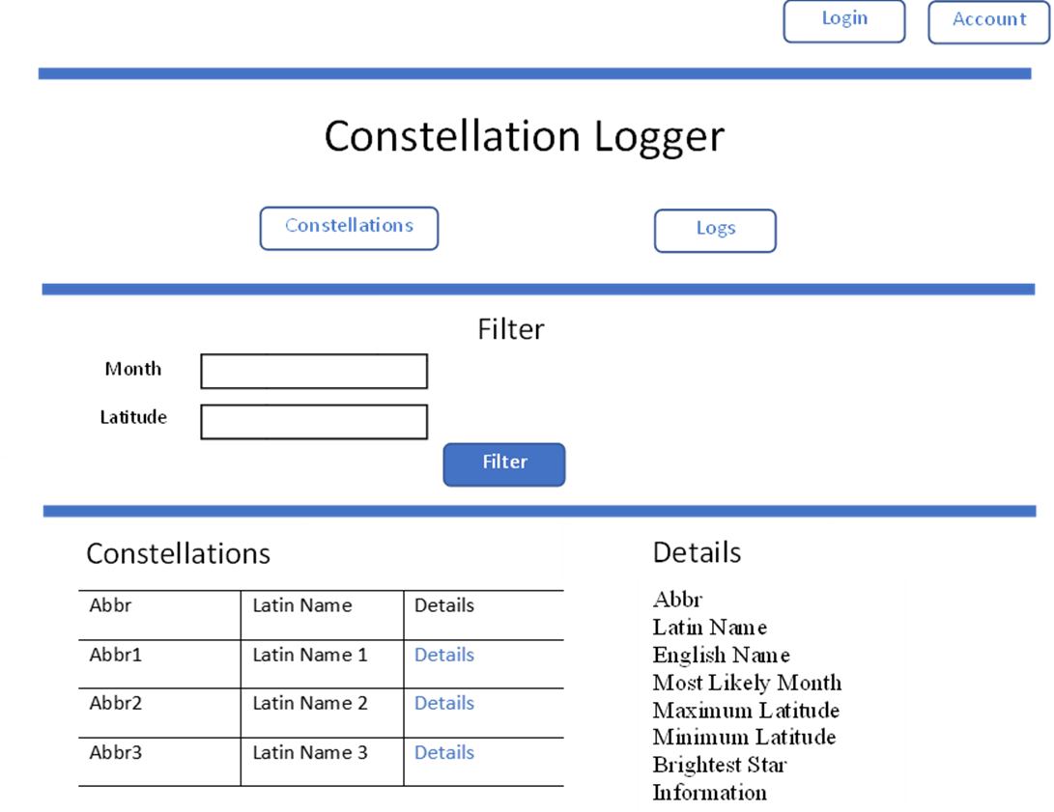
https://github.com/jarjc001/ConstellationLogger
Notes:
Main header/index
4 buttons will take you the different parts of the app
Logger,
Only able to access if logged in
will send user to log in url if not logged in

Slide 9
Notes:
Constellation Searcher
Free and can be assessed by people not logged in
Filter for month and latitude
Can have both or either on
A filter will wipe the previous filters
Each Constellation has a details link,
will display the details of the Constellation chosen
keeps the filtered list in place

Slide 10
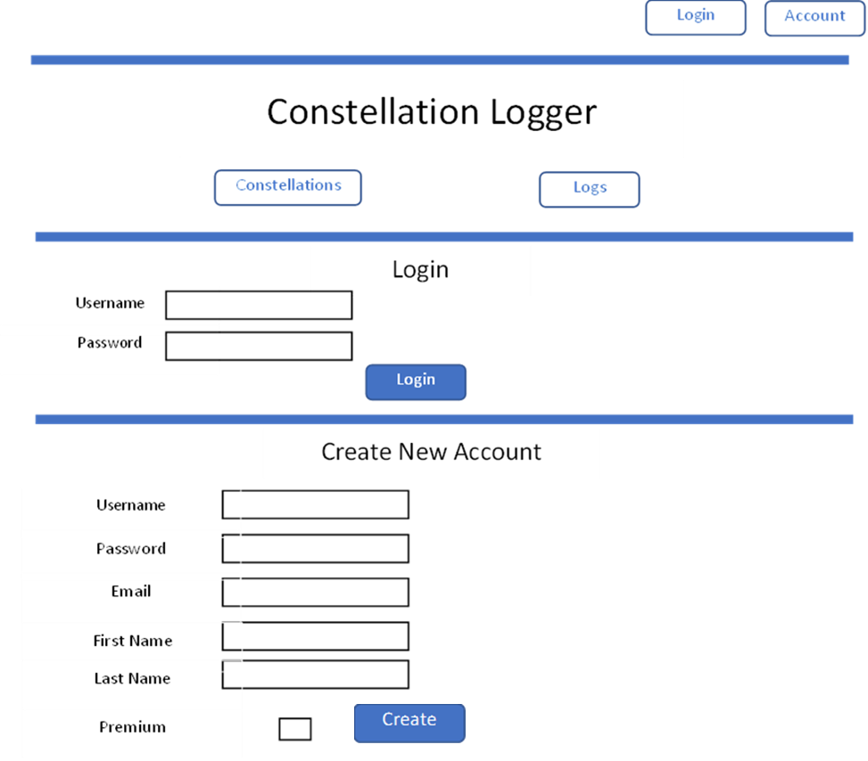
Notes:
Login area
Send here either by pressing login or logs while not being signed in
Login section
Both are case sensitive
while password hides the input
while log in if both username and password are correct
Create account
all have to be filled in
will check if the username has been taken though
once created, the new user will be automatically logged in in as well
Input Validation
correct username or password
all the fields filled when creating a new account
or the username has already been taken when creating a new account

Slide 11
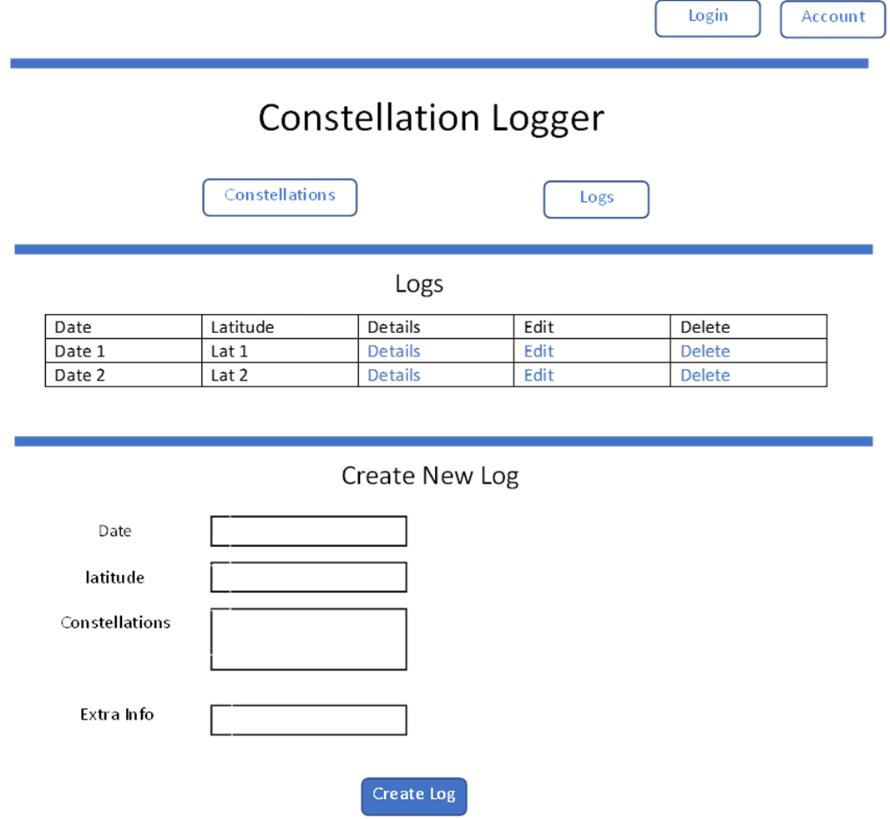
Notes:
Logger,
Only able to access if logged in
will send user to log in url if not logged in
Show the lift of logs for the current account
details and edit – merged
- go to the details url of the chosen log
delete will delete the chosen log and refresh page
Create log,
date and latitude have to be filled in
a list of the constellations can be picked from, allowing multiple choses

Slide 12
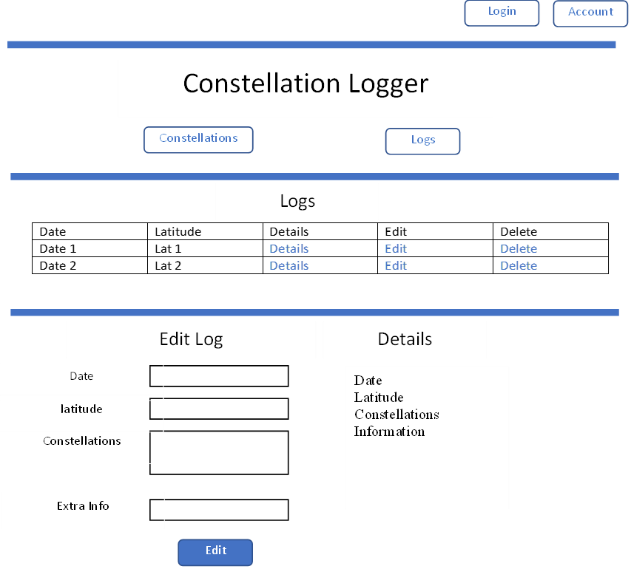
Notes:
For a given log
shows the details of the log
list of constellations has a details button next to each one,
will send to its details page
Edit
all forms need to be filled again including ones that don’t want to be changed

Slide 13
Problems Encountered
Keeping User logged in throughout website
Multiple filters Applied at once
Blank forms causing errors
Notes:
Keeping User logged in throughout website
Add a protected Static object for the logged in user,
change it every time someone logs in or out
Multiple filters Applied at once
If statements checking for null, and using the right SQL Statement based on it
Consterllation service
Blank forms causing errors
for latitude values for nullable values causing errors
data being placed into SQl
Go through with exception handling for each bit
addnew log in log service

Slide 14
Future Potential
Account Edit and Details
New Log Dropdowns changing based on the month/latitudes of Log
Create Separate Location Table In Database
More dynamic buttons based on the App’s current state
Add pictures / more information to Each Constellation
Notes:
Account Edit and Details
add an account edit/delete part on it own url
didn’t have enough time
New Log Dropdowns changing based on the month/latitudes of Log
when editing/adding logs
Only show the Constellations that apply to the logs date and latitude
Create Separate Location Table In Database
To allow more info on location of logs,
allow for the intended premium functionality
More dynamic buttons based on the App’s current state
Have one log in/Account button,
have it changed based on whether someone is logged in or not
Add pictures / more information to Each Constellation
for the details of each one
Filters have a Buffer Border
Show Constellations that are close to the filters separately from the main list
I month from the chosen month
10 degrees +/- from the latitude

Slide 15
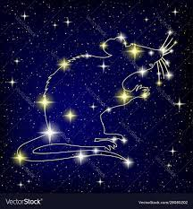
Questions?

