Slide 1
Ojanpohjien luotaussuunnitelma
UTU, Paavo N., helmi-2021

Slide 2
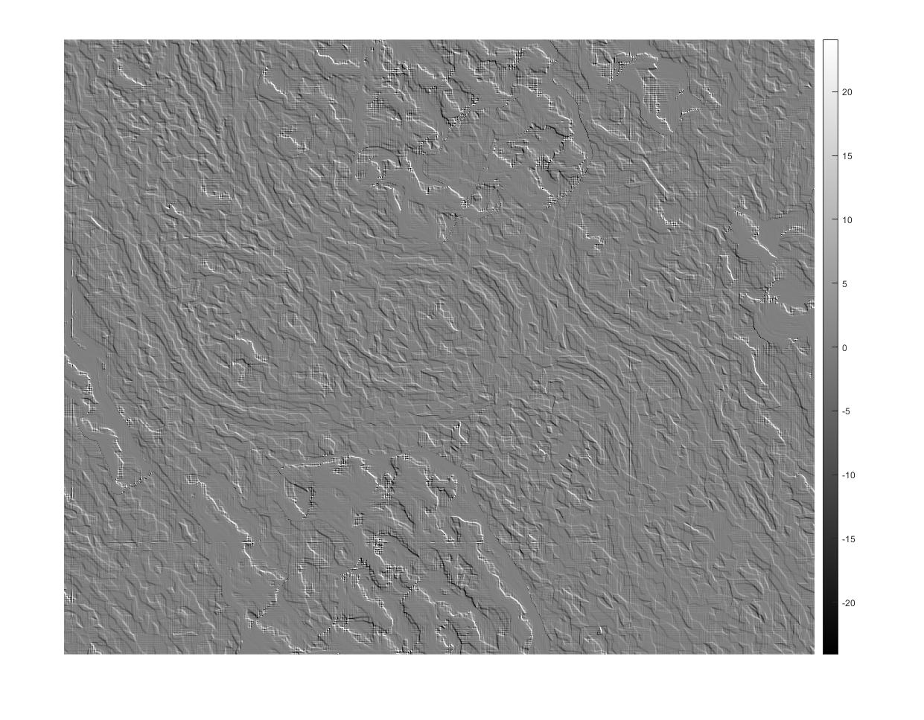
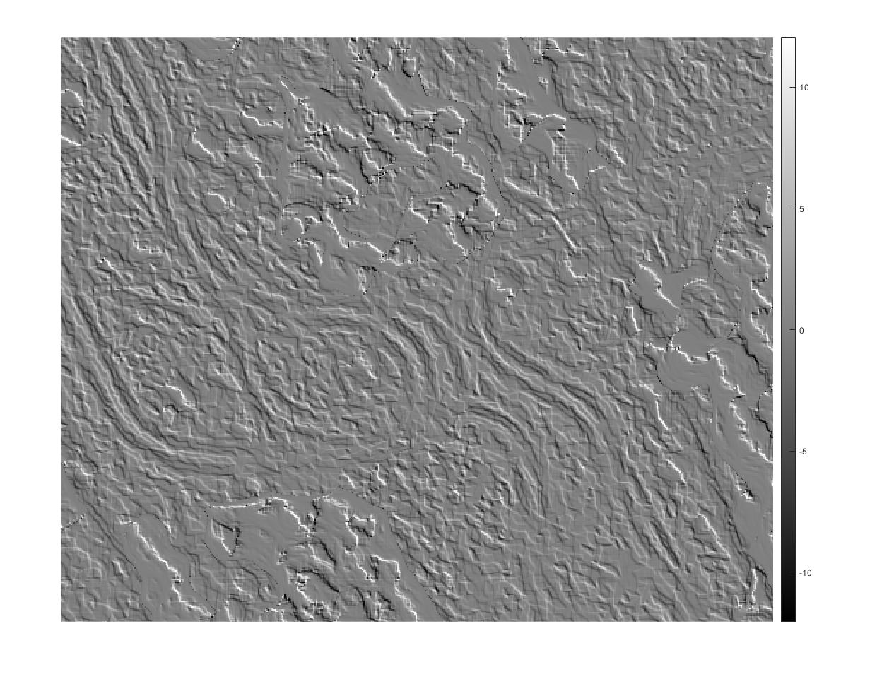
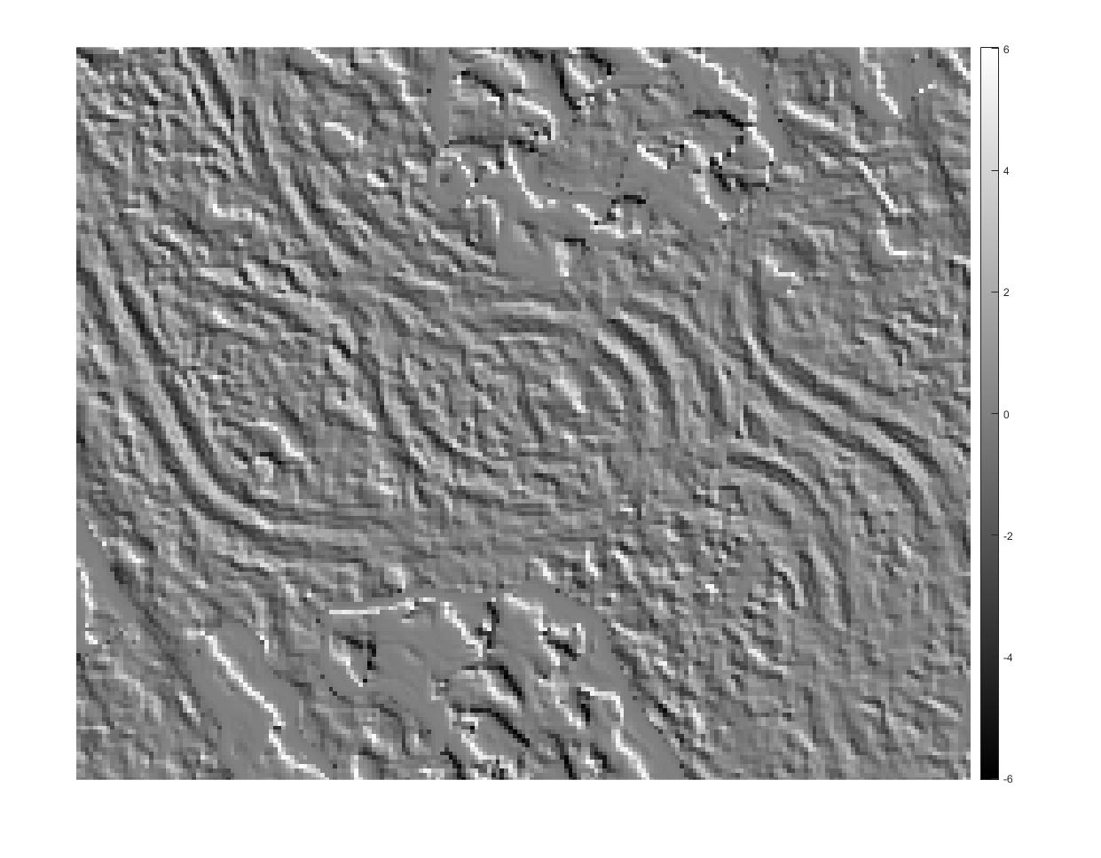
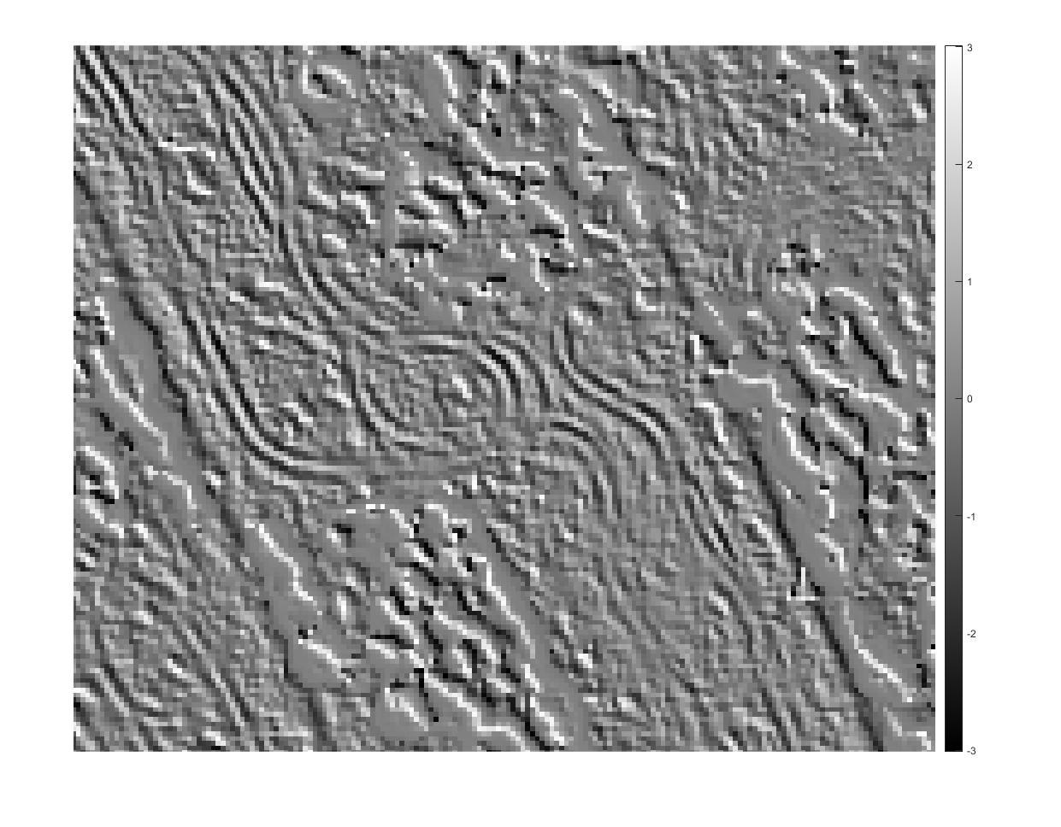
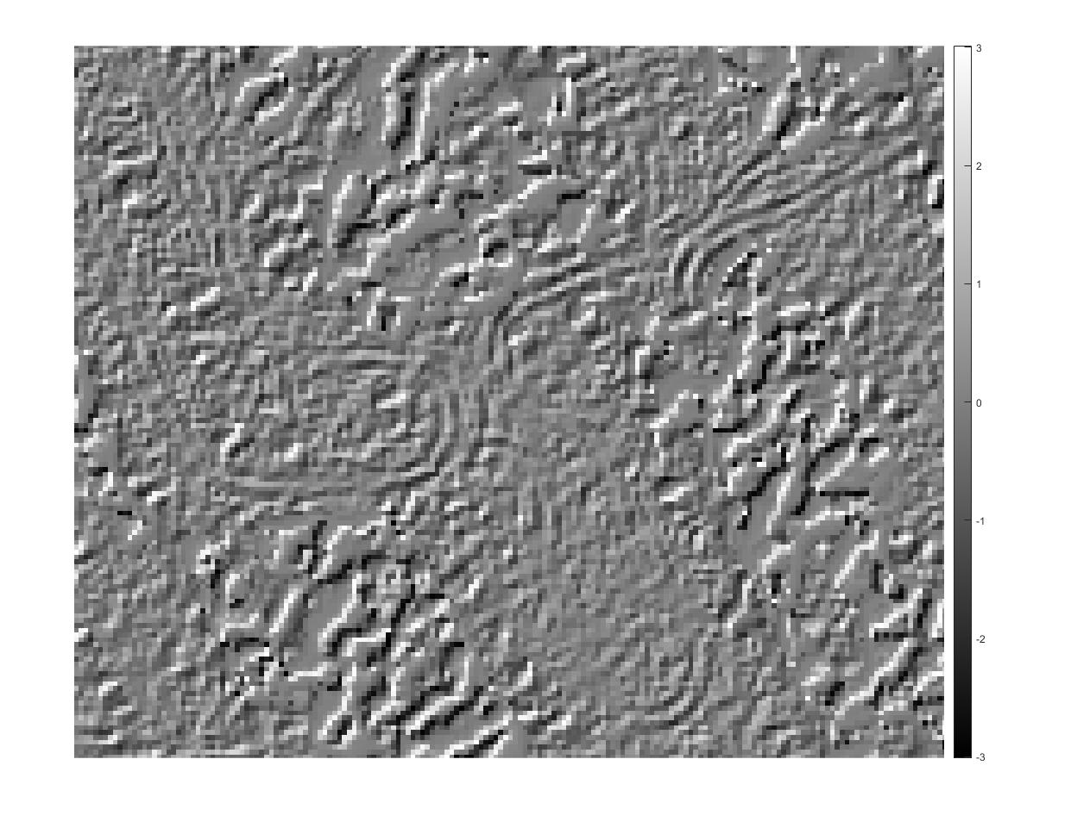
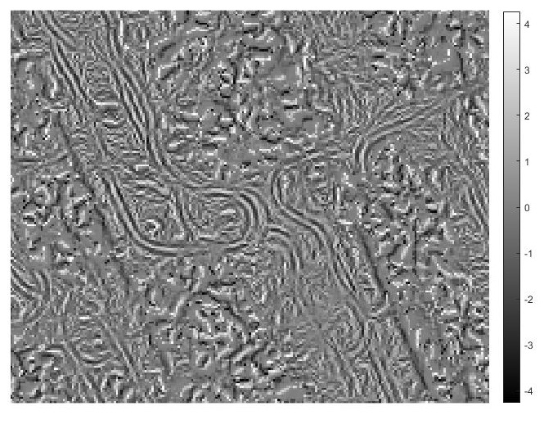


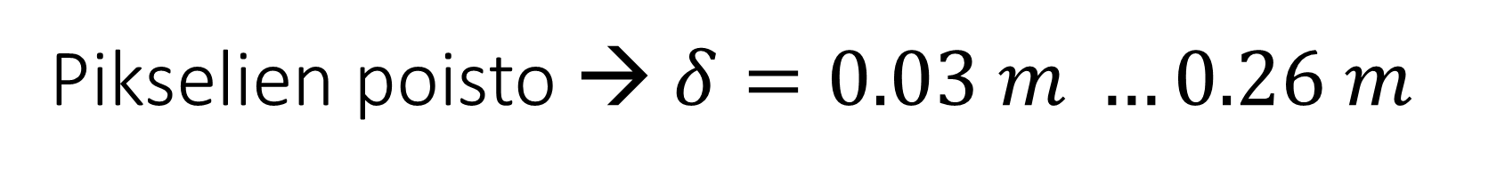




Pikselien poisto → $δ=0.03 m …0.26 m$
$$δ=0.032,α=−{45}^{o}$$
$δ=0.067$, $α=−{45}^{o}$
$δ=0.13$, $α=−{45}^{o}$
$δ=0.26, α=−{45}^{o}$
$δ=0.26, α=+{45}^{o}$
$δ=0.26, α=0, 90,±{45}^{o}$

Slide 3
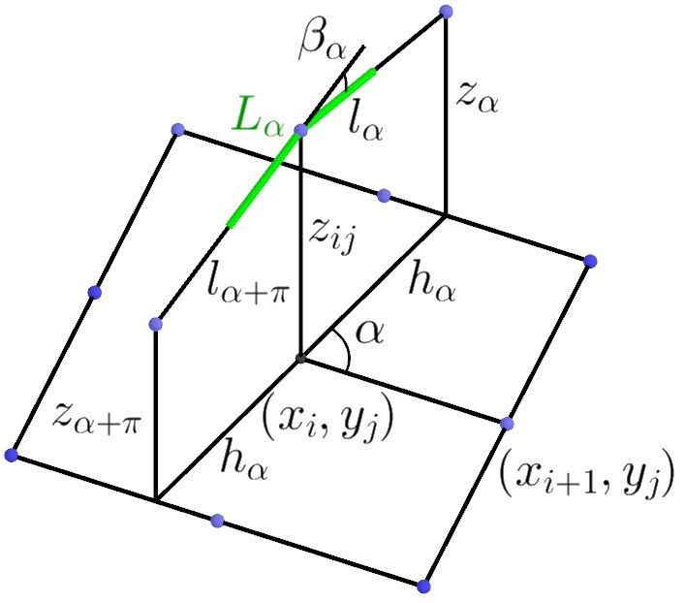
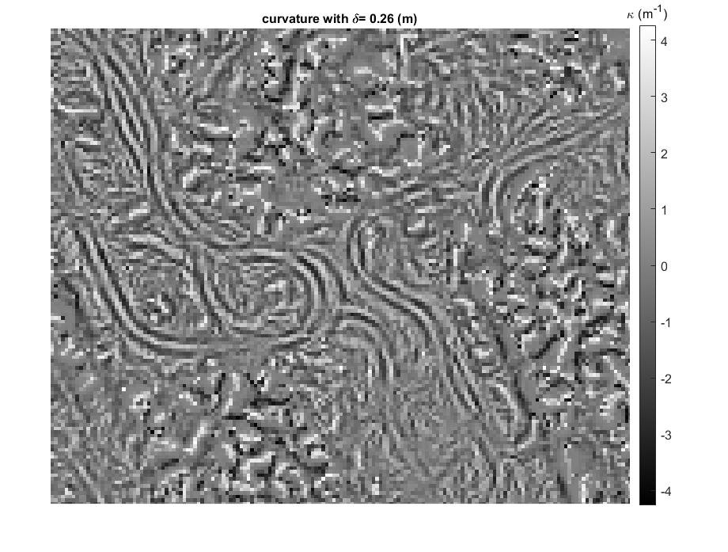
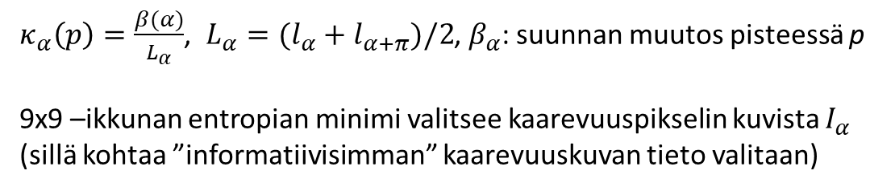
Suunnattu kaarevuus
$κ_{α}\left(p\right)=\frac{β(α)}{L_{α}}$, $L_{α}=(l_{α}+l_{α+π})/2$, $β_{α}$: suunnan muutos pisteessä p
9x9 –ikkunan entropian minimi valitsee kaarevuuspikselin kuvista $I_{α}$ (sillä kohtaa ”informatiivisimman” kaarevuuskuvan tieto valitaan)
$δ=0.26 m, α=0, 30,60,90,120,150^{o}$

Slide 4
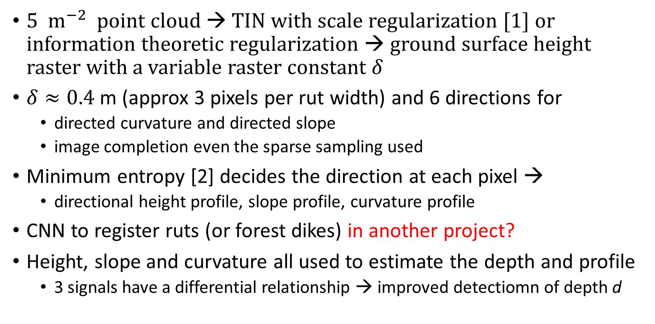
A proposal for harvester ruts (and for forest dikes)
5 $m^{−2}$point cloud → TIN with scale regularization [1] or information theoretic regularization → ground surface height raster with a variable raster constant $δ$
$δ≈0.4$ m (approx 3 pixels per rut width) and 6 directions for
directed curvature and directed slope
image completion even the sparse sampling used
Minimum entropy [2] decides the direction at each pixel →
directional height profile, slope profile, curvature profile
CNN to register ruts (or forest dikes) in another project?
Height, slope and curvature all used to estimate the depth and profile
3 signals have a differential relationship → improved detectiomn of depth d

Slide 5
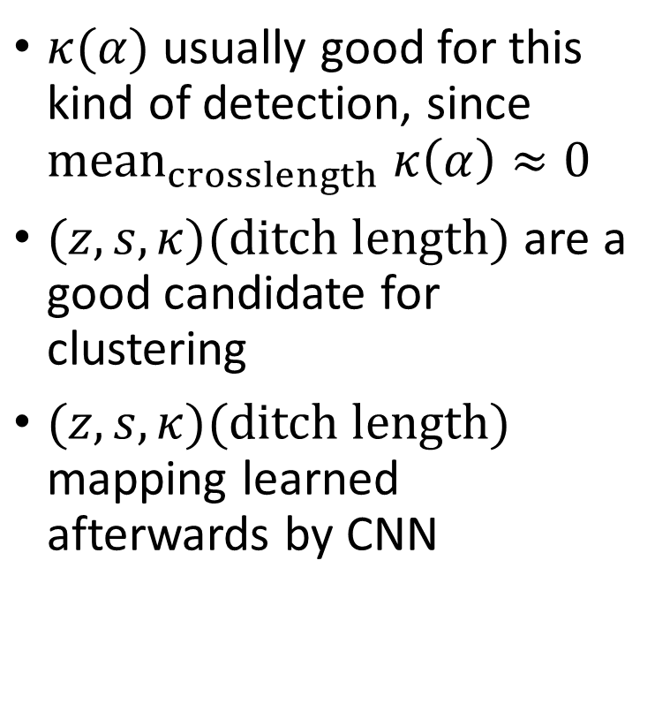
A proposal for harvester ruts (and for forest dikes)
$κ(α)$ usually good for this kind of detection, since ${mean}_{crosslength} κ\left(α\right)≈0$
$(z,s,κ)(ditch length)$ are a good candidate for clustering
$(z,s,κ)(ditch length)$ mapping learned afterwards by CNN

Slide 6
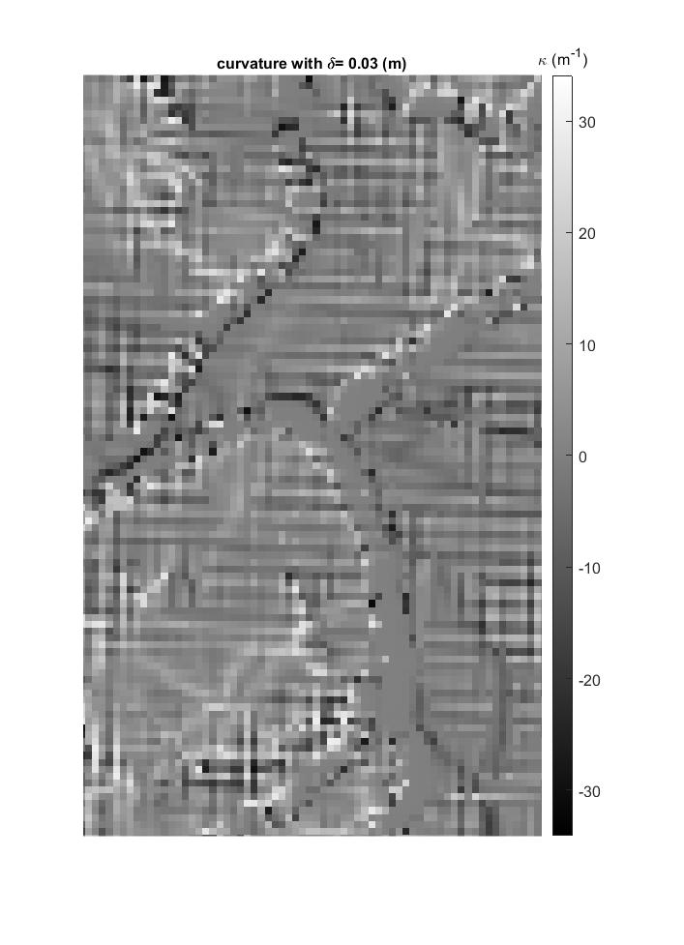
.obj vai PC (point cloud)
.obj –datassa numeerista kohinaa
tarvittaneen PC → TIN → pintarasteri

