Slide 1
Graph Representation

Slide 2

Networks are
Large
Sparse
Objects to analyze
Use computational
resources for analysis
Efficient ways of storing
the information
Need representations
amenable to efficient
algorithms
Notes:
Networks are large, sparse but meant for analysis

Slide 3
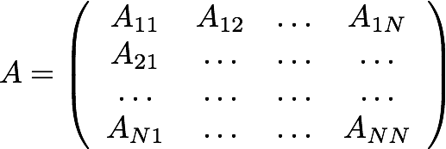
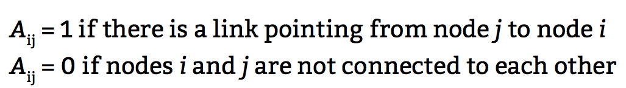
Matrix Representation
Notes:
Square matrix N

Slide 4
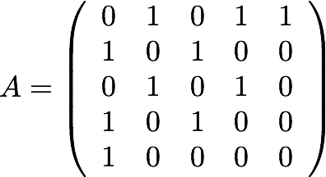
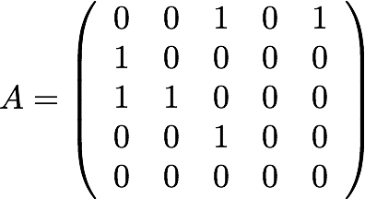
Adjacency Matrix
Undirected
Directed
1
1
5
2
5
2
4
3
4
3

Slide 5
Adjacency Matrix
Advantages
Convenient for analytical calculations
Easy to remove/add an edge (changing the value of an element in the matrix is O(1))
Disadvantages
Needs a lot of memory - O(N^2) space
Inconvenient for numerical calculations
Notes:
O(1) going to that spot in the matrix

Slide 6



Adjacency Matrix
O(N^2) doesn’t sound like a lot, but consider:
Adjacency matrix has entries, where N is the number of nodes in the network
If an integer = 4 bytes, and RAM =10 GB
, then
M.E.J. Newman. (2010). Networks: An Introduction. Oxford University Press.
Notes:
Use of full memory with 50k nodes

Slide 7
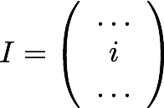
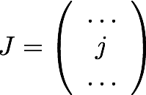

Edge list (ij-form)
Only if
Order of rows not important
If undirected:
only report link with i<j (L rows)
report both i j, and row j i (2L rows, redundancy)
If directed:
report each arc (L arcs)
Notes:
2L is necessary

Slide 8
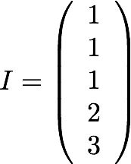
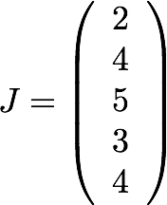
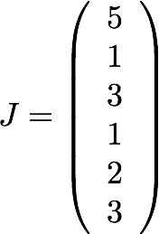
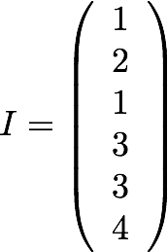
Edge list (ij-form)
Undirected
Directed
1
1
5
2
5
2
4
3
4
3
I
J
Notes:
i always smaller than j

Slide 9
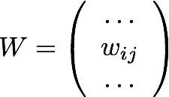

Edge list (ij-form)
Weighted networks
Only if
Notes:
Weighted networks: Next class

Slide 10
Edge list (ij-form)
Advantages
Most used in data repositories
Convenient for data collection
Disadvantages
Not easy to find elements
(e.g. check the existence of an edge is O(L)
Not useful for many analytical calculations

