Slide 1
NetworkX: a Python module
(and related modules)
Inspired by the tutorial of Salvatore Scellato for the course “Social and Technological Network Analysis”, University of Cambridge (2011)

Slide 2

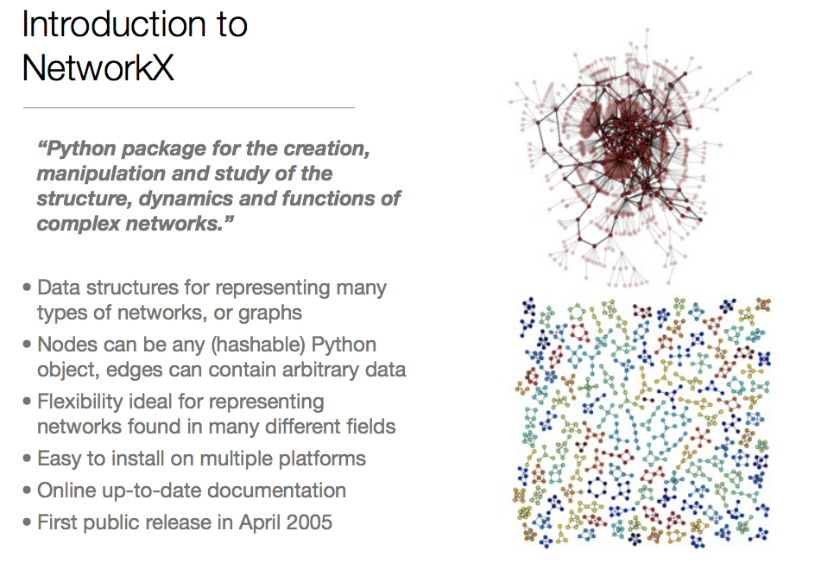

Slide 3

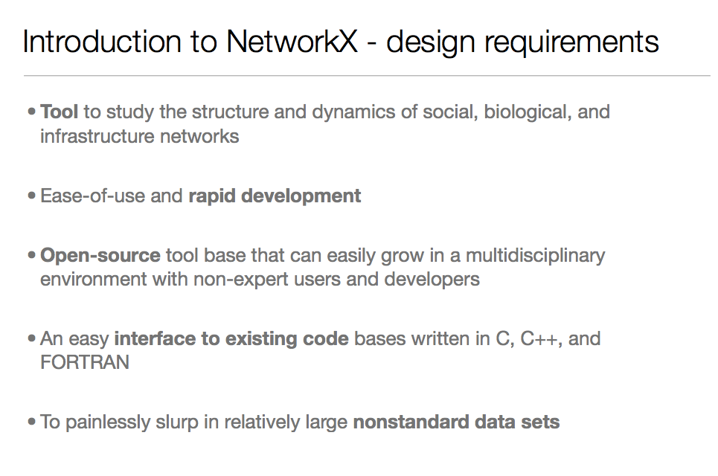

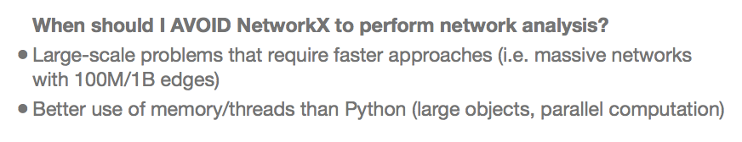

Slide 4
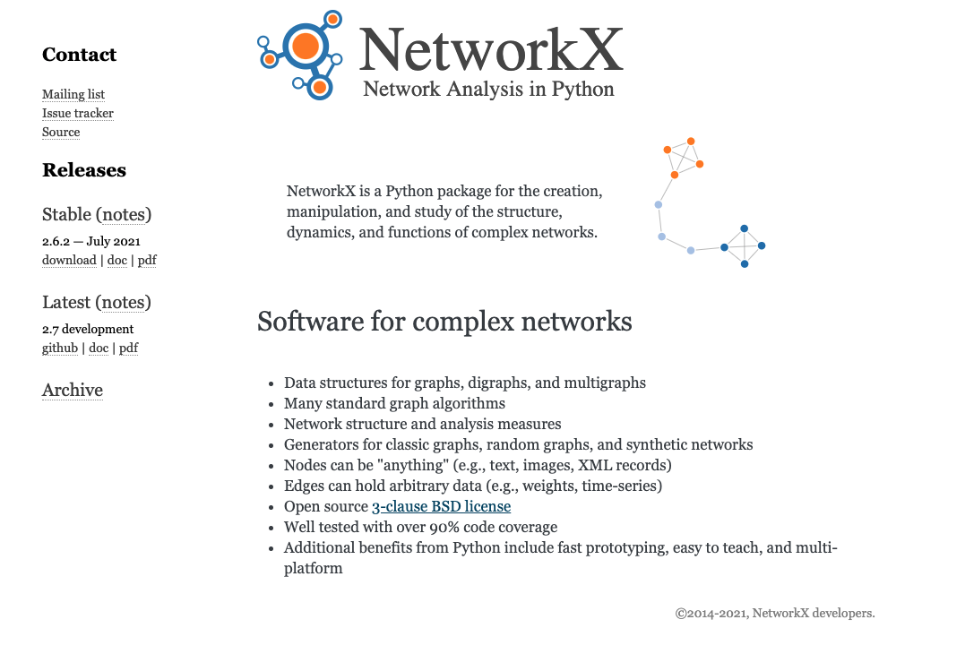
NetworkX: online resources
https://networkx.org/documentation/stable/tutorial.html

