Slide 1

Model Selection Criteria for Digital Humanities
Feat. Mark Twain and the 2,300 pages of his Autobiography
Jonathan Armoza
NYU English Department
October 7, 2021

Slide 2
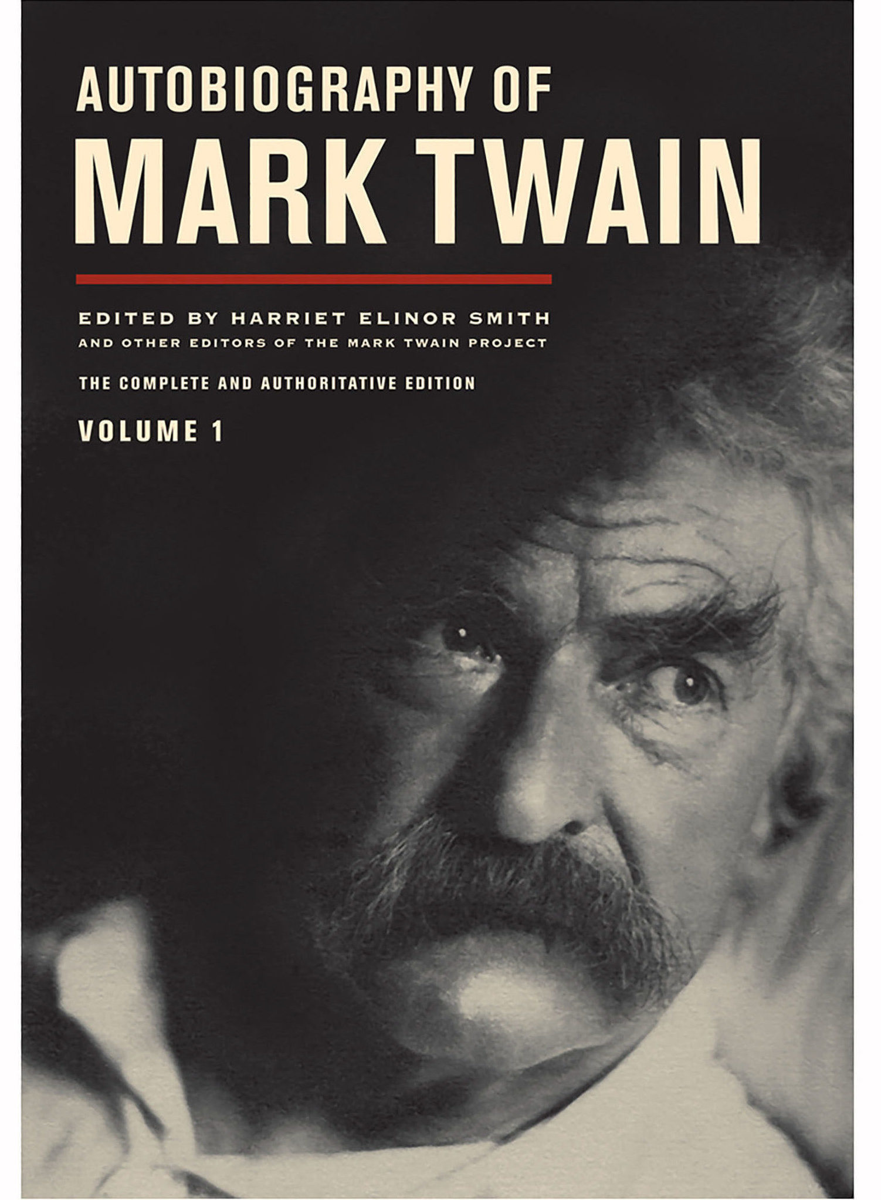
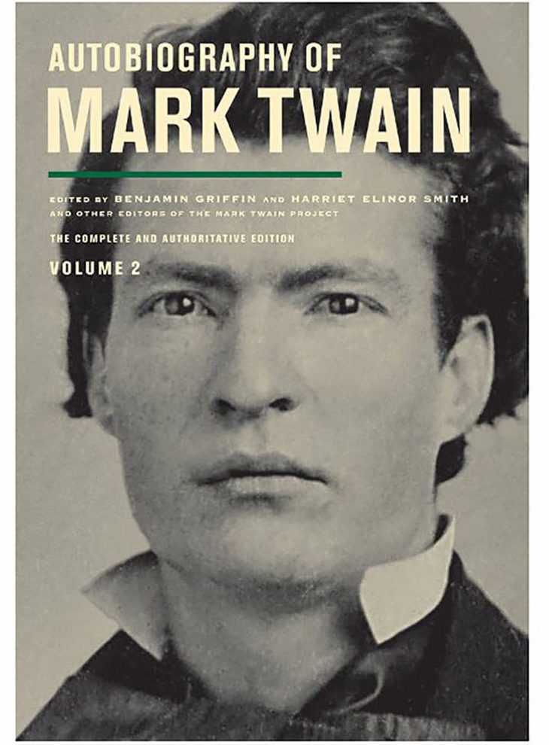
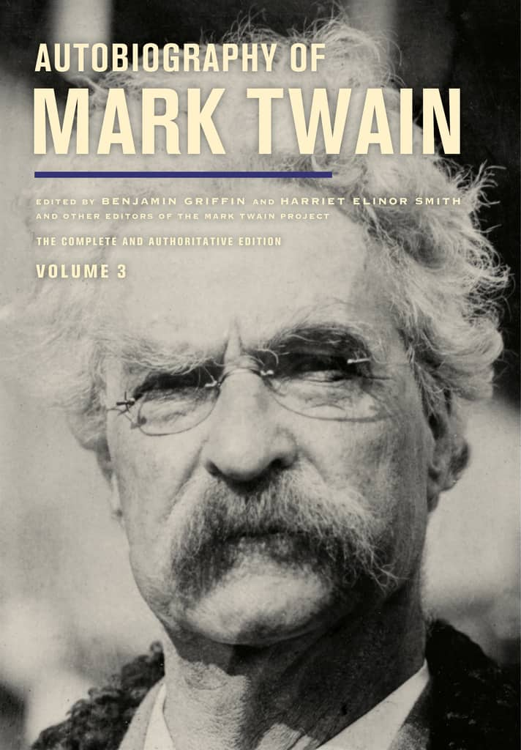
Twain’s Autobiography
Began in 1870, eventually completed 1909
Planned for bulk of the material to be published posthumously
Mark Twain Project edition
Comprehensive edition published in 3 volumes starting in 2010, one volume every 2 years

Slide 3
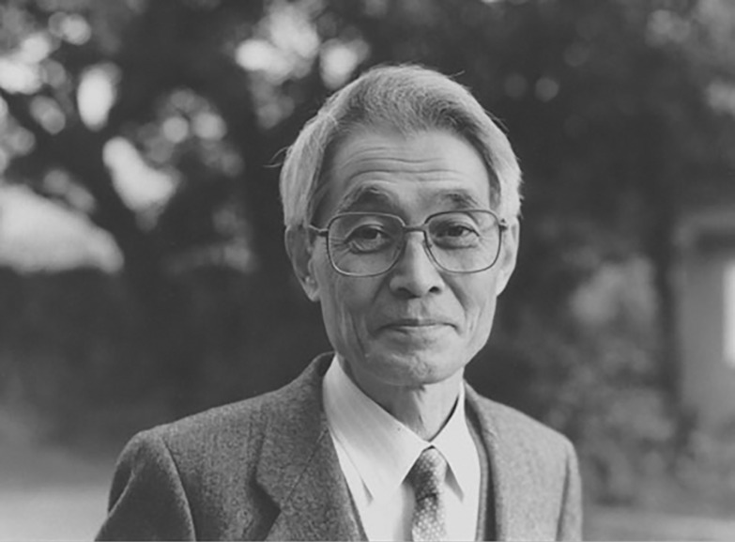
Information Criteria for Model Selection
Akaike Information Criteria (AIC)
Hirotugu Akaike (1971)
Still used today in modified and advanced forms
Estimator of prediction error – e.g. Model Quality
Used when no out of sample data is available
An alternative to traditional hypothesis testing

Slide 4
Information Criteria for Model Selection
AIC = -2 ln(L) + 2k
AIC uses a model’s maximum likelihood estimation (log-likelihood) as a measure of fit
L = likelihood, k = # of model parameters

Slide 5
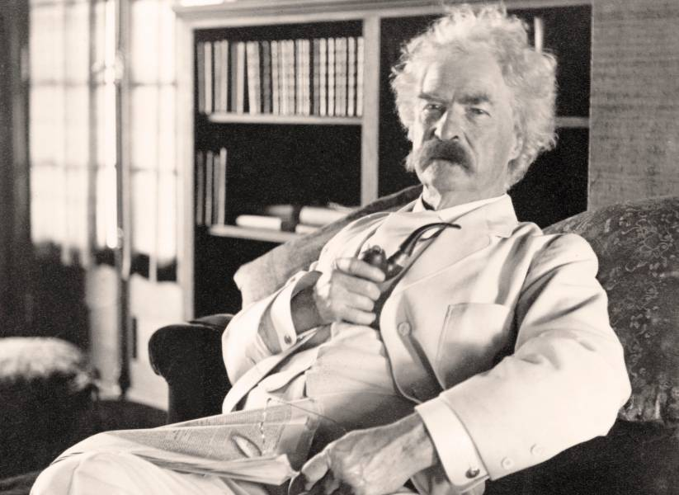
Aphorism Detector

Slide 6
Results Autobio’s sentences and Twain’s Aphorisms

Slide 7
Results Using AIC to Select Models

