Slide 1

Model Quality for Digital Humanities
Feat. Mark Twain and the 2,300 pages of his Autobiography
Jonathan Armoza
NYU English Department
October 7, 2021
DH Graduate Summer Fellowship

Slide 2
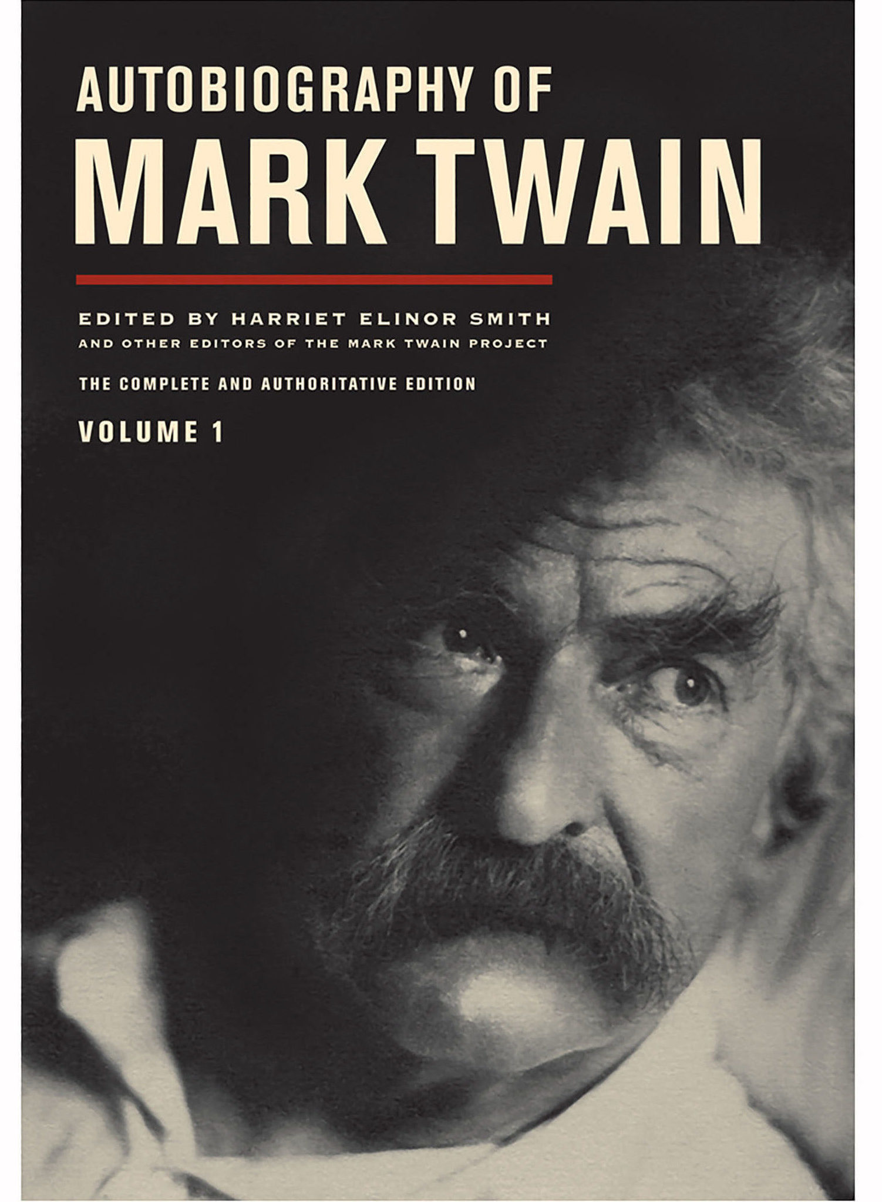

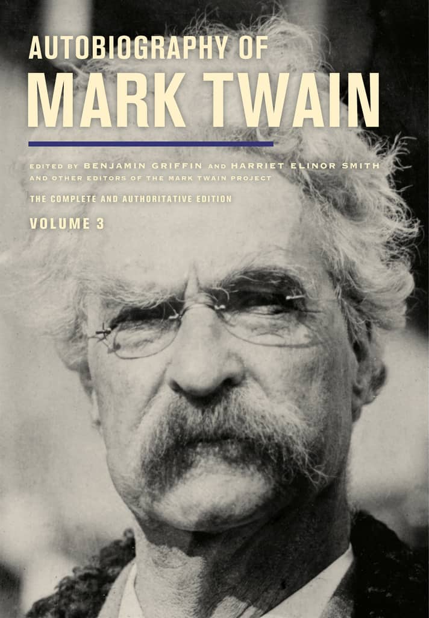
Twain’s Autobiography
Began in 1870, eventually completed 1909
Planned for bulk of the material to be published posthumously
Mark Twain Project edition
Comprehensive edition published in 3 volumes starting in 2010, one volume every 2 years
Over 2,300 pages

Slide 3
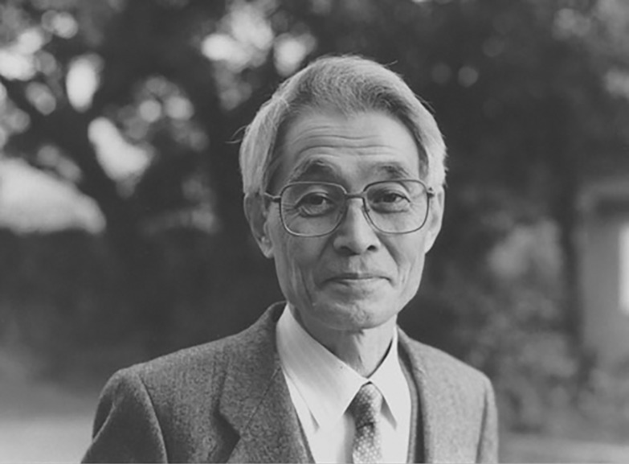
Information Criteria for Model Selection
Akaike Information Criteria (AIC)
Hirotugu Akaike (1971)
Still used today in modified and advanced forms
Estimator of prediction error – i.e. Model Quality
Used when no out of sample data is available or small data size
An alternative to traditional hypothesis testing
Among several kinds of evidentiary bases for literary models.

Slide 4
Information Criteria for Model Selection
AIC = -2 ln(L) + 2k
AIC uses a model’s maximum likelihood estimation (log-likelihood) as a measure of fit
L = likelihood, k = # of model parameters

Slide 5
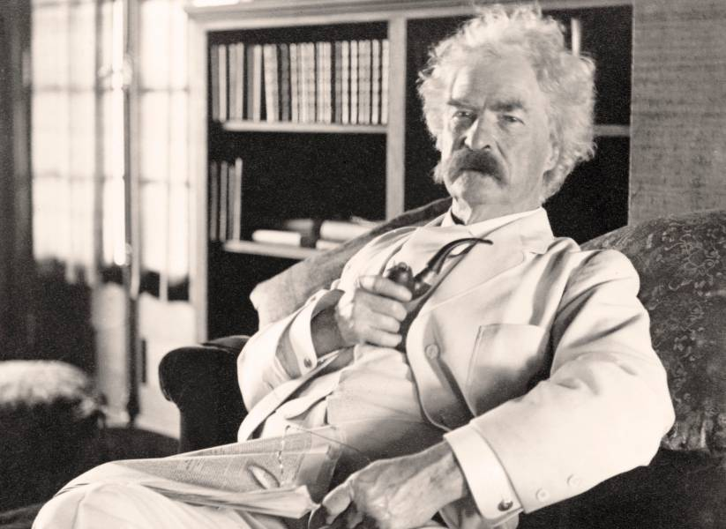
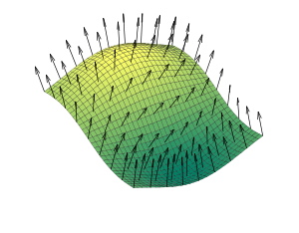
Aphorism Detector
“One mustn’t criticize other people on grounds
where he can’t stand perpendicular himself.”
Word2vec model of Twain’s Autobiography
List of Twain aphorisms
Question: How alike is each sentence of the autobiography to Twain’s aphorisms?
Aphorism score for each sentence

Slide 6
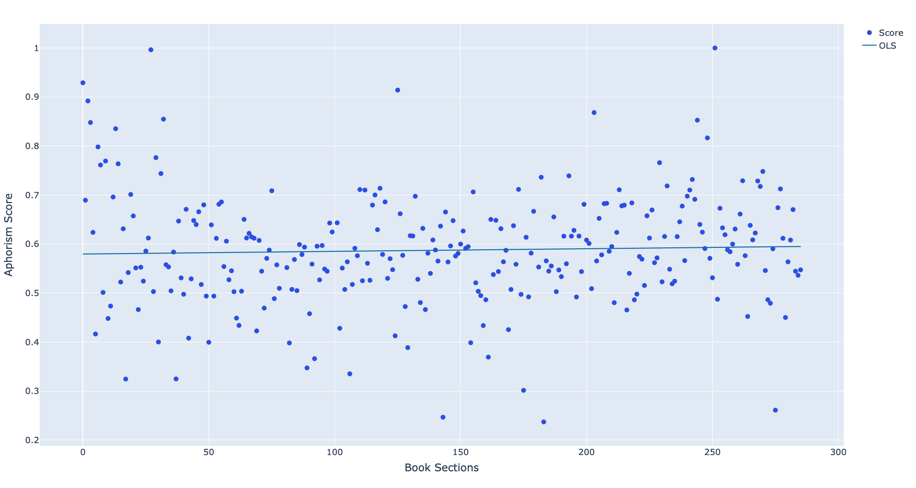
Aphorism scores for Autobiography’s sentences

Slide 7
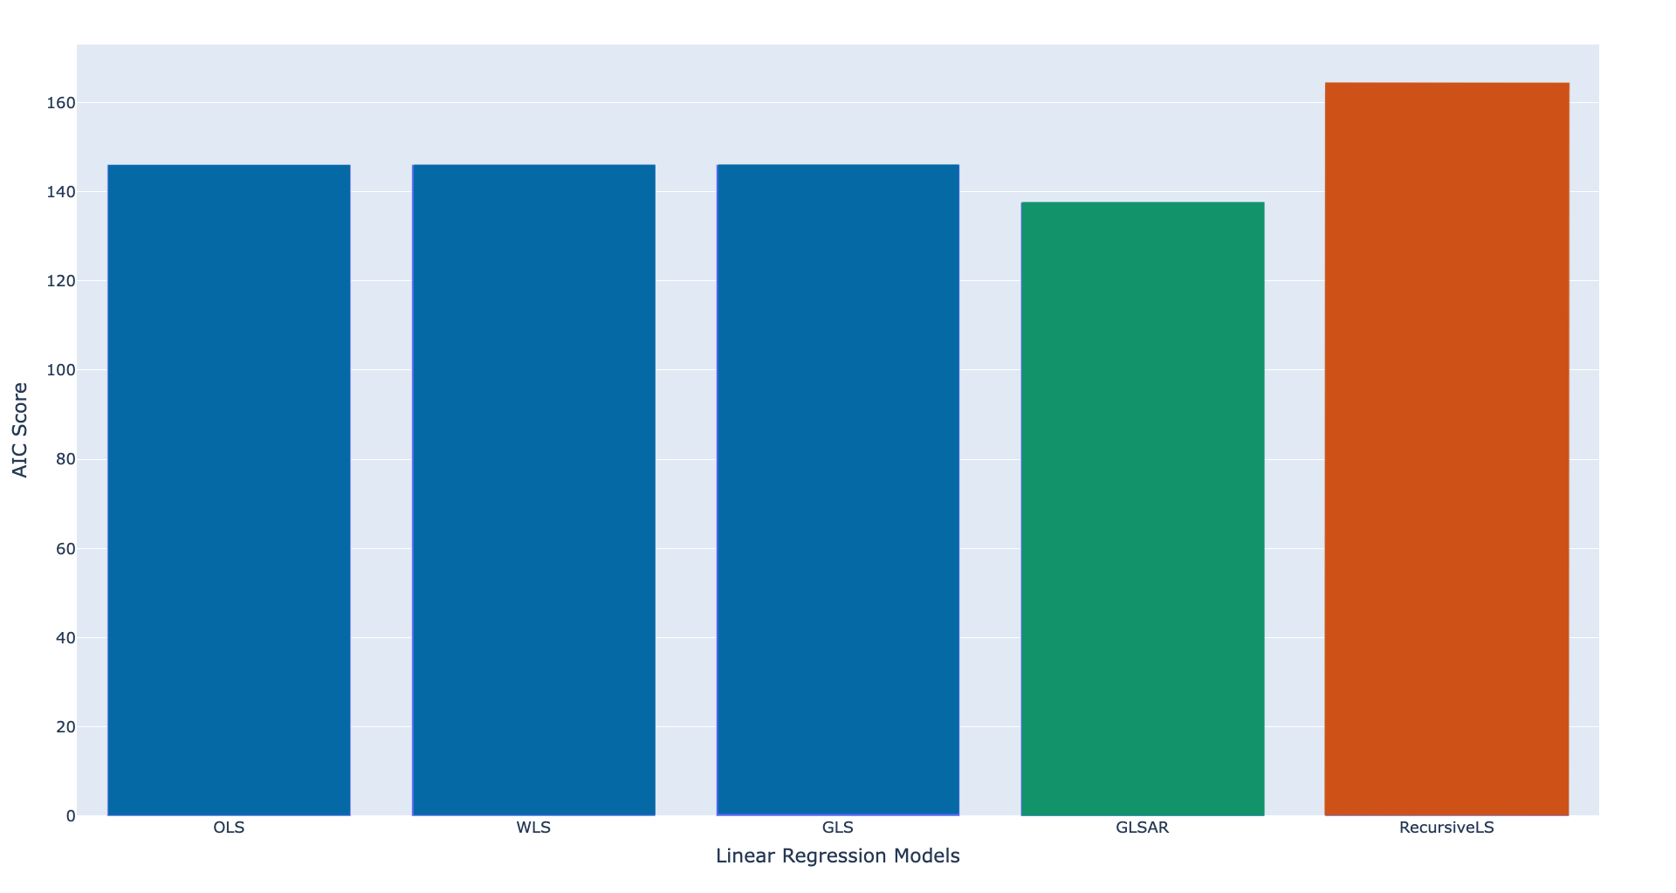
Using AIC to Select Models

Slide 8
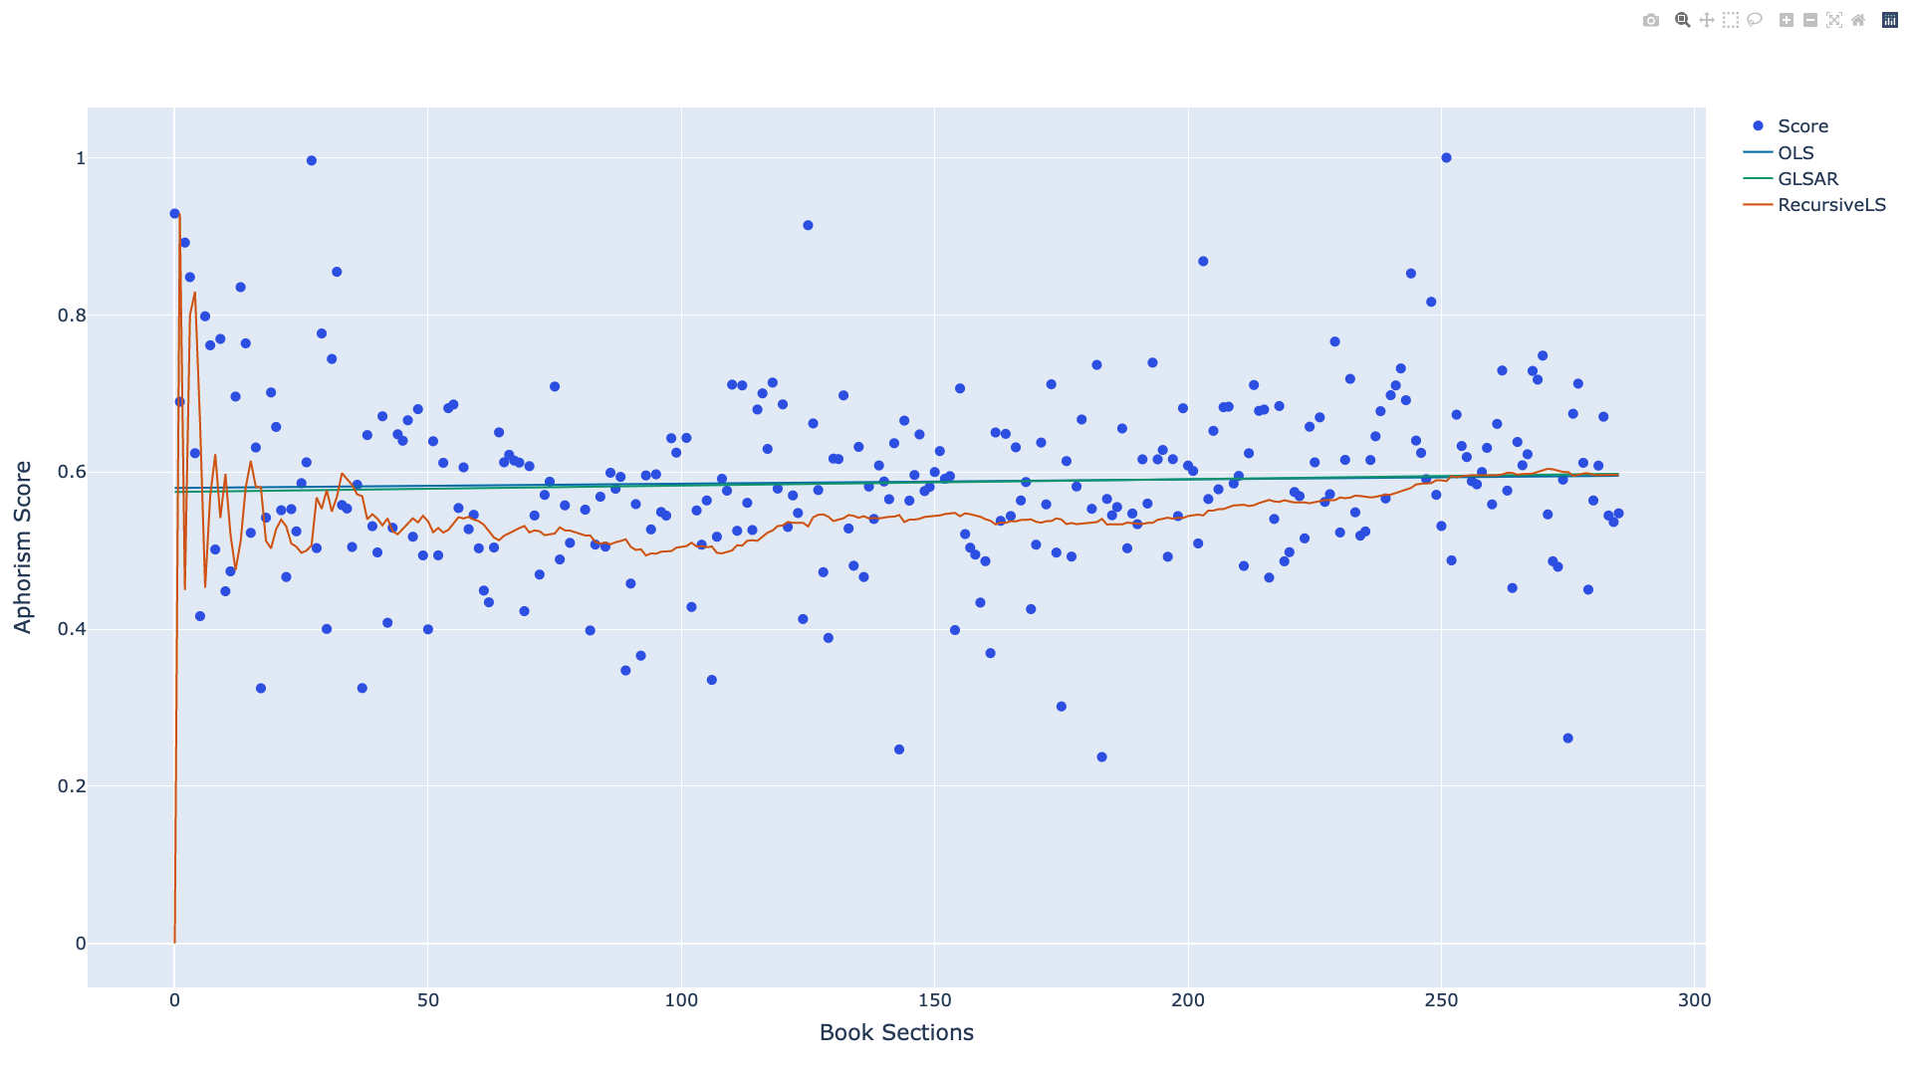
More Accurate Result with Statistical Basis

Slide 9
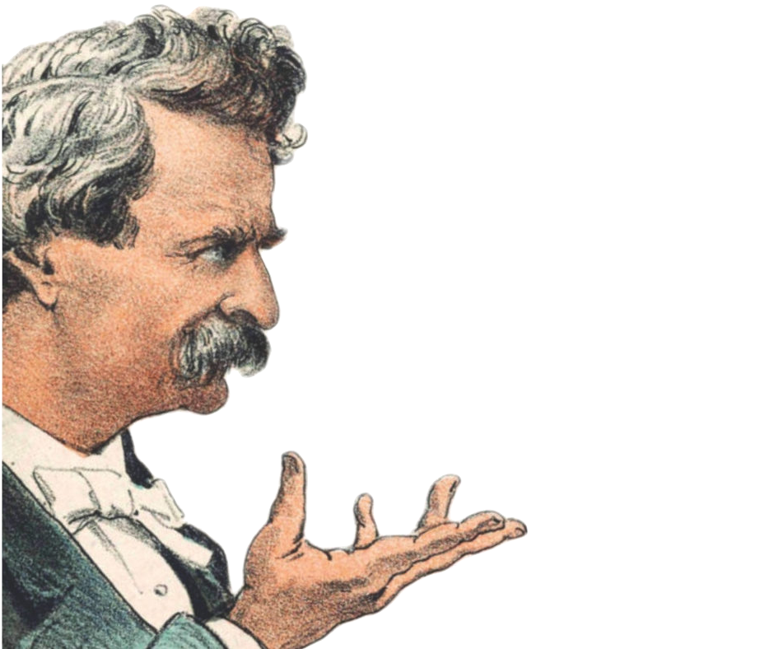
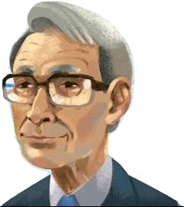
Thanks, and Stay Tuned!
Twitter: jonathangrams
Github: github.com/jarmoza/twain_autobio_modelquality
“Present conditions exhibit curious anomalies.”
AIC suggests Generalized Least Squares
with autoregressive covariance.
That’s what I said!

