Slide 1

Model Quality for Digital Humanities
Feat. Mark Twain and the 2,300 pages of his Autobiography
Jonathan Armoza
NYU English Department
October 7, 2021
DH Graduate Summer Fellowship

Slide 2
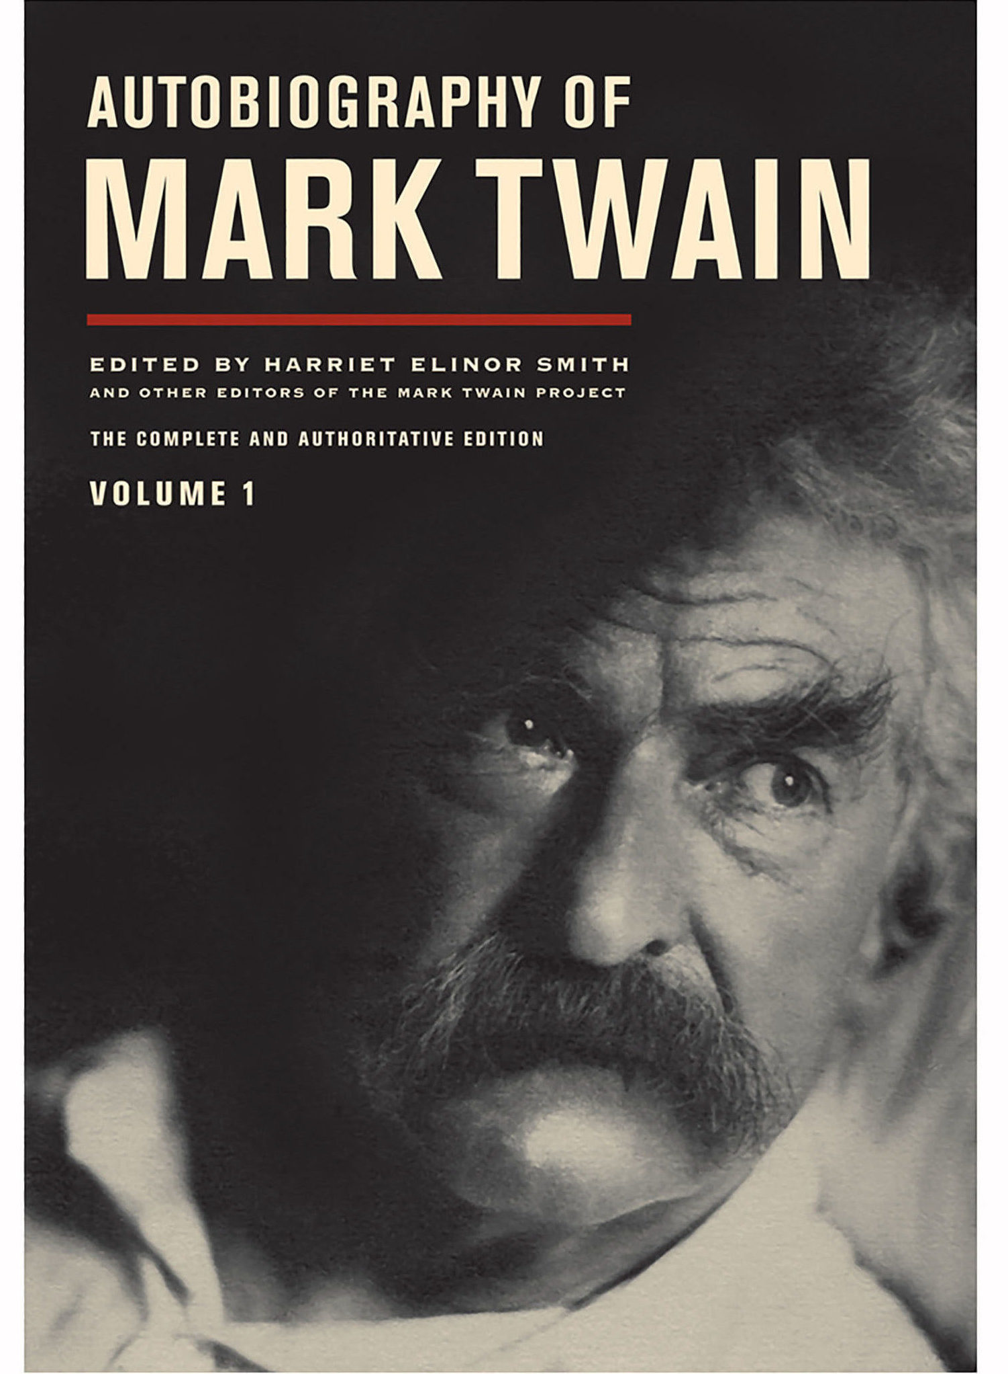

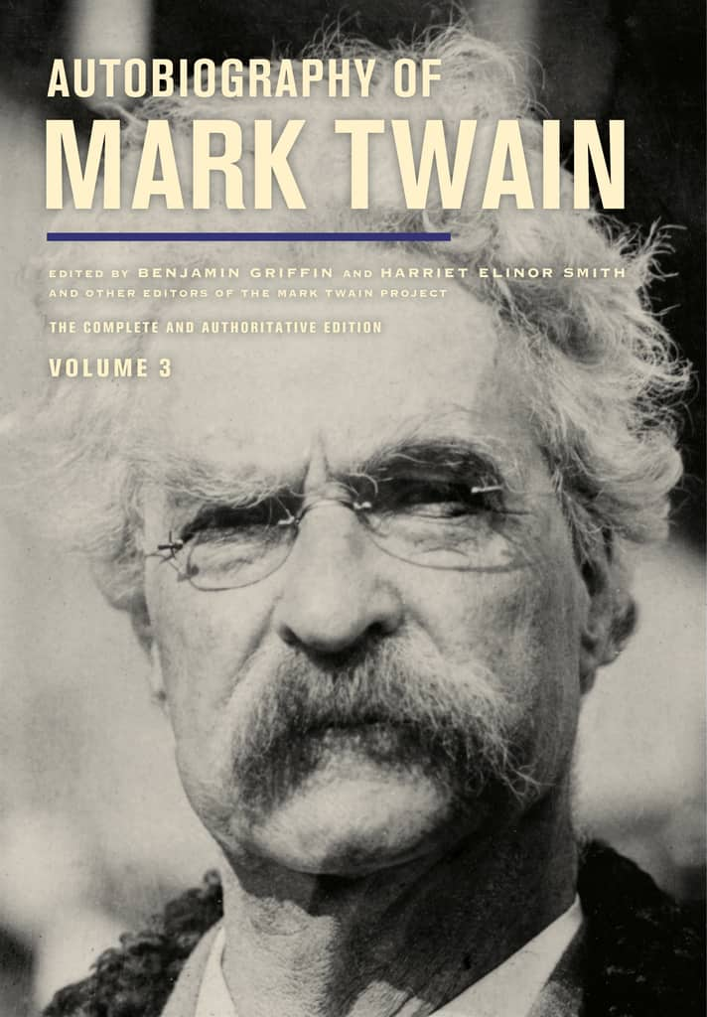
Twain’s Autobiography
Began in 1870, eventually completed 1909
Planned for bulk of the material to be published posthumously
Mark Twain Project edition
Comprehensive edition published in 3 volumes starting in 2010, one volume every 2 years
Over 2,300 pages

Slide 3
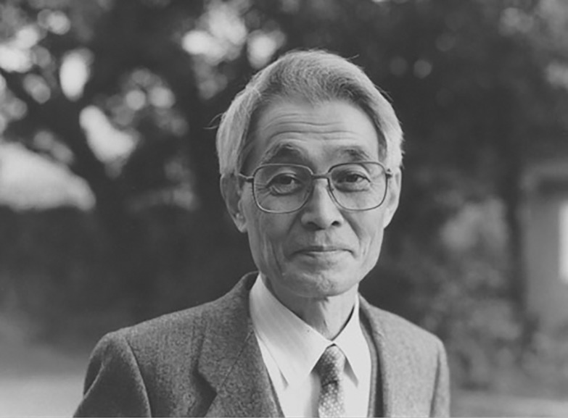
Information Criteria for Model Selection
Akaike Information Criteria (AIC)
Hirotugu Akaike (1971)
Still used today in modified and advanced forms
Estimator of prediction error – i.e. Model Quality
Used when no out-of-sample data is available or small data size
An alternative/complement to traditional hypothesis testing
Among several kinds of evidentiary bases for literary models.

Slide 4
Information Criteria for Model Selection
AIC = -2 ln(L) + 2k
AIC uses a model’s maximum likelihood estimation (log-likelihood) as a measure of fit
L = likelihood, k = # of model parameters

Slide 5
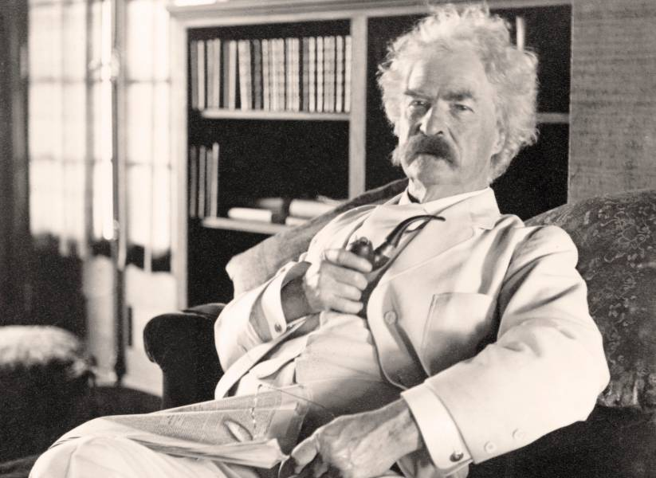
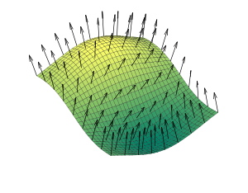
Aphorism Detector
“One mustn’t criticize other people on grounds
where he can’t stand perpendicular himself.”
Word2vec model of Twain’s Autobiography
List of Twain aphorisms
Question: How alike is each sentence of the autobiography to Twain’s aphorisms?
Aphorism score for each sentence

Slide 6
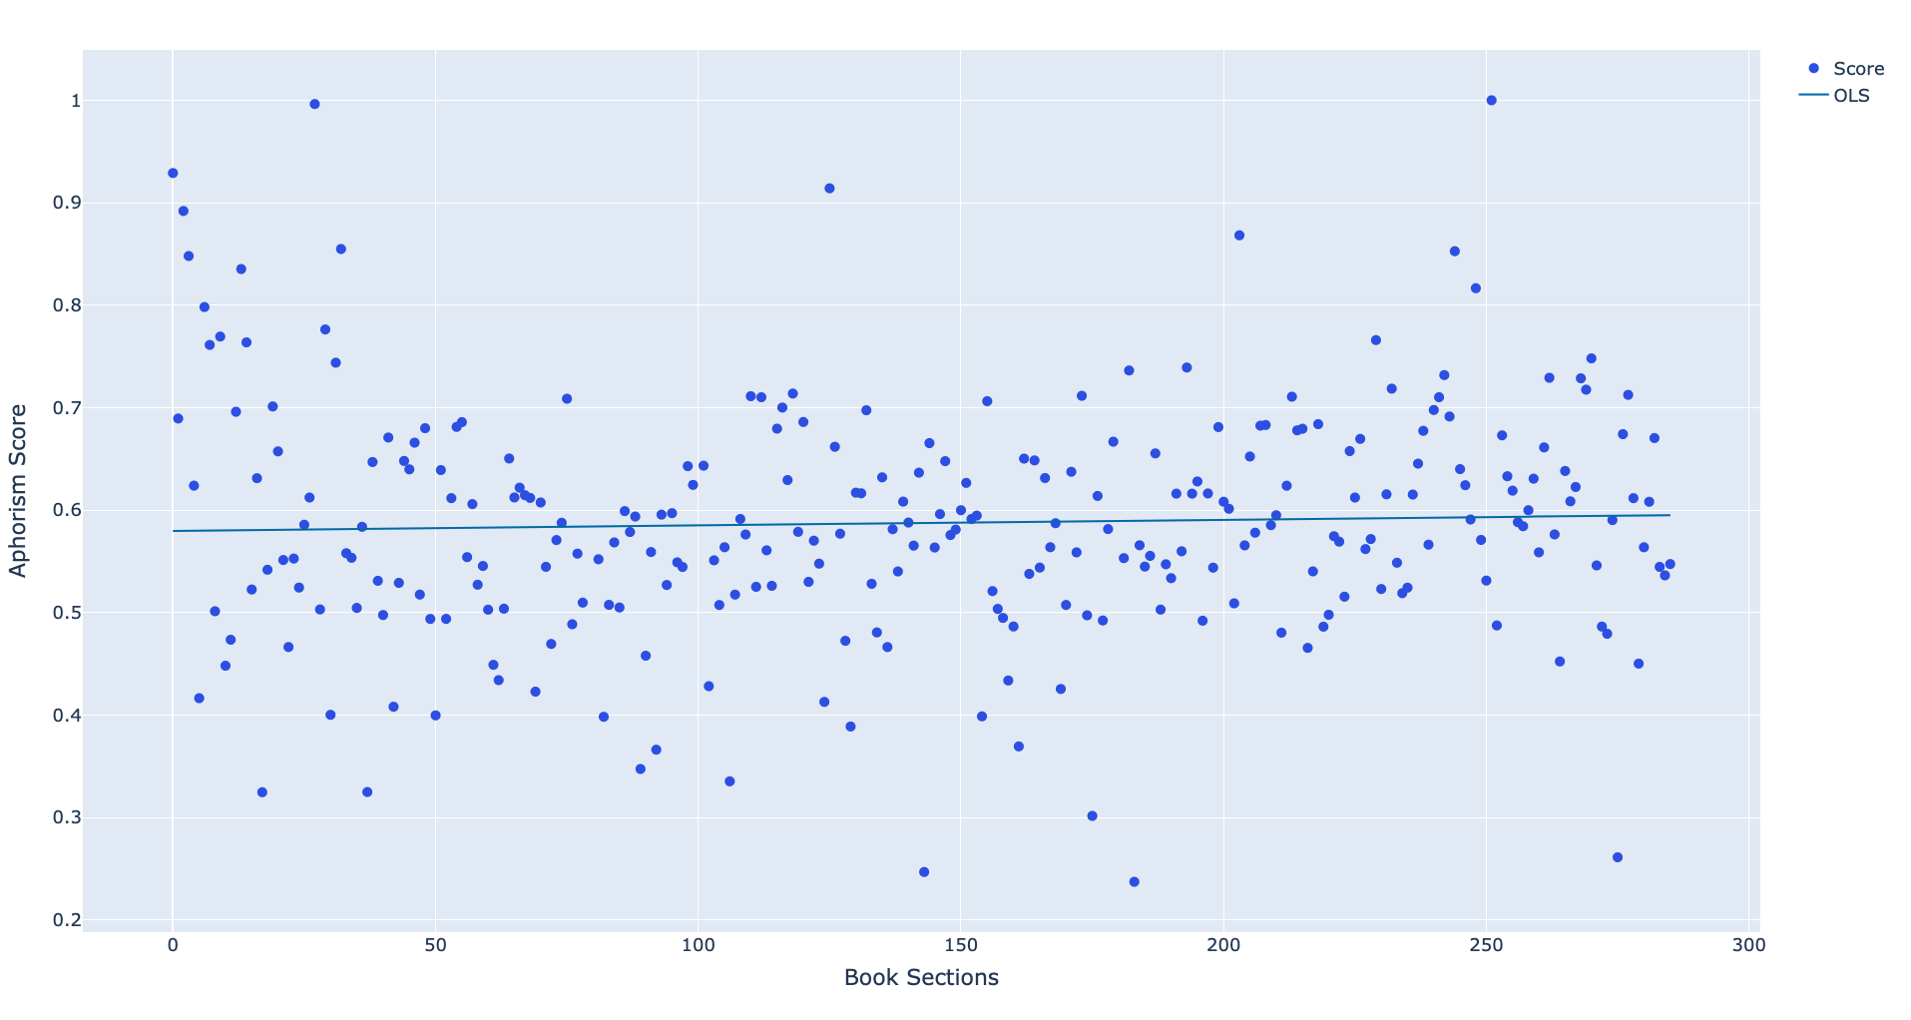
Aphorism scores for Autobiography’s sentences

Slide 7
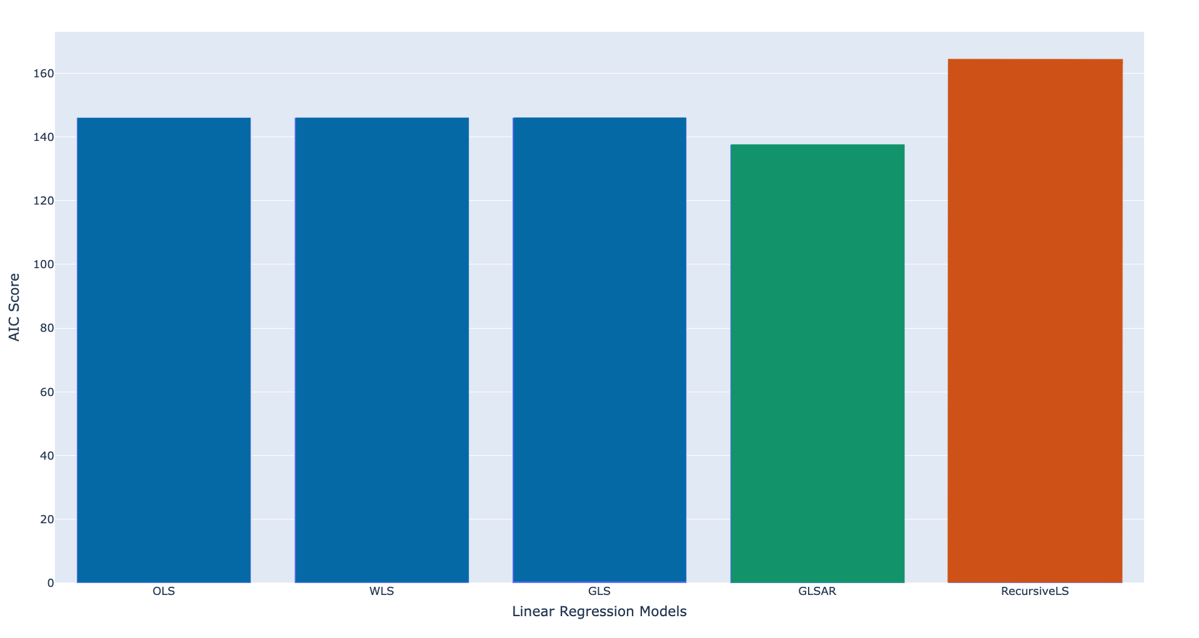
Using AIC to Select Models

Slide 8
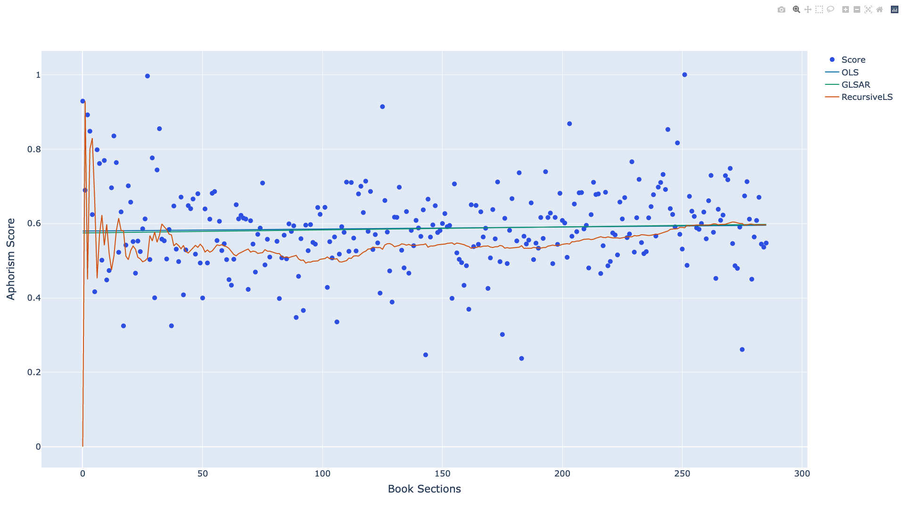
More Accurate Result with Statistical Basis

Slide 9
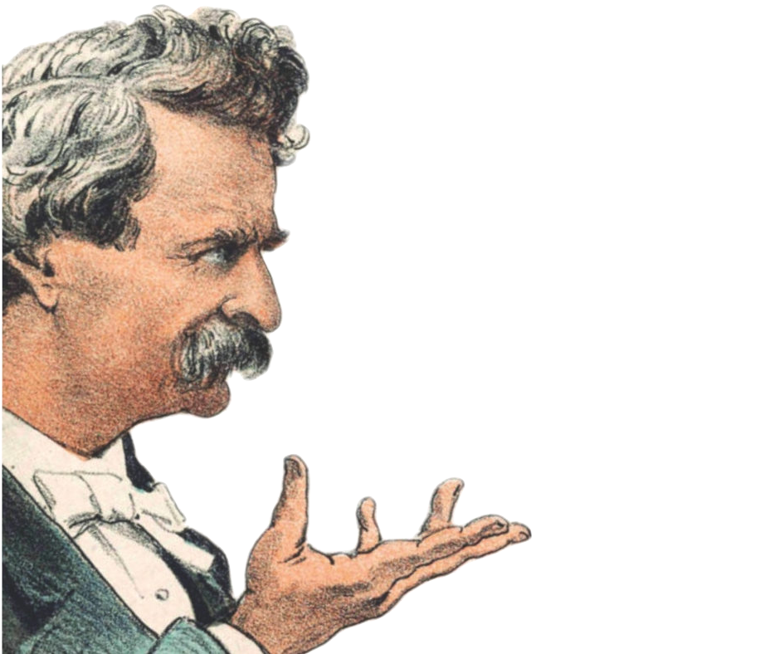
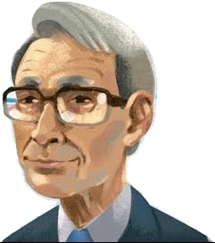
Thanks, and Stay Tuned!
Twitter: jonathangrams
Github: github.com/jarmoza/twain_autobio_modelquality
“Present conditions exhibit curious anomalies.”
AIC suggests Generalized Least Squares
with autoregressive covariance.
That’s what I said!

