Slide 1
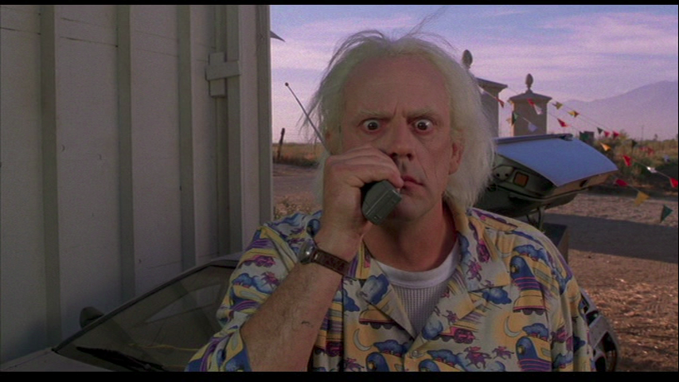
TeloTalkie -
Digital Audio Transmission
Fabian Fischer, Julian Arnold
17th July 2014

Slide 2
Introduction
Mic Amp
Telosb
Telosb
Audio Amp

Slide 3
Introduction
Digital audio transmission between two nodes
Telosb sensor mote
ADC and DAC
Normally used with TinyOS
Microphone amplifier
Audio amplifier

Slide 4
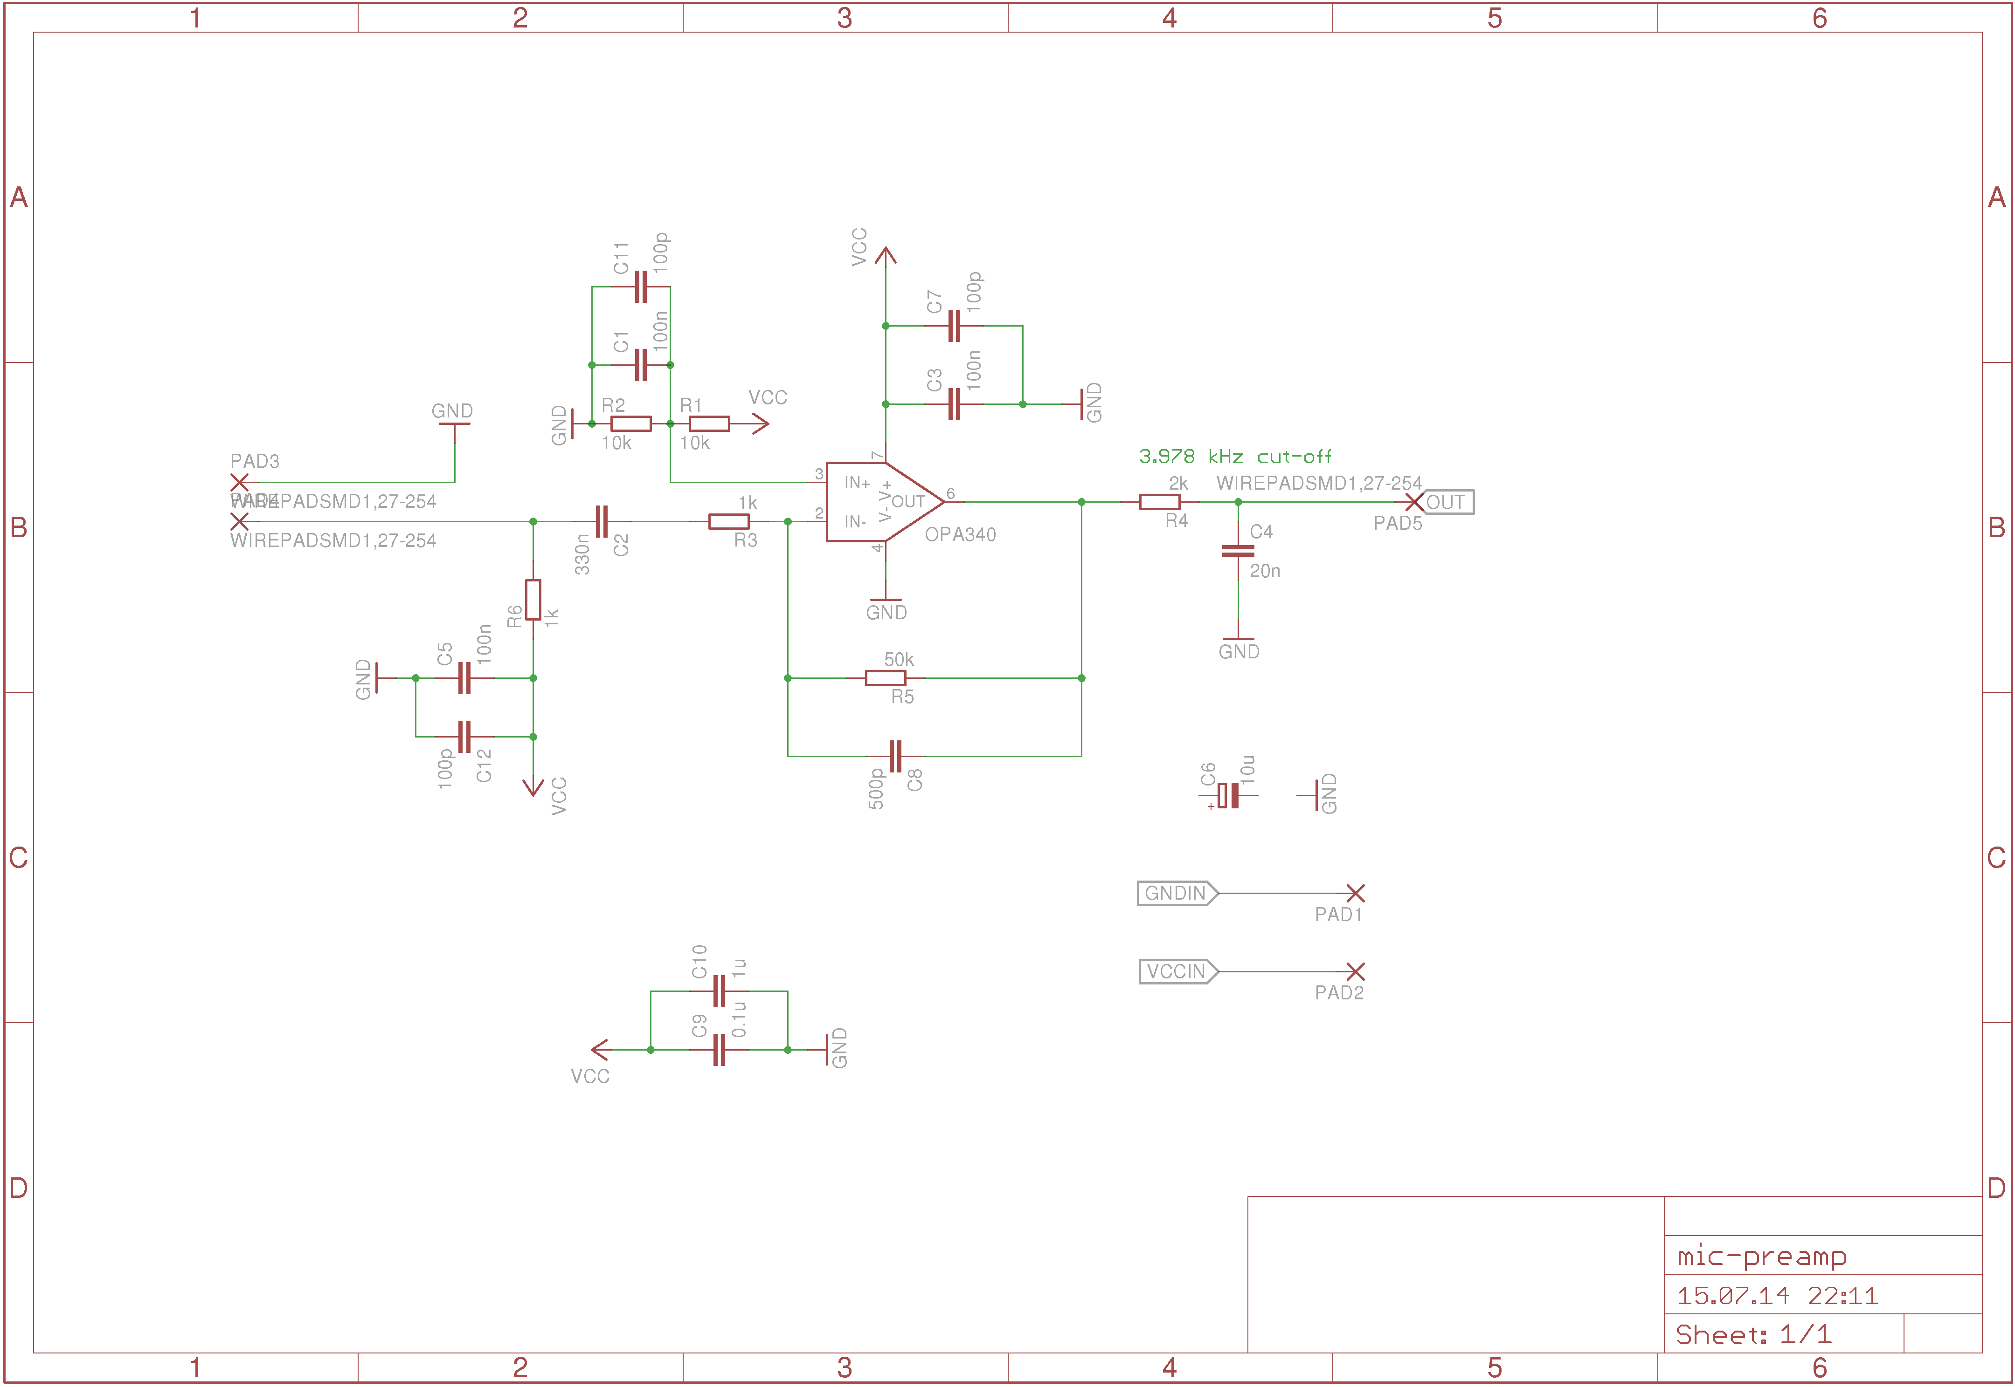
Microphone Amplifier

Slide 5
Microphone Amplifier
Signals coming from microphone very weak
OpAmp circuit to boost signal to match ADC input range
Low pass filter to band limit signal before sampling
Custom PCB
Remember: Active circuit which resides next to transmitter
While transmitting large drops in supply voltage
Disturbed power supply couples into signal path
Amplified by OpAmp

Slide 6
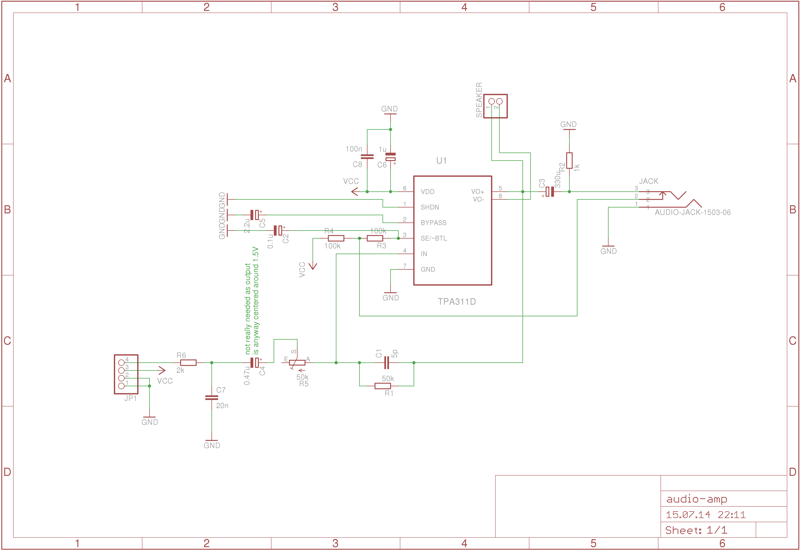
Audio Amplifier

Slide 7
Audio Amplifier
DAC not capable of driving headphones directly
Use audio OpAmp to deliver enough power
Interpolation filter required
Variable gain required
Custom PCB
Support for headphones and speaker
Only mono audio

Slide 8
Software Overview
ADC samples at 10kHz
ADC sample width 12bit
Required data rate 120kbits/s
Data rate not achievable using TinyOS
Do not use operating system at all
Bare-metal programming

Slide 9
Samples Pipeline
Sender
ADC
2x
Buffering
TX
Receiver
RX
3x
Buffering
DAC

Slide 10
Samples Pipeline
Tripel Buffering
At least Double Buffering to prevent underflow
RF Chip has the capability to send data only when channel is clear
The time between consecutive received samples is not constant
We need buffering for under- and overflow
Supports voice effects/enhancement, which needs computation time

Slide 11
Conclusion / Future Work
Good quality voice transmission
Interference fee design challenging
Sensor motes pretty constrained
Add better interference immunity
Add voice effects
Implement control protocol

Slide 12

Questions?

