Slide 1
Intro to Lasers
Jon A 5/2/26

Slide 2
Objectives
Learn basic Inkscape design
Importing a design for cutting
Learn to operate under supervision by an authorized person
Safe Operation

Slide 3
Requirements
Must be supervised by authorized user
Must use only during office hours or open-house.
18+ or supervised by parent/guardian
$20 Donation to Spark
  Please help us, it takes time and effort to keep these machines in good condition.
  We also have to pay for facilities, electricity, etc.
  You will not find a better deal anywhere!

Slide 4
Next Steps
If you become a member, there is additional training to:
  Operate unsupervised
  Maintain and align machine
If you enjoy this, we encourage you to become a member and get actively involved in the community.

Slide 5
Machine Basics
150 Watt CO2 Laser (10.6um wavelength)
Water cooled
Adjustable bed height
Usable Work Area: 550mm x 850mm (21.5in by 33.4in)
Air extraction
Air assist to improve cut quality/move debris away from nozzle

Slide 6
Topics Covered
We will go through a basic design in Inkscape
We will import file into Lightburn for cutting
We will set up cutter for operation
You will laser etch your own cutting board to take home

Slide 7
Possible Workflows
Your Idea
Draw your idea
Inkscape
Lightburn
Laser Cutter
Download
Picture
SVG
SVG, JPEG, PNG, GIF, ...
CAD
Software
Export SVG

Slide 8
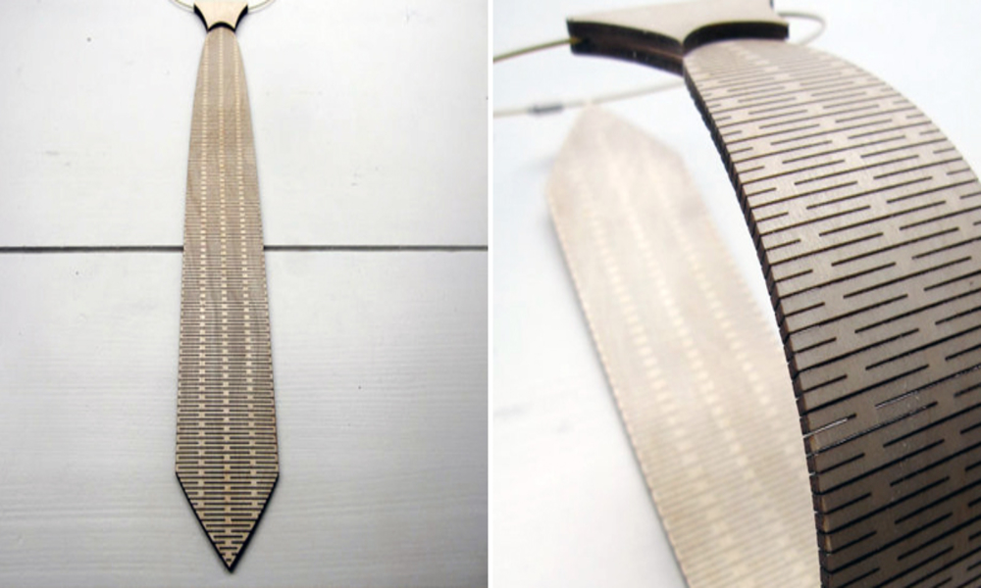
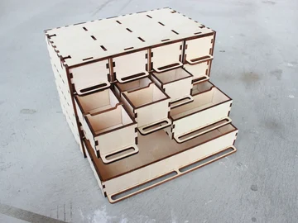
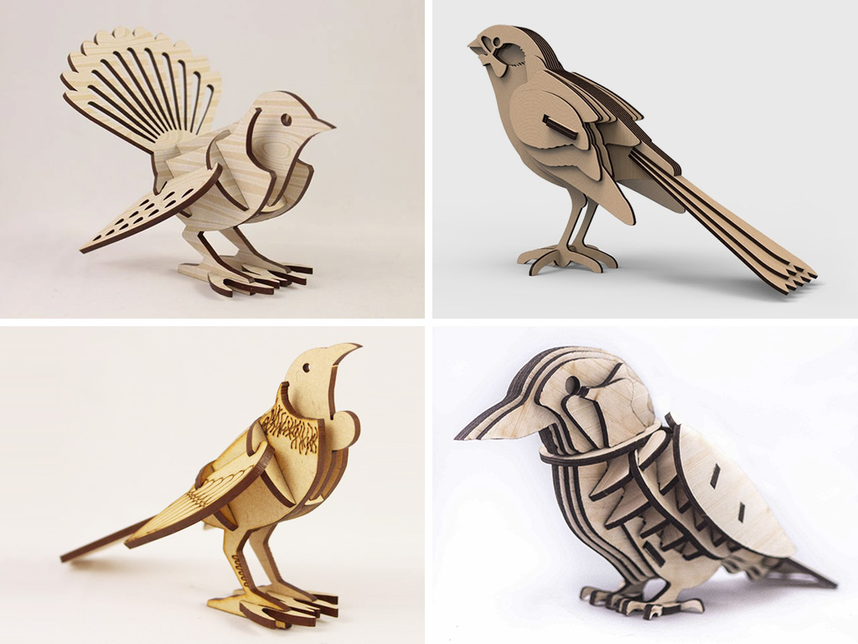
Example Projects (Inspiration)

Slide 9
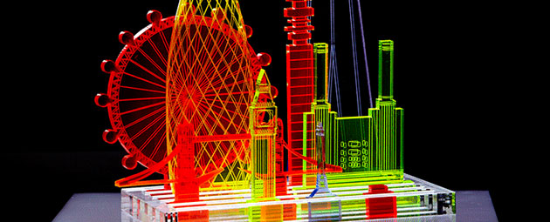
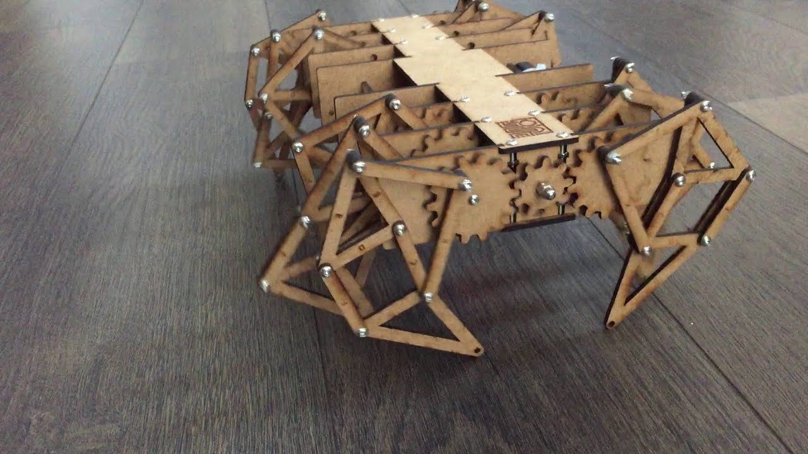
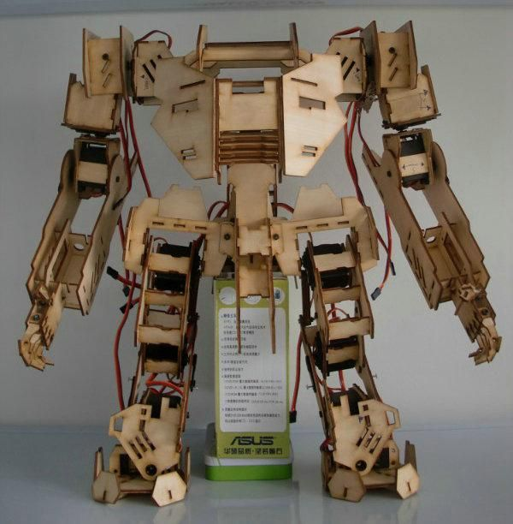
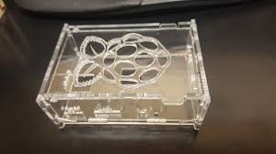
Example Projects (Inspiration)

Slide 10
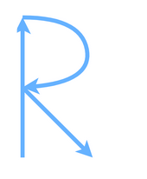

Vector and Raster images
Vectors are paths that the laser will follow
Raster images are “pixels” or points that will be etched

Slide 11
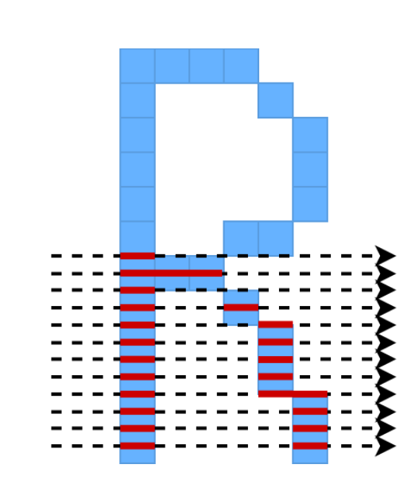
Cutting raster images
Raster images will be converted to black and white
Laser head will “Scan” back and forth pulsing the laser for each dot.

Slide 12
Inkscape

Slide 13
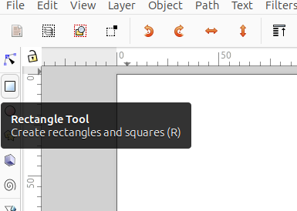
Example design
Rectangle tool to create rectangles

Slide 14

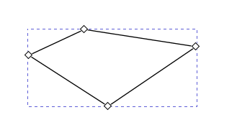
Pencil Tool
Pencil tool for straight lines
Nodes are the endpoints
You can drag control points to make curves

Slide 15

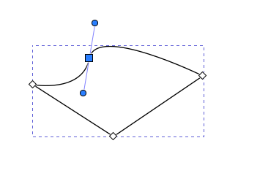
Nodes
Adjust node control points to make curves

Slide 16
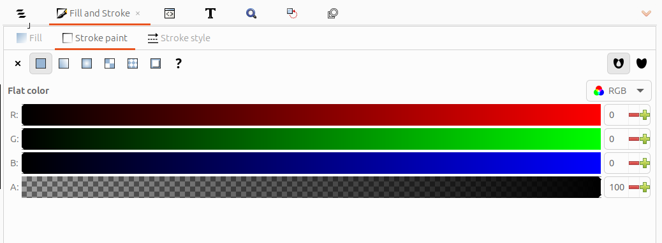

Fill and Stroke
Set color in fill and stroke section
Fill = None for just ouline
Fill color set for “engraving” the inside

Slide 17
Cutting Board Dimensions
Jig locates board at 60mm to the right and 60mm down from the top left corner of the design
Board measures 256.4mm wide and 383.4mm tall.
Decide if you want your board to be portrait or landscape
Make sure your design fits inside the board
You can use the example design SVG as a starting point

Slide 18
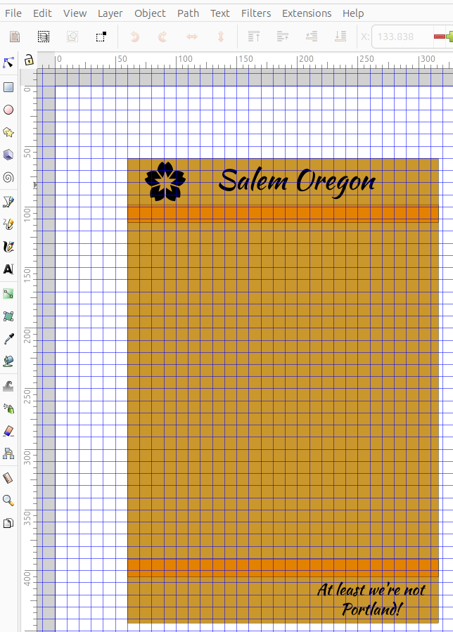
Finished Design
Design starts at 60mm, 60mm
Fits within the cutting board shape
Leaves a little margin at the edges

Slide 19
Speed and power
Each elementy in your design should be given a “color”. That “color” will later determine how the cuts happen.
Generally, each color will be assigned a “speed” and a “power” level. This will determine how the material gets cut.
Generally, higher power = more cutting
Lower speed = more cutting
Etch/engrave : High speed, low power
Cut: Low speed, high power (never above 50%)

Slide 20
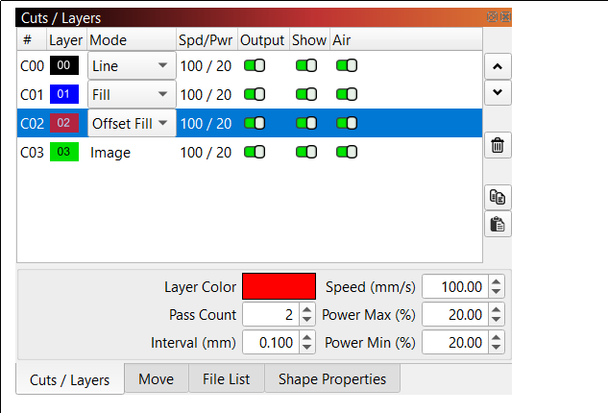
Lightburn
Import Design
Set speed and power settings
Assign each color to a “mode”, and speed/power.
Never exceed 50% power

Slide 21
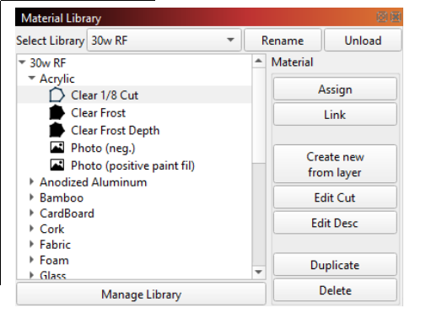
Material Library
You can set the speed/power manually if you want, or you can “Assign” it from the material library.
Make sure your “Cut” layer(s) are last, otherwise your work may fall down before it does the engraving layers.

Slide 22
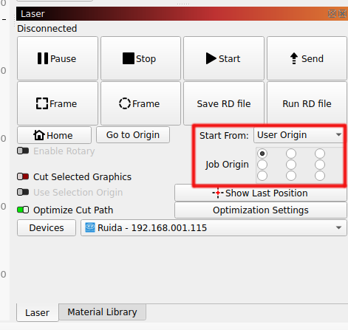
Send to machine for cutting
Once speed and power are set, we can send our design to the machine to cut it.
Start button directly starts machine
Send button sends file to machine. On machine, select file and press start button.

Slide 23
Safety
Materials: Approved
  MDF
  Plywood and most woods
  Some plastics
  UNTREATED leather
  Stone, Glass, Ceramic
Materials: Banned
  Plastics containing chlorine
    Vinyl, PVC, Nylon
  Resins
  Epoxies
  Metals

Slide 24
Safety
Make sure all panels are closed
Beware of fire and flare-ups on materials. Be prepared to extinguish fire with fire blanket
Keep lid closed to avoid blindness
Beware in case lens vaporizes (unlikely but possible), possible Selenium exposure
Be careful not to touch lenses or mirrors as they can bring the machine out of alignment.
Persons under 18 must have parent or guardian nearby

Slide 25
Making the cuts
Put material in machine
Your supervisor will turn on the machine, chiller, and air assist as well as opening the air vents.
Set focal distance between work and laser head.
Send design to machine
Close all doors/panels.
Select File
Press green “Start/Pause” button.
Don’t stare at beam
Don’t leave unattended

Slide 26
Congratulations!
You have now made your first laser-cut artifact.
Everything else is creativity and honing your technique

