Slide 1
Corporate Information Security
Network security

Slide 2
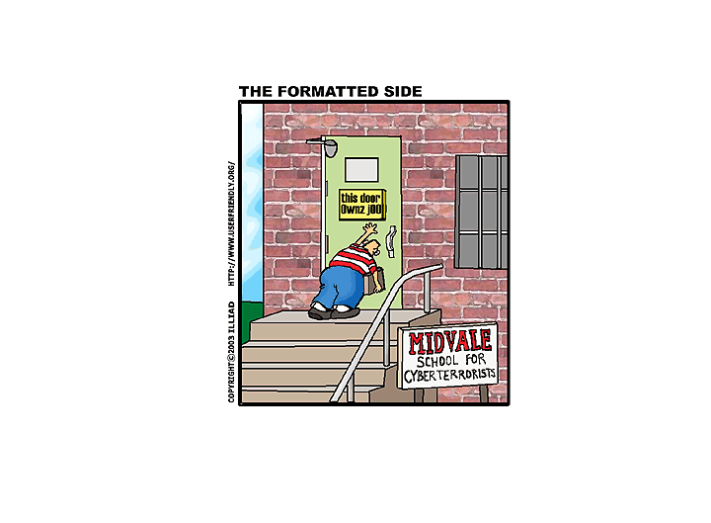
This is NOT what this course is about

Slide 3
Lecture Introduction
In the next two lectures we concentrate on
  Network attacks
  How to build network so that it is secure by default
  Securing the network
  Detecting attacks and misbehavior
  Network security tools and applications

Slide 4
Stage one
Attack

Slide 5
What The Attacker Wants To Do
Attacker is outside the local network
  To get inside the intranet
  0wn those computers that are visible to outside
  Knock your servers out with DOS or DDOS
  Spoof or inject some of your services to outside customers
  Listen and manipulate your outside traffic
  Get your users to execute backdoor or other trojan
  Fool your users with E-Mail or other social engineering
  Get your users to visit trojanized web sites

Slide 6
What The Attacker Wants To Do
Attacker is inside the local network
  Own one or several computers in the local network
  Access confidential information (files,email,intraweb)
  Leak the stolen information back to attacker
  Listen traffic in the local net and capture information, sessions, cookies, etc
  Corrupt, delete or modify information or break systems
  Join the computers into botnet
  Erase traces of attack

Slide 7
What The Attacker Wants To Get
Just to own the system
  To use for further attacks (step stone or botnet)
  Use for making money
Deface the web site
Attack your customers
Credit card information or other customer records
Revenge or otherwise express his opinion
Confidential company documents, source code
Anything that can be used to make money

Slide 8
What Attacker Needs To Succeed
A way in
  Server vulnerability
  Vulnerable network device
  Server misconfiguration
  Vulnerable client visiting hostile web site or other service
  User visiting a web site or other resource that has exploit
A way to access things in compromised host
A way to move to other hosts
A communication channel for commands, additional attack components and downloading whatever he is stealing

Slide 9
Who Is Your Enemy
Hobbyists, activists (criminals in training)
  “Scipt kiddies” trying to break in out of curiosity using ready made tools or public information
  Small minority of total attacks, but usually most visible
Professional criminals
  Attack anything that can be converted to income
  Either target you directly, or just want to use your systems
Corporate spies
  Mostly state actors (China, USA), intent on commercial gain
Malware (automated enemy)
  Bots, worms, trojans, etc that do the criminals dirty work

Slide 10
Typical Attacks That Have Made News
RSA breach and security token keys being leaked
  Attack over trojanized document file
  Infected document dropped a backdoor for further access
  Used as stepping stone to do industrial espionage to RSA clients
Sony Playstation network breach
  Massive leak of customer information
  Classical attack to unpatched chat server and from there onwards
Stratfor customer information leak
  Yet another leak of customer information and credit card details
  Done over SQL injection to stratfor server
  No onwards attack needed, public server contained the goods

Slide 11
Stages Of Attack
Recon the target
  Find out what targets are visible to Internet
  Find alternate routes to network
  Find out what OS/Software versions are installed
  Find vulnerabilities or other weak links in defenses
Attack the system
  Get into any system in the target network
  Continue to further targets
Get the loot and erase traces
  Find out any log files, and erase all traces of attack

Slide 12
Finding Information About Target Network
Get DNS information
  Misconfigured DNS can reveal all host names in system
    Anything that has 'test' in it's name is interesting target
    Especially effective against internal DNS
    DNS names also usually reveal good targets for DOS
Map the network
  Send Ping packets to local address range and see from which addresses you get answer
Search network for misconfigured proxy servers
Scan the local network for unpatched services
Dig Google, Shodan and other public sources

Slide 13
Snooping Over DNS
With zone transfer attackers get to read internal names
  So of course you want to prevent that
But just being able to query over DNS they can use
timing to see which domains are in cache
  http://304geeks.blogspot.co.uk/2013/01/dns-scraping-for-corporate-av-detection.html
So what good this does?
Well for one attackers can figure out what AV you are using
Also any other external service is obvious
Any AV can be circumvented provided you know what target is using

Slide 14
Port Scanning
Goes through range of addresses looking for services
  Sends connection requests to ports in target
  Listen target answer
  Usually services are very open on what they are :)
Used for getting a map of network
  What services are available and where
  Which server programs are used and on what versions
A very noisy but still commonly used method

Slide 15
Port Scanning Example
Probing a port with telnet (so you see the result)
Telnet www.drivermuseum.com 80
Trying 212.226.165.105...
Connected to www.drivermuseum.com.
Escape character is '^]'.
<!DOCTYPE HTML PUBLIC "-//IETF//DTD HTML 2.0//EN">
<HTML><HEAD>
<TITLE>501 Method Not Implemented</TITLE>
</HEAD><BODY>
<H1>Method Not Implemented</H1>
helo to /index.html not supported.<P>
Invalid method in request helo<P>
<HR>
<ADDRESS>Apache/1.3.26 Server at drivermuseum.com Port 80
</ADDRESS></BODY></HTML>
Connection closed by foreign host.

Slide 16
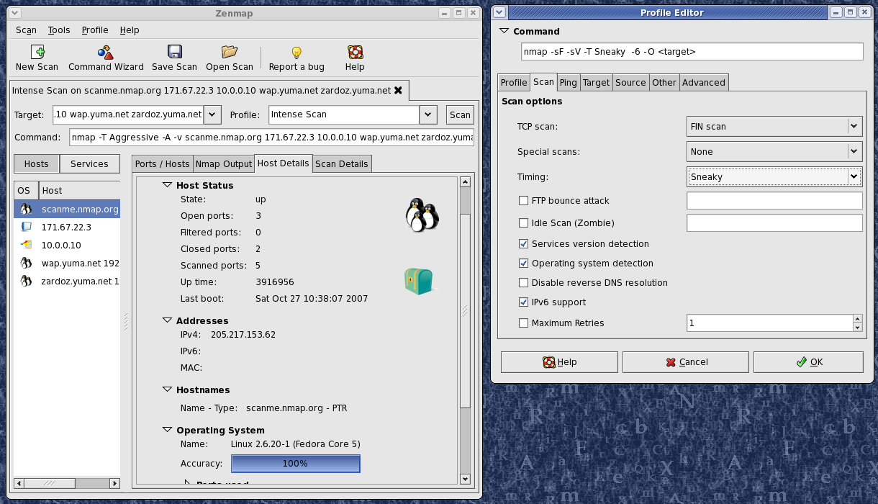
Nmap port scanner
Advanced port scanner
Creates a map of the
target segment
Lists all detectable hosts
and their open services
Can be very noisy, but
stealthy when done
over time
Or use throwaway
host for aggressive scan
Any big org is going to get scanned all the time anyway
http://nmap.org
Image © www.insecure.org

Slide 17
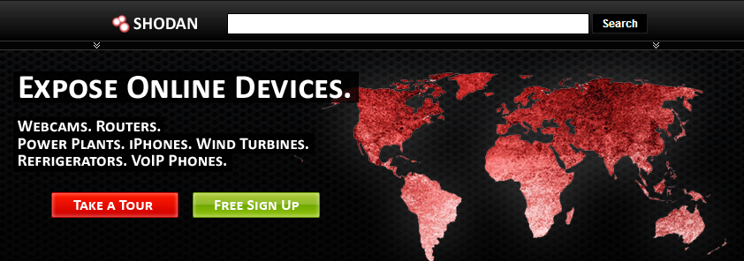
Obverse Your Target From Distance
Port scanning is a dangerous technique because it leaves tracks in the routers and firewalls
So what if attacker could find out things about your network from public source
  Then he doesn't even touch your network-> no traces!
  It would be nice if there is a search engine for such work

Slide 18
Shodan
http://www.shodanhq.com/
Shodan gives what Google doesn't want to
Shodan indexes systems, services, versions
With right searches you can find just about any
misconfiguration or vulnerability that can be indexed
https://www.defcon.org/images/defcon-18/dc-18-presentations/Schearer/DEFCON-18-Schearer-SHODAN.pdf

Slide 19
Surely This Kind Of Thing Is Harmless?
Gemnet a subsidiary of big Dutch operator KPN was hacked
Gemnet is a CA, their business is issuing SSL certs
Attackers were able to access information in backend DB,
but were not able to issue own certs
The attack happened over open PHP/Myadmin portal, which allowed database access over web
http://webwereld.nl/nieuws/108815/weer-certificatenleverancier-overheid-gehackt.html

Slide 20
Vulnerability Scanners
Advanced port map tool that knocks on ports at host and finds out who's answering
  Most services tell their name and version at connect
Scanners are used to detect vulnerable services and to get other host information
  Scanner gets the service version numbers and compares them to database of vulnerable services
Scanners are used both by hackers and system administrators

Slide 21
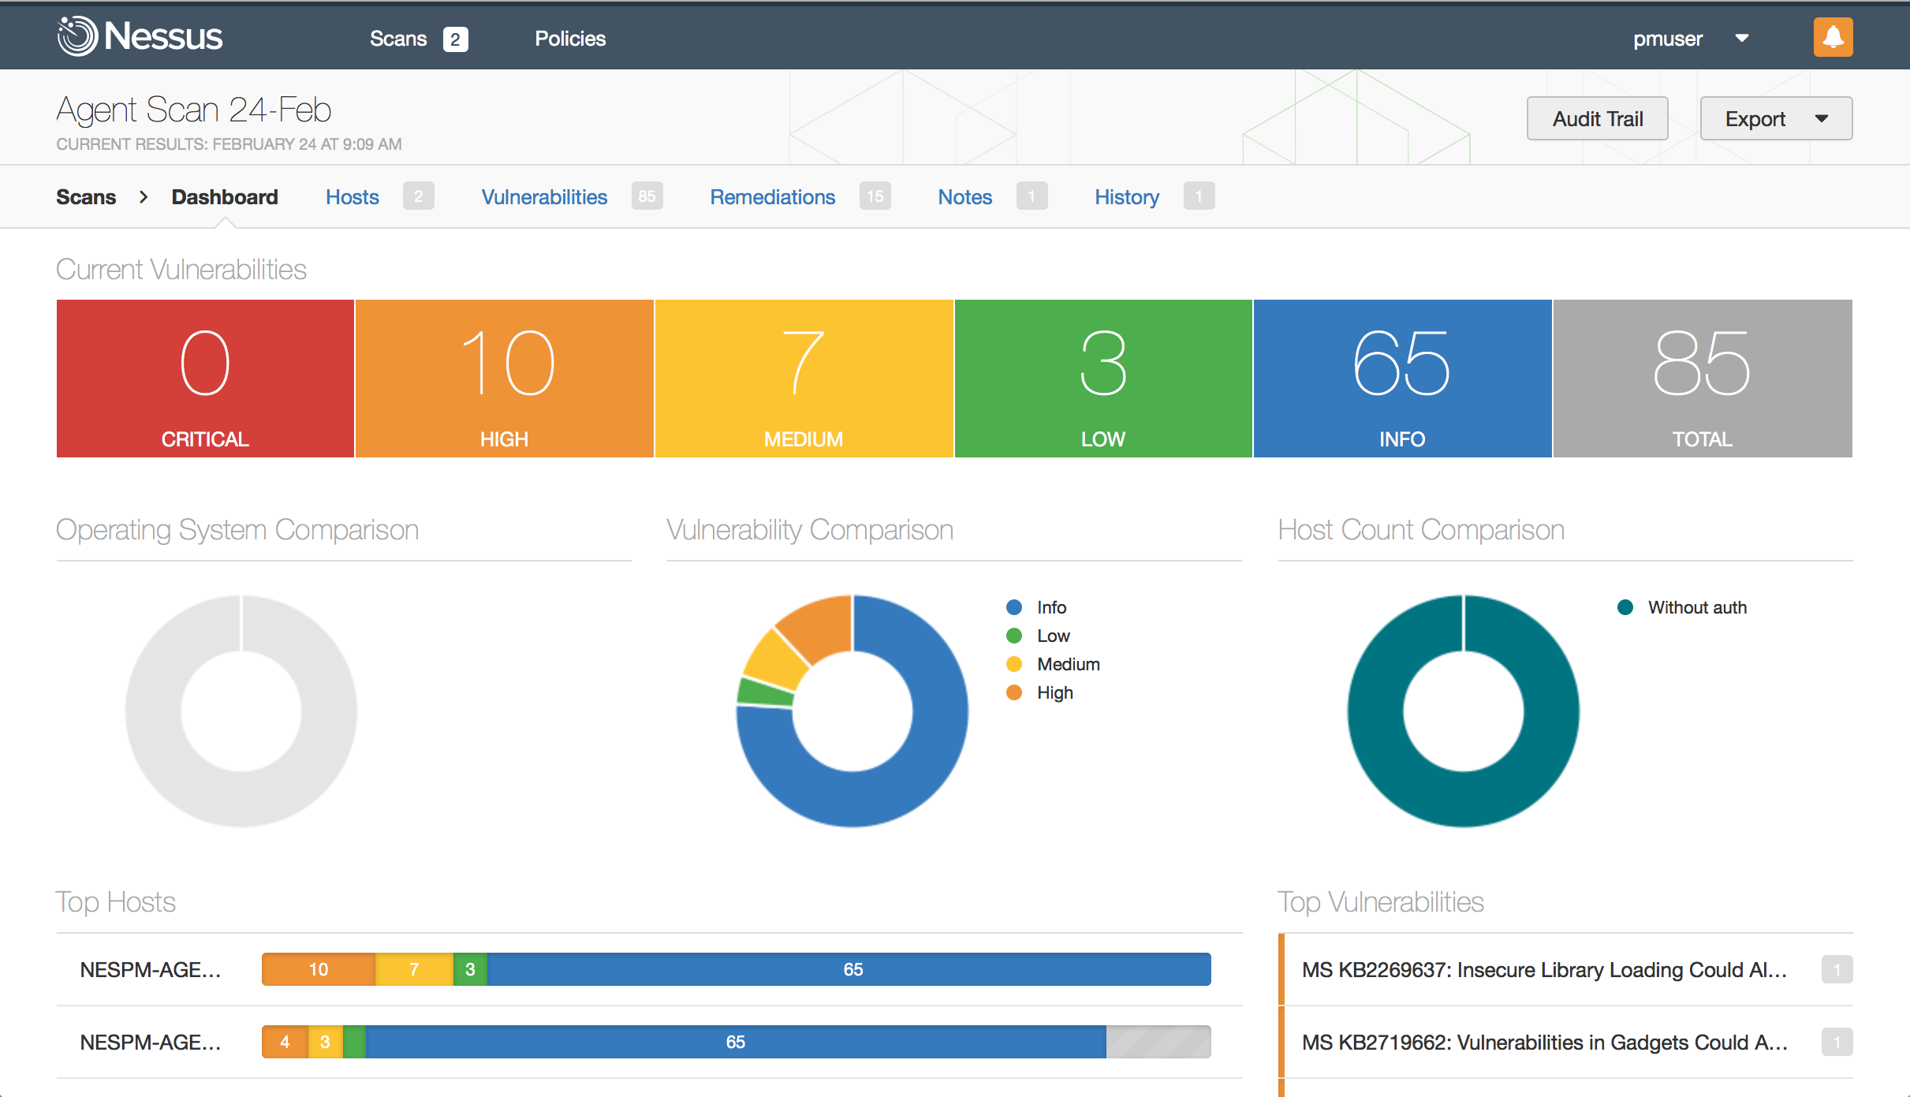
Nessus
An modular scanner
to which new exploit
detections can be
added as modules
Usually it takes only
couple days for a new
hole to be added into
Nessus database
Image © www.tenable.com

Slide 22
F-Secure Karhu
F-Secures own vulnerability scanner
Originally made by Nsense who got acquired by FS
Unlike Nessus, F-Secure does vulnerability audits
as consulting service
So we do use the tool ourselves to provide a service

Slide 23
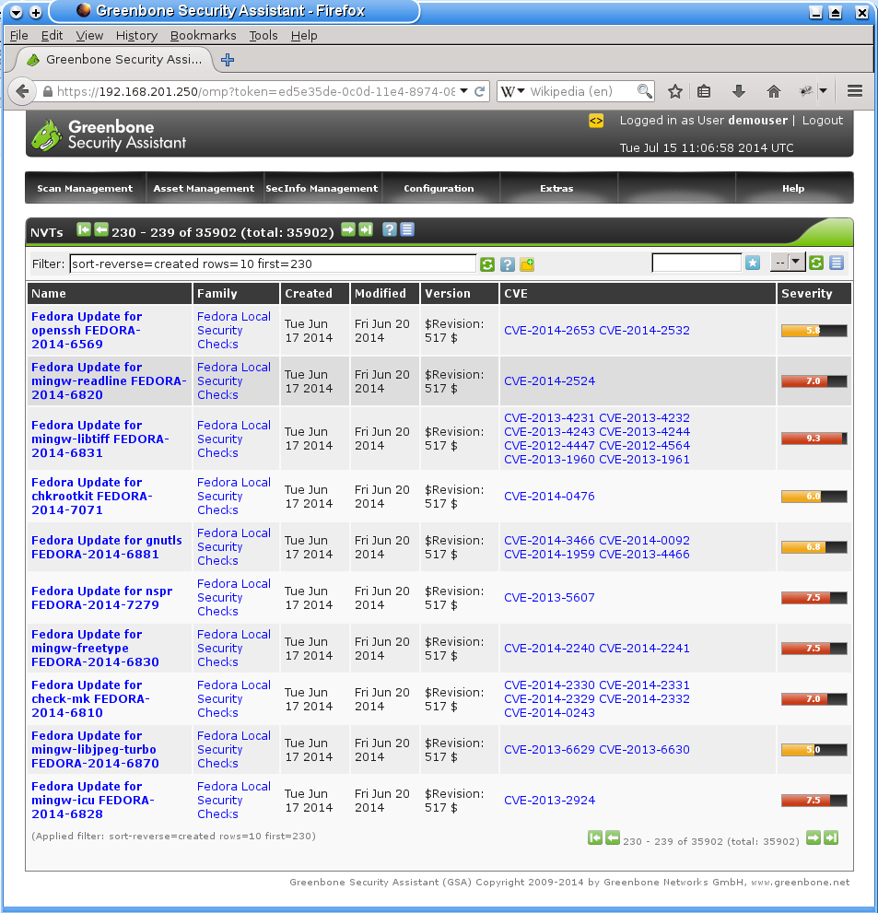
OpenVAS
Free alternative to Nessus
Has rather similar capabilties
Use at least OpenVAS

Slide 24
Rapid7 Metasploit
Metasploit is a combined vulnerability discovery and penetration testing (=attack) toolkit
With metasploit attacker can quickly find known vulnerabilities, and almost every vulnerability has metasploit module for easy exploit development
In practice metasloit is useful only for very badly defended targets
But it is still very educational, and of course if the system totally sucks it will work like a charm
http://null-byte.wonderhowto.com/how-to/hack-like-pro-getting-started-with-metasploit-0134442/
http://www.rapid7.com/products/metasploit/editions-and-features.jsp

Slide 25
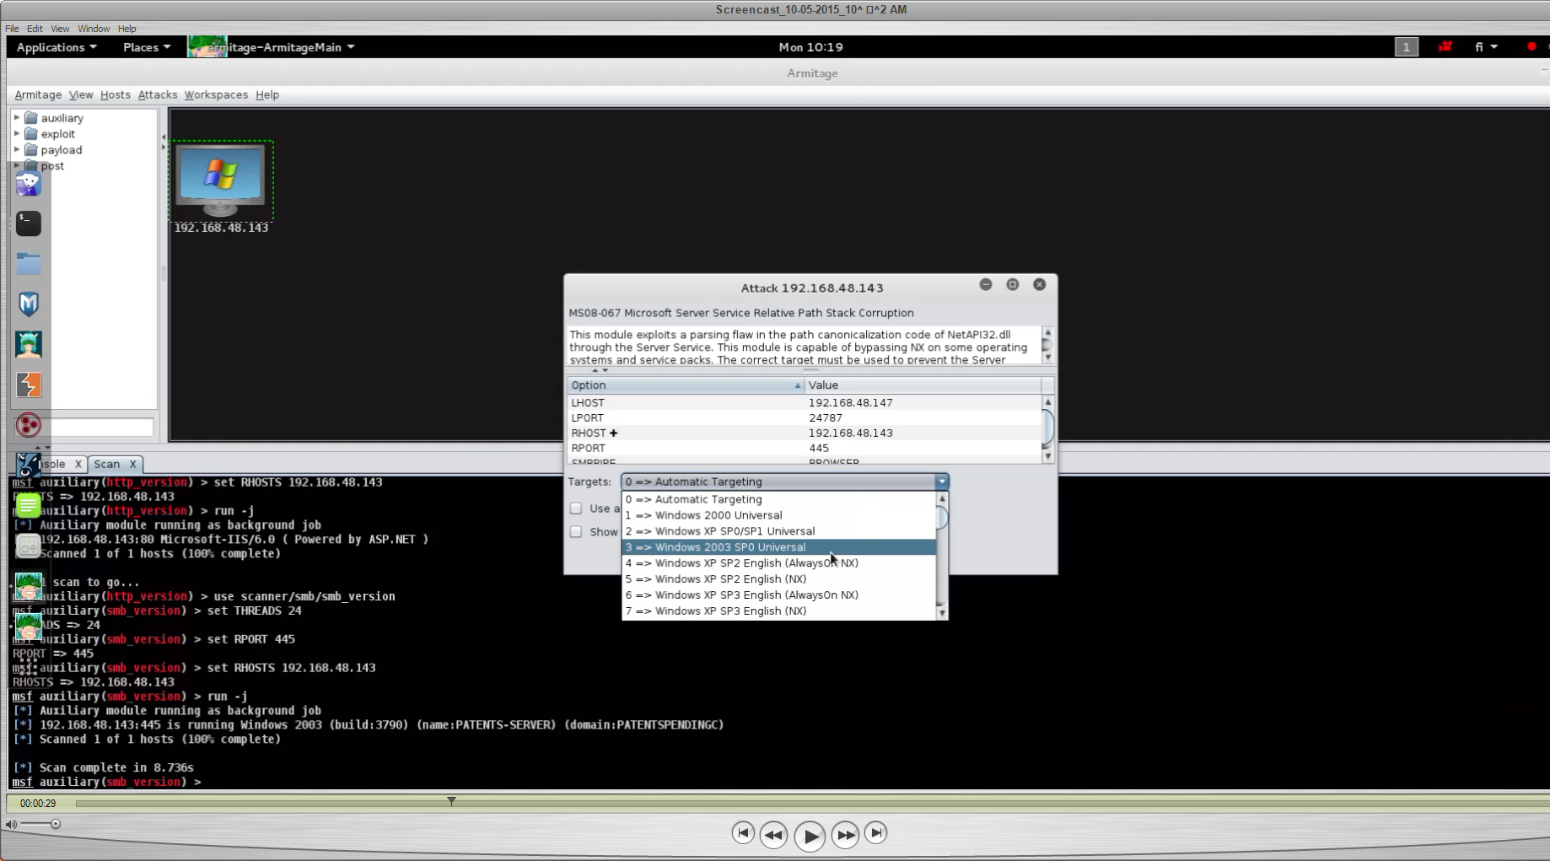
Metasploit With Armitage UI

Slide 26
Web Vulnerabilities
Operating systems are getting better
Currently the most commonly used method for attack is web vulnerabilities
That is a vulnerability or security misconfiguration that allows attacker to execute code on a web server
And from there continue to internal network

Slide 27
Social Engineering
Attacks the human element of the system
  Obtain user name and password from user or admin
  by deception
  Get details from user to be used for impersonation attack
  Or just get user to tell what software he is using
  Also many other schemes are used
    Fake warning or patch Emails that contain virus or trojan
    Web pages with misleading addresses WWW.LlNKEDlN.COM
    Fake customer service remote access links, for example using Teamviewer or other legit RA software

Slide 28
War walking
War walking (or driving,flying, etc)
  Use powerful WIFI (WLAN) antenna and scanning software to locate unsecured WLAN networks
  For example even if company doesn't have WIFI network, some employee may still use it at home and has a bad config

Slide 29
After Recon: ATTACK
Now the attacker has gathered enough info
  It's time to attack the system
  Usually at this stage the attacker knows exactly what attacks to use and where
  The attackers goal is to get in with minimum moves
  And minimum fuss
  If attacker is good enough, you never know that you were hit. Until it is too late, if you ever find out that is.

Slide 30
Attack Types
Use open service/account or know password
Listen/manipulate network traffic
  Get interesting information just by listening and recording
  Manipulate traffic (injection, playback, corruption)
  Hook application or update downloads and inject backdoor
Exploit a vulnerable service or network device
Spoof service or host to get past authentication based on host identification
Find way around the security measures
Denial Of Service, knock em out

Slide 31
Using Holes In The System
Many times no actual 'hacking' is necessary
  Find open service that has no authentication
  Find service that has default password
  Find router or switch that has default password
  Find leaked password from some dump
Exploiting weaknesses in service authentications
  Try to access content directly bypassing authentication
  Know addresses of 'deep' pages and access them directly
  Many web pages store session information in the hidden fields of forms, that can be easily manipulated.
  Find public FTP that allows anonymous upload

Slide 32
Exploiting Found Vulnerabilities
Attacker has found service that has a vulnerability
  For example unpatched version of MS IIS or Apache
  Or unpatched web application, such as Wordpress
  Attacker finds an exploit program f.ex from exploitdb.com
  Or makes his own
  Attacker executes the attack program
    Depending on the service attacker either gets direct root access or by some non-root account and he needs to find way to get root account (further exploits)
  After successful attack the attacker has control over the system

Slide 33
Sometimes The Target Is Your Customers
Council Of Foreign Relations website was hacked
Instead of trying to find something in server
attackers injected exploit payload to the site
Thus anyone who visited the site was under attack
CSR site is favored among US Political heavy weights
F.ex Hillary Clinton
This type of attack is called watering hole attack
http://freebeacon.com/chinese-hackers-suspected-in-cyber-attack-on-council-on-foreign-relations/

Slide 34
Get User To Help In Breaking The System
If Computer system doesn't have vulnerability there's always the user
  Get password from user with social engineering
  Get user to disable security on the target
  Get user to install spyware/backdoor sent over E-Mail or web
  Get user to visit web site that uses vulnerability in the browser
  Send user document that contains exploit and installs a backdoor
  Fool user to send the information attacker wants
Today most breaches happen by exploiting workstations over email or web based exploits

Slide 35
Internet Of Things
Sometimes the target is not a server or workstation
Anything goes as long as it is exploitable
  Router, especially cheap home router
  Printer
  Smart TV, network player
  TCP/IP enabled security camera
  Anything which has general purpose CPU and TCP/IP
For example several DOS attacks have been done with compromised home routers and other appliances

Slide 36
One Computer Taken Over Now What?
What attacker can do depends on the host
A host may contain interesting information by itself
Any host can be used as step stone for further attacks
  Listen the local traffic to catch authentication information
  Many times security in the local network is quite lax. The only firewall may be the one protecting from internet
  Baked Alaska network: Hard on the outside soft in the inside
  On most networks you can remote login to any other host
Many computers contain interesting credentials
  Domain admin may be found from the local cache

Slide 37
Spoofing
Spoofing is a general name for forging address information to fool the receiver about sender
IP spoofing
  Sending packets with forged source IP address
  Difficult for TCP trivial for UDP and other sessionless protos
  Blind attack outside own subnet
ARP spoofing
  Fools the receiver to believe that the spoofed IP address has the attackers MAC address instead of correct one

Slide 38
Spoofing
DHCP spoofing
  Used when new host requests IP address
  Attacker sends reply to host before the real DHCP server to give own answer to host
DNS spoofing
  Attacker compromises DNS tables in the target
  Requires either hacking of the router/DNS resolver or poisoning the local DNS cache with false reply to query to the authoritative server
  Nowadays known as Pharming or DNS poisoning

Slide 39
What Spoofing Can Do
Spoofing is very useful when you are inside target network
  Get access into systems that rely on sender identify as authentication
    FTP accounts, Rlogin and other services that 'identify' by IP address
    Poorly protected intra servers
    Shared network drives
  Hijack existing session to take control of it
  Send fake email or other communication that cannot be traced
  Use innocent system as relay or amplifier for DDOS or other attack

Slide 40
WLAN Evil Twin Attacks
Evil twin attack is based on setting up access point that has identical SSID to company access point
Evil twin waits for victim to search for access points and accept new connection because the name is familiar
Usually used to fake pay for use access points to capture login information or credit card numbers
But how about targeting company laptops that are connected by cable, but still look for WLAN connection
If connection is made attacker has network connection to target, which with any luck has default routing or can be exploited

Slide 41
Spoofing and Problem Of Trust
Spoofing is successful because most companies implicitly trust their internal “secure” network
  On many protocols the IP address or DNS name is taken as host identification
  But as seen on previous slides, these information can be forged
  So the host information cannot be trusted
The solution is to require extra authentication
  Don't trust the packet header, also check the source interface
  User authentication with passwords or kerberos
  Host authentication with host certificates, or other reliable method

Slide 42
Sniffers
Passively listen physical or wireless network
  Use network adapter in mode that it receives all traffic
  Then filter out the stuff that you find interesting
Any plaintext connection is a goldmine of information
  In many protocols passwords are in cleartext or are easily crackable, so attacker can get user logins
  While connections over internet are SSL protected, it is very typical that internal communication is totally insecure
  Also as almost everything is web based, you don't need to crack the password, just steal the cookies
  Also many clients are very 'chatty' and reveal a lot of information

Slide 43
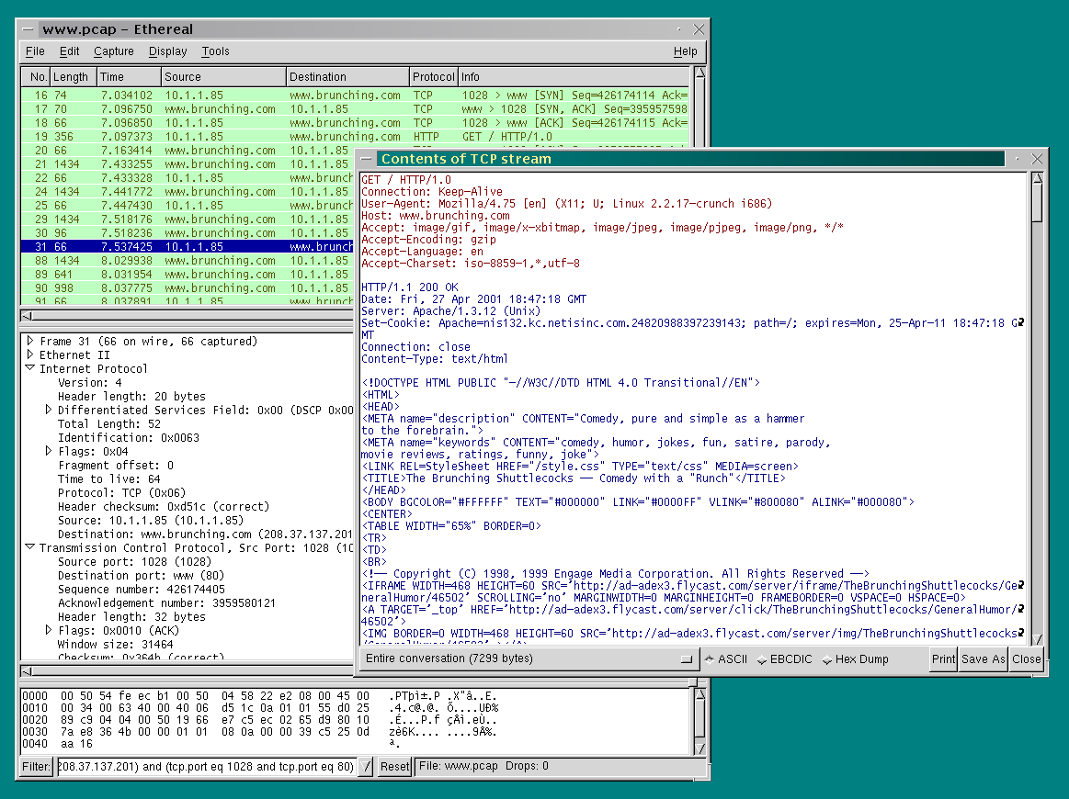
Image © www.wireshark.com

Slide 44
Man In The Middle
MITM means manipulating traffic between victim and server
Most classic case would be redirecting user to a fake site instead of real one
But content injection is currently in fashion by NSA,etc TLAs
  Modify downloaded binaries to contain a backdoor
  Add exploit to otherwise clean web traffic
  Show authentication dialog to fool password out of user
  Or just about anything else imagination gives to

Slide 45
Traffic Injection
Attacker gets MITM access
  Pineapple WiFi evil twin
  Lawful interception
  Chinas great cannon
Attacker injects traffic
  Exploit into any web page
  Evilgrading trojanize
  any unprotected software update
  Javascript injection to use victim as
  DDOS bot

Slide 46
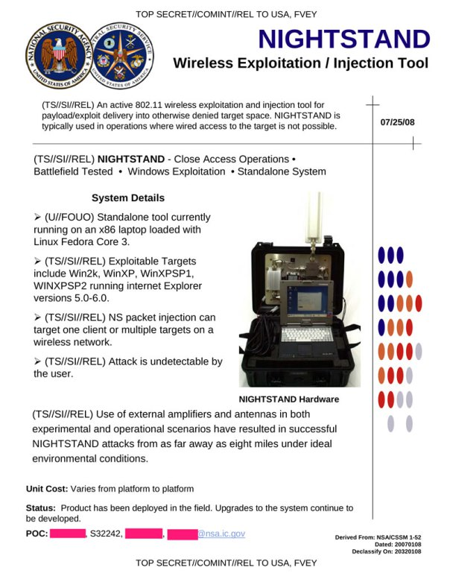
Hard Core Evil Twin

Slide 47
Communicating Back To Home
Attacker needs to be able to command the host
  Compromised host is no good unless it can be commanded
  Communication is also needed for uploading attack components and downloading stolen info
Communication happens over normal protocols and ports
  HTTP, IRC, SIP, ICMP, P2P
  Bots use either fixed IP/DNS or fast flux where contact address changes all the time
  Bots contact C&C node to get instructions and upload stolen info either to C&C or separate dump site

Slide 48
Denial Of Service
DOS attack aims to prevent anyone from using the target service
  The aim is not the penetrate the system, just to take it down
There are two types of DOS
  Malformatted attack
    Send corrupted packet/request that crashes the target
  Flooding attack
    Send perfectly valid requests, but at such numbers that the target is overloaded by them

Slide 49
Malformatted DOS Attack
Malformatted attack relies on a vulnerability on the target service
  Typically the target cannot handle packet that is corrupted in a special way
  Instead of trying to exploit the vulnerability the attacker sends corrupted packet that crashes the service
  Example: Ping Of Death attack sends ICMP ECHO (ping) packet that is larger than maximum allowed.
    The result is target crash or reboot
    Effective only on really old systems, but good example

Slide 50
Flooding DOS attack
The traffic sent by the attacker is perfectly valid
  There's just too much of it
  Bandwidth saturation
  Resource saturation
  System or application crash
Flooding attack can be simply sending just session initiations at enormous rate
  Leaves server with huge amount of unclosed sessions
  Each open session consumes system resources
Or the attacker a actually maintains session and just overloads the server by downloading

Slide 51
DDOS Amplification
Amplification attack makes use of spoofing and bad configs
Attacker sends a forged request to a DNS or other server
  The request is an UDP packet with forged return address
  The server will respond to the request
  The response will go to DDOS victim!
Usually the request is much smaller than response
Thus attacker can get up to 1000X amplification to traffic volume
Also the DDOS origin systems will stay hidden
http://www.watchguard.com/infocenter/editorial/41649.asp

Slide 52
Stage two
Attack
Defense

Slide 53
Defending The Network
Lets try to figure out some ways to defend the network
As with building security everything starts from the design and layout
  Limit access so that hosts have access only to where they need to
  Limit the user and group access, so that if attacker manages to get in with some user account, the exposure is limited
  Control the network traffic, packets need to travel only from source to destination, no need to be visible elsewhere
  Good security design has many layers, so that breaking one wont compromise everything
  Assume that attacker always has control of at least one workstation and plan your security by that

Slide 54
What Is Needed From A Secure Network?
Confidentiality
  Only the sender and receiver can see the communication
Integrity
  No one can tamper with communication
  No one can tamper with hosts of network devices
Availability
  Network can provide the services to users and customers

Slide 55
What Is Needed From A Secure Network?
Auditing/Monitoring
  Normal state of network is known
  There is monitoring that can detect anomalies
  Log history of network activity is being maintained
Access control
  All participants in network are reliably identified
  Workstations can access only those servers they need
  Users have access to only those network resources they need

Slide 56
How To Ruin Attackers Day
Prevent Attacker from getting in
  No way in, means no way to attack
Prevent attacker from moving to other hosts
  Even if attacker gets in the the damage is limited
Prevent attacker from communicating with exploited hosts
  If infected host cannot communicate outside, it is relatively harmless
  No communication means, no commands, no stolen data
  Assuming that attacker is not using some exotic C&C method

Slide 57
Building Network So That It Is Easy To Secure
Cheapest way to make secure network is build it to be secure in the first place
Most important security decisions are about network architecture, layout and what traffic is allowed
  Divide network into isolated areas
  Allow only necessary access between areas
  Preferably control the traffic at host level
  Allow only the traffic that is needed, block the rest
  Users should have easy access to what they need
    But no access to want they don't
  Remember, access is easy to grant but hard to revoke!

Slide 58
Tools To Build Secure Network
Trained users and administrators
Properly administrated user and group permissions
Up to date operating systems and services
Well configured services, including web applications
Well planned network layout
Properly maintained switches and routers
Network filters (Firewalls and content scanners)
Tunneled connections over VPN, SSH,SSL,etc
Intrusion Detection Systems
Anti-Virus

Slide 59
Network Implementations From Outside Point of View
Open network Masked network
Public IP
Public IP
Router
Fully open
Everything can be seen
and attacked from outside
NAT Router
Public IP
Private IP
W
W
W
W
W
W
W
W
MASKED with DMZ
Hosts in the intra are invisible to outside
Thus they cannot be targeted with direct
attacks
Ideally offers total protected from network
based attacks from outside
If it works properly...
Public IP
NAT Router
Public IP
S
S
Private IP
W
W
W
W
Public Servers
Servers are protected by firewall
But still outside the intra so they cant access
/attack any computers on intra

Slide 60
Network Implementations Seen From Inside
Open Segmented
Only own and allowed segments visible
Access control between sections
Limits compromise to own segment and
segments to which host has access to
Router
Router
Router
W
W
W
W
W
W
W
S
S
W
S
S
W
W
W
W
W
W
W
W
Development
Development
Development
Servers
Development
Servers
Finance
Finance
All hosts are fully visible
Any compromise can affect
whole network
AKA baked Alaska network
Hard on the outside soft and
sweet on the inside
Isolated
Each host has it's own 'segment'
Only allowed hosts visible (servers)
Limits compromise to allowed connections
Ideal from security point of view, but can be expensive to maintain
Router
W
W
S
W

Slide 61
From Castle To Airport
The previous layouts were based on so called 'castle' model
  Single entrance
  Easily seen routes of attack
Unfortunately the modern network is more like an airport
  Remote users connecting to mail and other servers
  Employees using laptops outside firewall
  Unsecured WLAN terminals connected to network
  Users phones, tablets and other BYOD crap

Slide 62
'Castle' View Of Network
Router
Router
W
W
W
W
W
W
W
S
S
W
S
S
W
W
W
W
Development
Development
Development
Servers
Development
Servers
Finance
Finance
Simple example, easy to explain. Mostly seen in books
and lecture slides

Slide 63
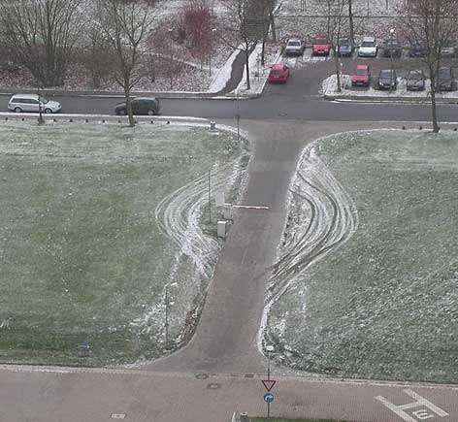
For Attacker, Castle Model Looks Like This

Slide 64
'Airport' View Of Network
Real life example, no one knows all routes to network.
Much harder to defend
Infected laptop
Remote user
Router
Router
W
W
Modem or xDSL
W
W
W
W
W
S
S
W
S
S
W
W
W
W
Development
Development
Development
Servers
Development
Servers
Floppy
USB autorun or other
“Adidas” network
Finance
Web site exploit
Finance
WLAN
Outlook sync
Phone mail sync
WLAN terminal

Slide 65
Switches And Routers As Security Tools
Proper switch makes sniffing difficult
    Ideal switch prevents hosts from seeing other traffic
    But switches can be fooled, for example by ARP spoofing
    Many switches also offer remote configuration, with default passwords.
    Like any servers also switches have vulnerabilities!
    In other words, make sure that a switch is up to date
Routers allow to segment network
    Using routers the network can be split into segments
    Most routers also have firewall functionality
    Like switches routers need to have their OS up to date!

Slide 66
Filtering The Network Traffic
Proper network layout and segmenting limit access between segments, but doesn't care what the actual traffic is
To limit network traffic into accepted form (ports, protocols and content) you need to use some form of network traffic filtering
Network filters remove unwanted traffic from the network at the filter point (gateway,router,host)
Network equipment are like PCs, they need updates and must be checked once in a while
http://www.spiegel.de/international/world/catalog-reveals-nsa-has-back-doors-for-numerous-devices-a-940994.html
http://www.informationweek.com/security/vulnerabilities/barracuda-security-equipment-contains-ha/240146890

Slide 67
Placing Firewalls In The Network
Internal network protected by NAT both
from outside and from DMZ
Servers are placed in DMZ and
protected both from outside and from inside
Servers in the DMZ have no direct
access to intra, intra looks same from
DMZ as it looks from outside
Thus if a server in DMZ is compromised
the intra is still safe
Remember use only packet filter at gateway
fancy stuff will only make DOS easy
At the gateway router
Firewall
S
S
W
W
W
W
Private network

Slide 68
Placing Firewalls
Between segments
Segments isolated from each other
For example no access from development to marketing
Only accepted hosts can access between segments
Each segment can have servers that are in the server segment, but access allowed only to that segment
Limits exposure to one segment
Router
Firewall
S
S
W
W
Servers
Marketing
W
W
W
W
Development
Private network

Slide 69
Firewalls At Each Host
So called 'personal' firewalling
Each host has firewall software installed
  Third layer of defense if dedicated firewalls fail
  Personal firewall protects laptop when out of office
Most personal firewall products also provide application filtering
  Allows to control which applications can use network
  Prevents many spyware, backdoors and trojans from working

Slide 70
So What Do You Want To Do With Firewalls?
Protect your systems from unauthorized outside traffic
  Everyone knows this and everyone does this
  So modern attacks do not come as inbound TCP/IP attacks
  Unless you neglect your network security that is
Use firewalls for damage control and containment
  If a single workstation gets infected, it must not be able to bring down the whole network
  Treat every host and server in your network as untrusted
  Switch your thinking from CIA to FBI
  There will be bad guys in the network, how do I locate and isolate them?

Slide 71
So What Do You Want To Do With Firewalls?
Make sure only right servers are allowed to send traffic
  Only mail server should be allowed to send mail
  Only HTTP proxy should be allowed to send HTTP/S
  Only IT workstations should be allowed to use remote desktop
  No remote login from one workstation to another
  Do your users need IRC,SSH,etc at work? If not don't allow it

Slide 72
Firewalls And Logs
Firewalls provide extensive logging capabilities
  What traffic was sent to this host
  What traffic was forwarded from a gateway
  Source/destination, protocol, port, etc
  Remember firewall logs are problematic in privacy issues!
    Record only the traffic headers, not content
By monitoring firewall logs its possible to notice problems and attacks
  Someone running a port scan
  Why that marketing host tries to access development source code server?

Slide 73
Application and Database Firewalls
IDS and Network filtering give only limited protection
The problem is that almost all new services are HTTP based
And these services have DB connections to DB servers
So use protocol specific Firewalls to filter actual traffic
These firewalls can inspect traffic and match it against profile of allowed behavior and filter out the rest
https://www.owasp.org/index.php/Web_Application_Firewall
http://www.imperva.com/products/dsc_database-firewall.html

Slide 74
So If I Do Network Security Right That's All I Need!
Not quite, if your users can use the net so can attackers
Even best filtering will not solve all your problems
The compromised host has at least the access it's user has
Thus you have to make sure that also user access is limited
Remember that even if you would be able to close all unauthorized access
The attacker can always use Facebook or Twitter for communication. And it is already being done
http://ddos.arbornetworks.com/2009/08/twitter-based-botnet-command-channel/

Slide 75
What About The Cloud?
Cloud is the buzzword of the day, everyone wants cloud
When implemented improperly cloud is quite a risk
Best way to treat cloud is like a server in remote office
  Limit network access only to your company
  Don't store critical material in external servers
By itself cloud adds only one additional risk
  Which is that someone who manages to break virtualization used by cloud provider can access other instances in same physical box
  But this is not different from someone breaking into hosting facility and accessing physical server

Slide 76
Selecting A Cloud Provider
Ask your Cloud service provider following questions, before taking signing any contract:
  Other than people I authenticate, who else can access my information? What about governmental access?
  Will the service provider in any way use my data and information?
  What happens in case of data loss or corruption?
  Would my competitor be able to see my data and information?
  If I wish to move to a different service provider, how easy that would be? Are there any hidden legal bits that I am not aware of?
http://www.afsheenjafry.com/cloud-computing

Slide 77
Prevent Attacker From Communicating
Prevent inbound traffic to disable server type backdoors
Client type backdoors need to find C&C node
    This means they need to use DNS query to find current C&C
    So block, .info,.biz, .cc and other TLDs that your users don't need
Simpler attacks use static C&C in China, Russia, etc
    Block outbound IP ranges to countries that your users don't need
Make sure there is no direct way out
    Allow only HTTP over proxy, check user agent
    Do not allow direct email out, only through company mailserver
    Some self updating apps do not understand proxy, so make exception for iTunes, etc that are allowed for users

Slide 78
Using DNS Filtering For Security
Why your DNS should resolve every domain in the world?
Your users need only very small fraction for business use
So set your DNS server to resolve only top 1M most common domains. For example by Alexa rank
Thus your users get to just about any page that they need
But malware which by their very nature use new and unknown domains will be unable to communicate
I did a test of comparing Alexa top 1M domains and 300K of malware domains, and overlap was only 0,4%
Which gives 99,6% protection rate

Slide 79
Use Content To Limit Unwanted Material
SPAM/Phishing filters
  Prevent your less intelligent users from falling to obvious
EMAIL filters
  Remove the type of content that you don't need
    Remove EXE, Javascript, etc
Anti-Virus
  Good quality AV also works as exploit detector to some level
Content classification controls
  Filter web pages based on unwanted content
    Racism, porn, politics, religion, recruitment and other touchy issues

Slide 80
Filter Out Unknown Active Content
Java, Flash and ActiveX are dangerous and mostly useless
  Thus you should allow them only from trusted sources
  Netbanks, Youtube, etc
Block active content from every other source
  For home users this would be too limiting
  But who cares if your users cannot see Flash based ads
  Actually I would filter out all advertisements to prevent malwertizing

Slide 81
Tunneling Protocols
IP based protocols have several problems
  Confidentiality
  Integrity
  Authentication
Now the problem is protecting content, not filtering
Tunneling protocols solve the problem by creating encrypted tunnel
  All parties in the communication are authenticated
  The communication is encrypted so that is cannot be eavesdropped or modified

Slide 82
Ideal tunneling
Traffic without tunneling Traffic with tunneling
Alice
Alice
Router
Encrypted tunnel
Hacker
Network
Router
Router
Bob
Bob

Slide 83
Tunneling For Security
Tunneling protocols provide secure transmission over untrusted network
Secure tunnel is provided by encryption and authentication
  What attacker cannot decode he cant understand
    Listening traffic is useless as security attack
  Authentication provides reliable detection for modifications
    Even if attacker can decode the transmission he cannot alter it without it being detected and rejected

Slide 84
SSL/TLS
TLS is the most commonly used tunneling nowadays
Both web apps and Android/iOS use TLS for protection
Setting up TLS feels simple
  Get certificate
  Install server
  Give user HTTPS link or make your app use TLS for comms
However doing TLS right is a good bit more difficult
https://www.ssllabs.com/downloads/SSL_TLS_Deployment_Best_Practices_1.3.pdf

Slide 85
TLS Problem 1: MITM
If attacker is between you and user, he can fudge things
  User tries to go to web bank http://bank.com
  Bank redirects user to https://bank.com
  Attacker makes the TLS connection to bank.com
  But to user attacker gives http://bank.com no crypto!
  Thus user thinks he is banking safe, but in reality only traffic from attacker to bank is protected
Solution: Always check that traffic is protected by TLS
  However it is difficult to get the users to verify this

Slide 86
TLS Problem 2: Certificate Spoofing
Attacker is MITM and TLS crypts forwarded traffic
  Which means that user will get TLS traffic just as expected
  Thus user will not notice anything out of the ordinary
  But browser will alarm for invalid or self generated cert
  So either attacker is government who can force CA to make a bogus cert that is still accepted by the web browser
  Or attacker has installed his on CA key to users OS
Solution: Use certificate pinning to make sure that certificate cannot be changed even to another valid CA generated cert without alarm. Unfortunately again requires client mod

Slide 87
TLS Problem 3: Algorithm Choosing
Attacker can affect session setup and choose crypto
  Web servers typically allow large set of encryption algorithms and protocols
  Sometimes the default list contains very weak options such as DES, which is easily crackable nowadays
  So if attacker can affect session creation, he can force weak implementation to make job easier
  Also some TLS vulnerabilities allow algorithm downgrading
Solution: Configure your server right
  Have best and strongest options first in the list
  Remove weak and obsolete options from the list
    Drop SSL v2 and SSL v3, Drop all obsolete crypto

Slide 88
TLS Problem 4: Record And Get Keys Later
Governments are patient, and they have plenty of storage
Thus they can easily record all encrypted traffic
And when they find something interesting enough
They simply send police to seize the servers
  And recover the certificate from the server
Thus all previously recorded traffic is now readable
Solution: Use PFS (perfect forward secrecy) option in TLS which uses Diffie Hellman key exchange which guarantees that session key cannot be recovered even if attacker gets cert later
http://ggramaize.wordpress.com/2013/08/02/tls-perfect-forward-secrecy-support-with-apache/
More TLS attacks

Slide 89
TLS Vulnerabilities
In addition of basic problems TLS implementations also have vulnerabilities
  BEAST
  CRIME
  Heartbleed
  POODLE
  Etc
So it is critical to make sure server and client versions are up to date
http://en.wikipedia.org/wiki/Transport_Layer_Security#Attacks_against_TLS.2FSSL

Slide 90
Virtual Private Networks
VPN forms general purpose tunnel
  Applications sending traffic over VPN don't even know that it exists
  Using VPN any traffic can be protected without any application modifications
  With VPN you can be your own CA and thus be safe from certificate spoofing and thus from most MITM attacks
  Technically most VPNs are using TLS, so same risks apply
Using VPN, admin can create virtual networks
  Joining two office networks into over protected tunnel
  Protecting traffic in the company intra, so that each connection goes over its own virtual 'cable'

Slide 91
Uses For VPN
Automatically secure unprotected protocols
  As VPN is transparent, all traffic can be routed over it
Reliable host identification
  IP address can be forged, host certificate can't
Secure connections inside company intranet
  No snooping, just being able to connect to LAN doesn't help
Better control over the computer on the intranet
  If the host doesn't have certificate, it cant use the net
Secure connections to remote offices
  Connect two networks transparently

Slide 92
Dangers Of VPN
VPN provides safe tunnel for traffic but it does not provide any security over end points
There are several cases where company network has been hacked or received a worm over VPN
  Users laptop gets compromised and offers direct route to company intra over VPN right past all firewalls
Thus any connections over VPN should be limited
  VPN access to own special segment
  Firewalls and IDS between VPN segment and intra
  Limited access to company servers only what VPN users need
Remember to update your tunneling software and it's config
http://www.nta-monitor.com/files/whitepapers/VPN-Flaws-Whitepaper.pdf

Slide 93
Protecting WIFI
Safest WIFI is to be without one at all
  So don't use it unless you really need wireless net
The key problem in WIFI is that since it is radio it can always be listened and attacks can be done without physical presence
Key points in implementing secure WIFI are
  Updated and well configured WIFI access points
  Well configured WIFI terminals (laptops etc)
  Well placed WIFI access points
  Protecting all traffic over WIFI (WPA2 preferably also VPN)

Slide 94
Placing WIFI terminal
Place access point physically so that it has minimum coverage outside the office walls
  Place the access points at center and measure outside
Place the WIFI access point into it's own segment in company network architecture
  Each segment that needs WIFI must be filtered
Basically all connections over WIFI should be treated with same distrust as VPN connections

Slide 95
Protecting WIFI Traffic
Switch the access point security ON!
  Some access points ship with no security settings on
  Enable WPA2 crypto and authentication
  Disable WEP and WPA1, don't allow connections over them
  Set access point so that it doesn't allow unknown WIFI cards to connect it
Use RADIUS or WPA2 authentication
For anything requiring real security use VPN over WIFI connections
  If WIFI gets hacked attacker still needs to fight VPN

Slide 96
WIFI And Laptops
Almost ever employee has a laptop nowadays
And users of those laptops will use any open WIFI they can
And all traffic in open WIFI is visible to everyone
  This means that attacker can do whatever they wish to any unencrypted connection
  Free services tend to do authentication over SSL and rest of the traffic in plaintext. Even Gmail used to do this
  Also just connecting to WIFI gives huge amount of information on what the laptop is and what software is has
  As soon as you connect to WIFI, skype, Outlook, Messengers and whatnot, try to find their servers.

Slide 97
Safe WIFI Access While On The Move
Treat any open WIFI with high suspicion
Especially in cafes or airports there can always be someone listening on all traffic
So the only safe way to use public WIFI is to take VPN connection to company server, and route all traffic to company network and from there to rest of the world
Or at least make sure that you are not using any web services that don't have encryption on all pages after authentication
And if you are in a hacker conference, even that is probably not enough. So don't bring your laptop in the first place.

Slide 98
Make Reconnaissance Difficult
Use separate DNS for inside and outside
Make sure that internal network is properly NAT isolated
Don't place any servers that offer internal services on DMZ
Don't give descriptive names to you Web or VPN proxy
Place only public stuff on public servers
  Make sure that all php,perl,etc cannot be downloaded
Place robots.txt on all directories and tag all pages
  <META name="robots" content="noindex, nofollow">
Check what GOOGLE shows about your domain!

Slide 99
Detecting Intrusions
Even the best protections can be defeated with time
  Thus it is very important to monitor the network to catch any intrusions when they happen
  Follow the type of traffic in the network and be alert for anything unusual
  There are many high level automatic tools available, but it helps to understand how they work
    Remember the best IDS is trained admin, IDS tools are just tools they need a skilled admin and well behaving network
  NOTE! Finland has extensive personal privacy protection laws, be careful what you monitor...

Slide 100
What To Look For in Network Traffic?
Look for anything unusual
  Unusually large amounts of traffic
  Connections to unusual or new ports
  New type of traffic or new protocol
  Large amount of failed logins, or from unusual sources
  Traffic from unexpected hosts (why development test computer is accessing finance network)
For this you need to know what is normal traffic
  And design your network so that the normal traffic is well behaving (network is segmented and filtered)

Slide 101
But My Regular Traffic Is A MESS
Then you have to fall back on monitoring IOCs
ie. Indicators Of Compromise shared by security experts
With IOCs you can monitor your network against known
attack anomalies

Slide 102
General IOCs
Unusual outbound network traffic
Geographical irregularities in traffic
Unusual logins or large number of failed logins
Swells in fatabase read volume
Unusual HTML response sizes
DNS request anomalies
http://www.darkreading.com/attacks-breaches/top-15-indicators-of-compromise/240162469

Slide 103
Tools For Network Monitoring
Log files
  Firewall, routers, servers, workstations
Sniffers placed at strategic locations in the network
  Look for packet headers for
    Source, Destination, Port, Protocol
Network status displays
  Show current load and traffic by type
  Gives nice overview what's going on at the moment
Set up traps
  Fake Email, intra web, version control, etc servers
IDS systems and other automatic intrusion detection tools

Slide 104
Intrusion Detection Systems
Scans network traffic for attacks or anomalies
  Either all traffic like sniffers or directed to this host
Signature based IDSes scan for known attacks
  Signature IDS looks for known forms of misuse
Anomaly IDSes monitor for suspicious activity
  Doesn't look for any specific attack. Anomaly IDS searches for alarming exceptions in the traffic that it sees, such as MS SQL server access in UNIX network
  Needs very careful configuration, and still probably causes false alarms

Slide 105
Signature Based IDS
Signature based IDS scans traffic for patterns that match for some known attack
  Traffic passing trough the IDS is compared against database of signature rules
  Each known attack needs it's own signature
  When signature matches it will trigger alarm in the IDS
  When new attacks appear signatures must be updated
  Signature IDS is also a perfect place to check for any IOCs

Slide 106
Anomaly based IDS
Anomaly IDS looks for exceptions and new trends in the network traffic
  When anomaly IDS is installed it needs to be taught what the normal traffic in the net looks like
  First two weeks the IDS analyzes and learns about the normal traffic
    Sources/Destinations, destination ports, protocols
  When active the IDS will alarm when it encounters new type of traffic
    For example port scan or SQL traffic to new destination
  Thus anomaly IDS will cause a lot of false alarms, especially at the beginning

Slide 107
IDS Terms
Sensor
  Single machine logging traffic and matching rules
Database
  Collection point where sensors send information about rule matches
Controller
  Analysis and output unit which collects the data, analyzes and reacts or warns

Slide 108
Set Up Traps
Users rarely access servers by name
  After all they have everything configured by IT
So avoid giving obvious names to your servers
However do have fake servers with obvious names
  Smtp.company.com, svn.company.com, dns.company.com
Have minimal services which do answer like they should
  But instead of serving the request log and alarm
  Any attacker scanning the network is likely to hit the honeypot

Slide 109
IDS Structure
Sensors capture and analyze traffic
  Information is saved into DB
Console reads the DB
  Alarms on alert cases
  Provides report on other
  activity
  Many IDS systems can be configured to react
  by blocking the attacker at the firewall
Sensor
Public IP
NAT Router
Sensor
Public IP
S
S
Private IP
Sensor
W
Console
Public Servers

Slide 110
Where To Place IDS sensors
At gateway
  Monitor network equipment for anomalies
  to catch backdoors
After gateway
  Catch any attempts to leak
  Check for any traffic that is supposed to be filtered by FW
To the mirroring port of a switch
  Inspect the traffic going in the network
To critical hosts
  Internal DHCP, file servers and other critical resources
Sensor
Public IP
Sensor
NAT Router
Public IP
S
S
Private IP
Sensor
W
W
Public Servers
Sensor

Slide 111
What To Do With IDS
Collect information on the network activity
  Basically advanced version of logging
  Tells administrator when to investigate
React automatically to attack
  Add firewall rule that block traffic from attacker
  Log all traffic from attacker to special log
  Disconnect host from the network
  Shut down attacked service
  Close partitions that have critical files

Slide 112
Snort
Snort is a free open source signature based IDS
  Available for both Unix and Windows
Based on the sensor/database/controller design
  Uses MySQL database
  Several user interfaces and report tools available
Supports plug-in extensions
  SnortSAM adds interface with firewalls for automatic blocking

Slide 113
Free IDS Options
Snort
  http://www.snort.org/
Bro
  http://www.bro.org/
Suricata
  http://suricata-ids.org/
http://blog.securitymonks.com/2010/08/26/three-little-idsips-engines-build-their-open-source-solutions/

Slide 114
Defending From DOS
First analyze and understand the attack
  Where is it coming from
    Is there only one attacker, or is it DDOS?
  What the attack is based on?
    If it's malformatted attack what type of packets they are sending?
    If it's a flooding attack, is it just session open commands, or do they actually download stuff?
  Why are you being attacked?
    Some kind of protest? Or random attack?

Slide 115
Fighting DOS
Try to filter the traffic
  If all DOS packets are identical it's easier to filter
  Block the DOSing hosts
  If there are several attackers make firewall rule that blocks attackers that send too many requests
  If possible try to move the blocking upstream, by asking the your ISP to block the DOS traffic for you
  It might be a good idea to verify the willingness and ability of you ISP for DOS blocking beforehand
  http://resources.infosecinstitute.com/the-red-spike-ddos-mitigation-strategies/

Slide 116
Move Out Of The Way
Find out is the attack targeted at fixed IP address or some other information you can change
  If so change the server IP address
  If you have several domains make sure that those that are not targeted by DOS are able to work
If the attack cannot be dodged, minimize load
  Replace the main page with text that directs to alternate page
  Give priority to to hosts that are in countries where you have customers

Slide 117
Conclusion
In this topic we covered
  Network attacks
  How network infrastructure helps on preventing attacks
  Tools to make the network infrastructure safe

Slide 118
References
General firewall whitepaper
  http://secinf.net/firewalls_and_VPN/General_Firewall_White_Paper.html
Firewalls And Internet Security, Second Edition
  Addison-Wesley, Cheswick, Bellowin, Rubin
Netfilter Packet filtering HOWTO
  http://www.netfilter.org/documentation/HOWTO//packet-filtering-HOWTO.html
Maximum Linux Security
  SAMS, Anonymous Hacker
Understanding Virtual Private Networks (VPN)
  http://www.giac.org/certified_professionals/practicals/gsec/0561.php

Slide 119
References
A short overview of IP spoofing
  http://staff.washington.edu/dittrich/papers/IP-spoof-1.txt
Netfilter IPtables firewall
  www.netfilter.org
Snort IDS tool
  www.snort.org
Google hacking
  http://johnny.ihackstuff.com/
Taxonomy of botnets
  http://www.cs.northwestern.edu/~ychen/classes/msit458-s09/Botnets_defense.ppt

