Slide 1
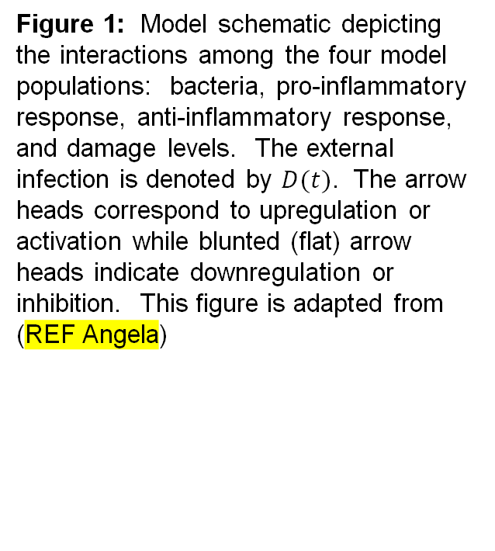
Figure 1: Model schematic depicting the interactions among the four model populations: bacteria, pro-inflammatory response, anti-inflammatory response, and damage levels. The external infection is denoted by $D(t)$. The arrow heads correspond to upregulation or activation while blunted (flat) arrow heads indicate downregulation or inhibition. This figure is adapted from (REF Angela)

