Slide 1
P1
By Jarod Nakamoto

Slide 2
Flights.csv Data Description
flights.csv is an excel file that spans flights for the 2013 year, originally organized by date.
The dataset contains the date, departure time, arrival time, the arrival delay, the flight carrier, tail number, flight number, origin, destination, air time, distance, hour, minute in relation to the time flown.

Slide 3
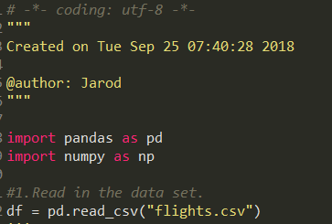
Read in the data set
As you can see the data set is read in.

Slide 4
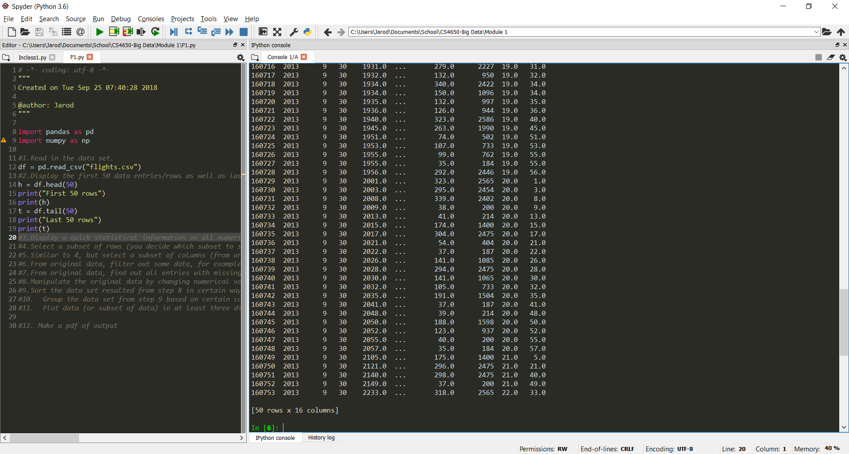
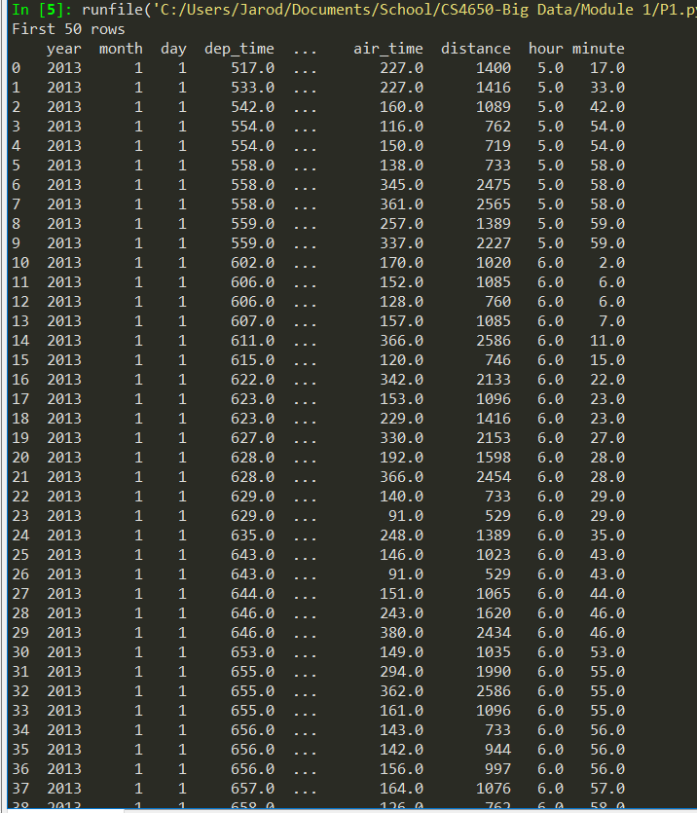
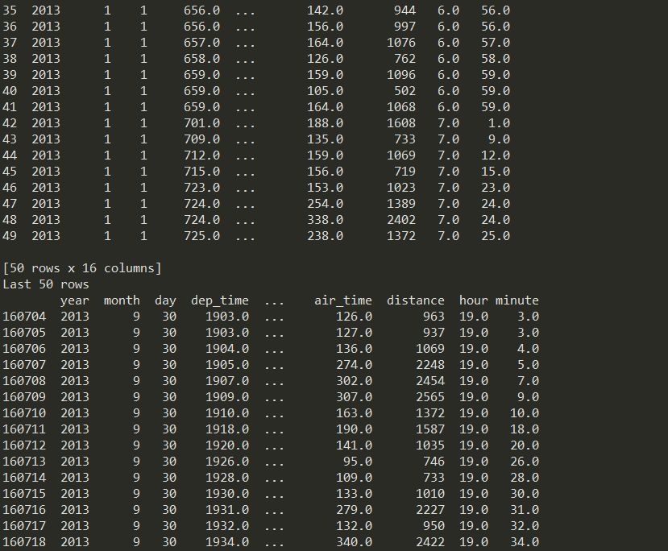
Display the first 50 data entries/rows as well as last 50 entries/rows

Slide 5
Display the first 50 data entries/rows as well as last 50 entries/rows

Slide 6

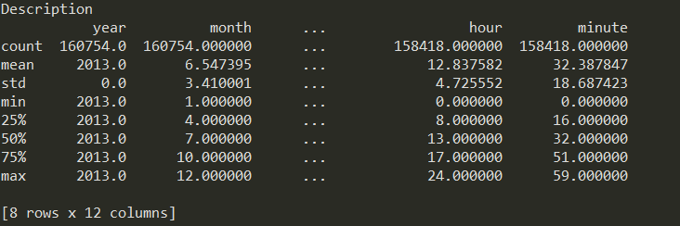
Display a quick statistical information on all numerical columns such as count, mean, std, min, max, etc.

Slide 7
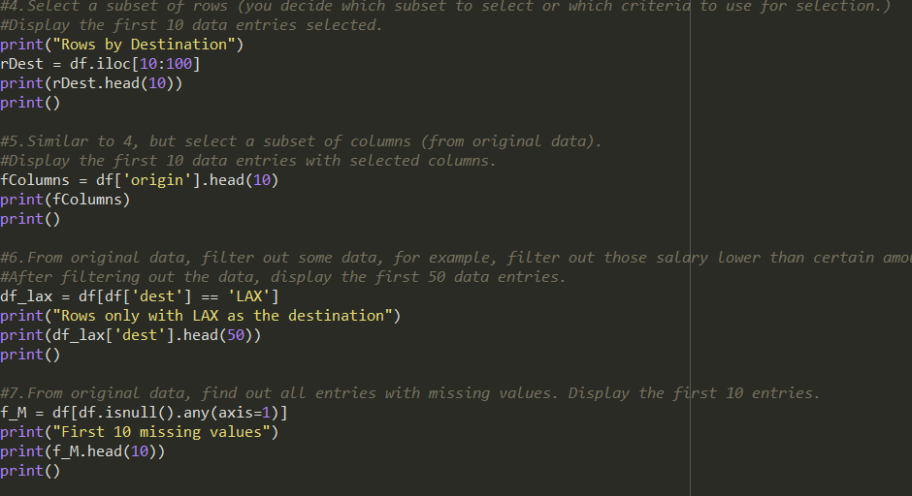
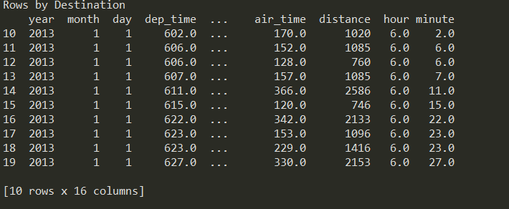
Select a subset of rows (you decide which subset to select or which criteria to use for selection.) Display the first 10 data entries selected.

Slide 8
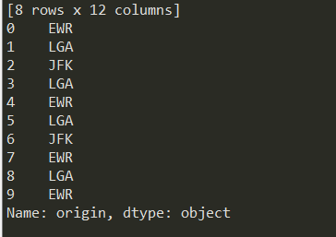
select a subset of columns (from original data). Display the first 10 data entries with selected columns.

Slide 9
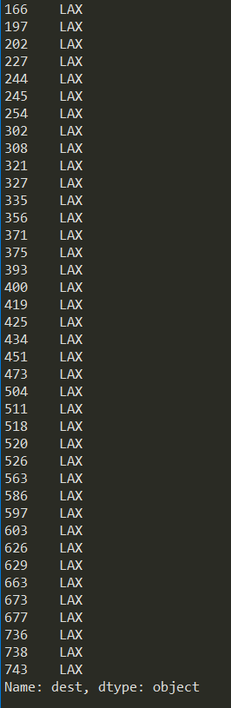
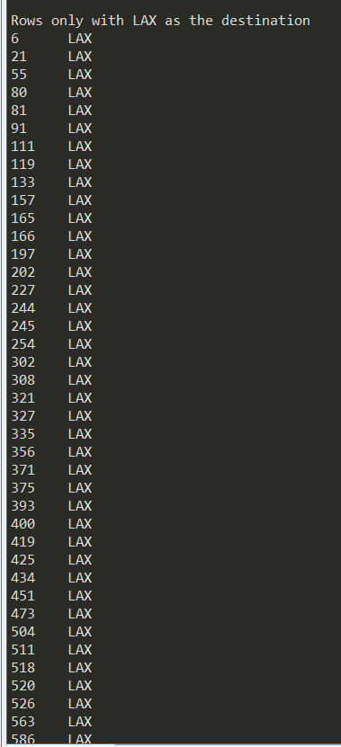
From original data, filter out some data, for example, filter out those salary lower than certain amount. After filtering out the data, display the first 50 data entries.

Slide 10
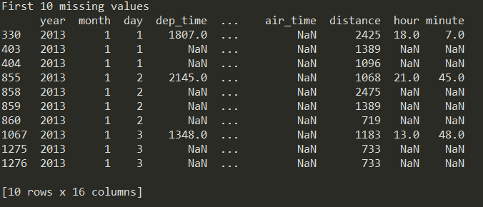
From original data, find out all entries with missing values. Display the first 10 entries.

Slide 11
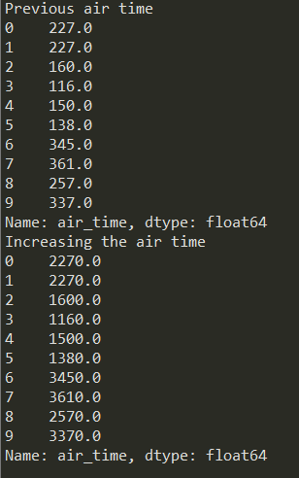
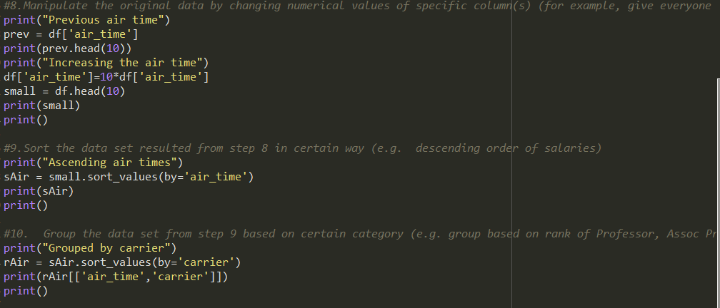
Manipulate the original data by changing numerical values of specific column(s) (for example, give everyone 10% raise!) Display the first 10 entries before update and after update.

Slide 12
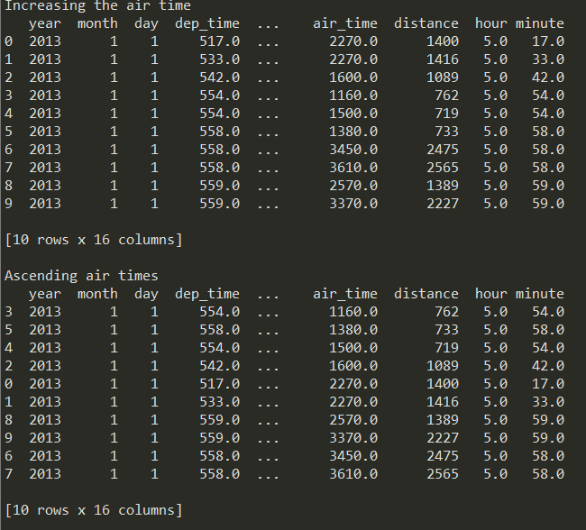
Sort the data set resulted from step 8 in Ascending order

Slide 13
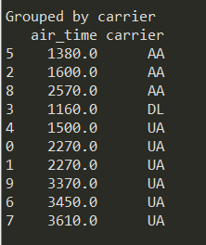
Group the data set from step 9 based on Carrier

Slide 14
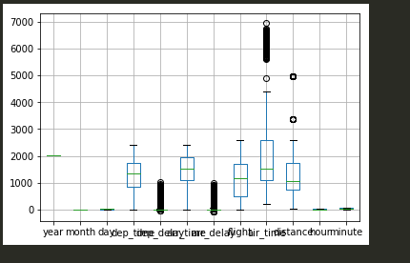

Boxplot

Slide 15
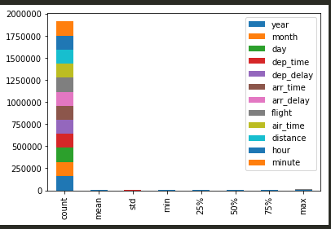
Bar Graph of statistics

Slide 16
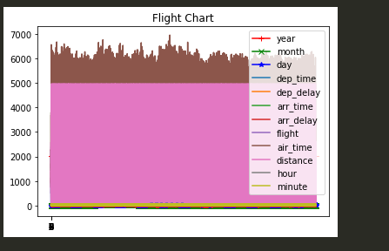
Normal plot

