Slide 1



Survey Master
Team: Barrbarians
Presenters: Holly Wagner and Jarod Sagendorph
Notes:
(H and J)

Slide 2
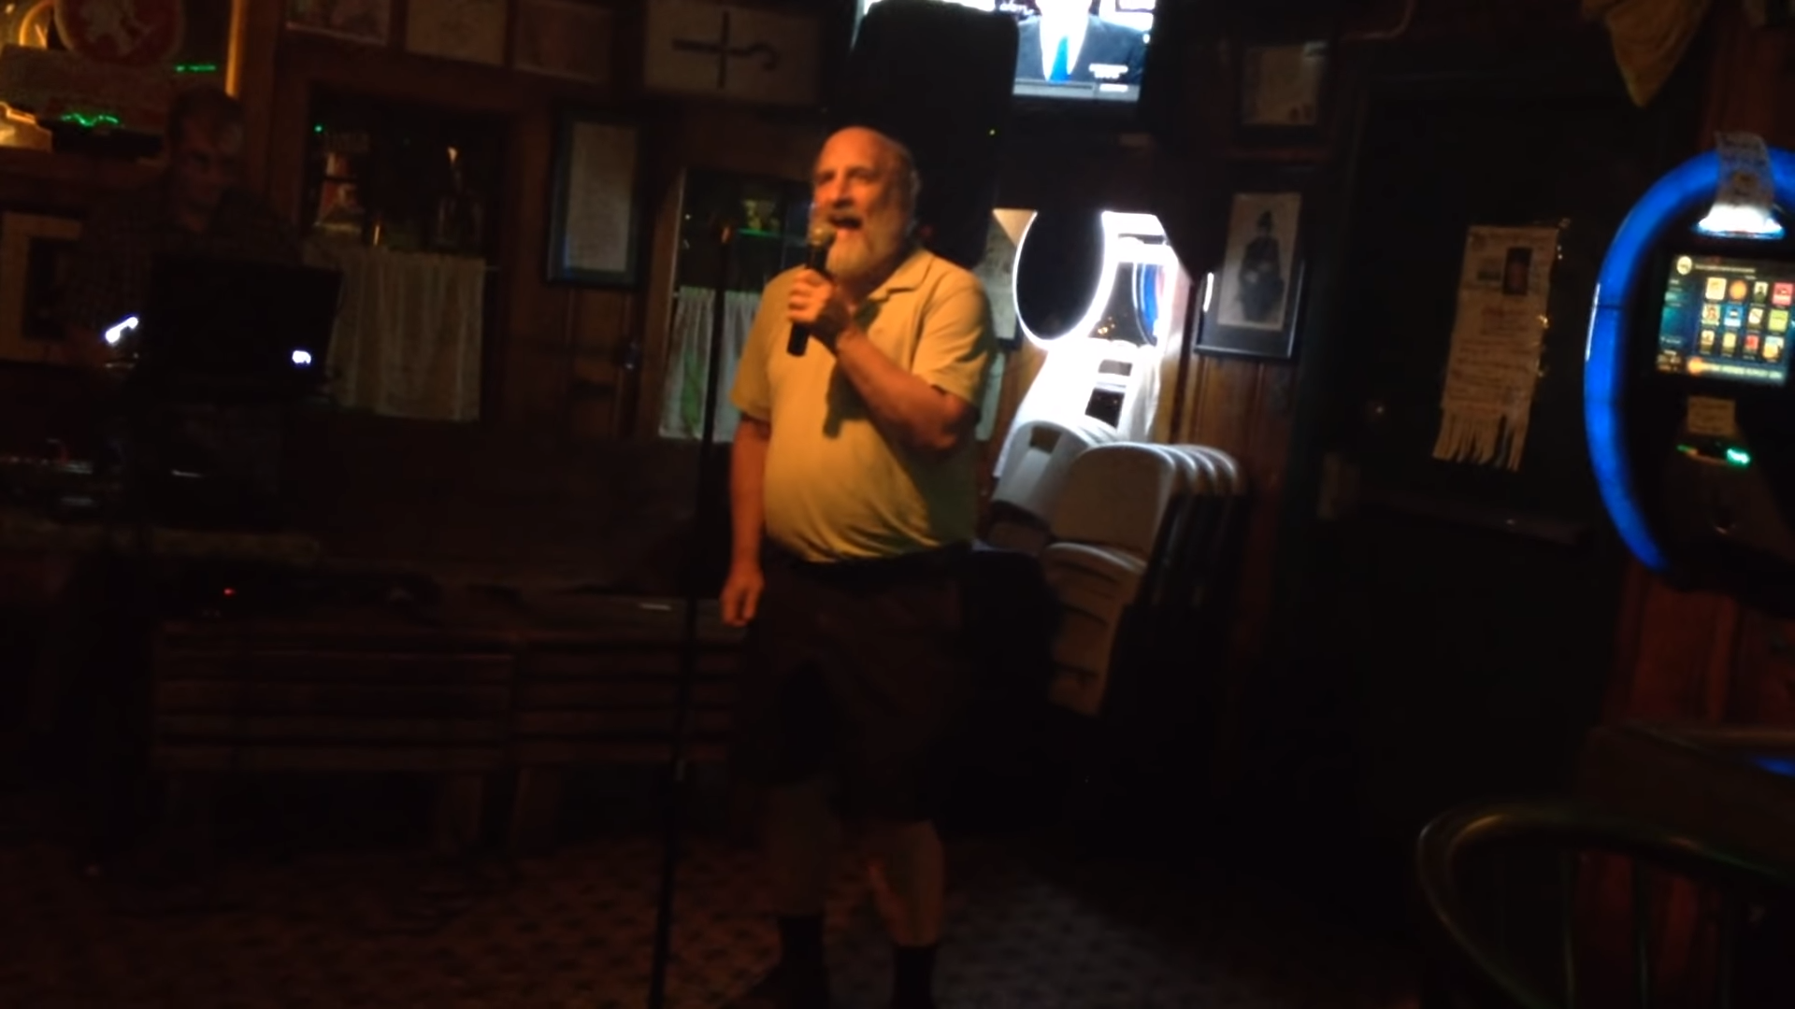
obligatory Prof. Barrington meme

Slide 3
Presentation Overview
Features summary
Product backlog
Sprint summary
Scrum: what worked and what didn’t
Live demo
Notes:
(J)

Slide 4
Developed Features
Allow managers to create a survey
Allow managers to take a survey
Allow users to login / logout
Allow employees to save their progress in a survey
Email blast
Notes:
(J)

Slide 5
Un/Partially developed Features
undeveloped
Create heuristic/algorithm for employee satisfaction
Allow managers to view long term trends of survey answers
partially developed
Allow manager to view statistics in a PDF format
working but must be run from command line
Notes:
(H) we were able to get all of the functional requirements completed, however there were some more ambitious features that we didn’t fully develop
Here are some incomplete features we want to highlight

Slide 6
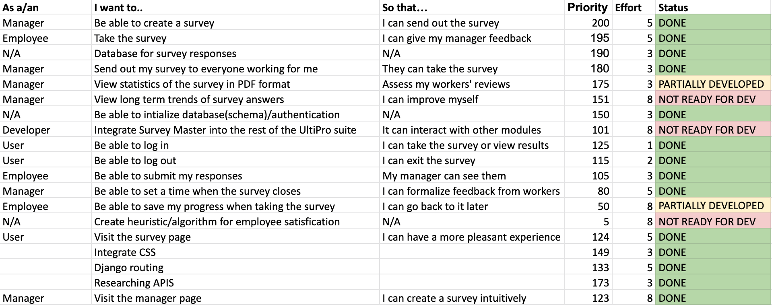
Product Backlog
Notes:
(J)

Slide 7
Sprint Summary
6 sprints total
3 teams for sprints 1-4
Front end: 3 people
Back end: 3 people
Database: 4 people
2 teams for sprints 5-6
Front end: 5 people
Backend: 5 people
We used the same metric for the sprint backlog as for the product backlog
Notes:
(H) we disbanded the database team after sprint 4, leaving any remaining database-related tasks to the Back End team

Slide 8
Scrum
What worked for us and what didn’t
continuous communication with the customer
incremental delivery
keeping a working product at all times
dividing work among 2-3 teams
skills of members taken into consideration
the last sprint
everything we didn’t get to
Notes:
(H) last sprint became a catch-call for all of the non-functional features we didn’t get to

Slide 9
Other issues?
Trying to get the PDFs working
a limitation of our library
Virtual environments breaking
Notes:
(J) could Back End elaborate on this?

Slide 10
Live Demo
Notes:
(H and J)

Slide 11
Questions?

