Slide 1
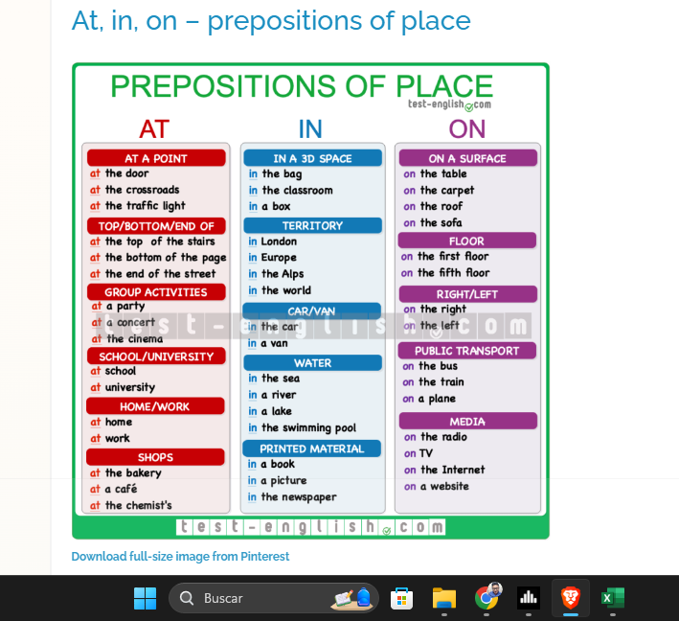
In your own words.

Slide 2
fdfgdgdgg

Slide 3
fdfgdgdgg

