Slide 1

Sports Courts Reconstruction Project Update
September 2023
Chris Peabody (S5)

Slide 2

Our Challenge
Our courts are 35-40 years old, beyond their typical useful life (15-20)
The courts have been previously repaired several times
All 4 courts are in poor condition with large, open cracks throughout.
  The cracks range from ½” in width up to as large as 3” wide
  Wider cracks were full depth through the asphalt down to the exposed stone layer
Most of the surface coating has debonded, including previously installed coatings

Slide 3
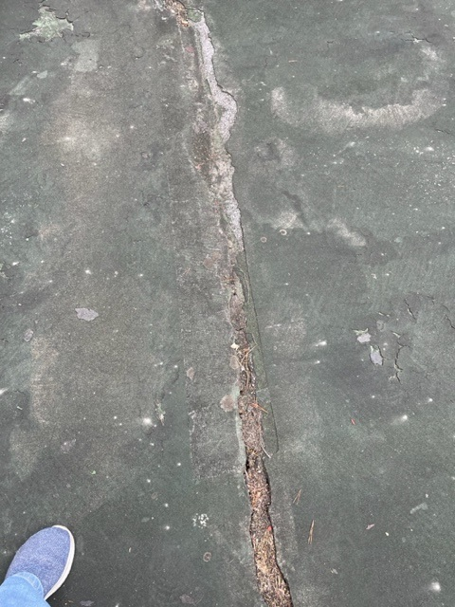
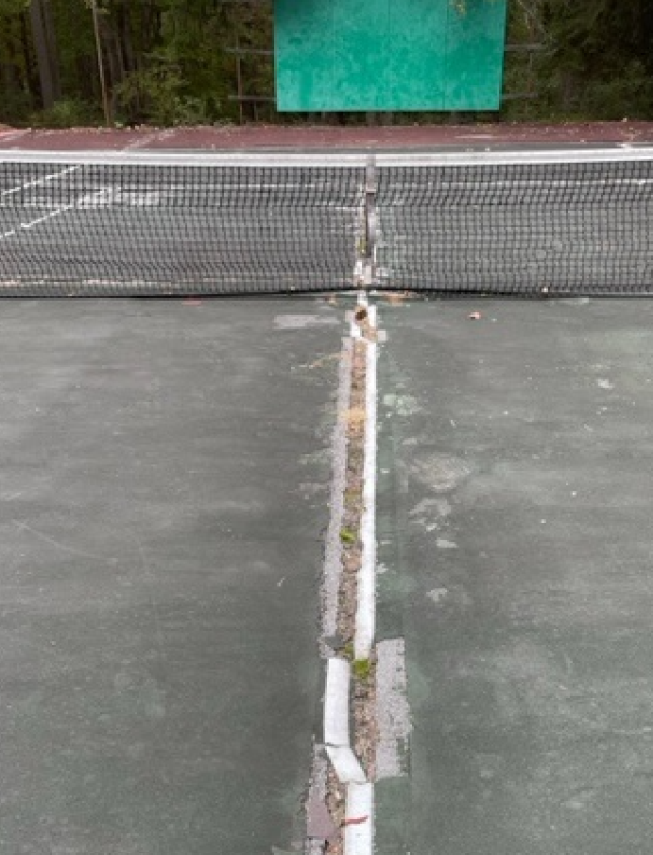
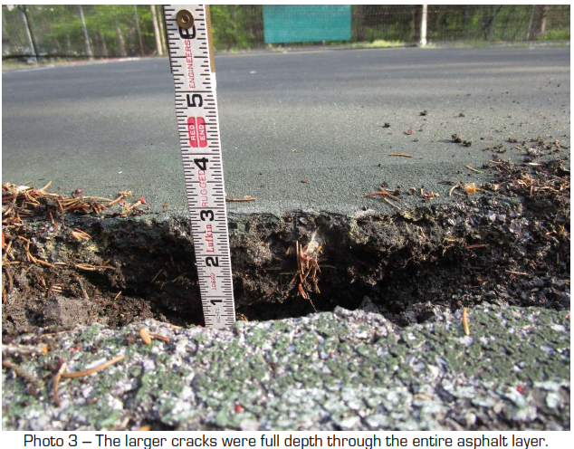
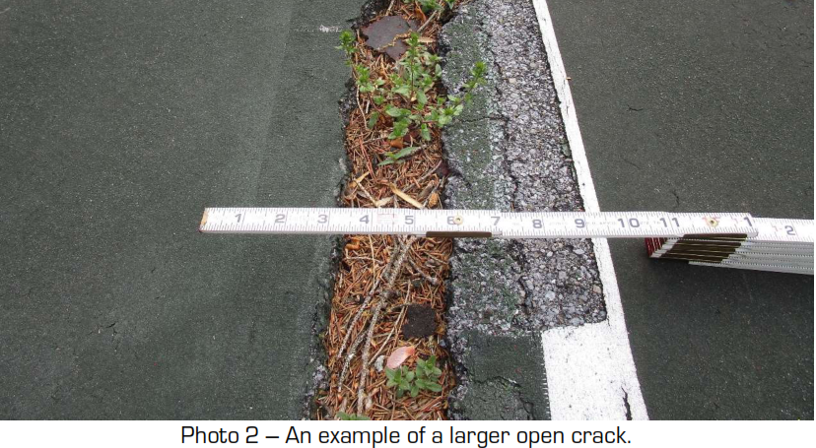
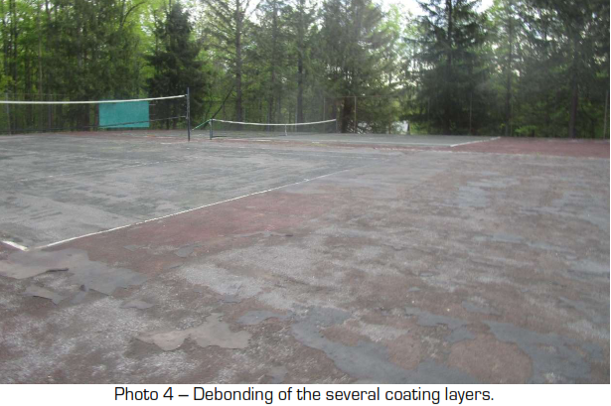

Slide 4

Step 1 - Get Smart Engineers to Conduct Ground Surveys
Gardner Engineering was hired and conducted a survey in April 2023
  The purpose of the excavation was to determine the asphalt and stone thicknesses and the type and quality of the subgrade stone and soils.
Surface evaluations included measuring cracks and general observations (previous pictures)
4 core samples were drilled through the asphalt, crushed stone and into the soil

Slide 5
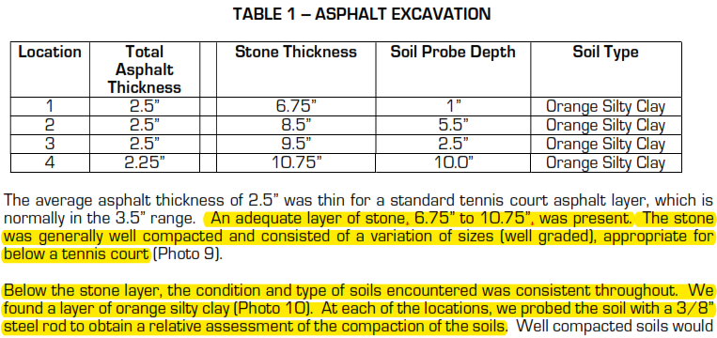
Step 1 - Get Smart Engineers to Conduct Ground Surveys
Survey Results

Slide 6


Step 2 - Get Smart Tennis Court Experts Engaged
(Firms that will come to Berkeley Springs)
I met ATC at a K-12 School Business Officers conference earlier this year
From their website: https://atccorpmd.com/
  ATC CORP has over 70 years of experience in the construction, maintenance, and renovation of sports surfaces and parking lots in the Mid-Atlantic region. In addition to surfacing systems, we offer a full range of accessories such as nets, net posts, windscreens, basketball backboards, rims, etc.

Slide 7
Step 2 - Get Smart Tennis Court Experts Engaged
(Firms that will come to Berkeley Springs)
Contacted 5 – 6 other companies that advertised that they “do sports courts” without success
  Most were really asphalt contractors, not sports courts experts
  One or two were legitimate Courts companies, but would not come to Berkeley Springs
ATC agreed to meet with Stephanie Rebant and me in June and provide a free estimate
  It was clear that this is their business
  Great advice and suggestions for how we might save money
    Example: Look for local contractors to do the demo work on the existing fencing, asphalt and nets…..One of their larger costs is always the disposal of the legacy asphalt – and we have a LOT of asphalt.
  They agreed to provide multiple options for the configuration of our future courts, to include Pickleball, Tennis and hoops for basketball

Slide 8
Agreed Upon Options
Option One
  Demo, and replace as existing (4 tennis courts)
Option Two
  Demo existing, and convert into 1 tennis court and 4 pickleball courts
Option Three
  Demo existing, and convert into 2 tennis courts and three pickleball courts
One minor item to note – after the legacy asphalt is removed, there will be an area of crushed stone remaining for Option 2 and Option 3 that will need to be covered with dirt or mulch (for a playground??) – because those new surface areas are smaller than the existing 4 courts.

Slide 9
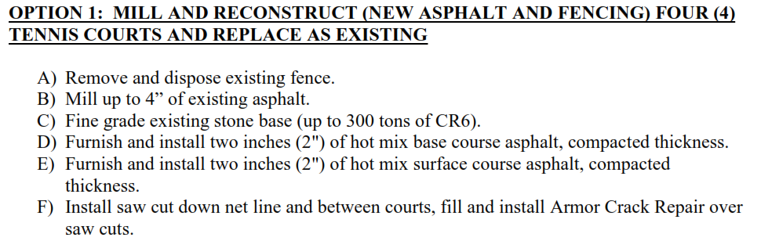
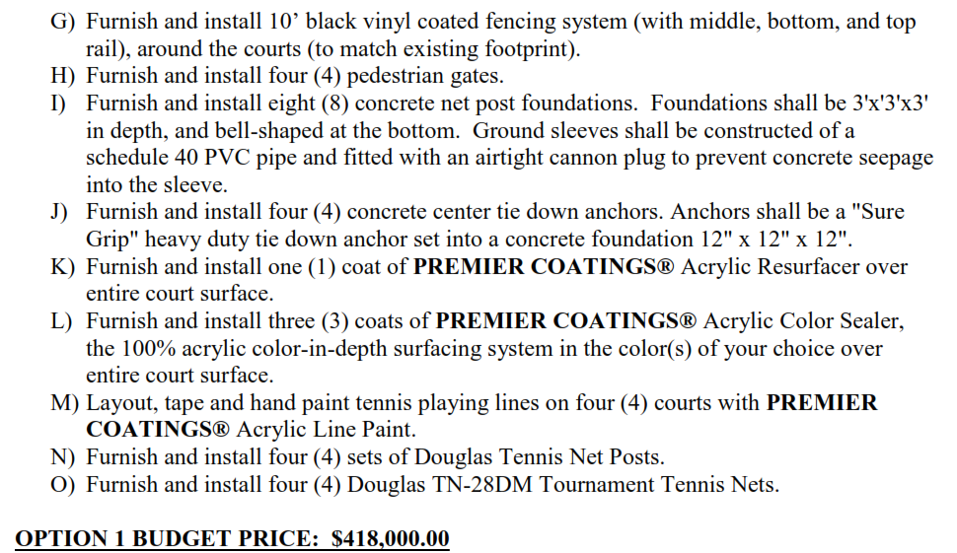
Option -1 (4 tennis courts)
Original Estimate

Slide 10
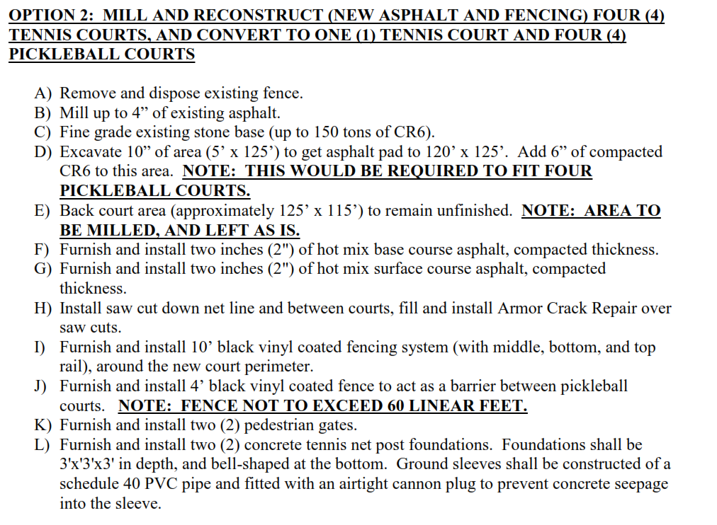
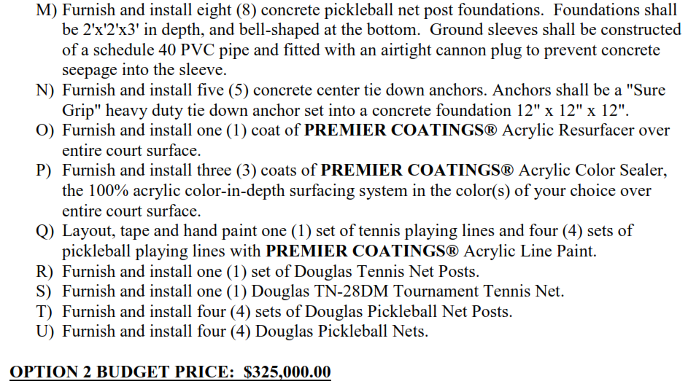
Option - 2 (1 tennis court – 4 Pickleball courts)
Original Estimate

Slide 11
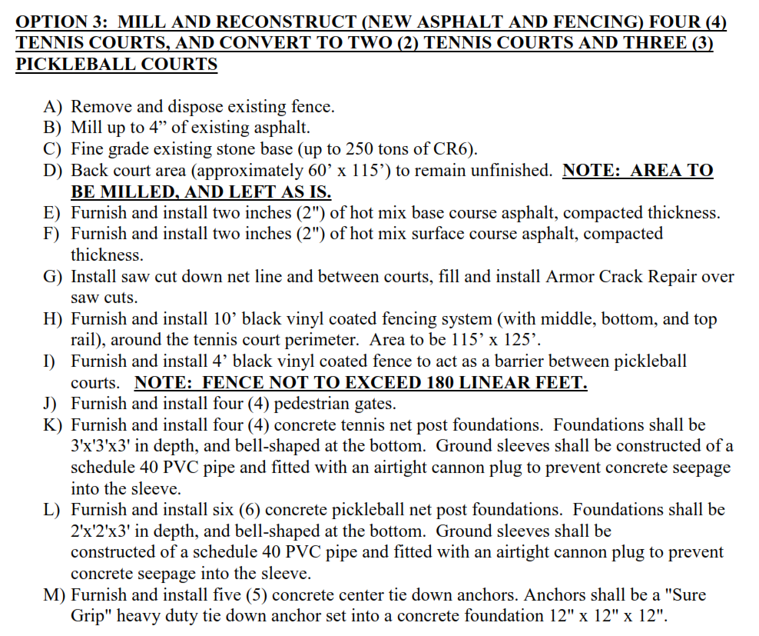
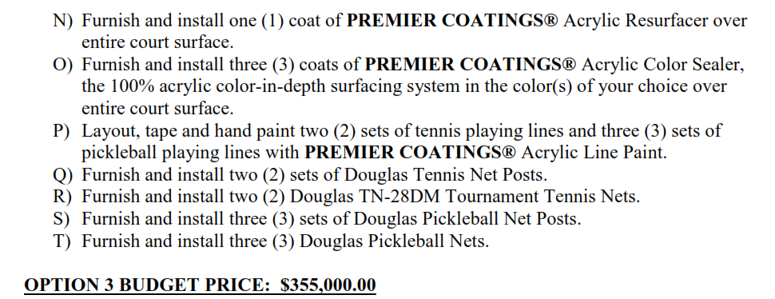
Option - 3 (2 tennis courts – 3 Pickleball courts)
Original Estimate

Slide 12
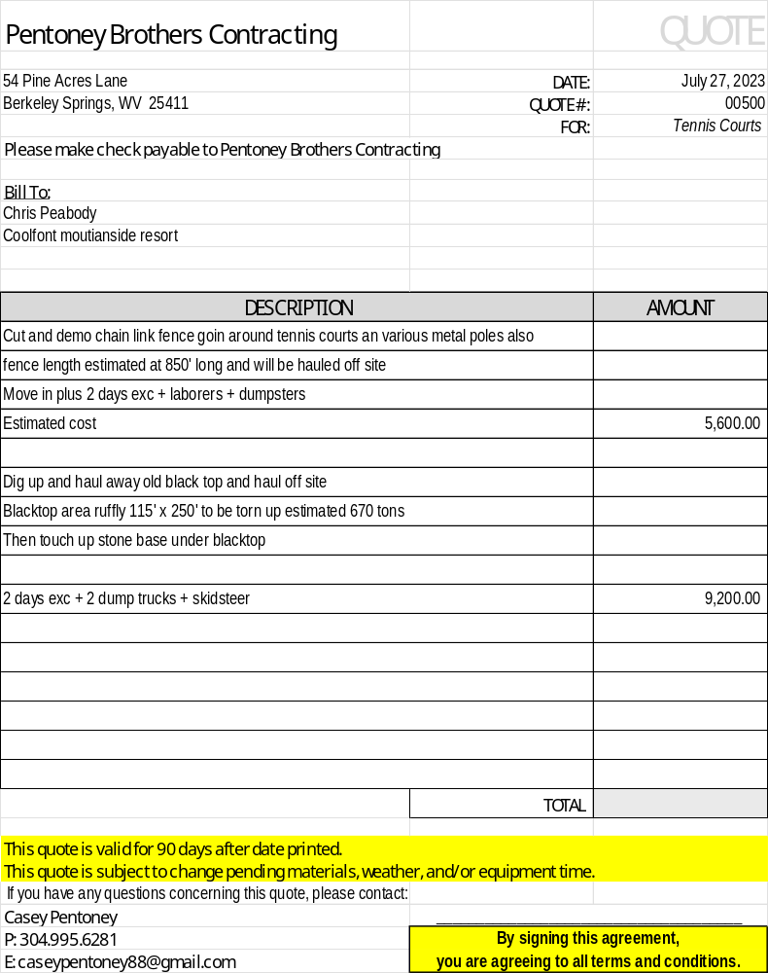
Step 3: We Explored an Alternative Demolition Option as Suggested
(Stephanie gets the credit here!)
Stephanie contacted Casey Pentoney, they’re a
local Construction firm.
I met with Casey on site – reviewed options
Pentoney will remove all fencing, nets and
Asphalt – including disposal for $14,800.00

Slide 13
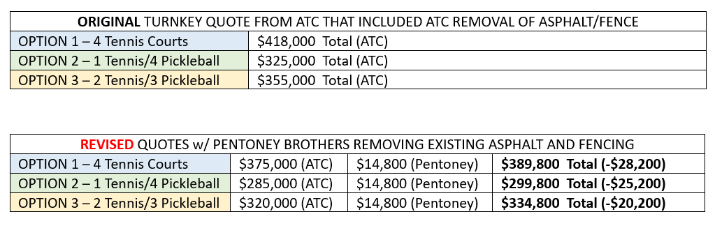
Step 4: Go back to ATC and ask for a revised quote – w/out demolition costs
Revised option pricing chart

Slide 14

Next Steps
If anyone knows a true courts firm that will provide us with a second quote, I’m willing to meet with them to get another bid.
Decide which court option/configuration we want
Determine how we’re going to pay for this project.
I am willing to remain engaged throughout the project.
Get back to enjoying our sports courts!

