Slide 1

OFM · Open Factory Model
acme / melbourne / packing / packline01 / filler / state
One model of the factory: live data, history, OEE and MES functions, built on open-source software
Jarek · November 2026 · Phase 3a complete: a simulated packing line with OEE
Notes:
OFM stands for Open Factory Model. It is a data platform for the plant: it collects live data from the PLCs, keeps its history, and turns it into production information such as OEE and downtime - all driven from one description of the factory. Everything in it is free, open-source software.

Slide 2








Plant data today is scattered and hard to trust
Today
With OFM
Data stuck in PLCs and HMIs
Every new report means a new point-to-point link to a controller
One model of the factory
Sites, lines, machines and signals described once, in a database
Downtime on paper, OEE in spreadsheets
Calculated differently on each line, days after the event
One live namespace
Every application reads the same plant-wide MQTT stream
Commercial platforms are expensive
Licences per tag, server or client; locked to one vendor
One historian
Every value with its time and quality, kept for years
No one place to ask
"What is Line 1 doing now, and what happened last Tuesday?"
One way to calculate
OEE and downtime calculated the same way on every line, live
Notes:
The problem OFM solves: data lives in PLCs and HMIs, every report is its own integration project, downtime and OEE are calculated by hand and differently per line, and commercial platforms that fix this are licensed per tag or per server. OFM gives one model, one namespace, one historian and one way of calculating.

Slide 3

The factory is described once; everything else follows
Adding a sensor means adding a row to the model: no flow editing, no typing of topic names, no dashboard changes.
Information model
Unified Namespace
Historian
Applications
PostgreSQL
MQTT · Mosquitto
TimescaleDB
Grafana · line view
Every site, line, machine and signal, with units, limits and PLC address. Edited like a spreadsheet.
The live state of the plant, one topic per signal: …/packline01/filler/speed
Every value with its time and quality; compressed; averages for years.
Dashboards, OEE and downtime, the operator's line view; later SPC, food safety, traceability.
Notes:
Four building blocks. The information model in PostgreSQL is the single source of truth. From it the runtime generates the Unified Namespace - an MQTT broker with one topic per signal in the plant's own hierarchy (ISA-95: enterprise, site, area, line, machine). Every value also goes into the historian. Applications read the namespace or the historian, never the PLCs.

Slide 4
How the pieces fit together
One server · Docker · encrypted (HTTPS / TLS)
Siemens S7
S7-300/400, S7-1200/1500 (S7 protocol)
Grafana
Dashboards, OEE
Model
PostgreSQL: what to read, scale, publish
Unified Namespace
Mosquitto MQTT: live values
Allen-Bradley
CompactLogix, ControlLogix (EtherNet/IP)
Line view
Operators: orders, stops
Runtime
Node-RED: reads the PLCs, scales, checks, machine states, counts, KPIs
Historian
TimescaleDB: every value, states, counts, orders, reasons
Any OPC UA server
Machines, HMIs, gateways
Mathesar
Engineers edit the model
Simulated packing line
Six machines, for demos and training
Your tools
Power BI, Python, AI (SQL, MQTT)
PLC protocols stay on the machine network; only encrypted connections leave the server.
Notes:
Left: the controllers OFM reads today - Siemens S7, Allen-Bradley via EtherNet/IP and anything with an OPC UA server - plus the simulated packing line used for the demo. In the middle, one server running everything in Docker containers: the model tells the runtime what to read; the runtime publishes to the namespace and writes the historian in parallel, so a database outage never stops the live data. Right: the applications. Read access for Power BI or Python is plain SQL or MQTT.

Slide 5







What OFM does today, and what comes next
WORKING
WORKING
WORKING
WORKING
WORKING
Live data and UNS
Historian
Machine states and downtime
Work orders
OEE and loss waterfall
Every signal in the plant hierarchy, with unit and quality
Raw values 1 year, 1-minute and 1-hour averages 5 years
Running, idle, starved, blocked, fault…; reasons from PLC fault codes or operators
Start, changeover, complete; counts per order; who did what
A, P, Q, OEE per hour, shift, day, order; MTBF and MTTR per machine
WORKING
PLANNED
PLANNED
PLANNED
PLANNED
Operator line view
SPC
Food-safety checks
Traceability and inventory
Analytics and AI
Live line, orders, stops to code; sign-in with employee number and PIN
Sampled characteristics with frozen control limits (Phase 3c)
Electronic check records with verification (Phase 3d)
Material lots and movements (Phase 3e)
Scale-out, analysis, AI assistance (Phases 4–5)
Notes:
Green: working today and tested on the simulated packing line. Grey: designed (decision records exist) and planned in later phases. The MES functions are built on the same model and historian, so each new one reuses everything below it.

Slide 6
Data collection: how fast and how much
2,000
0.7 s
< 2 s
0.6 core
values per second sustained for 10 minutes; none lost (1,132,000 sent = 1,132,000 stored)
median from a change in the PLC to the namespace; 99 % within 1.1 s
target for 95 % of values at default read settings
and 1.2 GB memory used by OFM at 2,000 values per second
Source | Default reading | Fastest | Timestamp
OPC UA servers | sampled every 0.5 s, sent every 1 s | 0.1 s | from the device
Siemens S7-300/400/1200/1500 | polled every 1 s | 0.1 s | on arrival
Allen-Bradley (EtherNet/IP) | polled every 1 s | 0.1 s | on arrival
Counters, machine states | counts per minute; states on every change | – | from the change
Faster reading is set per source, only where a need is named, to keep the load on the PLCs light. Measured in OFM's load test (release v0.2).
Notes:
Figures from the load test of release v0.2: 2,000 values per second for ten minutes, every value both published and stored. Typical delay from the PLC to the namespace 0.7 s. Default reading every second keeps PLC communication load low; a source can be read as fast as every 0.1 s where somebody needs it. A pilot line is expected to produce around 50 values per second, a whole plant around 500.

Slide 7





Built to be trusted: no lost data, honest quality
Nothing lost when the database is down
Values queue on disk (up to 10 GB, compressed) and are written when it is back; the live data never stops
Every value has its time and quality
Time in UTC milliseconds from the device; good, uncertain or bad; stale data shown as stale
History is never overwritten
States, counts, orders and reasons are only added; a correction is a new record with who and when
Encrypted and locked down
TLS for every connection from another computer; OFM's own certificates; a login per role
Least privilege
A dashboard cannot change the model; the runtime cannot rewrite history; screens only call set functions
Failure drills passed
PLC unplugged, broker killed, database stopped, runtime crashed: each recovered by itself
Notes:
These are the properties that make the numbers trustworthy. The drills were run on purpose during Phases 1 and 2: unplugging a PLC, killing the MQTT broker, stopping the database and crashing the runtime. Each time OFM recovered without losing history, and the quality flags showed the outage honestly.

Slide 8
OEE the right way: every second is accounted for
69 %
Availability
running ÷ planned production
66 %
Performance
units × ideal cycle time ÷ running
98 %
Quality
good ÷ all units
44 %
OEE
fully productive ÷ planned production
Reasons come from PLC fault codes or from operators. A filler starved by a broken carton erector is charged to the erector. Code a stop later and every figure updates.
Notes:
OEE in OFM is time-based: every second of the calendar lands in exactly one loss category, so the waterfall always adds up. This example, from OFM's automated tests: two hours, one of them not scheduled; cleaning, changeover, a breakdown, minor stops and an uncoded stop; then speed and quality losses. OEE 44 %, which is availability times performance times quality. Nothing is stored as a fixed number: a reason coded the next day reclassifies the time at once.

Slide 9
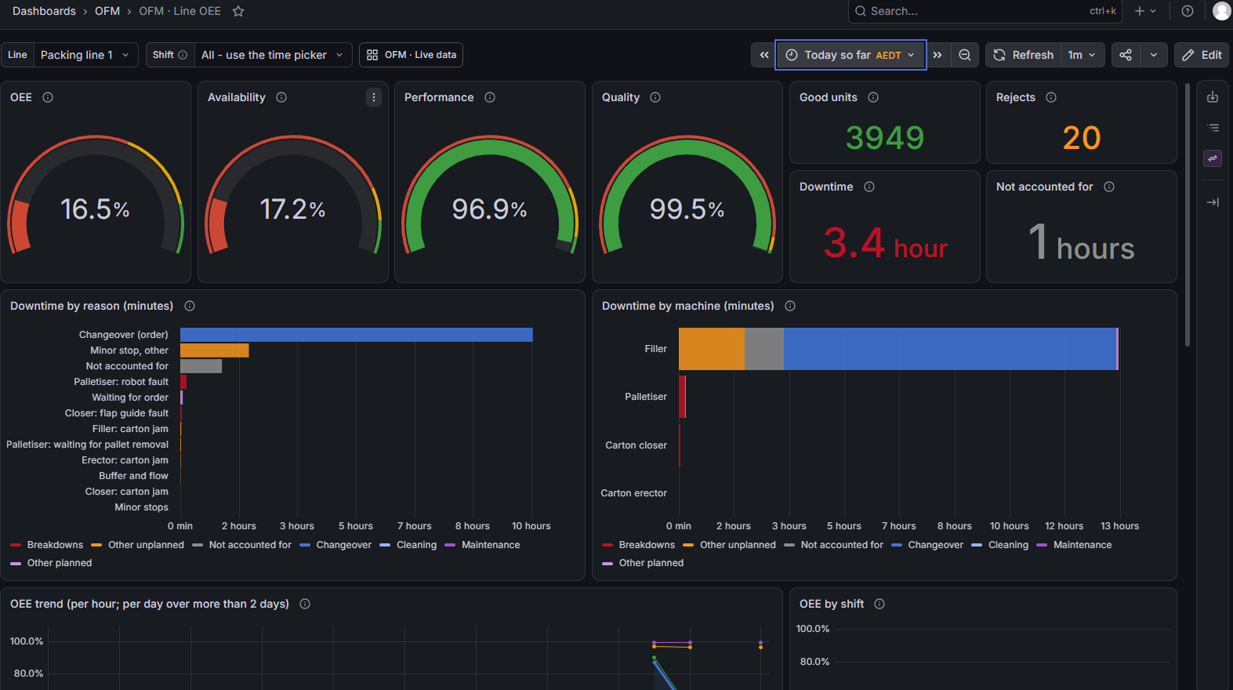
Grafana: Line OEE
For any order, shift or period
OEE, availability, performance and quality as gauges (red, amber, green); downtime by reason and by machine; trend per hour or day; OEE by shift; loss waterfall; machines, stops and orders below.
Notes:
The Line OEE dashboard. At the top you choose the line and the period: the running order (the default), a shift, or any period. Every panel is calculated from the history when it is shown, so it always agrees with the operator's screen.

Slide 10
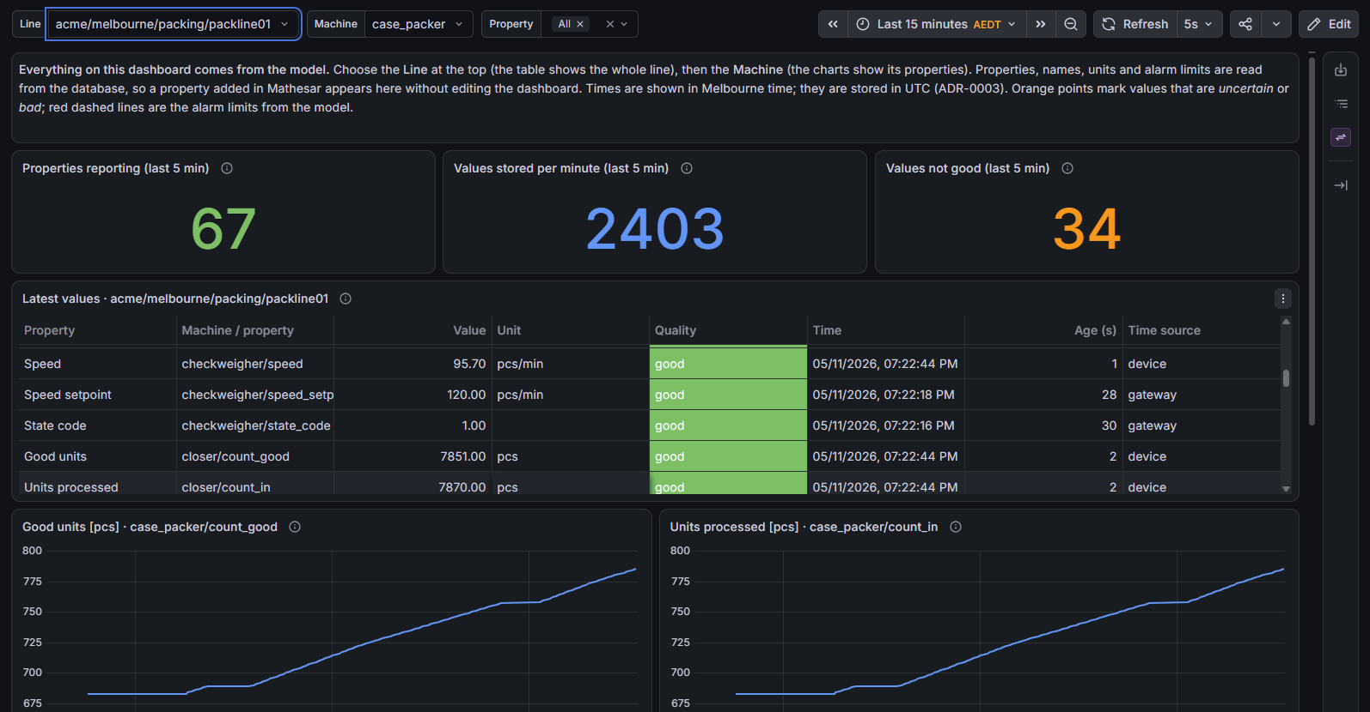
Grafana: Live data, generated from the model
Nothing typed by hand
Lines, machines, signals, units and alarm limits come from the model. A signal added in Mathesar appears here without editing the dashboard.
Notes:
The engineering view: every value of a line with its unit, quality and age, and charts per machine. Its lists come from the model, so a new machine or signal shows up by itself.

Slide 11
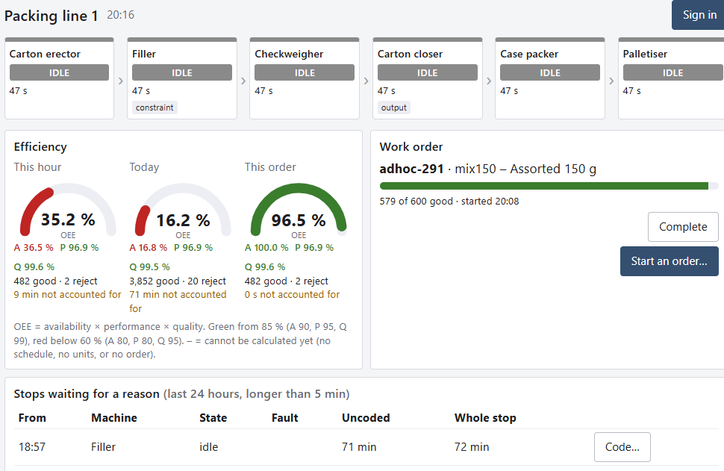

The operator's line view
The line at a glance
Each machine's state and how long; OEE of this hour, today and this order
Work orders
Start, changeover done, complete; progress in good units
Stops waiting for a reason
Long stops nobody explained, coded in two taps
Who did it
Sign-in with employee number and PIN; recorded by name and ID
Notes:
The screen at the line, on a panel PC or tablet. Anyone can look; to change something an operator signs in with employee number and PIN. Every order event and coded stop is recorded with who did it, which food-safety records will need too.

Slide 12
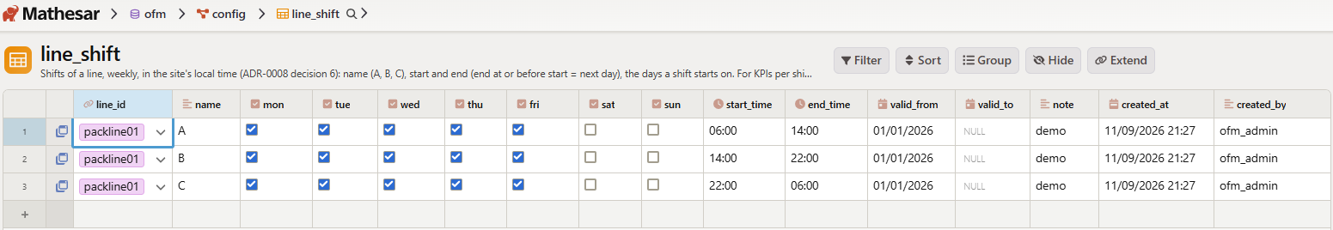



Easy to change, easy to install
The model in Mathesar: shifts of a line, edited like a spreadsheet
Change the model, not the software
A machine, signal, product rate, schedule or shift is a row; live within a second, no restart
Install with two commands
One offline bundle: no internet needed at the plant; every version pinned
A simulated line included
Six-machine packing line for demos, training and testing changes safely
Guides for every step are in the repository; checks after each change are written down and automated.
Notes:
Day to day, engineers change OFM by editing rows in Mathesar - a spreadsheet-like web page on the database. Changes reach the running system within a second. Installation is two commands from an offline bundle, because plant automation networks usually have no internet access.

Slide 13

Hardware and deployment
 | Pilot (one line) | Whole plant
Processor | 64-bit x86, 4 cores | 4–8 cores
Memory | 16 GB (8 GB works) | 32 GB
Disk (SSD) | 500 GB | 1–2 TB
History after 5 years | about 100 GB | about 720 GB
Network | plant network + PLC network | same
Operating system | Ubuntu Server LTS + Docker Engine | same
Two ways to deploy, same software
A virtual machine
On plant IT's servers: backup, UPS and monitoring come with it
An industrial PC
In a panel near the line: closest to the PLCs, independent of IT
Light on resources
Measured: 0.6 of a core, 1.2 GB at 2,000 values per second
Sizes for a pilot of about 200 signals and a plant of about 2,000; plus a UPS and the plant's time server.
Notes:
Modest hardware: in the load test OFM used 0.6 of a CPU core and 1.2 GB of memory at 2,000 values per second; the rest of the memory speeds up the dashboards. It runs either on a virtual machine provided by IT or on an industrial PC near the line; nothing in OFM changes between the two.

Slide 14
How OFM was built and tested
27 Oct · v0.1
Live data path
30 Oct · v0.1.1
Real PLCs: S7-300, S7-1200, CompactLogix
2 Nov · v0.2
Robust, editable, encrypted; load test
10 Nov · Phase 3a
Packing line: states, orders, OEE, screens
793
28
22
3
automated checks, run with one command
decision records (one decision each)
database migrations, never edited once applied
real PLC families tested on the bench
One automation engineer with Claude (AI) as programming partner. Every step: a short design agreed first, built and tested on a replica, then checked by hand on the laptop before it is committed. Failure drills before each release. Everything in Git.
Notes:
OFM was built in small steps: design agreed, built, tested automatically, checked by hand, committed. The test suite now has 793 checks covering the database rules, the runtime logic, the payload formats and the live system. Decisions are recorded one per page so anyone can see why something is the way it is.

Slide 15
Licence cost: zero
$0
Component | Role | Licence
PostgreSQL | Model and history | PostgreSQL Licence
TimescaleDB | Time-series historian | Apache 2.0; compression: Timescale License (free to self-host)
Node-RED | Runtime | Apache 2.0
Eclipse Mosquitto | MQTT broker (UNS) | EPL 2.0 / EDL 1.0
Grafana | Dashboards | AGPL 3.0
Mathesar | Model editor | GPL 3.0
Caddy | HTTPS front door | Apache 2.0
Docker Engine | Runs the containers | Apache 2.0
Ubuntu Server | Operating system | free
in licences, per tag, per server, per user, per year
What it does cost
A server (VM or industrial PC), the time to model each line, and support in-house: there is no vendor contract.
Notes:
Every component is free to use in production. All are open source except TimescaleDB's compression, which is source-available and free to self-host. The real costs are a server, engineering time and supporting it ourselves.

Slide 16

Roadmap and the decision we need
Now
Next
Pilot
Then
Later
Future
Simulated packing line
Management demo
One real line, alongside today's tools
Management views, SPC
Food safety, traceability
Scale-out, analytics, AI
For a pilot on one packing line we need
A server
A VM from IT or an industrial PC
Access to the line's PLCs
Read access, agreed with the PLC owners
QA's view
On electronic records and retention
A few weeks
Running beside today's tools, then a review
Notes:
Where we are and what comes next. The simulated line shows the Phase 3a functions working end to end. The next step is a pilot on one real line, running alongside today's tools for a few weeks. For that we need a server, read access to the line's PLCs agreed with their owners, and QA's view on electronic records.

