Slide 1
Data Warehouse
Dimensional Design
Radoslav Golian
26.09.2018
Notes:
<number>

Slide 2
Data Warehouse
Fundamentals
Notes:
<number>

Slide 3
Agenda
Operational vs. Analytic
Measurement & Context
Facts & Dimensions

Slide 4
Operational vs. Analytic
 | Operational System | Analytic System
Purpose | Execution of a business process | Measurement of a business process
Primary Interaction | DML & Query | Query
Scope of Interaction | Individual transaction | Aggregated transactions
Query Patterns | Predictable & Stable | Unpredictable & changing
Focus | Current | Current & historic
Optimization | DML concurrency | Query performance
Design Principle | ER design in 3NF+ | Star schema, Cube
Names | Transaction System OLTP System Source System | DWH Data Mart

Slide 5
Operational vs. Analytic
 | Operational System | Analytic System
Update Frequency | Real-time, when a business event occurs | Periodic (daily), via ETL/ELT, moving near to real-time
Update Concurrency | High | Low
Rows per transaction | Tens/hundreds | Milions
Data Volume | GiB, TiB | TiB, PiB, EiB
Selection Criteria | Precise, narrow | Fuzzy, broad

Slide 6
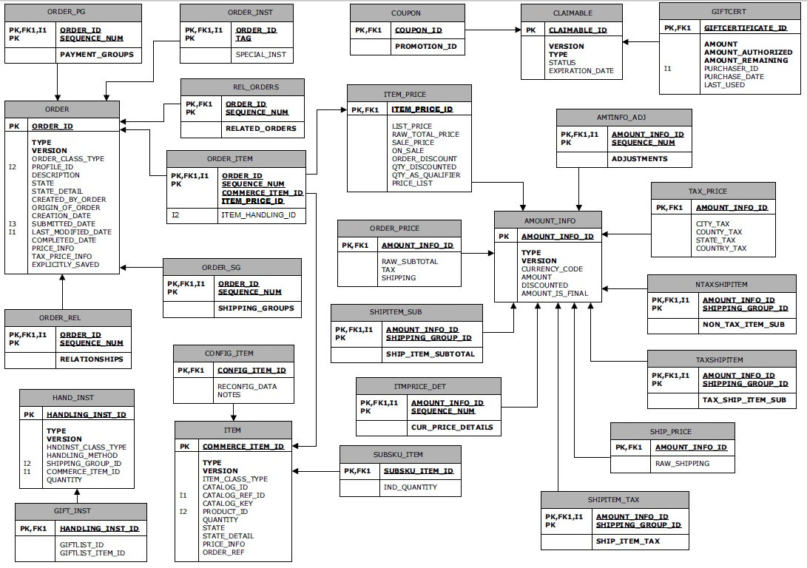
Operational

Slide 7
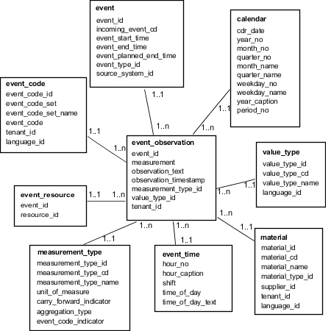
Analytic

Slide 8
Measurements
What are gross margins by product category for December?
What is the average account balance by education level?
How many sick days were taken by employees last year?

Slide 9
Measurements & Context
Questions center on a business process (sales, finance, attendance)
To answer them it’s necessary to look at a group of transactions
Questions reveal how the business process is measured
Without a context measurement is useless:
Sales were 10000€ (period?, product(s) ? )
Notes:
Sales were 10000 – single product or many products? In what period?
<number>

Slide 10
Measurements & Context
What are gross margins by product category for December?
Gross margin is viewed in context of
Product category
Time
Measurement and context are the foundation of dimensional design

Slide 11
Measurements & Context
A process is described by
Capturing what is measured
Context in which are measures evaluated
Measurements = Facts
Context descriptions = Dimensions

Slide 12
Dimensions in Speech
What are order euros by product category for January
What are margin euros by order number
Dimensions
Provide context
Can be numeric (age, size, phone numbers, …)
Usually “by” and ”for” indicate a dimension
Product category is a named dimension
January is an instance of unnamed dimension (we infer it’s month)

Slide 13
Facts in Speech
What are order euros by product category for January
What are margin euros by order number
Facts
Something that can be specified at varying level of detail
Tend to be numeric
People want them to “roll up” or “break up”
Order euros are numeric can be roll up by product category

Slide 14
Facts & Dimensions in Reports
Facts and Dimensions identification
How they would be used in a query or if they were shown in a report?
Dimensions
Filters and query predicates
Groupings, “break levels”, level of subtotals
Facts
Aggregated, summarized, subtotaled elements

Slide 15
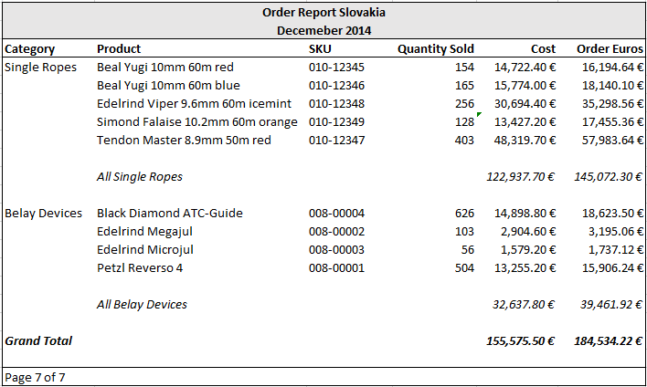
Facts & Dimensions in Reports
Controlling aggregation
Filtering
Aggregated
Breaking up
Subtotal level
Subtotaled
Summarized
Notes:
<number>

Slide 16
Grouping Dimensions & Facts
Dimensions usually share relationship to one another (independent of facts)
These are grouped together in a single table
Facts are at the same level can be grouped
These are grouped together in a single table

Slide 17
Grouping Dimensions & Facts
Facts | Dimensions | Dimensions (cont’d)
Order Euros | Product | Territory
Cost Euros | Product Description | Territory Code
Quantity Ordered | SKU | Territory Manager
 | Brand Code | Region
 | Brand Manager | Region Code
 | Category Code | Region VP
 | Category | Customer
 | Order Date | Customer ID
 | Month of Order | Billing Address
 | Quarter of Order | Billing City
 | Fiscal Period of Order | Billing Country
 | Year of Order | Billing ZIP
 | Salesperson | Industry Name of Customer
 | Salesperson ID

Slide 18
Grouping Dimensions & Facts
Salesperson
Salesperson
Salesperson ID
Territory
Territory Code
Territory Manager
Region
Region Code
Region VP
Product
Product
Product Description
SKU
Brand Code
Brand Manager
Category Code
Category
by
by
Facts
Order Euros
Cost Euros
Quantity Ordered
Customer
Customer
Customer ID
Billing Address
Billing City
Billing Country
Billing ZIP
Industry Name of Customer
Day
Order Date
Month of Order
Quarter of Order
Fiscal Period of Order
Year of Order
by
by
Notes:
<number>

Slide 19
The Star Schema
SALESPERSON
PRODUCT
ORDER_FACTS
DAY
CUSTOMER
Cube
Dimensional design for multidimensional database
Star schema
Dimensional design for relational database
Related dimensions are grouped as columns in dimension tables (shortened: dimensions)
Facts are stored as columns in fact tables (shortened: facts)
Appearance of a star

Slide 20
The Star Schema
PRODUCT
product_key
product
product_description
sku
brand_code
brand_manager
category_code
category
SALESPERSON
salesperson_key
salesperson
salesperson_id
territory
territory_code
territory_manager
region
region_code
region_vp
ORDER_FACTS
salesperson_key
day_key
product_key
customer_key
ordered_euros
cost_euros
quantity_ordered
CUSTOMER
customer_key
customer
customer_id
billing_address
billing_city
billing_country
billing_zip
industry_name
DAY
day_key
full_date
month_name
quarter
year
fiscal_period

Slide 21
Dimension Tables
Provide rich context needed for facts study
Dimension table columns
Used to specify aggregation
May be used for filtering
Provide context for each measurement (textual labels)
May be used to drive master-detail relationships, subtotaling, cross-tabulation, or sorts
Usually not in 3NF (not necessary)
Normalized dimensions → Snowflake
Notes:
<number>

Slide 22
Keys and History
Star schema
Each dimension table is given a surrogate key
Natural key
A unique identifier in the operational system
Surrogate key
A unique identifier exclusively for DWH
Assigned and maintained in the star schema loading process
Typically an integer without special meaning
Primary key in the dimension table

Slide 23
Keys and History
Separation of natural and surrogate key allows to track changes
DWH does not rely on natural keys
We can store multiple versions of the natural key
Versions are distinguished by different surrogate key values
We could supplement a natural key with sequence number
We would have to join on multiple columns

Slide 24
Fact Tables
A fact table is the core of a star schema
Contains facts and surrogate keys referring to dimension table
A (sub)set of all surrogate keys may sometimes uniquely identifies a row
Grain
Each rows in the fact table stores facts at a specific level of detail
ORDER_FACTS
salesperson_key
day_key
product_key
customer_key
ordered_euros
cost_euros
quantity_ordered

Slide 25
Using a Star Schema
Querying facts
Most of the queries follow a consistent pattern
select
p.category,
p.product,
sum(o.ordered_euros)
from day d, product p, order_facts o
where d.month_name = 'January'
and d.year = 2015
and d.day_key = o.day_key and o.product_key = p.product_key
group by p.category,
p.product
order by p.category,
p.product
Dimensions in results
Aggregated fact in results
Dimensions used to
filter the results
joins based on surrogate keys
Dimensions specify scope of aggregation
and control sorting of results
Notes:
<number>

Slide 26
Data Warehouse
DWH Architectures
Notes:
<number>

Slide 27
Corporate Information Factory
W. H. Inmon
Data for analysis dimensional format
Users
Operational
Systems
Datamarts
DSS
Applications
ETL
Enterprise
Data
Warehouse
Exploration
& Mining
Integrated repository of atomic data (Normalized - 3NF)
Notes:
Creator: Inmon
Operational Systems support business
An ETL process – extracts data from operational systems or various data sources, consolidate it, transform it and load it into single repository called EDWH.
Non-trivial process – restructuring data, accessing various information, etc.. ETL may be a batch process or transaction based process.
EDWH - Integrated repository of data from various systems – definitive and consistent representation of business activities.
Data in the repository are captured at lowest possible level of detail.
Not intended to be queried directly.
Purpose is to feed additional data stores.
Usually a RDBMS.
Datamarts – dimensional design, depoartmental view of information, may contain aggregated data.
ETL is reserved for movement of data from operational sysstems to EDWH.
Other data movements are defined as “data delivery”
<number>

Slide 28
Dimensional Data Warehouse
Ralf Kimball
Data Mart: Subject area within
the DWH
Dimensional DWH - Detail
Operational
Systems
ETL
Users
Dimensional
Data
Warehouse
Integrated repository of atomic data
(Dimensional format)
Notes:
Difference: DWH – dimensional modeling (stars, cubes)
DWH may be accessed directly.
Variation 1: 3NF transformation step is acceptable, if the tables are accessed only by ETL process.
Variation 2: DWH may be insulated from direct access by analytic application. In this case data marts may be constructed by extracting data from DWH. Data marts may aggregate or reorganize data.
<number>

Slide 29
Stand-Alone Data Marts
Operational
Systems
Data marts:
Subject area focus
(dimensional or normalized)
ETL
Data mart 1
users
ETL
Data mart 2
users
ETL
Data mart 3
users
ETL
Data mart 4
users
Notes:
Stand alone data marts:
Rapid and inexpensive results (in short-term)
May be costly and inefficient (in long-term)
Analytic data store – not designed in enterprise context
Exclusively focused on a subject area
Do not require cross-functional analysis, consolidation,
Direct implementation
Inefficiencies: multiple data marts may load from the same sources
Narrow set of needs – may not me adjustable to answer future questions
Subjects may not be comparable because they reside on different data marts (Islands of information)
<number>

Slide 30
Approach Comparison
Architecture | Description | Role of Dimensional Design
Corporate Information Factory | EDWH is a repository of atomic data EDWH is not accessed directly Data Marts reorganize data for analysis | Used only for data marts
Dimensional Data Warehouse | Dimensional DWH is a repository of atomic data Dimensional DWH may by accessed directly Subject areas within Dimensional DWH may be called Data marts | Used for all data
Stand-Alone Data Marts | Subject area implementation without an enterprise context | May be used

Slide 31
Approach Comparison
Architecture | Enterprise Level |  |  | Subject Area Level
 | Integrated Repository | Format | Direct Access | Data Marts | Format | Direct Access
Corporate Information Factory | Yes | 3NF | No | Physical | Dimensional* | Yes
Dimensional DWH | Yes | Dimensional | Yes* | Logical* | Dimensional | Yes
Stand-Alone Data Marts | No | N/A | N/A | Physical | Dimensional* | Yes
* Optional

Slide 32
Star Schema
Stars
Notes:
<number>

Slide 33
Surrogate and Natural Keys
PRODUCT
product_key (SK)
product
product_description
sku (NK)
brand_code
brand_manager
category_code
category
SALESPERSON
salesperson_key (SK)
salesperson
salesperson_id (NK)
territory
territory_code
territory_manager
region
region_code
region_vp
ORDER_FACTS
salesperson_key
day_key
product_key
customer_key
ordered_euros
cost_euros
quantity_ordered
CUSTOMER
customer_key (SK)
customer
customer_id (NK)
billing_address
billing_city
billing_country
billing_zip
industry_name
DAY
day_key (SK)
full_date (NK)
month_name
quarter
year
fiscal_period
Notes:
SK – surrogate key, created especially for DM / DWH, usually an integer, generated during ETL/ELT (no meaning to users)
NK – natural key, a key from a source system (usually have meaning to users)
NK – may be coumpound (id, source_system)
<number>

Slide 34
Surrogate and Natural Keys
Natural key
May be compound (id, source_system)
Usually have meaning to users
Surrogate key
Created for DWH
Simplifies schema design
Allows DWH to respond to the changes in source data (SCD)
A surrogate key should be assigned to each dimension
Notes:
(natural key, sequence number) or (natural key, date) is not a good solution
- Multi column FK in fact table: complicated joins, start transformation might not work,
<number>

Slide 35
Rich Set of Dimensions
Provide a rich and comprehensive set of dimension attributes
Each attribute increases the number of analytical possibilities
Dimension tables are usually wide
Common combinations
Codes and descriptions
Flags and their values
Multi-part column

Slide 36
Rich Set of Dimensions
CUSTOMER
customer_key (SK)
first_name (Arthur)
middle_name (C.)
last_name (Clark)
full_name (Arthur C. Clark)
full_name_last_first (Clark, Arthur C.)
attribute
credit_order_flag (Not Credit order)
attribute
channel_code (002)
channel_name (Online)
attribute
region_code (07-701)
country_code (07)
country_name (United States)
territory_code (701)
territory_name (East)
ORDER
attribute
attribute
cust_name_first
cust_name_mid
cust_name_last
attribute
attribute
credit_order_flag (N)
attribute
attribute
channel_code (002)
attribute
region_code (07-701)
attribute
attribute
Source table
Notes:
Codes and descriptions - descriptions may be more useful than codes.
Source table – usually only codes are present.
Flags and their values – by storing descriptive value is the usage easier
Multi-part columns – full and constituent values should be in the dimension
<number>

Slide 37
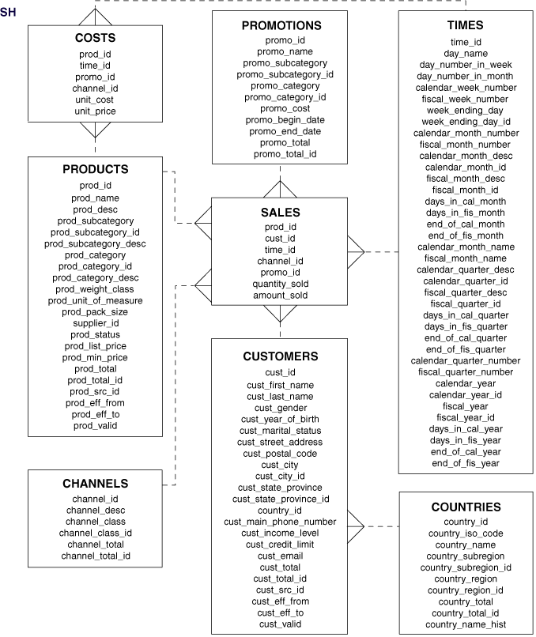

Slide 38
Dimensions
Dimensions with numeric values
Unit price, codes, etc.
“How many products were sold for 10€?”
Behavioral dimensions
Computed based on facts
“What discounts receive customers who generate over 1 million € profit“

Slide 39
Dimension Tables
Dimensional design embraces redundancy
Grouping dimensions
Based on affinity (customer, product)
Junk dimensions (no affinity)
Cartesian product of all possible values
Snowflakes and Outriggers
May be useful if RDBMS is optimized for snowflakes
Oracle – Bitmap join indices

Slide 40
Junk Dimension
Junk dimension
SALESPERSON
ORDER_INFO
order_info_key
order_type_code
order_type_desc
credit_flag
reorder_flag
ORDER_FACTS
salesperson_key
day_key
product_key
customer_key
order_info_key
ordered_euros
cost_euros
quantity_ordered
PRODUCT
DAY
CUSTOMER

Slide 41
Snowflakes and Outriggers
SALESPERSON
…
territory_key
PRODUCT_CATEGORY
category_key
catogory_code
category
outriggers
TERRITORY
territory_key
territory
territory_code
territory_manager
region_key
PRODUCT
product_key (SK)
…
sku
category_key
brand_key
ORDER_FACTS
salesperson_key
day_key
product_key
customer_key
ordered_euros
cost_euros
quantity_ordered
TERRITORY
region_key
region_code
region_name
BRAND
brand_key
brand_manager
outriggers
DAY
CUSTOMER

