Slide 1
Oracle SQL
Radoslav Golian
03.10.2018

Slide 2
SQL features
Querying data
  SELECT statement
  selection, aggregation, sorting, ordering...
Data Manipulation Language (DML)
  DELETE, INSERT, UPDATE, MERGE
Data Definition Language (DDL)
  CREATE, DROP, ALTER, RENAME, TRUNCATE, COMMENT

Slide 3
SQL features
Data Control Language (DCL)
  Controlling access to the database and its objects
  GRANT, REVOKE
Transaction Control Language (TCL)
  COMMIT, ROLLBACK, SAVEPOINT

Slide 4
Basic elements
Data types
Literals
Format models
Operators
NULLs
Comments
Database objects

Slide 5
Oracle Build-in Data Types
VARCHAR2(size [BYTE|CHAR])
  VARCHAR2(2 CHAR), VARCHAR2(10 BYTE), …
  4000 or 32767 bytes (12c: MAX_STRING_SIZE)
CHAR(size [BYTE|CHAR])s
  Default size: 1, fixed size (r-padding with chr(32))
  Do not use
NUMBER(precision[, scale])
  precision: 1 to 38
    maximum number of significant decimal digits
  scale: -84 to 127
    number of digits from the decimal point to the least significant digit
Notes:
http://docs.oracle.com/cd/E16655_01/server.121/e17209/sql_elements001.htm#SQLRF30020

Slide 6
Oracle Build-in Data Types
NUMBER(10,-2), scale < 0
  Rounds to hundreds, 12345 → 12300
NUMER(10, 2), scale > 0
  Rounds to hundredths 123.456 → 123.46
NUMBER(3,5), scale > precision
  precision: maximum number of significant digits to the right of the decimal point
  0.000127 → 0.00013
NUMBER(p) = NUMBER(p,0)

Slide 7
Oracle Build-in Data Types
DATE
  1.1. 4712 BC – 31.12. 9999 AD
  year, month, day, hour, minute, second
TIMESTAMP(fractional_second_precision)
  Contains also fractional seconds
INTERVAL
  INTERVAL YEAR (year_precision) TO MONTH
    year_precision: 0 - 9
  INTERVAL DAY(day_precision) TO SECOND (fractional_second_precision)
    precisions: 0 - 9

Slide 8
Datetime/Interval Arithmetic
Rules
  NUMBERS can be used in arithmetic operations
    1 = 1 day, 1 / (60*60*24) = 1 second (smallest unit)
    SYSDATE + 1, SYSDATE - 7, SYSDATE + (30/1440)
    DATE/TIMESTAMP ± NUMBER = DATE (fractions of second lost)
    DATE₁ - DATE₂ = NUMBER
    TIMESTAMP₁ - TIMESTAMP₂/DATE = INTERVAL
    TIMESTAMP₁/DATE - TIMESTAMP₂ = INTERVAL
    DATE₁ ± INTERVAL = DATE₂
    TIMESTAMP₁ ± INTERVAL = TIMESTAMP₂
    INTERVAL₁ ± NUMBER/INTERVAL₂ = INTERVAL₃
  Functions
    ADD_MONTHS, SYSDATE, LAST_DAY, MONTHS_BETWEEN
    TRUNC, NEXT_DAY

Slide 9
Oracle Build-in Data Types
CLOB, BLOB
  A character/binary large object
  Maximum size is (4 gigabytes - 1) * (database block size)
NVARCHAR2, NCHAR, NCLOB
  National character set
BOOLEAN
  nie je v Oracle SQL

Slide 10
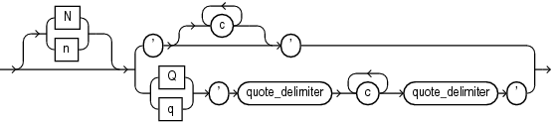
Literals (constant values)
Text literals
  'z', 'reťazec', 'O''Brien',
  Alternative quoting mechanism: q'#O'Brien#'
  Alternative quoting mechanism: nq'ï Ÿ1234 ï'
    National character set
Numeric
  7.26, -1, 1.E3, -4., 2E3, .5, -9.3e-3, +10.1
Datetime
  DATE '2008-12-25‘
    No time portion
Notes:
http://docs.oracle.com/cd/E16655_01/server.121/e17209/sql_elements003.htm#SQLRF00217

Slide 11
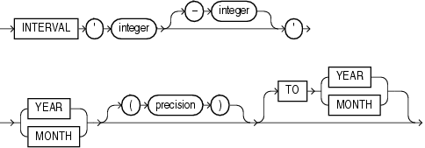
Literals
Datetime
  Function: TO_DATE(’31.12.2014 17:30:59',‘DD.MM.YYYY HH24:MI:SS')
  TIMESTAMP '2009-02-28 12:12:01'
  TIMESTAMP '2008-01-31 09:26:56.66 +02:00‘
Intervals (YEAR TO MONTH)
  INTERVAL ‘2' YEAR TO YEAR
  INTERVAL '3-2' YEAR(1) TO MONTH
  INTERVAL ‘300' MONTH

Slide 12
Literals
Intervals (DAY TO SECOND)
  INTERVAL '5 04:03:02.01' DAY TO SECOND
  INTERVAL '400 5' DAY(3) TO HOUR
  INTERVAL '4 5:12' DAY TO MINUTE
  INTERVAL '11:20' HOUR TO MINUTE
  INTERVAL '4' DAY
  INTERVAL '40' MINUTE
  INTERVAL '120' HOUR(3)

Slide 13
Format Models
Format model
  character literal describing the format of datetime/numeric data stored in a string
Examples
  Datetime
    '09:12:45' → 'HH24:MI:SS'
    '2014-12-13' → 'YYYY-MM-DD'
    '2014-12-13 09:12:45' → 'YYYY-MM-DD HH24:MI:SS'
  Numeric
    '12.34' → '99.99'
    '01234' → '09999'
    ‘100,000,123.120’ → ‘999G999G999D990'
Functions
  TO_CHAR(datetime, fm), TO_DATE(string, fm)
  TO_CHAR(number, fm), TO_NUMBER(string, fm)

Slide 14
Implicit Conversions
When comparing a character value with a numeric value
  character data → numeric value
  WHERE employee_id = '200‘
Conversion TIMESTAMP → DATE value
  The fractional seconds portion of the timestamp value is truncated.
When comparing a character value with a DATE value
  character data → DATE.
  SELECT last_name FROM employees
  WHERE hire_date = '24-JUN-06';
During concatenation operations
  noncharacter data types → CHAR or NCHAR.
  SELECT ‘salary:’ || salary FROM employees;

Slide 15
NULLs (Unknown Values)
Comparison
  IS NULL, IS NOT NULL
  Do not use other operators with NULL (=, >, <,…)
NOT | TRUE | FALSE | NULL
 | FALSE | TRUE | NULL
IS NOT NULL | NULL
 | FALSE
AND | TRUE | FALSE | NULL
TRUE | TRUE | FALSE | NULL
FALSE | FALSE | FALSE | FALSE
NULL | NULL | FALSE | NULL
IS NULL | NULL
 | TRUE
=, <>, <, > | NULL
NULL | NULL
OR | TRUE | FALSE | NULL
TRUE | TRUE | TRUE | TRUE
FALSE | TRUE | FALSE | NULL
NULL | TRUE | NULL | NULL

Slide 16
NULLs (Unknown Values)
Condition | Value of X | Evaluation
X IS NULL | 100 | FALSE
X IS NOT NULL | 100 | TRUE
X IS NULL | NULL | TRUE
X IS NOT NULL | NULL | FALSE
X = NULL | 100 | NULL (not FALSE)
X <> NULL | 100 | NULL (not TRUE)
X = NULL | NULL | NULL (not TRUE)
X <> NULL | NULL | NULL (not FALSE)
X = 100 | NULL | NULL (not FALSE)
X <> 100 | NULL | NULL (not TRUE)

Slide 17
Comments
Multiline comments
/* */
Single-line comments
--
Hints
  Special type of comments to instruct the optimizer
  --+ hint
  /*+ hint */
SELECT /*+ index_rs(employees)*/
id, first_name, salary
FROM employees
WHERE salary >= 100 -- only those, who ...
/* for test only:
and department_id = 10
and ...
*/
ORDER BY salary

Slide 18
Database Object Names
Names must be from 1 to 30 characters long
Quoted identifier
  Case sensitive
  Special characters (database character set)
  Example: "Identifier 2 & 3", "reťazec"
Nonquoted identifier
  Case insensitive
  Example: identifier1, IDENTIFIER1 (the same)

Slide 19
Tables
Tables
  Structure (columns → names + types)
  Data (rows)
  Every table should have an ID
  Data may reference to other tables (FK)
ID | FIRST_NAME | SURNAME | SALARY | DEPARTMENT_ID
1 | Radoslav | Golian | 100 | 10
2 | Larry | Ellison | 2000 | 10
3 | Tom | Kyte | 1000 | 20

Slide 20
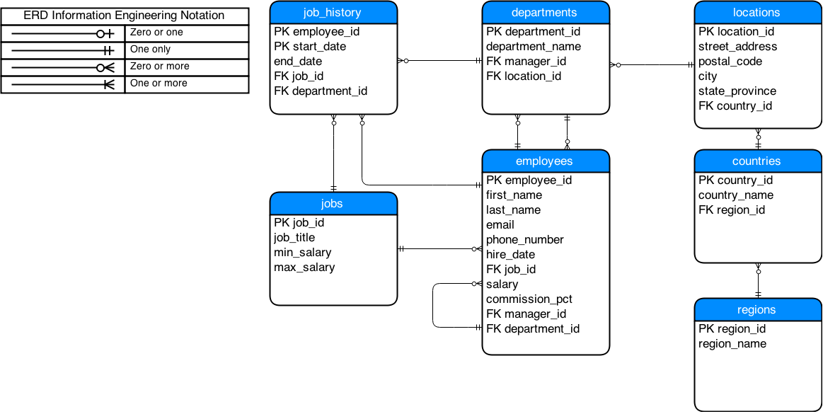
HR Schema

Slide 21
Simple SELECT statement
SELECT * -- asterisk = all columns
FROM employees; -- semicolon is required in some tools
ID | FIRST_NAME | SURNAME | SALARY | DEPARTMENT_ID
1 | Radoslav | Golian | 100 | 10
2 | Larry | Ellison | 2000 | 10
3 | Tom | Kyte | 1000 | 20
SELECT e.id "Id",
e.first_name as fn,
employees.salary -- projection
FROM employees e -- e is an alias
WHERE e.salary >= 1000 -- restriction / selection
ORDER BY e.salary -- ordering
Id | FN | SALARY
1 | Tom | 1000
2 | Larry | 2000

Slide 22
Operators
Arithmetic
  , *, /, +, -
Concatenation
  ||
  Example: ‘string1’ || ‘string2’ = ‘string1string2’
Conditional
  =, <, >, <>, <=, >=,
  IS [NOT] NULL, [NOT] LIKE, [NOT] BETWEEN, [NOT] IN
  NOT, OR, AND,

Slide 23
Operator precedence
Precedence
  +, - (unary)
  *, /
  +, - (binary), ||
  SQL conditions
    =, !=, <, >, <=, >=
    IS [NOT] NULL, LIKE, [NOT] BETWEEN, [NOT] IN, EXISTS
    NOT
    AND
    OR

Slide 24
LIKE
expr1 [NOT] LIKE expr2
  %, _, ESCAPE
ID | FIRST_NAME | SURNAME | SALARY | DEPARTMENT_ID
1 | Radoslav | Golian | 100 | 10
2 | Larry | Ellison | 2000 | 10
3 | Tom | Kyte | 1000 | 20
SELECT e.id, e.first_name || ‘ ’ || e.surname name,
e.salary, rownum
FROM employees e
WHERE e.surname LIKE ‘%li%'
ORDER BY e.salary DESC
ID | NAME | SALARY | ROWNUM
2 | Larry Ellison | 2000 | 2
1 | Radoslav Golian | 100 | 1

Slide 25
LIKE
ID | FIRST_NAME | SURNAME | SALARY | DEPARTMENT_ID
1 | Fero | Gorda | 100 | 10
2 | Jan | Gonda | 200 | 10
3 | Juraj | Gondal | 10 | 20
SELECT e.id, e.first_name, e.salary
FROM employees e
WHERE e.surname LIKE ‘Go_da'
ORDER BY e.salary
ID | FIRST_NAME | SURNAME | SALARY
1 | Radoslav | Gorda | 100
2 | Jan | Gonda | 200

Slide 26
LIKE
ID | FIRST_NAME | SURNAME | SALARY | DEPARTMENT_ID
1 | Radoslav | Go%ian | 100 | 10
2 | Jan | Golian | 200 | 10
3 | Juraj | Janosik | 10 | 20
SELECT e.id, e.first_name, e.salary
FROM employees e
WHERE e.surname LIKE ‘Go\%ian‘ ESCAPE ‘\’
ORDER BY e.salary
ID | FIRST_NAME | SURNAME | SALARY
1 | Radoslav | Go%ian | 100

Slide 27
BETWEEN
BETWEEN
  Expr1 [NOT] BETWEEN expr2 AND expr3
    Equivalent to [NOT] (expr2 <= expr1 AND expr1 <= expr3)
ID | FIRST_NAME | SURNAME | HIREDATE | DEPARTMENT_ID
1 | Radoslav | Golian | 2012-01-01 | 10
2 | Jozef | Mrkva | 2012-02-01 | 20
SELECT e.id, e.first_name, e.hiredate
FROM employees e
WHERE e.hiredate BETWEEN DATE ’2011-12-31’ AND DATE '2012-01-02'
ID | FIRST_NAME | SURNAME | HIREDATE
1 | Radoslav | Golian | 2012-01-01

Slide 28
IN
Expr1 [NOT] IN (expr2, expr3, ….)
  Equivalent to Expr1 = expr2 OR expr1 = expr3 OR …
ID | FIRST_NAME | SURNAME | SALARY | DEPARTMENT_ID
1 | Radoslav | Golian | 100 | 10
2 | Ján | Gonda | 200 | 10
3 | Juraj | Jánošík | 10 | 20
SELECT e.id, e.first_name as "First Name", e.salary
FROM employees e
WHERE e.surname IN ('Golian', 'Gonda')
ORDER BY e.salary
ID | First Name | SALARY
1 | Radoslav | 100
2 | Ján | 200

Slide 29
NOT IN
Expr1 NOT IN (expr2, NULL, ….)
  Equivalent to
  Expr1 <> expr2 AND expr1 <> NULL AND …
  Always FALSE
ID | FIRST_NAME | SURNAME | SALARY | DEPARTMENT_ID
1 | Radoslav | Golian | 100 | 10
2 | Ján | Gonda | 200 | 10
3 | Juraj | Jánošík | 10 | 20
SELECT e.id, e.first_name, e.salary
FROM employees e
WHERE e.surname NOT IN ('Gonda', NULL)
ORDER BY e.salary
ID | FIRST_NAME | SALARY

Slide 30
Pseudocolumn ROWNUM
Description
  Returns a number indicating the order in which the row was selected
  The first row selected has ROWNUM of 1, the second has 2, and so on.
  Condition rownum > x does not make sense
    x <= 0, always true
    x > 0, always false
Notes:
http://docs.oracle.com/cd/E11882_01/server.112/e26088/pseudocolumns009.htm

Slide 31
Pseudocolumn ROWNUM
ID | FIRST_NAME | SURNAME | SALARY | DEPARTMENT_ID
1 | Radoslav | Golian | 100 | 10
2 | Larry | Ellison | 2000 | 10
3 | Tom | Kyte | 1000 | 20
SELECT e.id, e.first_name, e.salary, rownum
FROM employees e
WHERE rownum = 1 -- get only first row
ORDER BY e.salary DESC -- !!! ordering is done after the restriction
ID | FIRST_NAME | SALARY | ROWNUM
1 | Radoslav | 100 | 1

Slide 32
DUAL Table
FROM clause is mandatory
  SELECT upper(‘a’)
    Does not work in Oracle
SQL> describe dual
Name Type Nullable Default Comments
----- ---------------- -------- ------- --------
DUMMY VARCHAR2(1 BYTE) Y
SQL> SELECT * FROM dual;
DUMMY
-----
X

Slide 33
DUAL Table
SELECT upper('a') FROM dual
-----------------------------------------------------------------
| Id | Operation | Name | Rows | Cost (%CPU)| Time |
-----------------------------------------------------------------
| 0 | SELECT STATEMENT | | 1 | 2 (0)| 00:00:01 |
| 1 | FAST DUAL | | 1 | 2 (0)| 00:00:01 |
-----------------------------------------------------------------
SELECT dummy FROM dual
--------------------------------------------------------------------------
| Id | Operation | Name | Rows | Bytes | Cost (%CPU)| Time |
--------------------------------------------------------------------------
| 0 | SELECT STATEMENT | | 1 | 2 | 2 (0)| 00:00:01 |
| 1 | TABLE ACCESS FULL| DUAL | 1 | 2 | 2 (0)| 00:00:01 |
--------------------------------------------------------------------------

Slide 34
CASE Expression
    CASE
    WHEN condition1 THEN result1
    WHEN condition2 THEN result2
    ...
    WHEN condition2 THEN resultN
    ELSE
    resultM
    END
    CASE selector
    WHEN expression1 THEN result1
    WHEN expression2 THEN result2
    ...
    WHEN expressionN THEN resultN
    ELSE
    resultM
    END
    SELECT /*simple*/
    CASE s.grade
    WHEN 'A' THEN 'Excellent'
    WHEN 'B' THEN 'Very good'
    WHEN 'C' THEN 'Good'
    WHEN 'D' THEN 'Fair'
    WHEN 'E' THEN 'Poor'
    WHEN 'Fx' THEN 'Bad luck'
    ELSE 'N/A'
    END
    FROM student_grade s
    SELECT /*searched*/
    CASE
    WHEN s.grade = 'A' THEN 'Excellent'
    WHEN s.grade = 'B' THEN 'Very good'
    WHEN s.grade = 'C' THEN 'Good'
    WHEN s.grade = 'D' THEN 'Fair'
    WHEN s.grade = 'E' THEN 'Poor'
    WHEN s.grade = 'Fx' THEN 'Bad luck'
    ELSE /*if not defined null */
    'N/A'
    END
    FROM student_grade s

