Slide 1
Oracle SQL (2)
Radoslav Golian
03.10.2018

Slide 2
Agenda
Ordering
Sets and Multisets
(Single-row) Functions
  numeric, string, date, comparison, null related
Subqueries
Joins
  cross, inner, outer, semi, anti
DML Statements
  INSERT, UPDATE, DELETE, MERGE

Slide 3
ORDER BY
ORDER BY exp [DESC|ASC] [NULLS FIRST|LAST]
  DESC – descending sort
  ASC – ascending sort (default)
  NULLS LAST – NULL values at the end (default)
  NULLS FIRST – NULL values at the beginning
  Exp could be also a subquery
SELECT * FROM employees e
ORDER BY e.commission DESC NULLS LAST,
e.salary DESC,
e.surname ASC

Slide 4
(Multi)set operations
(Multi)set operations implemented by Oracle
  UNION: {1,2} U {1,3} = {1,2,3}
  INTERSECT: {1,2} ∩ {1,3} = {1}
  MINUS: {1,2} – {1,3} = {2}
  UNION ALL: {1,2} U_{B} {1,3} = {1,1,2,3}
Not implemented by Oracle
  INTERSECT ALL: {1,1,2} ∩_{B} {1,1,2,3} = {1,1,2}
  MINUS ALL: {1,1,2} –_{B} {1,2,3} = {1}
ORDER BY clause is allowed only after the last component

Slide 5
(Multi)set operations
SELECT e.first_name
FROM employees e
WHERE e.department_id = 80
/*order by not allowed here*/
UNION [ALL] | INTERSECT | MINUS
SELECT eh.first_name
FROM eh.employees_history eh
WHERE eh.commission_pct IS NOT NULL
ORDER BY first_name

Slide 6
Numeric functions
ABS(x), BITAND(x, y)
TRUNC(x [, y]), ROUND(x [, y]), CEIL(x), FLOOR(x), REMAINDER(x, y), MOD(x, y)
POWER(x, y), SQRT(x)
LN(x), LOG(x, y),
SIN(x), COS(x), ACOS(x), …
Notes:
abs(-1) = abs(1) = 1
bitand(5,1) = 1 (101 & 001 = 001)
bitand(4,1) = 0 (10 & 01 = 0)
bitand(7, 3) = 3 (111 & 011 = 011)
bitand(6, 3) = 2 (110 & 011 = 010)
trunc(5.1) = trunc(5.9) = 5
trunc(16.12, -1) = 10
trunc(10.238, 2) = 10.23
round(5.1) = 5
round(5.9) = 6
round(16.12, -1) = 20
round(10.238, 2) = 10.24
ceil(4.1) = ceil(4.9) = 5
floor(4.1) = floor(4.9) = 4
mod (x, y) = x - y * FLOOR(x/y)
remainder(x, y) = x - y * ROUND(x/y)
power(3, 2) = 9
sqrt(225) = 15

Slide 7
String functions
CONCAT
  Equivalent to concatenation operator (II)
INITCAP, LOWER, UPPER
LPAD, RPAD
LTRIM, RTRIM, TRIM
CHR, ASCII
REPLACE, TRANSLATE
SUBSTR, INSTR, LENGTH
Notes:
CONCAT(‘stringA’, ‘stringB’) = ‘stringA’ || ‘stringB’ = ‘stringAstringB’
INITCAP(‘capital letters') = ‘Capital Letters‘
LOWER(‘SOMETHING') = ‘something’
UPPER(‘somethin') = ‘SOMETHING’
LPAD(‘A’, 5) = ‘ 5’
LPAD(‘15’, 5, ‘0’) = ‘00015’
RPAD(‘aaa’, 8, ‘BC’) = ‘aaaBCBCB’
CHR(67) = ‘C’
CHR(32) = ‘ ’
CHR(10) = \n (new line - unix)
CHR(13) || CHR(10) = \n\r (new line - windows)
ASCII(‘C’) = 67
ASCII(‘ ’) = 32
LTRIM(‘**&%&&WHAT%%#*#’, ‘&%#*’) = ‘WHAT%%#*#’
RTRIM(‘**&%&&WHAT%%#*#’, ‘&%#*’) = ‘**&%&&WHAT’
LTRIM(‘ WHAT ’) = TRIM(LEADING ‘ ’ FROM ‘ WHAT ’) = ‘WHAT ’
RTRIM(‘ WHAT ’) = TRIM(TRAILING ‘ ’ FROM ‘ WHAT ’) = ‘ WHAT’
TRIM(‘ WHAT ’) = TRIM(BOTH ‘ ’ FROM ‘ WHAT ’) = ‘WHAT’
TRIM(‘*’ FROM ‘****WHAT*******’) = ‘WHAT’
REPLACE(‘AAABBBCCC’, ‘AB’) = ‘AABBCCC’
REPLACE(‘AAABBBCCC’, ‘AB’, ‘XXX’) = ‘AAXXXBBCCC’
TRANSLATE(‘A&&BB****CC%%%DD’, ‘&*%’, ‘123’) = ‘A11BB2222CC333DD’
TRANSLATE(‘A&&BB****CC%%%DD$$’, ‘&*%$’, ‘123’) = ‘A11BB2222CC333DD’
TRANSLATE(‘A&&BB****CC%%%DD$$’, ‘&*%$’, ‘’) = NULL
TRANSLATE(‘A&&BB****CC%%%DD$$’, ‘@&*%$’, ‘@’) = ‘ABBCCDD’
SUBSTR(‘123456’, 3) = SUBSTR(‘123456’, 3, 4) = ‘3456’
SUBSTR(‘123456’, -3) = SUBSTR(‘123456’, -3, 3) = ‘456’
LENGTH(‘ABCD’) = 4
INSTR(where, what, position, occurrence)
INSTR(’AABBCBC’, ‘BC’) = 4
INSTR(’AABBCBC’, ‘BC’, -1) = 6
INSTR(’AABBCBC’, ‘BC’, 1, 2) = 6
INSTR(’AABBCBC’, ‘BC’, 5) = 6

Slide 8
Datetime Functions
ADD_MONTHS, MONTHS_BETWEEN
LAST_DAY, NEXT_DAY
ROUND, TRUNC
CURRENT_DATE, CURRENT_TIMESTAMP, SYSDATE, SYSTIMESTAMP,
Notes:
Details: http://docs.oracle.com/cd/E16655_01/server.121/e17209/functions002.htm#SQLRF51181
ADD_MONTHS(date ‘2014-01-31’, 1) = date ‘2014-02-28’
ADD_MONTHS(date ‘2014-01-28’, 1) = date ‘2014-02-28’
ADD_MONTHS(date ‘2014-01-27’, 1) = date ‘2014-02-27’
ADD_MONTHS(date ‘2014-02-28’, 1) = date ‘2014-03-31’
ADD_MONTHS(date ‘2014-01-27’, -1) = date ‘2013-12-27’
MONTHS_BETWEEN(date ‘2014-01-31’, date ‘2014-02-28’) = -1
MONTHS_BETWEEN(date ‘2014-01-28’, date ‘2014-02-28’) = -1
MONTHS_BETWEEN(date ‘2014-03-01’, date ‘2014-01-01’) = 2
MONTHS_BETWEEN(date ‘2014-03-27’, date ‘2014-01-25’) = 2.06451613
LAST_DAY(date ‘2014-01-12’) = date ‘2014-01-31’
LAST_DAY(date ‘2012-02-01’) = date ‘2012-02-29’
NEXT_DAY(date ‘2014-02-24’, ‘MONDAY’) = date ‘2014-03-03’
ROUND(date ‘2014-12-01’, ‘YEAR’) = date ‘2015-01-01’ (rounds up on July 1)
TRUNC(date ‘2014-04-01’, ‘YEAR’) = date ‘2014-01-01’
ROUND(date ‘2014-04-01’, ‘YEAR’) = TRUNC(date ‘2014-04-01’, ‘YEAR’) = date ‘2014-01-01’
TRUNC(date ‘2014-04-10’, ‘MONTH’) = date ‘2014-04-01’
See more: http://docs.oracle.com/cd/E16655_01/server.121/e17209/functions265.htm#SQLRF52059
ALTER SESSION SET TIME_ZONE = '-5:0';
CURRENT_DATE, CURRENT_TIMESTAMP, SYSDATE, SYSTIMESTAMP
ALTER SESSION SET TIME_ZONE = ‘+5:0';
CURRENT_DATE, CURRENT_TIMESTAMP, SYSDATE, SYSTIMESTAMP
SYSDATE and SYSTIMESTAMP give the same value – system time of the server (difference will be in seconds)
CURRENT_DATE and CURRENT_TIMESTAMP give different values (10 hours) – system time is converted using session time zone

Slide 9
Comparison Functions
GREATEST
  GREATEST(1, 4.14, 2, 0) = 4.14
  GREATEST('ab', 'bb', 'bc', 'ac') = 'bc'
LEAST
  LEAST(1, 4.14, 2, 0) = 0
  LEAST('ab', 'bb', 'bc', 'ac') = 'ab'

Slide 10
Conversion Functions
TO_CHAR (datetime), TO_CHAR(number)
TO_NUMBER
TO_DATE, TO_TIMESTAMP, TO_TIMESTAMP_TZ
TO_CLOB, TO_BLOB
CAST: CAST (<value> AS <type>)
CONVERT
NUMTODSINTERVAL, TO_DSINTERVAL, TO_YMINTERVAL, NUMTOYMINTERVAL
Notes:
TO_CHAR(timestamp ‘2014-01-01 22:11:10’ ,’DD.MM.YYYY HH24:MI’) = 01.01.2014 22:11
For more format models see: http://docs.oracle.com/cd/E16655_01/server.121/e17209/sql_elements004.htm#SQLRF00210

Slide 11
Encoding & Decoding Functions
DECODE
  DECODE(job_id, 'IT_PROG', 1.2*salary,
  'ST_CLERK', 1.1*salary,
  'SA_REP', 1.05*salary,
  salary)
DUMP
  DUMP(‘abc’) = ‘Typ=96 Len=3: 97,98,99’
VSIZE
  Number of bytes in the internal representation
  VSIZE(‘aaa’) = 3
  VSIZE(1) = 2
  VSIZE(date ‘2014-01-31’) = 7

Slide 12
NULL related functions
COALESCE
  Short-circuit evaluation
  COALESCE(null, null, 1, 2, 3) = 1
NVL(x, y)
  All arguments are evaluated
  CASE x IS NOT NULL THEN x ELSE y END
  NVL(null, 1) = 1
  NVL(1, 2) = 1
NVL2(x, y, z)
  All arguments are evaluated
  CASE x IS NULL THEN y ELSE z END
  NVL2(NULL, 1, 2) = 1
  NVL2(3, 1, 2) = 2
NULLIF(x, y)
  CASE WHEN x = y THEN NULL ELSE x END
  z / NULLIF(x, 0) – to avoid division by zero error

Slide 13
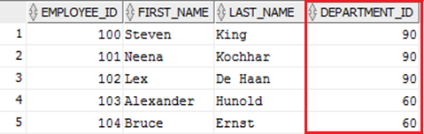
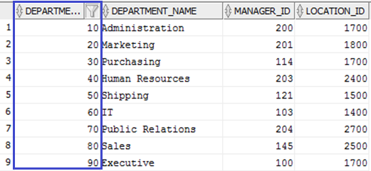
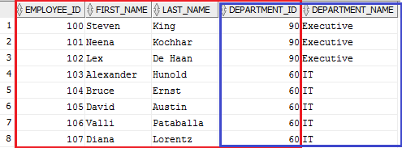
Joins
Obtaining data from multiple tables
EMPLOYEES
DEPARTMENTS
RESULT

Slide 14
CROSS JOIN
SELECT *
FROM tab1, tab2;
SELECT *
FROM tab1 CROSS JOIN tab2;
TAB1
TAB2
A | B
1 | 1
2 | null
C | D
1 | 2
2 | 3
3 | null
A | B | C | D
1 | 1 | 1 | 2
1 | 1 | 2 | 3
1 | 1 | 3 | null
2 | null | 1 | 2
2 | null | 2 | 3
2 | null | 3 | null
Notes:
Cartesian product
Pseudocode:
FOR l_tab1_row IN (SELECT * from tab1) LOOP
FOR l_tab2_row IN (SELECT * from tab2) LOOP
dbms_output.put_line(l_tab1_row, l_tab2_row);
END LOOP;
END LOOP;

Slide 15
CROSS JOIN (example)
Generating test data
SELECT ROWNUM id,
CASE ceil(dbms_random.value(0, 2))
WHEN 1 THEN 'M'
WHEN 2 THEN 'F' END gender,
CASE ceil(dbms_random.value(0, 5))
WHEN 1 THEN '18 and under'
WHEN 2 THEN '19-25'
WHEN 3 THEN '26-30'
WHEN 4 THEN '31-40'
WHEN 5 THEN '41 and over' END age_group,
rpad('*', 200, '*') data
FROM (SELECT NULL FROM dual CONNECT BY LEVEL < 1e6)
CROSS JOIN
(SELECT NULL FROM dual CONNECT BY LEVEL < 100);

Slide 16
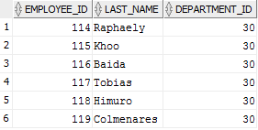

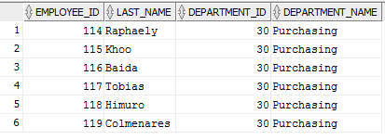
INNER JOIN
SELECT e.employee_id, e.last_name, d.department_id, d.department_name
FROM hr.employees e
INNER JOIN hr.departments d ON (d.department_id = e.department_id)
WHERE d.department_id = 30
EMPLOYEES
DEPARTMENTS

Slide 17
INNER JOIN
SELECT *
FROM tab1, tab2
WHERE tab1.b = tab2.d;
SELECT *
FROM tab1 INNER JOIN tab2 ON tab1.b = tab2.d;
TAB1
TAB2
A | B
1 | 1
2 | 1
3 | 2
4 | 3
5 | 4
6 | null
C | D
1 | 1
2 | 2
3 | 2
4 | 4
5 | null
A | B | C | D
1 | 1 | 1 | 1
2 | 1 | 1 | 1
3 | 2 | 2 | 2
3 | 2 | 3 | 2
5 | 4 | 4 | 4
Notes:
Podmienka samozrejme môže byť zložitejší výraz – v podstate ľubovoľná boolovská funkcia nad stĺpcami joinovaných tabuliek
Pre každý záznam z tab1 vyberie všetky záznamy z tab2, ktoré spĺňajú join podmienku.
Jedna z implementacii (nested loops):
Pseudokód:
FOR l_tab1_row IN (SELECT * from tab1) LOOP
FOR l_tab2_row IN (SELECT * from tab2) LOOP
IF join_condition(l_tab1_row, l_tab2_row) THEN
dbms_output.put_line(l_tab1_row, l_tab2_row);
END IF;
END LOOP;
END LOOP;

Slide 18
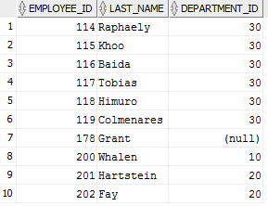
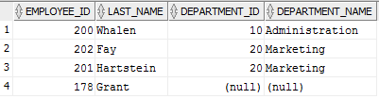
LEFT OUTER JOIN
SELECT e.employee_id, e.last_name, d.department_id, d.department_name
FROM hr.employees e
LEFT OUTER JOIN hr.departments d ON (d.department_id = e.department_id)
WHERE d.department_id IN (10, 20) OR d.department_id IS NULL
EMPLOYEES
DEPARTMENTS

Slide 19
LEFT OUTER JOIN
SELECT *
FROM tab1, tab2
WHERE tab1.b = tab2.d(+);
SELECT *
FROM tab1 LEFT OUTER JOIN tab2 ON tab1.b = tab2.d;
TAB1
TAB2
a | b | c | d
1 | 1 | 1 | 1
2 | 1 | 1 | 1
3 | 2 | 2 | 2
3 | 2 | 3 | 2
4 | 3 | null | null
5 | 4 | 4 | 4
6 | null | null | null
a | b
1 | 1
2 | 1
3 | 2
4 | 3
5 | 4
6 | null
c | d
1 | 1
2 | 2
3 | 2
4 | 4
5 | null
Notes:
Operátor (+) udáva, ktorá z hodnôt môže byť NULL.
Pre každý záznam z tab1 vyberie všetky záznamy z tab2, ktoré spĺňajú join podmienku, pričom každý záznam z tabuľky tab1 sa vyskytne vo výsledku aspoň raz, ak k nemu neexistuje v tabuľke tab2 záznam, tak položky z tabuľky tab2 budú mať hodnotu NULL (V tabuľke označené červenou farbou)
NULL = NULL je NULL nie TRUE!
Jedna z implementacii (nested loops):
Pseudokód:
FOR l_tab1_row IN (SELECT * from tab1) LOOP
l_found := FALSE;
FOR l_tab2_row IN (SELECT * from tab2) LOOP
IF join_condition(l_tab1_row, l_tab2_row) THEN
dbms_output.put_line(l_tab1_row, l_tab2_row);
l_found := TRUE;
END IF;
END LOOP;
IF NOT l_found THEN
dbms_output.put_line(l_tab1_row, NULL);
END IF;
END LOOP;

Slide 20

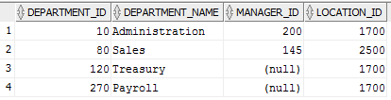
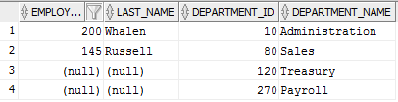
RIGHT OUTER JOIN
SELECT e.employee_id, e.last_name, d.department_id, d.department_name
FROM hr.employees e
RIGHT OUTER JOIN hr.departments d ON (d.manager_id = e.employee_id)
WHERE d.department_id IN (10, 80, 120, 270)
EMPLOYEES
DEPARTMENTS

Slide 21
RIGHT OUTER JOIN
SELECT *
FROM tab1, tab2
WHERE tab1.b(+) = tab2.d;
SELECT *
FROM tab1 RIGHT OUTER JOIN tab2 ON tab1.b = tab2.d;
TAB1
TAB2
a | B
1 | 1
2 | 1
3 | 2
4 | 3
5 | 4
6 | null
a | b | c | d
1 | 1 | 1 | 1
2 | 1 | 1 | 1
3 | 2 | 2 | 2
3 | 2 | 3 | 2
5 | 4 | 4 | 4
null | null | 5 | null
c | d
1 | 1
2 | 2
3 | 2
4 | 4
5 | null
Notes:
FULL OUTER JOIN nie je možné vykonať nasledovne: SELECT * FROM tab1, tab2 WHERE tab1.b(+) = tab2.d(+)
Podobné ako LEFT/RIGHT OUTER JOIN, s tým, že každý záznam z obidvoch tabuliek sa vyskytne vo výsledku aspoň raz, ak sa nenájde k nemu záznam z druhej tabuľky (podľa join podmienky), tak vo výslednom zázname bude v stĺpcoch patriacich druhej tabuľke hodnota NULL.
Červenou sú označené záznamy, ku ktorým sa nenašiel záznam z pravej tabuľky, ktorý by spĺňal join podmienku.
Modrou sú označené záznamy, ku ktorým sa nenašiel záznam z ľavej tabuľky, ktorý by spĺňal join podmienku.
FULL OUTER JOIN (Je to možné prepísať aj pomocou (+) notácie):
SELECT FROM tab1 LEFT OUTER JOIN tab2 ON tab1.b= tab2.d
UNION ALL
SELECT * FROM tab1 RIGHT OUTER JOIN tab2 ON tab1.b= tab2.d
WHERE a IS NULL;

Slide 22
SELF JOIN
SELECT *
FROM hr.employees e1
INNER JOIN hr.employees e2
ON (e1.manager_id = e2.employee_id)
SELECT *
FROM hr.employees e1
LEFT OUTER JOIN hr.employees e2
ON (e1.manager_id = e2.employee_id)

Slide 23
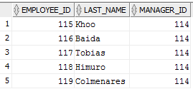

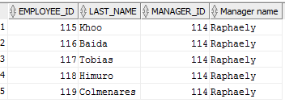
SELF JOIN
SELECT e1.employee_id, e1.last_name, e1.manager_id, e2.last_name "Manager name"
FROM hr.employees e1
INNER JOIN hr.employees e2 ON (e1.manager_id = e2.employee_id)
WHERE e1.manager_id = 114
EMPLOYEES E1
EMPLOYEES E2

Slide 24
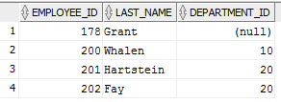

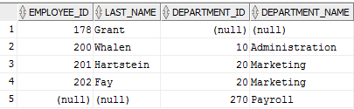
FULL OUTER JOIN
SELECT e.employee_id, e.last_name, d.department_id, d.department_name
FROM hr.employees e
FULL OUTER JOIN hr.departments d ON (d.department_id = e.department_id)
WHERE d.department_id IN (10, 20, 270) OR e.employee_id = 178
EMPLOYEES
DEPARTMENTS

Slide 25
FULL OUTER JOIN
SELECT *
FROM tab1 FULL OUTER JOIN tab2 ON tab1.b = tab2.d;
TAB1
TAB2
a | b | c | d
1 | 1 | 1 | 1
2 | 1 | 1 | 1
3 | 2 | 2 | 2
3 | 2 | 3 | 2
4 | 3 | null | null
5 | 4 | 4 | 4
null | null | 5 | null
6 | null | null | null
a | B
1 | 1
2 | 1
3 | 2
4 | 3
5 | 4
6 | null
c | D
1 | 1
2 | 2
3 | 2
4 | 4
5 | null

Slide 26

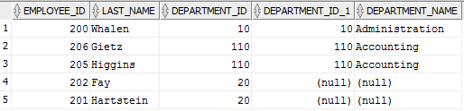
OUTER JOIN (join predicates)
SELECT e.employee_id, e.last_name, e.department_id, d.department_id, d.department_name
FROM hr.employees e
LEFT OUTER JOIN hr.departments d ON (d.department_id = e.department_id)
WHERE e.department_id IN (10, 20, 110)
AND d.department_name LIKE 'A%';
SELECT e.employee_id, e.last_name, e.department_id, d.department_id, d.department_name
FROM hr.employees e
LEFT OUTER JOIN hr.departments d ON (d.department_id = e.department_id AND d.department_name LIKE 'A%')
WHERE
e.department_id IN (10, 20, 110)

Slide 27
OUTER JOIN (join predicates)
SELECT * FROM tab1, tab2
WHERE tab1.b = tab2.d(+) AND tab2.d = 2;
SELECT *
FROM tab1 LEFT OUTER JOIN tab2 ON tab1.b = tab2.d
WHERE tab2.d = 2;
TAB1
TAB2
a | b
1 | 1
2 | 1
3 | 2
4 | 3
5 | 4
6 | null
c | d
1 | 1
2 | 2
3 | 2
4 | 4
5 | null
a | b | c | d
3 | 2 | 2 | 2
3 | 2 | 3 | 2
Notes:
Používame podmienku, ktorá spôsobí to, že vyberieme len záznamy, ktoré neobsahujú NULL hodnoty (konkrétne, ktoré obsahujú hodnotu 2), teda OUTER JOIN je zbytočný, postačuje INNER JOIN.
Zelenou sú označené záznamy, ktoré budú vybrané uvedeným selektom.
Ekvivalentné selekty:
SELECT * FROM tab1, tab2
WHERE tab1.b = tab2.d AND tab2.d = 2
SELECT *
FROM tab1 INNER JOIN tab2 ON tab1.b = tab2.d
WHERE tab2.d = 2

Slide 28
OUTER JOIN (join predicates)
SELECT * FROM tab1, tab2
WHERE tab1.b(+) = tab2.d AND tab2.d(+) = 2;
SELECT *
FROM tab1 LEFT OUTER JOIN tab2 ON tab1.b = tab2.d
AND tab2.d = 2;
TAB1
TAB2
a | b
1 | 1
2 | 1
3 | 2
4 | 3
5 | 4
6 | null
c | d
1 | 1
2 | 2
3 | 2
4 | 4
5 | null
a | b | c | d
1 | 1 | null | null
2 | 1 | null | null
3 | 2 | 2 | 2
3 | 2 | 3 | 2
4 | 3 | null | null
5 | 4 | null | null
6 | null | null | null
Notes:
Červenou sú označené záznamy, ku ktorým sa nenašiel záznam z pravej tabuľky, ktorý by spĺňal join podmienku.
Nasledujúce dopyty nie sú ekvivalentné s dopytmi uvedenými na slide. Podmienka „tab2.d = 2 OR tab2.d IS NULL“ nie je join podmienka a vykoná sa až po dopyte
SELECT *
FROM tab1 LEFT OUTER JOIN tab2 ON tab1.b = tab2.d
WHERE tab2.d = 2 OR tab2.d IS NULL
SELECT * FROM tab1, tab2
WHERE tab1.b(+) = tab2.d AND (tab2.d = 2 OR tab2.d IS NULL)

Slide 29
Subqueries
Subquery
  SELECT statement within SELECT/DML statement
Types
  Correlated
  Non-correlated
SELECT * FROM employees
WHERE employee_id IN
(SELECT employee_id FROM bonuses);
SELECT * FROM (SELECT * FROM table)

Slide 30
Paging (< 12c)
SELECT ename, sal, deptno FROM (
SELECT ename, sal, deptno, ROWNUM rnum FROM (
SELECT e.ename, e.sal, e.deptno
FROM emp e WHERE e.sal BETWEEN 1000 AND 3000
ORDER BY e.ename)
WHERE ROWNUM <= 10)
WHERE rnum > 5

Slide 31
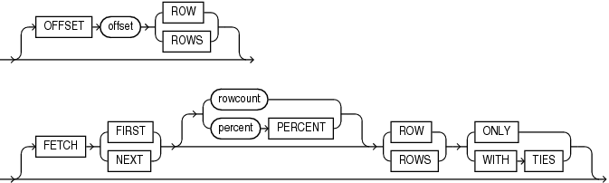
Paging (12c)
SELECT employee_id, last_name
FROM employees
ORDER BY employee_id
OFFSET 5 ROWS FETCH NEXT 5 ROWS ONLY;

Slide 32
Scalar subquery
A query in SELECT clause
  returns exactly one column and at most one row
  results for distinct variables are cached
  useful if cardinality of variable’s values is low
  could be used to remove left/right outer join
SELECT
e.ename,
(SELECT d.dname -- correlated: d.deptno = e.deptno
FROM dept d WHERE d.deptno = e.deptno) dname
FROM emp e;
Notes:
Výhoda tohto prístupu je cacheovanie..
Pokiaľ máme x rôznych deptno, skalárne subquery vykoná len raz pre každé deptno (samozrejme existujú výnimky, nemusí to byť vždy práve raz pokiaľ je príliš veľa rôznych deptno, ale caching mechanizmus tam je)..
Len pre zaujímavosť:
Je možné vrátiť aj viacero stĺpcov a riadkov, ak pretypujeme výsledok na kurzor – budeme mať teda jeden stĺpec typu kurzor
SELECT
e.ename,
CURSOR(SELECT d.* FROM dept d WHERE d.deptno = e.deptno) dname
FROM emp e;

Slide 33


SEMI JOIN
SELECT e.employee_id, e.last_name, e.department_id
FROM hr.employees e
WHERE EXISTS (SELECT NULL FROM hr.departments d
WHERE d.department_id = e.department_id
AND d.department_name LIKE 'A%');
SELECT e.employee_id, e.last_name, e.department_id
FROM hr.employees e
WHERE e.department_id IN (SELECT d.department_id
FROM hr.departments d
WHERE d.department_name LIKE 'A%');
DEPARTMENTS

Slide 34
SEMI JOIN
SELECT * FROM tab1
WHERE tab1.b IN (SELECT tab2.d FROM tab2);
SELECT * FROM tab1
WHERE EXISTS (SELECT NULL FROM tab2 WHERE tab2.d = tab1.b);
TAB1
TAB2
a | b
1 | 1
2 | 1
3 | 2
4 | 3
5 | 4
6 | null
c | d
1 | 1
2 | 2
3 | 2
4 | 4
5 | null
a | b
1 | 1
2 | 1
3 | 2
5 | 4
Notes:
IN – malá tabuľka tab2, veľká tabuľka tab1
EXISTS – malá tabuľka tab1, veľká tabuľka tab2

Slide 35
ANTI JOIN
SELECT * FROM tab1
WHERE tab1.b NOT IN (SELECT tab2.d FROM tab2);
SELECT * FROM tab1
WHERE NOT EXISTS (SELECT NULL FROM tab2 WHERE tab2.d = tab1.b);
SELECT tab1.*
FROM tab1 LEFT OUTER JOIN tab2 ON tab1.b = tab2.d
WHERE tab2.d IS NULL;
NULL values in NOT IN
x NOT IN (2, NULL, 3) equals
x <> 2 AND x <> NULL AND x <> 3
Notes:
NOT IN – malá tabuľka tab2, veľká tabuľka tab1
NOT EXISTS – malá tabuľka tab1, veľká tabuľka tab2

Slide 36
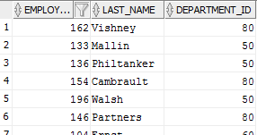
ANTI JOIN
SELECT e.employee_id, e.last_name, e.department_id
FROM hr.employees e
WHERE NOT EXISTS (SELECT NULL FROM hr.departments d
WHERE d.manager_id = e.employee_id);
SELECT e.employee_id, e.last_name, e.department_id
FROM hr.employees e
LEFT OUTER JOIN hr.departments d ON (d.manager_id = e.employee_id)
WHERE d.manager_id IS NULL;

Slide 37

ANTI JOIN
SELECT e.employee_id, e.last_name, e.department_id
FROM hr.employees e
WHERE e.employee_id NOT IN (SELECT d.manager_id
FROM hr.departments d );

Slide 38
NATURAL JOIN
SELECT * FROM tab1 NATURAL [INNER|LEFT|RIGHT|FULL [OUTER]] JOIN tab2
SELECT *
FROM employees
NATURAL JOIN departments
NATURAL JOIN jobs

Slide 39
NATURAL JOIN
Features
  Join condition is implicit and depends on column names of joined tables: AND(tab1.ci = tab2.ck), for i, k where the names ci a ck are equal
  If there is no equally named column then resulting join method is CROSS JOIN
  Bug waiting to happen → do not use
    adding, removing, renaming of a column may lead to result set change
Notes:
AND je tu myslený v podobnom kontexte ako suma.
USING syntax nie je „nebezpečná“
Príklad:
Pridáme stĺpec do jednej z tabuliek, ktorý bude mať rovnaké meno ako stĺpec z druhej tabuľky, čím rozšírime množinu stĺpcov, z ktorých sa vytvára join podmienka, čo nám pravdepodobne zmení výsledky dopytu.
Premenujeme stĺpec v jednej z tabuliek, čím rozšírime alebo zúžime množinu stĺpcov, z ktorých sa vytvára join podmienka.
Odstránime stĺpec v jednej z tabuliek, čím zúžime množinu stĺpcov, z ktorých sa vytvára join podmienka.
Možné problémy s typmi stĺpcov – pokiaľ sme pôvodne nemali v úmysle joinovať podľa nového/premenovaného stĺpca a máme dva stĺpce v joinovaných tabuľkách s rovnakým menom, pričom majú rôzne typy, môže dôjsť k chybe pri konverzii, teda dopyt nebude vôbec fungovať (čo je nakoniec ten lepší prípad ako predchádzajúce 3, keďže budeme vedieť, že je v dopyte chyba)

Slide 40
INSERT
Creates a new row in a table
insert into hr.employees
(employee_id, first_name, last_name, email,
phone_number, hire_date, job_id,
salary, commission_pct, manager_id, department_id)
values
(1000, 'Radoslav', 'Golian', 'rgolian@gmail.com',
'+421999111222', DATE '2004-04-01', 'SA_REP',
100, 0.25, 145, 80);
insert into hr.employees
values
(1000, 'Radoslav', 'Golian', 'rgolian@gmail.com',
'+421999111222', DATE '2004-04-01', 'SA_REP',
100, 0.25, 145, 80);
Notes:
http://docs.oracle.com/cd/E16655_01/server.121/e17209/sql_elements001.htm#SQLRF30020

Slide 41
INSERT
Copying data: INSERT … SELECT ….
insert into myschema.employees
(employee_id, first_name, last_name, email,
phone_number, hire_date, job_id,
salary, commission_pct, manager_id, department_id)
select employee_id, first_name, last_name, email,
phone_number, hire_date, job_id,
salary, commission_pct, manager_id, department_id
from hr.employees
where ...

Slide 42
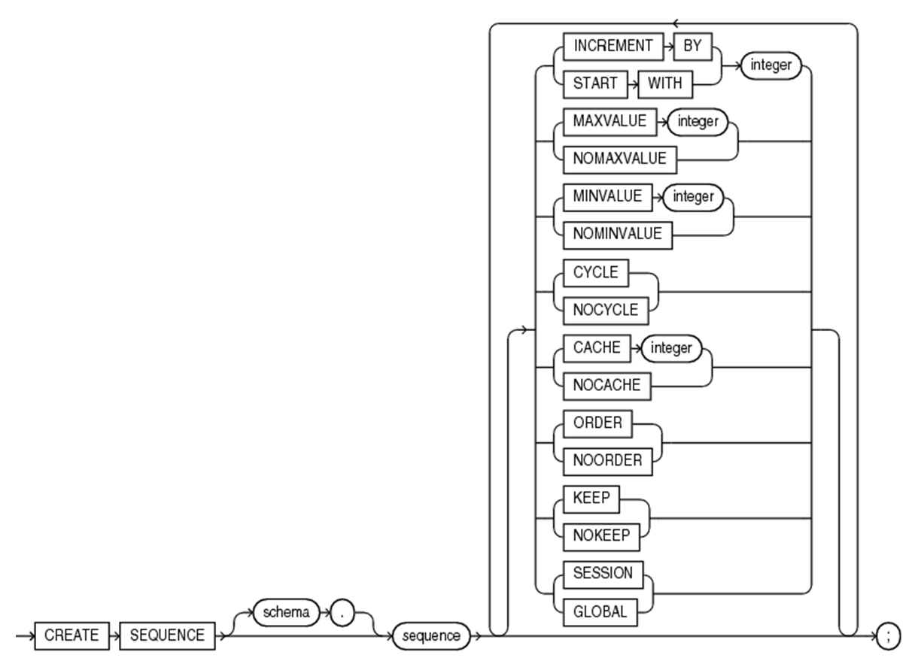
Generating IDs
Sequences
CREATE SEQUENCE
  KEEP|NOKEEP (12c)
  SESSION|GLOBAL (12c)

Slide 43
Sequences
NEXTVAL attribute
  Gets next value from sequence
CURRVAL attribute
  Gets current value from sequence
The most important parameters
  CACHE
    Interval of IDs stored in memory
    Should be bigger if we are inserting a lot
  NOCACHE
    Every NEXTVAL call imply an I/O operation
  ORDER
    Forces ordered ID generation
  SESSION|GLOBAL
    Session or global sequence (useful for temporary tables)

Slide 44
INSERT with generated id
CREATE SEQUENCE customers_seq
START WITH 1
INCREMENT BY 1
CACHE 100;
INSERT INTO customers(id, ...)
VALUES (customers_seq.nextval, ...);

Slide 45
Identity Column (12c)
CREATE TABLE identity_test (
id NUMBER GENERATED ALWAYS AS IDENTITY,
description VARCHAR2(30)
);
-- OK
INSERT INTO identity_test (description)
VALUES ('Some description');
-- error
INSERT INTO identity_test (description)
VALUES (100, 'Some description');
-- error
INSERT INTO identity_test (description)
VALUES (NULL, 'Some description');

Slide 46
Identity Column (12c)
CREATE TABLE identity_test (
id NUMBER GENERATED BY DEFAULT AS IDENTITY,
description VARCHAR2(30)
);
-- OK
INSERT INTO identity_test (description)
VALUES ('Some description');
-- OK
INSERT INTO identity_test (description)
VALUES (100, 'Some description');
-- error
INSERT INTO identity_test (description)
VALUES (NULL, 'Some description');

Slide 47
Identity Column (12c)
CREATE TABLE identity_test (
id NUMBER GENERATED BY DEFAULT
ON NULL AS IDENTITY,
description VARCHAR2(30)
);
-- OK
INSERT INTO identity_test (description)
VALUES ('Some description');
-- OK
INSERT INTO identity_test (description)
VALUES (100, 'Some description');
-- OK
INSERT INTO identity_test (description)
VALUES (NULL, 'Some description');

Slide 48
Multi-table INSERT
INSERT ALL
INTO <table_name> VALUES (<column_name_list>)
INTO <table_name> VALUES (<column_name_list>)
...
subquery;
INSERT ALL
INTO customers VALUES (customer_id, program_id, delivered_date)
INTO orders VALUES (order_date, program_id)
SELECT program_id, delivered_date, customer_id, order_date
FROM some_table

Slide 49
Multi-table INSERT
INSERT [ALL|FIRST]
WHEN (<condition>) THEN
INTO <table_name> (<column_list>)
VALUES (<values_list>)
WHEN (<condition>) THEN
INTO <table_name> (<column_list>)
VALUES (<values_list>)
...
ELSE
INTO <table_name> (<column_list>)
VALUES (<values_list>)
subquery;

Slide 50
Multi-table INSERT (example)
INSERT ALL
WHEN ottl < 100000 THEN INTO small_orders VALUES (oid, ottl, sid, cid)
WHEN ottl > 290000 THEN INTO special_orders
VALUES (oid, ottl, sid, cid)
SELECT o.order_id oid, o.customer_id cid, o.order_total ottl, o.sales_rep_id sid, c.credit_limit cl, c.cust_email cem
FROM orders o
INNER JOIN customers c ON o.customer_id = c.customer_id;

Slide 51
UPDATE
Modifies a row
update hr.employees e
set e.salary = e.salary * 1.05,
e.commision_pct = NULL
where e.department_id = 50;
update hr.employees e
set (e.job_id, e.phone_number, e.salary)
= (select 'ST_MAN','650.124.9876', salary * 1.5
from dual)
where e.employee_id = 131;
update (select salary
from hr.employees
where department_id = 50) e
set e.salary = 10000;

Slide 52
DELETE
Deletes a row
delete
from hr.employees e
delete
from hr.employees e
where e.employee_id = 100
delete
from (select employee_id
from hr.employees
where employee_id = 100) e

Slide 53
MERGE
MERGE INTO tab
USING (table|view|subquery) ON (cond)
[WHEN MATCHED THEN
UPDATE SET tab.col1 = expr, …
WHERE cond
[DELETE WHERE cond]]
[WHEN NOT MATCHED THEN
INSERT [(column list)] VALUES (…)
[WHERE cond]]
Notes:
Príkaz umožňuje vykonať súčasne UPDATE, INSERT a DELETE
Pre každý záznam z tabuľky/pohľadu/dopytu uvedenom v USING klauzule sa pokúsime nájsť záznam v tabuľke tab, ktorý spĺňa podmienku v ON klauzule
Pokiaľ sa taký záznam nájde vykoná WHEN MATCHED klauzula
Pokiaľ sa taký záznam nenájde vykoná WHEN NOT MATCHED klauzula
Všetky operácie UPDATE, INSERT, DELETE sa vykonávajú nad tabuľkou tab, pričom pri každom z týchto príkazov je možné uviesť WHERE klauzulu, teda vykonať príkaz iba vtedy ak je splnená nejaká podmienka

Slide 54
MERGE (example)
MERGE INTO bonuses b
USING (
SELECT employee_id, salary, department_id
FROM employees WHERE department_id = 20) e
ON (b.employee_id = e.employee_id)
WHEN MATCHED THEN
UPDATE SET b.bonus = e.salary * 0.1
DELETE WHERE e.salary < 40000
WHEN NOT MATCHED THEN`
INSERT (b.employee_id, b.bonus)
VALUES (e.employee_id, e.salary * 0.1)
WHERE (e.salary > 40000);

