Slide 1
Oracle SQL (3)
Radoslav Golian
03.10.2018

Slide 2
Agenda
Aggregations

Slide 3
Aggregations (GROUP BY)
Aggregation based on defined expressions
  How the groups are created
    A group is a set of expressions (columns from FROM clause may be used in the expressions)
    Rows with the same value are in the same group
    Every group is represented by one row
    Within a group an aggregate function can be executed
  Only those non-aggregated expressions may appear in a SELECT clause which are defined in GROUP BY clause
SELECT e.department_id, sum(e.salary) FROM hr.employees e
GROUP BY e.department_id;

Slide 4


Aggregate Functions (all rows)
SELECT sum(e.salary), count(*) FROM hr.employees e;
SELECT sum(e.salary), count(*) FROM hr.employees e GROUP BY 1;
SELECT sum(e.salary), count(*) FROM hr.employees e GROUP BY ();
Wrong:
SELECT e.last_name, sum(e.salary) FROM hr.employees e;
SELECT e.last_name, sum(e.salary) FROM hr.employees e
GROUP BY e.departmend_id;

Slide 5
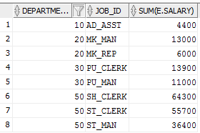
Aggregate Functions
SELECT e.department_id, e.job_id, sum(e.salary)
FROM hr.employees e
WHERE e.department_id IN (10, 20, 30, 50)
GROUP BY e.department_id, e.job_id
ORDER BY e.department_id, e.job_id;

Slide 6
HAVING
HAVING clause
  Allows to define a condition on aggregate function
  The conditions are applied after GROUP BY
  Aggregate function cannot be referenced in WHERE clause
  HAVING clause may contain a subquery
  HAVING clause may contain condition valid for WHERE clause (not a good practice)

Slide 7
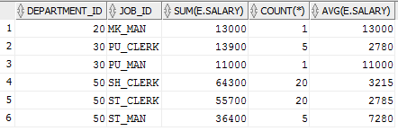
HAVING
SELECT e.department_id, e.job_id, sum(e.salary), count(*), avg(e.salary)
FROM hr.employees e
WHERE e.department_id IN (10, 20, 30, 50)
GROUP BY e.department_id, e.job_id
HAVING sum(e.salary) >= 1e4
ORDER BY e.department_id, e.job_id;

Slide 8
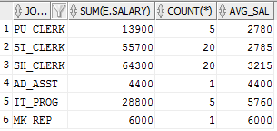
HAVING
SELECT e.job_id, sum(e.salary), count(*), avg(e.salary) avg_sal
FROM hr.employees e
GROUP BY e.job_id
HAVING avg(e.salary) < (SELECT median(e2.salary)
FROM hr.employees e2)
ORDER BY avg_sal;

Slide 9
Aggregate Functions
„Simple“
  AVG, COUNT, MAX, MEDIAN, MIN, SUM, ...
„Complex“
  FIRST, LAST + DENSE_RANK
  LISTAGG, DENSE_RANK + WITHIN GROUP
  MIN, MAX, SUM, AVG, COUNT + KEEP
Can appear in SELECT, HAVING, ORDER clauses
Notes:
DENSE_RANK = olympic rank, tj, ak sú dve hodnoty rovnaké, tak sú na tom istom mieste, pričom sa miesta nepreskakujú, tj. ak sú dvaja prvý, tak je aj druhé miesto nie len tretie.
Príklad : {13,10,10,11,12,13}
Usporiadanie je:
1 – 10
1 – 10
2 – 11
3 – 12
4 – 13
4 – 13
Obyčajné usporiadanie by bolo nasledujúce
1 – 10
1 – 10
3 – 11
4 – 12
5 – 13
5 – 13

Slide 10
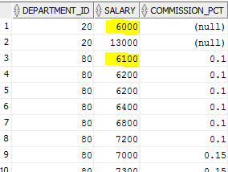

Aggregate Functions
SELECT e.department_id, e.salary, e.commission_pct
FROM hr.employees e
WHERE e.department_id IN (20, 80)
ORDER BY e.department_id, e.commission_pct, e.salary;
SELECT e.department_id, min(e.salary) KEEP (DENSE_RANK FIRST ORDER BY e.commission_pct) min_sal_com
FROM hr.employees e
WHERE e.department_id IN (20, 80)
GROUP BY e.department_id;
Notes:
Uvedený dopyt s KEEP vráti pre každé oddelenie minimálny plat z tých zamestnancov, ktorý majú najnižšie odmeny (comm)
S FIRST/LAST je možné použiť tieto agregačné funkcie MIN, MAX, SUM, AVG, COUNT, VARIANCE a STDDEV
Môžeme si to predstaviť aj takto:
Rozdelíme záznamy do skupín podľa oddelenia
Zotriedime záznamy v každej skupine podľa comm (odmena)
V každej skupine vyberieme záznamy, ktoré sú na prvom mieste
Pre každú skupinu vrátime minimálny plat zo záznamov vybraných v kroku 3.

Slide 11
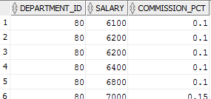

Aggregate Functions
SELECT e.department_id, salary, commission_pct
FROM hr.employees e
WHERE e.department_id = 80
ORDER BY e.salary, e.commission_pct;
SELECT e.department_id, dense_rank(6250, .1) WITHIN GROUP (ORDER BY e.salary, e.commission_pct) dr
FROM hr.employees e
WHERE e.department_id = 80
GROUP BY e.department_id;
Notes:
Uvedený dopyt s WITHIN GROUP spočíta umiestenie („olympijské“), kde by sa umiestnili dané hodnoty v jednotlivých oddeleniach, keď zotriedime plat a odmeny v jednotlivých oddeleniach.
Môžeme si to predstaviť aj takto:
Rozdelíme záznamy do skupín podľa oddelenia
Zotriedime záznamy v každej skupine podľa sal (plat) a comm (odmena)
Pozrieme sa, pre každú skupinu, na akom mieste by bola dvojica (3000, 100), kde 3000 je plat a 100 je odmena
Pre každú skupinu vrátime poradie vypočítané v kroku 3.
Funkcia akceptuje zoznam výrazov, ktoré musia byť konštantné v rámci každej skupiny

Slide 12
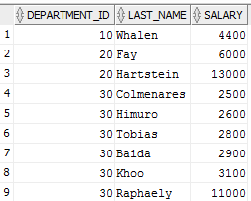

Aggregate Functions
SELECT e.department_id, listagg(e.last_name, ',') WITHIN GROUP (ORDER BY e.salary) l
FROM hr.employees e
WHERE e.department_id IN (10,20,30)
GROUP BY e.department_id
ORDER BY e.department_id;

Slide 13
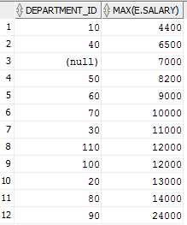


Nested Aggregate Functions
SELECT e.department_id, max(e.salary)
FROM hr.employees e
GROUP BY e.department_id
ORDER BY 2; -- order by column position
SELECT median(max(e.salary))
FROM hr.employees e
GROUP BY e.department_id;
SELECT median(e.salary)
FROM hr.employees e;

