Slide 1
Oracle SQL (4)
Radoslav Golian
03.10.2018

Slide 2
Agenda
Superaggregations
  GROUPING SETS
  ROLLUP
  CUBE
Analytic functions
Paging revisited

Slide 3
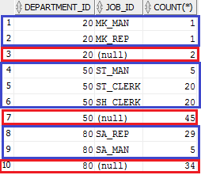
GROUPING SETS
Sets of group by expressions
Allows to execute more aggregations at once
  Without GROUPING SETS we would have to run more queries and combine the results with UNION ALL
SELECT e.department_id, e.job_id, count(*)
FROM hr.employees e
WHERE e.department_id IN (20, 50, 80)
GROUP BY e.department_id, e.job_id
UNION ALL
SELECT e.department_id, NULL, count(*)
FROM hr.employees e
WHERE e.department_id IN (20, 50, 80)
GROUP BY e.department_id
ORDER BY department_id -- without alias

Slide 4
GROUPING SETS
SELECT e.department_id, e.job_id, count(*)
FROM hr.employees e
WHERE e.department_id IN (20, 50, 80)
GROUP BY GROUPING SETS
(
(e.department_id, e.job_id),
(e.department_id)
)
ORDER BY e.department_id

Slide 5
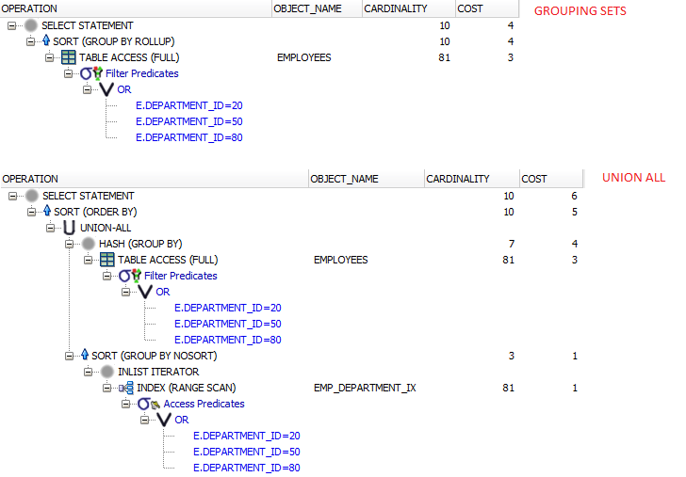
GROUPING SETS vs UNION ALL

Slide 6
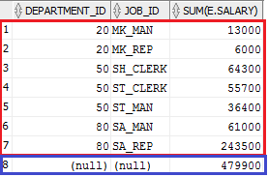
GROUPING SETS
SELECT e.department_id, e.job_id, sum(e.salary)
FROM hr.employees e
WHERE e.department_id IN (20, 50, 80)
GROUP BY GROUPING SETS ((e.department_id, e.job_id), ())
ORDER BY e.department_id
SELECT e.department_id, e.job_id, sum(e.salary)
FROM hr.employees e
WHERE e.department_id IN (20, 50, 80)
GROUP BY e.department_id, e.job_id
UNION ALL
SELECT NULL, NULL, sum(e.salary)
FROM hr.employees e
WHERE e.department_id IN (20, 50, 80)
ORDER BY department_id

Slide 7
ROLLUP
Creates aggregations
  No added functionality
  Every expression can be rewritten with GROUPING SETS
  For n expressions in GROUP BY ROLLUP creates n+1 groups:
    Group for all n expressions
    Group for first n-1 expressions
    ...
    Group for first n-n expressions
    ROLLUP (e₁, …, e_{n}) = GROUPING SETS ((e₁, …, e_{n}), …(e₁, …, e_{n-i}), …, (e₁), ())

Slide 8
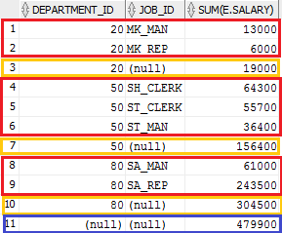
ROLLUP
SELECT e.department_id, e.job_id, sum(e.salary)
FROM hr.employees e
WHERE e.department_id IN (20, 50, 80)
GROUP BY ROLLUP (e.department_id, e.job_id)
ORDER BY e.department_id
SELECT e.department_id, e.job_id, sum(e.salary)
FROM hr.employees e
WHERE e.department_id IN (20, 50, 80)
GROUP BY GROUPING SETS (
(e.department_id, e.job_id),
(e.department_id),
())
ORDER BY e.department_id

Slide 9
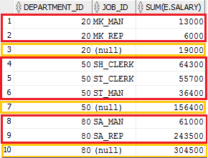
ROLLUP
SELECT e.department_id, e.job_id, sum(e.salary)
FROM hr.employees e
WHERE e.department_id IN (20,50,80)
GROUP BY e.department_id, ROLLUP (e.job_id)
ORDER BY e.department_id
SELECT e.department_id, e.job_id, sum(e.salary)
FROM hr.employees e
WHERE e.department_id IN (20,50,80)
GROUP BY GROUPING SETS (
(e.department_id, e.job_id),
(e.department_id))
ORDER BY e.department_id

Slide 10
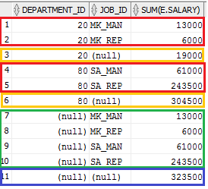
ROLLUP
SELECT e.department_id, e.job_id, sum(e.salary)
FROM hr.employees e
WHERE e.department_id IN (20,80)
GROUP BY ROLLUP (e.department_id), ROLLUP (e.job_id)
ORDER BY e.department_id, e.job_id
SELECT e.department_id, e.job_id, sum(e.salary)
FROM hr.employees e
WHERE e.department_id IN (20,80)
GROUP BY GROUPING SETS (
(e.department_id, e.job_id),
(e.department_id),
(e.job_id),
()
)
ORDER BY e.department_id

Slide 11
ROLLUP
ROLLUP (e.department_id), ROLLUP (e.department_id, e.job_id)
1 (e.department_id)
2 ()
X
a (e.department_id, e.job_id)
b (e.department_id)
c ()
1.a (e.department_id, e.department_id, e.job_id) =
(e.department_id, e.job_id)
2.a (e.department_id, e.job_id)
1.b (e.department_id, e.department_id) = (e.department_id)
2.b (e.department_id)
1.c (e.department_id)
2.c ()

Slide 12
CUBE
Creates aggregations for all expression combinations
  No added functionality
  Every expression can be rewritten with GROUPING SETS
  2^n aggregations, where n is count of expressions in CUBE
  CUBE(s₁, s₂, ... ,s_{n}) = ROLLUP(s₁) , ROLLUP(s₂), ..., ROLLUP(s_{n})
  CUBE(s₁, s₂, ... ,s_{n}) = GROUPING SETS (all combinations of (s₁, s₂, ... ,s_{n}) and () )

Slide 13
GROUP BY CUBE
SELECT e.department_id, e.job_id, sum(e.salary)
FROM hr.employees e
WHERE e.department_id IN (20,80)
GROUP BY CUBE(e.department_id, e.job_id)
ORDER BY e.department_id, e.job_id
SELECT e.department_id, e.job_id, sum(e.salary)
FROM hr.employees e
WHERE e.department_id IN (20,80)
GROUP BY GROUPING SETS (
(e.department_id, e.job_id),
(e.department_id),
(e.job_id),
()
)
ORDER BY e.department_id
Notes:
Samozrejme všetko je možne kombinovať dokopy :) (nehľadajte hlbší význam v nižšie uvedenom dopyte)
SELECT e.department_id, e.job_id, sum(e.salary)
FROM hr.employees e
GROUP BY GROUPING SETS(CUBE(e.department_id, e.job_id), ROLLUP(e.job_id))

Slide 14
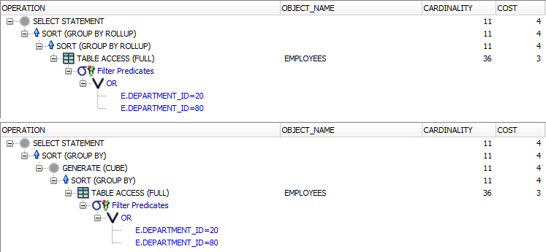
Execution plans
SELECT e.department_id, e.job_id, sum(e.salary)
FROM hr.employees e
WHERE e.department_id IN (20,80)
GROUP BY ROLLUP (e.department_id), ROLLUP (e.job_id)
GROUP BY CUBE(e.department_id, e.job_id)
ROLLUP
CUBE

Slide 15
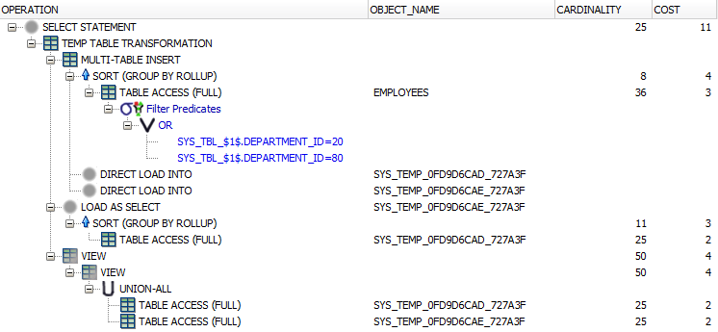
Execution plans
SELECT e.department_id, e.job_id, sum(e.salary)
FROM hr.employees e
WHERE e.department_id IN (20,80)
GROUP BY GROUPING SETS ((e.department_id, e.job_id),
(e.department_id), (e.job_id), () )

Slide 16
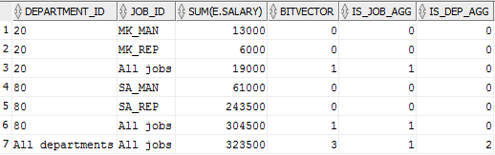
GROUPING & GROUPING_ID
SELECT CASE grouping(e.department_id) WHEN 1 THEN 'All departments' ELSE to_char(e.department_id) END department_id,
decode(grouping(e.job_id), 1, 'All jobs', e.job_id) job_id,
sum(e.salary),
grouping_id(e.department_id, e.job_id) bitvector,
bitand(grouping_id(e.department_id, e.job_id), 1) is_job_agg,
bitand(grouping_id(e.department_id, e.job_id), 2) is_dep_agg
FROM hr.employees e
WHERE e.department_id IN (20, 80)
GROUP BY ROLLUP (e.department_id, e.job_id);

Slide 17
Aggregate Functions & NULLs
All aggregate functions ignore NULLs (except count(*), grouping, and grouping_id)
  We can create aggregate values conditionally
SELECT
sum(CASE WHEN cond THEN column ELSE NULL END)
count(CASE expr1 WHEN expr2 THEN expr3 END)
FROM ...
WHERE ...
GROUP BY ...
Notes:
Pozor: iba count(*) ignoruje NULL, nie count(column)
Pozn :
Podmienka cond v CASE môže byť ľubovoľný boolovský výraz, ktorý môže samozrejeme referencovať všetky stĺpce (nie len tie čo sú uvedené v group by, keďže výraz je vo vnútri agregačnej funkcie)

Slide 18
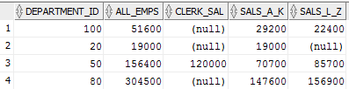
Aggregate Functions & NULLs
SELECT e.department_id,
sum(e.salary) all_emps,
sum(CASE WHEN job_id LIKE '%CLERK%'
THEN salary END) clerk_sal,
sum(CASE WHEN regexp_like(last_name, '^[A-K].*$')
THEN salary END) sals_a_k,
sum(CASE WHEN regexp_like(last_name, '^[L-Z].*$')
THEN salary END) sals_l_z
FROM hr.employees e
WHERE e.department_id IN (20, 50, 80, 100)
GROUP BY e.department_id;

Slide 19
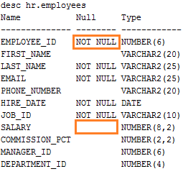




Aggregate Functions & NULLs
SELECT count(*) FROM hr.employees;
SELECT count(salary) FROM hr.employees;

Slide 20
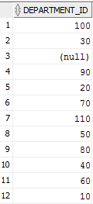
DISTINCT / UNIQUE
Returns distinct values
SELECT (DISTINCT|UNIQUE) <expr_list>
FROM ...
SELECT DISTINCT e.department_id
FROM hr.employees e;
SELECT UNIQUE e.department_id
FROM hr.employees e;
SELECT e.department_id
FROM hr.employees e
GROUP BY e.department_id ;

Slide 21

Aggregate functions & DISTINCT
Most of aggregate functions accept DISTINCT / UNIQUE
SELECT agg_function([DISTINCT|UNIQUE] expr)
FROM ...
SELECT count(DISTINCT e.job_id)
FROM hr.employees e;
SELECT count(DISTINCT substr(e.last_name, 1, 1)) letters
FROM hr.employees e

Slide 22
Analytic Functions
Analytic functions
  Last operations performed in a query
  Evaluated before ORDER BY
    Can appear only in SELECT or ORDER BY clauses
  Syntax:
SELECT func(arg₁, ..., arg_{n}) OVER ([PARTITION BY ...] [ORDER BY ...] [<window_clause>])
FROM ...

Slide 23
PARTITION BY
PARTITION BY
  Creates groups according to defined expressions (similar to GROUP BY)
  If not defined then whole result set is a group
SELECT sum(e.salary) OVER (),
sum(e.salary) OVER (PARTITION BY e.department_id)
FROM hr.employees e

Slide 24
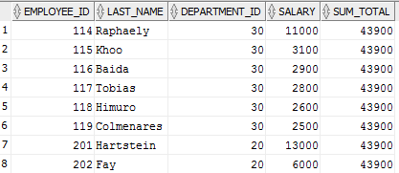
No Partitioning
SELECT e.employee_id, e.last_name, e.department_id, e.salary,
sum(e.salary) OVER () sum_total
FROM hr.employees e
WHERE e.department_id IN (20, 30)
ORDER BY e.employee_id;

Slide 25
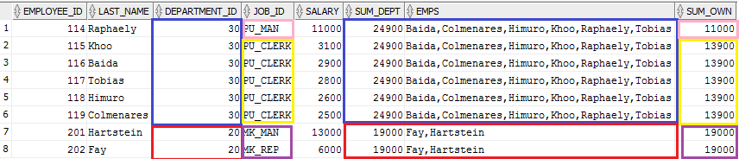
PARTITION BY
SELECT e.employee_id, e.last_name, e.department_id, e.job_id, e.salary,
sum(e.salary) OVER (PARTITION BY e.department_id) sum_dept,
listagg(e.last_name, ',') WITHIN GROUP (ORDER BY e.last_name) OVER (PARTITION BY e.department_id) emps,
sum(e.salary) OVER (PARTITION BY CASE e.job_id WHEN 'PU_MAN' THEN 1 WHEN 'PU_CLERK' THEN 2 WHEN 'MK_MAN' THEN 3 WHEN 'MK_REP' THEN 3 END) sum_own
FROM hr.employees e
WHERE e.department_id IN (20, 30)
ORDER BY e.employee_id;
Notes:
Farebne sú odlíšené jednotlivé partície

Slide 26
Analytic Functions
Differences between aggregate and analytic functions
  Analytic functions do not reduce the result set
  The result of an analytic function is assigned to each row
  Aggregate functions usually reduce the result set (they create groups)
  The result of an aggregate function is assigned to each group

Slide 27
ORDER BY (Analytic Functions)
ORDER BY
  Only for functions where the result depends on ordering
    LEAD, LAG, RANK, DENSE_RANK, NTILE ROW_NUMBER,...
  Functions for which the result does not depend on ordering
    SUM, COUNT, AVG, MIN, MAX, ...
  We can specify:
    DESC, ASC
    NULLS FIRST. NULLS LAST

Slide 28
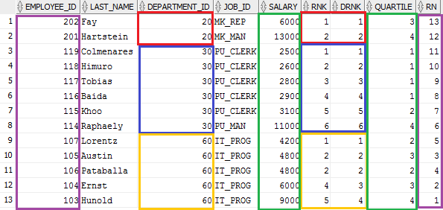
ORDER BY (Analytic Functions)
SELECT e.employee_id, e.last_name, e.department_id, e.job_id, e.salary,
rank() OVER (PARTITION BY e.department_id ORDER BY e.salary) rnk,
dense_rank() OVER (PARTITION BY e.department_id ORDER BY e.salary) drnk,
ntile(4) OVER (ORDER BY e.salary) quartile,
row_number() OVER (ORDER BY e.employee_id) rn
FROM hr.employees e
WHERE e.department_id IN (20, 30, 60)
Notes:
Farebne sú odlíšené jednotlivé partície

Slide 29
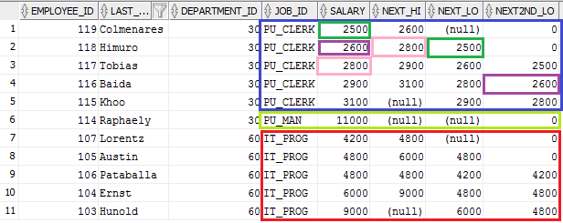
LEAD & LAG
SELECT e.employee_id, e.last_name, e.department_id, e.job_id, e.salary,
lead(e.salary) OVER (PARTITION BY e.job_id ORDER BY e.salary) next_hi,
lag(e.salary) OVER (PARTITION BY e.job_id ORDER BY e.salary) next_lo,
lead(e.salary, 2, 0) OVER (PARTITION BY e.job_id ORDER BY e.salary DESC) next2nd_lo
FROM hr.employees e
WHERE e.department_id IN (30, 60)
ORDER BY e.department_id, e.salary;
Notes:
LEAD (<value_expr>, <offset>, <default>) OVER (<analytic_clause>)
<value_expr> Výraz nad záznamom nasledujúcim za aktuálnym záznamom, slúži na výpočet hodnoty
<offset> Offset nasledujúceho riadku – relatívny berie sa od aktuálneho riadku (default 1), musí byť kladný
<default> Ak offset odkazuje mimo partíciu použije sa táto hodnota (default NULL)
LAG(<value_expr>, <offset>, <default>) OVER (<analytic_clause>)
Analogicky ako LEAD, s tým, že sa pozerá na predchádzajúce riadky, nie na nasledujúce

Slide 30
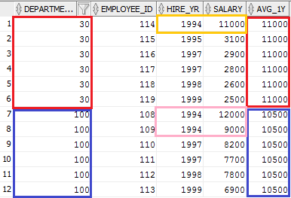
Analytic Functions (FIRST, LAST)
SELECT e.department_id, e.employee_id,
extract(YEAR FROM e.hire_date) hire_yr, e.salary,
avg(e.salary) KEEP (DENSE_RANK FIRST ORDER BY extract(YEAR FROM e.hire_date)) OVER (PARTITION BY e.department_id) avg_1y
FROM hr.employees e
WHERE e.department_id IN (30, 100)
ORDER BY e.department_id, hire_yr;
Notes:
Function( ) KEEP (DENSE_RANK FIRST ORDER BY <expr>) OVER (<partitioning_clause>)
Podobne ako pri agregačných funkciách je možné použiť jednu z funkcií MIN, MAX, SUM, AVG, COUNT, VARIANCE, alebo STDDEV
LAST ma analogickú syntax

Slide 31
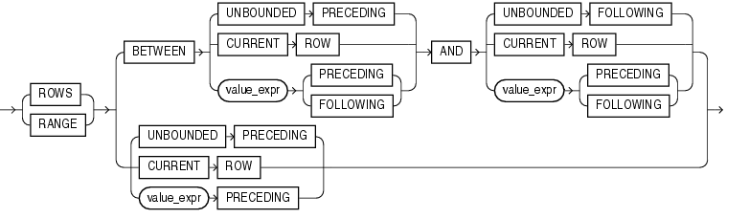
Analytic Functions (Window)
Notes:
ROWS/RANGE umožňujú pre každý riadok definovať okno (množina riadkov), funkcia pre daný záznam je potom vyhodnotená zo záznamov z jeho okna (okno sa pohybuje zdola nahor), ak definujeme okno musí byť uvedená ORDER BY klauzula (v analytickej časti)
ROWS – definuje okno pomocou fyzických jednotiek – riadkov
RANGE – definuje okno pomocou logických jednotiek – hodnôt
UNBOUNDED PRECEDING - okno sa začína prvým riadkom partície
UNBOUNDED FOLLOWING - okno sa končí posledným riadkom partície.
CURRENT ROW
Počiatočný bod – okno začína aktuálnym riadkom / hodnotou (podľa toho či sme špecifikovali ROW alebo RANGE). Ako koncový bod nie je možné použiť value_expr PRECEDING.
Koncový bod - okno končí aktuálnym riadkom / hodnotou (podľa toho či sme špecifikovali ROW alebo RANGE). Ako počiatočný bod nie je možné použiť value_expr FOLLOWING.
value_expr PRECEDING|FOLLOWING – umožňuje definovať okno aj od iného miesta ako začiatok/koniec partície, resp. od/po aktuálny riadok.
Zjavné obmedzenia (inak by okno neobsahovalo žiadne záznamy)..
Ak použijeme value_expr PRECEDING ako koncový bod, potom aj počiatočný musí byť definovaný pomocou value_expr PRECEDING
Ak použijeme value_expr FOLLOWING ako počiatočný bod, potom aj koncový musí byť definovaný pomocou value_expr FOLLOWING
Analytické funkcie, pri ktorých je možné zadefinovať okno (len pre info)
AVG, CORR, COVAR_POP, COVAR_SAMP, COUNT, FIRST_VALUE, LAST_VALUE, MAX, MIN, REGR_*, STDDEV, STDDEV_POP, STDDEV_SAMP, SUM, VAR_POP, VAR_SAMP, VARIANCE

Slide 32
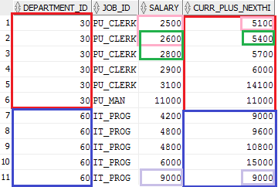
Analytic Functions (Window)
SELECT e.department_id, e.job_id, e.salary,
sum(e.salary) OVER (PARTITION BY e.department_id
ORDER BY e.salary
ROWS BETWEEN CURRENT ROW
AND 1 FOLLOWING) curr_plus_nexthi
FROM hr.employees e
WHERE e.department_id IN (30, 60)
Notes:
Dopyt vytvorí dve partície podľa deptno
Zotriedi ich podľa sal
V sal2 spočíta sumu platu pre aktuálny riadok a platu z nasledujúceho riadku

Slide 33
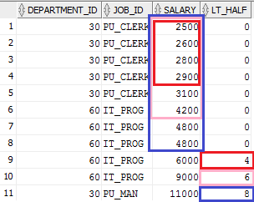
Analytic Functions (Window)
SELECT e.department_id, e.job_id, e.salary,
count(*) OVER (ORDER BY e.salary
RANGE BETWEEN UNBOUNDED PRECEDING
AND e.salary/2 PRECEDING) lt_half
FROM hr.employees e
WHERE e.department_id IN (30, 60);
Notes:
Pre každého zamestnanca chceme zistiť koľko zamestnancov zarába menej ako polovicu jeho platu
Zotriedime podľa platu a vytvoríme logické okno:
Zdola neohraničené a z hora ohraničené polovicou platu, aktuálneho zamestnanca.

Slide 34
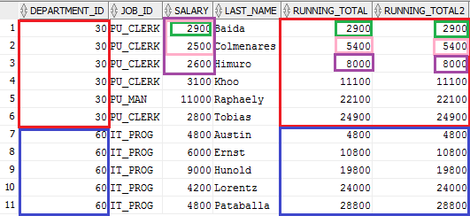
Analytic Functions (Window)
SELECT e.department_id, e.job_id, e.salary, e.last_name,
sum(e.salary) OVER (PARTITION BY e.department_id
ORDER BY e.last_name) running_total,
sum(e.salary) OVER (PARTITION BY e.department_id
ORDER BY e.last_name
RANGE BETWEEN UNBOUNDED PRECEDING
AND CURRENT ROW) running_total2
FROM hr.employees e
WHERE e.department_id IN (30, 60);

Slide 35
Paging - revisited
Page count
  Risk of unnecessary I/O operations
  Risk of inconsistence
  Implementations:
      ROWNUM (pseudocolumn)
      COUNT (aggregate & analytic function)
      [ROW_NUMBER (analytic function)]
      OFFSET (12c)

Slide 36
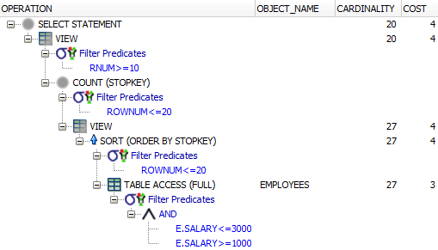
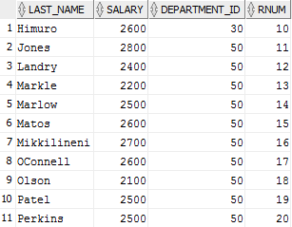
Paging
SELECT last_name, salary, department_id, rnum FROM (
SELECT last_name, salary, department_id, ROWNUM rnum FROM (
SELECT e.last_name, e.salary, e.department_id
FROM hr.employees e WHERE e.salary BETWEEN 1000 AND 3000
ORDER BY e.last_name)
WHERE ROWNUM <= 20)
WHERE rnum >= 10;
Notes:
Modrou farbou je znázornený vnútorný dopyt, ktorý výberá záznamy, ktoré chceme stránkovať,
V rámci tohto dopytu nemôžeme použiť podmienku rownum, pretože chceme riadky utriediť (Ak nepoužijeme ORDER BY podľa nejakého stĺpca, výsledky budú nedeterministické – čo sa týka usporiadania záznamov)
Nemôžeme použiť WHERE ROWNUM < 21 AND ROWNUM > 9, vzhľadom na spôsob vyhodnocovania ROWNUM, podmienka by nikdy nebola splnená, pretože ROWNUM > 9 je vždy FALSE, tj. musíme použiť ďalší vnorený dopyt.
Poznámka: Oracle utriedi sice všetky záznamy, ale ziska len prvých 20 (ROWNUM <= 20) - nepotrebuje materializovat cely vysledok ale len 20 zaznamov
Čím vyššiu stránku chceme, tým je práca na jej získanie náročnejšia – musí sa ziskať 10 (počet záznamov na stránku) * (číslo stránky) záznamov
Dalo by sa použiť:
SELECT ename, sal, deptno FROM (
SELECT ename, sal, deptno, ROWNUM rnum FROM (
SELECT e.ename, e.sal, e.deptno
FROM emp e WHERE e.sal BETWEEN 1000 AND 3000
ORDER BY e.ename))
WHERE rnum BETWEEN 10 AND 20
Ale v tomto prípade Oracle bude aplikoval predikát rnum BETWEEN... Na všetky záznamy, nie len prvých 20 – menej efektívne

Slide 37
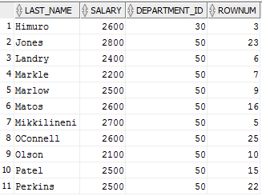
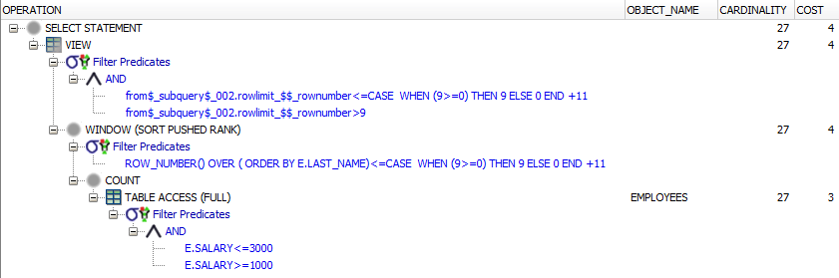
Paging (12c)
SELECT e.last_name, e.salary,
e.department_id, ROWNUM
FROM hr.employees e
WHERE e.salary BETWEEN 1000 AND 3000
ORDER BY e.last_name
OFFSET 9 ROWS FETCH FIRST 11 ROWS ONLY;

Slide 38
Page Count
Aggregate function COUNT
  Query is executed twice
    Once to get row count
    Once to get the page
    Risk of inconsistence (default isolation level: READ COMMITED)
    Additional load – we have to count the rows to obtain page count

Slide 39

Page Count
Example for the previous query
  There is no need to order values, so we may remove ORDER BY
SELECT count(*)
FROM hr.employees e WHERE e.salary BETWEEN 1000 AND 3000

Slide 40
Page Count
Analytic function COUNT
  Query is executed only once
  Page count is computed in the same query
    Only one query implies consistent results
  Less load on DBMS as an aggregate function (one query instead of two)
  Database has to go through the whole result set to count the rows

Slide 41
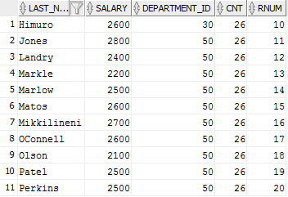
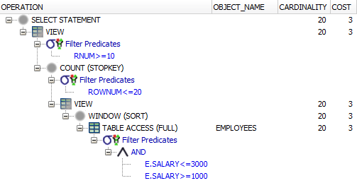
Page Count
SELECT last_name, salary, department_id, cnt, rnum FROM (
SELECT last_name, salary, department_id, cnt, ROWNUM rnum FROM (
SELECT e.last_name, e.salary, e.department_id, count(*) OVER () cnt
FROM hr.employees e WHERE e.salary BETWEEN 1000 AND 3000
ORDER BY e.last_name)
WHERE ROWNUM <= 20)
WHERE rnum >= 10;
Notes:
Poznámka: Teraz už Oracle musí získať všetky záznamy, nie len prvých 20, pretože funkcia COUNT(*) OVER (), potrebuje prejsť celý výsledok a spočítať záznamy

Slide 42
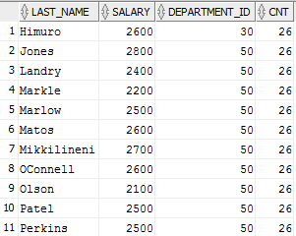
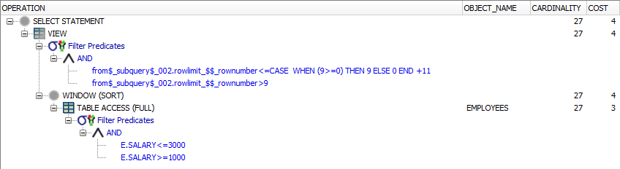
Page Count (12c)
SELECT e.last_name, e.salary,
e.department_id,
count(*) OVER () cnt
FROM hr.employees e
WHERE e.salary BETWEEN 1000 AND 3000
ORDER BY e.last_name
OFFSET 9 ROWS FETCH FIRST 11 ROWS ONLY;

Slide 43
Page Count
The best solution
  Do not count the pages ☺
An improvement for paging
  Set an upper bound
SELECT last_name, salary, department_id, cnt, rnum FROM (
SELECT last_name, salary, department_id, cnt, ROWNUM rnum FROM (
SELECT e.last_name, e.salary, e.department_id, count(*) OVER () cnt
FROM hr.employees e WHERE e.salary BETWEEN 1000 AND 3000
ORDER BY e.last_name)
WHERE ROWNUM <= least(20, :max_records))
WHERE rnum >= 10;

Slide 44
Pivot Queries
Pivot queries
  Rotate rows to columns aggregating data in the process of the rotation
Implementation
  DECODE function, CASE expression (<11g)
  PIVOT clause (with implicit GROUP BY)
    All columns from pivoted table not referenced in PIVOT clause are used in implicit GROUP BY

Slide 45
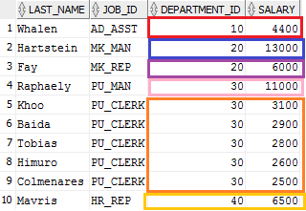
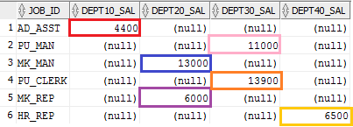
Pivot Queries (<11g)
SELECT e.job_id,
sum(decode(e.department_id,10,e.salary)) dept10_sal,
sum(decode(e.department_id,20,e.salary)) dept20_sal,
sum(decode(e.department_id,30,e.salary)) dept30_sal,
sum(CASE e.department_id WHEN 40 THEN e.salary END) dept40_sal
FROM hr.employees e
WHERE e.department_id IN (10,20,30,40)
GROUP BY e.job_id;
Notes:
Instead of decode CASE expression can be used, e.g. CASE deptno WHEN 10 THEN sal END

Slide 46
Pivot Queries (>=11g)
SELECT * FROM (
SELECT e.job_id, e.department_id, e.salary
FROM hr.employees e
WHERE e.department_id IN (10, 20, 30, 40)
) d
PIVOT (sum(salary) AS sal FOR department_id IN (10 AS dept10, 20 AS dept20, 30 AS dept30, 40 AS dept40))
Notes:
Job is not referenced in the pivot clause, implicit group by job occurs

Slide 47
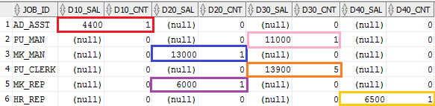
Pivot Queries (>=11g)
SELECT * FROM (
SELECT e.job_id, e.department_id,
e.salary
FROM hr.employees e
WHERE e.department_id IN (10, 20, 30, 40)
) d
PIVOT (sum(salary) AS sal, count(*) AS cnt
FOR department_id IN (10 AS d10, 20 AS d20,
30 AS d30, 40 AS d40))
Notes:
Job is not referenced in the pivot clause, implicit group by job occurs

Slide 48
Unpivot Queries
Unpivot queries
  Rotate columns into rows
Implementation
  CROSS JOIN & CASE expression or DECODE function (<11g)
  UNPIVOT clause (>=11g)
    INCLUDE NULLS
    EXCLUDE NULLS

Slide 49
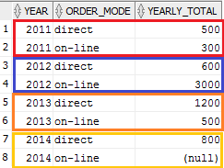
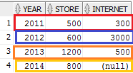
Unpivot Queries (<11g)
SELECT ys.year, m.order_mode,
CASE m.order_mode
WHEN 'on-line' THEN ys.internet
WHEN 'direct' THEN ys.store END yearly_total
FROM yearly_sales ys
CROSS JOIN -- creating new rows
(SELECT 'on-line' order_mode FROM dual
UNION ALL
SELECT 'direct' FROM dual) m
ORDER BY ys.year, m.order_mode

Slide 50
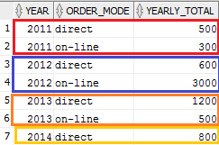
Unpivot Queries (>=11g)
SELECT *
FROM yearly_sales ys
UNPIVOT ( yearly_total
FOR order_mode IN (store AS 'direct', internet AS 'on-line')
ORDER BY year, order_mode

Slide 51
Unpivot Queries (>=11g)
SELECT *
FROM yearly_sales ys
UNPIVOT INCLUDE NULLS ( yearly_total
FOR order_mode IN (store AS 'direct', internet AS 'on-line')
ORDER BY year, order_mode

