Slide 1
Oracle SQL (5)
Radoslav Golian
03.10.2018

Slide 2
Agenda
Recursive queries
Subquery factoring
Recursive subquery factoring
DDL statements

Slide 3
Recursive Queries
START WITH <condition>
  Specifies the root row(s) of the hierarchy
CONNECT BY <condition>
  Specifies the relationship between parent rows and child rows of the hierarchy
  NOCYCLE
    Instructs Oracle Database to return rows from a query even if a loop exists in the data

Slide 4
Recursive Queries
CONNECT BY
  Condition usually contains PRIOR operator
    PRIOR expr – expression is evaluated for the parent row of the current row
    CONNECT BY manager_id = PRIOR employee_id
      The employee_id expression is evaluated for the parent row of the current row therefore value of employee_id column is taken from the parent row
    CONNECT BY clause may contain more expressions with PRIOR operator

Slide 5
Recursive Queries
Recursive query processing
  A join, if present, is evaluated first
  Recursive clauses are evaluated
    Root row(s) are selected (START WITH condition)
    Child rows of each root row are selected (CONNECT BY condition).
    Successive generations of child rows are selected (CONNECT BY condition)
  Non-join WHERE conditions are applied on the hierarchy
  Rows are returned in pre-order
    Children appear bellow their parents

Slide 6
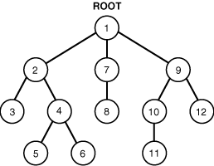
Recursive Queries
Oracle returns the rows in preorder
  GROUP BY and ORDER BY destroy hierarchical order

Slide 7
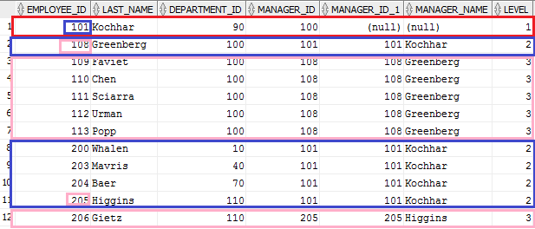
Recursive Queries (Example)
SELECT e.employee_id, e.last_name, e.department_id, e.manager_id, PRIOR e.employee_id manager_id,
PRIOR e.last_name manager_name, LEVEL
FROM hr.employees e
START WITH e.employee_id = 101
CONNECT BY e.manager_id = PRIOR e.employee_id;

Slide 8
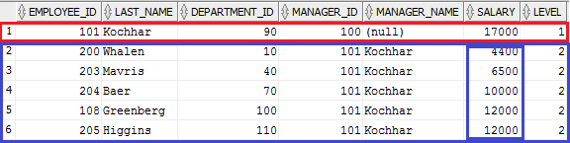
ORDER BY SIBLINGS
ORDER SIBLINGS BY expr
  Valid only for hierarchical queries
  Orders rows of siblings of the same parent
SELECT e.employee_id, e.last_name, e.department_id, e.manager_id,
PRIOR e.last_name manager_name, e.salary, LEVEL
FROM hr.employees e --WHERE LEVEL <= 2 -- also valid
START with e.employee_id = 101
CONNECT BY e.manager_id = PRIOR e.employee_id AND LEVEL <= 2
ORDER SIBLINGS BY e.salary;

Slide 9
Recursive Queries
Pseudocolumns
  LEVEL
    Level of a row in the hierarchy (root rows have level 1, their children level 2, …)
  CONNECT_BY_ISCYCLE
    Returns 1 if the current row has a child which is also its ancestor. Otherwise it returns 0
  CONNECT_BY_ISLEAF
    Returns 1 if the current row is a leaf of the tree defined by the CONNECT BY condition. Otherwise it returns 0.

Slide 10
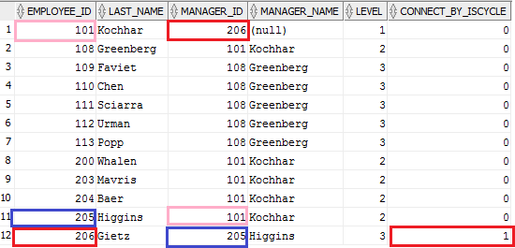

CONNECT_BY_ISCYCLE
SELECT e.employee_id, e.last_name, e.manager_id,
PRIOR e.last_name AS manager_name, LEVEL, CONNECT_BY_ISCYCLE
FROM employees e
START WITH e.employee_id = 101
CONNECT BY
NOCYCLE e.manager_id = PRIOR e.employee_id;
UPDATE employees e
SET e.manager_id = 206
WHERE e.employee_id = 101
Without NOCYCLE
Notes:
create table employees as select e.employee_id, e.last_name, e.manager_id from hr.employees e;
update employees e
set e.manager_id = 206
where e.employee_id = 101;

Slide 11
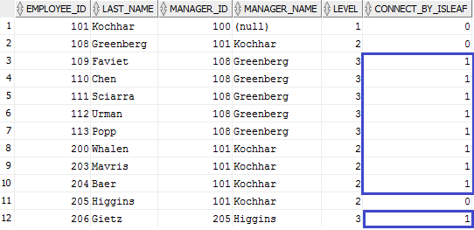
CONNECT_BY_ISLEAF
SELECT e.employee_id, e.last_name, e.manager_id,
PRIOR e.last_name AS manager_name, LEVEL, CONNECT_BY_ISLEAF
FROM hr.employees e
START WITH e.employee_id = 101
CONNECT BY e.manager_id = PRIOR e.employee_id;

Slide 12
Recursive Queries
Functions
  SYS_CONNECT_BY_PATH(col, char)
    Returns the path of a column value from root to node, with column values separated by char for each row returned by CONNECT BY condition.
Operator
  CONNECT_BY_ROOT
    Unary operator
    Returns the column value using data from the root row

Slide 13
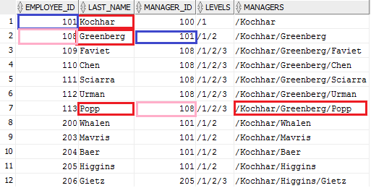
SYS_CONNECT_BY_PATH
SELECT e.employee_id, e.last_name, e.manager_id,
sys_connect_by_path(LEVEL, '/') AS levels,
sys_connect_by_path(e.last_name, '/') AS managers,
FROM hr.employees e
START WITH e.employee_id = 101
CONNECT BY e.manager_id = PRIOR e.employee_id;

Slide 14
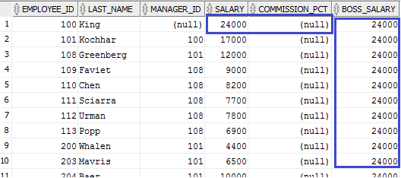
CONNECT_BY_ROOT
SELECT e.employee_id, e.last_name, e.manager_id,
e.salary, e.commission_pct,
CONNECT_BY_ROOT e.salary * (1 +
coalesce(e.commission_pct, 0)) AS boss_salary
FROM hr.employees e
START WITH e.manager_id IS NULL
CONNECT BY e.manager_id = PRIOR e.employee_id;

Slide 15
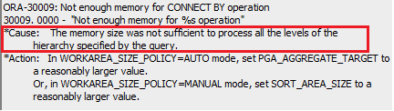

The Limits
SELECT count(*) FROM dual CONNECT BY LEVEL < 1e7;
SELECT count(*)
FROM
(SELECT NULL FROM dual CONNECT BY LEVEL <= 1e4)
CROSS JOIN
(SELECT NULL FROM dual CONNECT BY LEVEL <= 1e3);

Slide 16
Subquery Factoring (WITH)
Subquery factoring
  Lets us assign a name to a subquery block
  Subquery block can be referenced in multiple places in the query by specifying the name
WITH
emp_data AS (SELECT e.* FROM hr.employees e),
dept_data AS (SELECT d.* FROM hr.departments d)
SELECT e.employee_id, e.last_name, e.salary,
d.department_name
FROM emp_data e, dept_data d
WHERE e.department_id = d.department_id
Notes:
Poznámky:
emp_data je možné použiť aj v nasledujúcom subquery (v dept_data)
WITH je možné použiť iba pre raz v SQL príkaze
Od verzie 11g je možné pomocou klauzuly WITH deklarovať rekurzívne dopyty

Slide 17
Subquery Factoring (WITH)
Two types of optimization
  Temporary table (Materialization)
    A temporary table containing the result of the subquery is created
    Subquery references are replaced by temporary table name
    Appropriate for computation-intensive subqueries referenced multiple times
  Inline view (Substitution)
    All subquery references are replaced by the subquery
  CBO decides, based on query cost
Notes:
Len pre zaujímavosť:
Správanie je možné ovplyvniť hintami (nezdokumentované v Oracle dokumentácii, preto by sa nemali používať)
inline – substituuje referenciu dopytom
materialize – vytvorí a naplní temporárnu tabuľku

Slide 18
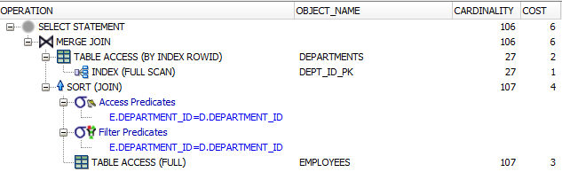
Subquery Factoring (Plans)
WITH
emp_data AS (SELECT e.* FROM hr.employees e),
dept_data AS (SELECT d.* FROM hr.departments d)
SELECT e.employee_id, e.last_name, e.salary,
d.department_name
FROM emp_data e, dept_data d
WHERE e.department_id = d.department_id

Slide 19
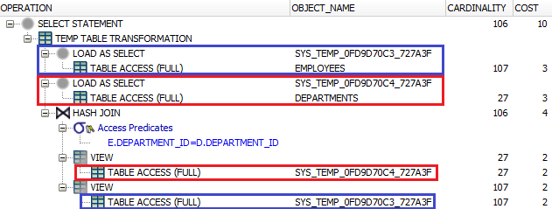
Subquery Factoring (Plans)
WITH
emp_data AS (SELECT /*+materialize*/ e.* FROM hr.employees),
dept_data AS (SELECT /*+materialize*/ d.* FROM hr.departments)
SELECT e.employee_id, e.last_name, e.salary,
d.department_name
FROM emp_data e, dept_data d
WHERE e.department_id = d.department_id

Slide 20
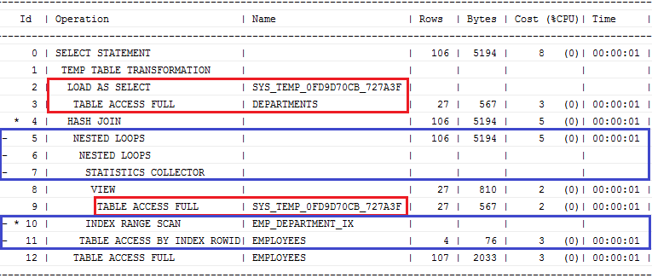
Subquery Factoring (Plans)
EXPLAIN PLAN FOR WITH
emp_data AS (SELECT /*+inline*/ e.* FROM hr.employees),
dept_data AS (SELECT /*+materialize*/ d.* FROM hr.departments)
SELECT e.employee_id, e.last_name, e.salary,
d.department_name
FROM emp_data e, dept_data d
WHERE e.department_id = d.department_id;
SELECT * FROM table(dbms_xplan.display(format => '+ADAPTIVE'));
Notes:
select * from table(dbms_xplan.display(FORMAT=>'+ADAPTIVE'));

Slide 21
Recursive Subquery Factoring
Common Table Expressions = CTE
-- query name: rec
WITH rec(param₁, param₂, …, param_{n}} AS (
SELECT exp₁, exp₂, …, exp_{n} -- anchor member
FROM t
UNION ALL
SELECT exp₁, exp₂, …, exp_{n} -- recursive member
FROM t INNER JOIN rec ON (cond)
) [<search clause>] -- optional
[<cycle clause>] -- optional
SELECT *
FROM rec
Notes:
Number of column aliases referenced in WITH query_name, anchor member and recursive member must be the same

Slide 22
CTE
Anchor (non-recursive) member
  Must appear before the recursive member
Recursive member
  Must follow anchor member
  Must be combined with anchor member using UNION ALL operator
  Must reference query name exactly once
  Cannot contain
    DISTINCT, GROUP BY
    Aggregate function (analytic functions are allowed)
    Outer join referencing query name as right table
    Subquery referencing query name (EXISTS, IN, …)
Notes:
Anchor member can be composed of one or more query blocks combined by the set operators (MINUS, UNION ALL, UNION, INTERSECT)

Slide 23
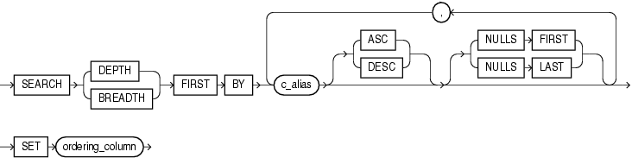
CTE
Search clause
  BREADTH FIRST BY c_alias
    Sibling rows are returned before any child rows
    Siblings are ordered by columns in c_alias
  DEPTH FIRST BY c_alias
    Child rows are returned before any sibling rows
  SET
    ordering_column is automatically added to the column list for the query name and can by used in ORDER BY clause of query selecting from query name
Notes:
c_alias = column name list from the column alias list for query name

Slide 24
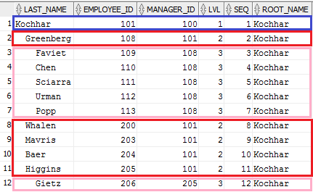
CTE
WITH rec (last_name, employee_id, manager_id, lvl, root_name) AS
(SELECT e.last_name, e.employee_id, e.manager_id, 1, e.last_name
FROM hr.employees e WHERE e.employee_id = 101
UNION ALL
SELECT e.last_name, e.employee_id, e.manager_id, r.lvl+1, r.root_name
FROM rec r INNER JOIN hr.employees e ON (r.employee_id = e.manager_id)
) SEARCH DEPTH FIRST BY employee_id SET seq
SELECT lpad(' ', 2 * r.lvl - 2, ' ')
|| r.last_name AS last_name,
r.employee_id, r.manager_id,
r.lvl, r.seq,
r.root_name
FROM rec
ORDER BY seq;
CONNECT_BY_ROOT
Notes:
set seq – pridáme ďalší stĺpec, ktorý sa inkrementuje postupne ako sa prechádzajú jednotlivé záznamy, všimnite si, že je použitý v order by klauzule, teda vysledok bude utriedený podľa toho ako sa záznamy postupne pridali do množiny..
depth – prehľadávanie do hĺbky
breadth – prehľadávanie do šírky

Slide 25
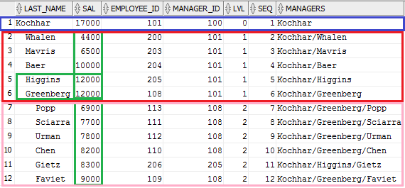
CTE
WITH rec (last_name, employee_id, manager_id, lvl, managers, sal) AS
(SELECT e.last_name, e.employee_id, e.manager_id, 0, e.last_name,e.salary
FROM hr.employees e WHERE e.employee_id = 101
UNION ALL
SELECT e.last_name, e.employee_id, e.manager_id, r.lvl+1, r.managers || '/' || e.last_name, e.salary
FROM rec r INNER JOIN hr.employees e ON (r.employee_id = e.manager_id)
) SEARCH BREADTH FIRST BY sal, last_name DESC SET seq
SELECT lpad(' ', 2 *
r.lvl, ' ') ||
r.last_name AS last_name,
r.sal, r.employee_id,
r.manager_id, r.lvl,
r.seq, r.managers
FROM rec r
ORDER BY r.seq;
SYS_CONNECT_BY_PATH

Slide 26
CTE (Cycles)
CYCLE clause
  Used to mark cycles in the recursion
  c_alias columns are used to detect a cycle
  cycle_value and no_cycle_value should be a string of length 1
If a cycle is detected
  Column cycle_mark_c_alias is set to cycle_value for the row causing the cycle
  The recursion will stop for the row
  The recursion will continue for non-cyclic rows
Notes:
If you omit the CYCLE clause, then the recursive WITH clause returns an error if cycles are discovered.
In this case, a row forms a cycle if one of its ancestor rows has the same values for all the columns in the column alias list for query_name that are referenced in the WHERE clause of the recursive member.

Slide 27
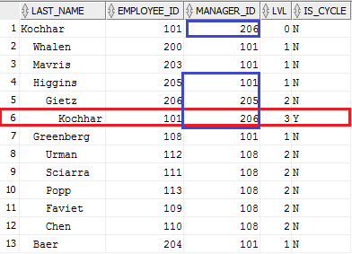

CTE (Cycles)
WITH rec (last_name, employee_id, manager_id, lvl) AS
(SELECT e.last_name, e.employee_id, e.manager_id, 0
FROM employees e where e.employee_id = 101
UNION ALL
SELECT e.last_name, e.employee_id, e.manager_id, r.lvl+1
FROM rec r INNER JOIN employees e ON (r.employee_id = e.manager_id)
) SEARCH DEPTH FIRST BY last_name DESC SET seq
CYCLE employee_id SET is_cycle TO 'Y' DEFAULT 'N'
SELECT lpad(' ', 2 * r.lvl, ' ')
|| r.last_name AS last_name,
r.employee_id, r.manager_id,
r.lvl, r.is_cycle
FROM rec r
ORDER BY r.seq;
Updated to 206 (cycle)
Without CYCLE
Notes:
create table employees as select e.employee_id, e.last_name, e.manager_id from hr.employees e;
update employees e
set e.manager_id = 206
where e.employee_id = 101;

Slide 28
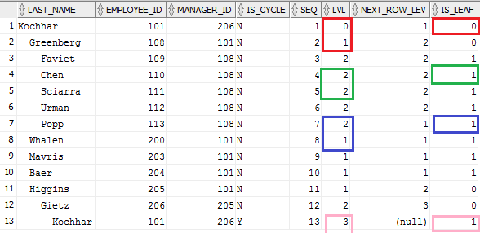
CTE (Identifying Leafs)
WITH rec (last_name, employee_id, manager_id, lvl) AS (...)
SEARCH DEPTH FIRST BY employee_id SET seq
CYCLE employee_id SET is_cycle TO 'Y' DEFAULT 'N'
SELECT lpad(' ', 2 * r.lvl, ' ') || r.last_name AS last_name,
r.employee_id, r.manager_id, r.is_cycle, r.seq, r.lvl,
lead(lvl) OVER (ORDER BY seq) next_row_lev,
CASE WHEN lvl-lead(lvl) OVER (ORDER BY seq)<0 THEN 0 ELSE 1 END is_leaf
FROM rec r --WHERE r.is_cycle = 'N'
ORDER BY r.seq;

Slide 29
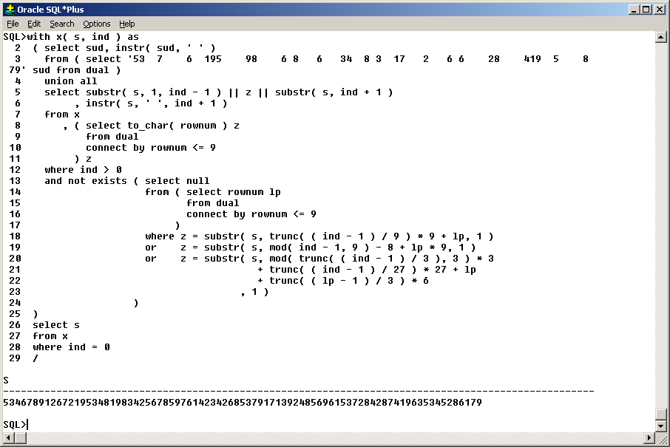
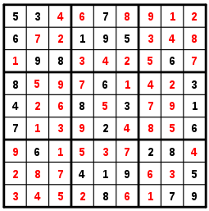
Solving Sudoku with CTE
https://technology.amis.nl/2009/10/13/oracle-rdbms-11gr2-solving-a-sudoku-using-recursive-subquery-factoring

Slide 30
Data Definition Language (DDL)
CREATE
  CREATE TABLE, CREATE VIEW, ...
ALTER
  ALTER TABLE, ALTER SEQUENCE, ...
DROP
  DROP TABLE, DROP INDEX, ...

Slide 31
CREATE TABLE
CREATE TABLE <table_name> (
column1 <type1> [DEFAULT ...] [NOT NULL],
column2 <type2>,
...
columnN <typen>
) TABLESPACE <tablespace_name>
CREATE TABLE emp (
empno NUMBER(10) NOT NULL,
ename VARCHAR2(40) NOT NULL,
sal NUMBER(8,2) NOT NULL,
comm NUMBER(3,2) DEFAULT 0,
deptno NUMBER(10) NOT NULL
) TABLESPACE users;
Notes:
This is a very basic example..

Slide 32
ALTER & DROP TABLE
ALTER TABLE emp ADD (mgr NUMBER(10), active VARCHAR2(1))
ALTER TABLE emp MODIFY (mgr NUMBER(11));
ALTER TABLE emp DROP COLUMN active;
ALTER TABLE emp RENAME TO emp2;
ALTER TABLE emp2 NOLOGGING;
...
DROP TABLE emp2 PURGE;

Slide 33
Views
CREATE VIEW view_name AS
SELECT empno, deptno, sal, mgr
FROM emp;
CREATE OR REPLACE VIEW view_name AS
SELECT empno, deptno, sal, mgr
FROM emp;
CREATE OR REPLACE FORCE VIEW view_name AS
SELECT empno, deptno, sal, mgr
FROM emp
WHERE deptno=to_number(sys_context('ctx','deptno'))
WITH CHECK OPTION;
ALTER VIEW view_name READ ONLY;
DROP VIEW view_name;

