Slide 1
Basics
Bitmap Indices
Radoslav Golian
10.10.2018

Slide 2
Agenda
Bitmap indices
Start transformations

Slide 3
Oracle Indices
Index types
  B*Tree
  [Reverse key]
  Bitmap
  Bitmap join
  [Function-Based]
  [Index Organized Tables (IOT)]
    Secondary indices in IOTs
  [Linguistic]
  [Cluster]
  [Domain]

Slide 4
Introduction
Oracle implements indices as B*Tree
  B*Tree is always balanced
  Index entries are always ordered
An update consists of delete and insert
Leaf entries consists of value and rowid
Index scans usually use single block reads
  Exception: Fast Full Index Scan

Slide 5
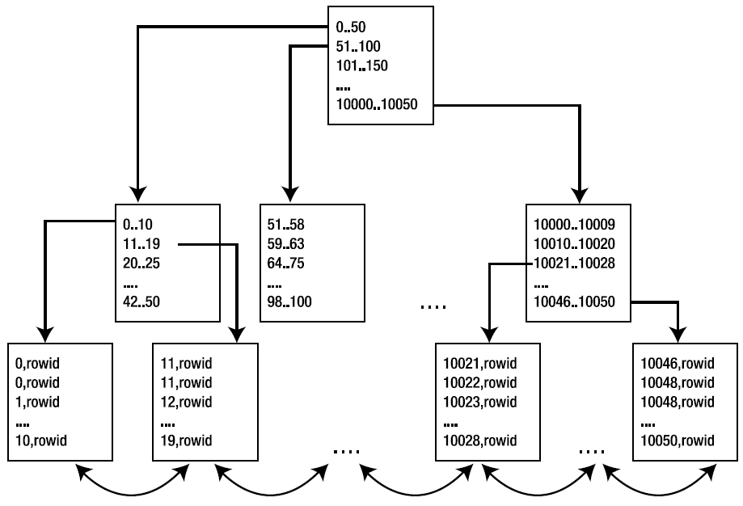
Oracle B*Tree Index
Root block
Vlastnosti
Branch blocks
Leaf blocks
Notes:
Štruktúra indexu
Koreňový blok (root block)
Branch bloky – medzi koreňom a listami
Dáta sú iba v listoch.
NULL hodnoty nie sú indexované.
Listy obsahujú každú hodnotu a pointer (rowid) do tabuľky na záznam, kde sa táto hodnota nachádza.
Pokiaľ sa nachádza hodnota v indexovanom stĺpci v tabuľke viackrát v indexe budú všetky výskyty.
Každý index je unikátny:
Dvojica unikátna je dvojica ((s1, s2, .., sn), rowid), kde (s1, s2, .., sn) je hodnota zo stĺpcov (s1, s2, .., sn), nad ktorými sa nachádza index.
Listy tvoria obojsmerný spájaný zoznam – kvôli range scanom (triedeniu)
Hodnoty v B*Tree indexe sú vzostupne utriedené
Vyhodnotenie podmienky:
WHERE x BETWEEN 0 AND 12
Získame list kde je hodnota x je 0
Čítame všetky nasledujúce bloky (prechádzame spájaný zoznam) až kým nedočítame všetky hodnoty, kde x je 12
Priebežne k sa pre získane rowid pozeráme do tabuľky a vyberáme príslušné záznamy

Slide 6
Clustering Factor
0..50
51..100
101..150
….
10000.. 10050
0..10
11..19
20..25
….
47.. 50
51..58
59..63
64..75
….
98.. 100
10000.. 10009
10010.. 10020
10021..10028
…
10046..10050
….
1,rowid
2 rowid
3,rowid
4 rowid
5, rowid
6, rowid
7, rowid
8, rowid
… …
…
…
…
….
….
….
….
….
….
Pk Name
1 Alice
2 Sue
3 Victor
4 Will
Pk Name
5 Irene
6 Kelly
7 Melanie
8 Oliver
Pk Name
9 George
10 Candy
11 Uwe
12 Wally
Pk Name
13 Ellen
14 Tom
15 Rick
16 Paul
Pk Name
17 Doug
18 Irene
19 Lance
20 Jack
Pk Name
21 Hank
22 Frank
23 Nicole
24 Bob

Slide 7
Clustering Factor
Alice..Hank
...
…
…
...
Alice..Dough
Elen..Hank
…
…
…
..
..
..
….
..
..
..
..
…
…
….
Alice, rowid
Bob, rowid
Candy, rowid
Doug , rowid
Elen, rowid
Frank, rowid
George, rowid
Hank, rowid
… …
…
…
…
….
….
….
….
….
….
Pk Name
1 Alice
2 Sue
3 Victor
4 Will
Pk Name
5 Irene
6 Kelly
7 Melanie
8 Oliver
Pk Name
9 George
10 Candy
11 Uwe
12 Wally
Pk Name
13 Ellen
14 Tom
15 Rick
16 Paul
Pk Name
17 Doug
18 Irene
19 Lance
20 Jack
Pk Name
21 Hank
22 Frank
23 Nicole
24 Bob

Slide 8
Bitmap Indices
Designed for DWH
Usually not appropriate for OLTP
Use a bitmap sequence to denote the occurrence of an index value within a range of rowids
Bitmap can efficiently compressed
Bitmap indices can be used in combination with several such indices

Slide 9
Bitmap Indices
CREATE BITMAP INDEX <index_name> ON <table_name>(<column_list>)
ANALYST 0-0-0-0-0-0-0-1-0-0-0-0-1-0
CLERK 1-0-0-0-0-0-0-0-0-0-1-1-0-1
MANAGER 0-0-0-1-0-1-1-0-0-0-0-0-0-0
PRESIDENT 0-0-0-0-0-0-0-0-1-0-0-0-0-0
SALESMAN 0-1-1-0-1-0-0-0-0-1-0-0-0-0
CLERK OR 1-0-0-1-0-1-1-0-0-0-1-1-0-1
MANAGER
CLERK AND 0-0-0-0-0-0-0-0-0-0-0-0-0-0
MANAGER

Slide 10
Bitmap Indices
JOB LO-ROWID HI-ROWID BITS
--------- -------- -------- --------------------------
ANALYST AAAR4AAA AAABEEAAH 0-0-0-0-0-0-0-1-0-0-0-0-1-0
ANALYST AAAR4AAI AAABEEAAM 1-0-0-0-0-0-0-0-0-0-1-1-0-1
ANALYST AAAR4AAN AAABEEAAT 0-0-0-1-0-1-1
PRESIDENT AAAR4AAA AAABEEAAH 0-0-0-0-0-0-0-0-1-0-0-0-0-0
PRESIDENT AAAR4AAI AAABEEAAM 0-1-1-0-1-0-0-0-0-1-0-0-0-0
PRESIDENT AAAR4AAN AAABEEAAT 1-0-1-0-0-1-1
value, rowid range, bitmap of occurrence
More bitmaps may exist for a value

Slide 11
Bitmap Indices
Effective paths
  Count rows of given value
  Bitmaps for AND, OR, IN may be combined
  NOT predicated may also benefit from the bitmap indices (BITMAP MINUS)

Slide 12
Example (Setup)
CREATE TABLE bitmap_test (gender NOT NULL,
location NOT NULL, age_group NOT NULL, data)
AS
SELECT CASE ceil(dbms_random.value(0, 2))
WHEN 1 THEN 'M'
WHEN 2 THEN 'F' end gender,
ceil(dbms_random.value(0, 50)) location,
case ceil(dbms_random.value(0, 5))
WHEN 1 THEN '18 and under'
WHEN 2 THEN '19-25'
WHEN 3 THEN '26-30'
WHEN 4 THEN '31-40'
WHEN 5 THEN '41 and over' END age_group,
rpad('*', 20, '*') data
FROM dual
CONNECT BY LEVEL <= 1000000;
EXECUTE dbms_stats.gather_table_stats( user, 'BITMAP_TEST');

Slide 13
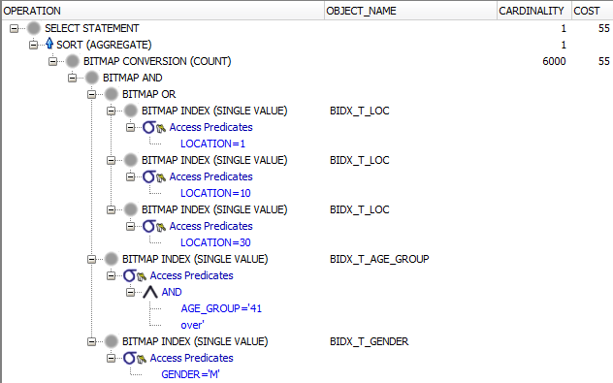
Bitmap Indices
CREATE BITMAP INDEX bidx_t_gender ON bitmap_test(gender);
CREATE BITMAP INDEX bidx_t_age_group ON bitmap_test(age_group);
CREATE BITMAP INDEX bidx_t_loc ON bitmap_test(location);
SELECT count(*) FROM bitmap_test WHERE gender = 'M'
AND location IN (1,10, 30) AND age_group = '41 and over';

Slide 14
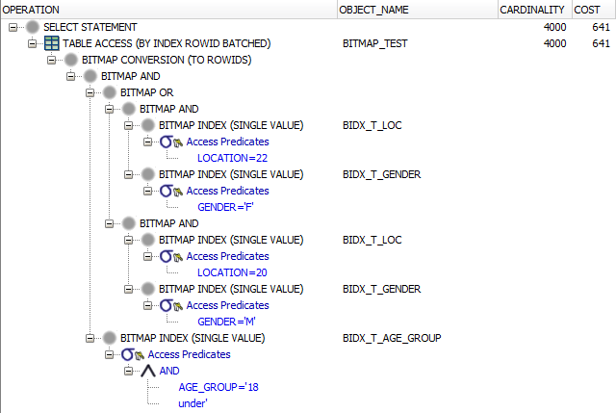
Bitmap Indices
SELECT * FROM bitmap_test
WHERE ((gender = 'M' AND location = 20)
OR (gender = 'F' AND location = 22))
AND age_group = '18 and under';

Slide 15
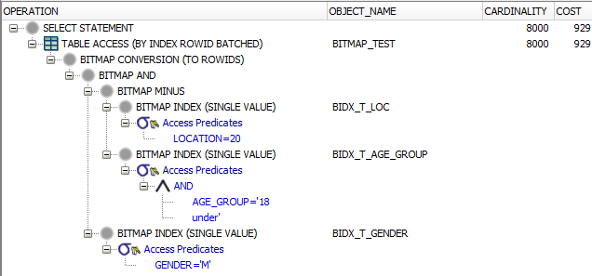
Bitmap Indices
SELECT * FROM bitmap_test
WHERE gender = 'M'
AND location = 20
AND NOT (age_group = '18 and under');

Slide 16
Bitmap Indices Consequences
Locking
  INSERT, DELETE, UPDATE (if indexed column is updated), MERGE
    One lock bite for entire bitmap
Do not use when many sessions modify the table

Slide 17
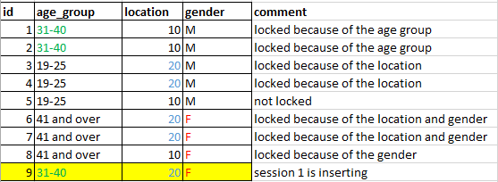
Bitmap Indices Locking
INSERT INTO t(id, age_group, location, gender)
VALUES (9, '31-40', 20, 'F');

Slide 18
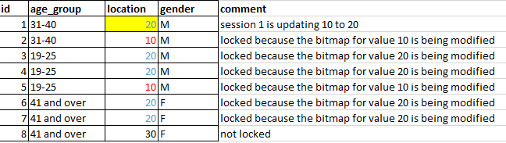
Bitmap Indices Locking
UPDATE t
SET location = 20 --(original value was 10)
WHERE id = 1;

Slide 19
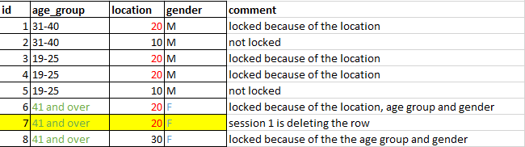
Bitmap Indices Locking
DELETE FROM t
WHERE id = 7;

Slide 20
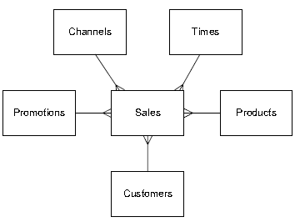
Star Transformation
Start Transformation is an optimization technique used with star schemas
  Fact table
    Central large table containing
    data
    References dimensions
  Dimensions
    Smaller “codetables”
  Fact table FKs must be bitmap indexed

Slide 21
Star Transformations (Query)
SELECT c.cust_state_province,
t.fiscal_month_name, sum(s.amount_sold) AS amount_sold
FROM sh.sales s, sh.customers c,
sh.times t, sh.products p
WHERE s.cust_id = c.cust_id
AND s.time_id = t.time_id
AND s.prod_id = p.prod_id
AND c.cust_year_of_birth BETWEEN 1970 AND 1979
AND p.prod_subcategory = 'Cameras'
GROUP BY c.cust_state_province,
t.fiscal_month_name
ORDER BY c.cust_state_province,
sum(s.amount_sold) DESC

Slide 22
Star Transformations
Optimization of a query against the star schema
  Start evaluating each dimension table that has restrictions on it
  Assemble a list with the resulting dimension keys
  Use this list to extract the matching rows from the fact table
Cannot be implemented with regular joins
  Database can join only two data sets at one time

Slide 23
Star Transformations
Requirements
  Set parameter star_transformation_enabled to temp_disable or TRUE
  Single-column bitmap index must exists for each foreign key in the fact table
    Optimizer can convert B*Tree indices to bitmap (less effective solution)
Optimizations
  Temporary tables
  Bitmap join indices

Slide 24
Star Transformations (Query)
SELECT c.cust_state_province,
t.fiscal_month_name, sum(s.amount_sold) AS amount_sold
FROM sh.sales s, sh.customers c,
sh.times t, sh.products p
WHERE s.cust_id = c.cust_id
AND s.time_id = t.time_id
AND s.prod_id = p.prod_id
AND c.cust_year_of_birth BETWEEN 1970 AND 1979
AND p.prod_subcategory = 'Cameras'
GROUP BY c.cust_state_province,
t.fiscal_month_name
ORDER BY c.cust_state_province,
sum(s.amount_sold) DESC

Slide 25
Star Transformation
ALTER SESSION SET star_transformation_enabled=temp_disable;
-----------------------------------------------------------------------------------
| Id | Operation | Name |
-----------------------------------------------------------------------------------
| 0 | SELECT STATEMENT | |
| 1 | SORT ORDER BY | |
| 2 | HASH GROUP BY | |
|* 3 | HASH JOIN | |
| 4 | TABLE ACCESS FULL | TIMES |
|* 5 | HASH JOIN | |
|* 6 | TABLE ACCESS FULL | CUSTOMERS |
| 7 | VIEW | VW_ST_FE4FBDB9 |
| 8 | NESTED LOOPS | |
| 9 | PARTITION RANGE ALL | |
| 10 | BITMAP CONVERSION TO ROWIDS | |
| 11 | BITMAP AND | |
| 12 | BITMAP MERGE | |
| 13 | BITMAP KEY ITERATION | |
| 14 | BUFFER SORT | |
| 15 | TABLE ACCESS BY INDEX ROWID BATCHED| PRODUCTS |
|* 16 | INDEX RANGE SCAN 'Cameras' | PRODUCTS_PROD_SUBCAT_IX |
|* 17 | BITMAP INDEX RANGE SCAN | SALES_PROD_BIX |
| 18 | BITMAP MERGE | |
| 19 | BITMAP KEY ITERATION | |
| 20 | BUFFER SORT | |
|* 21 | VIEW | index$_join$_063 |
|* 22 | HASH JOIN | |
| 23 | BITMAP CONVERSION TO ROWIDS | |
|* 24 | BITMAP INDEX RANGE SCAN >=1970..| CUSTOMERS_YOB_BIX |
| 25 | INDEX FAST FULL SCAN | CUSTOMERS_PK |
|* 26 | BITMAP INDEX RANGE SCAN | SALES_CUST_BIX |
| 27 | TABLE ACCESS BY USER ROWID | SALES |
-----------------------------------------------------------------------------------
Notes:
------------------------------------------------------------------------------------
Plan hash value: 489202133
-----------------------------------------------------------------------------------
| Id | Operation | Name |
-----------------------------------------------------------------------------------
| 0 | SELECT STATEMENT | |
| 1 | SORT ORDER BY | |
| 2 | HASH GROUP BY | |
|* 3 | HASH JOIN | |
| 4 | TABLE ACCESS FULL | TIMES |
|* 5 | HASH JOIN | |
|* 6 | TABLE ACCESS FULL | CUSTOMERS |
| 7 | VIEW | VW_ST_FE4FBDB9 |
| 8 | NESTED LOOPS | |
| 9 | PARTITION RANGE ALL | |
| 10 | BITMAP CONVERSION TO ROWIDS | |
| 11 | BITMAP AND | |
| 12 | BITMAP MERGE | |
| 13 | BITMAP KEY ITERATION | |
| 14 | BUFFER SORT | |
| 15 | TABLE ACCESS BY INDEX ROWID BATCHED| PRODUCTS |
|* 16 | INDEX RANGE SCAN | PRODUCTS_PROD_SUBCAT_IX |
|* 17 | BITMAP INDEX RANGE SCAN | SALES_PROD_BIX |
| 18 | BITMAP MERGE | |
| 19 | BITMAP KEY ITERATION | |
| 20 | BUFFER SORT | |
|* 21 | VIEW | index$_join$_063 |
|* 22 | HASH JOIN | |
| 23 | BITMAP CONVERSION TO ROWIDS | |
|* 24 | BITMAP INDEX RANGE SCAN | CUSTOMERS_YOB_BIX |
| 25 | INDEX FAST FULL SCAN | CUSTOMERS_PK |
|* 26 | BITMAP INDEX RANGE SCAN | SALES_CUST_BIX |
| 27 | TABLE ACCESS BY USER ROWID | SALES |
-----------------------------------------------------------------------------------
Predicate Information (identified by operation id):
---------------------------------------------------
3 - access("ITEM_1"="T"."TIME_ID")
5 - access("ITEM_2"="C"."CUST_ID")
6 - filter("C"."CUST_YEAR_OF_BIRTH">=1970 AND
"C"."CUST_YEAR_OF_BIRTH"<=1979)
16 - access("P"."PROD_SUBCATEGORY"='Cameras')
17 - access("S"."PROD_ID"="P"."PROD_ID")
21 - filter("C"."CUST_YEAR_OF_BIRTH">=1970 AND
"C"."CUST_YEAR_OF_BIRTH"<=1979)
22 - access(ROWID=ROWID)
24 - access("C"."CUST_YEAR_OF_BIRTH">=1970 AND
"C"."CUST_YEAR_OF_BIRTH"<=1979)
26 - access("S"."CUST_ID"="C"."CUST_ID")
Note
-----
- star transformation used for this statement
54 rows selected

Slide 26
Star Transformation (Temp)
ALTER SESSION SET star_transformation_enabled=true;
--------------------------------------------------------------------------------------
| Id | Operation | Name |
--------------------------------------------------------------------------------------
| 0 | SELECT STATEMENT | |
| 1 | TEMP TABLE TRANSFORMATION | |
| 2 | LOAD AS SELECT | SYS_TEMP_0FD9D6624_C8304D |
|* 3 | TABLE ACCESS FULL >=1970.. | CUSTOMERS |
| 4 | SORT ORDER BY | |
| 5 | HASH GROUP BY | |
|* 6 | HASH JOIN | |
| 7 | TABLE ACCESS FULL | SYS_TEMP_0FD9D6624_C8304D |
|* 8 | HASH JOIN | |
| 9 | TABLE ACCESS FULL | TIMES |
| 10 | VIEW | VW_ST_16AF99B7 |
| 11 | NESTED LOOPS | |
| 12 | PARTITION RANGE ALL | |
| 13 | BITMAP CONVERSION TO ROWIDS | |
| 14 | BITMAP AND | |
| 15 | BITMAP MERGE | |
| 16 | BITMAP KEY ITERATION | |
| 17 | BUFFER SORT | |
| 18 | TABLE ACCESS BY INDEX ROWID BATCHED| PRODUCTS |
|* 19 | INDEX RANGE SCAN 'Cameras' | PRODUCTS_PROD_SUBCAT_IX |
|* 20 | BITMAP INDEX RANGE SCAN | SALES_PROD_BIX |
| 21 | BITMAP MERGE | |
| 22 | BITMAP KEY ITERATION | |
| 23 | BUFFER SORT | |
| 24 | TABLE ACCESS FULL | SYS_TEMP_0FD9D6624_C8304D |
|* 25 | BITMAP INDEX RANGE SCAN | SALES_CUST_BIX |
| 26 | TABLE ACCESS BY USER ROWID | SALES |
--------------------------------------------------------------------------------------
Temporary table
Notes:
ALTER SESSION SET star_transformation_enabled=true;
--------------------------------------------------------------------------------------
| Id | Operation | Name |
--------------------------------------------------------------------------------------
| 0 | SELECT STATEMENT | |
| 1 | TEMP TABLE TRANSFORMATION | |
| 2 | LOAD AS SELECT | SYS_TEMP_0FD9D6624_C8304D |
|* 3 | TABLE ACCESS FULL | CUSTOMERS |
| 4 | SORT ORDER BY | |
| 5 | HASH GROUP BY | |
|* 6 | HASH JOIN | |
| 7 | TABLE ACCESS FULL | SYS_TEMP_0FD9D6624_C8304D |
|* 8 | HASH JOIN | |
| 9 | TABLE ACCESS FULL | TIMES |
| 10 | VIEW | VW_ST_16AF99B7 |
| 11 | NESTED LOOPS | |
| 12 | PARTITION RANGE ALL | |
| 13 | BITMAP CONVERSION TO ROWIDS | |
| 14 | BITMAP AND | |
| 15 | BITMAP MERGE | |
| 16 | BITMAP KEY ITERATION | |
| 17 | BUFFER SORT | |
| 18 | TABLE ACCESS BY INDEX ROWID BATCHED| PRODUCTS |
|* 19 | INDEX RANGE SCAN | PRODUCTS_PROD_SUBCAT_IX |
|* 20 | BITMAP INDEX RANGE SCAN | SALES_PROD_BIX |
| 21 | BITMAP MERGE | |
| 22 | BITMAP KEY ITERATION | |
| 23 | BUFFER SORT | |
| 24 | TABLE ACCESS FULL | SYS_TEMP_0FD9D6624_C8304D |
|* 25 | BITMAP INDEX RANGE SCAN | SALES_CUST_BIX |
| 26 | TABLE ACCESS BY USER ROWID | SALES |
--------------------------------------------------------------------------------------
Predicate Information (identified by operation id):
---------------------------------------------------
3 - filter("C"."CUST_YEAR_OF_BIRTH">=1970 AND
"C"."CUST_YEAR_OF_BIRTH"<=1979)
6 - access("ITEM_2"="C0")
8 - access("ITEM_1"="T"."TIME_ID")
19 - access("P"."PROD_SUBCATEGORY"='Cameras')
20 - access("S"."PROD_ID"="P"."PROD_ID")
25 - access("S"."CUST_ID"="C0")

Slide 27
Bitmap Join Indices
Common (B*Tree, bitmap) index is created only on one table
Bitmap join index allows to access data in one table using predicate from another table
Common approach: dept(dname), emp(deptno)
Bitmap join index: emp(d.dname)
SELECT e.*
FROM emp e, dept d
WHERE e.deptno = d.deptno
AND d.dname = 'SALES'

Slide 28
Bitmap Join Indices
EMP
DEPT
CREATE BITMAP INDEX emp_bm_idx
ON EMP(DEPT.DNAME)
FROM EMP, DEPT
WHERE EMP.DEPTNO = DEPT.DEPTNO;
Indexed column is dept.dname
Indexed table is emp
Index condition must reference PK or UK
Index emp(dept.dname) contains
  values from column dept.dname
  rowids from table emp

Slide 29
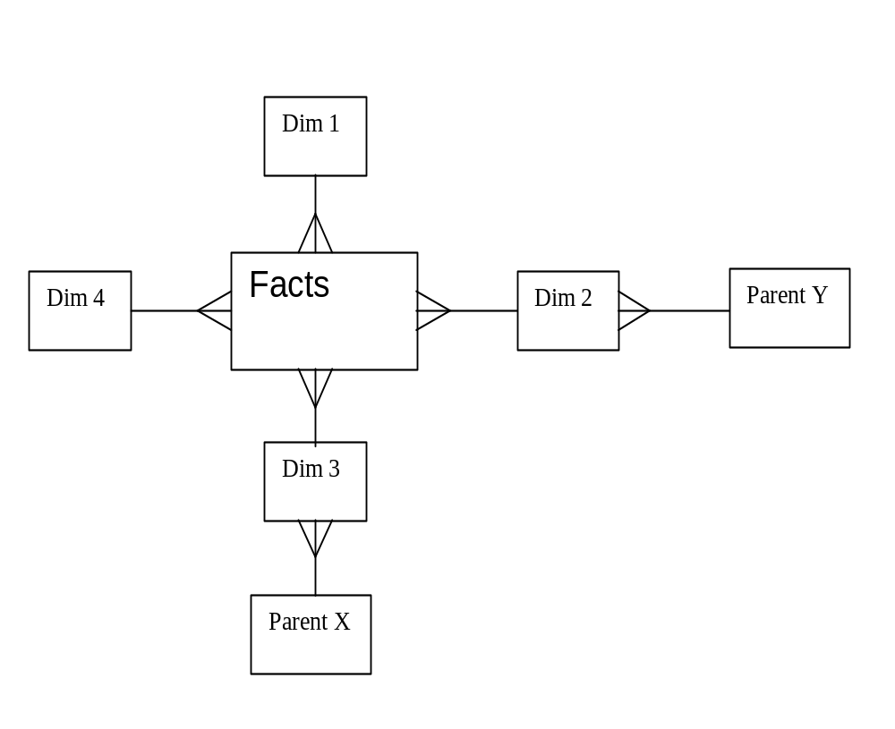
Bitmap Join Indices
Commonly used in DWH
  Facts, dimensions
  We can access facts without accessing dimensions
  Optimization technique for
  star transformations

Slide 30
Star Transformations (Query)
SELECT c.cust_state_province,
t.fiscal_month_name, sum(s.amount_sold) AS amount_sold
FROM sh.sales s, sh.customers c,
sh.times t, sh.products p
WHERE s.cust_id = c.cust_id
AND s.time_id = t.time_id
AND s.prod_id = p.prod_id
AND c.cust_year_of_birth BETWEEN 1970 AND 1979
AND p.prod_subcategory = 'Cameras'
GROUP BY c.cust_state_province,
t.fiscal_month_name
ORDER BY c.cust_state_province,
sum(s.amount_sold) DESC

Slide 31
Star Transformations
ALTER SESSION SET star_transformation_enabled=true;
ALTER TABLE sh.customers MODIFY CONSTRAINT customers_pk VALIDATE ;
ALTER TABLE sh.products MODIFY CONSTRAINT products_pk VALIDATE ;
CREATE BITMAP INDEX sh.sales_prod_subcategory_bix ON sh.sales (p.prod_subcategory)
FROM sh.sales s, sh.products p
WHERE s.prod_id = p.prod_id
LOCAL;
CREATE BITMAP INDEX sh.sales_cust_year_of_birth_bix ON sh.sales (c.cust_year_of_birth)
FROM sh.sales s, sh.customers c
WHERE s.cust_id = c.cust_id
LOCAL;
EXPLAIN PLAN FOR SELECT ...

Slide 32
Execution Plan (Without Hint)
---------------------------------------------------------------------------------------
| Id | Operation | Name |
---------------------------------------------------------------------------------------
| 0 | SELECT STATEMENT | |
| 1 | SORT ORDER BY | |
| 2 | HASH GROUP BY | |
|* 3 | HASH JOIN | |
| 4 | TABLE ACCESS FULL | TIMES |
|* 5 | HASH JOIN | |
| 6 | TABLE ACCESS BY INDEX ROWID BATCHED | CUSTOMERS |
| 7 | BITMAP CONVERSION TO ROWIDS | |
|* 8 | BITMAP INDEX RANGE SCAN | CUSTOMERS_YOB_BIX |
| 9 | PARTITION RANGE ALL | |
| 10 | TABLE ACCESS BY LOCAL INDEX ROWID BATCHED| SALES |
| 11 | BITMAP CONVERSION TO ROWIDS | |
| 12 | BITMAP AND | |
| 13 | BITMAP MERGE | |
| 14 | BITMAP KEY ITERATION | |
| 15 | BUFFER SORT | |
| 16 | TABLE ACCESS BY INDEX ROWID BATCHED| PRODUCTS |
|* 17 | INDEX RANGE SCAN | PRODUCTS_PROD_SUBCAT_IX |
|* 18 | BITMAP INDEX RANGE SCAN | SALES_PROD_BIX |
| 19 | BITMAP MERGE | |
|* 20 | BITMAP INDEX RANGE SCAN | SALES_CUST_YEAR_OF_BIRTH_BIX |
---------------------------------------------------------------------------------------
Predicate Information (identified by operation id):
---------------------------------------------------
3 - access("S"."TIME_ID"="T"."TIME_ID")
5 - access("S"."CUST_ID"="C"."CUST_ID")
8 - access("C"."CUST_YEAR_OF_BIRTH">=1970 AND
"C"."CUST_YEAR_OF_BIRTH"<=1971)
17 - access("P"."PROD_SUBCATEGORY"='Cameras')
18 - access("S"."PROD_ID"="P"."PROD_ID")
20 - access("S"."SYS_NC00009$">=1970 AND "S"."SYS_NC00009$"<=1971)

Slide 33
Execution Plan (With Hint)
---------------------------------------------------------------------------------------
| Id | Operation | Name |
---------------------------------------------------------------------------------------
| 0 | SELECT STATEMENT | |
| 1 | SORT ORDER BY | |
| 2 | HASH GROUP BY | |
|* 3 | HASH JOIN | |
| 4 | TABLE ACCESS FULL | TIMES |
|* 5 | HASH JOIN | |
| 6 | TABLE ACCESS BY INDEX ROWID BATCHED | CUSTOMERS |
| 7 | BITMAP CONVERSION TO ROWIDS | |
|* 8 | BITMAP INDEX RANGE SCAN | CUSTOMERS_YOB_BIX |
| 9 | PARTITION RANGE ALL | |
| 10 | TABLE ACCESS BY LOCAL INDEX ROWID BATCHED| SALES |
| 11 | BITMAP CONVERSION TO ROWIDS | |
| 12 | BITMAP AND | |
|* 13 | BITMAP INDEX SINGLE VALUE | SALES_PROD_SUBCATEGORY_BIX |
| 14 | BITMAP MERGE | |
|* 15 | BITMAP INDEX RANGE SCAN | SALES_CUST_YEAR_OF_BIRTH_BIX |
---------------------------------------------------------------------------------------
Predicate Information (identified by operation id):
---------------------------------------------------
3 - access("S"."TIME_ID"="T"."TIME_ID")
5 - access("S"."CUST_ID"="C"."CUST_ID")
8 - access("C"."CUST_YEAR_OF_BIRTH">=1970 AND
"C"."CUST_YEAR_OF_BIRTH"<=1971)
13 - access("S"."SYS_NC00008$"='Cameras')
15 - access("S"."SYS_NC00009$">=1970 AND "S"."SYS_NC00009$"<=1971)
Notes:
Hint: /*+index (s sales_prod_subcategory_bix ) */ was used
explain plan for
SELECT /*index(s sales_prod_subcategory_bix) */
c.cust_state_province,
t.fiscal_month_name, sum(s.amount_sold) AS amount_sold
FROM sh.sales s, sh.customers c,
sh.times t, sh.products p
WHERE s.cust_id = c.cust_id
AND s.time_id = t.time_id
AND s.prod_id = p.prod_id
AND c.cust_year_of_birth BETWEEN 1970 AND 1971
AND p.prod_subcategory = 'Cameras'
GROUP BY c.cust_state_province,
t.fiscal_month_name
ORDER BY c.cust_state_province,
sum(s.amount_sold) DESC
;
select * from table(dbms_xplan.display(format=>'BASIC +PREDICATE'));

Slide 34
Further Information
https://richardfoote.wordpress.com/

