Slide 1
Dimension Design
Radoslav Golian
10.10.2018

Slide 2
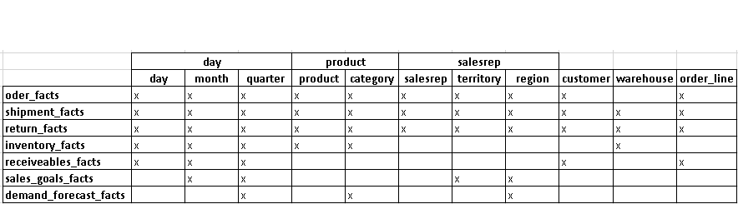
Planning Conformance
Conformance is a central feature of the dimensional design
Conformance matrix
Also degenerate dimensions used for drilling across should appear (order line) in the matrix

Slide 3
Conformance Matrix
Not every dimension needs to be included
e.g.: shipper, return_reason, …
Dimensions that are crucial in linking different processes
A blueprint for [incremental] implementation

Slide 4
Architecture and Conformance
Dimensional Data Warehouse
Conformance framework of the dimensional model is a top-level focus of dimensional DW design – an upfront activity
All available data sources and processing rules have to be identified for each conformed dimension
Conflict resolution – key entities
Implementation may take place in parallel
Legacy systems may be incompatible

Slide 5
Architecture and Conformance
Corporate Information Factory (Inmon)
Atomic repository (3NF)
Conformance is necessary within and across data marts
Stand-alone data marts
Do not conform
The risks may be partially mitigated by good planning

Slide 6
Grouping Dimensions into Tables
When dimensions belong in the same table and when they should be placed in separate table?
Do a given pair of attributes share natural affinity?
product – brand
territory – region
The relationship exists without a transaction
The same table
territory_dim
territory_key
territory
territory_code
territory_manager
region
region_code
…
sales_goals_fact
month_key
version_key
territory_key
goal_euos
..

Slide 7
Grouping Dimensions into Tables
Is a given pair of attributes only related based on transaction or activity?
salesrep – customer
Only when transaction (an order) occurs
Different contexts
Assignment, phone call, visit,
Relationship is captured in a fact table
Separate tables

Slide 8
Browsability test
Product and brand are not browsable
It’s possible to study them only in context of orders
order_facts
date_order_key
product_key
brand_key
salesrep_key
quantity_ordered
..
order_euros
…
order_id
order_line_num
brand_dim
brand_key
brand
brand_code
brand_manager
category
category_code
product_dim
product_key
product
product_description
sku

Slide 9
Breaking-Up Large Dimensions
What [not] to do when a dimension table is too large to maintain
Dimensions may contain lot of attributes (hundreds)
May grow fast because of “Slowly changing dimensions” concept
Break-up options
Splitting dimension tables arbitrary
Outrigger (normalization)
Mini-dimensions

Slide 10
Splitting Dimension Tables
order_facts
date_order_key
product_key
customer_key
salesrep_key
quantity_ordered
..
order_euros
…
order_id
order_line_num
customer_part1_dim
customer_key
customer_id
customer_name
address_line1
…
customer_part2_dim
customer_key
customer_id
product_description
sku

Slide 11
Splitting Dimension Tables
Drawbacks
Joins
May mislead BI tools, which generate queries
Browsability is affected
Foreign key may reference only one table
Workaround: add a column containing the same value
ETL processing
Complicated ETL process – two tables are handled as one logical table
Complicated SCD implementation

Slide 12
Splitting Dimension Tables
Alternatives
Two dimensions with their own surrogate key
Free-form text fields to an outrigger
Mini-dimensions

Slide 13
Slowly Changing Dimensions – Retain
Type 0: Retain Original
Dimension attribute value never changes
Facts are always grouped by this original value
Appropriate for any attribute labelled “original”, such as a customer’s original credit score or a durable identifier (natural keys)
Applies to most attributes in a date dimension.

Slide 14
SCD - Overwrite
Type 1: Overwrite
The old attribute value in the dimension row is overwritten with the new value
Type 1 attributes reflects the most recent assignment
This technique destroys history
Easy to implement
No additional dimension rows
Aggregate fact tables and OLAP cubes affected by the change must be recomputed.

Slide 15
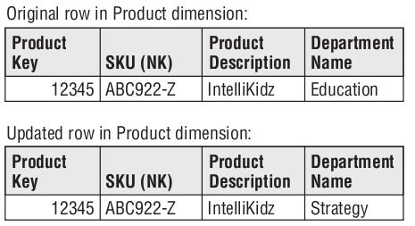
SCD - Overwrite
Type 1: Overwrite
Used to corrections

Slide 16
SCD – Add a New Row
Type 2: Add New Row
Add a new row in the dimension with the updated attribute values
Requires generalizing the primary key beyond the natural or durable key because there will potentially be multiple rows describing each member.
A new primary surrogate key is assigned to the new row and used as a foreign key in all fact tables from the moment of the update until a subsequent change creates a new dimension key and updated dimension row

Slide 17
SCD – Add a New Row
Additional columns should be added to the dimension row
Row effective date or date/time stamp
Row expiration date or date/time stamp
Current row indicator.

Slide 18
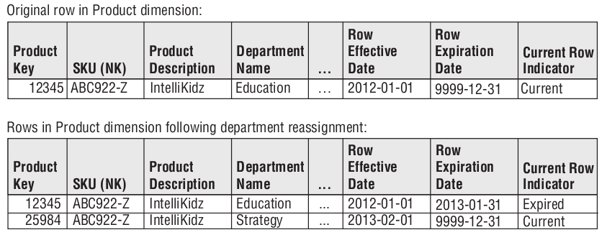
SCD – Add a New Row

Slide 19
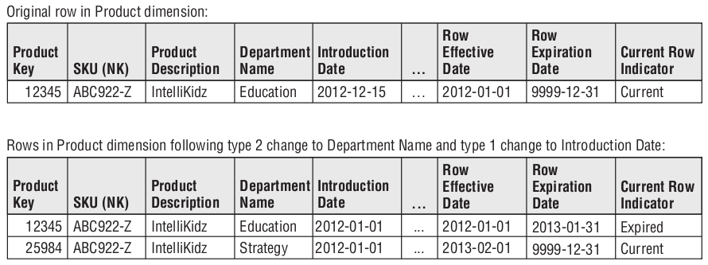
SCD – Add a New Row
Type 1 in Type 2 dimension (Introduction date)

Slide 20
SCD – Add a New Attribute
Type 3: Add New Attribute
Add a new attribute in the dimension to preserve the old attribute value
The new value overwrites the main attribute as in a type 1 change
Sometimes called an alternate reality
A business user can group and filter fact data by either the current value or alternate reality
Relatively infrequently used
Not useful for attributes that change unpredictably

Slide 21
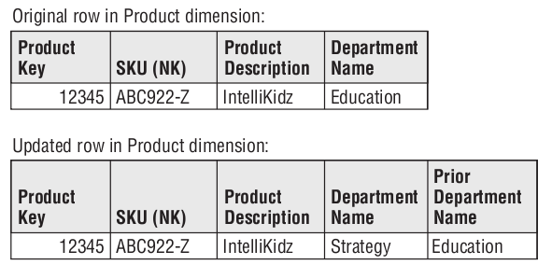
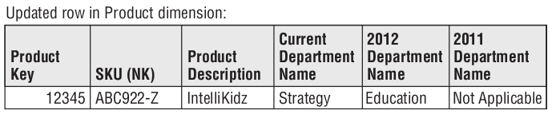
SCD – Add a New Attribute

Slide 22
SCD – Add a Mini-Dimension
Type 4: Add Mini-Dimension
Used when a group of attributes in a dimension rapidly changes (rapidly changing monster dimension)
Candidates: frequently used attributes in multimillion-row dimension tables, even if they don’t frequently change
Requires its own unique primary key
The primary keys of both the base dimension and mini-dimension are captured in the associated fact tables

Slide 23
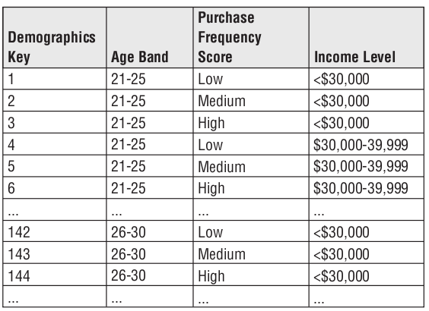
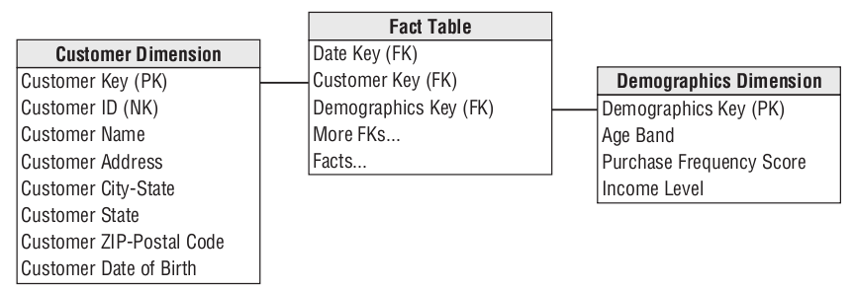
SCD – Add a Mini-Dimension

Slide 24
SCD – Add a Mini-Dimension and Type 1 Outrigger
Type 5: Add Mini-Dimension and Type 1 Outrigger
Used to accurately preserve historical attribute values
Reports historical facts according to current attribute values
Built on the type 4 mini-dimension and type 1 reference to the mini-dimension in the base dimension
Base dimension and mini-dimension outrigger is logically represented as a single table

Slide 25
SCD – Add a Mini-Dimension and Type 1 Outrigger
Type 5: Add Mini-Dimension and Type 1 Outrigger
Useful if you want a current profile of the customer (in the absence of fact table metrics)
Useful if you want to roll up historical facts based on the customer’s current profile
The ETL process has to overwrite type 1 mini-dimension reference whenever the current mini-dimension assignment changes

Slide 26
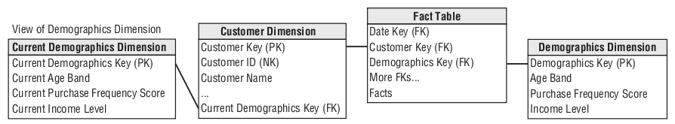
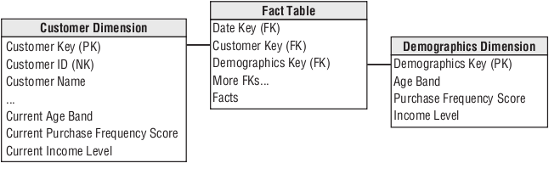
SCD – Add a Mini-Dimension and Type 1 Outrigger

Slide 27
SCD – Add Type 1 Attributes to Type 2 Dimension
Type 6: Add Type 1 Attributes to Type 2 Dimension
Like type 5, type 6 also delivers both historical and current dimension attribute values.
Built on the type 2 technique by also embedding current type 1 versions of the same attributes in the dimension row
Fact rows can be filtered or grouped by either the type 2 attribute value in effect when the measurement occurred or the attribute’s current value

Slide 28
SCD – Add Type 1 Attributes to Type 2 Dimension
Type 1 attribute is systematically overwritten on all rows associated with a particular durable key whenever the attribute is updated

Slide 29
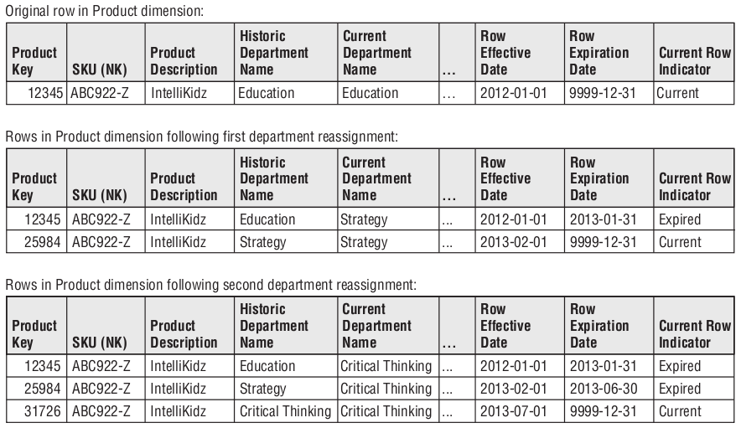
SCD – Add Type 1 Attributes to Type 2 Dimension

Slide 30
SCD – Dual Type 1 and Type 2 Dimensions
Type 7: Dual Type 1 and Type 2 Dimensions
Final hybrid technique used to support both as-was and as-is reporting.
A fact table can be accessed through a dimension modelled both as
type 1 dimension: showing only the most current attribute values
type 2 dimension: showing correct contemporary historical profiles.

Slide 31
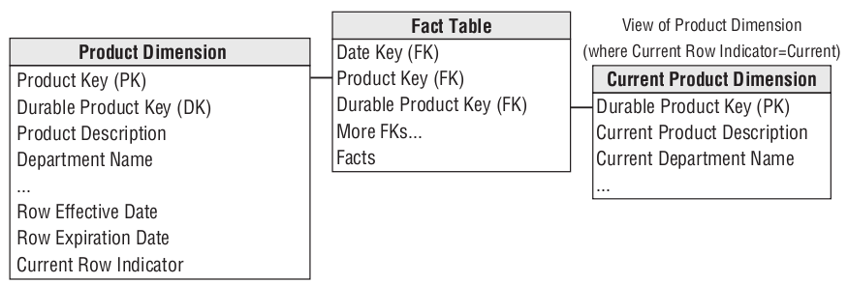
SCD – Dual Type 1 and Type 2 Dimensions

Slide 32
SCD – Dual Type 1 and Type 2 Dimensions
Type 7: Dual Type 1 and Type 2 Dimensions
Both the durable key and primary surrogate key of the dimension are placed in the fact table
For the type 1 perspective, the current flag in the dimension is constrained to be current, and the fact table is joined via the durable key
For the type 2 perspective, the current flag is not constrained, and the fact table is joined via the surrogate primary key

Slide 33
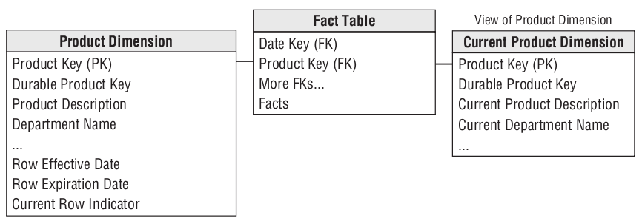
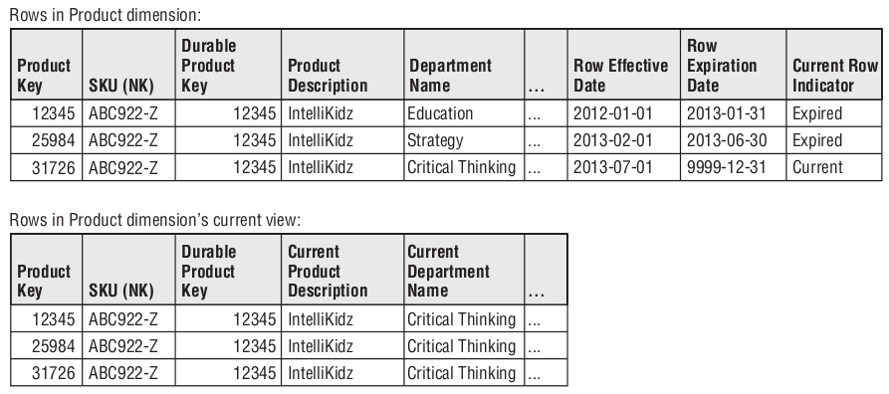
SCD – Dual Type 1 and Type 2 Dimensions

Slide 34
SCD Summary
SCD | Dimension Table Action | Impact on Fact Analysis
0 | No change to attribute value | Facts associated with attribute’s original value.
1 | Overwrite attribute value. | Facts associated with attribute’s current value.
2 | Add new dimension row for profile with new attribute value. | Facts associated with attribute value in effect when fact occured.
3 | Add new column to preserve attribute’s current and prior values | Facts associated with both current and prior attribute alternative values

Slide 35
SCD Summary
SCD | Dimension Table Action | Impact on Fact Analysis
4 | Add mini-dimension table containing rapidly changing attributes. | Facts associated with rapidly changing attributes in effect when fact occured
5 | Add type 4 mini-dimension, along with overwritten type 1 mini-dimension key in base dimension. | Facts associated with rapidly changing attributes in effect when fact occurred, plus current rapidly changing attribute values.
6 | Add type 1 overwritten attributes to type 2 dimension row, and overwrite all prior dimension rows. | Facts associated with attribute value in effect when fact occurred, plus current values.
7 | Add type 2 dimension row with new attribute value, plus view limited to current rows and/or attribute values | Facts associated with attribute value in effect when fact occurred, plus current values.

