Slide 1
Fact Tables Techniques
Radoslav Golian
17.10.2018

Slide 2
Additivity
Additive Facts
The most flexible and useful facts
Additive measures can be summed across any of the dimensions associated with the fact table
Semi-additive Facts
Can be summed across some dimensions, but not all
Balance amounts: they are additive across all dimensions except time.

Slide 3
Additivity
Non-additive Facts
Typical example ratios
Fully additive components of the non-additive measure should be stored
Calculation of the final non-additive fact is done be aggregating these components
This final calculation is often done in the BI layer or OLAP cube.

Slide 4
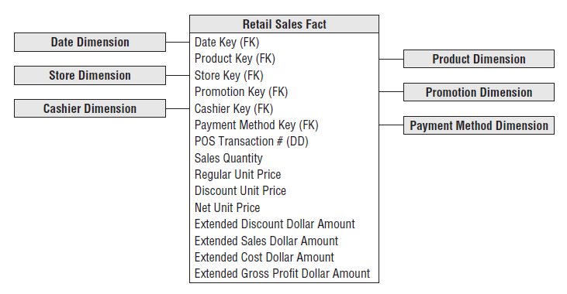
Additivity
Notes:
Additive: sales quantity and the extended discount, sales, cost dollar amounts
Non-additive: Gross margin, Unit Price

Slide 5
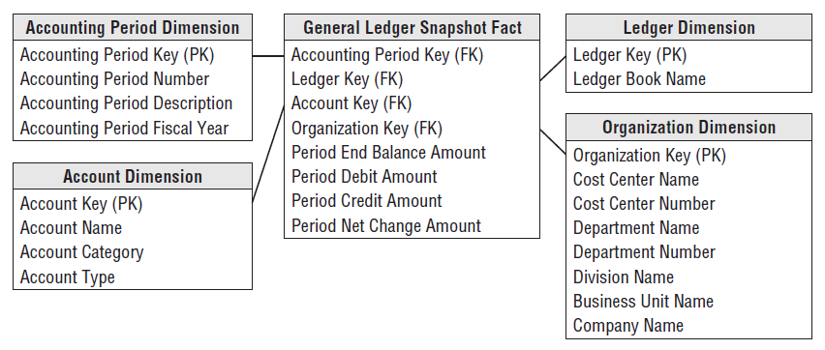
Additivity

Slide 6
NULL in Fact Tables
Null-valued measurements behave gracefully in fact tables
The aggregate functions (SUM, COUNT, MIN, MAX, and AVG) all do the “right thing” with null facts. However,
Nulls must be avoided in the fact table’s foreign keys
The associated dimension table must have a default row (and surrogate key) representing the unknown or not applicable condition

Slide 7
Conformed Facts
Same measurement in separate fact tables
Technical definitions of the facts must be identical if they are to be compared or computed together
If the separate fact definitions are consistent, the conformed facts should be identically named
if they are incompatible, they should be differently named to alert the business users and BI applications.

Slide 8
Transaction Fact Tables
Transactional business processes are the most common.
The grain
one row per transaction or transaction line
Tend to be sparse (not every product is sold every to every customer)
Can be truly enormous
Tend to be highly dimensional.
The metrics resulting are typically additive
Optionally: precise timestamp, degenerated dimensions

Slide 9
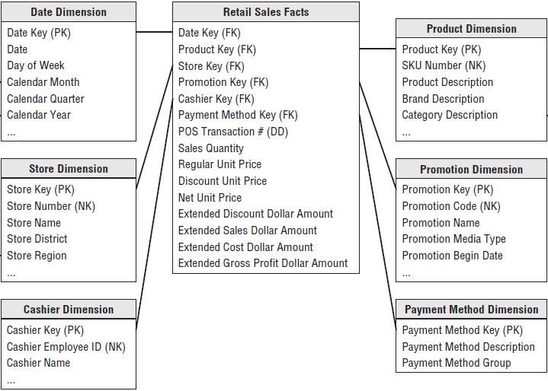
Transaction Fact Tables

Slide 10
Periodic Snapshot Fact Tables
A row summarizes many measurement events occurring over a standard period
The grain
Period (day, week, month, year, …), not the individual transaction
Many facts
Any measurement event consistent with the fact table grain is permissible
Uniformly dense in their foreign keys
if no activity takes place, a row containing a zero or null for each fact is created

Slide 11
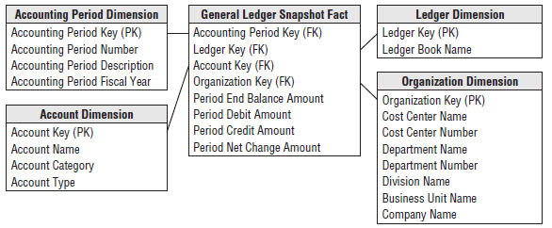
Periodic Snapshot Fact Tables

Slide 12
Accumulating Snapshot Fact Tables
A row summarizes the measurement events occurring at predictable steps between the beginning and the end of a process
Pipeline or workflow processes
Order fulfilment, claim processing
Defined start point, standard intermediate steps, and defined end point
Date foreign key for each critical milestone in the process.

Slide 13
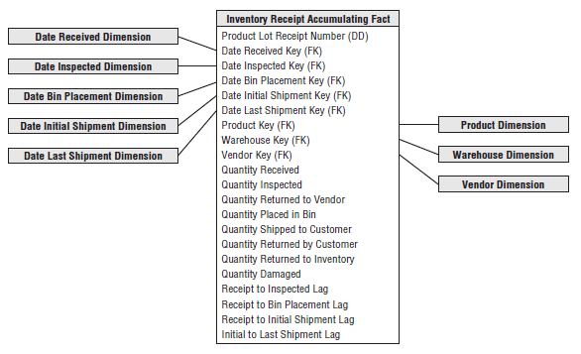
Accumulating Snapshot Fact Tables
An individual row corresponding for instance to a line on an order
Initially inserted when the order line is created
As pipeline progress occurs, the accumulating fact table row is revisited and updated

Slide 14
Factless Fact Tables
It is possible that an event merely records a set of dimensional entities coming together at a moment in time
Student attending a class on a given day (calendar day, student, teacher, location, class)
Can also be used to analyze what did not happen
a factless coverage table that contains all the possibilities of events that might happen
an activity table that contains the events that did happen
activity is subtracted from the coverage

Slide 15
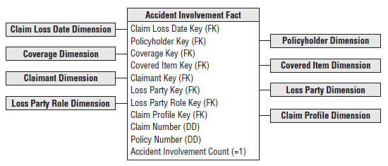
Factless Fact Tables

Slide 16
Fixed Depth Positional Hierarchies
A series of many-to-one relationships
Product to brand to category to department
Number of levels is fixed
The hierarchy levels should appear as separate positional attributes in a dimension table.
Predictable and fast query performance

Slide 17
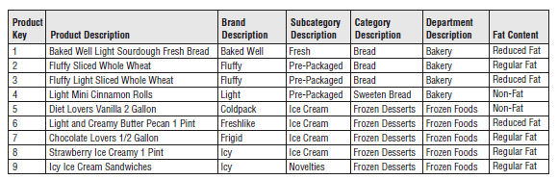
Fixed Depth Positional Hierarchies

Slide 18
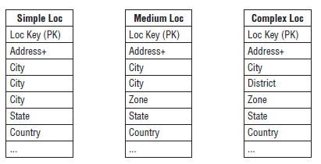
Slightly Ragged/Variable Depth Hierarchies
Number of levels is not fixed
Range in depth is small
Geographic hierarchies (3-6 levels)
Fixed depth positional design
Separate dimension attributes for the maximum number of levels
Attributes are populated based on rules from the business

Slide 19
Variable Depth Hierarchies with Hierarchy Bridge Tables
Indeterminate depth are difficult to model and query in a relational database
SQL extensions and OLAP access languages provide some support for recursive parent/child relationships
Approach: Modelling ragged hierarchy with a specially constructed bridge table.
Bridge table
Contains a row for every possible path
Enables all forms of hierarchy traversal to be accomplished with standard SQL

Slide 20
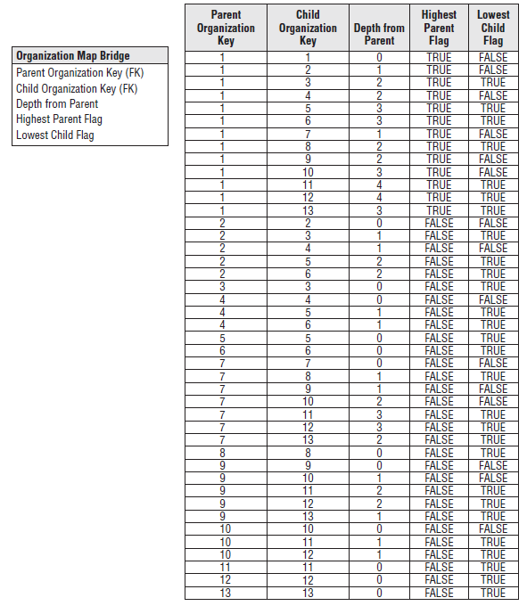
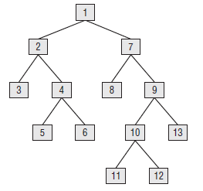
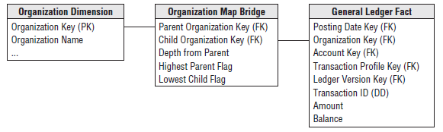
Variable Depth Hierarchies with Hierarchy Bridge Tables

Slide 21
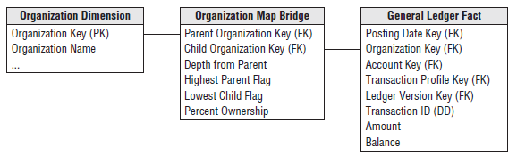
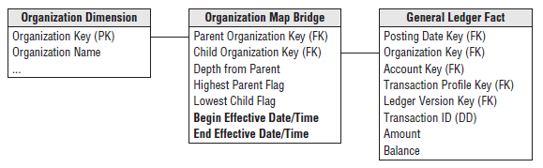
Shared Ownership & Time Varying Hierachies

Slide 22
Variable Depth Hierarchies with Pathstring Attributes
Bridge table can be avoided by implementing a pathstring attribute
Pathstring
Defined for each row in the dimension
Contains a specially encoded text string containing the complete path description from the root to the node described dimension row.
Does not enable rapid substitution of alternative hierarchies or shared ownership hierarchies.
Structure changes could force the entire hierarchy to be relabelled

Slide 23
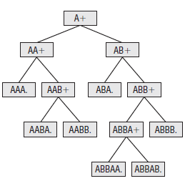
Variable Depth Hierarchies with Pathstring Attributes

Slide 24
Centipede Fact Tables
Centipede fact tables should be avoided
Separate normalized dimensions for each level of a many-to-one hierarchy
date dimension, month dimension, quarter dimension, and year dimension
FK for each low cardinality dimension
Fixed depth, many-to-one hierarchically related dimensions should be collapsed back to their unique lowest grains
A junk dimension should be created for low-cardinality dimension tables

Slide 25
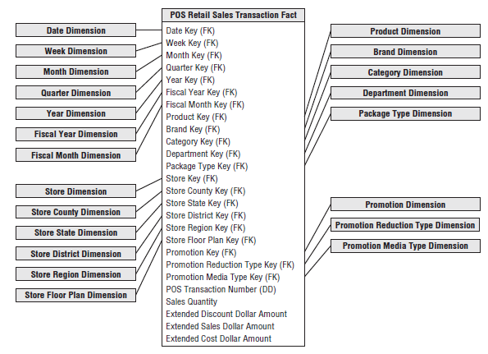
Centipede Fact Tables

Slide 26
Numeric Values as Attributes or Facts
Numeric value
If it is used primarily for calculation purposes, it likely belongs in the fact table
If a stable numeric value is used predominantly for filtering and grouping, it likely belongs in the dimension table
In some cases, it is useful to model the numeric value as both a fact and dimension attribute

Slide 27
Lag/Duration Facts
Accumulating snapshot fact tables capture multiple process milestones, each with a date foreign key
Business users often want to analyse the lags or durations between these milestones
differences between dates
lags are based on more complicated business rules (e.g working hours)

Slide 28
Lag/Duration Facts
Dozens of steps in a pipeline could imply hundreds of possible lags
one time lag for each step measured against the process’s start point.
every possible lag between two steps can be calculated as a subtraction between the two lags stored in the fact table

Slide 29

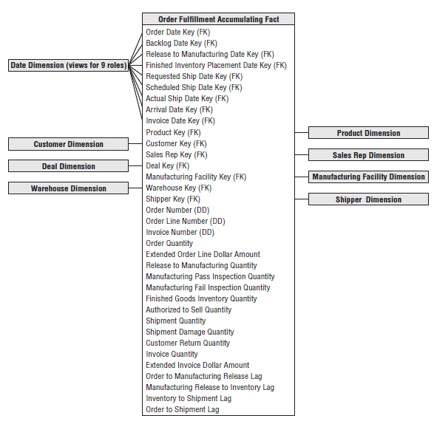
Lag/Duration Facts

Slide 30
Header/Line Fact Tables
Operational transaction systems often consist of a transaction header row that’s associated with multiple transaction lines
With header/line schemas
All the header-level dimension foreign keys and degenerate dimensions should be included on the line-level fact table

Slide 31
Allocated Facts
It is quite common in header/line transaction data to encounter facts of differing granularity
header freight charge.
The header facts should be allocated down to the line level
Based on rules provided by the business
Allocated facts can be sliced and rolled up by all the dimensions
In many cases, creating a header-level fact table can be avoided

Slide 32
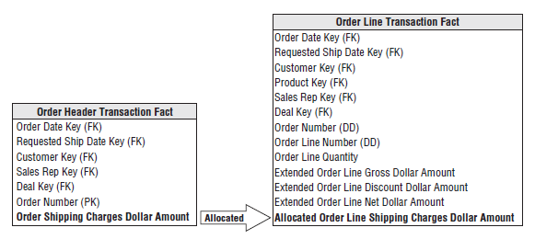
Allocated Facts

Slide 33
Multiple Currency Facts
Fact tables that record financial transactions in multiple currencies should contain a pair of columns for every financial fact in the row.
True currency of the transaction
Single standard currency used throughout the fact table.
Created in an ETL process according to an approved business rule for currency conversion.
This fact table also must have a currency dimension to identify the transaction’s true currency.

Slide 34
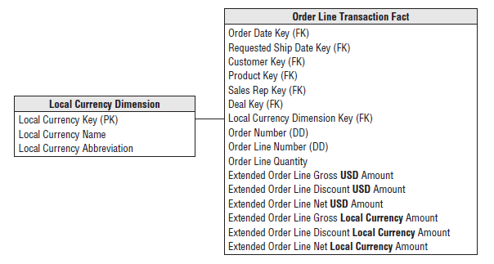
Multiple Currency Facts

Slide 35
Multiple Units of Measure Facts
Some business processes require facts to be stated simultaneously in several units of measure.
For example, a supply chain may need to report the same facts as pallets, ship cases, retail cases, or individual scan units.
If the number of facts is large, a convenient technique is to store the facts once in the table at an agreed standard unit of measure
Store conversion factors between the standard measure and all the others (in the fact table)

Slide 36
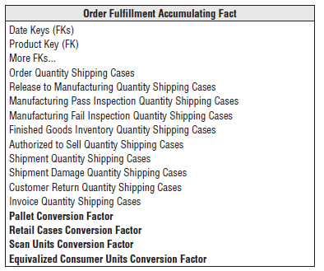
Multiple Units of Measure Facts

Slide 37
Year-to-Date Facts
The best practise is to calculate the YTD metrics in the BI applications or OLAP cube rather than storing YTD facts in the fact table.

Slide 38
Timespan Tracking in Fact Tables
Three basic fact table grains
Transaction
Periodic snapshot
Accumulating snapshot
In isolated cases
It is useful to add a row effective date, row expiration date, and current row indicator
Scenario: Slowly changing inventory balances
A frequent periodic snapshot would load identical rows with each snapshot.

Slide 39
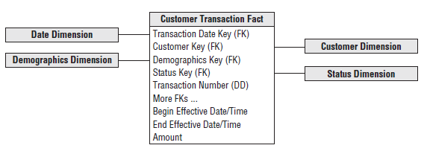
Timespan Tracking in Fact Tables

Slide 40
Late Arriving Facts
A fact row is late arriving if the most current dimensional context for new fact rows does not match the incoming row.
This happens when the fact row is delayed.
In this case, the relevant dimensions must be searched to find the dimension keys that were effective when the late arriving measurement event occurred

Slide 41
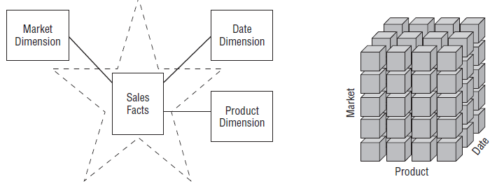
Star Schemas vs. OLAP Cubes
Star Schemas
Dimensional models implemented in RDBMS
Online analytical processing (OLAP) cubes
Dimensional models implemented in multidimensional database environments
Stars & OLAP Cubes
Common logical design (dimensions, measures)
Physical implementation differs.

Slide 42
OLAP Cubes
Data is stored and indexed using formats and techniques that are designed for dimensional data.
Performance aggregations or precalculated summary tables are often created and managed by the OLAP cube engine.
Cubes deliver superior query performance because of the precalculations, indexing strategies, and other optimizations.

Slide 43
OLAP Cubes
A star schema
Good physical foundation for building a cube
Basis for backup and recovery.
OLAP cubes
Used to have extreme performance advantages over RDBMSs
Less important distinction (appliances, in-memory databases, columnar databases)
OLAP cube data structures
More variable (different vendors)
More difficult to port

Slide 44
OLAP Cubes
More sophisticated security options
Limiting access to detailed data but providing more open access to summary data.
Significantly richer analysis capabilities
Main justification for using an OLAP product.
SCD 2 Support
Need to be reprocessed whenever data is overwritten using alternative SCD techniques
Transaction and periodic snapshots supported
Accumulating snapshots not supported

Slide 45
OLAP Cubes
OLAP cubes
support complex ragged hierarchies of indeterminate depth (organization charts, bills of material, …) using native query

