Slide 1
ETL
Radoslav Golian
14.11.2018

Slide 2
ETL
Extraction
Data extraction from multiple source systems
Should be eficient
CDC (Change Data Capture)
Clean
Data cleansing and conforming

Slide 3
ETL
Transformation
Data transformation according to business rules and logic
Calculations
SCD
Loading
Data load of transformed data to target storage
Most complex and time consuming task
ca. 80% of DWH processing

Slide 4
ETL Importance
ETL Adds value to data
Removes mistakes and corrects data
Captures flow of transactional data
Adjust data from multiple sources to be used together (confomance)
Conformed dimensions and facts
Create structures suitable for BI tools and processing (star & snowflake schemas)
Enables BI and analytical processing

Slide 5
ETL
ETL Process
Data extraction
Enforcing data quality (DQ) and consistency standards
Conforming data from various source systems
Delivering data to the target
ETL Tool
Software implementing ETL steps
Designed specifically to perform data transfomations

Slide 6
ETL Tools
Extract and Load are flexible on interfaces
Flat files, databases, XML data, message queues, web services, LDAP
Semi-structured data (emails, logs, wiki)
Unstructured data (blogs, documents)
Extensible with custom connectors
Change data capture
Local data, FTP, SFTP, SCP, HTTP

Slide 7
ETL Tools
Clean and Transform
Lookups, validations, filters, translations
Changing data structure
Joins
Normalization / Denormalization
Aggregations, partitioning

Slide 8
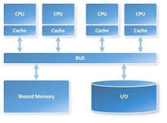
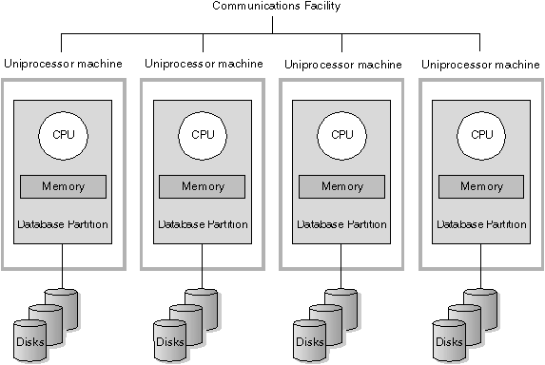
ETL Tools
Performance
Dedicated HW
Symetric multiprocessing (SMP)
Pipeline, multithreaded
Massive parallel processing (MPP)
Clustering, MapReduce
Load balancing
Efective development
Reusable components
Impact analysis – Data lineage

Slide 9
ETL Tools
User friendly
GUI
Metadata
Manegeability
Team collaboration
Transformation repository
Metadata repository
Developement process
Runtime
Schedulers, Recovery & Restart, Workflow

Slide 10
ETL Tools
Mappings
Mapping is the process of defining the source and destination of data as well as the transformations to perform as you move the data.
Business Glossary
This glossary helps to ensure that everyone is on the same page regarding business terms and synonyms. For example, the glossary might define common data values that are important to the business process and the common terminology of reference to be used

Slide 11
ETL Tools
Data Quality
Data quality problems can include missing, incomplete, or incorrect data, and any of these issues will have adverse effects on data integration process.
The time to deal with data quality issues is as early in your process as possible.

Slide 12
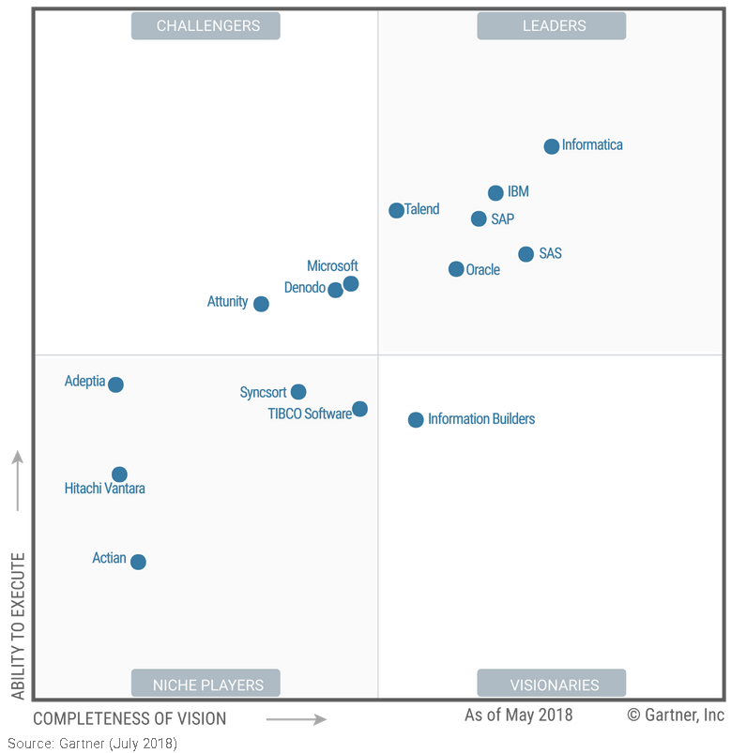
ETL Market

Slide 13
ELT
Extract – Load – Transformation
Pushed mainly by Oracle (Oracle Data Integrator)
Data is firstly loaded to database
Processing in the database

Slide 14
ETL or ELT?
ETL
More flexible
ELT
Less flexible
Tighly bound to the database
Less output formats
Possibly better performance
All data is processed in the same database
Data is not unloaded form the database (efective joins and lookups)

Slide 15
ETL Tool Example (Informatica)
Infomatica can be used as:
ETL tool
Data cleansing tool
Data integration tool
Data migration tool

Slide 16
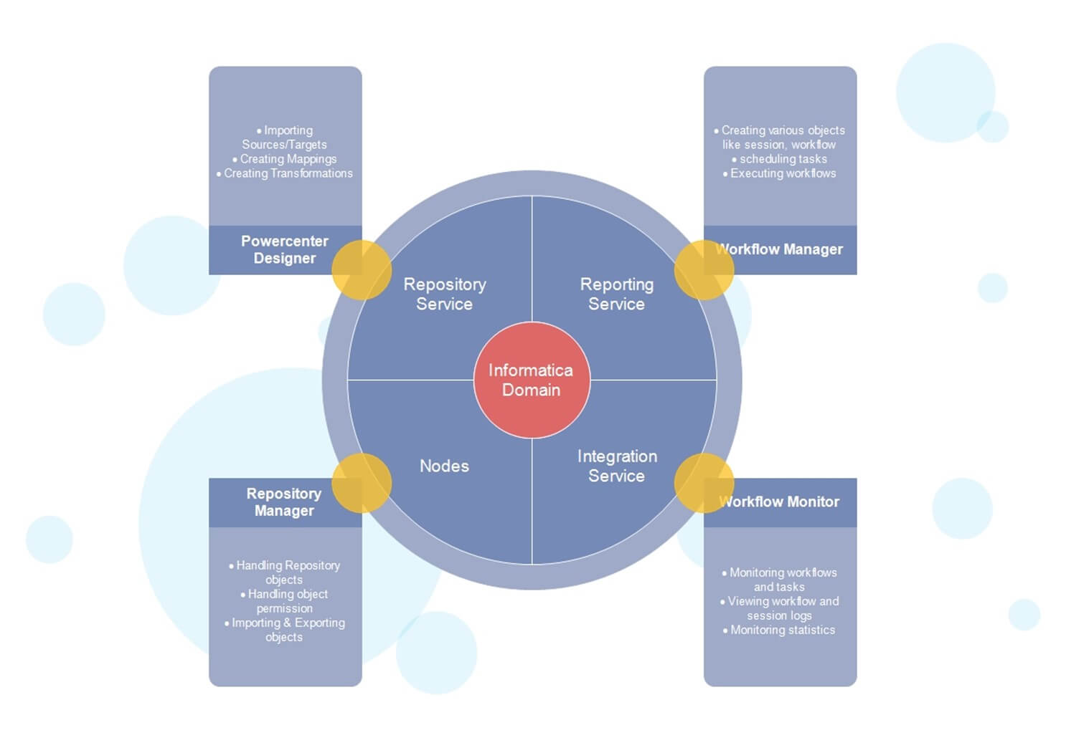
Informatica Architecture
Notes:
Informatica ETL tool consists of following services & components
Repository Service – Responsible for maintaining Informatica metadata & providing access of same to other services.
Integration Service – Responsible for the movement of data from sources to targets
Reporting Service - Enables the generation of reports
Nodes – Computing platform where the above services are executed
Informatica Designer - Used for creation of mappings between source and target
Workflow Manager – Used to create workflows and other task & their execution
Workflow Monitor – Used to monitor the execution of workflows
Repository Manager – Used to manage objects in repository

Slide 17
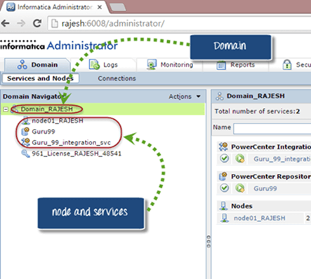
Domain
Node is a logical representation of a machine inside the domain. Node is required to run services and processes for Informatica.
Notes:
The overall architecture of Informatica is Service Oriented Architecture (SOA).
Informatica Domain is the fundamental administrative unit in Informatica tool
It is a collection of nodes and services. Further, this nodes and services can be categorized into folders and sub-folders based on the administration requirement.
There are two types of services in Domain
Service Manager: Service manager manages domain operations like authentication, authorization, and logging. It also runs application services on the nodes as well as manages users and groups.
Application Services: Application service represents the server specific services like integration service, repository service, and reporting service. These services run on different nodes based upon the configuration.

Slide 18
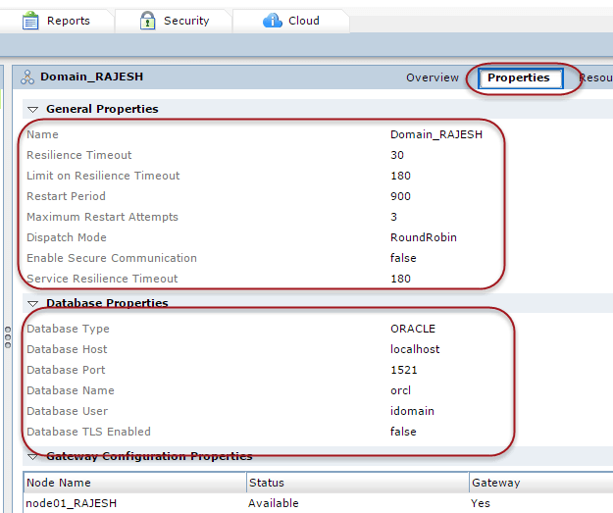
Domain Properties
Notes:
Key properties of the domain are
Resilience timeout – If any of the integration service or repository services goes down then resilience timeout is the no of seconds the application service tries to connect to those services.
Restart Period – It is the maximum number of seconds the domain spends to restart a service.
Dispatch Mode – It is the policy used by the load balancer to dispatch tasks to various nodes.
Database type – The type of database on which domain is configured.
Database host – Hostname of the machine on which domain is configured.
Database port & name – It is the database port and the database instance name for the domain.
These properties can be modified based upon requirement.

Slide 19
PowerCenter Repository
Relational database
Stores medatata
Managed by repository service
Used by
Designer
Workflow Monitor
Workflow Manager

Slide 20
Server – Client Architecture
Client tools
Powercenter designer, workflow manager, a repository manager, and workflow monitor are the main client tools.
The mappings and objects that we create in these client tools are saved in the Informatica repository which resides on the Informatica server. So the client tools must have network connectivity to the server.
Notes:
Client tools connects to the sources and targets to import the metadata and source/target structure definitions. So it also must have connectivity to the source/target systems.
To connect to the integration service and repository service, PowerCenter client uses TCP/IP protocols and
To connect to the sources/targets PowerCenter client uses ODBC drivers.

Slide 21
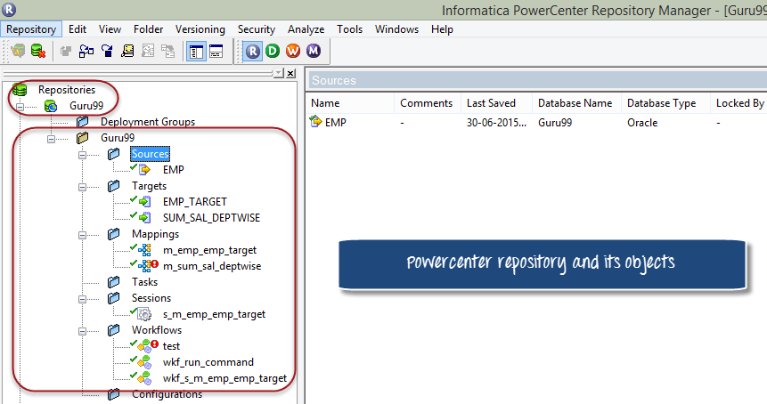
Repository Service
Notes:
The repository service maintains the connections from Powercenter clients to the PowerCenter repository. It is a separate multi-threaded process, and it fetches, inserts and updates the metadata inside the repository. It is also responsible for maintaining consistency inside the repository metadata.

Slide 22
Integration Service
Executes the tasks that created in Informatica
A user executes a workflow
Informatica instructs the integration service to execute the workflow
The integration service reads workflow details from the repository
Integration service starts execution of the tasks inside the workflow
Once execution is complete, the status of the task is updated (failed, succeeded, aborted..)

Slide 23
Integration Service
After completion of execution, session log and workflow log is generated.
The integration service also combines data from different sources (e.g. Database table with a flat file)
This service is responsible for loading data into the target systems
Notes:
Informatica integration service is a process residing on the Informatica server waiting for tasks to be assigned for the execution. When we execute a workflow, the integration service receives a notification to execute the workflow. Then the integration service reads the workflow to know the details like which tasks it has to execute like mappings & at what timings. Then the service reads the task details from the repository and proceeds with the execution.

Slide 24
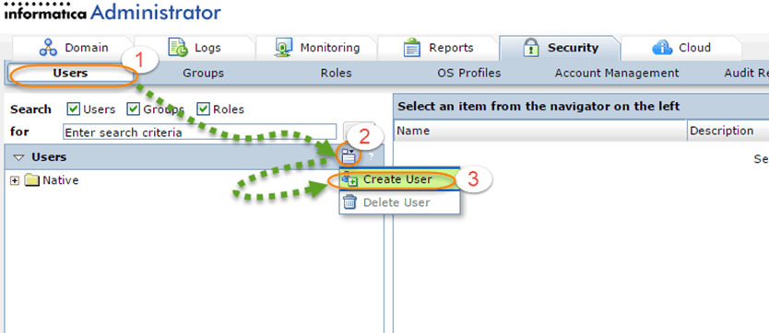
Users
Notes:
To create mappings in Informatica designer and to perform various tasks like, executing workflows, managing repository folders, monitoring workflows, etc. a valid Informatica user is required, and the user must have privileges. A user can be administrator user or developer user based on the roles assigned to it. You can create any no. of users based upon requirement.

Slide 25
Sources & Targets
Rational
Database tables
Flat Files
CSV, fixed length, tab delimited
Change Data Capture
Real-time stream of changes
Notes:
A Source in ETL is an entity from where you pull the records, and then you store these records in temporary tables (staging tables) or Informatica transformation caches
.
On the basis of mapping design document/business requirement you make a change in these data records (transform the data) and then you load the transformed data in another tables structures, called target tables.
Informatica being an ETL and Data integration tool, you would be always handling and transforming some form of data. The input to our mappings in Informatica is called source system. We import source definitions from the source and then connect to it to fetch the source data in our mappings. There can be different types of sources and can be located at multiple locations. Based upon your requirement the target system can be a relational or flat file system. Flat file targets are generated on the Informatica server machine, which can be transferred later on using ftp.

Slide 26
Source Analyzer
Options
Creation of sources from scratch
Import different types of sources
Objects
Tables, Views, Flat files, XML files, ...
Imported metadata
Source (Table) name, Database location
Name of Columns, Columns Data types
Constraints

Slide 27
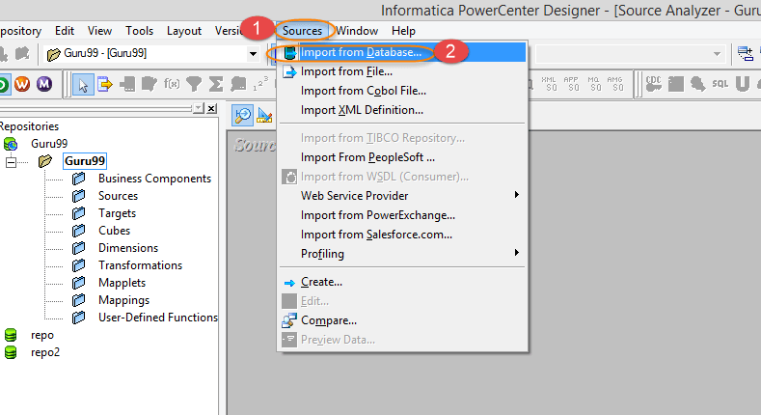
Source Analyzer

Slide 28
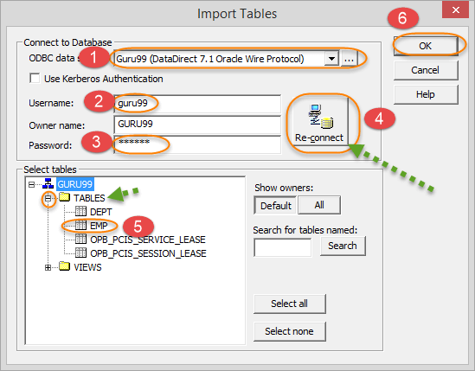
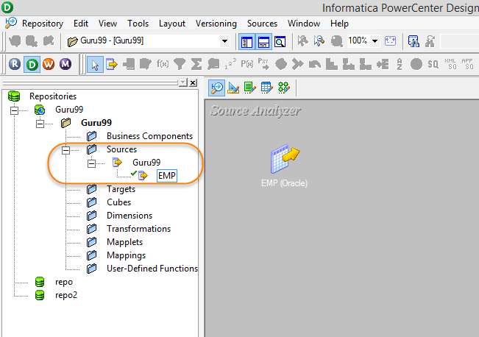
Source Analyzer (Table Import)

Slide 29
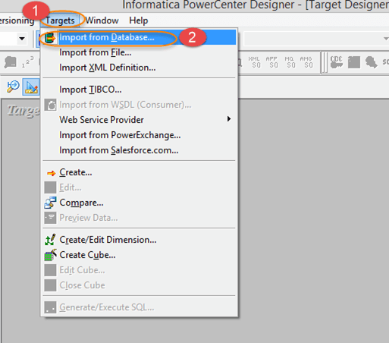
Target Designer

Slide 30
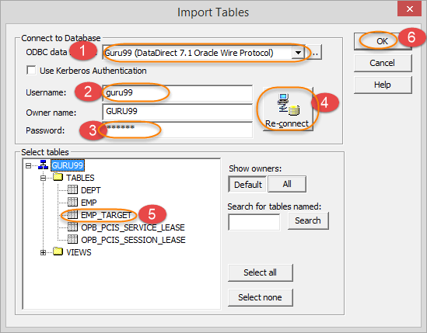
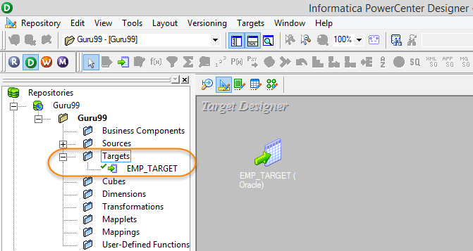
Target Designer

Slide 31
Mappings in Informatica
Mapping
a collection of source and target objects linked together by a set of transformations.
transformations consist of a set of rules, which define the data flow and how the data is loaded into the targets.

Slide 32
Mapping objects
Source Definition
The structure and characteristic of the source, data types, type of the data source, etc.
Transformation
how the source data is transformed, and various functions can be applied during the process
Target Definition
final target where the data will be loaded
Notes:
Mapping is an object in Informatica with the help of which you can define how the source data is modified before it reaches the destination or target object. Like if you have employee name as "Bill Clinton" in your source system and in the target system the requirement is to have employee name in the format as "Clinton Bill", such operations can be designed at the mapping level. In basic terms, what you do with the source data is defined at the mapping level.
Mapping is the basic Informatica object with the help of which we can define the data transformation details and source/target object characteristics. Mappings help us to define the data transformation at the individual column levels for each row. Even in a single mapping you can handle multiple sources and targets.

Slide 33
Mapping objects
Links
connect the source definition to different transformations and target tables. It defines how the data flows from source to target and the transformations.

Slide 34
Stage Mapping
A mapping in where we create the replica of the source table
Source and Target tables have identical structures
The data in the target table is a replica of source table data or
Data in stage (target) table is a subset of source data.
Production downtime does not affect ETL
ETL does not affect production performance

Slide 35
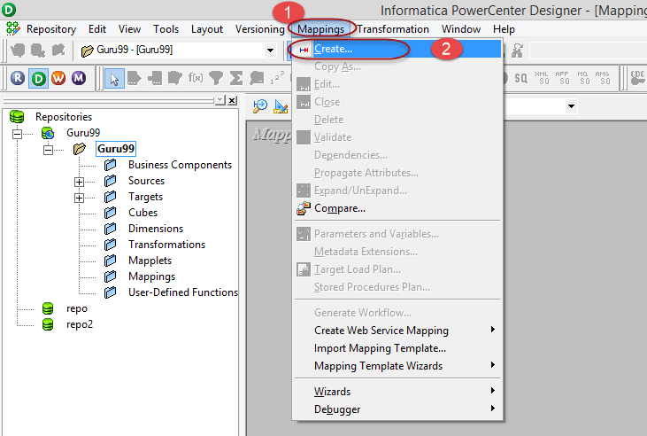
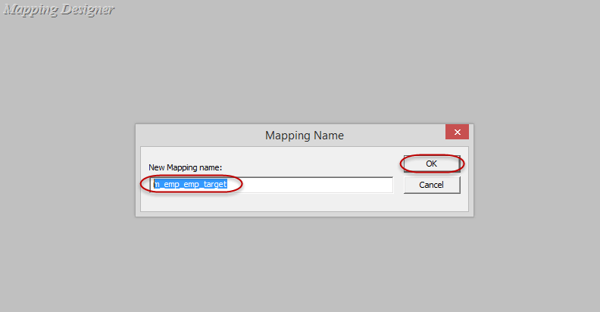
Mapping Designer

Slide 36
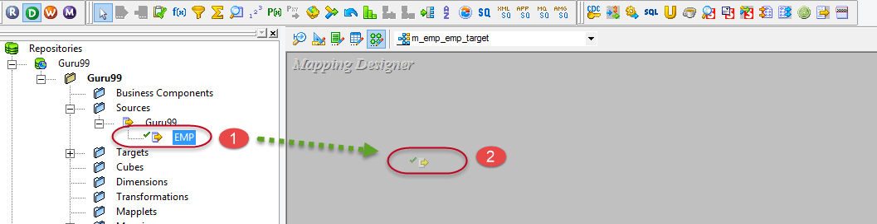
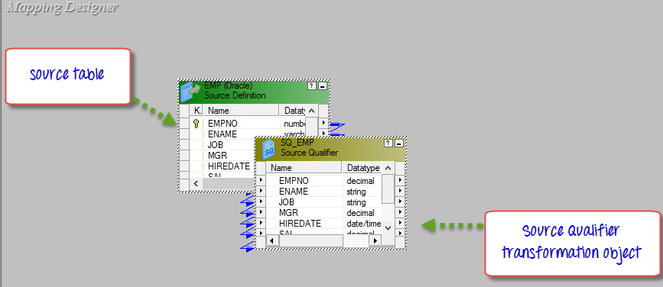
Mapping Designer
Notes:
When you import any relational (database) table in a mapping, an additional object of source qualifier type will also be created. This source qualifier transformation is necessary and helps Informatica integration service to identify the source database table and its properties. Whenever you import a source table, source qualifier transformation will also be created. You should never delete a source qualifier object in a mapping.

Slide 37
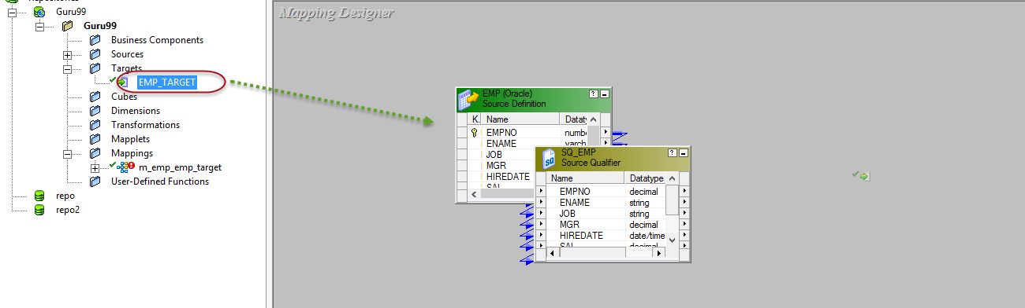
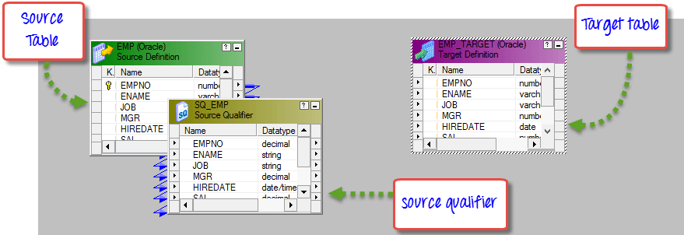
Mapping Designer

Slide 38
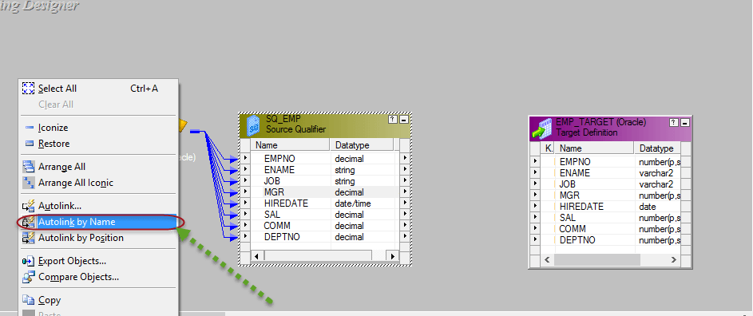
Mapping Designer

Slide 39
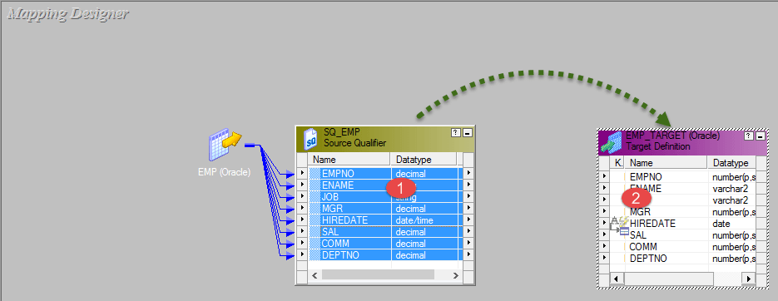
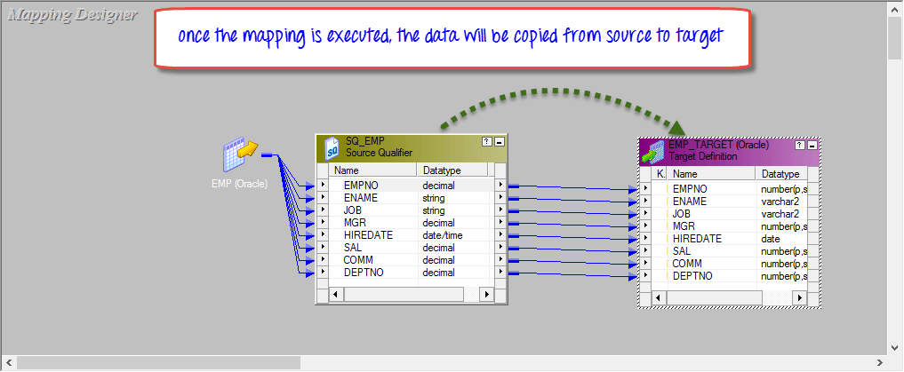
Mapping Designer
Notes:
Select Source table columns.
Drag and drop columns to the target table.
Here you have linked all source columns to the respective target table column. It means, for every source record fetched, all the columns of the target will get loaded. If you want to exclude any specific column from getting loaded, click on that column link and press delete key from the keyboard. The link will get removed, and the target column will not get loaded.

Slide 40
Mapping Parameters and Variables
Parameter
Assigned value remains constant throughout the mapping run
Variable
Values can be reassigned during the run

Slide 41
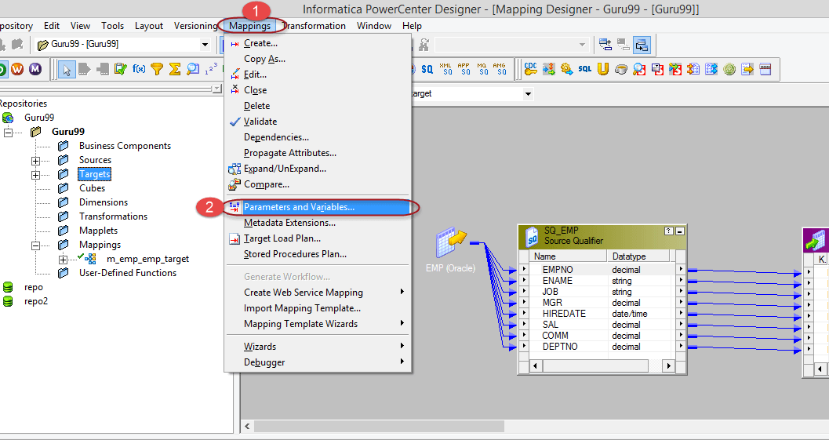
Create Parameter/Variable

Slide 42
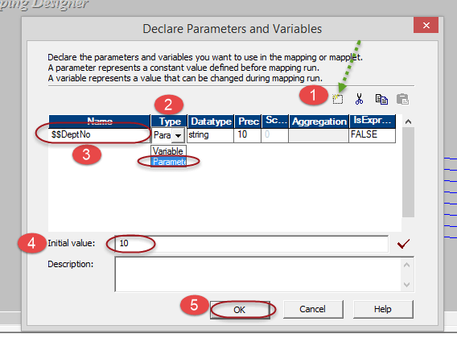
Create Parameter/Variable

Slide 43
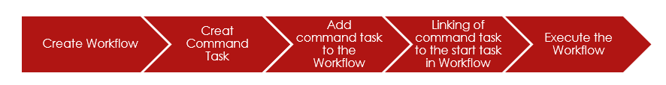
Workflow in Informatica
Workflow
A group of instructions/commands to the integrations service in Informatica
The integration service is an entity which reads workflow information from the repository, fetches data from sources and after performing transformation loads it into the target.
It defines how to run tasks like session task, command task, email task, etc

Slide 44
Workflow
Workflow
Sequence
Tasks execute in the order in which they are defined
Event based
Tasks gets executed based on the event conditions.

Slide 45
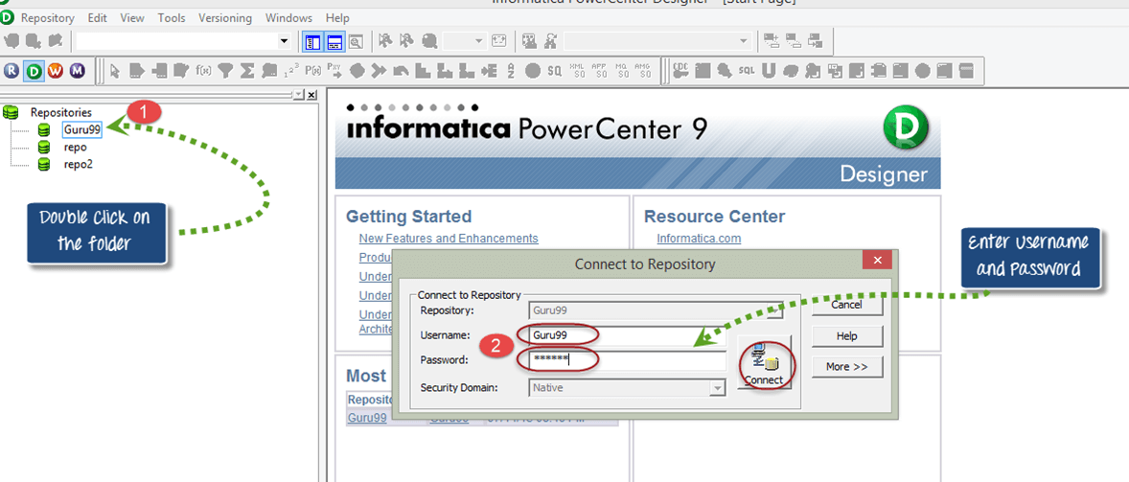
Workflow Manager

Slide 46
Workflow Manager
Connections
To execute any task in workflow manager, a connection
If there is a source table in oracle database in a mapping, then oracle connection must be created so that integration service can connect to the oracle database to fetch the source data
Connection types
Relational, Ftp, Queue, Application

Slide 47
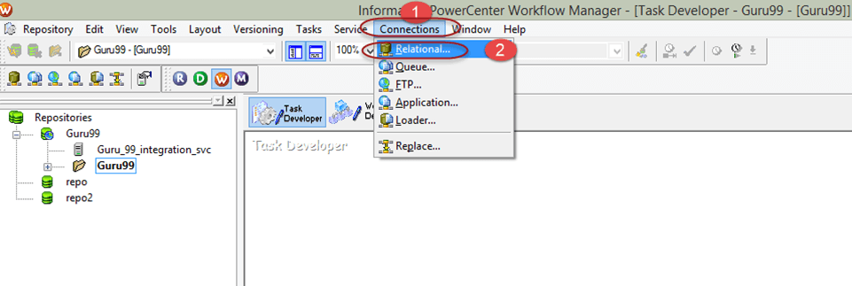
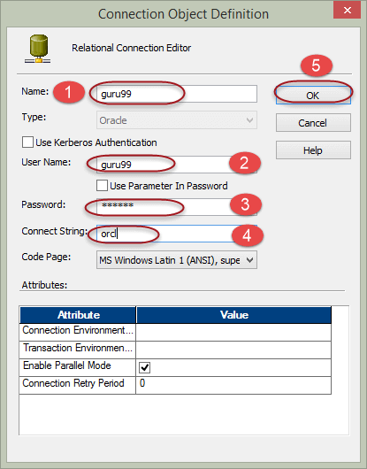
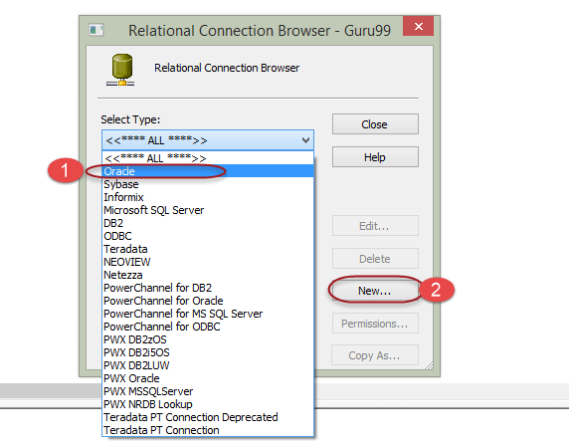
Relational Connection

Slide 48
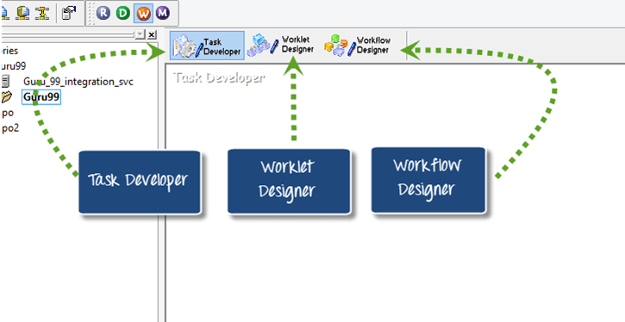
Workflow Manager
Notes:
Task Developer – Task developer is a tool with the help of which you can create reusable objects. Reusable object in workflow manager are objects which can be reused in multiple workflows. For Example, if you have created a command task in task developer, then you can reuse this task in any number of workflows.
The role of Workflow designer is to execute the tasks those are added in it. You can add any no of tasks in a workflow.
You can create three types of reusable tasks in task developer.
Command task
Session task
Email task
Command task – A command task is used to execute different windows/unix commands during the execution of the workflow. You can create command task to execute various command based tasks. With help of this task you can execute commands to create files/folders, to delete files/folders, to do ftp of files etc.
Session Task - A session task in Informatica is required to run a mapping.
Without a session task, you cannot execute or run a mapping
A session task can execute only a single mapping. So, there is a one to one relationship between a mapping and a session
A session task is an object with the help of which informatica gets to know how and where to execute a mapping and at which time
Sessions cannot be executed independently, a session must be added to a workflow
In session object cache properties can be configured and also advanced performance optimization configuration.
Email task - With the help of email task you can send email to defined recipients when the Integration Service runs a workflow. For example, if you want to monitor how long a session takes to complete, you can configure the session to send an email containing the details of session start and end time. Or, if you want the Integration Service to notify you when a workflow completes/fails, you can configure the email task for the same.

Slide 49
Task Developer
Command task
OS commands
Session task
A session task in Informatica is required to run a mapping.
One session : one mapping
Email task

Slide 50
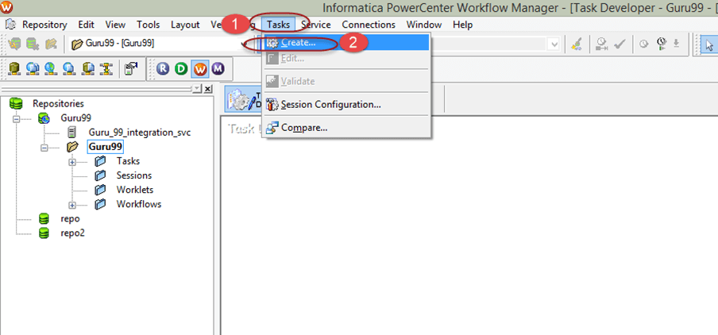
Session Task

Slide 51
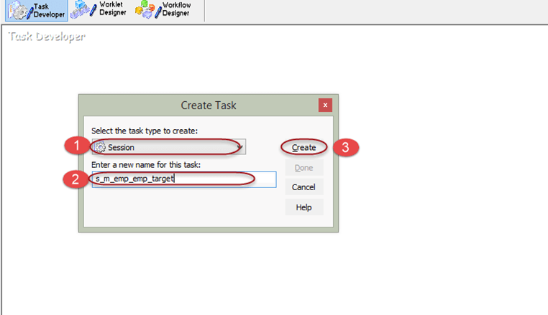
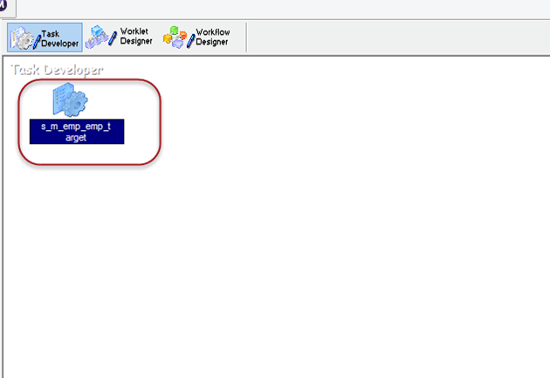
Session Task
Notes:
Session object will appear in the task developer

Slide 52
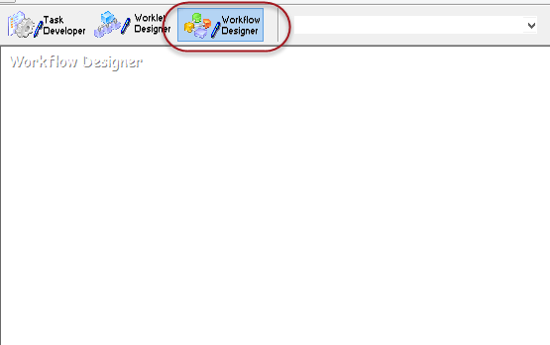
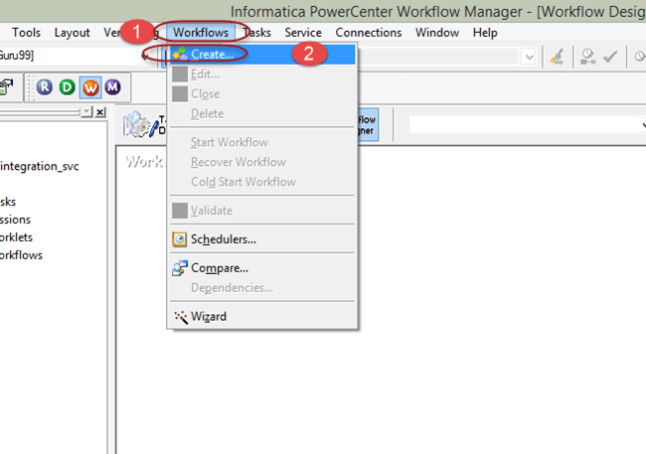
Session Task

Slide 53
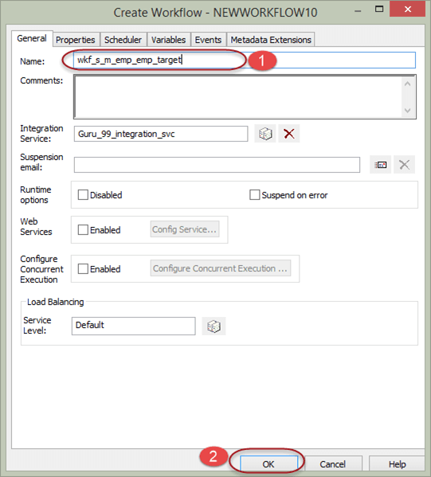
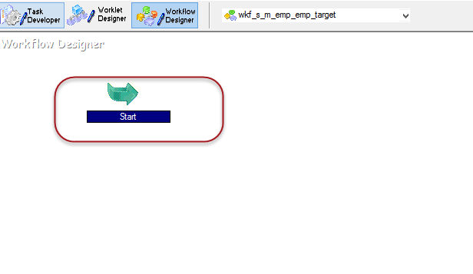
Session Task

Slide 54
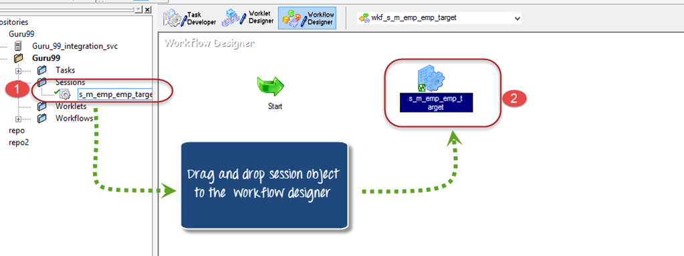
Session Task

Slide 55
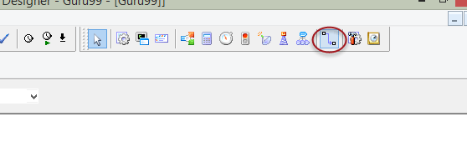
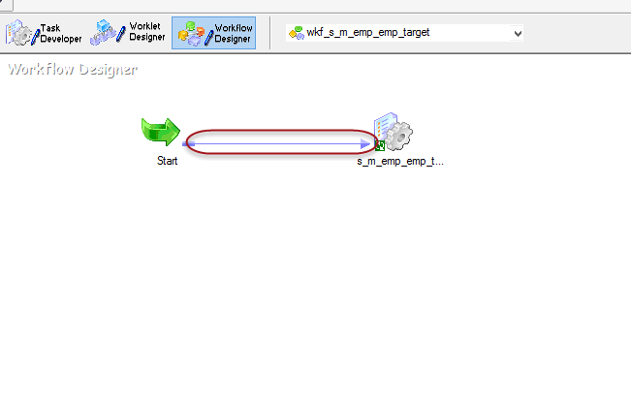
Session Task

Slide 56
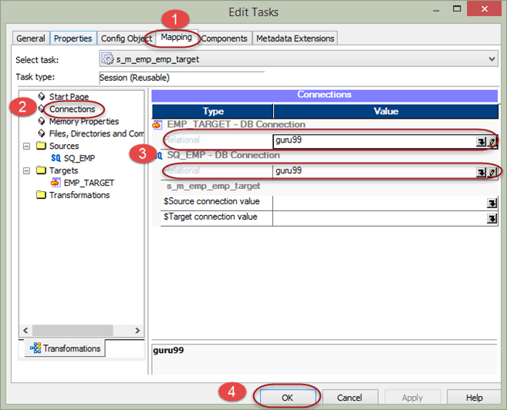
Session Task
Notes:
Double click on the session object in wokflow manager. It will open a task window to modify the task properties.
In the edit task window
Select mapping tab
Select connection property
Assign the connection to source and target, the connection which we created in early steps.
Select OK Button

Slide 57
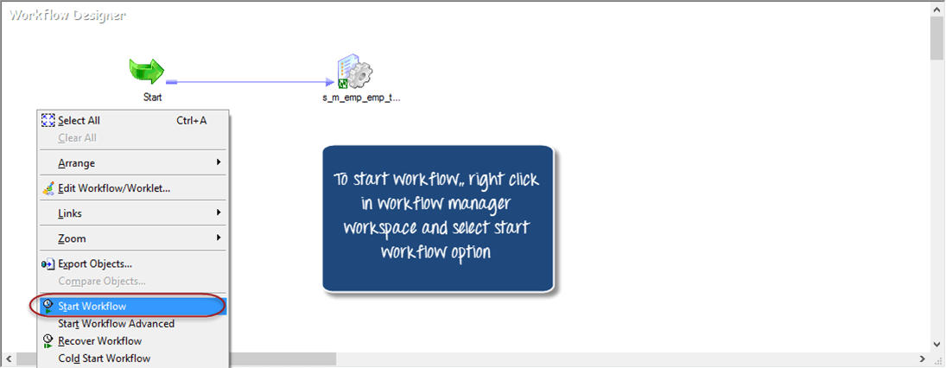
Session Task

Slide 58
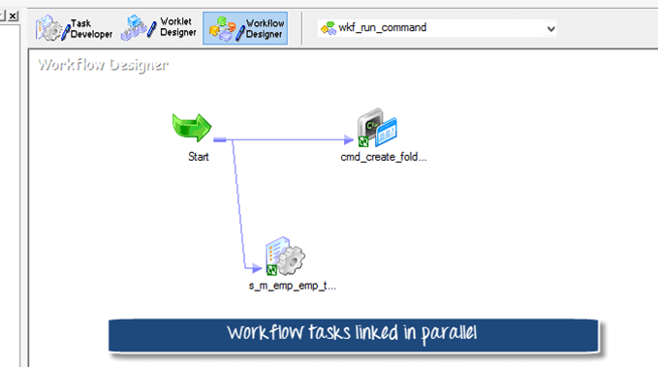
Parallel Tasks

Slide 59
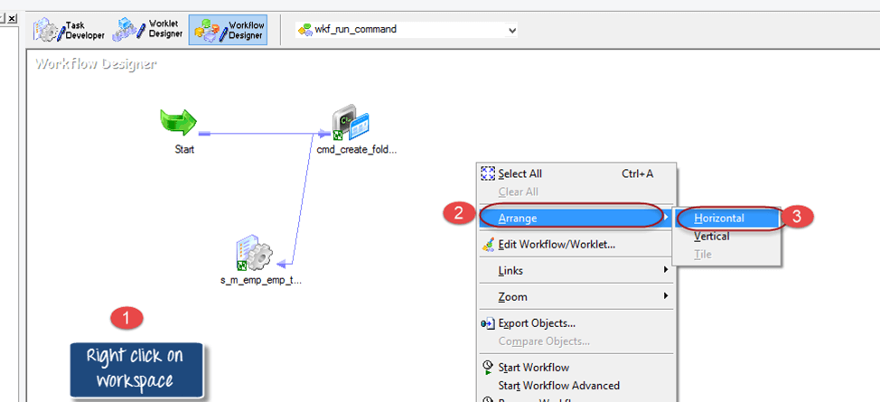
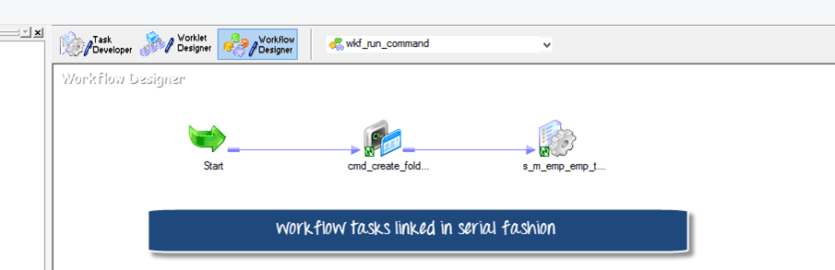
Serial Tasks

Slide 60
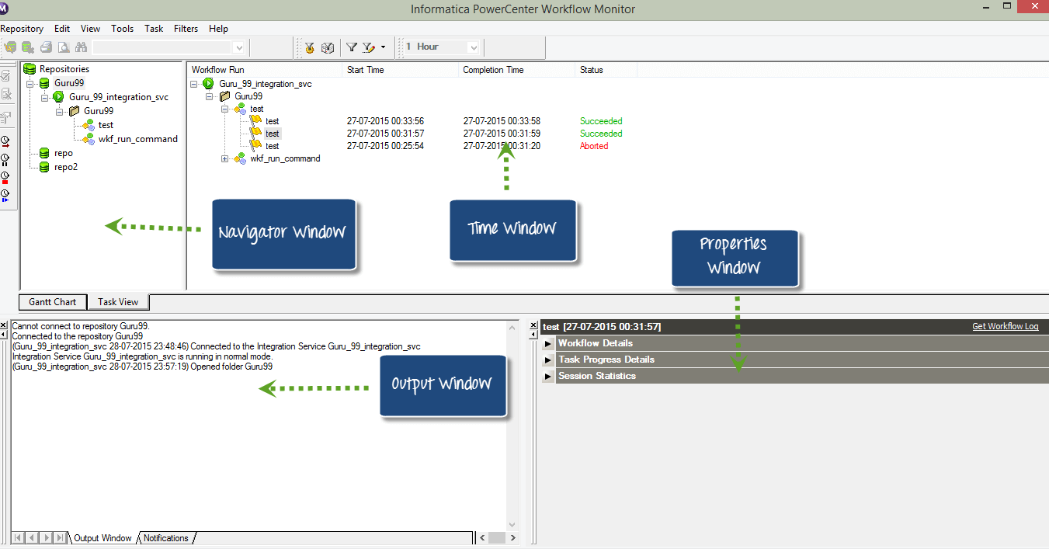
Workflow monitor

