Slide 1
ETL (Informatica)
Radoslav Golian
21.11.2018

Slide 2
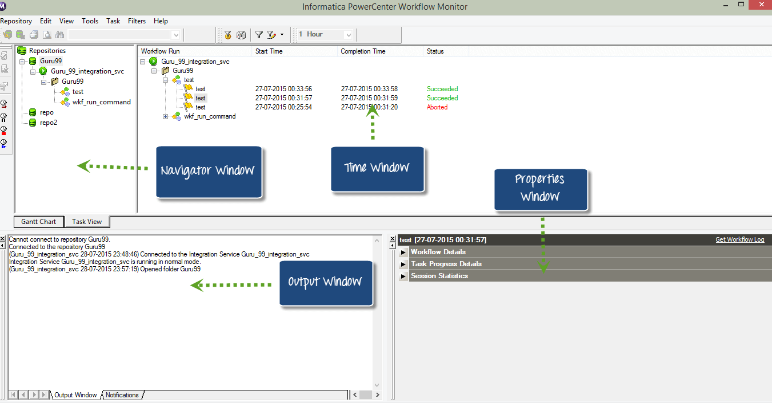
Workflow Monitor

Slide 3
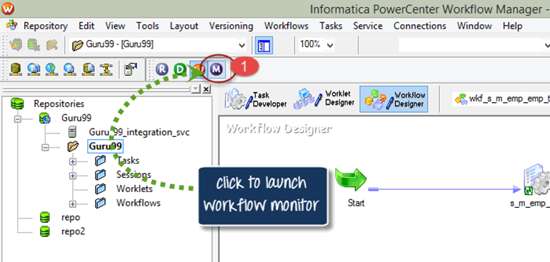
Workflow Monitor
Notes:
In Informatica Designer or Workflow manager toolbox, click on the workflow monitor icon

Slide 4
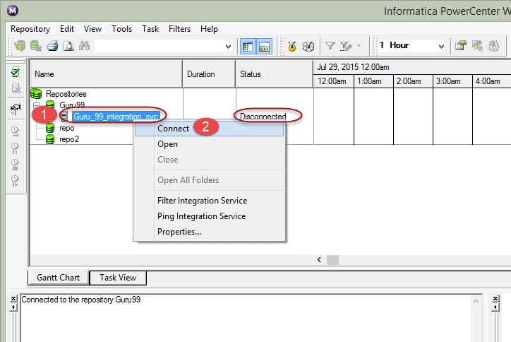
Workflow Monitor
Notes:
In the workflow monitor tool, you will see the repositories and associated integration services on the left side. Under the status column, you will see whether you are connected or disconnected to integration service. If you are in the disconnected mode, you won't see any running workflows. There is a time bar which helps us to determine how long it took a task to execute.
The workflow monitor is in a disconnected mode by default. To connect to integration service:
Right click on the integration service
Select connect option

Slide 5
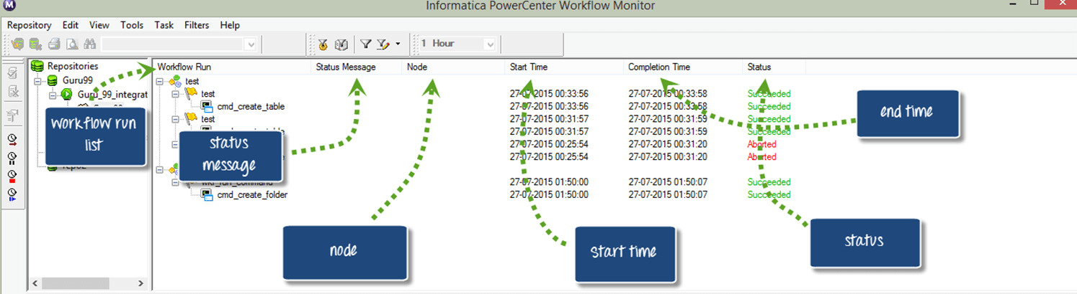
Workflow Monitor (Task View)
Notes:
Task view shows the following details
Workflow run list – Shows the list of workflow runs. It contains folder, workflow, worklet, and task names. It displays workflow runs in chronological order with the most recent run at the top. It displays folders and Integration Services alphabetically.
Status message - Message from the Integration Service regarding the status of the task or workflow.
Node - Node of the Integration Service executed the task.
Start time - The time at which task or workflow started.
Completion time – The time at which task or workflow completed the execution.
Status - Shows status of the task or workflow, whether the workflow started, succeeded, failed or aborted.

Slide 6
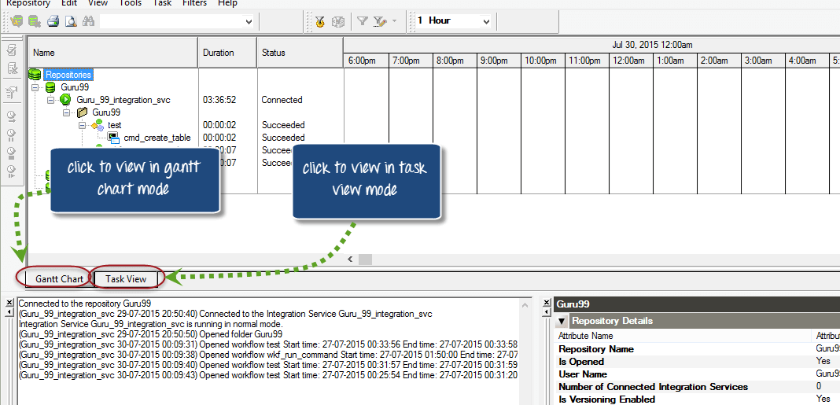
Workflow Monitor (Gantt Chart)
Notes:
In Gantt chart view, you can view chronological view of the workflow runs. Gantt chart displays the following information.
Task name – Name of the task in the workflow
Duration – The time taken to execute the task
Status – The most recent status of the task or workflow

Slide 7
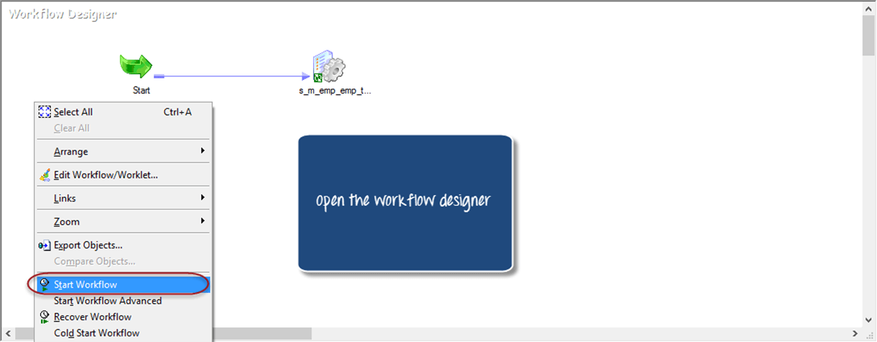
Workflow Monitor (Example)
Notes:
In previous examples, we have created a
Mapping "m_emp_emp_target": A mapping is a set of instructions on how to modify the data and processing of transformations that affects the record set.
Session "s_ m_emp_emp_target" : A session is a higher level object to a mapping which specifies the properties of execution. For example performance tuning options, connection details of sources/targets, etc.
Workflow "wkf_s_m_emp_emp_target": A workflow is a container for the session and other objects, and it defines the timing of the execution of tasks and the dependency or flow of execution.

Slide 8
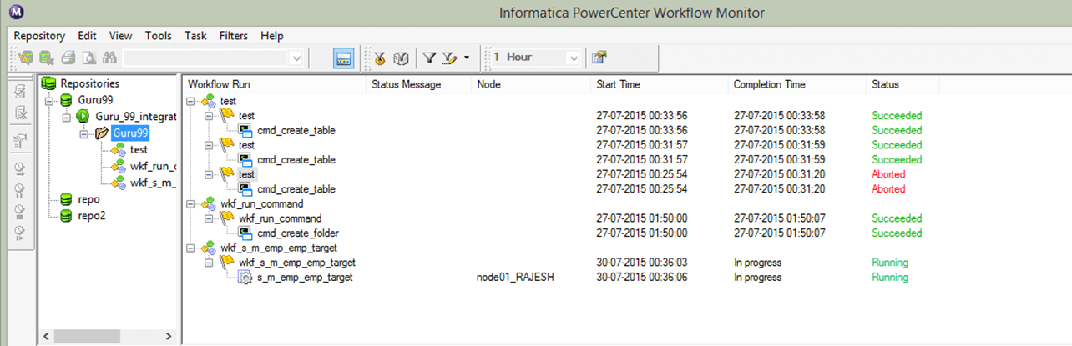
Workflow Monitor (Example)
Notes:
Go to workflow monitor and in the monitor window you will see details as shown in screen shot like repository, workflow run details, node details, workflow run start time, workflow run completion time and status.

Slide 9
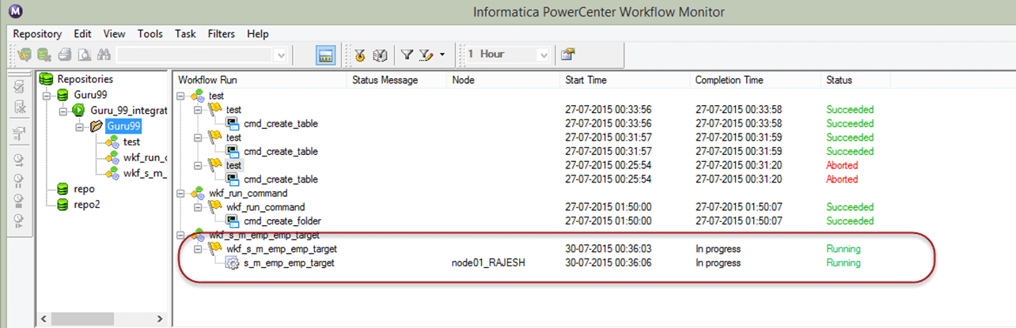
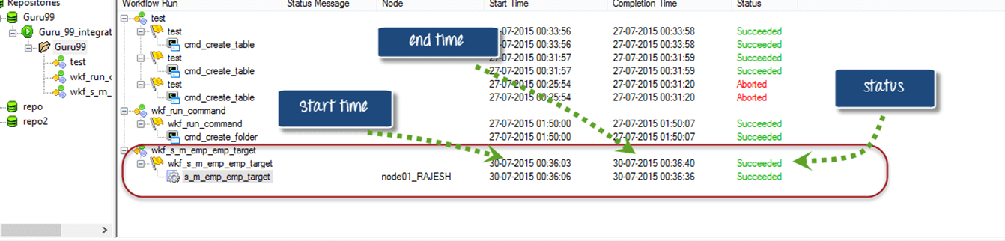
Workflow Monitor (Example)

Slide 10
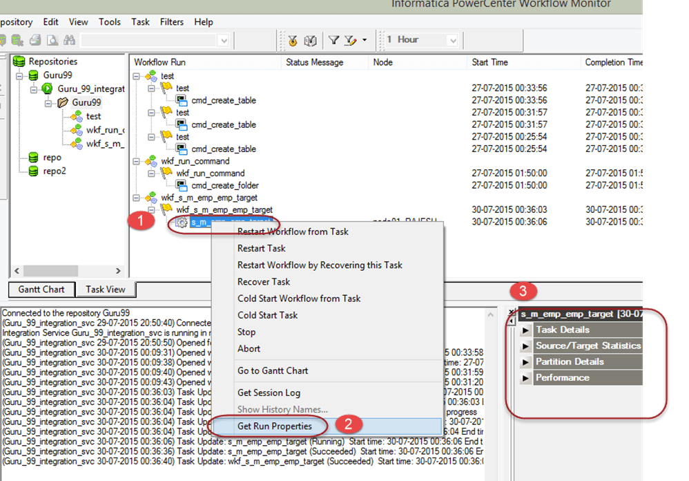
Workflow Monitor (Example)

Slide 11
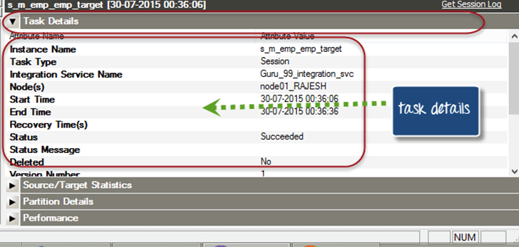
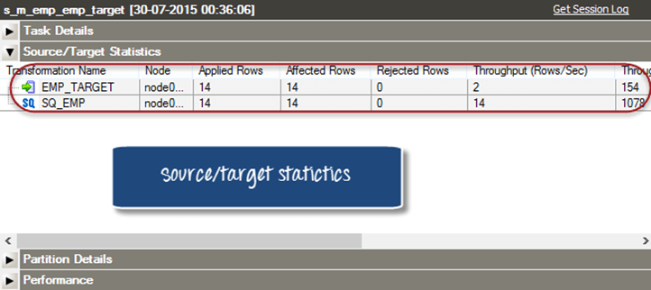
Workflow Monitor (Example)
Notes:
Source and Target Statistics
Source and target statistics gives the details of source and target. For example, how many rows are fetched from the source and how many rows are populated in the target the current throughput, etc
In the following screen, 14 records are fetched from the source, and all 14 are populated in the target table.
Applied rows signify how many records Informatica had tried to update or insert the target
Affected rows signify how many numbers of applied rows were actually succeeded.Here all 14 rows are successfully loaded in the target, so the count is same for both.
Rejected rows signify how many rows are dropped due to target constraint or other issues.

Slide 12
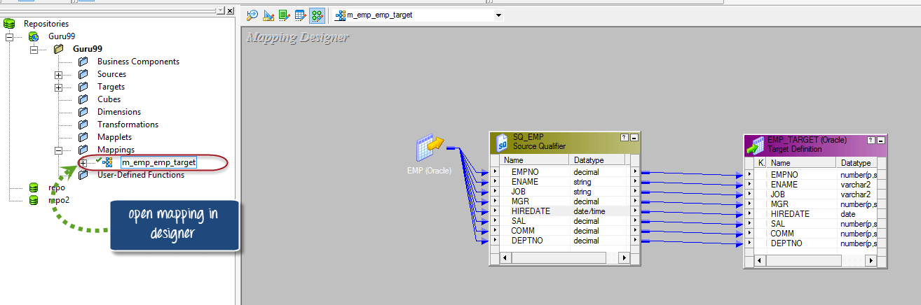
Debugging a Mapping
Notes:
Debugger is a very handy utility in Informatica. When we execute the mapping, Informatica executes the mapping based on the transformation logic defined.
Its execution is similar to batch mode execution where we cannot see the intermediate results, or how the data is getting modified from transformation to transformation.
Many a times we get the data in the target which is not as we expected. With the help of debugger, we can analyze how the data is moving within the mapping. We can analyze the data row by row in a debugger.
The use of debugger requires a session instance, we can either reuse an existing session which was created earlier to run the mapping, or we can create a new debug session instance. Since during debugging the data will be fetched from the source, so we have the option of what to do with that data.
Either we can discard the data or the data can be loaded into the target

Slide 13
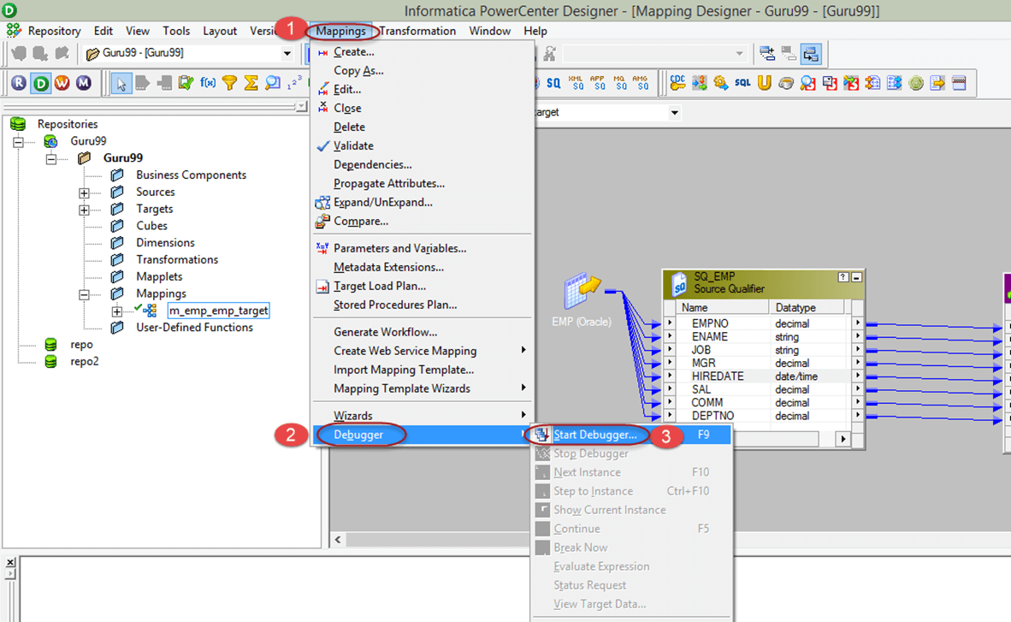
Debugging a Mapping (Start)

Slide 14
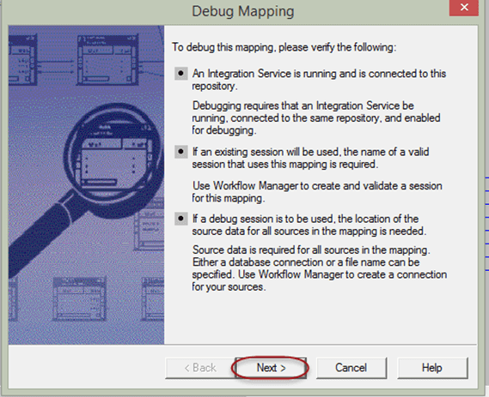
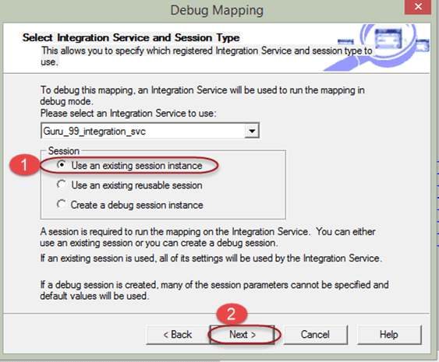
Debugging a Mapping (Start)
Notes:
When you use the existing session, Informatica will use the earlier session which you created for this mapping. When you select the create debug session instance, a new session instance will be created for debugging.

Slide 15
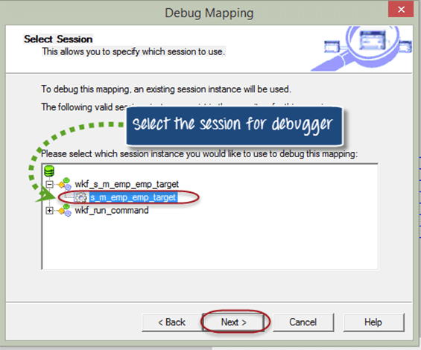
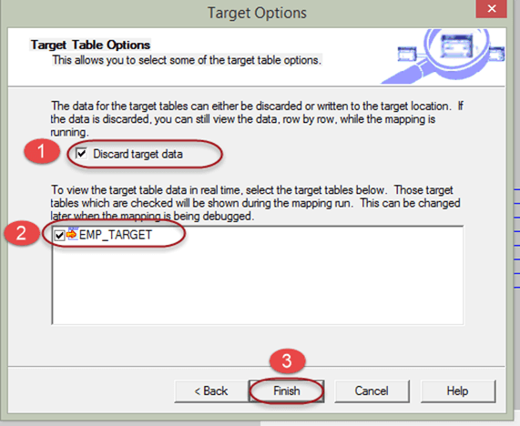
Debugging a Mapping (Start)

Slide 16
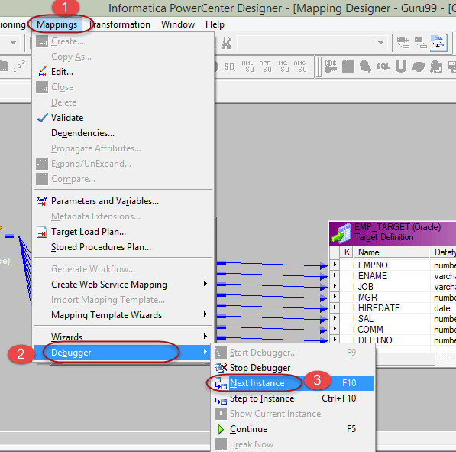
Debugging a Mapping (Fetching)

Slide 17
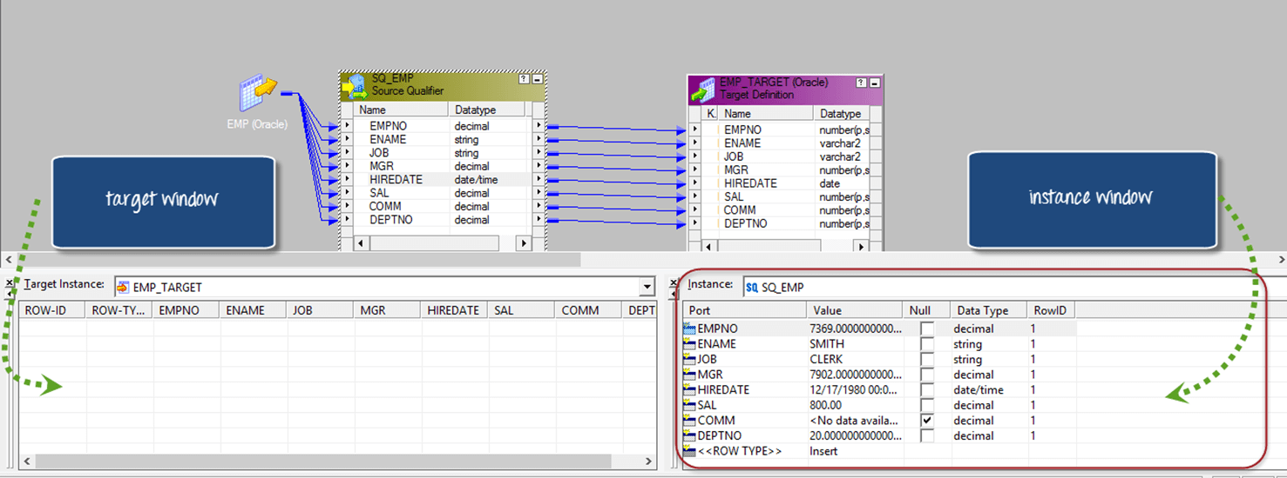
Debugging a Mapping (Fetching)
Notes:
To monitor the debugger, there are two windows in Informatica designer
Target window
Instance window
In target window, the target record which is going to be inserted into the target table is shown. In instance window, you can select any of the transformation instances of the mapping. After that, all the ports of that transformation are visible in this window, and you can analyze the data, how it is getting transformed.

Slide 18
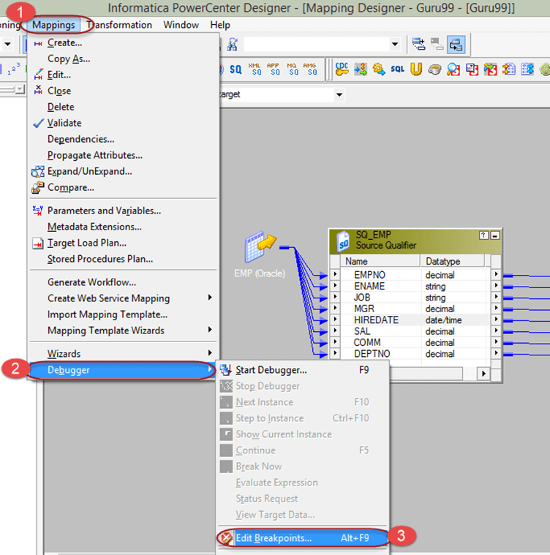
Debugging a Mapping (Breakpoint)
Notes:
A breakpoint is a condition or a set of a condition defined during configuration of debugging such that when that condition becomes true the debugger halts to that particular instance.
For example if we define deptno=20 in a breakpoint, then whenever for a record if this condition is true, then the debugger will stop to that instance of data.

Slide 19
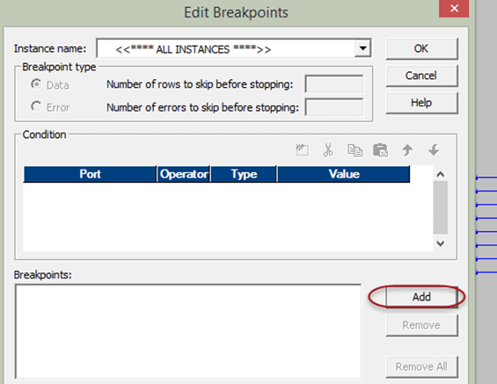
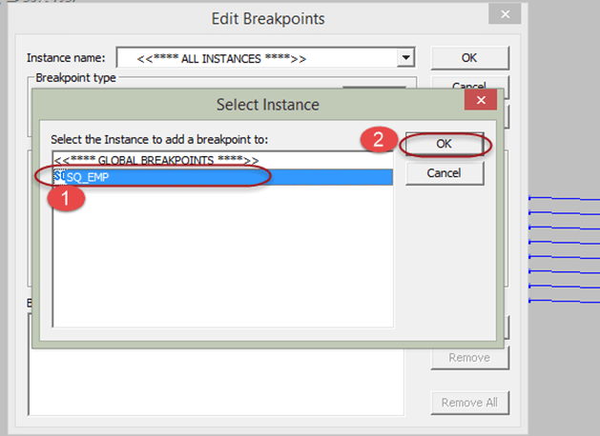
Debugging a Mapping (Breakpoint)

Slide 20
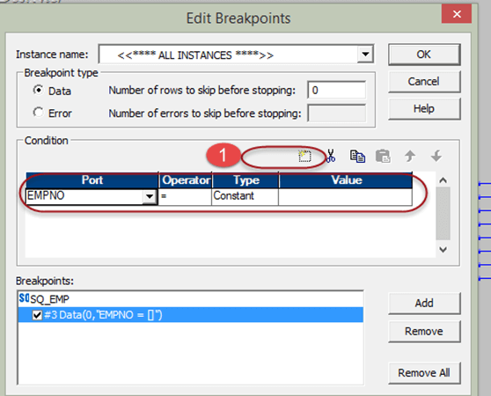
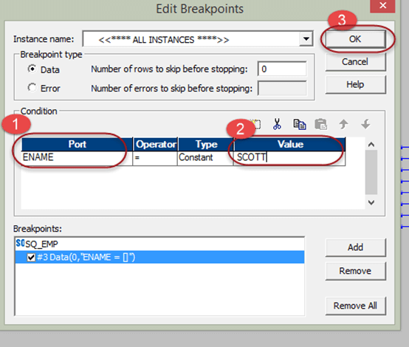
Debugging a Mapping (Breakpoint)

Slide 21
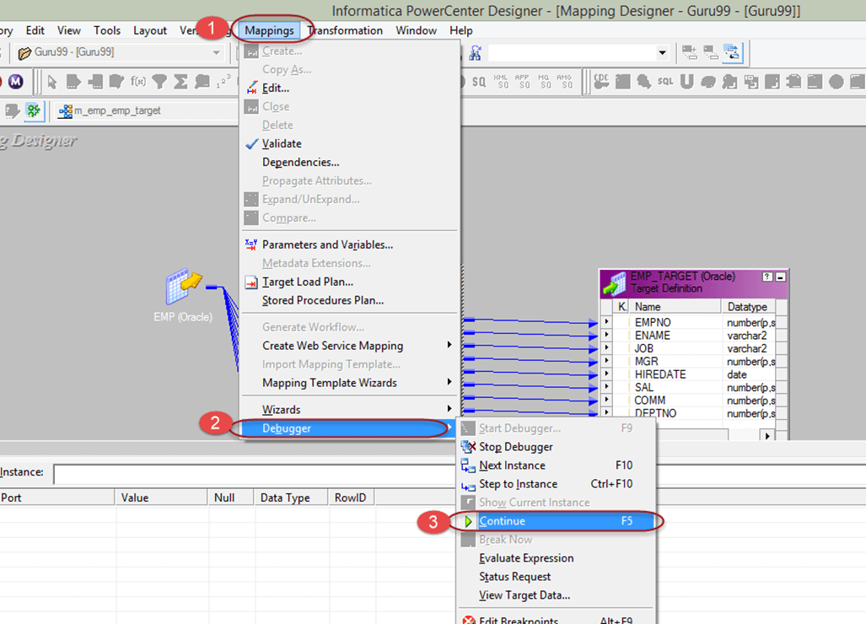
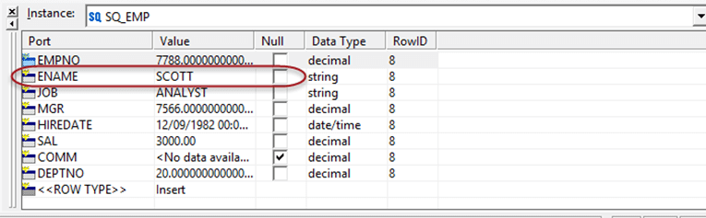
Debugging a Mapping (Breakpoint)

Slide 22
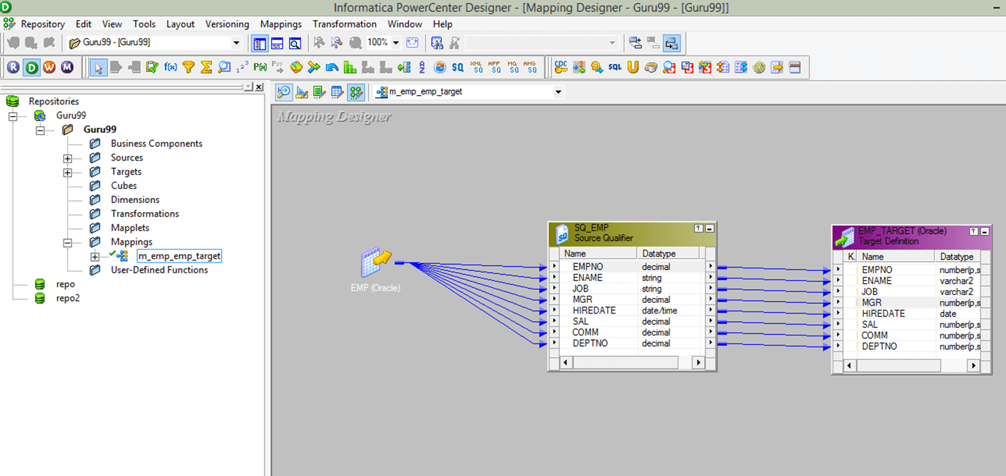
Tracing a Mapping
Notes:
Double click on the transformation (Source Qualifier transformation "SQ_EMP")

Slide 23
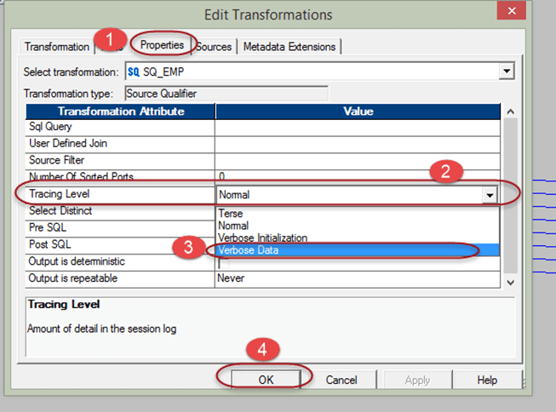
Tracing a Mapping
Notes:
In normal mode, Informatica writes about the transformation initialization and status information, errors encountered and summarizes sessions result.
In Terse Mode, Informatica writes only about initialization information and error details. Terse mode writes minimum details into the session log.
In Verbose Initialization mode, Informatica writes the log details similar to normal mode and in addition also writes about the data and index files used and transformation statistics.
In Verbose data, Informatica writes log similar to verbose initialization but in addition also writes every data which passes through the transformation.
By default the tracing level is set to normal, it is recommended to use verbose data mode only when you are debugging the mapping. The terse mode can be used to improve the performance, as it writes the minimum details. So the overhead of writing log will be minimum.

Slide 24
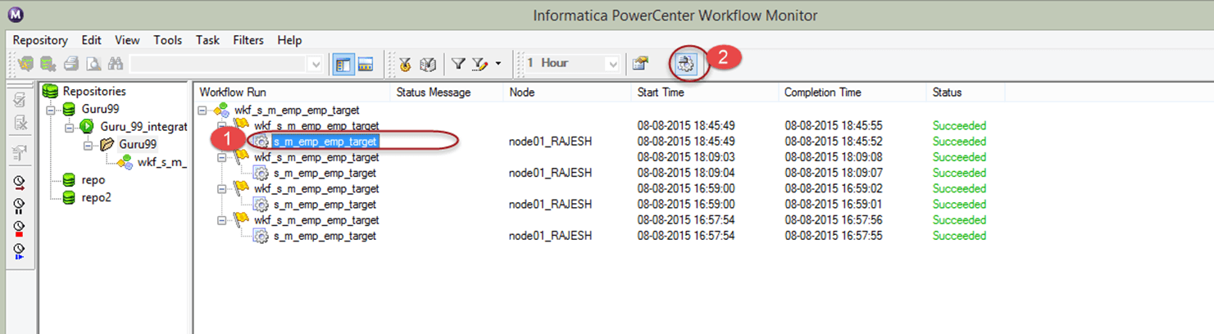
Tracing a Mapping

Slide 25
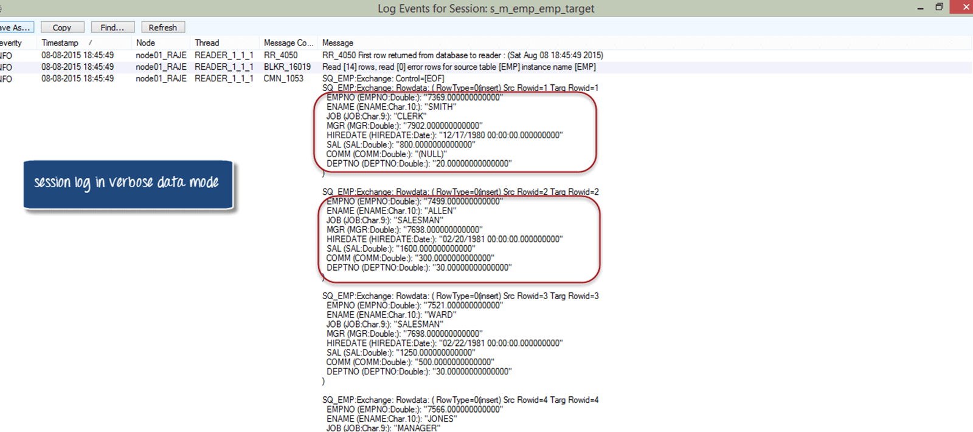
Tracing a Mapping

Slide 26
Session Properties
Treat source rows as
Commit Interval
Session log file
Test Load
Log options
Error Handling
Source/Target Properties
Connections
Notes:
Session property is a set of instructions that instructs Informatica how and when to move the data from source to targets.
A session property is a task, just like other tasks that we create in workflow manager. Any session you create must have a mapping associated with it.
A session can have a single mapping at a time and once assigned, it cannot be changed. To execute a session task, it must be added to a workflow.
A session can be a reusable object or non-reusable. When you create a session in task developer, then it can be reused, but when you create a session in workflow designer, then it is non-reusable.
A reusable session can be added to multiple workflows.

Slide 27
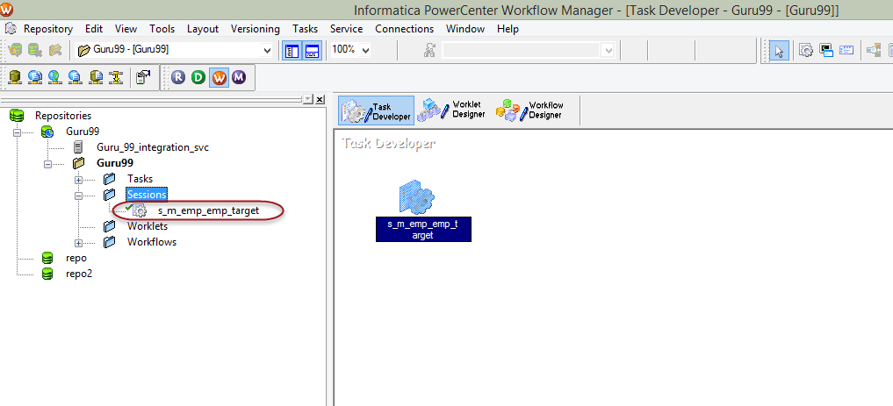
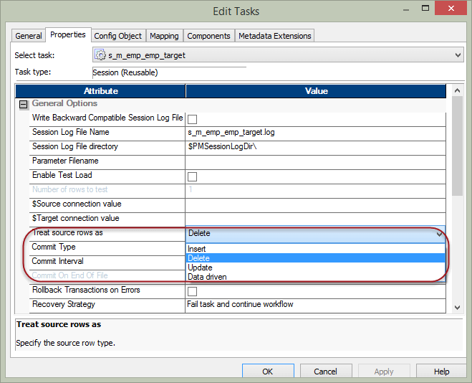
Session Properties
Notes:
Double click on the session icon inside Task Developer to open edit task window.

Slide 28
Treat Source Rows As
Insert
The source data will be marked to be inserted. It means the data will only be inserted.
Update
The target data will be updated by the source data. For updating of data primary key needs to be defined in the target table
Delete
The source data which is already present in the target will be deleted from the target table. Primary key should be defined in the target table

Slide 29
Treat Source Rows As
Data-driven
The Informatica checks what source records are marked. If in a mapping the source records are marked as insert then records will be inserted into the target. If records are marked as an update in the mapping, then the records will be updated in the target. So what operation will be performed at the target depends on how records are handled inside the mapping.

Slide 30
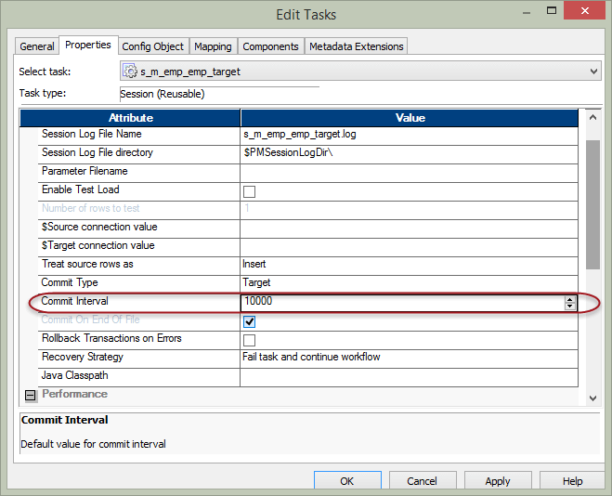
Commit Interval

Slide 31
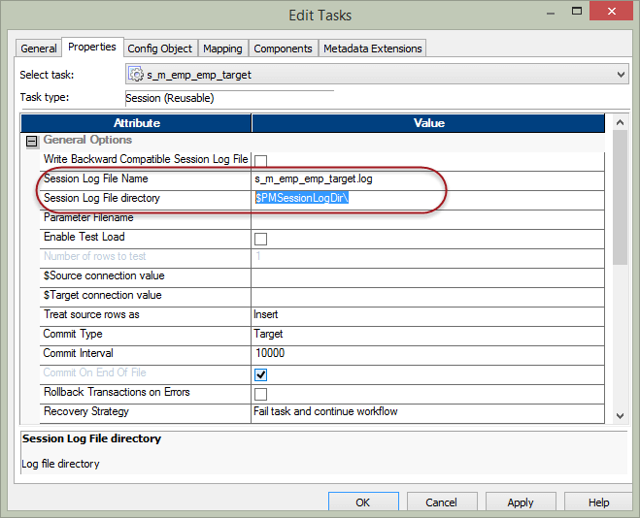
Session Log File Name Session Log File directory
Notes:
Configure this property to modify
Default session log file name and Path of the log file
The $PMSessionLogDir\ is an Informatica variable and in windows it points to the following default location "C:\Informatica\9.6.1\server\infa_shared\SessLogs".

Slide 32
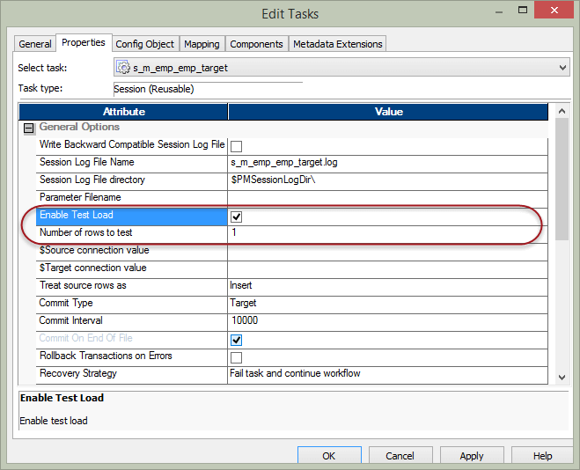
Enable Test Load
Records are fetched from the sources but they don't get loaded into the target
Notes:
Using this property, you can test your session and mappings. When you use this feature and execute the sessions, records are fetched from the sources but they don't get loaded into the target. So this feature helps in Testing he correctness of mappings, parameter files, functioning of various transformations inside the mapping.

Slide 33
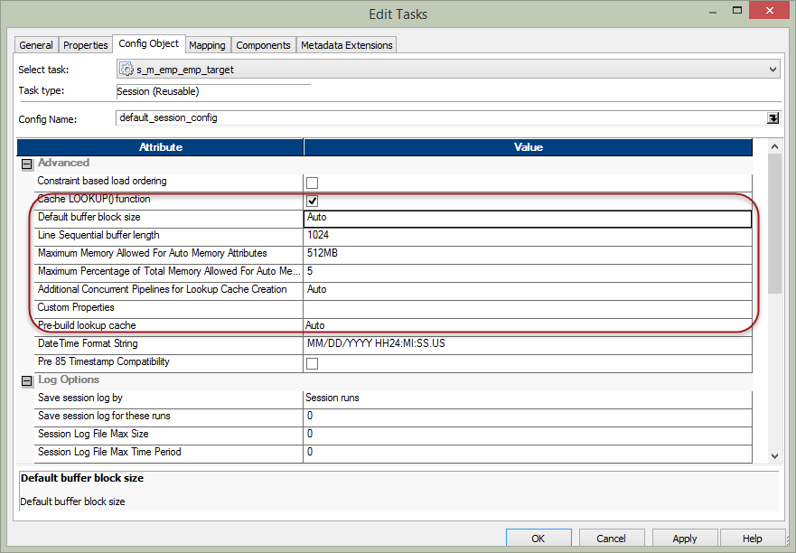
Memory Properties

Slide 34
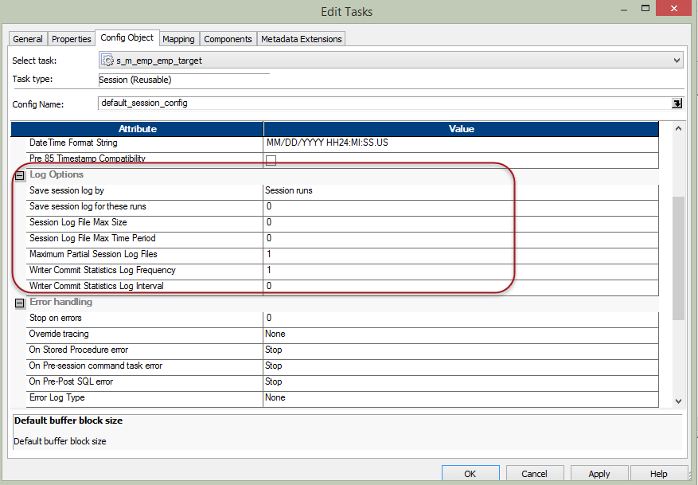
Log and Error Handling
Notes:
Using Stop on errors you can configure after how many errors the session has to be stopped.
Using override tracing you can override the mapping tracing levels.
You can also configure the behaviour of the session for various errors encountered for example stored procedure error, pre-post SQL error, etc.

Slide 35
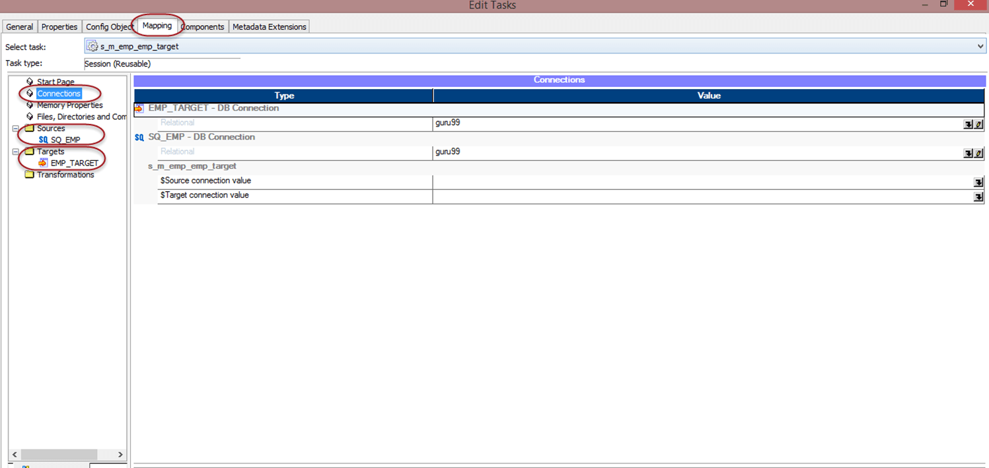
Mapping and Source/Target Properties
Notes:
In the mapping tab of the edit task window of the session, you can configure the properties related to the mapping and its sources/targets and transformations. With this section of properties, you can override the properties of the source and targets. For the sources and targets we can override the table names, we can apply table name prefixes. Inside the mappings we can configure the properties of various transformations, sources and targets, in addition to that in this section we can also review and override those properties. It's like a single place to review all those properties.

Slide 36
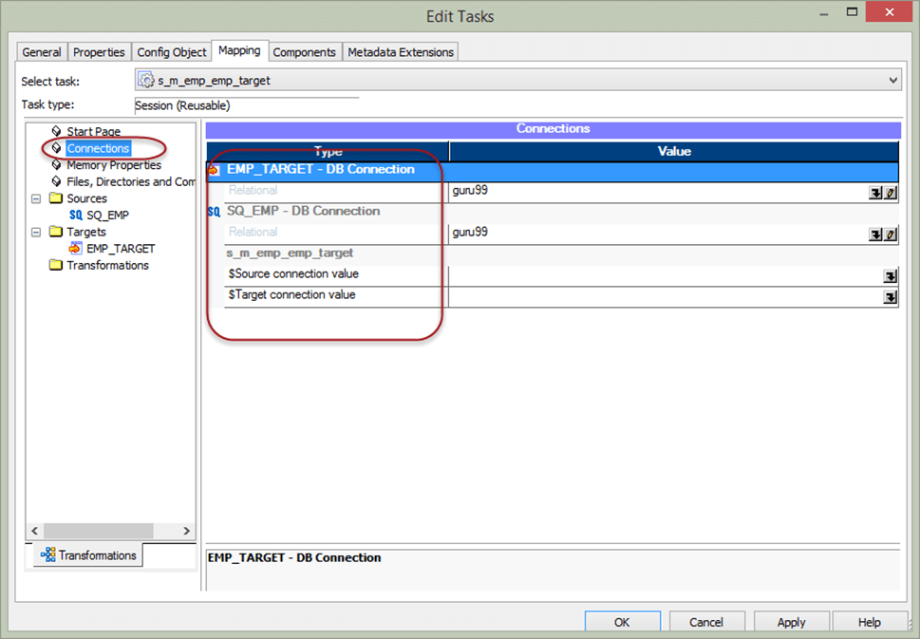
Connection Properties in Mapping

Slide 37
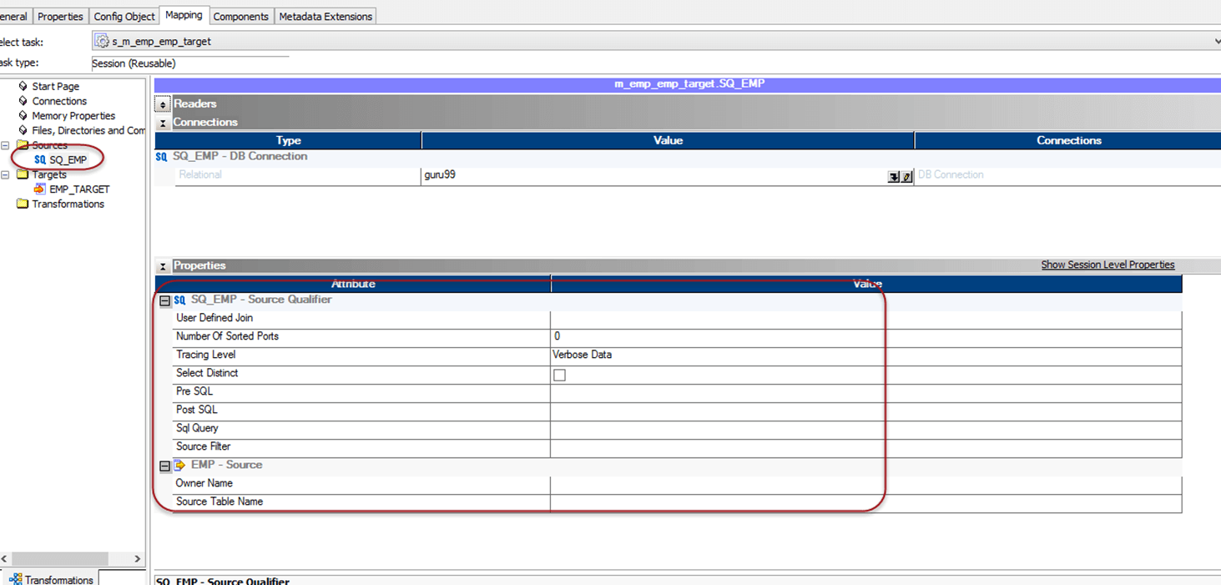
Source Properties
Notes:
In this section, you can configure the properties related to the source of the mapping. You can configure pre and post SQL scripts for the source.
Using SQL query property, you can override the SQL for the source. You can also override the source table name in this section.

Slide 38
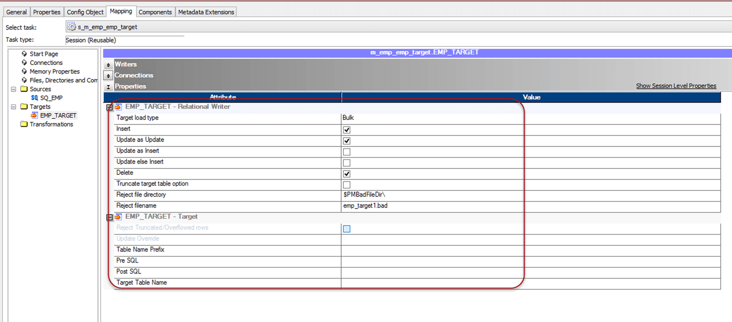
Target Properties
Notes:
In this section, you can configure the details of the target. You can define whether target load has to be a bulk load or a normal mode.
In bulk load, the performance gain is achieved as during the load there are no redo log buffers managed by the database.
On the other hand, normal load is slower as compared to bulk load, but in case of failure database recovery is possible.
You can also define the property to truncate the target table before populating it. It means before loading any records in the target, the target table will be truncated, and then the load will be performed. This property is useful when we create mappings for stage load.
We can also define target table pre SQL and post SQL. Pre SQL is the piece of SQL code which will be executed before performing insert in the target table, and post SQL code will be executed after the load of target table is completed.

Slide 39
Transformations
Transformation
objects which creates, modifies or passes data to the defined target structures (tables, files or any other target).
modifies the source data as per the requirement of target system.
ensures the quality of the data being loaded into the target.

Slide 40
Transformations
Connected transformations
transformations which are connected to other transformations (e.g. Source qualifier)
Unconnected transformations
not connected to any other transformations
called inside other transformations like Expression transformation.
not part of the pipeline
useful when their functionality is only required periodically or based upon certain conditions (e.g. Tax calculation when tax value is not available)

Slide 41
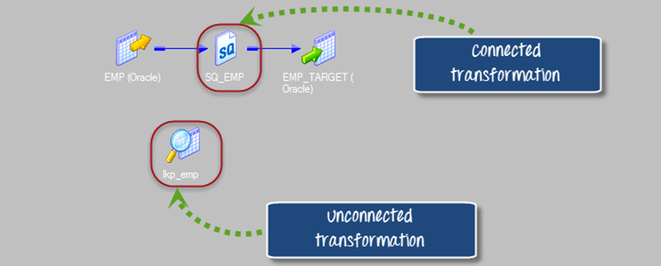
Transformations

Slide 42
Transformations
Passive
does not change the number of input rows
data is modified at row level
no new rows are created, or existing rows are dropped.
Active
modifies the data rows and the number of input rows passed to them.
Example: transformation receives ten rows as input, and it returns fifteen rows as an output
the data in the row is also modified

Slide 43
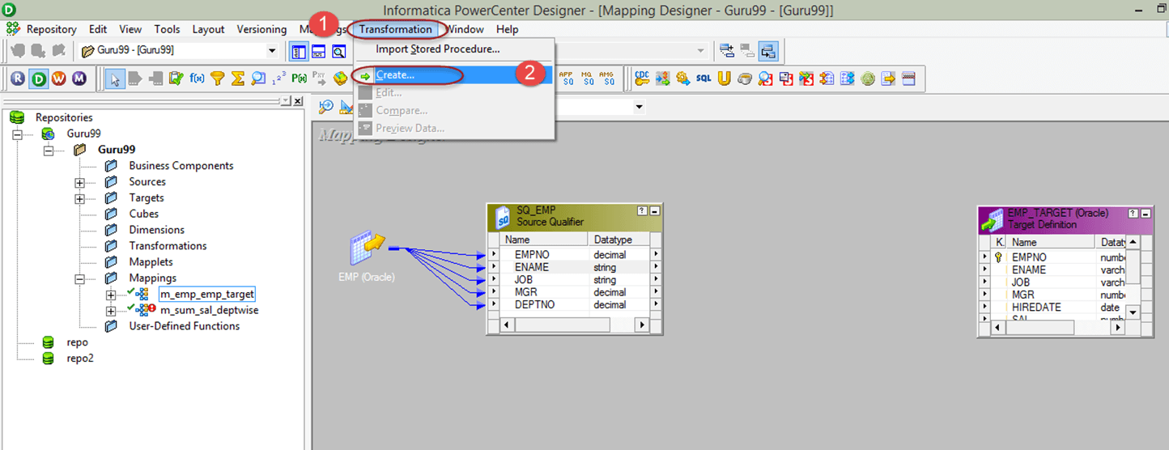
Filter Transformation
Active transformation
Filters records based on a filter condition

Slide 44
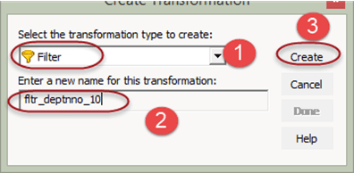
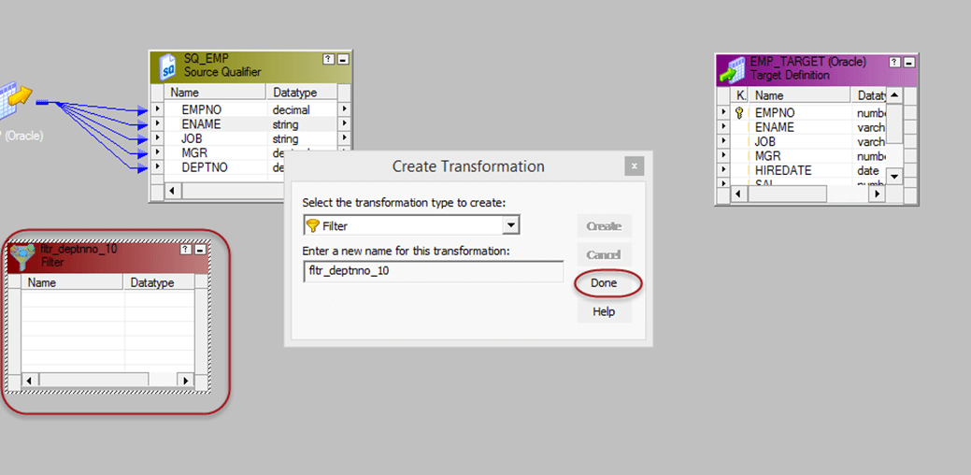
Filter Transformation

Slide 45
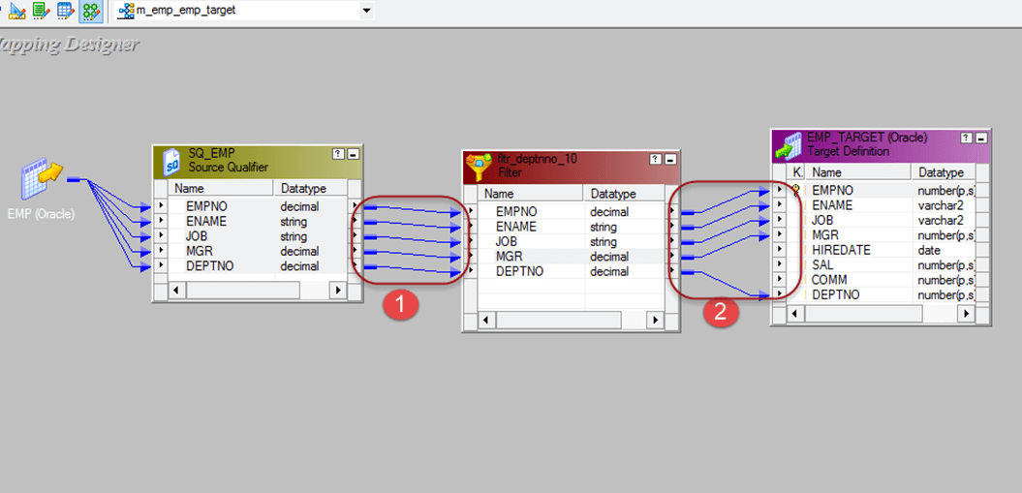
Filter Transformation
Notes:
1. Drag and drop all the Source qualifier columns to the filter transformation
2. Link the columns from filter transformation to the target table
Double click on the filter transformation to open its properties, and then
Select the properties menu
Click on the Filter condition editor

Slide 46
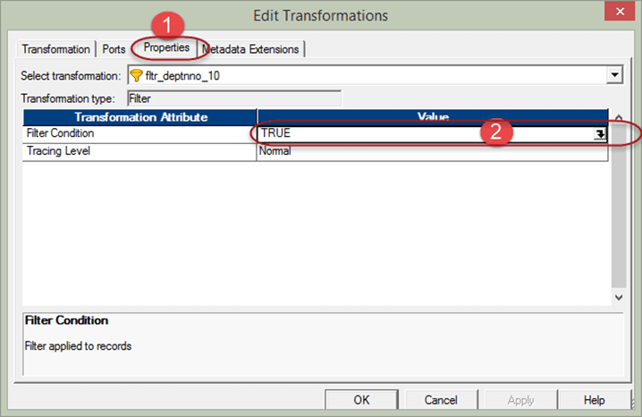
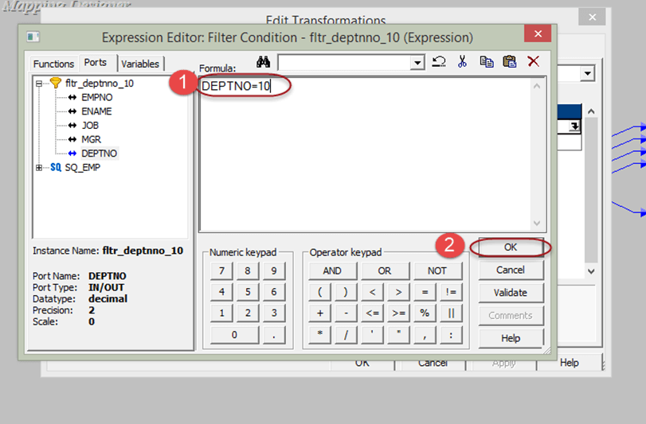
Filter Transformation

Slide 47
Source Qualifier Transformation
Active and connected
Represents the rows that the integrations service read
Whenever a source is added to a mapping, a source qualifier transformation is required
When we add a source to a mapping, source qualifier transformation is added automatically.
We can define and override how the data is fetched from the source.

Slide 48
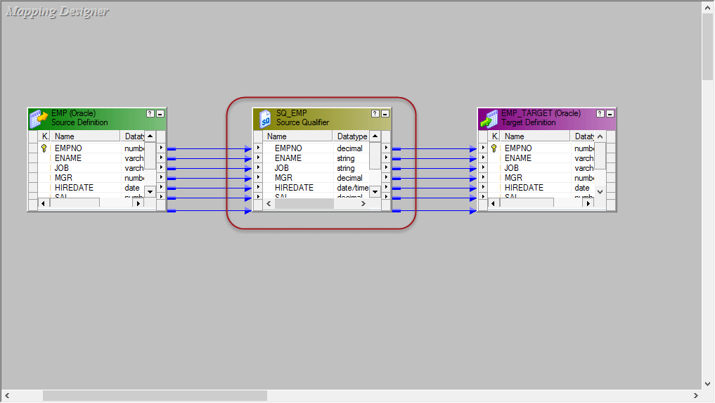
Source Qualifier Transformation
Notes:
Double click on the source Qualifier transformation "SQ_EMP". It will open edit transformation property window for it.

Slide 49


Source Qualifier Transformation

Slide 50

Source Qualifier Transformation
Notes:
In this way, you can override in source qualifier what columns needs to be fetched from the source & this is the only way to override what specific columns will be brought inside the mapping.

Slide 51

Source Qualifier Transformation
Notes:
Source Filter – Using the source filter property you can filter the number of source records. For example, you want to fetch only the employees of deptno 10, then you can enter the filter condition deptno=10 in source filter property and execute the data.
Number for sorted ports – In source qualifier transformation, you can also sort the input records based on the ports number. So when the data is passed on to the transformations inside the mapping, it will read the port number and sort the data accordingly.
As data can be sorted based on a single or multiple ports, you have to give the number of ports which will be used in sorting. If you give value as 1, then only empno data will be sorted. If you give value as 2 then on empno and ename on both columns data will be sorted.
Select Distinct – you can fetch only distinct records from the source using this property. When you select the select distinct option, only distinct combination of source data will be fetched by source qualifier.

Slide 52
Aggregator Transformation
An active transformation
Used to perform aggregate calculations (sum, avg, ...)
Aggregator cache memory is used

Slide 53

Aggregator Transformation
New target table

Slide 54

Aggregator Transformation
Notes:
From the Source Qualifier, delete the columns empno, ename, job, mgr, hiredate & comm so leaving only the columns deptno and sal.
Create a new aggregator transformation using the toolbox menu as shown in screen shot. When you click on the aggregator icon, a new aggregator transformation will be created.

Slide 55

Aggregator Transformation
Notes:
Drag and drop SAL & DEPTNO columns from source qualifier (SQ_EMP) to the aggregator transformation
– Double click on the aggregator transformation to open its properties

Slide 56


Aggregator Transformation
Notes:
1. Add a new port in the transformation
2. Rename the port name to SUM_SAL
3. Change the data type of this new port to double
4. Make this port as output port by selecting the checkbox of the output port.
5. Click on the expression option

Slide 57

Aggregator Transformation

Slide 58

Aggregator Transformation
Notes:
Link the deptno and sum_sal columns from aggregator transformation to the target table

Slide 59
Router Transformation
Active and connected transformation
Similar to filter transformation
The discarded data (filtered out data) can also be collected in the mapping
Multiple filter conditions can be applied to get multiple sets of data
Gives multiple output groups
Default output group
record sets which do not satisfy any of the group conditions

Slide 60
Router Transformation
Groups
Input group
Default output group
Output group for every filter condition
Different targets can be connected to different groups.

Slide 61

Router Transformation

Slide 62


Router Transformation

Slide 63


Router Transformation

Slide 64

Router Transformation

Slide 65
Joiner Transformation
Active and connected transformation
Joins (similar to database joins)
Input sources can be heterogenous
Master source
cached into the memory for joining purpose
Recommendation: smaller table
Details source

Slide 66
Joiner Transformation
Join types
Master outer join = detail left outer join master
Detail outer join = master left outer join detail
Full outer join
Normal join = inner join

Slide 67


Joiner Transformation

Slide 68

Joiner Transformation
Notes:
Drag and drop all the columns from both the source qualifiers to the joiner transformation
Double click on the joiner transformation, then in the edit transformation window

Slide 69


Joiner Transformation

Slide 70

Joiner Transformation

Slide 71

Joiner Transformation

Slide 72
Rank Transformation
An active and connected transformation
Performs a filtering of data based on group and ranks
Provides the feature to do ranking based on groups (similar to partition by in SQL analytic functions)
Notes:
For example, you want to get ten records of employees having highest salary, such kind of filtering can be done by rank transformation.

Slide 73

Rank Transformation

Slide 74

Rank Transformation

Slide 75

Rank Transformation

Slide 76

Rank Transformation
Notes:
Our requirement is to load top 3 salaried employees for each department; we will implement this using rank transformation.

Slide 77

Rank Transformation

Slide 78
Sequence Transformation
Sequence generator transformation is passive
Used to generate numeric sequence values
Two output ports
CURRVAL
NEXTVAL
To generate the sequence numbers NEXTVAL is used

Slide 79
Sequence Transformation
Properties
Start Value – It is the first value that will be generated by the transformation, the default value is 0.
Increment by – This is the number by which you want to increment the values. The default value is 1.
End value – It is the maximum value that the transformation should generate.
Cycle – if this option is set then after reaching the end of the value, the transformation restarts from the start value

Slide 80

Sequence Transformation

Slide 81

Sequence Transformation

Slide 82

Sequence Transformation

Slide 83
Transaction Control Transformation
An active and connected transformation
Allows to commit or rollback transactions during the execution of the mapping
Commit should not be done too frequently
The best is to commit whole transaction at once

Slide 84
Transaction Control Transformation
Built-in variables
TC_CONTINUE_TRANSACTION
No operations performed, the process of data load continues as it is
TC_COMMIT_BEFORE
Commit is performed before the processing of current row
TC_COMMIT_AFTER
The current row is processed then a commit is performed
TC_ROLLBACK_BEFORE
TC_ROLLBACK_AFTER

Slide 85

Transaction Control Transformation

Slide 86

Transaction Control Transformation

Slide 87


Transaction Control Transformation
Notes:
It means if deptno 20 is found then commit transaction in target, else continue the current processing.

Slide 88


Lookup Transformation
A passive transformation
Used to look up a source, source qualifier, or target to get the relevant data

Slide 89

Lookup Transformation
Notes:
Drag and drop DEPTNO column from source qualifier to the lookup transformation, this will create a new column DEPTNO1 in lookup transformation. Then link the DNAME column from lookup transformation to the target table.
The lookup transformation will lookup and return department name based upon the DEPTNO1 value.

Slide 90

Lookup Transformation

Slide 91

Lookup Transformation
Notes:
Link rest of the columns from source qualifier to the target table

Slide 92
Reusable Transformation
A normal transformation is an object that belongs to a mapping and can be used inside that mapping only.
By making a transformation reusable it can be re-use
For example, a lookup transformation which fetches employee details based on employee number can be used at multiple mappings wherever employee details are required. d inside several mappings.

Slide 93

Reusable Transformation

Slide 94
Normalizer Transformation
An active transformation, used to convert a single row into multiple rows and vice versa
Pivoting
Unpivoting

Slide 95

Normalizer Transformation

Slide 96

Normalizer Transformation

Slide 97


Normalizer Transformation

Slide 98

Normalizer Transformation
Notes:
1. Link the four column of source qualifier of the four quarter to the normalizer columns respectively.
2. Link store name column to the normalizer column
3. Link store_name & sales columns from normalizer to target table
4. Link GK_sales column from normalizer to target table

Slide 99
Expression Transformation
A passive and Connected transformation
Calculates values in a single row before writing to the target. For example, to calculate discount of each product or to concatenate first and last names or to convert date to a string field

Slide 100
Stored Procedure Transformation
A passive and connected & unconnected
Can be used to automate time-consuming tasks and it is also used in error handling, to drop and recreate indexes and to determine the space in database, a specialized calculation etc.

Slide 101
Sorter Transformation
A connected and an active transformation
It allows to sort data either in ascending or descending order according to a specified field.
Used to configure for case-sensitive sorting, and specify whether the output rows should be distinct.

Slide 102
Other Transformations
XML Source Qualifier Transformation
Advanced External Procedure (AEP) Transformation
External Procedure (EP) Transformation
DLL, unix shared library
Difference between AEP a EP
External Procedure returns single value, whereas Advanced External Procedure returns multiple values
AEP supports only Informatica procedures

Slide 103
Performance
Joiner Transformation
DB joins are faster
Master data should be the smaller table
Lookup Tramsformation
Uses effective access path on DB for the used lookup column (index, hash cluster, …)
Join on DB level, if possible
Filter Transformation
Filter as early as possible
Use source qualifier to filter the data (override SQL)

Slide 104
Performance
Aggregator Transformation
Filter the data before aggregating, if possible
Limit the number of ports (columns)
Source Qualifier Transformation
Bring only the required columns from the source
Most of the times not all the columns of the source table are required

