Slide 1
Small Czech towns clustering
Coursera Capstone

Slide 2
The problem
Let’s imagine, that someone has several job offers in different towns. Those offers are almost the same, but each is in different city so he will have to move. He loves his city, so he wants to move to some similar place.
What smaller cities in Czech Republic are similar?

Slide 3
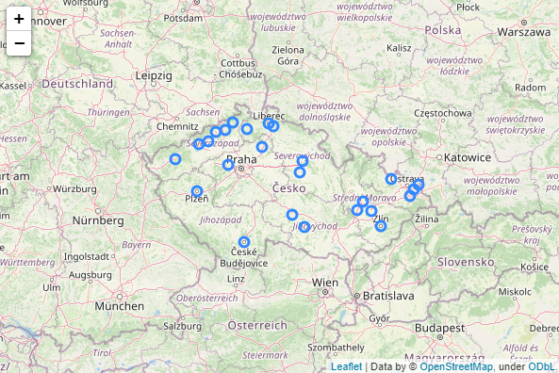
The Data

Slide 4
The Data
Wikipedia to get list of cities with number of population
Geopy to get cities locations
Foursquare API to get information about venues

Slide 5
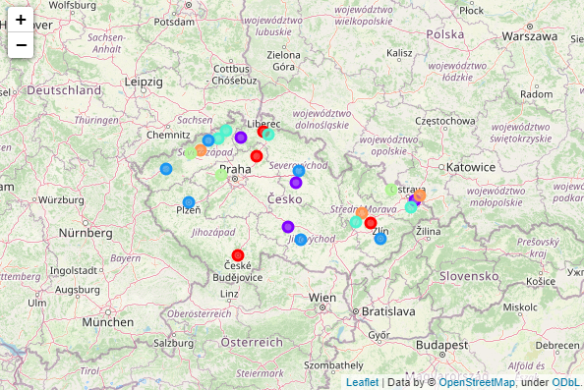
The Clusters
ScikitLearn Kmeans to get the clusters

Slide 6
Conclussion
For me this part of course, which I otherwise liked a lot, was disappointing. I could think a lot of useful machine learning applications, but not if I must use Foursquare. As I have mentioned I my report several times, this API is intended to do absolutely different job, so data you can get from it will always be incomplete for such analysis. It is even against Foursquare policy! All you can do is somehow alternate the example from earlier lessons and I am not interested in that at all. At least not this way.

