Slide 1
Scenario
Eol
File
CR
LF
CRLF
Bom
B
B
B
B
...
B
B
B
B
B
B
B
B
...
B
B
B
B
B
Encoding
Encoding Detector
UTF-8
0D
0D 0A
No Bom
0D
0A
EF BB BF
EF BB BF
UTF-16LE
0D 00
0A 00
0D 00 0A 00
FF FE
UTF-16BE
00 0D
00 0A
00 0D 00 0A
FE FF
UTF-32LE
0D 00 00 00
0A 00 00 00
0D 00 00 00 0A 00 00 00
FF FE 00 00
UTF-32BE
00 00 00 0D
00 00 00 0A
00 00 00 0D 00 00 00 0A
00 00 FE FF
00
00
00
0D
X
X
X
X
Block Length
Maximum Block Length
00
00
00
0D
00
00
00
0A
Eols to find
Final Eol
Eol found
EolDataConverter
Eol not found
Conversion
00
00
00
31
00
00
00
32
CR
LF
CRLF
00
00
00
31
00
00
00
32

Slide 2
Statistics
19 classes
18 test classes
117 tests
100% code coverage, 89% branches coverage
1372 lines of code
Small classes
Small methods
High cohesion
Reusable code
Minimal duplicity

Slide 3
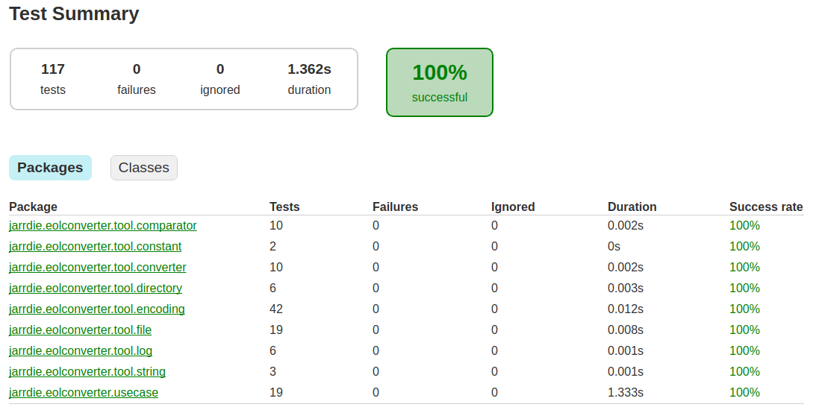
Unit Tests

Slide 4
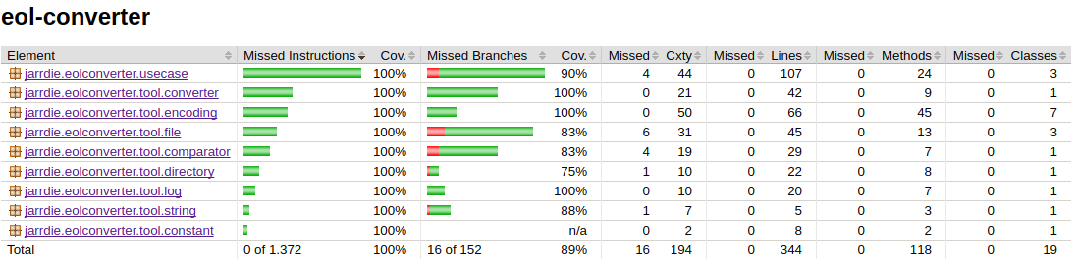
Tests Coverage

