Slide 1
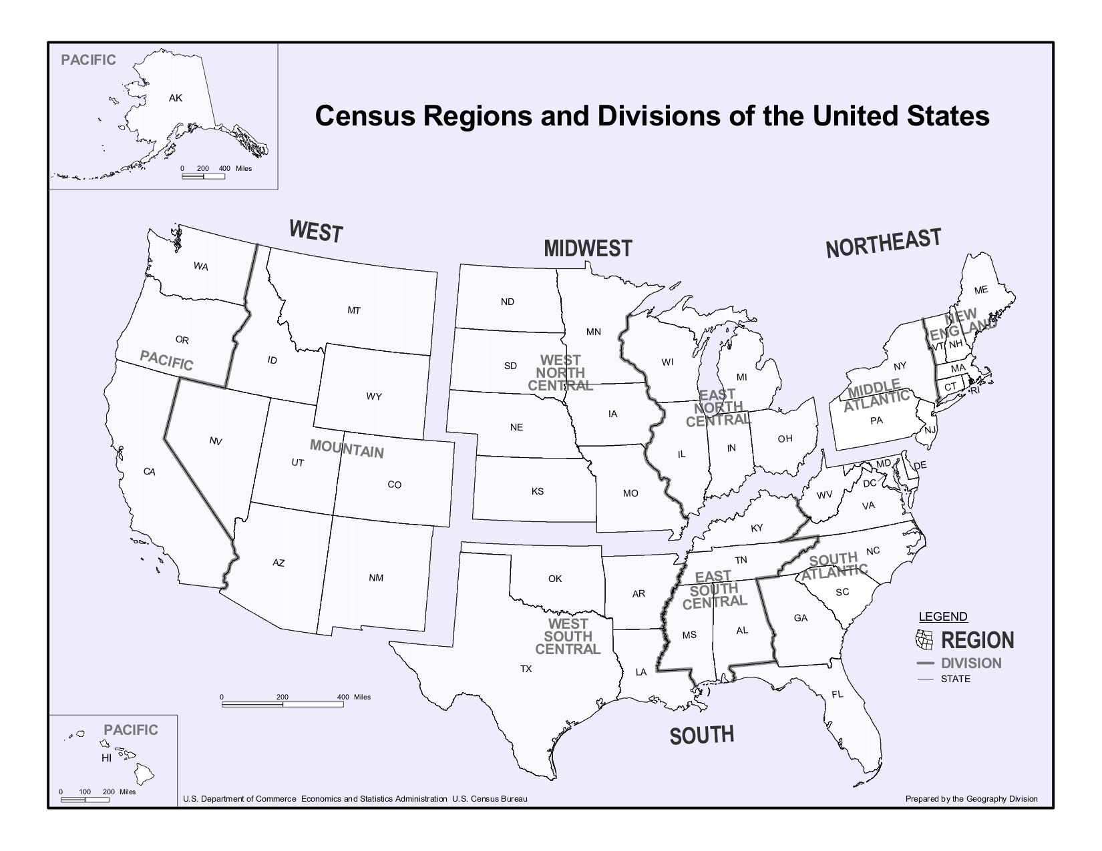
Analysis of Upserve Database
Xiaofei Yang, Lijie Ding, and Xinyue Yu
Brown University March 4th 2018

Slide 2
Approaches
Sales Analytics-See your sales in a whole new way, making it easy to make the decisions that matter. Spot the trends that make your business tick and take action.
Menu Intelligence--tells you everything you need to know to make smarter menu decisions in a whole new way.
Suggestion of future strategy - Classification and distribution of restaurants

Slide 3
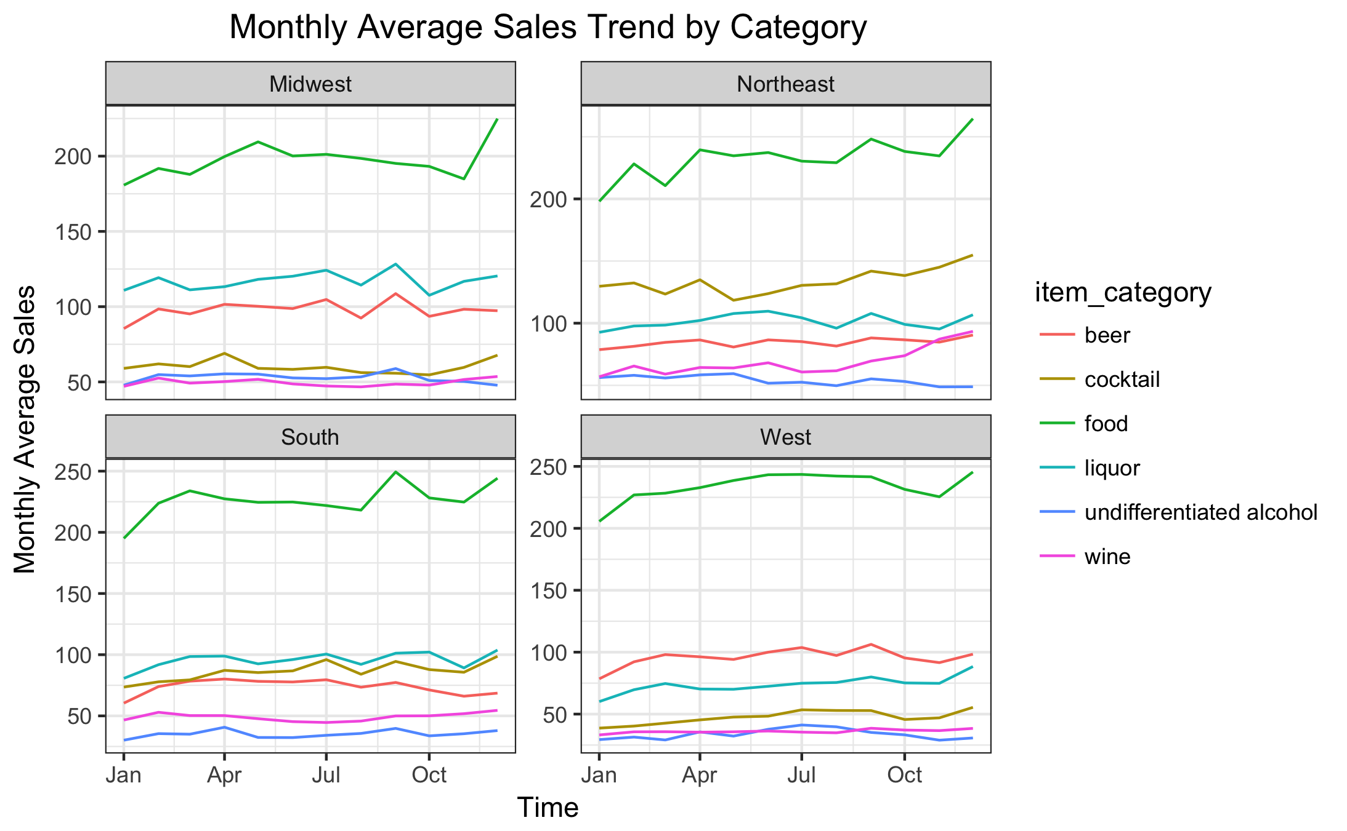
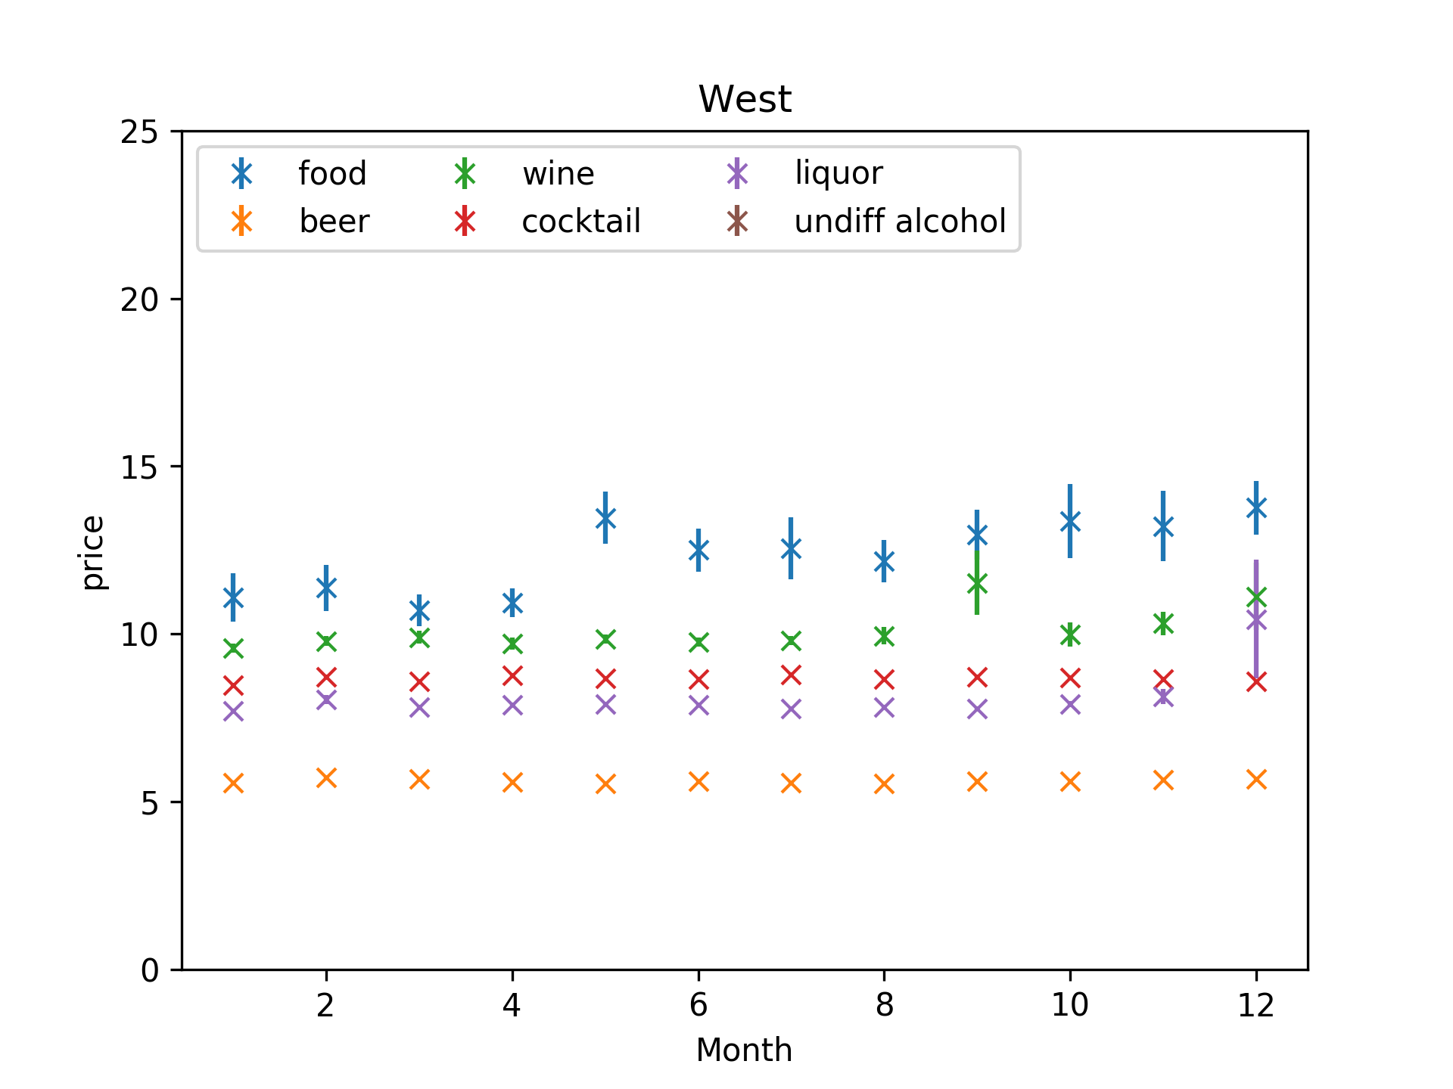
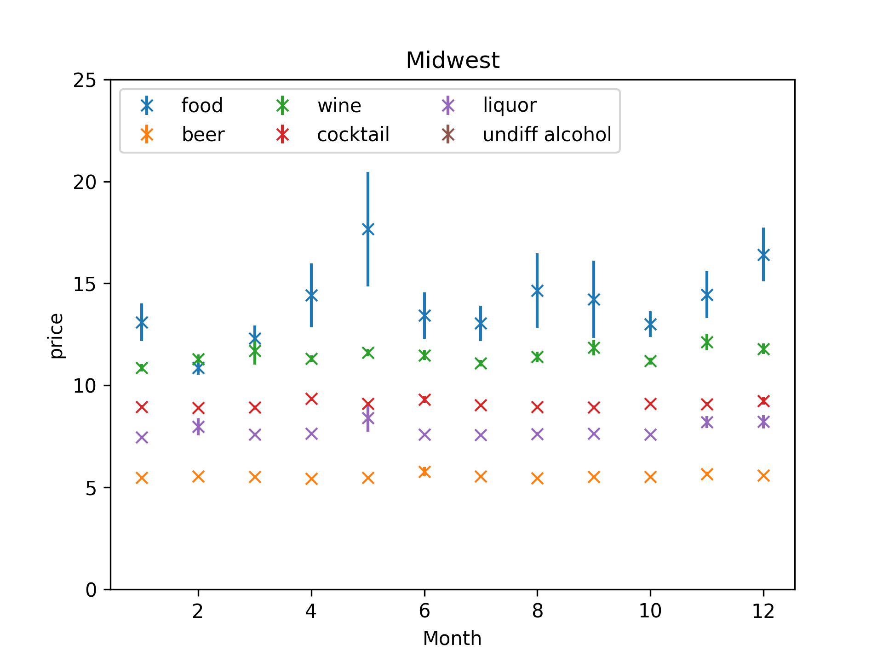
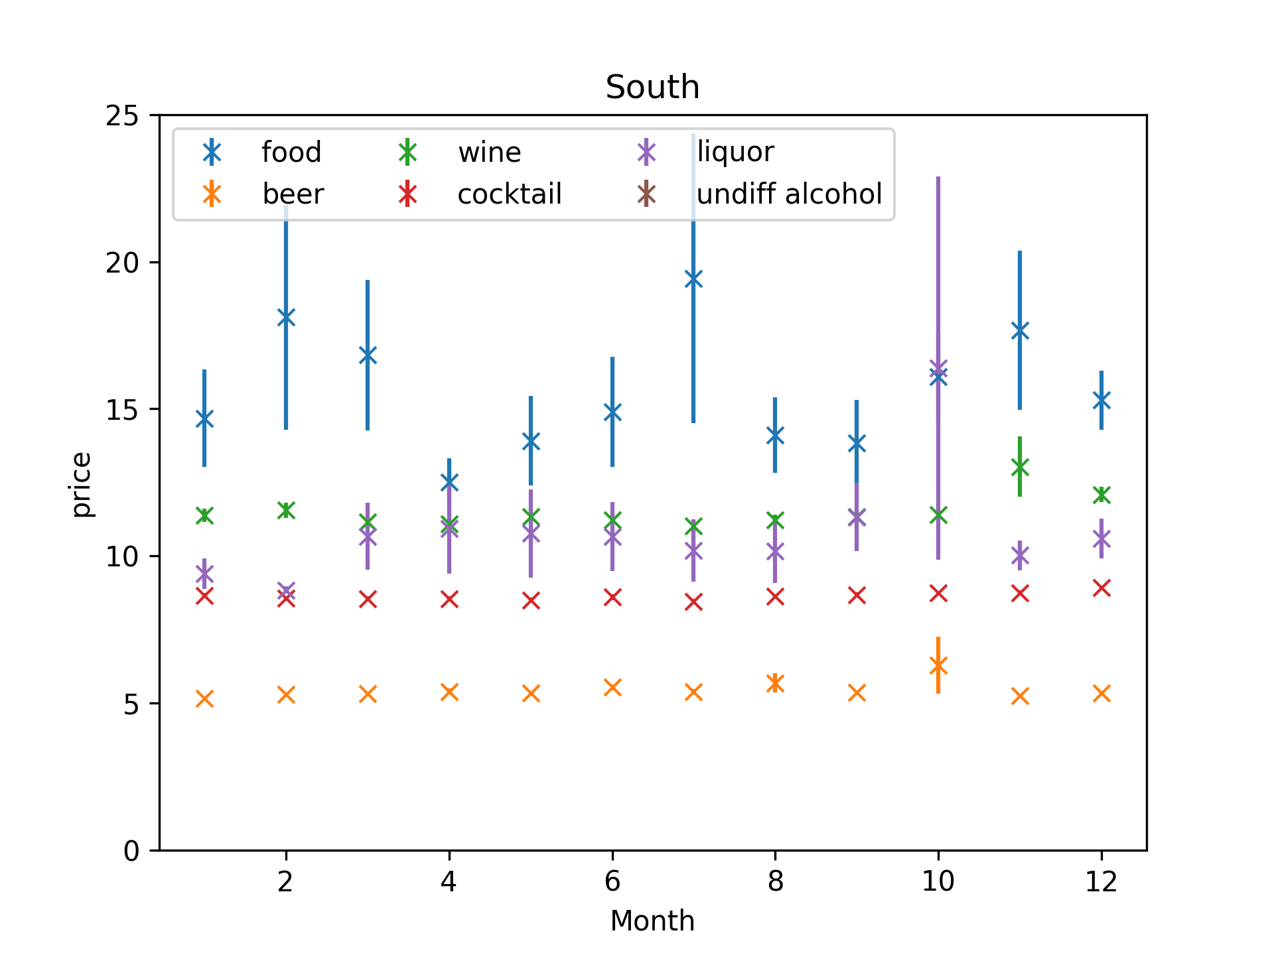
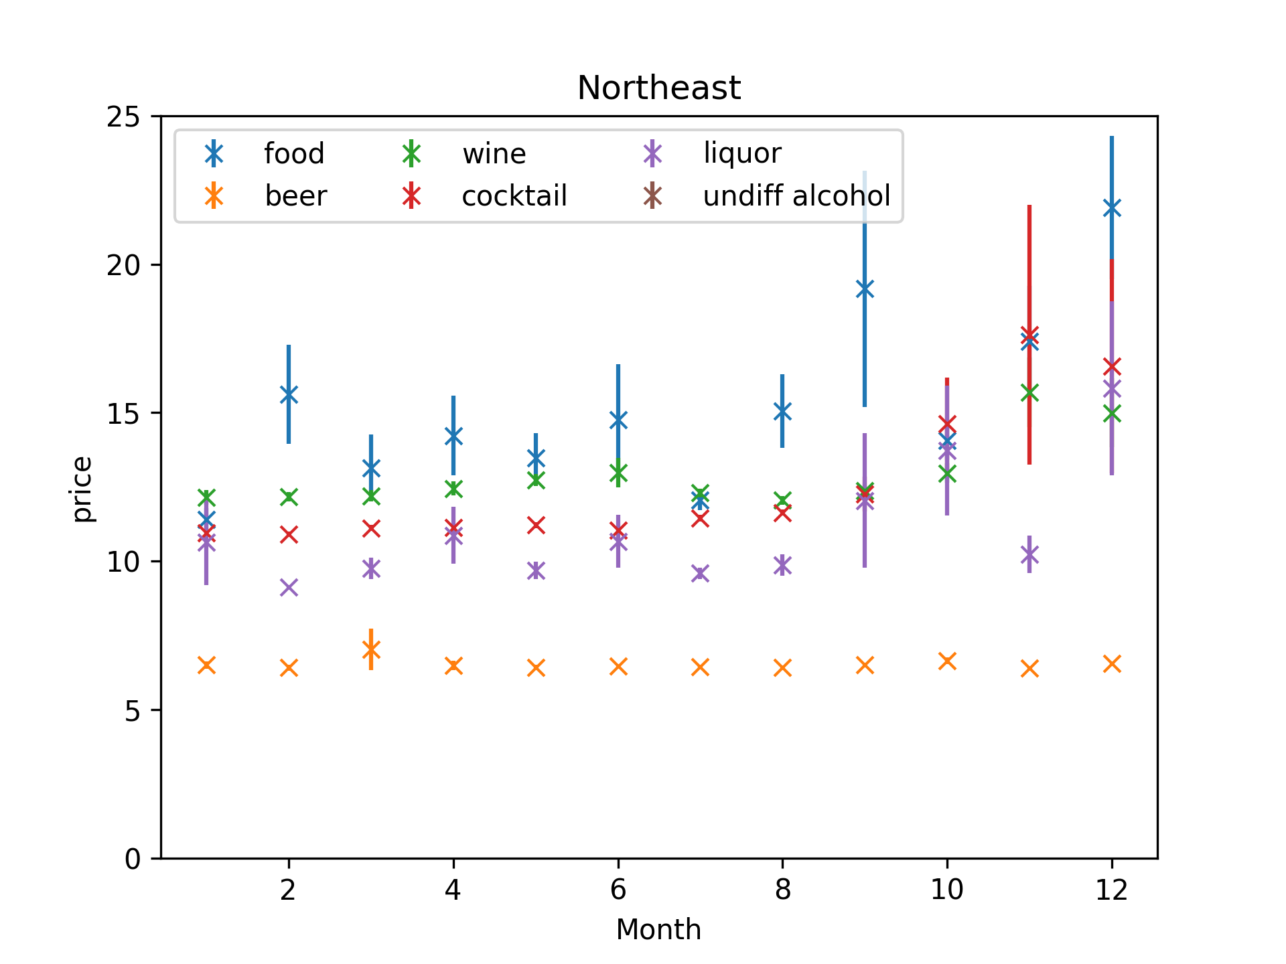
Timeline analysis

Slide 4
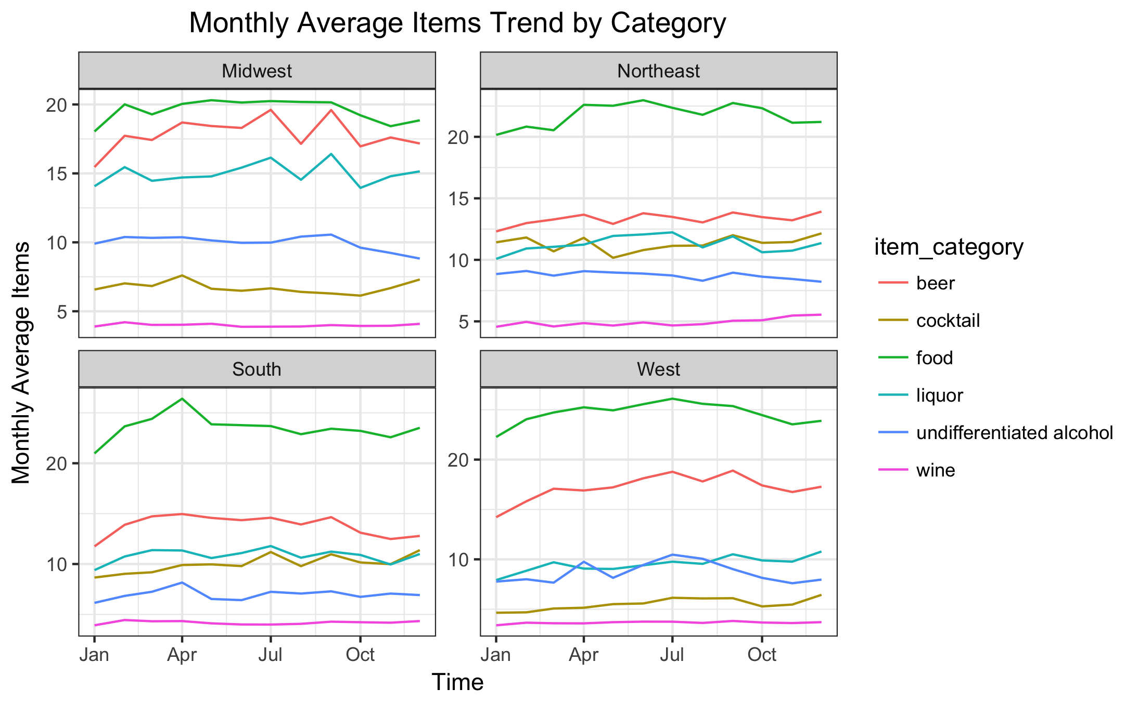
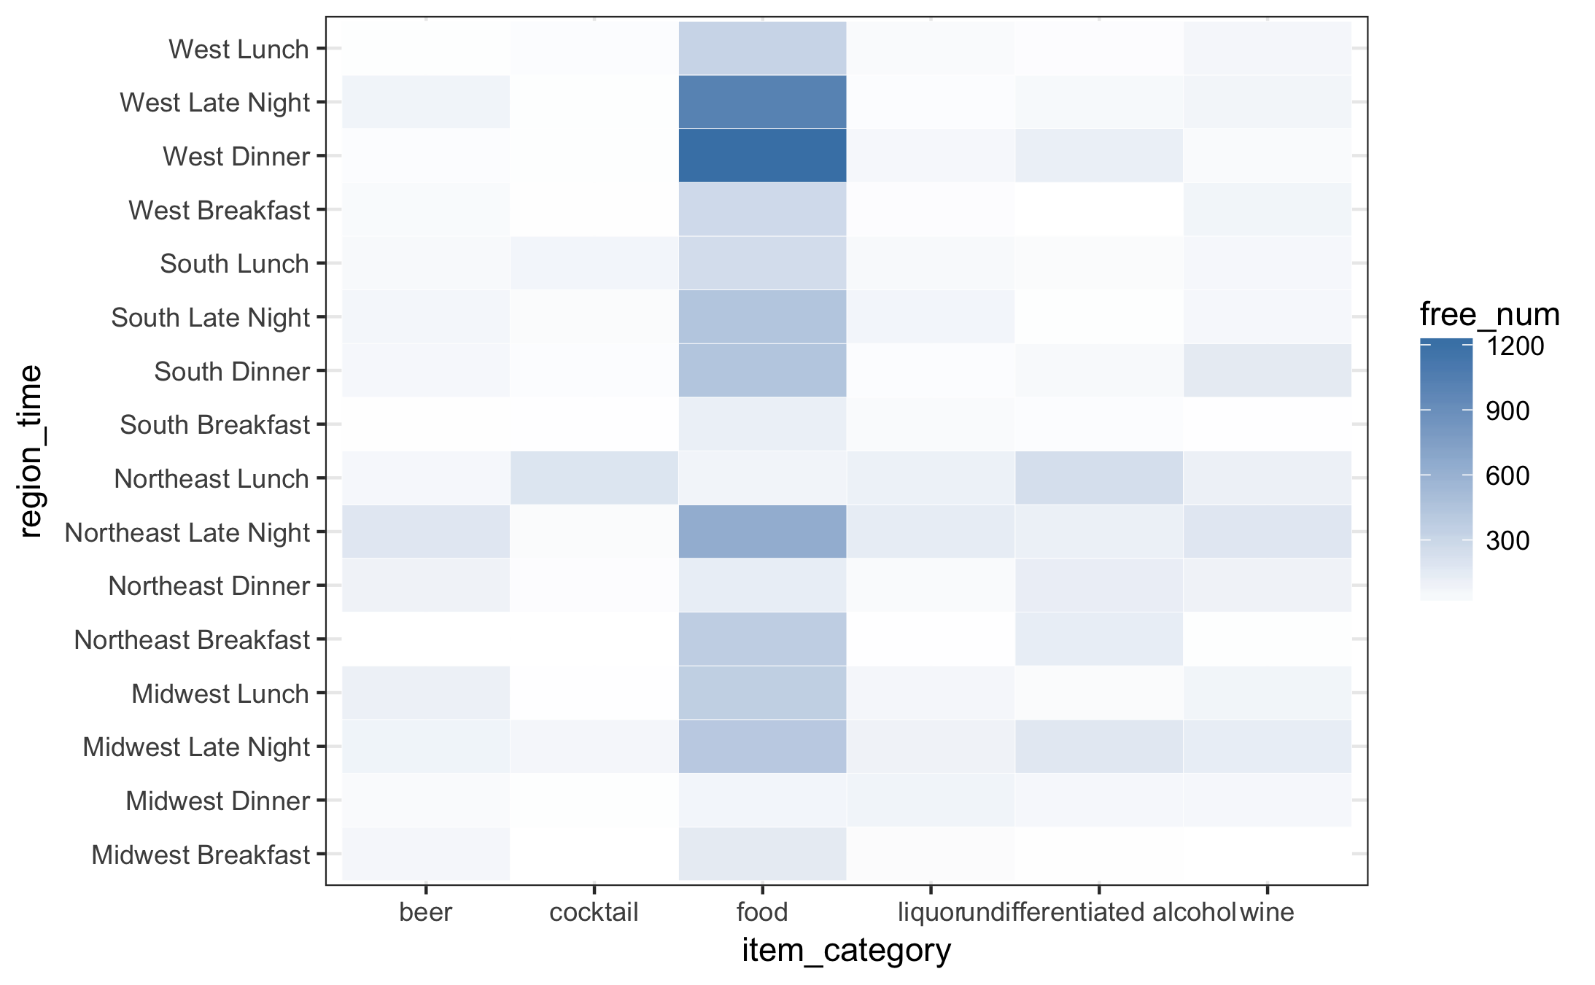
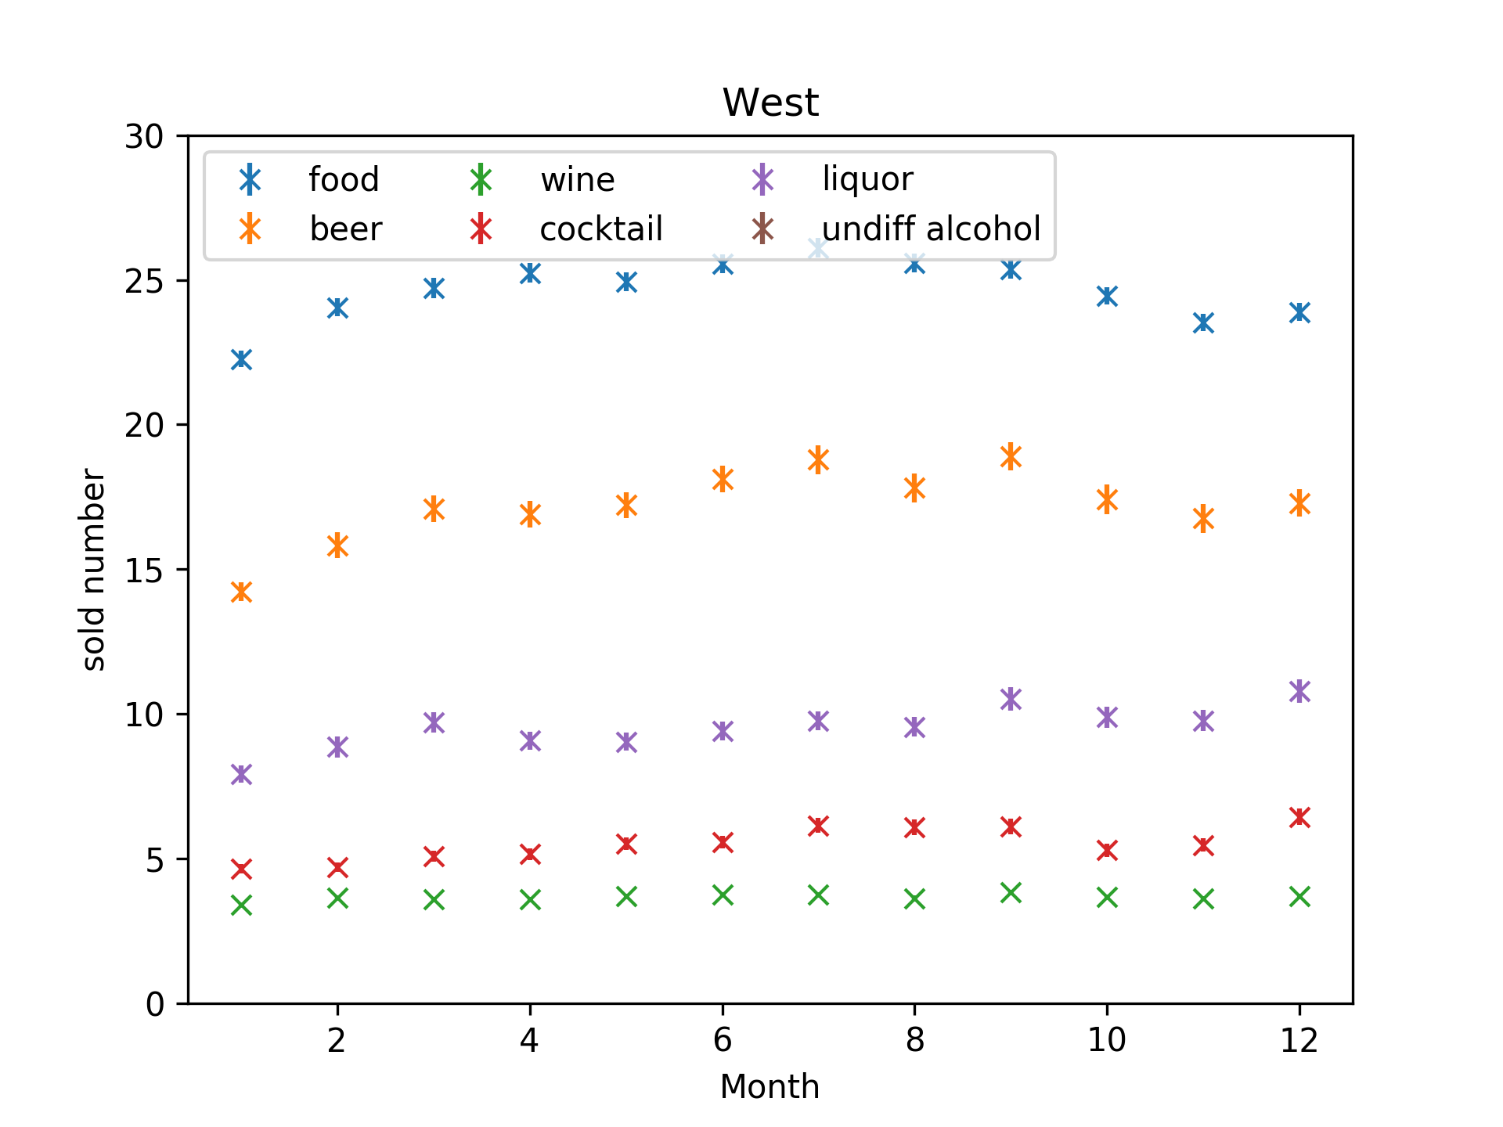
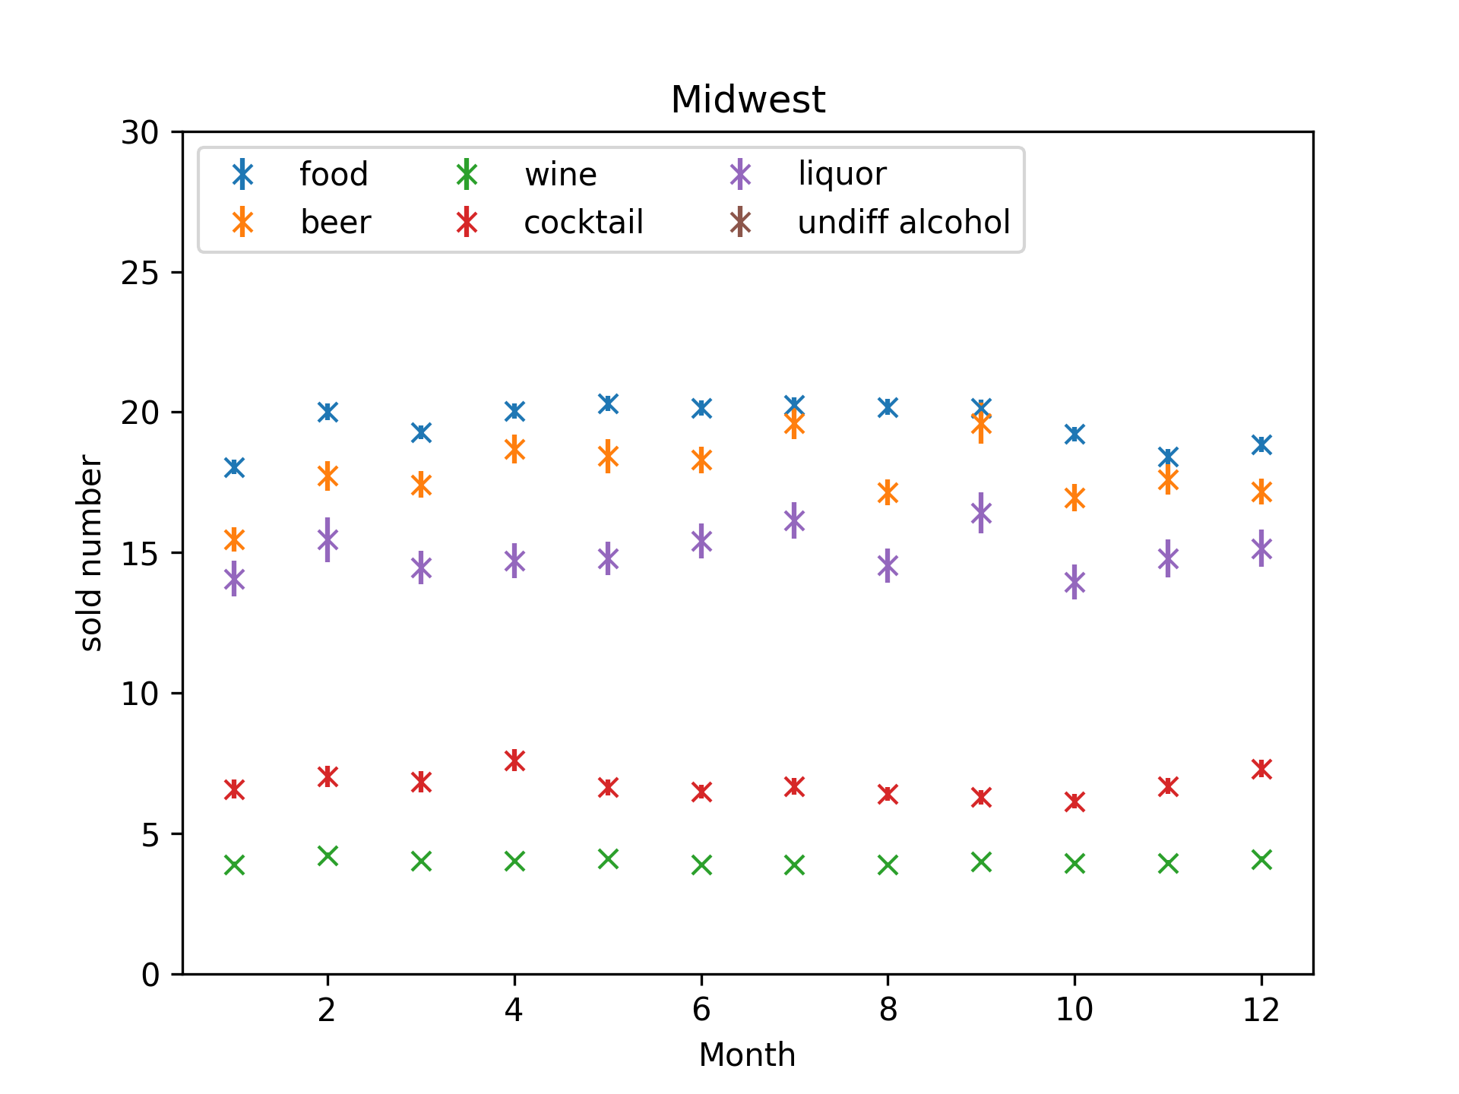
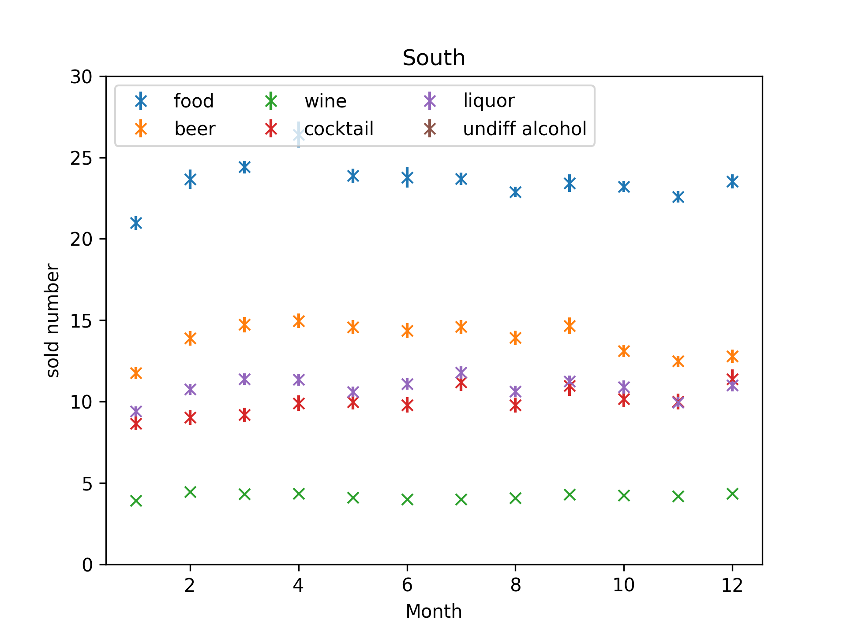
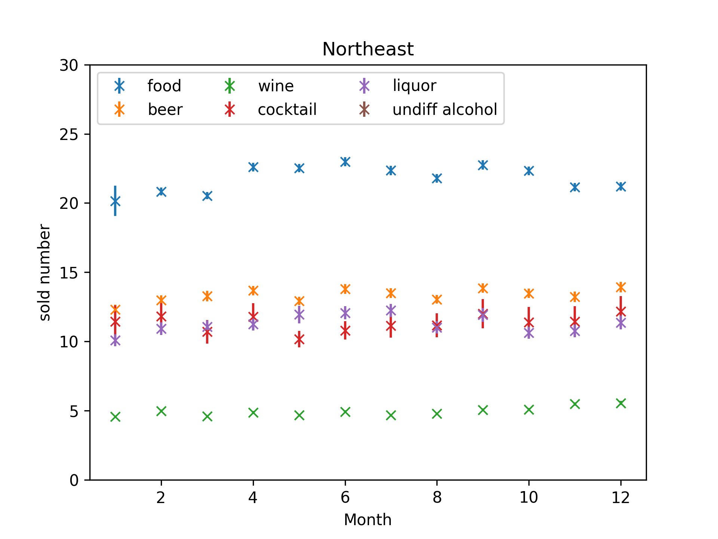

Slide 5
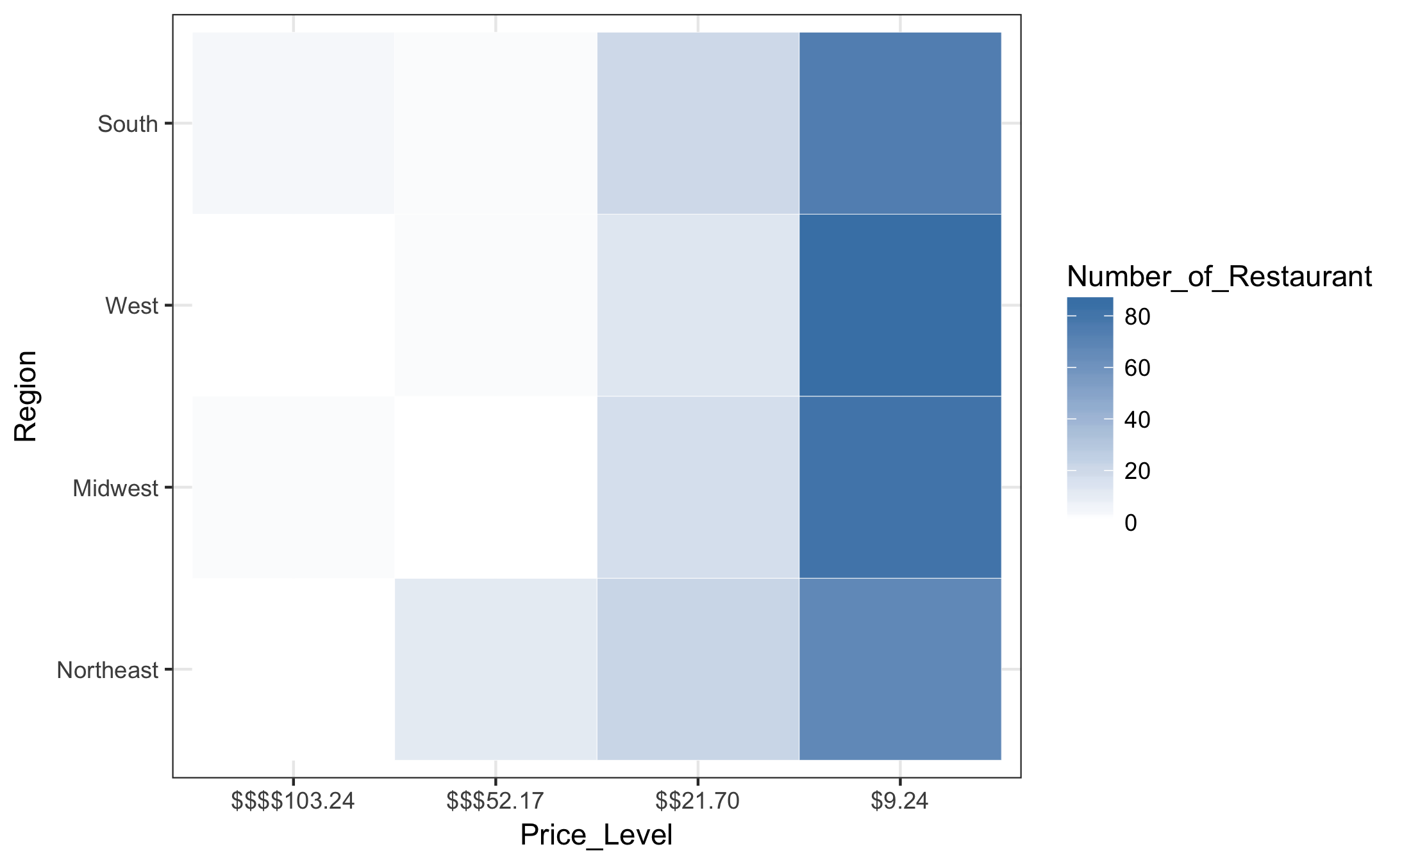

Slide 6
Thank you!

