Slide 1
Comprehending Neural Networks via Translation to And-Inverter Graphs
Jarren Briscoe

Slide 2
Introduction
Neural networks: supervised learning
AIG: Boolean circuits (And-Inverter Graphs)
Comprehensibility → Conciseness
AIG more concise than neural networks

Slide 3
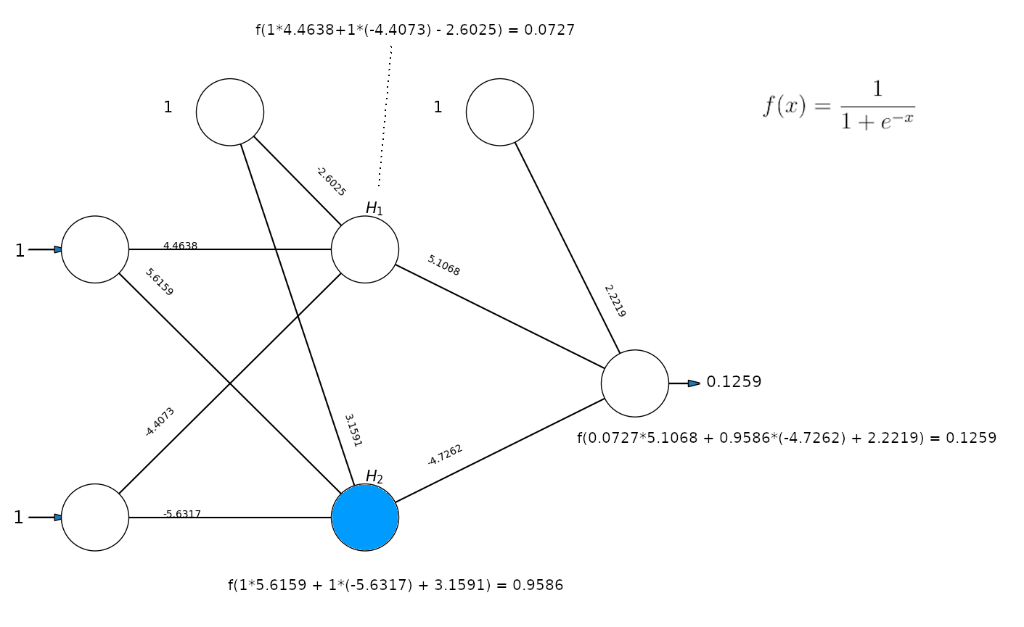
Neural Networks

Slide 4
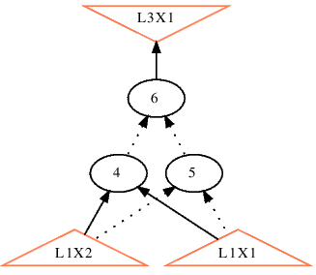
And-Inverter Graphs (AIGs)

Slide 5
Comprehension
Philosophy, cognitive psychology, neuroscience, anthropology.
Cognitive science searches for a formal model

Slide 6
Comprehending Models
Simplified
Must understand relationships R = {inputs, transitions, states, outputs}.
Assumption: less time to understand → more comprehensible
Each element in R takes time to comprehend. Therefore fewer elements → more comprehensible.
Conciseness → Comprehensibility
Notes:
simplified

Slide 7
AIG Versus Neural Networks
Transitions = {NOT, AND}
Boolean
Transitions include multiplication, addition, and activation functions.
Real-valued
Notes:
Each part of AIG simpler than NN
AIG more concise and each part is simpler

Slide 8
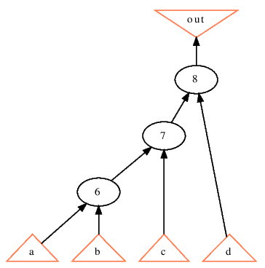
Inputs Comprehension
Inputs must be understood to understand the relationships.

Slide 9
Ashley
Ashley’s preference in men is given by (a,b,c,d) = (confident, humble, masculine, gentle)
Some see contradictions
Investigate meanings
Notes:
Dimension reduction

Slide 10
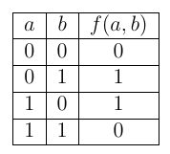
Neural Networks (Multi-Layer Perceptions)
Supervised Learning
XOR
  McCulloch and Pitts
Backprogation
  Minimize the Loss Function
  Stochastic Gradient Descent
XOR

Slide 11

Neural Network Example
Binary crossentropy for loss function
Stochastic Gradient Descent
Notes:
Q_i is the loss function with the activation function substituted in.
Momentum other stuff can be used.
Post-hoc analysis only cares about feedforward.

Slide 12
Activation Functions

Slide 13
Goal: Binarize Neural Networks
Sum-of-products (SoP) is multiple ORs of ANDs.
Approximate each neural node as a SoP
Compile and simplify all SoPs
Notes:
SoP = disjunctive normal form
Disjunction of conjunctions

Slide 14
Global and Local

Slide 15
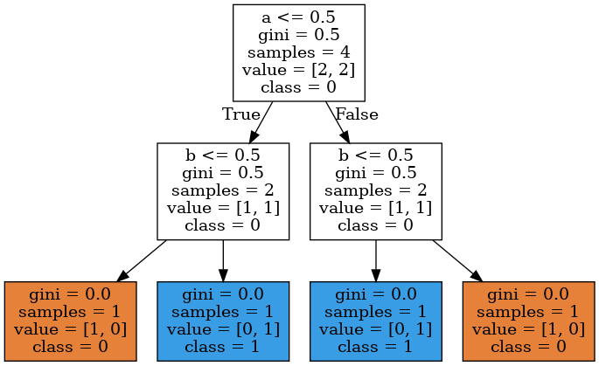
Binary Decision Tree
Traditional methods of measuring importance include information gain and Gini impurity.

Slide 16

Optimized Binary Decision Tree

Slide 17
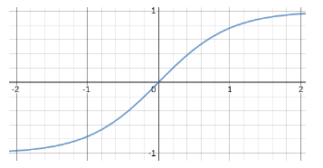
Notes:
Step activation function

Slide 18
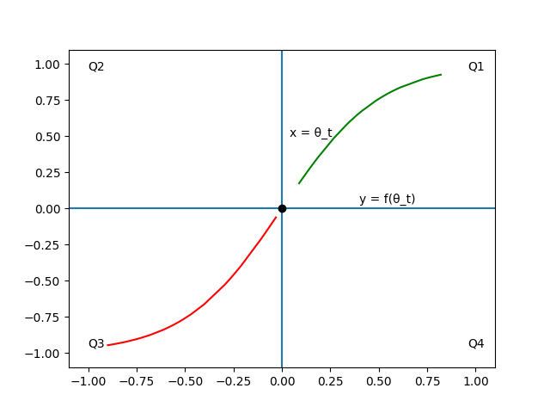
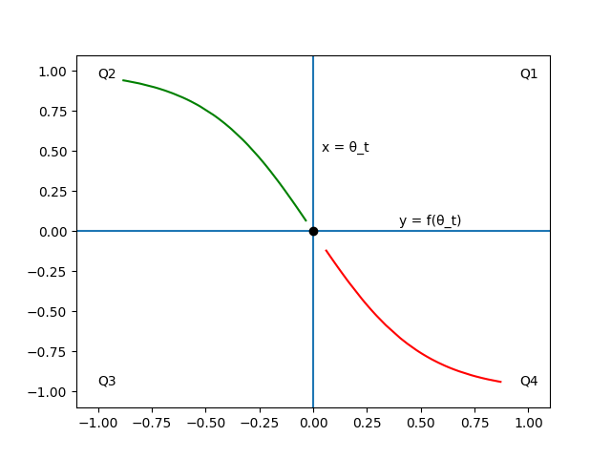
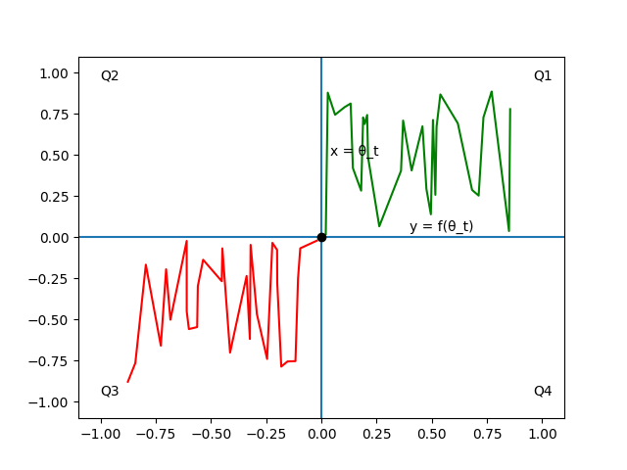
Diagonal Quadrant Property

Slide 19
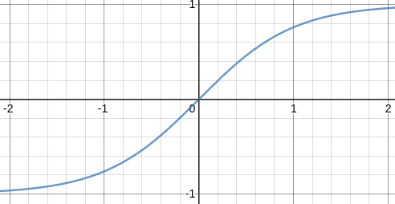
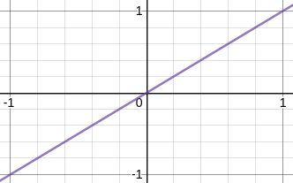
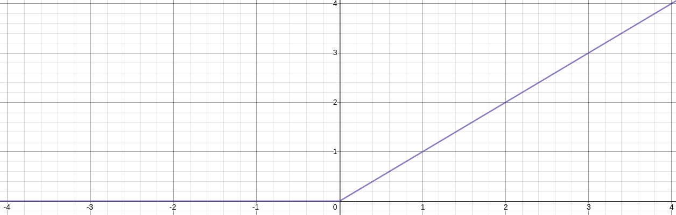
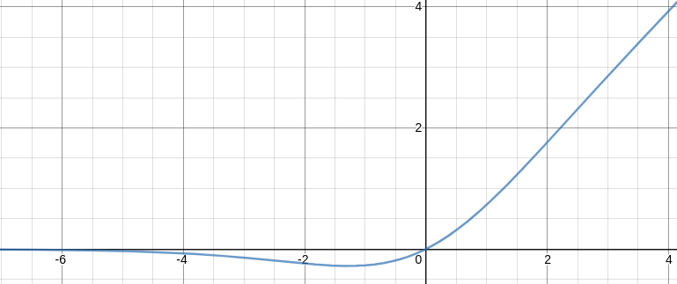
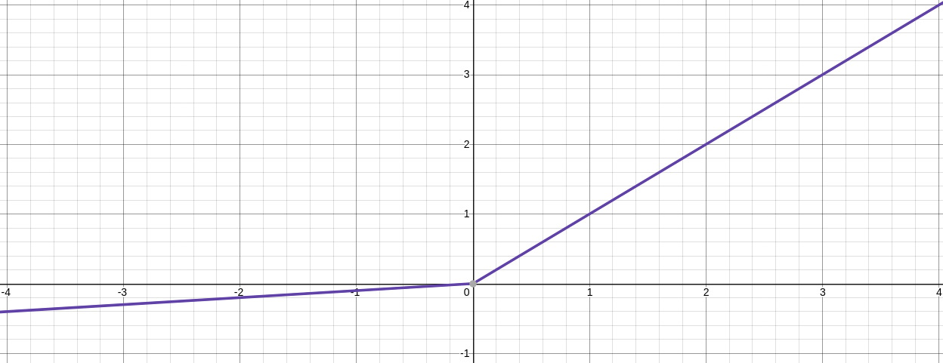
Satisfying Diagonal Quadrants

Slide 20
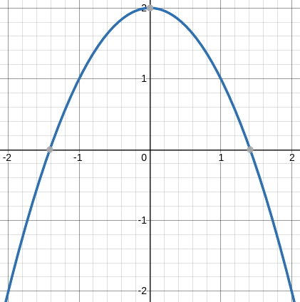
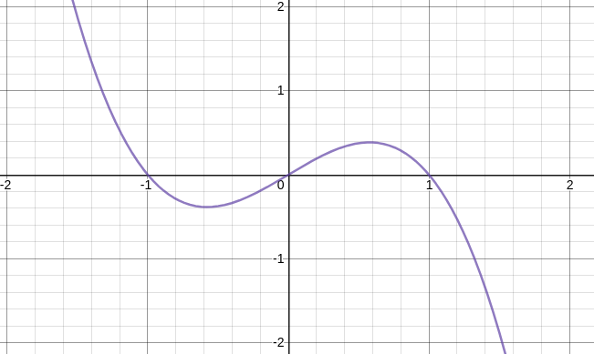
Unsatisfied Diagonal Quadrant (x=0)

Slide 21
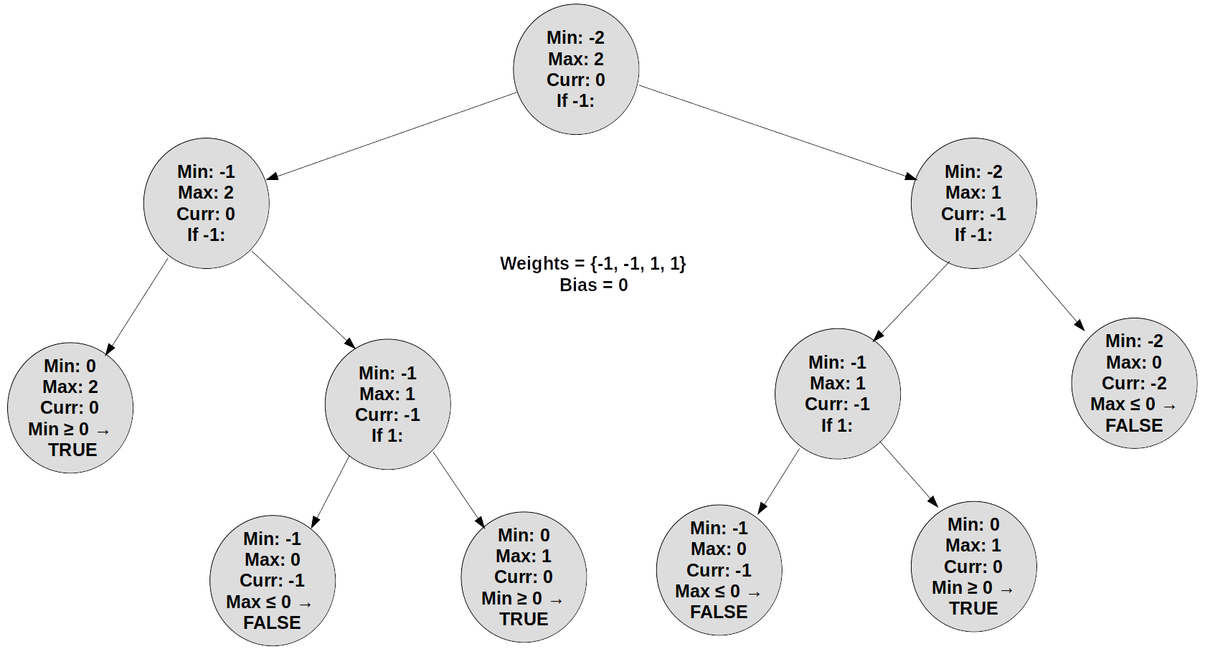
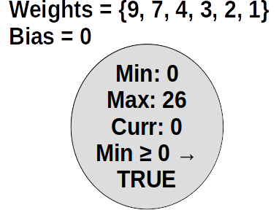
Complexities of
Notes:
Best case checks if any weight + bias is negative (linear). Before the sort.

Slide 22
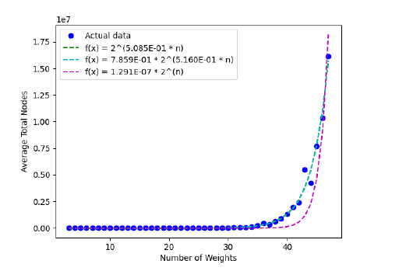
Why Exponential
Regression fits for average case:
See Chapter 9 for more.

Slide 23
Neural Node to SoP: Other Algorithms

Slide 24
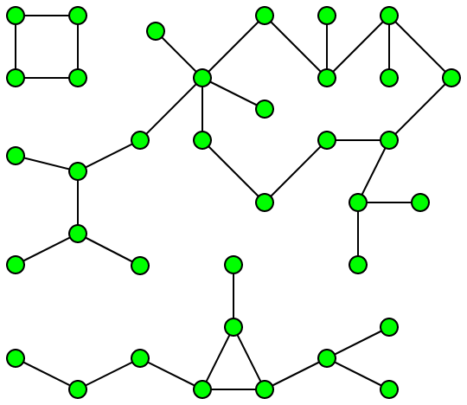
Traversing the Neural Network
Forward traversal gave islands and dead ends.
Solution: reverse traversal and skip all negligible nodes.
  Considers output (global)
Notes:
Deadend: inputs but no outputs
Island: no inputs

Slide 25
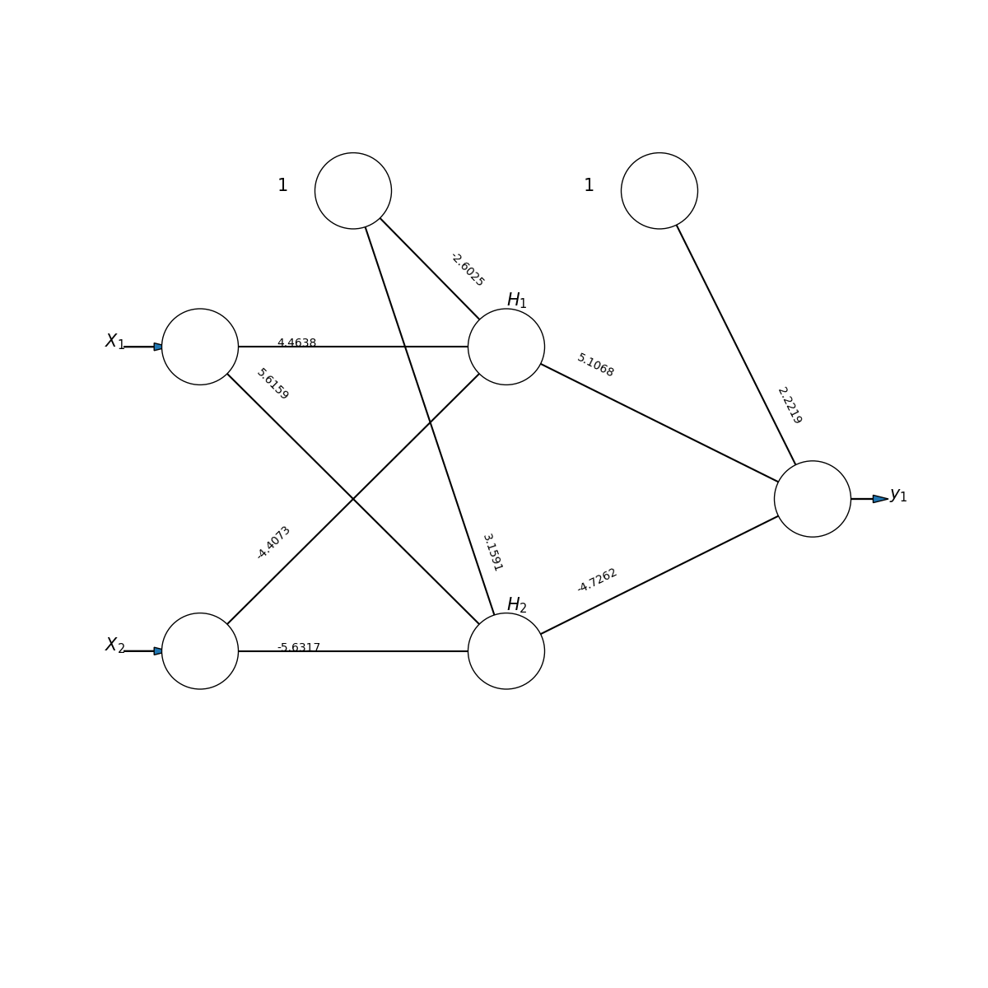
Neural Network to AIG
Employing on the XOR NN below

Slide 26
Don’t-Care Variables
Don’t affect output
Example:
Neglible nodes are don’t-cares

Slide 27
RYG
Y and G are don’t cares.
Does the neural network and AIG capture this?

Slide 28
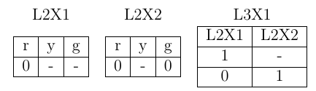
RYG
1. Train a 3X2X1 NN
2. Traverse with
3. Illustrate the SoP as an LUT
...
optimized away the don’t-care variable y

Slide 29
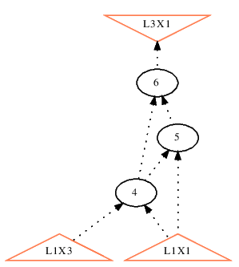
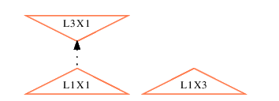
RYG
4. Directly illustrate the LUT network as an AIG
5. Further simplify with ABC
RYG was successfully simplified and the don’t-cares removed.

Slide 30
Why Two Simplifications
simplifies nodes based on the immediate next layer
  Stops islands
  Reduces the times is used
ABC simplifies nodes over many layers

Slide 31
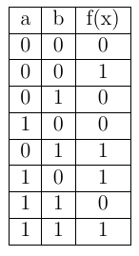
Binarization of Real-Valued Data
Input space may be exhaustive (HIGGs)
Single bit → single threshold

Slide 32
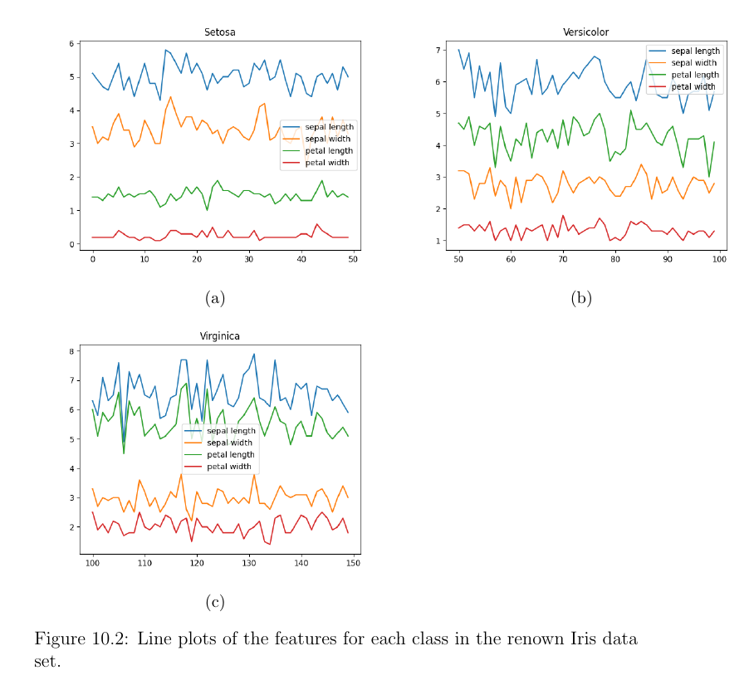
Real Data: Iris

Slide 33
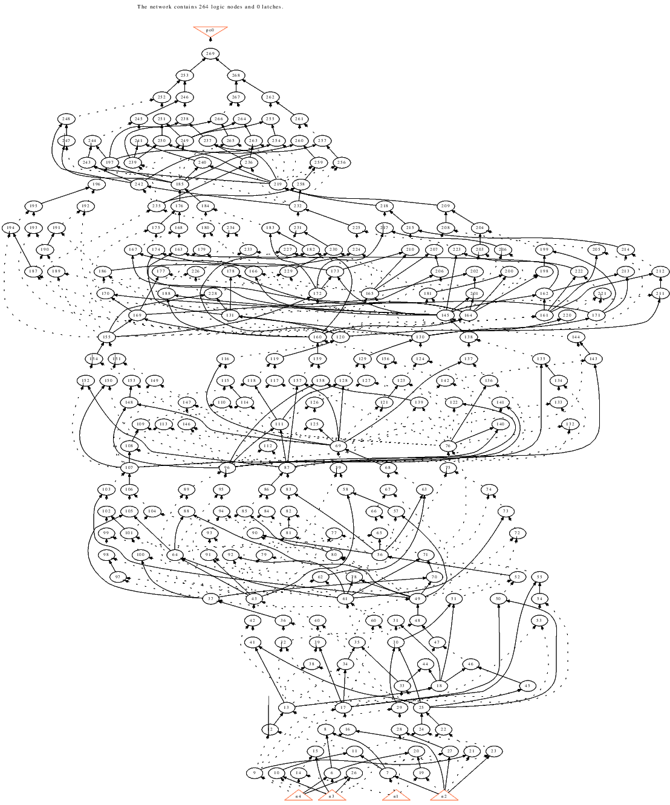
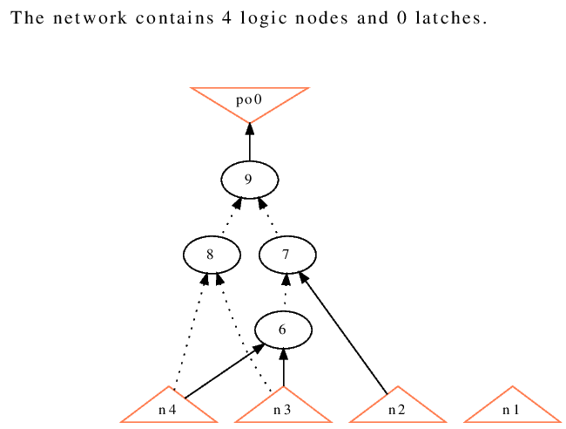
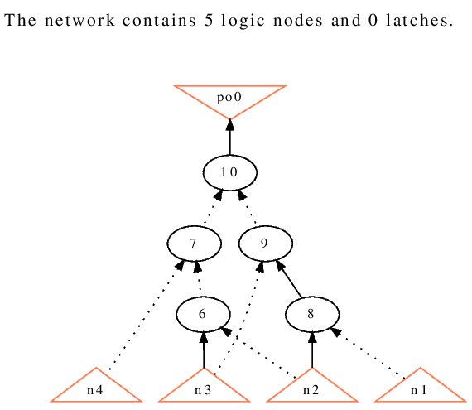
Memorization versus Generalization
memorized subtle and developing relationships
4X5X5X5X5X5X1
4X2X1
4X2X1

Slide 34
Comparing AIGs from Similar NN
Major similarities
Noise scaled with NN size

Slide 35
Mitigating Memorization Noise
Maximum tree depth
AIG ensemble
Note: ABC’s fraig command can greatly simplify AIGs. This thesis looks for alternative simplification techniques.

Slide 36
Comprehensibility Metric
Comprehensibility is inversely proportional to the sum of inputs and operators

Slide 37
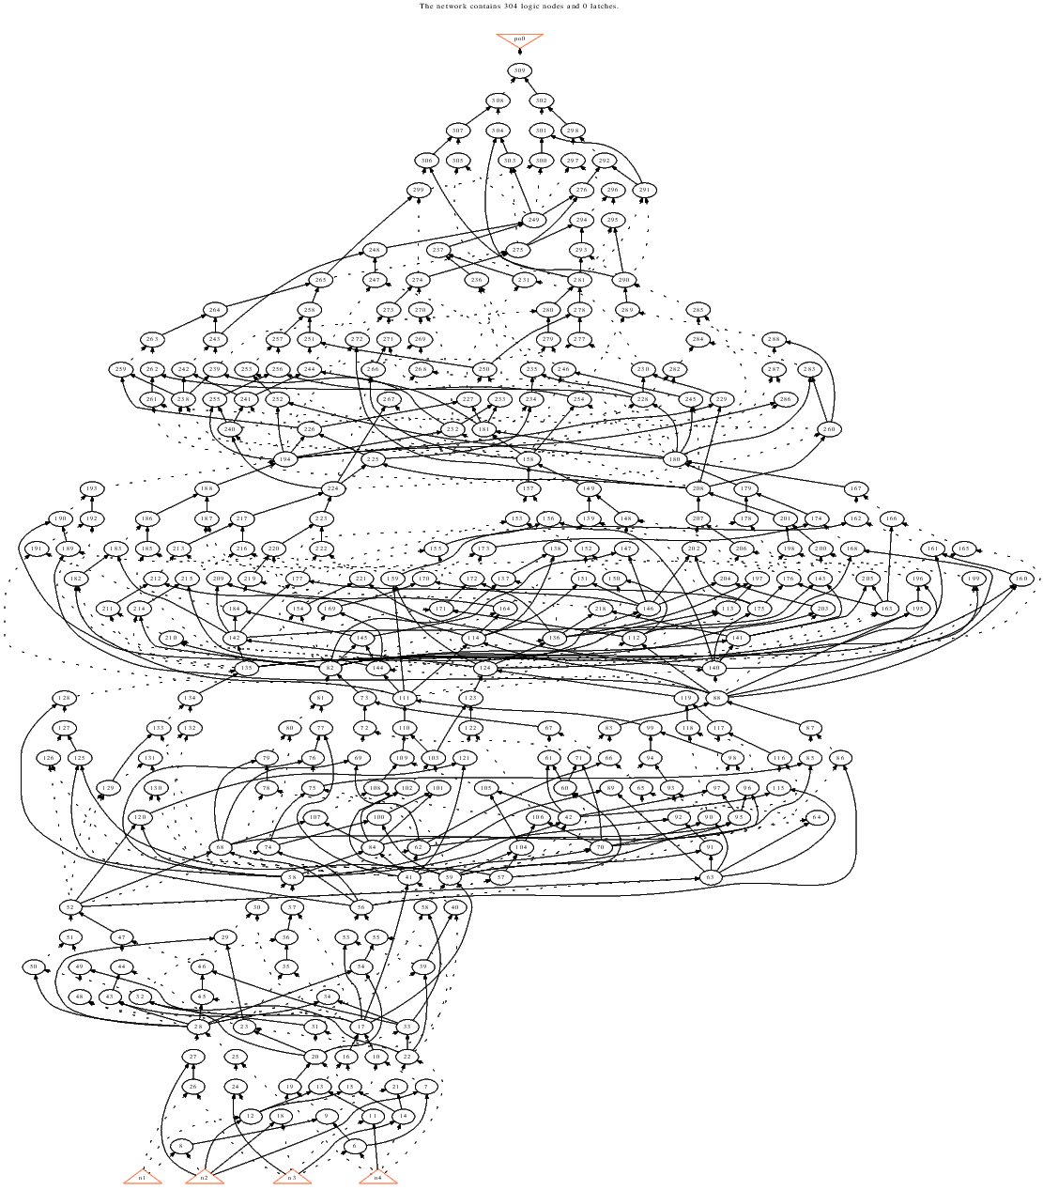
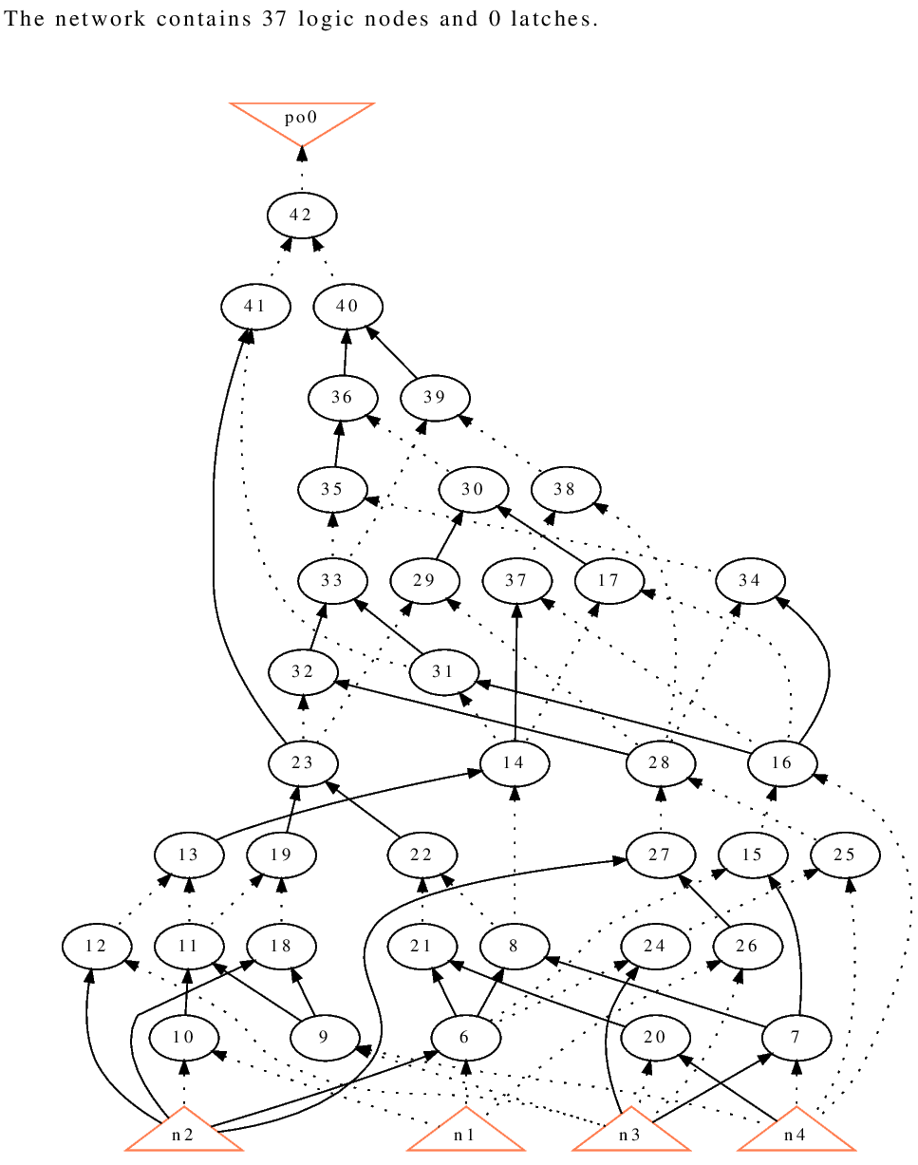
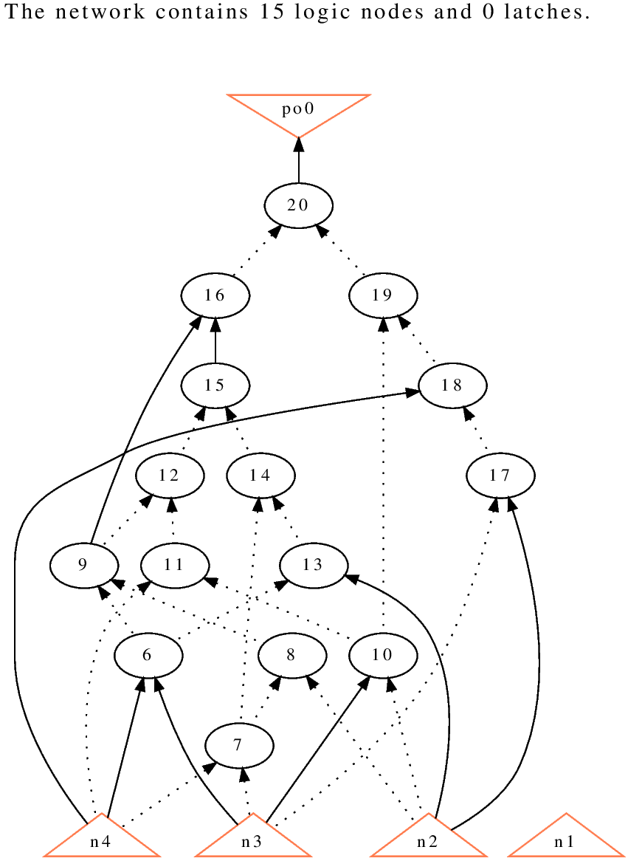
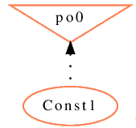
‘s Maximum Depth
Unlimited Depth
(maximum depth reached was 5)
Maximum Depth = 4
Maximum Depth = 3
Maximum Depth = 2

Slide 38
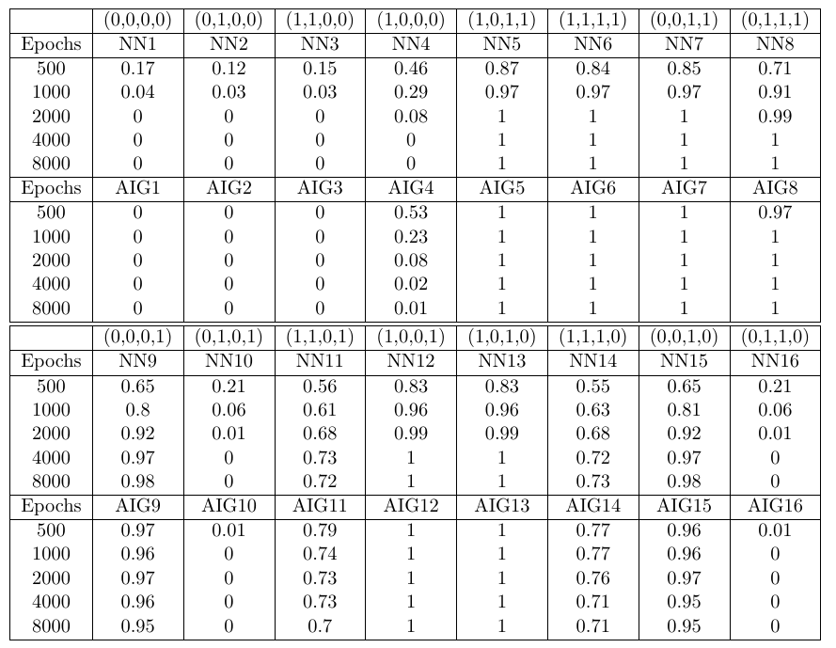
NN → AIG Ensemble
Tested ensembles of 4X3X3X1 and 4X8X8X8X8X8X1 neural networks on Iris
Future work: convert to simpler, more comprehensible AIG.
Notes:
Outside of thesis scope.
Random sampling for AIGs

Slide 39
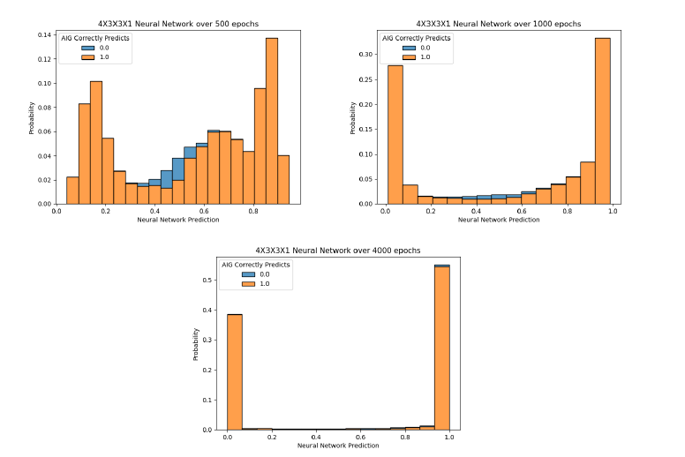
More Epochs → More Accurate AIG
Due to lossy binary mapping

Slide 40
Future Work
Ensembles
NN pruning
Binary-Weight-Networks
Consider input space
MIG or BDD
Satisfiability
Multiple outputs

Slide 41
Conclusion
Conciseness → comprehensibility
NNs less comprehensible than AIGs
Convert NN to AIG with local and global techniques
Memorization versus generalization
  Noise scales with NN size

Slide 42
Questions

