Slide 1
Charles Aranist 1st Start
07/11/22

Slide 2

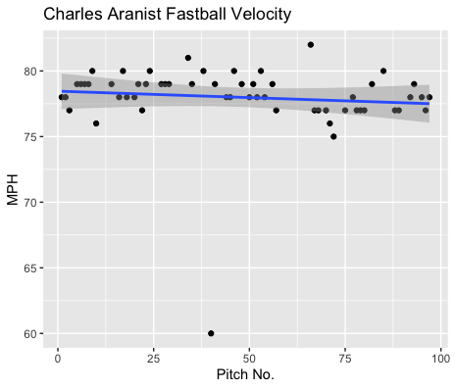
Fastball Usage
Average Velocity = 78MPH
Max Velocity = 82MPH
59% Usage
Aranist’s fastball was consistent as the clustering and trendline indicate.
All his pitches were in the high 70s range except for two pitches above 80MPH and one pitch of 60MPH.
Aside from those 3 pitches his fastball was thrown very effectively from a velocity standpoint.

Slide 3
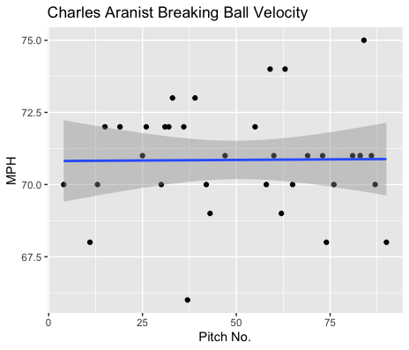
Breaking Ball Usage
Average Velocity = 70.9MPH
Max Velocity = 75MPH
35% Usage
Like his fastball, Aranist’s breaking ball was consistent as the trendline indicates.
His breaking ball hovered in the low 70s area aside from a few pitches in the mid 70s and high 60s.

Slide 4
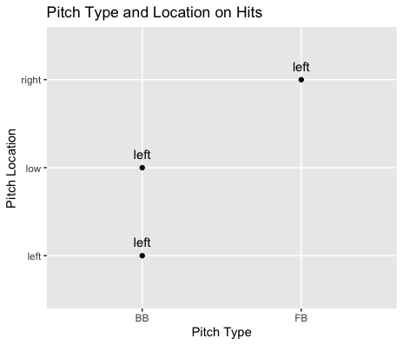
Hits
Aranist pitched incredibly well to contact.
His breaking ball did end up yielding 2 hits.
All hits were given up to left-handed hitters.
Off-speed and low or outside, and an inside fastball.

Slide 5
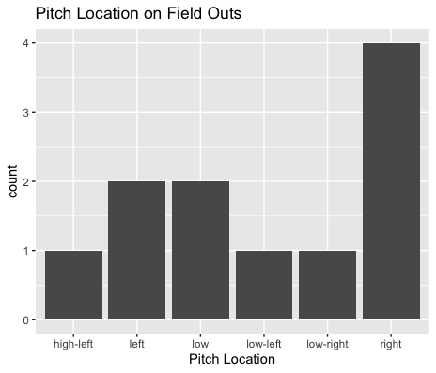
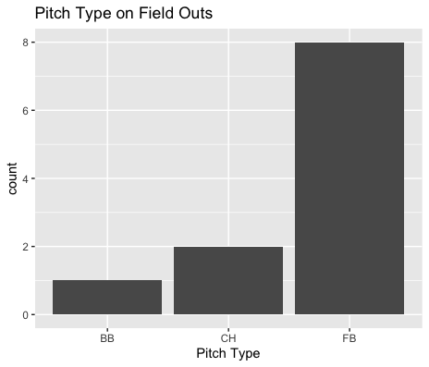
Field Outs
Aranist’s fastball played extremely well to contact, with hitters going 1-for-9 on the fastball.
Right-handed hitters went 0-for-4 on any variation of outside fastball.
Right-handed hitters went 0-for-7 when putting the ball in play.
Left-handed hitters were 3-for-7.

Slide 6
Stats
BABIP = .214
H/9 = 5.4
K/9 = 7.2
BB/9 = 9
K:BB = 0.8
Aranist pitched a fantastic game.
His fastball performed impeccably to contact, his BABIP was low, and his H/9 was also low.
The only possible fault on his performance was a high walk rate, but his strikeout rate wasn’t that much further outshined by his walk rate.

Slide 7
Overview
Aranist’s fastball was ridiculously good went playing to contact, in addition to being thrown consistently over the course of the game.
Aranist got 2 outs on 2 balls hit in play on his changeup, maybe his changeup usage can increase with a decreased breaking ball usage.
Aranist may have control issues (high walk rate) or difficulty pitching to left-handed hitting.
Overall, Aranist seems to pitch incredibly well against contact, as well as right-handed hitting.

