Slide 1
Charles Aurandt 2nd start
07/17/22

Slide 2

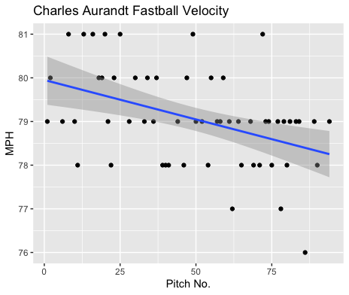
Fastball Usage
Average Velocity = 79.1MPH
Max Velocity = 81MPH
59% Usage
Aurandt’s fastball was consistent over the course of his start, as you can see a lot of clusters in the 78-81MPH range.
His fastball did decrease in velocity towards the end of his start, with 3 pitches below 78MPH.

Slide 3
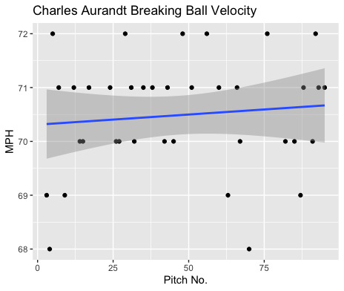
Breaking Ball Usage
Average Velocity = 70.5MPH
Max Velocity = 72MPH
38% Usage
Like his fastball, there are a lot of clusters of 70-72MPH for his breaking ball.
Unlike his fastball, his breaking ball seemed to grow in velocity as his start progressed.

Slide 4
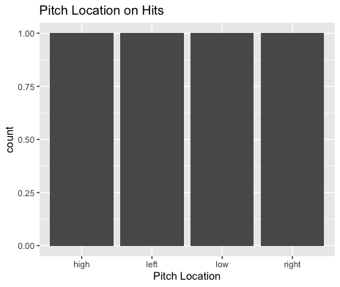
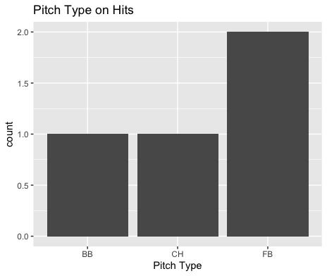
Hits
All hits given up were to right-handed hitters.
Aurandt gave up 2 line-drive singles, on one breaking ball and one changeup.
Hitters didn’t really find success attacking one location.

Slide 5
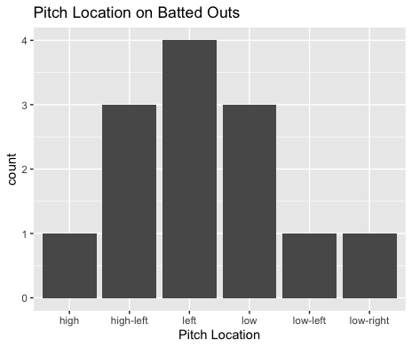
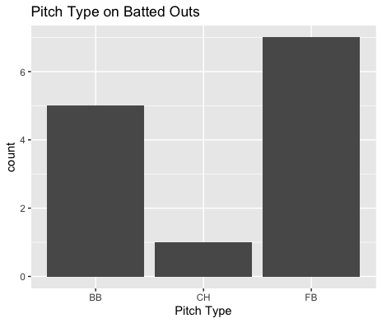
Outs
Aurandt found a lot of success on the left side of the plate, getting 4 outs, 3 inside to right-handers.
Aurandt also might have gotten luck on 2 fastballs that resulted in lineouts.
His breaking ball and fastball both pitched very well to contact again.

Slide 6
Stats
BABIP = .235
H/9 = 6.75
K/9 = 5.07
BB/9 = 6.75
K:BB = 0.75
Aurandt again pitched well to contact.
His overall opponent BABIP was .235 however he did get lucky with 2 lineouts, his BABIP could easily be something like .353 if those lineouts resulted in singles.
His walk rate may be concerning as he walked more batters than he struck out.

Slide 7
Comparison to his first start
Aurandt continued to pitch great against contact, with both his fastball and breaking ball leading to many batted outs.
His changeup did give up 1 hit and only 1 field out, which may indicate a lesser effectiveness than his breaking ball and fastball.
His strikeout rate again was very solid.
However, his walk rate again was very high, in addition to having a strikeout to walk rate below 1.
The only possible fault on Aurandt is his walk rate, however he pitched great.

