Slide 1
Branden Chun-Ming
06-20-22

Slide 2
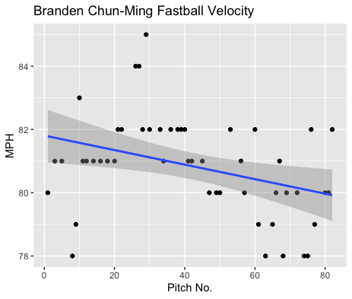
Fastball Usage
Average Velocity = 80.8MPH
Max Velocity = 85MPH
61% Usage
His fastball hovered around the 80-82 MPH range throughout most of the game, however after he hit pitch 60 a lot of pitches below 80MPH bring the average MPH down as well as the trend line.

Slide 3
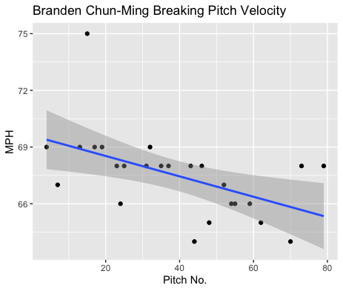
Breaking Pitch Usage
Average Velocity = 67.5MPH
Max Velocity = 75MPH
30% Usage
He hit 75MPH on one of his first breaking pitches however as the game progressed the data mostly hovers around the 66-69MPH range.

Slide 4
Batted Balls
Chun-Ming gave up 12 batted balls, with 5 of them resulting in hits.
All of hits were given up to right-handed batters and featured some variation of middle range pitches.
He additionally gave up 3-line drives that resulted in 2 singles and a double.
4 of his 5 hits were given up on singles, and his breaking ball had a BABIP of .250. Which is good in comparison to his overall BABIP of .412.
One changeup was put in play and resulted in a flyout.

Slide 5
Stats
BABIP = .412
H/9 = 11.25
K/9 = 6.75
BB/9 = 6.75
K:BB = 1
In addition to a high walk rate, and 3 walks, Chun-Ming hit 3 batters. This may indicate some command issues, as well as having an equal strikeout to walk ratio.
He got unlucky with balls put in play, however his H/9 was not ridiculously high.
His control concerns seem more important that giving up contact.

Slide 6
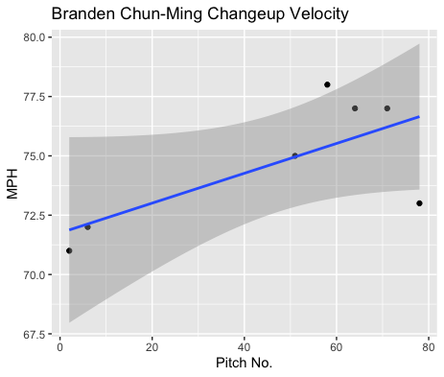
Review
Chung-Ming has some control issues and his fastball performed poorly when it was put in play.
I would suggest an increased usage of his breaking ball, as well as his changeup to see if the two can yield better batted ball results.
His breaking ball was very consistent, and his changeup increased in velocity as the game progressed, despite a small sample size.

